Slide 1
Best Practices in Supporting Veterans in Higher Education for Faculty Senate
Office of Military and Veteran Affairs
LTC (ret) Andrew Griffin EdD

Slide 2
Our Calling Recruit-Retain-Graduate
Colleges Should Help Veterans on Path to New Future,
VA Secretary Says
Phoenix—
Eric K. Shinseki, Secretary of the U.S. Department of Veterans Affairs, told
college leaders here today at the American Council on Education's annual meeting
that:
“Colleges should reach out to the veterans arriving on their campuses and help
them make the transition from the combat zone to college.”
“Veterans especially need help in the first six months to a year, as they move from a
high-stress, highly structured environment into a looser one at college.”
“But admitting veterans with benefits from the new GI Bill is not enough, I’m looking
at graduation rates.”
—The Chronicle of Higher Education, March 9, 2010.

Slide 3
Who are Today’s Military?
1.9 Million have served since 9/11
Guard and Reserves in unprecedented numbers
86% male, 66% white, average ages 30-35
Often have had several deployments
Heavily engaged in combat
Combat engagements have been primarily random
Explosive mechanisms have accounted for 75% of all injuries
Drawdown of the military will continue at a fast pace through 2016
http://www.military.com/video/operations-and-strategy/afghanistan-conflict/huge-taliban-ied-hits-buffalo/1708063884001/

Slide 4
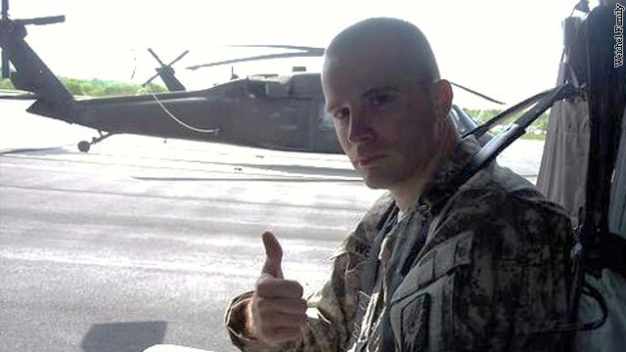
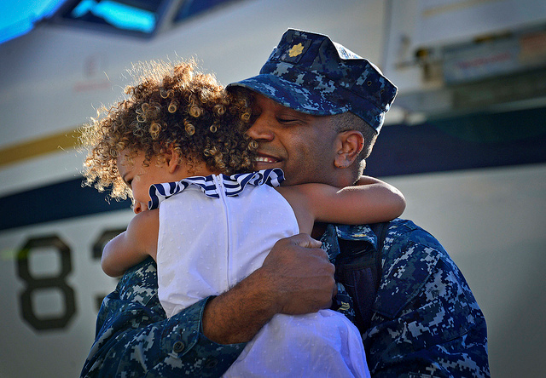
Who are our Campus Veterans?
Currently serving 817
Have the Post 9/11 GI Bill
660,000 enrolled in higher education
Only 15% traditional college age
Older students: Average age is 27
27% female
More likely to have families
Previous post-secondary education
Often have had several deployments
Resilient
Know what they want
Motivated to succeed

Slide 5
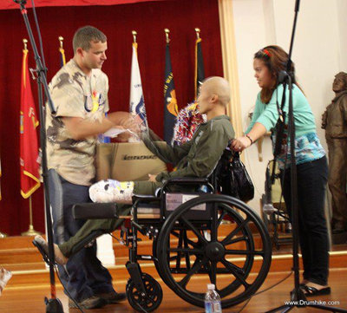
Transition Challenges
1. The Post 9-11 G.I. Bill
2. Transfer credit and initial academic counseling
3. Navigating both college and veteran bureaucracies.
4. Adjusting to the classroom and academic rigor
5. Social relationships on campus
6. A non-traditional student
7. Military deployments while in school
8. Musculoskeletal and hearing problems
9. Post-traumatic Stress Disorder (PTSD)
10. Traumatic Brain Injury (TBI)

Slide 6
Post-Traumatic Stress Disorder
Understanding the combat stressors of Iraq and Afghanistan
How common is PTSD among veterans?
What are some of the most common symposiums?
Flashbacks and frightening thoughts
Hyper-vigilance
Detachment and emotional numbness
Sleep disturbances
Irritability and anger
Substance abuse

Slide 7
Post-Traumatic Stress Disorder
Academic Impacts:
Unwillingness to seek help
Adapting to the general college environment
Difficulty concentrating
Information processing difficulties
Learning and memory challenges
Impairments in executive functions: Problem-solving, planning, insight

Slide 8
Best Practices?
Resources, Policies, and Recommendations
Service and support based on:
AZ Senate Bill 1373, section 41-609: Arizona Veterans Supportive Campuses
Executive Order 13607 -- Establishing Principles of Excellence for Educational
Institutions Serving Service Members, Veterans, Spouses, and Other Family Members
President Obama’s “8 Keys to Success” in serving student veterans
Department of Defense Voluntary Education Memorandum of Understanding
American Council on Education (ACE) Toolkit for Veteran Friendly Institutions

Slide 9
Arizona Veterans Supportive Campus AZ Senate Bill 1373, section 41-609 Signed April 2011
To qualify Institutions of Higher Learning must:
1. Conduct a campus survey of student veterans
2. Establish a campus steering committee
3. Conduct sensitivity and awareness training on campus
4. Establish student veteran orientation programs
5. Have peer mentoring and peer support programs for student veterans
6. Develop and implement outreach strategies to local military bases
7. Have one-stop resource and study centers on campus
8. Promote community-based collaborations
http://www.azdvs.gov/veteran_supportive_campuses.aspx

Slide 10
Faculty Development Training: November 13, 11:30 to 12:30
What do I need to know to help military veterans be successful in my class?
Five member panel to offer insight into the following questions:
1. Who are today’s service members?
2. Who are today’s woman service members and veterans?
3. Who are today’s student veterans?
4. What are the major challenges facing our student veterans on our college campuses?
5. What is the reality and some misconceptions regarding the student veteran and Post-traumatic Stress Disorder (PTSD)?
Panel:
Facilitator: Dr. Andrew Griffin, Director of Veteran Affairs
Dr. Michael Blocher: Professor, College of Education
Jamie Axelrod: Director of Disability Recourses
Katie Montoya: Case Manager, Counseling Services
Marc Hunter: Student Veteran, President of the SVA
Lilly Race: Female Student Veteran

Slide 11
Best Practices in Supporting Veterans in Higher Education for Faculty Senate
Office of Military and Veteran Affairs
LTC (ret) Andrew Griffin EdD

