Slide 1
End-of-Term Course Evaluation SETE
Fall 2013 Campus Wide Trial

Slide 2
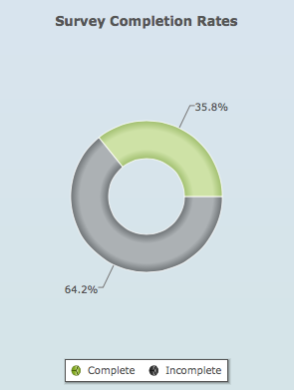
Response Rate
128,747 surveys scheduled
46,093 surveys completed

Slide 3
Response Rates by College

Slide 4
Benefits
Green system
Single system across campus
Consistent questionnaire
Uses up-to-date information from PeopleSoft SoC
Integration with FAAR
Centralized reporting
Aggregate reports for units
Individual reports for faculty
SETE score

Slide 5
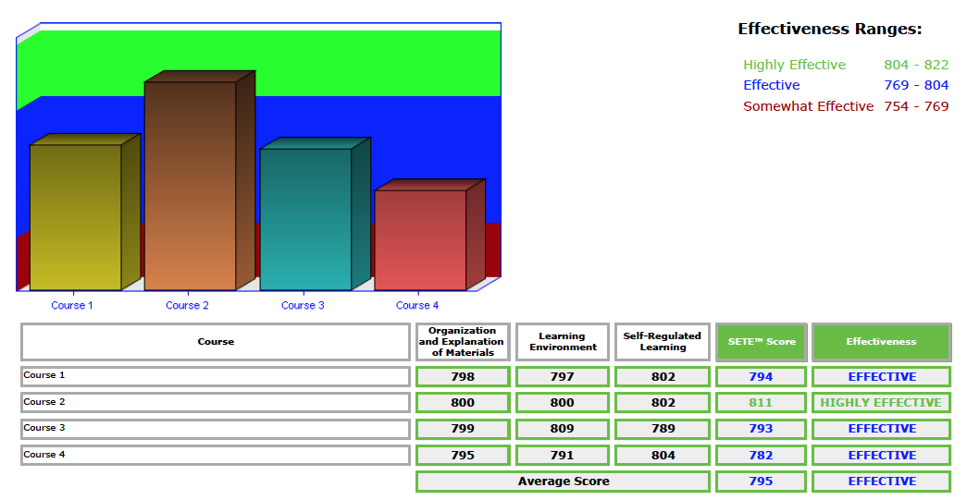
Faculty Reports

Slide 6
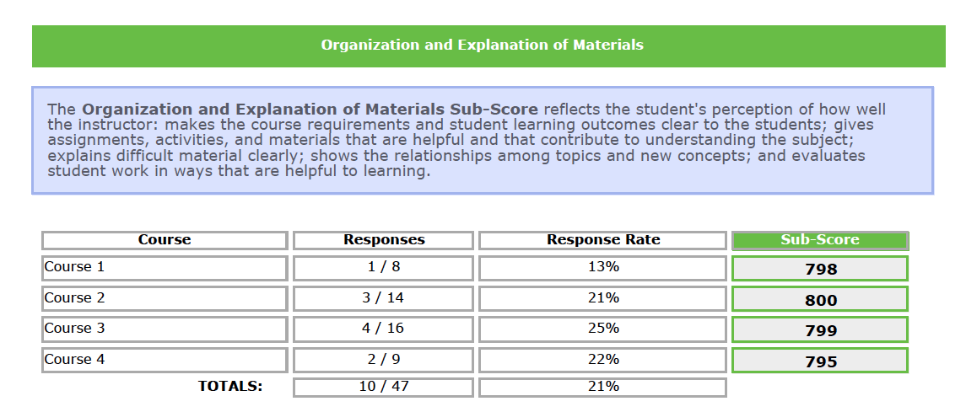
Faculty Reports

Slide 7
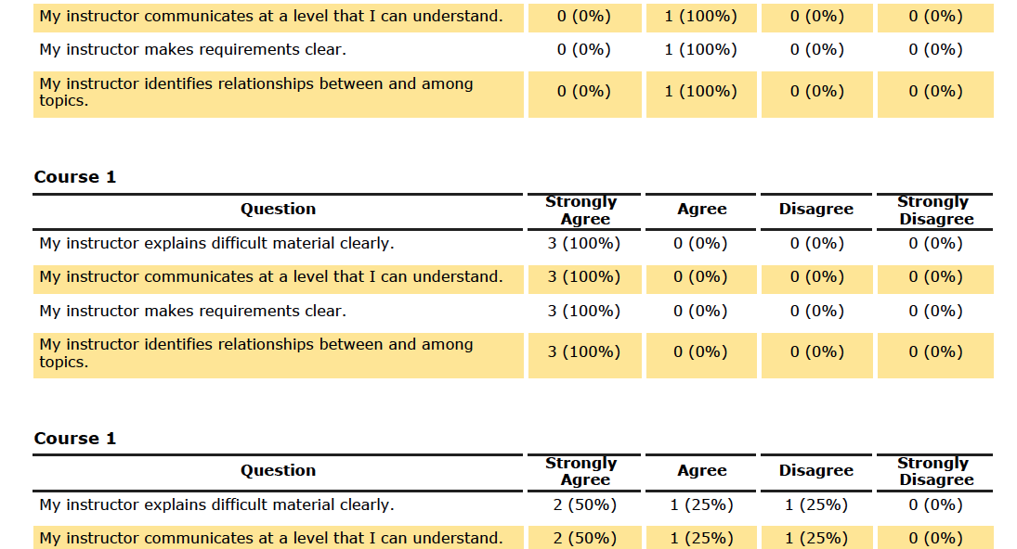
Faculty Reports

Slide 8
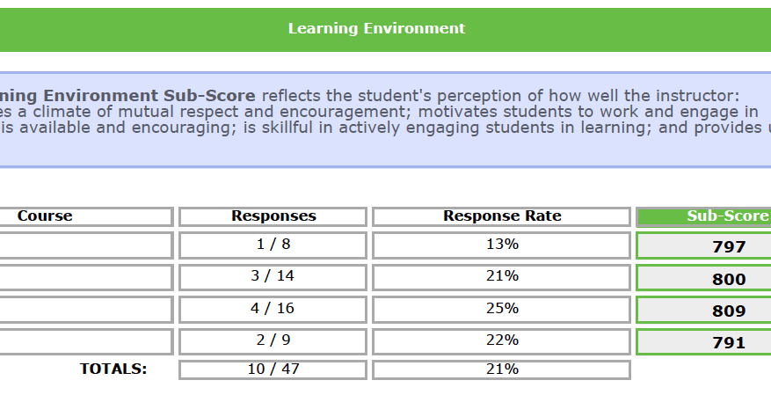
Faculty Reports

Slide 9
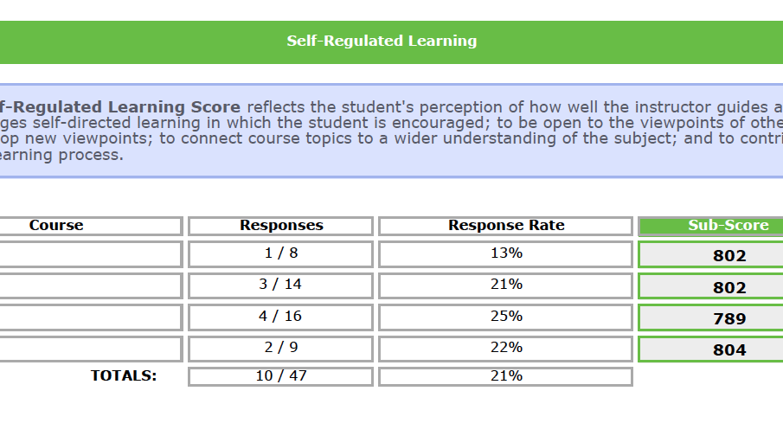
Faculty Reports

Slide 10
Campus Wide Trial Challenges
Planning and implementing simultaneously
Decentralized institution
Dynamically classes
Sequentially taught courses
Inconsistency in SoC Primary Instructor

Slide 11
Decisions Made on the Fly
Overlay the new system on the old
Open and close dates
Roster view available after 5 responses
Responses available with less than 5 after the close

Slide 12
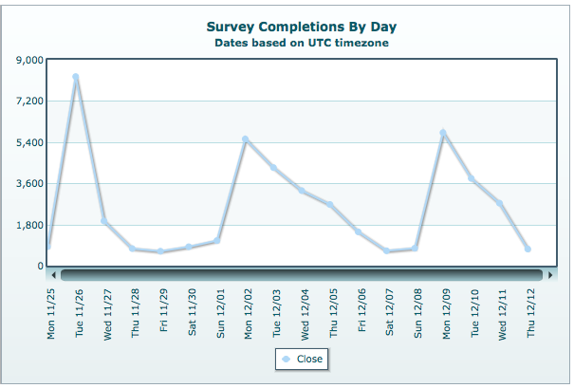
Lessons Learned
Send more than three notifications
Make clear close date
Support faculty in encouraging student response

Slide 13
Lessons Learned
Centralize mapping of evaluations
Continuous communication with students
Encourage Smarter Services to:
Develop normed national data
Expand ways to analyze the results

Slide 14
Gathering Feedback
Comments
Please send additional comments to Denise Helm at Denise.helm@nau.edu

Slide 15
Special Thank You
The Implementation Team
ITS, ELC, Student Support Desk, Office of the Registrar

