Slide 1

Update on
Sustainable Environmental Practices Action Team (SEPAT) and Herbicide-free Campus
Paul Gazda
Fall 2014

Slide 2
April 2007
Paul Gazda presented document
to the Faculty Senate Executive Committee:
  Significant health and environmental hazards of campus herbicides.
  Eliminating herbicides advances NAU’s sustainability goals.

Slide 3

May 2007
Faculty Senate passed resolution
  Eliminate herbicides on campus by Spring 2009
  Form ad hoc committee to recommend how this
  could be accomplished

Slide 4
June 2007
Committee formed, chaired by Marcus Ford.
Included Facility Services senior management plus other staff and students.

Slide 5
Summer 2007 – Spring 2008
Committee conducted extensive research
and interviews regarding herbicide-free
techniques.
Proposed a pilot project to evaluate turf
management methods.
Proposed new dual layer weed barriers for
effective weed suppression in rock mulch.

Slide 6
Summer 2008 – Spring 2010
Committee lost Facility Services members.
Grounds Department adopted dual layer weed barriers for rock mulch.
Attempts to move turf pilot project forward failed due to lack of funding.

Slide 7

January 2010
Faculty Tom Rogers and Patrick Pynes, with Paul Gazda, formed the Environmental Caucus’s
Sustainable Environmental Practices Action Team (SEPAT)
Eliminating the use of toxic herbicides, pesticides, and other hazardous materials on the NAU campus.
Facilitating land-based practices that demonstrate sustainable methods.

Slide 8

October 2010
Faculty Senate Committee issued final report
  Encouraged the Faculty Senate to continue its
  advocacy of a herbicide-free campus.
  Appoint a liaison to SEPAT.
Bill Culbertson volunteered
as liaison.

Slide 9

SEPAT
  Sustainable Landscape Maintenance Project
  Establishment of Campus Organic Gardener
  Literature review of campus herbicide health
  hazards
  Faculty advising of student interns
  Participation in STARS reporting

Slide 10
December 2010
Students Bobby Benedetto and Liz Erdelyi, with Paul Gazda, prepared NAU Green Fund proposal for Sustainable Landscape Maintenance Project
Carried forward Faculty Senate Committee
pilot project proposal.
Approved by Green Fund

Slide 11
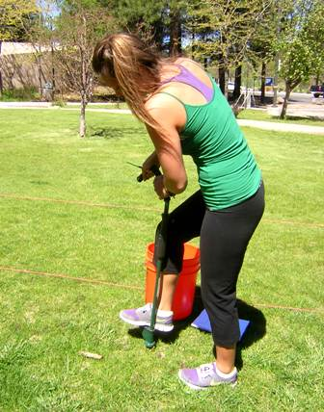
January 2011 – December 2013
Sustainable Landscape Maintenance (SLM) Project conducted on campus.
Mayleen Farrington (Master’s candidate in Sustainable Communities) was Research Coordinator
Paul Gazda was Staff Advisor
21 student interns

Slide 12
SLM Accomplishments
  Weed abundance and diversity
    Dominant species: Dandelion, white clover, plantain
  Alternative weed control treatments
    Corn gluten meal - natural, non-toxic pre-emergent
    Hand weeding – 6 to 8 minutes per 100 sq. ft.
    Digging out and overseeding for excessive clover, plantain
  Turf quality
    Quantitative measure of turf quality
    Test plots consistently better turf quality than control plots
  Soil health analysis and modification
    Applications of sulfur to reduce pH
    Corn gluten meal as natural nitrogen source
    Topdressing with compost

Slide 13
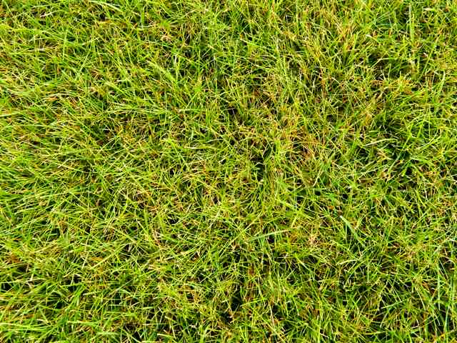
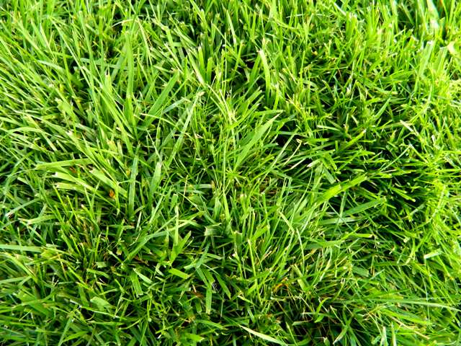
Improved Turf Quality
Control Site Turf
with herbicide spray
Test Site Turf
with no herbicide spray

Slide 14
SLM Accomplishments
Laboratory Research
Collaboration among SLM, SEPAT, faculty
  Weed barrier study
    Dual vs single vs no weed barrier
  Influence of potassium on dandelions
    Low soil potassium selectively suppresses dandelions
  Micorrhizal fungal colonization of root systems
    Significantly more fungal colonization in test plot vs control
    Further evidence that project methods improve soil health
  Soil micro-arthropod analysis
    Comparing micro-arthropod populations in test vs control plots

Slide 15
SLM Influence
  No herbicide spraying on campus lawns in 2013, 2014
    Without SLM program of manual weed removal, soil health, overseeding & composting, weeds will take over
  Assoc. VP for Facility Services supportive
    Wants pesticide-free campus
    Asked SLM Research Coordinator for budget for full SLM program on all campus turf
  FS Dir. Planning, Design, Construction supportive
    Invited Paul Gazda to Steering Committee for Campus Landscape Assessment
    Invited SLM Research Coordinator to provide input
  2014 pilot project treating 1/3 of campus lawns with full SLM
  protocol
    Lacks resources -> partial implementation

Slide 16
Looking Ahead
FY 2015-16 Budget Process
  Crucial for continuing momentum toward herbicide-free campus
  Assoc. VP for Facility Services requesting budget to implement
  SLM protocol on all campus lawns
  Year 1 startup ballpark: $100,000
  Ongoing annual operation ballpark: $75,000
  Improve campus health & student recruitment
SEPAT
  Continue to advocate/participate in herbicide-free campus actions
  Signage (physical, interactive web) for sustainable, healthy campus landscape features

Slide 17

Faculty Senate
Faculty Senate support has been instrumental in moving the herbicide-free landscape effort forward.
Please:
  Support Facility Services request for funding for herbicide-
  free campus
  Continue support and involvement with SEPAT

