Slide 1
LGBTQIA Task Force
Matthew Tombaugh (Chair)
Ángel Román Verdugo (Vice-Chair)

Slide 2
Who are We?
Organized in Fall 2010.
Comprised of Faculty, Staff, Students & Invited Community Partners (Coconino County Health, PFLAG, etc.) working to promote mutual respect, fairness, equity, improved campus climate and support for LGBTQIA (Lesbian, Gay, Bisexual, Transgender, Queer, Intersex, Ally) diversity at NAU.
We have open meetings once a month and also have an active listserv interested folks can join.

Slide 3
Why we do what we do:
Inclusion and the creation of a more welcoming space for all is a central goal of the institution. Sexual orientation and gender identity are both part of NAU’s non-discrimination policy.
Despite this, there remains work to do in improving campus climate, institutional practices and LGBTQIA community members continue to experience incidents of bias and aggression.

Slide 4
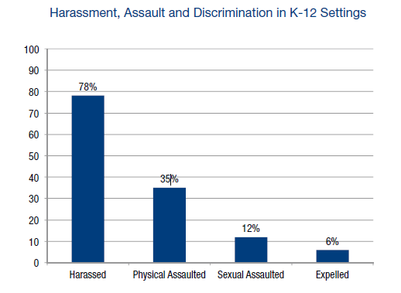
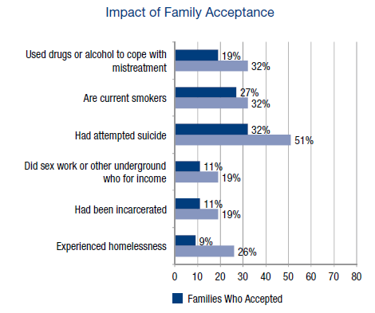
Transgender Individuals
Grant, Jaime M., Lisa A. Mottet, Justin Tanis, Jack Harrison, Jody L. Herman, and Mara Keisling. Injustice at Every Turn: A Report of the National Transgender Discrimination Survey. Washington: National Center for Transgender Equality and National Gay and Lesbian Task Force, 2011.

Slide 5
GLBT Undergraduate Students:
“More than one-third (36%) of GLBT undergraduate students have experienced harassment within the past year…”
“Those who experienced harassment reported that derogatory remarks were the most common form (89%) and that students were most often the source of harassment (79%).
“Twenty percent of all respondents feared for their physical safety because of their sexual orientation or gender identity, and 51 percent concealed their sexual orientation or gender identity to avoid intimidation.”
Rankin, Susan R. (2003). Campus Climate for Gay, Lesbian, Bisexual, and
Transgender People: A National Perspective. New York: The National Gay
and Lesbian Task Force Policy Institute. www.ngltf.org

Slide 6
Our Priorities:
LGBTQIA Identified Students' Academic Success: LGBTQIA identified students are shown nationally to be at greater risk for a host of factors that impact their academic success. Improving overall student retention is a critical goal of the university and one the Task Force fully supports.
Improving the Campus Climate for LGBTQIA Individuals: Creating a positive, safe, and inclusive working and learning environment for all of the university's members is a core value of the institution.
Transgender Access & Support: There remain barriers that are unique to transgender individuals which inhibit their ability to fully participate in the academic and work environment.
LGBTQIA Identified Faculty/Staff Recruitment & Retention: Examining barriers to faculty/staff performance and well-being is a key component in reaching the institution's goals of employing a qualified and diverse cohort of academics and professionals.

Slide 7
Some of What our members have done:
Supported the creation of LGBTQA Support & Resources Office (Fall 2011).
Created and hosted first Rainbow Convocation (May 2012).
Worked with Residence Life for creation of LGBQTIA Living Learning Community, as well as Gender Inclusive Housing (both opened Fall 2012).
Supported the creation/implementation of new Queer Studies Minor (Spring 2013).
Partnered with campus offices and U of A/ASU, in hosting webinars, programs, conferences, etc.

Slide 8
Our Current Work Includes:
Partnering to improve bias incident reporting and response measures on campus.
Collaboration with the Registrar’s Office to ease students’ ability to update personal information (i.e. name and gender).
Increasing access to gender neutral/unisex restrooms on campus.
Creation of LGBTQ student scholarship and exploring early orientation opportunity.
Working with AA and HR in providing LGBTQIA recruitment materials and information to selection committees.
Strengthening campus training around LGBTQIA issues and bystander intervention.
Creation of voluntarily “out” faculty/staff list as a mentorship and general resource.
Work with specific offices about services and climate (i.e. Medical Services, Athletics, etc).
Promote inclusion of LGBT subject matter into course curriculum.

Slide 9
Where we need your help:
Relaying information and resources to represented departments.
Advocacy for training and inclusion of LGBTQIA subject matter into course curriculum as well as promotion of LGBTQ inclusive environments in the classroom.
Trainings available around gender and sexual identities.
Handouts attached to presentation.
Promotion of LGBTQIA programs, workshops, and events to the NAU community.
Get involved and encourage others to show support via events, meetings, and through continued dialogue.

Slide 10
Contact Information:
Matthew.Tombaugh@nau.edu
Angel.Verdugo@nau.edu
Task Force Website: http://nau.edu/LGBTQIA-Task-Force/
LGBTQA Support & Resources Office: http://nau.edu/LGBTQA/
http://architect.lgbtcampus.org/
www.campuspride.org
“Injustice at Every Turn” (2011 National Transgender Report): http://www.thetaskforce.org/reports_and_research/ntds
“2010 State of Higher Education for LGBT People”: http://lgbtq.sdes.ucf.edu/docs/campuspride2010lgbtreportsummary.pdf
Additional Resources:

