Slide 1
Student Health Advisory Committee Tobacco Initiative
Faculty Senate Committee Meeting

Slide 2
SHAC
Founded in 2011
Student organization to act as liaison
Focuses on student health
Determined tobacco to be a health concern at NAU

Slide 3
Tobacco Free NAU
Pursing a tobacco free policy since 2012
After student/faculty/staff survey results supported NAU becoming a tobacco free campus
Currently there are over 1,100 colleges and universities nationwide that have implemented either a smoke free or tobacco free policy.
Effective August 2013 Arizona State University is a tobacco free campus.
University of Arizona’s College of Medicine is tobacco free and they are currently working on a campus wide policy.

Slide 4
Tobacco Free NAU
Only11.4% of NAU students reported smoking cigarettes in the past 30 days.*
While the perceived rate of cigarette use was 88.4%*
Only 10.0% of NAU students reported smoking tobacco from a water pipe (hookah) in the past 30 days.*
While the perceived rate of hookah use was 85.9%.*
*Information and data obtained from the NCHA-II Web Spring 2013
Northern Arizona University Executive Data Summary Report

Slide 5
Tobacco Free NAU
Health
A tobacco free campus would promote a healthier population free of smoke-related illnesses.
Tobacco is detrimental to overall health and can lead to cancer, heart disease, and respiratory disease among other serious illnesses.*
Secondhand smoke contains more than 7,000 chemicals. Hundreds are toxic and about 70 can cause cancer.*
There is no risk-free level of exposure to secondhand smoke.*
*Centers of Disease Control and Prevention

Slide 6
Tobacco Free NAU
Is second-hand smoke a concern or annoyance to you and others on campus?

Slide 7
Tobacco Free NAU
Green NAU
NAU takes pride in promoting a “green” campus to students, faculty and staff at the University.
A tobacco free campus would continue the tradition of a green campus and preserve the aesthetics of our campus.
It is estimated that several trillion cigarette butts are littered worldwide every year, making cigarette butts the number one littered item in America and the world.*
Cigarette filters are made of cellulose acetate tow and can take decades to degrade.*
*www.cigarettelitter.org

Slide 8
Tobacco Free NAU
Do you think the Incorrect Disposal of Smoking Material like Cigarette Butts are a Problem on Campus?

Slide 9
Tobacco Free NAU
Student Success
Many employers are now screening applicants for tobacco use and choosing to hire tobacco free employees, potentially limiting job prospects for our graduates.
The Affordable Care Act has a provision allowing health insurance companies to charge up to 50% more for tobacco users.

Slide 10
Achievement Timeline
Fall 2011
SHAC identifies tobacco as a significant health concern for NAU students
Spring 2012
SHAC attends Tobacco Free Campus Policy training
Tobacco subcommittee is formed
Tobacco Task Force established
Fall 2012
Media campaign and education continued
Tobacco survey for students and staff conducted
Spring 2013
Presentations to student groups about tobacco free campus
Petition signatures obtained
Presentations to CSPAC and EMSA Directors
Meeting with President Haeger to discuss moving forward with a tobacco free policy

Slide 11
Proposed Policy Draft
Purpose:
A tobacco free campus policy at Northern Arizona University will:
Provide a health and safe learning and working environment free from tobacco and second-hand smoke
Protect the natural environment by reducing air pollution and litter associated with tobacco use

Slide 12
Proposed Policy Draft
Policy: Northern Arizona University is a tobacco free campus.
Smoking and the use of all tobacco products, including those not approved by the FDA for cessation, is prohibited at all facilities and in vehicles owned operated or leased by Northern Arizona University. This includes, but is not limited to, the use of cigarettes, e-cigarettes, hookah, e-hookah, chew, snuff, cigars, pipes, etc.
Smoking and the use of all tobacco products shall not be permitted in any enclosed space, including private residential space operated by NAU housing.
Smoking and the use of all tobacco products shall not be prohibited outdoors on all NAU campus properties including parking lots and athletic facilities.
This policy applies to all students, staff, faculty, contractors and visitors to the NAU campus, regardless of the purpose for the visit.

Slide 13
SHAC’s Goal
SHAC would like to see a tobacco free policy for NAU implemented in Fall 2014.
With your support we can make NAU a tobacco free, healthy and beautiful campus, that students, faculty and staff can take pride in.

Slide 14
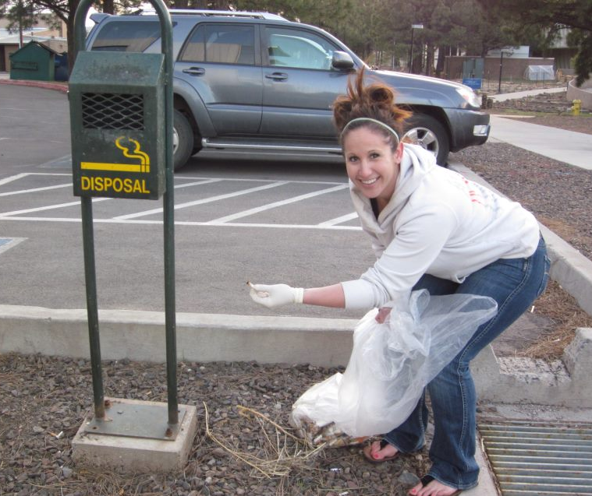
Tobacco Free NAU
Questions/Comments/Concerns

