Slide 1
Cline Library FY15 Macro-Budget Request
Expanded Library Research Content: An Area of Critical Need $2 million - $6.5 million

Slide 2
While user needs for high quality research content continue to grow, NAU falls further behind its peers in terms of university investment in research content. Among our ABOR peer group, NAU is the lowest peer for materials expenditures “per student” and “per faculty.”

Slide 3
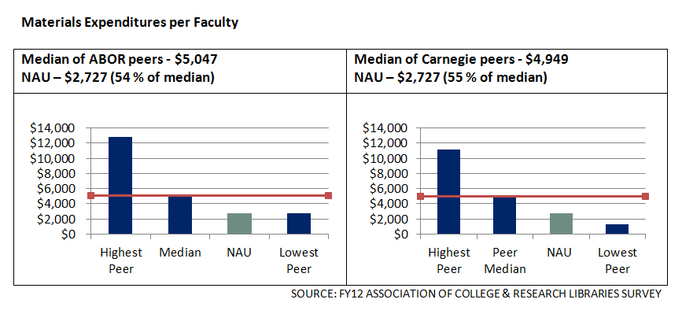
Additional ongoing funding needed to match “per-faculty” median of ABOR peers
$2 million

Slide 4
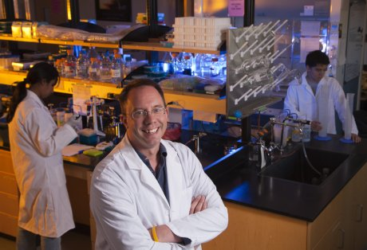
Impact of Increased Research Content Funding on NAU’s Research Agenda
Quick, stable access to research content supports:
Grant procurement
Undergraduate and graduate research skill development
Recruitment and retention of high quality faculty and students
Researchers at all levels can focus on reading and writing – not waiting for materials.

Slide 5
Impact of Increased Research Content Funding on Growth of Degree Programs
NAU can’t launch high quality programs without the high quality resources they need to thrive.
Required research content for accredited health science programs, which are a current focus for NAU growth, is among the most expensive.
New degree programs that don’t have adequate start-up or recurring funding for relevant research content present special challenges.

Slide 6
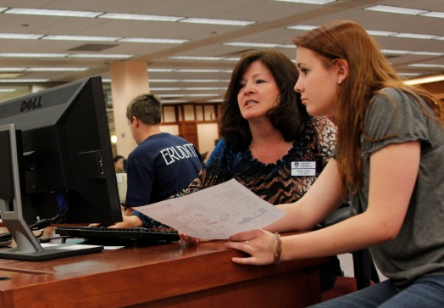
Impact of Increased Research Content Funding on Success in the Classroom for Students and Faculty
Increases affordability for students by reducing the need for them to make book and other content purchases.
A number of recent studies correlate library usage with student success.
At all levels – from English 105 to doctoral research – faculty expect student work to include citations from current resources.
Stable funding supports instructional content in classrooms and online.

Slide 7
Impact of Increased Research Content Funding on Sustainability and Effectiveness
Economic realities and university directions that have created added pressures include:
Inflation
Impact of a low budget compounded over time
A challenging publishing environment
A diverse and growing spectrum of students served

Slide 8
In 2013 it would have taken $2.67 million to meet the 1990 spending level of $1.5 million based on the Consumer Price Index. The Higher Education Price Index (HEPI) rate of inflation was even higher.

Slide 9
Current Annual Renewal Costs for Selected Resources
Science Direct $294,973 Wiley Online $201,885
JSTOR $57,700
Web of Knowledge $56,315
Films on Demand $28,656

Slide 10
Cline Library has a tradition of leadership in integrating content into technology-rich environments
Licensing online resources with ASU and UA to reduce subscription costs 1995
Digitizing archival collections and delivering them online 1995
Partnering with faculty to integrate digital audio, video and text into courses 1998
Supporting students and faculty in NAU distance learning programs 1986
1985 1990 1995 2000

Slide 11
Thanks to the university’s support, Cline Library’s current strengths also include:
Creating technology-rich student learning spaces
“Greening” library facilities
Partnering with CCC, PBC, ASNAU
Collaborating with faculty to develop strong learning outcomes and experiences

Slide 12
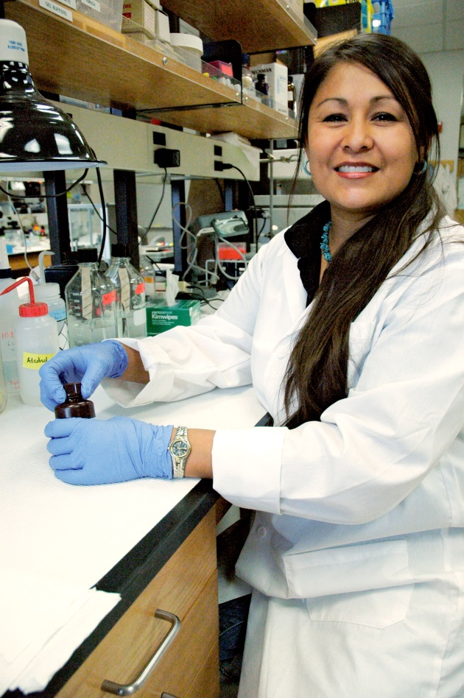
With your support, we can shift NAU’s investment in research content from an area of urgent need to an area of strength.

