Slide 1
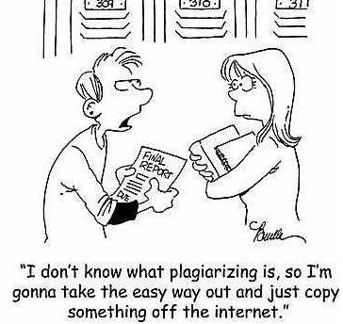
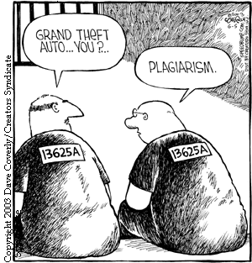
Academic Integrity at NAU
CONSULTATION
Images Copied off the Internet ☺
ACADEMIC INTEGRITY AT NAU

Slide 2
Purpose
Why?
To create a culture of academic integrity at NAU

Slide 3
Event | Timing | Result
Academic Integrity Town hall meeting | October 2012 | Received input from faculty, students and administrative staff Discussed best practices Recommended revisions of policy
ACADA Working Committee on Academic Integrity | Fall 2012 | Draft revision of Academic Integrity Policy
Vice Provost’s Working Committee | Spring 2013 - present | Academic Integrity Survey administered and report prepared NAU academic integrity existing resources researched & compiled Draft policy reviewed and revised per suggestions from ACADA, Town Hall & Survey results
Consultation with NAU stakeholder bodies | August/September 2013 | Input to be solicited from all stakeholder organizations (ACC, PALC, ASNAU, ACADA, GSG, Faculty Senate, EC, Student Life, ASC)
Academic Integrity Town hall meeting | October 25, 2013 | Reporting on process and results of consultations so far, Recommendations
Academic Integrity Policy | November 2013 – March 2014 | Revision of policy, vetting by legal Implementation of policy and steps for strengthening a Culture of Academic Integrity

Slide 4
Existing NAU Resources
Resource | Location | Provost Committee Comments/Suggestions
E-Learning training | http://www2.nau.edu/d-elearn/support/tutorials/academicintegrity/ - | Suggestion: Update the training and structure by topic: group work, citation, stolen/borrowed tests, etc. and note the key ideas/points students would need to take away.
Academic Catalog | https://policy.nau.edu/policy/policy.aspx?num=100601 | Suggestion: Rewrite policy with focus on academic integrity instead of dishonesty
Cline Library Supports and integrates E-Learning Resource above | http://azhin.org/NAU-ClineLibrary-HowDoI | micro pages on topics such as How do I Prevent Plagiarism? and Cite my Sources.
 | https://libproxy.nau.edu:8080/refworks2/default.aspx?r=authentication::init&groupcode=RWNArizonaU | Refworks is an online research management, writing and collaboration tool, that supports responsible use of information
 | databases | The Cline Library provides access to a multitude of research databases containing a variety of mediums which are designed to support responsible research & locate a large number of articles related to Academic and Research Integrity

Slide 5
Existing NAU Resources
Resource | Location | Comments
Student handbook Appendix | http://nau.edu/uploadedFiles/Administrative/EMSA_Sites/Folder_Templates/_Forms/Academic_Dishonesty.pdf | Suggestion: When updated, we should make sure the training aligns with the policy. Because it includes process, it will never totally line up.
Faculty page | http://home.nau.edu/universitypolicies/AcaAffairs.asp
Academic dishonesty reporting form | http://nau.edu/uploadedFiles/Administrative/Provost/Provost/_Forms/Academic%20Dishonesty%20Form%20PDF%20Final%202013.pdf | This new form is completely online so it is easy to report. It is tied to a database in LOUIE so administrators can find prior incidents easily

Slide 6
Survey
Presented 18 academic dishonesty statements from the current policy in the Student Handbook Respondents: faculty, students, administrators, staff | Respondents were asked to choose how each statement should be sanctioned from a list of six scaled sanctions, selecting only one sanction per statement
Scaled sanctions --from least to most | no sanction
 | educational assignment such as completing an academic dishonesty tutorial
 | instructor lowers grade
 | warning including academic probation
 | suspension or expulsion
Following tables represent categorized responses based on the highest percentage of response to each act of academic dishonesty

Slide 7
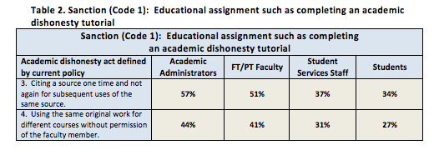

Slide 9
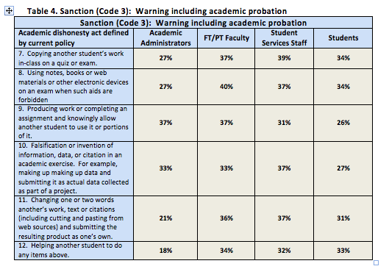

Slide 10
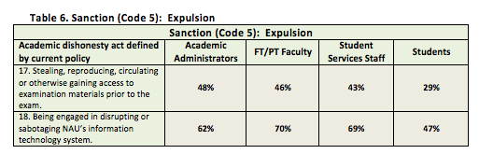

Slide 11
Your Views on Academic Integrity?
Questions (You can also send your comments/suggestions to Cyndi.Banks@nau.edu)
1. What best practices should NAU and its faculty, students and staff employ to promote academic integrity?
2. Should we use a common framework for sanctions?
3. What discretion should there be for individual faculty adaptation of that framework?

