Slide 1
MetaData
Metadata is data about data. It is that documentation about data and everything you do it
It can be as simple as a date and an author or pages of detailed descriptions
It can be embedded in the data or a separate file.
It should be included for everything you intend to share with others but is often the most forgotten thing when doing a project.
I didn’t include it in these workshop projects for the purpose of saving time for everything else.

Slide 2
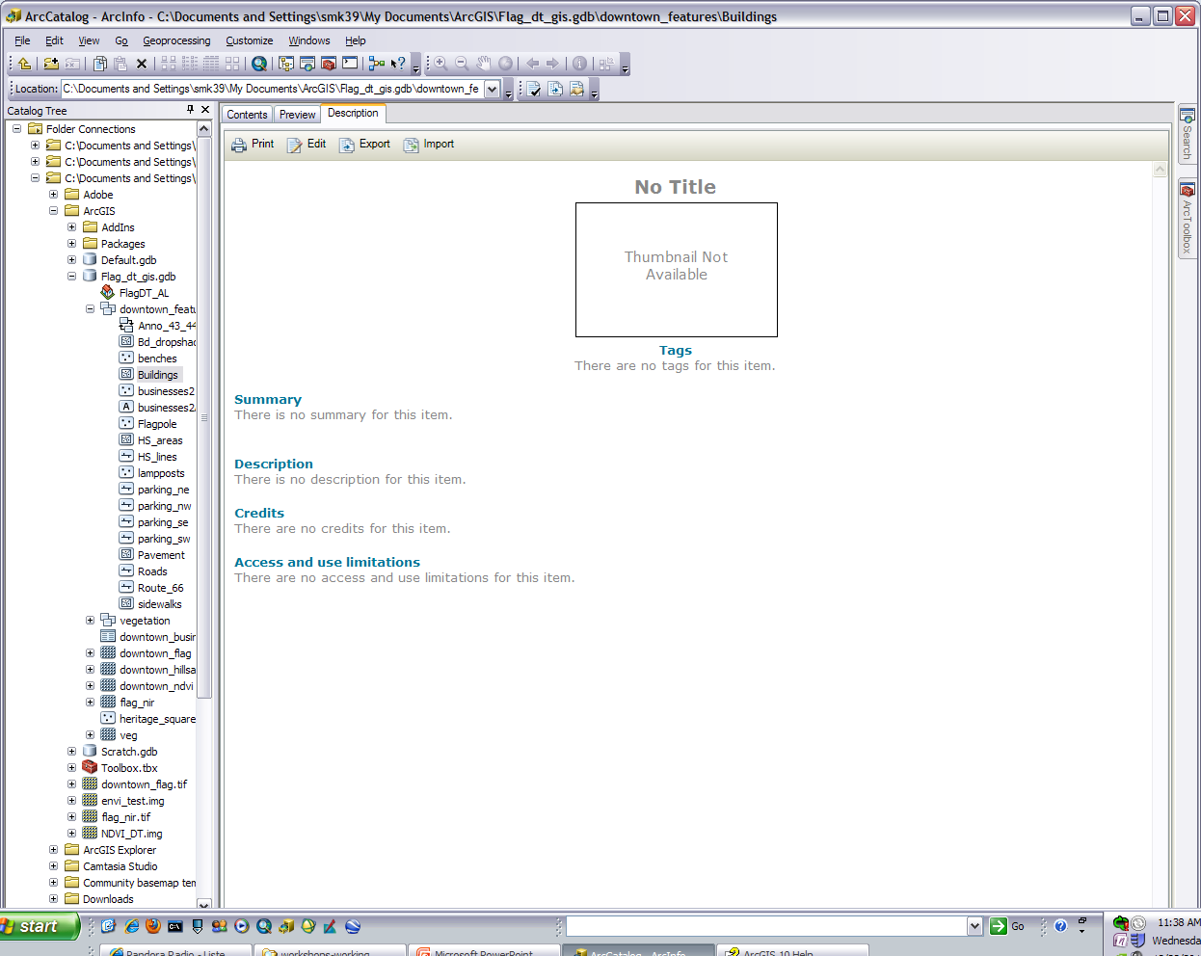
Creating it in ArcCatalog
Be on the description tab for an item and click the Edit button to add metadata to the selected data. There is a description of the items at the bottom if you hover over them.

Slide 3
Some Things to Keep in Mind
It is important to add metadata for others to understand your work and for validation purposes.
Different groups, such as the government, require that your metadata be in certain formats and contain certain information. Most of these can be found online.
Keep your metadata clear and precise. Think academic/technical writing. Carefully thought through creativity is OK in some cases.
When doing it with spatial data it is helpful to include the projection and extent

