Slide 1
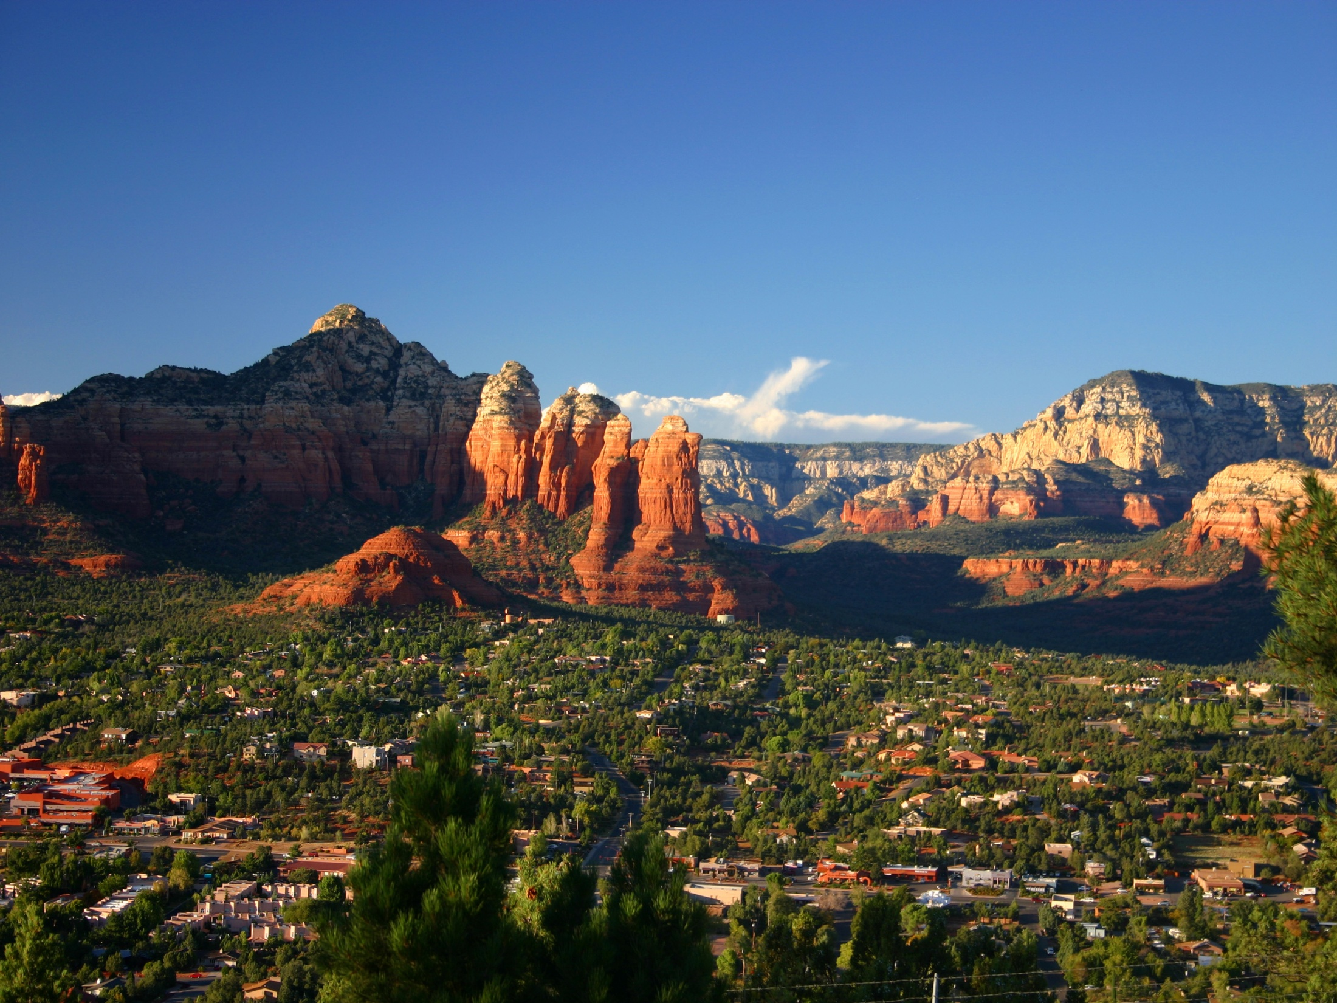
Designing a Community or Campus GIS
Module 4: Details, Polish, and Publishing
Created by: Scott Kelly 2010
Notes:
Welcome to the fourth module of Designing a Community or Campus GIS. In this module we will do a little more feature refining, talk about more display options including hyperlinks, and discuss how you can publish or make you GIS available to others.
At this juncture in our workshop you know how to create a basic community or campus GIS. The point of this last module is to illustrate to you some more things you can do with your GIS that may not even be essential for your purposes. That being said some of what we will be doing is teaching you how to do things and won’t necessarily be 100% spatially accurate.

Slide 2
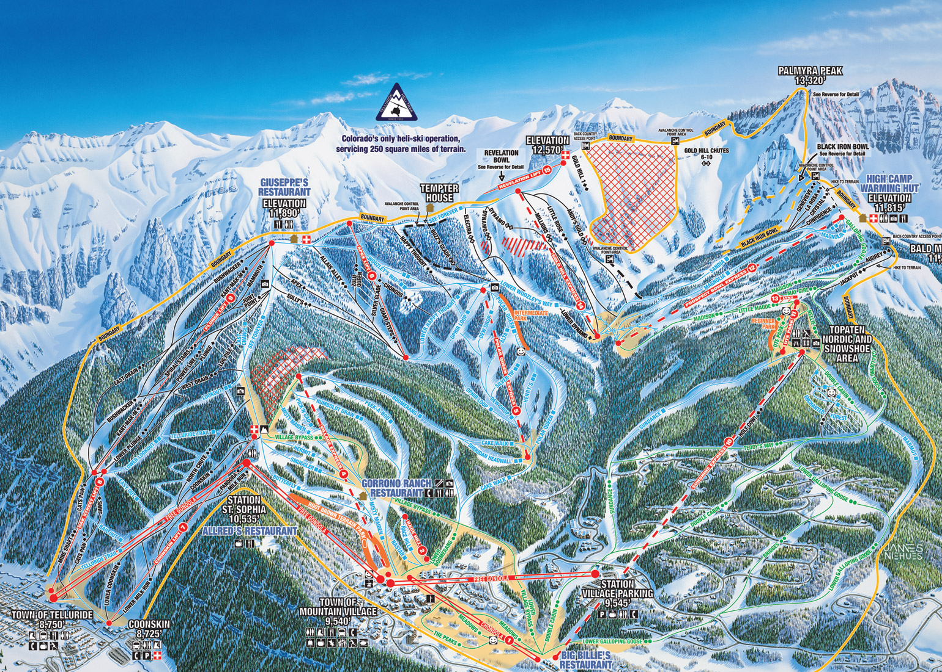
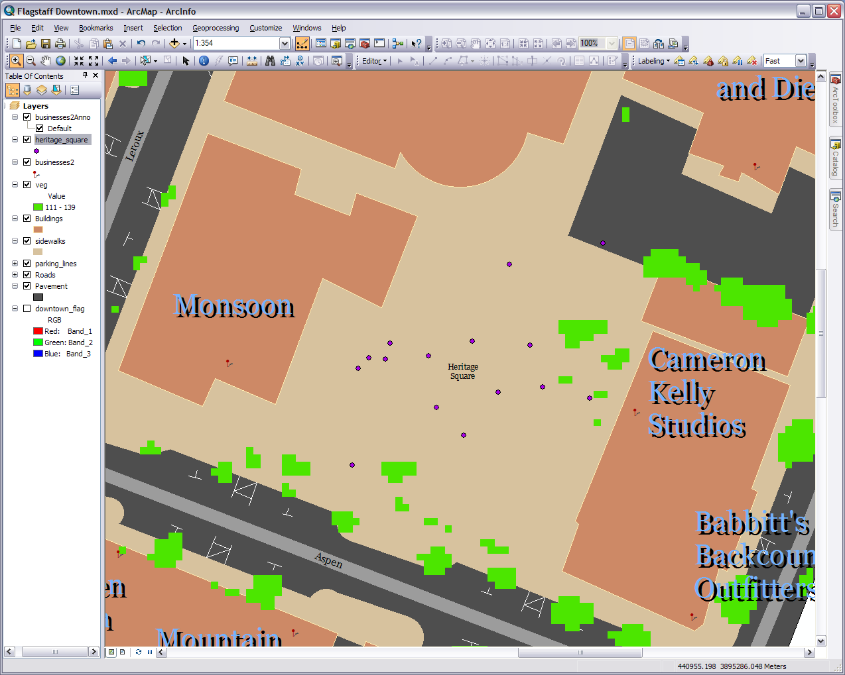
Notes:
Let’s do some more feature work first. The purpose of this step is to show how things might be done for some details at a large scale (meaning closely zoomed in). Heritage Square has some details that would be of interest to a community/campus GIS. Many are hard to see or at least differentiate on the basemap imagery. As a result I went with a standard GPS unit and collected several feature locations. I used a free program called DNR Garmin, pull them off my GPS unit, and put them into a shapefile. Find This shapefile, called heritage_square_features, in the folder you download and then import it into your geodatabase. It is in the projection we are working with so there should be no trouble. DNR Garmin adds a bunch of fields we can ignore. Make sure you are zoomed into Heritage Square.
There are three different features seen in the attribute table: benches, lampposts, and a flagpole. Pull each of these out making three separate point feature classes. One for each. You can do this by using the method we have used before (make three copies, select and delete the unwanted, name and rename appropriately) or try a new method. You can select the data you want (I do it in the attribute table), right click on the layer, go to data>export data, and export the selected features to the feature dataset in our database with an appropriate name. It will create a new feature class each time you do it and after you are done you can remove and delete the old. Either way you might want to change the names under the IDENT field in the attribute table. The editor gives you as much liberty to edit the attribute table as the features associated with it. Right now it is Be# for benches and Lp# for lampposts.

Slide 3
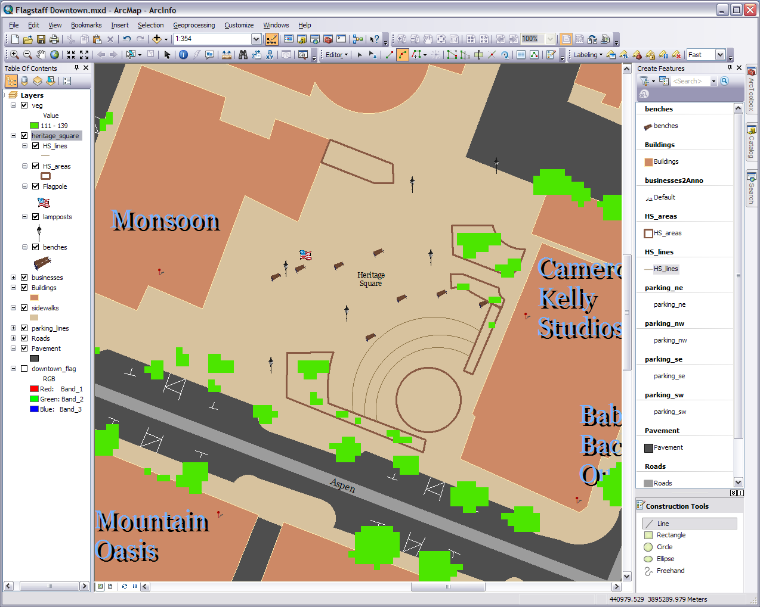
Notes:
Add the three new feature classes to our map and group them in a layer called heritage_square. Display each set of points with a representative icon (Style References). Even though the features may be hard to discern on the basemap (even the Bing aerial) you can see that the points I collected are off. This mostly due to the accuracy of the GPS receiver but also to some other things. You can shift them around if you want but to keep the module moving I’m just going to keep things as they are.
First there are some walls, an amphitheatre, and a gazebo type area we are going to add relative to our points. You can go off the basemap if you desire, as I am for the polygons, but some features may not match up (again the points are off). Add a line and a polygon feature class to our feature dataset. Call them what you want (HS_lines & HS_areas?). Put them on the map in our Heritage Square group. You can draw them from what you see in the screen shot here if you would like. Unlike the points I’m just going to give them a simple display.
Second we’ll create the polygons. There are six of them. A small gazebo/covered porch off the top right corner of the Monsoon building, two on either side of a ramp down to Cameron Kelly Studios, one between the amphitheatre and a path parallel to the lower east building near that ramp, one on the south edge separating the amphitheatre from the sidewalk, and the circular stage of the amphitheatre. Remember the goal here is to show features at a large scale so I’m not necessarily going for the exact spot.
Third we will put in the lines. Now I could of grabbed these lines with my GPS unit (tracks) but in the interest of simplifying things we are just going to draw them in arbitrarily. What I’m putting in are the terrace levels/steps down to the amphitheatre stage. I’m going to use the arc tool due to the steps being curved around the stage and go off two of the polygons framing the amphitheatre. I also put my vegetation layer on top and group my business and business annotation.

Slide 4
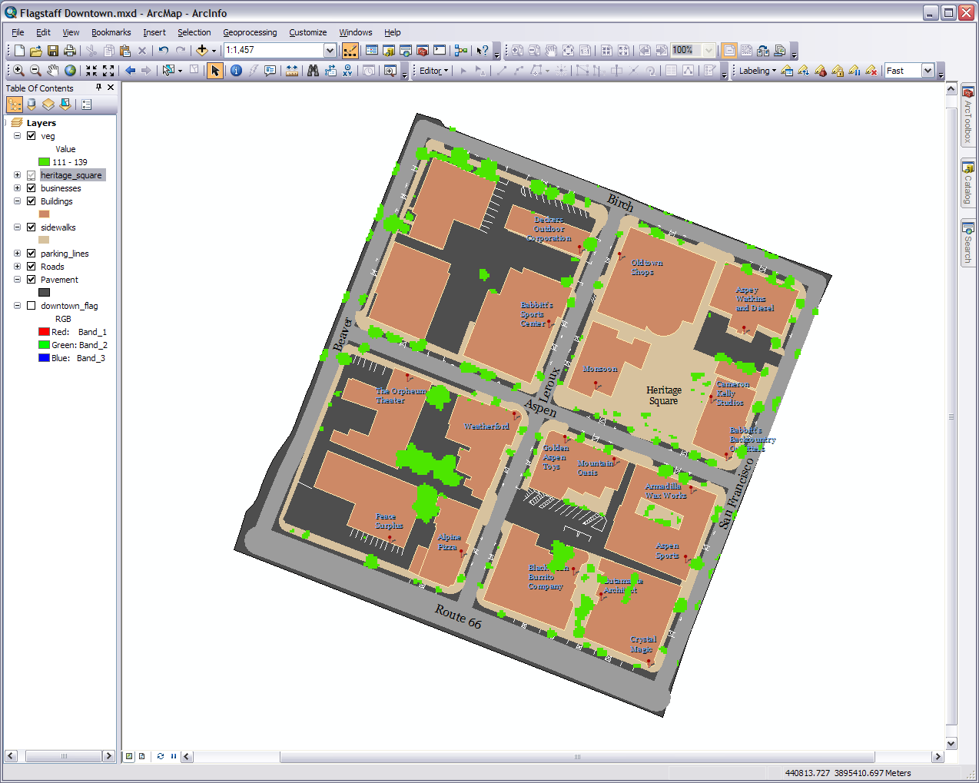
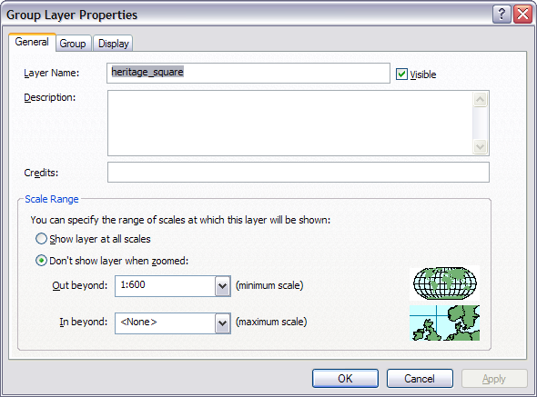
Notes:
Now for those of who are familiar with Heritage Square you know there is more to it than what we have done here. However the goal is to show you how to do community features at this large of scale. There is one more thing we need to do with this. If you zoom back to our reference scale (the pavement layer) you’ll see our features in Heritage Square have become a bit of a jumbled mess.
Here is what you do. As they are all grouped together we can change group settings by right clicking on the group name. Do so now and go to properties. Under the scale range choose “Don’t show layer when zoomed” and for “Out beyond” type in 1:600. Leave the “In beyond” at none and press OK. Does it look like our features disappeared? That’s because we set them to only be visible when we are zoomed in the 1:600 scale or larger. That way we won’t have the mess when zoomed out to smaller scales. You might also noticed when the group isn’t visible the check mark next to the name is ghosted out.
Going off of this concept, remember our roads layers? We talked about the roads appearing thinner when we zoomed in even though we set them to widths of the roads in the base image. Well to deal with this and other visual discrepancies when zooming in and out just do what we did. Create a number of groups of all the layers and set them to appear at different scales. Then configure the display settings for each of the features in the various groups.

Slide 5
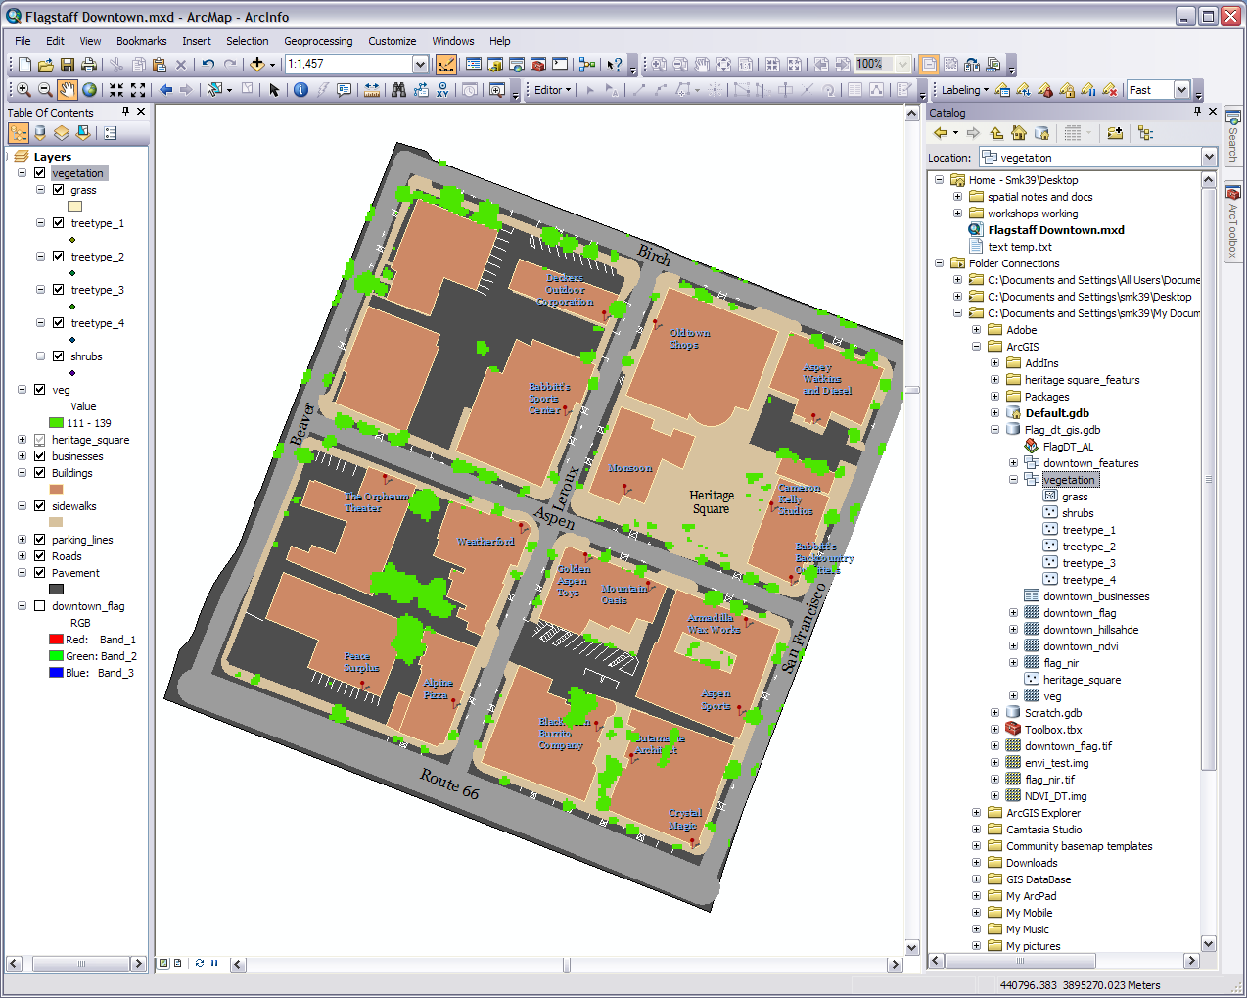
Type 1 is pine like trees
Grass/Lawn
Type 4
Type 1
Shrubbery
Shrubbery
Tree type 4 lines the streets and is our default for the unknown
Type 3 is for cottonwood/crabapple like trees
Type 2 is for aspens
Notes:
Since we are working on detailing in this module let’s do something about our vegetation layer. Back when we first made this layer we did it with an all inclusive raster layer. Well we know there are various types of plant life downtown so guess what? We are going to create some more layers.
If you were creating your own campus/community GIS and wanted to differentiate your vegetation you would probably find out the various types, names, and GPS the locations the best you could. Well for simplicity sake we just going to generalize. In your geodatabase make another feature dataset called vegetation with the same projection information (UTM WGS84 Zone 12) as the rest of the data. In it create four point feature classes named and numbered tree type 1-4, another one called shrubs, and a polygon feature class called grass. Bring them into the map and put them in a group called vegetation.
Don’t get rid of your raster vegetation layer yet. This part of down town flagstaff has aspens, ash, pine, and others along with some small lawn areas in the top left corner on the northwest block and some shrubbery in places. I took a brief in the field survey of the area and have a general idea of their arrangement which is OK for this workshop. Between my survey, our veg raster, and the basemap image we’ve got a pretty good idea of the downtown flora. Note as you may be familiar with there a several ways to differentiate vegetation (there are doctorate degrees in biologic remote sensing) but this is just one simple, accurate, and correct way to do it.

Slide 6
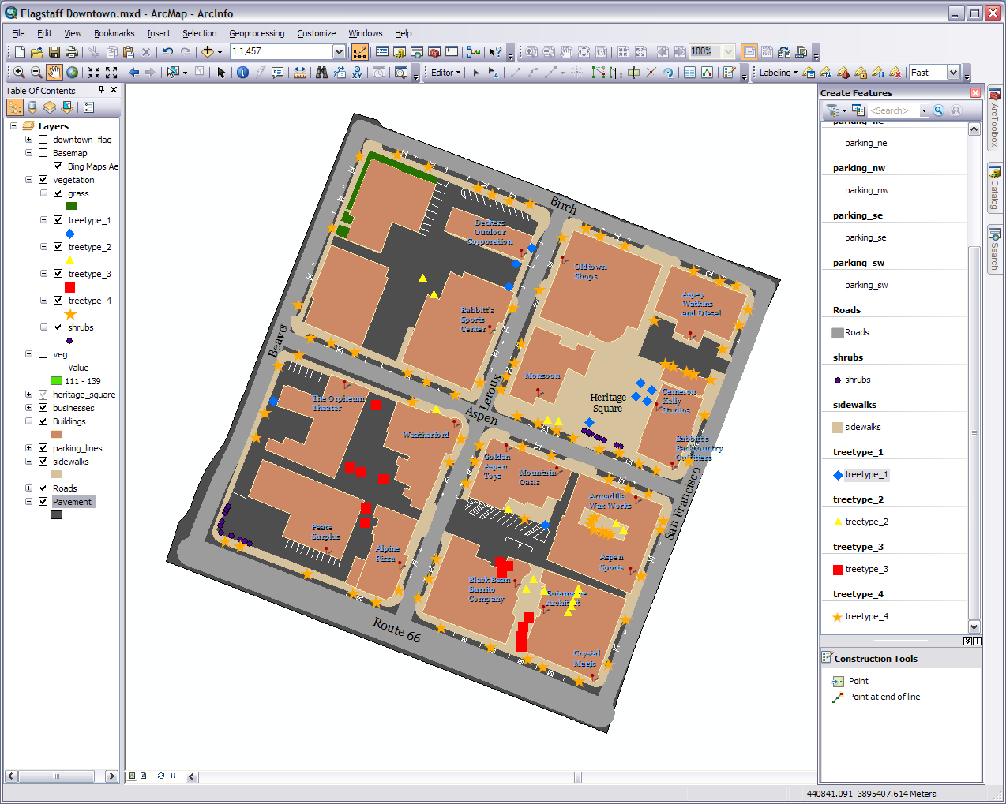
Remember you can click here of a new editing template
Notes:
We are going to add the features first and worry about symbology later. I hope this and the last screen shot gives you an idea of how the foliage is laid out. You can of course use the veg layer and basemap image too. Feel free to make it up as you go if you don’t know if it should be tree type 2, 3, or whatever.
First I’m going to start small and add the grass lawn around the front and north side on that top left building in the northwest block. It goes around both sides between the building and sidewalk. Yes there are some trees and a walk to the front door but for simplicity I’m just going to ignore them.
Second we’ll add some shrubby. There are two places. One is in that bottom most polygon we added to Heritage Square. Zoom in if needed and know there is a tree (pine?) on the left end. The other is around the corner of the pavement of lower left corner of the southwest block. The hedge shows up on the basemap image but our veg layer missed it.
Third is the trees. Well we have four types so have fun marking spots. The general guideline I’m using is to look the canopy of what I can discern as an individual tree and mark the “center” where I assume the trunk is. Keep in mind we are not going for 100% spatial accuracy, you don’t have to every single tree, and we’ll take care of the symbology in the next step.
On a side note I had something happen to me in the Arc 10 create features window. With all our layers there is quite a bit of editor templates in the window and some of the tools didn’t show up when I turned it on. I had to double click the top of the window to get everything to show up. Try it if your window isn’t behaving properly. Just to let you know incase it happened to you.

Slide 7
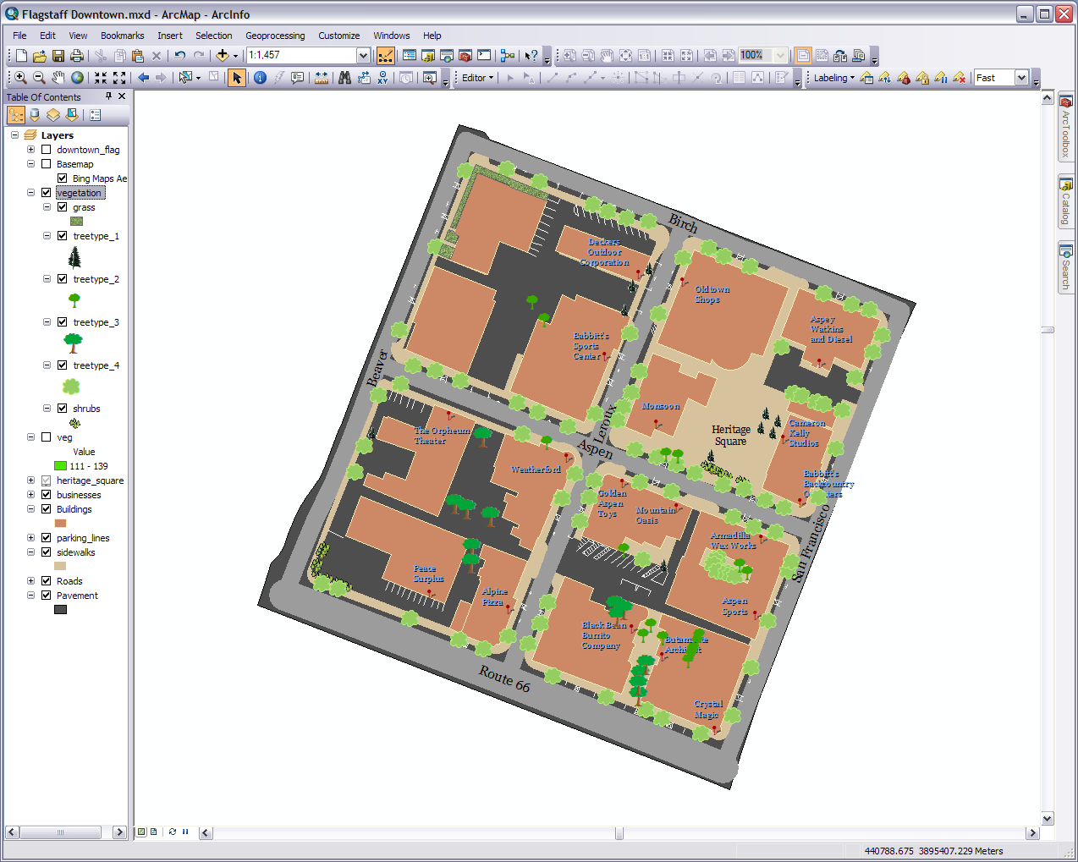
Notes:
Now we will work on the symbology. You’ve done this before so just click on the icon for the layer and turn on style references if needed. Remember when doing a GIS you are trying to make this as representative as possible
Obviously not all plants of the same type are created equal. For your own GIS you could go into the attribute table and record the characteristics of each individual plant. For example: we could go into tree type 3, create a field called size, and rate each tree on a scale from 1 to 5. Then under the symbology tab in the properties choose quantities>graduated symbols, set field value to size, and the class to 5 we will have the symbols displayed at different sizes relative to the size of the trees.

Slide 8
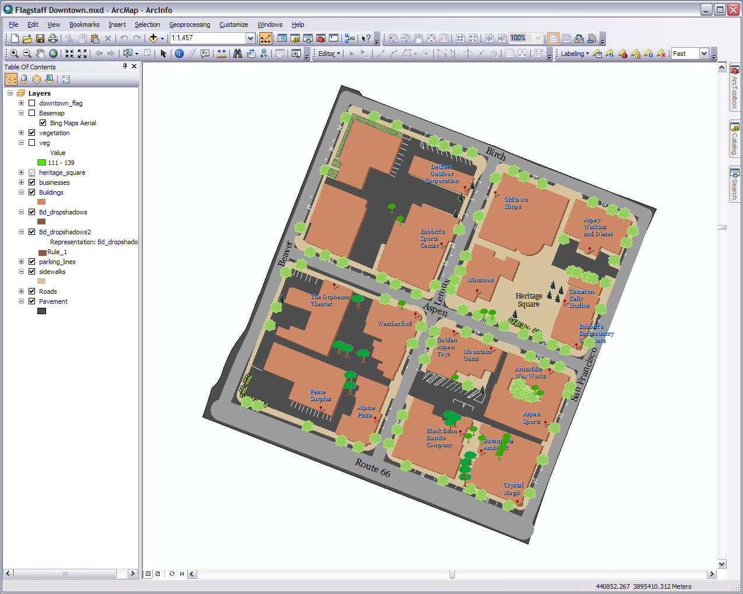
Drop shadows
This is a copy of this
This is a representation of this
Drop shadows
Notes:
Do you want add some more visual effects? How about building drop shadows? Note if you choose to do this step some of the effects are permanent so make sure you have a backup copy somewhere of the files we are going to mess with and/or the geodatabase. If you are ready, create in the geodatabase a copy of your buildings feature class and bring it into you map. Call it Bd_dropshadows (target name) and put it under your buildings layer. We are creating a copy because we want these representations separate from the actual buildings
1) Turn off any layers above that might get in the way and take off any outline you have around your buildings (leave the fill). Right click on your drop shadows layer. 2) Select Convert Symbology to Representation. Call it Bd_dropshadows2 and leave the rest. 3) Press Convert and a new layer will appear in the map. Move it just under your drop shadows layer. This representation layer is now a part of but won’t show up in your geodatabase. 4) Go to the symbology tab in the properties. You can double click the layer’s subtitle for a shortcut.
Once in the representations dialog box it will first show your settings for your fill. 5) Set this to an appropriate color by double clicking on the color bar on the right side. This is the color of the dropshadow. 6) In the middle bar with the icons click on the top icon. It is the one with a ruler in it. It will say No Global Effect. 7) Click on the + button in the upper right to add an effect. 8) Click on Move (not Offset) and press OK. I picked 1.5 & -1.5 for my offsets 9) You can press apply (and OK to the warning) to see what happens or just press OK. You can go back to this dialog box at any time to change the settings.
Consider the following before you save the map (.mxd). The representation is now embedded in your drop shadows layer. If you save the map right now as is, the representation layer will continue to appear as a separate layer on the map only. If you don’t save the map right now as is and close it, the next time it opens it won’t appear as a separate layer. Either way the representation can be accessed under the symbology tab in the properties so it is unnecessary to have that extra layer after you reopen the map.
If you mess up at any time in this process or simply decide you don’t want to do it after all then just delete the stuff you created and replace it with original copies from where you made the backups.

Slide 9
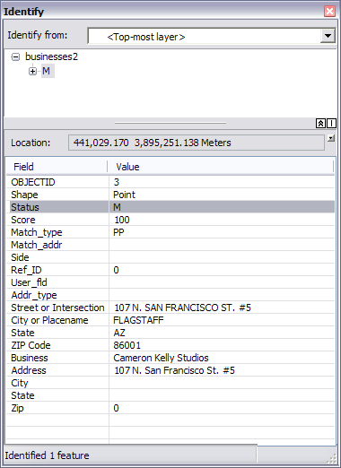
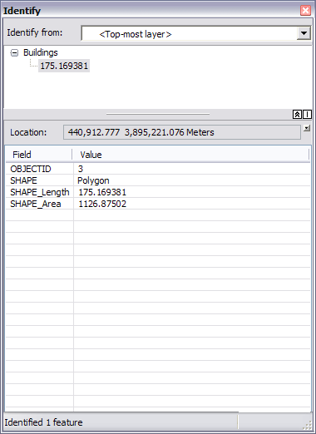
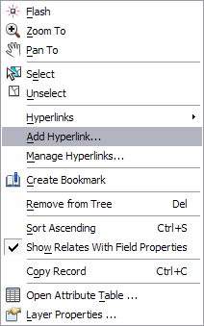
Right click here
Notes:
Now to make this GIS a bit more lively we can add some hyperlinks to photos, web sites, or whatever. This is a simple process but only if you know where to look. Please note as the map and file locations change the hyperlinks may need to be changed and of course when you print the map the hyperlinks are not printed with it.
Example 1: A) From the folder you downloaded put the Weatherford Hotel.jpg picture in a convenient location. B) Select the identify tool on the Tools Toolbar (the blue orb with the white i in it). C) Click on the building where the Weatherford is located. An Identify window will pop identifying the Weatherford building as in the buildings layer and uses the data in a cell from one of the attribute table fields to note that particular building. Well we never named any of the buildings so the computer doesn't have much to work with. D) Right click on the identifier (in this case a number) under Buildings. In the menu that pops up pick Add Hyperlink and then Link to a Document. E) Click the browse button next to the blank field, locate the picture, press OK, and press OK. The lighting bolt (hyperlink tool) next to the identify tool on the tool bar is now active. Use that and click on the feature to access the link.
Example 2: A) Select the identify tool on the Tools Toolbar (the blue orb with the white i in it). B) Click on the pin where the Cameron Kelly Studios is located. An Identify window will pop identifying the business as in the business layer and uses the data in a cell from one of the attribute table fields to note that particular business. Unfortunately it only picks from the first field after the shape identifying field but that is OK for us. C) Right click on the identifier (in this case an M) under businesses. In the menu that pops up pick Add Hyperlink and then Link to a URL. D) Add http://www.cameronkellystudio.com/ in the blank field, and press OK. The lighting bolt (hyperlink tool) next to the identify tool on the tool bar is now active. Use that and click on the feature to access the link. While on the hyperlink tool those features with hyperlinks will be noted.
Another dynamic activity for your map In ArcGIS is MapTips. MapTips is simply when you hover the cursor over a feature a attribute displays. You just go to the properties of a layer. Click the Display tab and check Show MapTips. Choose the field you want to display with the drop-down arrow. Click OK. In data view, move the mouse pointer over a feature to see the MapTip.

Slide 10
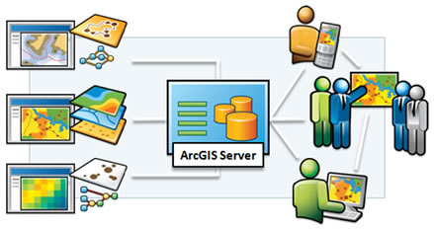
Image source: http://www.esri.com/software/arcgis/arcgisserver/index.html
Notes:
At some point you will probably want to share your community/campus GIS with others. We’ll go through some of the ways to publish your GIS to communities and clients in the next few steps. Keep in mind when publishing your target audience and the available options to you.
Going from large to small we will start with ArcGIS Server. It serves up data to clients like any other data server only this guy is specifically engineered for spatial data. Kind of like how ArcCatalog is a more specialized data manager then a general file explorer. GIS projects and other spatial data are stored on an ArcSDE (Spatial Databse Enginge) database which ArcGIS Server pulls data from. The data can then be retrieved by the clients who have access. The technology also operates with the Cloud technology. For an example of what the clients see got to http://www.grail.nau.edu/flag_rec. We also connected to GRAIL’s ArcGIS Server in Module 3 of the Introduction to GIS workshop.
I’m sure many of you are saying “I don’t have access to such software and hardware” or “I’m not a database administrator/programmer.” Well you don’t need to be. There are plenty of other ways to publish and if you have access to ArcGIS Server great. I just want you to be aware of it. I also want you to be aware that ArcGIS Server is only one of several spatial database/server packages out there.

Slide 11
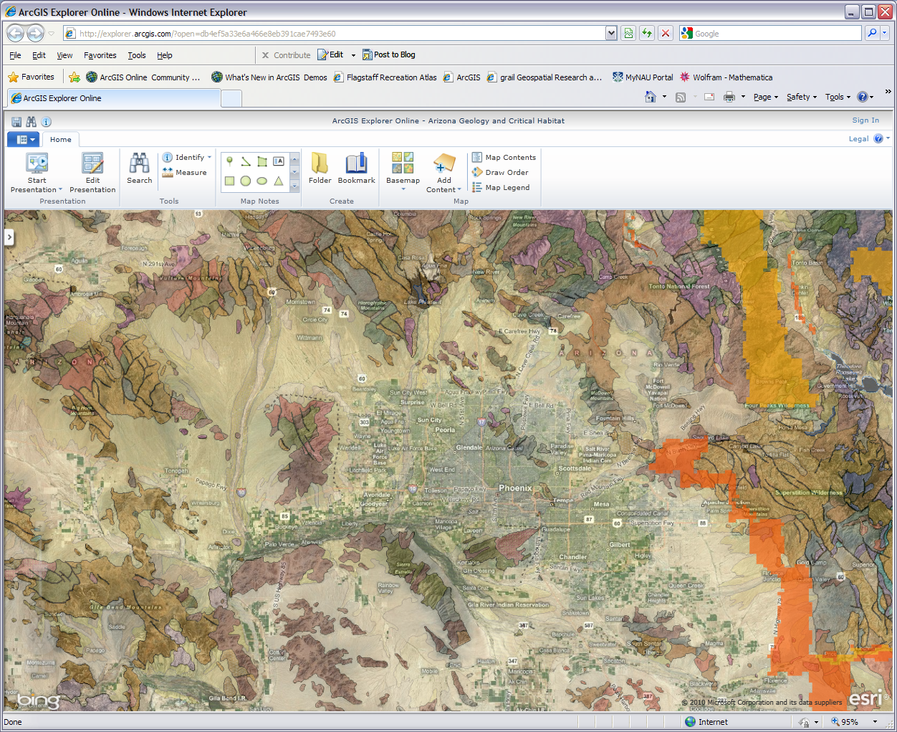
Notes:
Online sharing is another big way to publish your spatial data. If you go to ArcGIS Online and type in a search you can see the many dataset the ArcGIS community has made available. You don’t even have to have GIS software on your computer. I has an online version of ArcGIS Explorer so you can view the data in your browser. You can of course also join user groups and share your own data. ArcGIS Online and their Community Maps Program could take up a whole workshop each so for more information you can go to http://www.arcgis.com/home/index.html or http://www.esri.com/software/arcgis/arcgisonline/community-maps.html

Slide 12
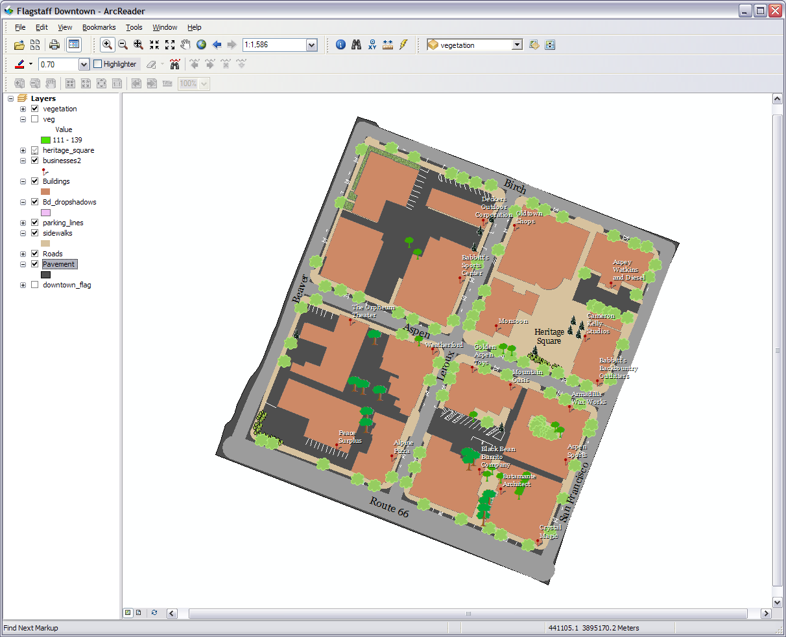
Notes:
So what’s something you can do other than ArcGIS Server and ArcGIS Online? Well moving down the line there is a Publish toolbar in ArcMap. It is an extension you may or may not have (GRAIL does) and the extension must be turned on in the customize menu. It allows you to prepare your data to be viewed in ArcReader. ArcReader is basically a very simplified watered-down browser version of ArcMap and has very little data manipulation capabilities. The good news is ArcReader is a free download (you have to register with ESRI) and the client or community user may not need to be connected to the data source location. So you can send your data packaged from the Publish toolbar to whomever and have them download ArcReader to view it. ArcReader won’t read anything other than data published from ArcMap (http://www.esri.com/software/arcgis/arcreader/download.html).
After you have downloaded and installed ArcReader the process isn’t too complicated. First go back to the Publisher toolbar in ArcMap. The two basic tools (the first two icons) are to publish your map and package you data for a published map. From the drop down arrow you can also change the settings of how you want to publish your map. If all you want to do is create a publish map the just press the Publish Map icon and it can be viewed in ArcReader. This however will only include a connection link to where your data is located and not the actual data so if some without access to your data is trying to view the map they won’t be able to.
Once you have a published map you can create data package to send along with your map. Click on the second icon to do this and have an empty folder (create one) where the package can be set up. Choose the format you would like (the default is usually fine) and press OK. Now when you or someone else opens it in ArcReader the data in the map is linked to the data package (open the map from the data package). Unfortunately non simple features like annotations can’t be packaged so when creating the published map don’t include those layers by removing them from ArcMap (labels are OK) before starting the publishing process. For more help see webhelp.esri.com/arcgisdesktop/9.3/pdf/ArcGIS_Publisher_Tutorial.pdf arcgis

Slide 13
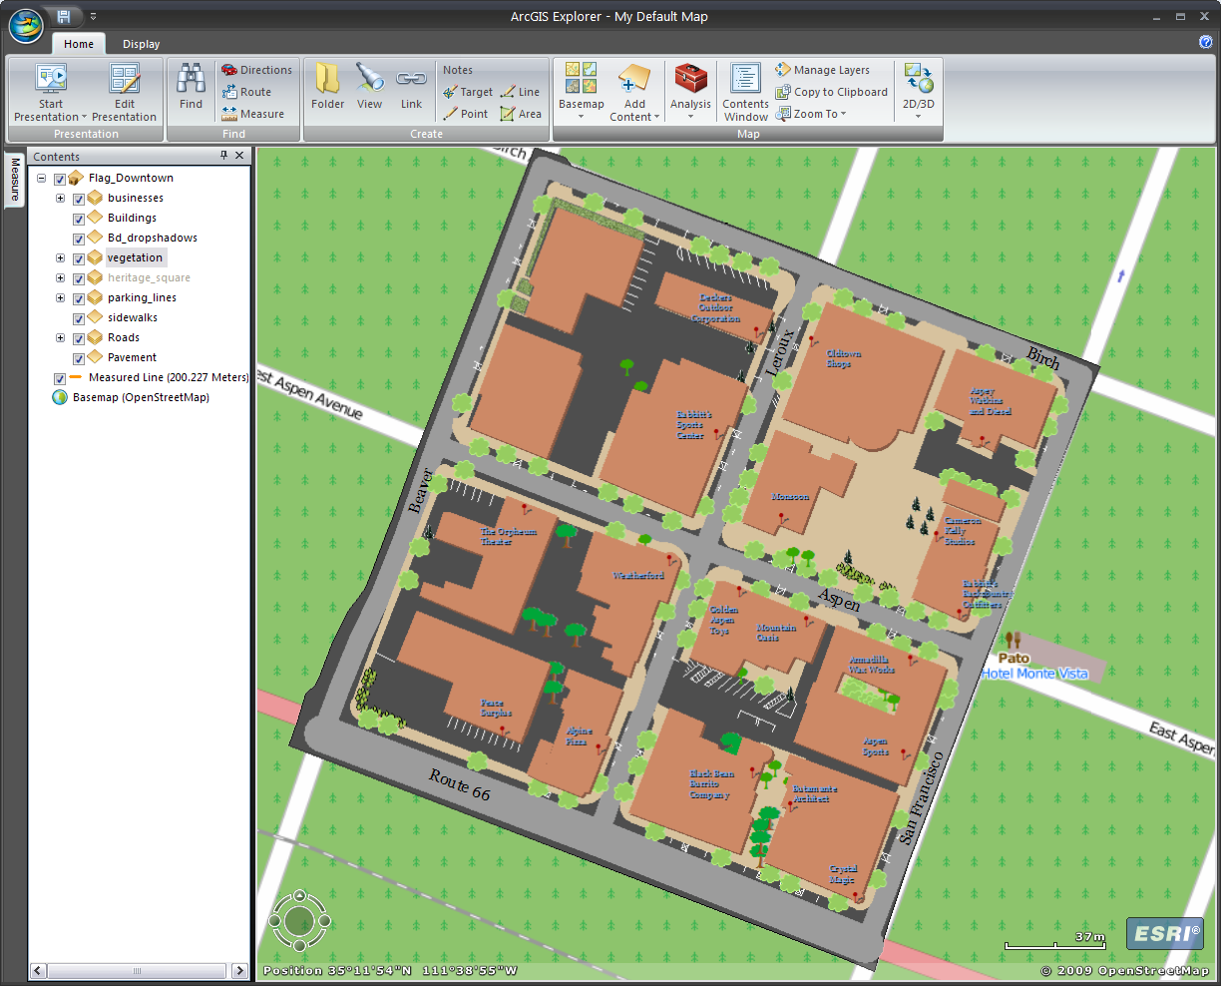
Notes:
Another free ESRI download that people can use to view your GIS is ArcExplorer . This program was used in three of the other workshops so you should be familiar with it (http://www.esri.com/software/arcgis/explorer/download.html). Explorer will read anything in a geodatabase as well as shapefiles, rasters, and other spatial data. So if you send them your geodatabase they be able to load the data from it. Unfortunately Explorer doesn't read .mxd files; so while it will be able to load our data it won’t know how to display it. If we want it to display it the way we have our .mxd file (map) displayed in ArcMap we have to save it as a layer package (not a layer file). ArcExplorer will read these.
A layer package is like a .mxd file in that it saves the definitions of the data in the package and not the actual data. What is saved is links to the data, how the data is setup and displayed, and what is need to interact with the data. Keep in mind the client at the other end needs to be able to connect to where the actual data is located and the layer data can’t be worked with but not edited in ArcExplorer.
Creating a layer package is simple. First create a new group and put everything you want in it. Groups can go into groups. In the properties for the group under the general tab you must put in a description even if it is just Howdy. Once you have a description right click on the group and go to create layer package. You first have to validate the package so Arc can make sure everything will work. If you are saving it to a file check to see it is going to the right location. If you are uploading it to ArcGIS Online just select that option (you must have an account). When you have validated the package and it is set for your desired location press share. It will save it and can now be opened in ArcExplorer.

Slide 14
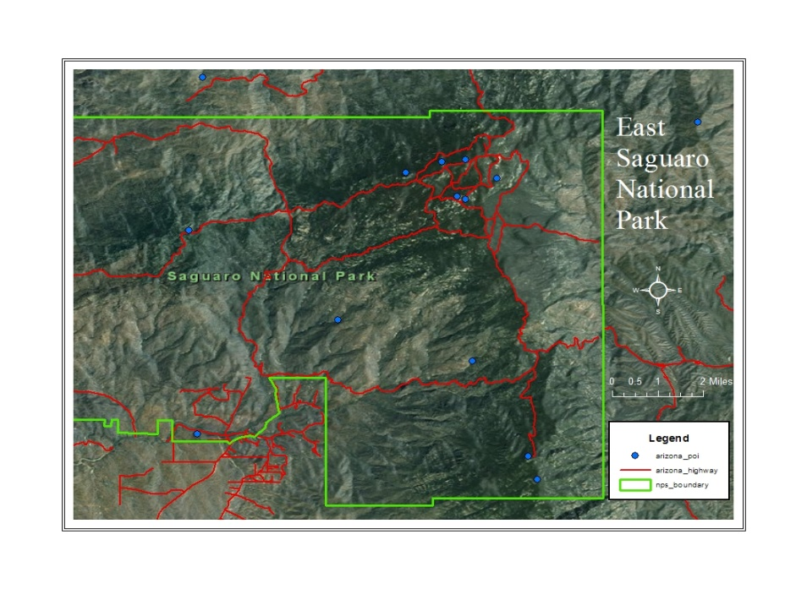
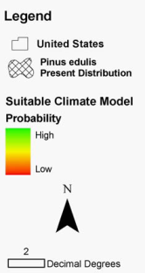
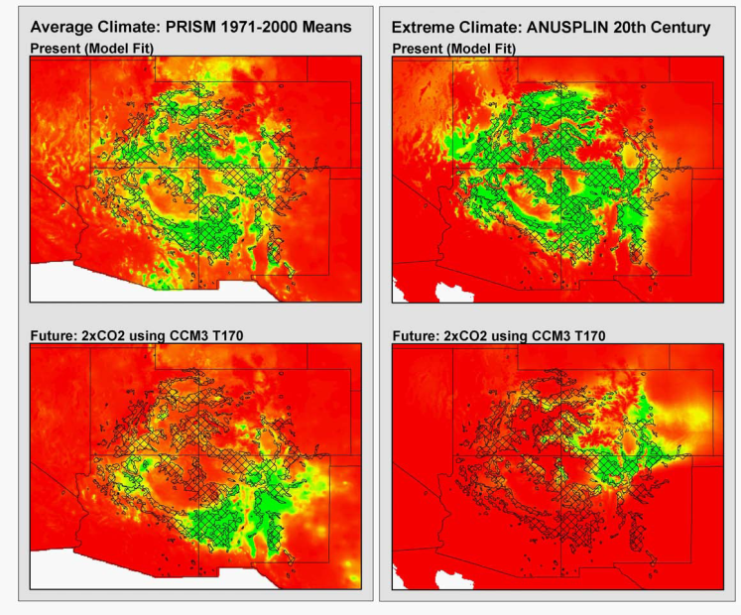
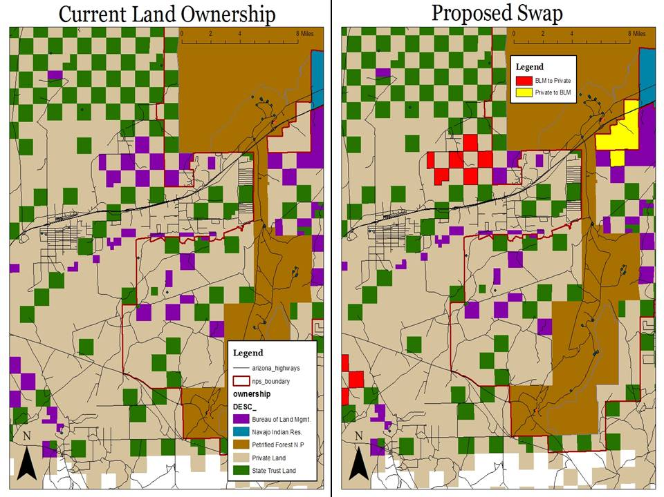
Different Baselines and Different Variables of Interest result in Different Predictions
For the Future
PRISM Group, Oregon
State University,
http://www.prismclimate.org,
created 10 Jul 2002
Arundel, S., Northern
Arizona University,
http://www.geog.nau.edu/gl
obal_change/climate_surfac
es.html, created 7 Jan 2003
(Duffy et. al, 2003)
(Govindasamy et. al, 2003)
(Cole et. al, 2007)
(Ironside Unpublished Data)
Not Official Business
Petrified Forest NP Proposed Land Acquisition
Created by Richard Blaine, 31 Feb 2015
Notes:
You can of course publish your map in numerous other ways. You can print it, convert it and put it on Google Earth (ArcToolbox>Conversion Tools>To Kml), add it to a report or poster, upload to a web site, use it on another GIS and Remote Sensing program, put on a mobile device, burn it to a disk, and so on. We’ve shown you in other workshops how you can switch to the layout view in ArcMap to prepare a map for publishing. You can also go to file>export map to export in various raster formats, even a Geo TIFF (a spatially correct .tif format image, remember to write the Geo TIFF tags). Just keep in mind that you often times need to have the data linked to or embedded in the map. Also once it is outside of an ArcGIS or other spatial program the computer will probably interpret as just another image or graphic.

Slide 15
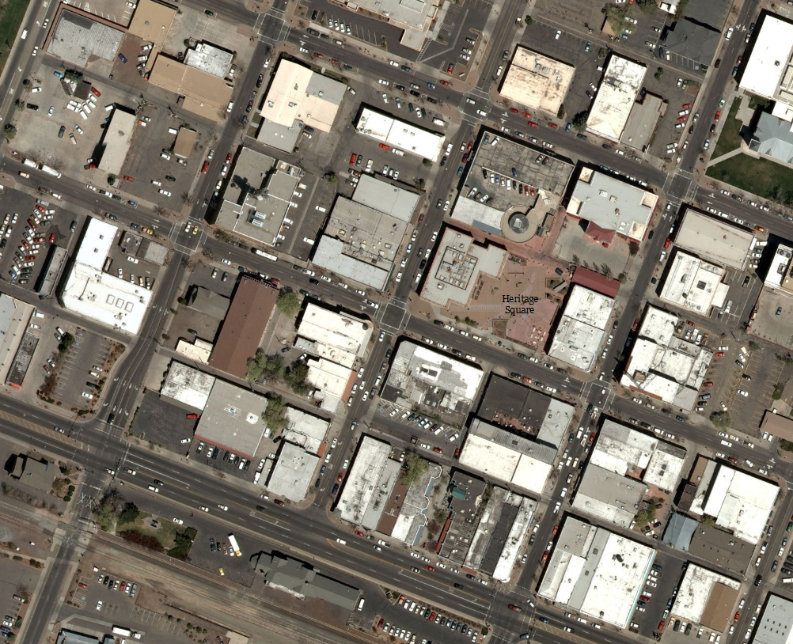
Notes:
Well there is not too much more to a basic community campus GIS. Just remember this is basic data and not an in-depth mono-focused project. What we are looking for is a simple understanding of the spatial aspects of an area. You are providing spatial data you and others can build off of for further adventures. I hope you enjoyed it.

