Slide 1
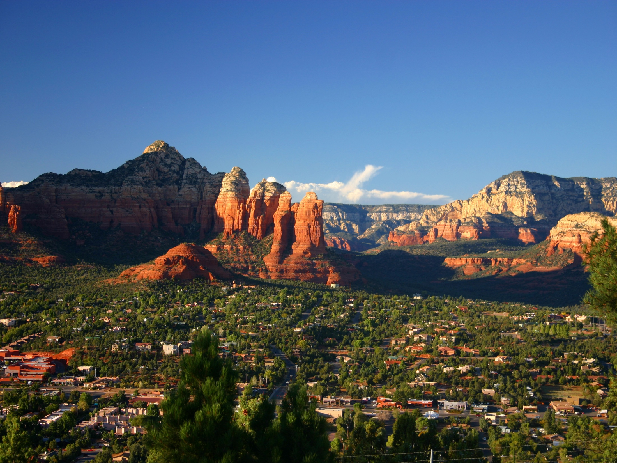
Designing a Community or Campus GIS
Module 3: Adding more character to the community
Created by: Scott Kelly 2010
Notes:
Welcome to the third module of Designing a Community or Campus GIS. In this module we will continue to work with the community GIS of downtown Flagstaff. We are going to do some detail work and add some more features. I’m probably going to leave my vegetation layer off through most of this module to make things easier so don’t worry if you don’t see it on the map.

Slide 2
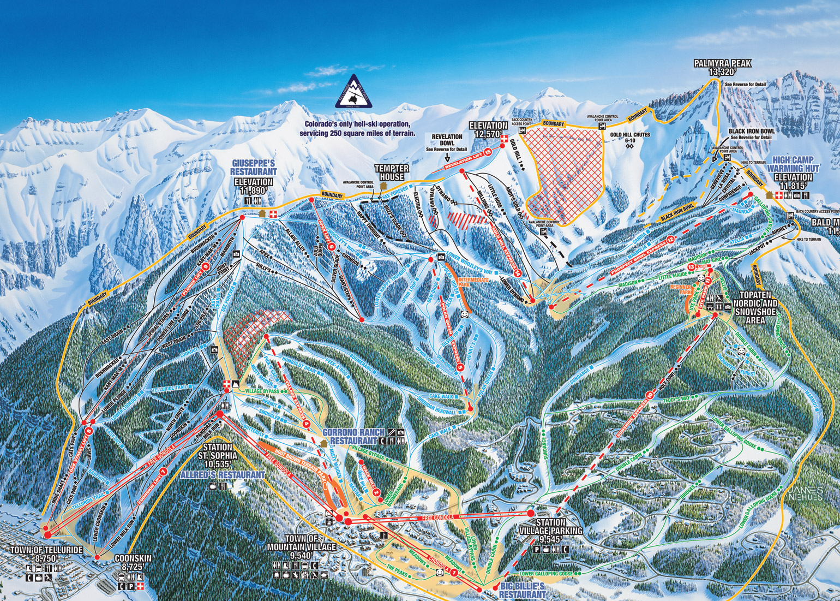
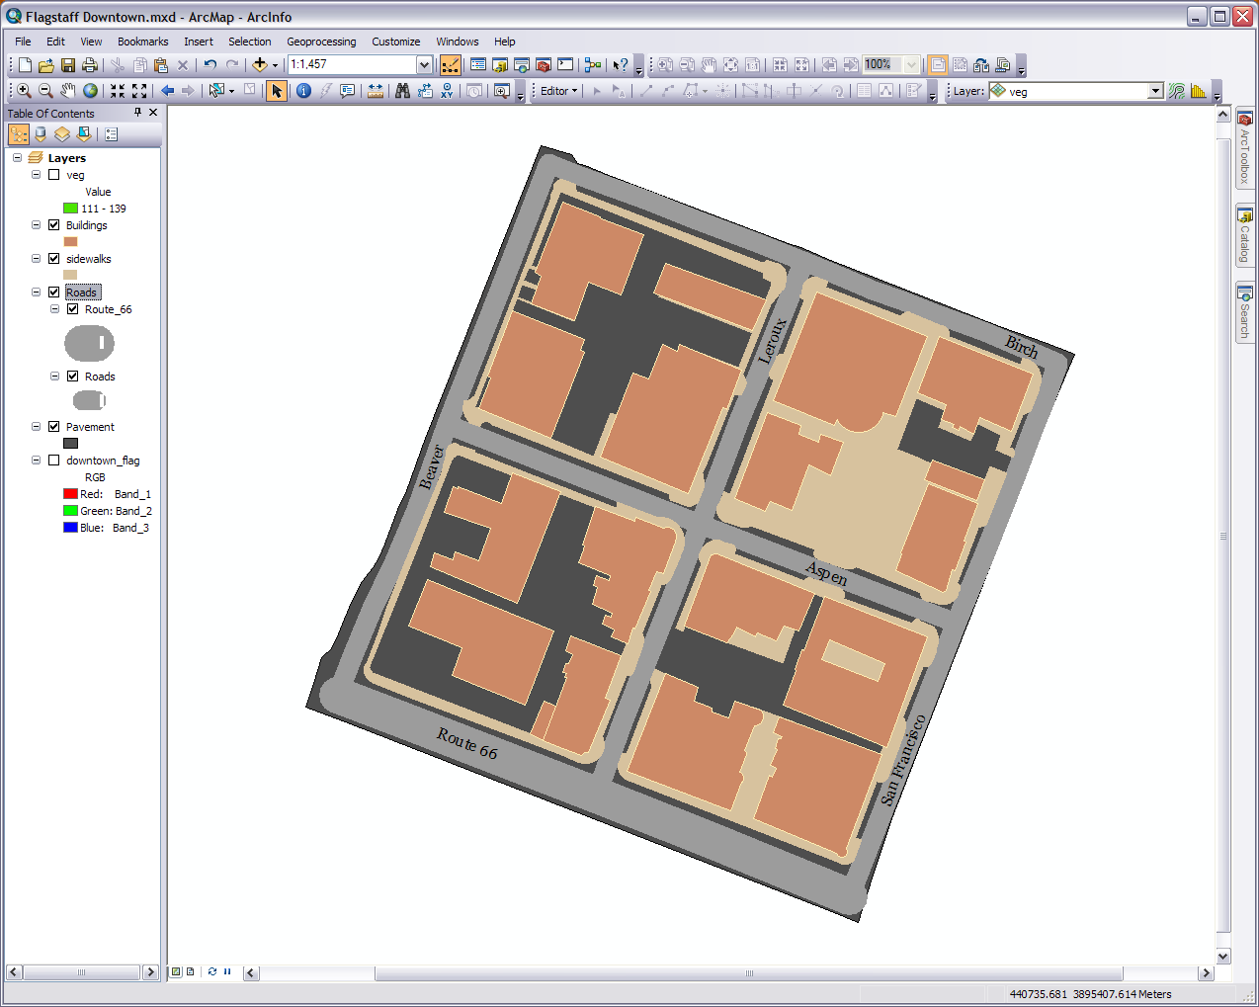
Our roads are put together in a group
Notes:
Start by opening up your map from the last module. Our first order of business is to clean things up a bit. Zoom to your pavement layer and we’ll start working at that scale (right click on the layer name>zoom to layer). That is the reference scale we’ll often go back to it as you may need to zoom in and out. Of course change the display and turn layers off and on as desired.
Let’s start by fixing up Route 66 via a similar procedure we’ve done in past workshops. 1) In ArcCatalog make a copy of the roads feature class in your feature dataset and rename it Route 66. 2) Bring it into your map above or below your roads layer and start the Editor. 3) Open the attribute table and select Route 66 by left clicking the small gray square at the head of the row. 4) In the options menu in the top left corner switch the selection. 5) Now right click on one of the gray squares of the selected roads and delete the selection. All you’ll have left is Route 66. 6) Close the table, save the edits, and stop the Editor. 7) Now make Route 66 the same color as the other roads and make it as wide as the Route 66 in the basemap image (bring the basemap in or turn it on for the moment). It’s OK if makes it look a little longer than the line we drew because any person viewing this would know the road actually extends well beyond the edges of our GIS. 8) Now where it says Layers at the top of our table of contents right click and start a new group called Roads. Drag Route 66 and our other roads into the group and put the group right above the pavement layer. You can collapse it by clicking on the minus sign next to it.
Next we’ll work on our pavement polygon. When we first created this foundation slab we did a basic tracing of the outside edges of the roads surrounding our blocks. Yours may look better than mine so you may not need to do much to tidy up this feature. Using the basemap image and the Editor tools, particularly the adjust vertices and reshape polygons tools, go around the edges and smooth things out. It’s perfectly alright to make this feature larger than when you started. Just remember the four blocks we’re focused on. I can’t give you any more specific directions than that so have fun with it.
Third on the list is sidewalk and curb cleanup. Again you may not have to do much and a plethora of specific instructions is unavailable. Just keep in mind that sidewalks and streets meet at the edges, there is parallel parking downtown, and curbs and street corners can be the same thing. You may just want to get more detailed with your features. It is probably better to use the basemap image for the confirming reference because remember our roads are just lines with length and no actual width. At the current scale we have them matching up with the actual road width but if we were to zoom in significantly they wouldn’t appear so. I’ll tell you how to work with this at a later time but for now don’t worry about it. You’re also looking to find and close holes. For example on lowest most building I found a sliver where the building and sidewalk didn’t match up or over lap. These small holes may not seem like much but they compromise the GIS’s integrity and if someone else where to use the GIS they might be getting misinformation. Just do the best you can.

Slide 3
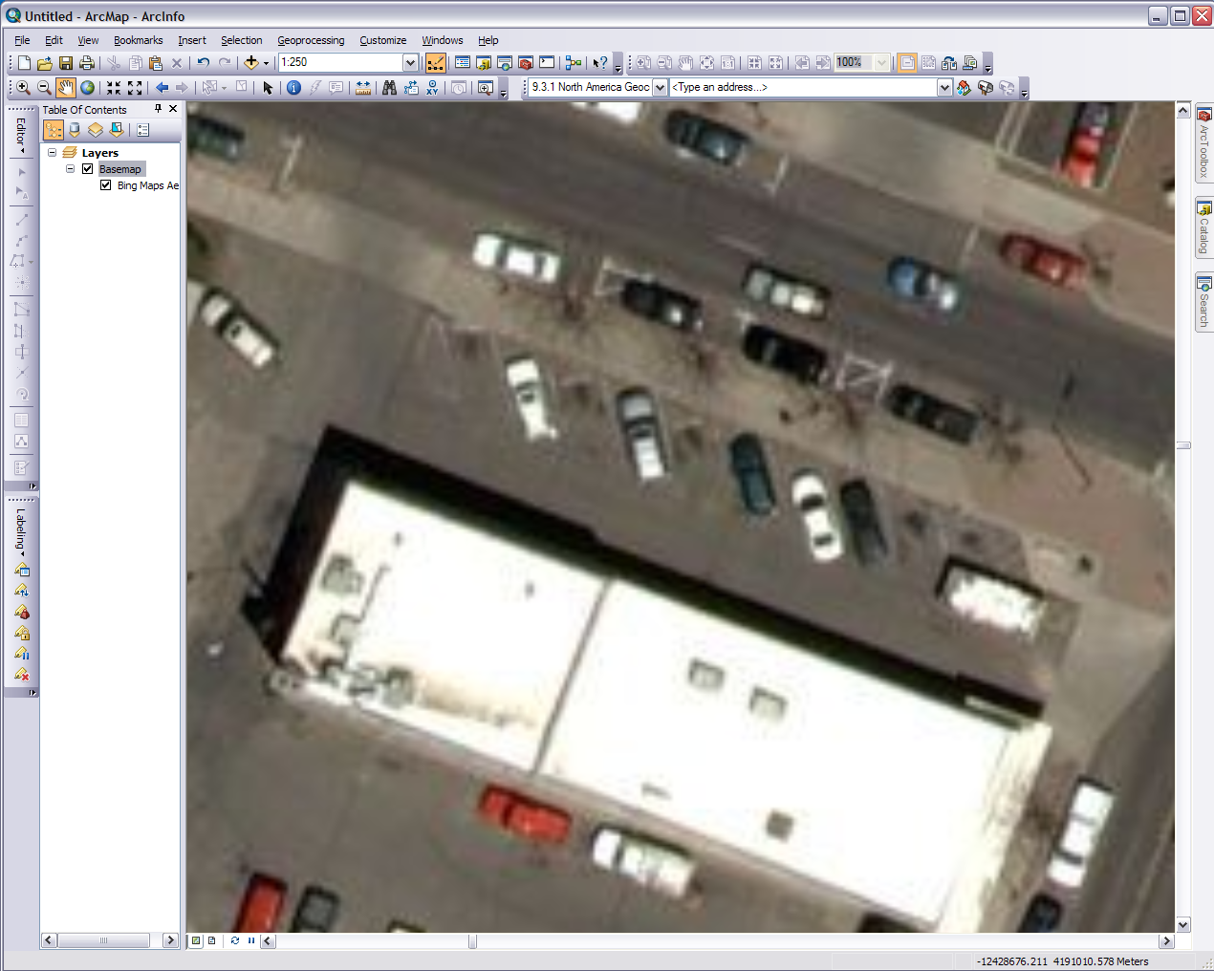
Geocoding toolbar for later
Diagonal and parallel parking lines at the top of the northwest block
Notes:
What we are going to do next is trace the parking lines like we did with the buildings and other layers. Only this time instead of polygons it will be line features. In many cases a campus GIS or any one at the large scale we are using has the parking lots detailed with their parking lines (see some of the examples in Module 1). When doing your own community GIS you probably have a good idea where the parking lines are and may be able to go out with a GPS unit and mark them for better accuracy than what we are going to do. The street views from Google are very helpful too. These parking lines can be between you pavement and roads or roads and sidewalks layers so its OK if you lines slip into to road a bit.
If you bring back in our basemap imagery (or if you are in Arc10 the Bing Maps Aerial basemap) you’ll see our four blocks have quite a bit less parking lines than the rest of the downtown area. In fact there isn’t much at all making our job a little easier, however it will still take some time. In the basemap imagery we’ve been tracing off of the lines can be a little hard to see (it’s somewhat easier if you use the Bing Maps Aerial basemap) but this is just an exercise so we’ll use it anyway. If you are able to use any other source to supplement our task here that is great.

Slide 4
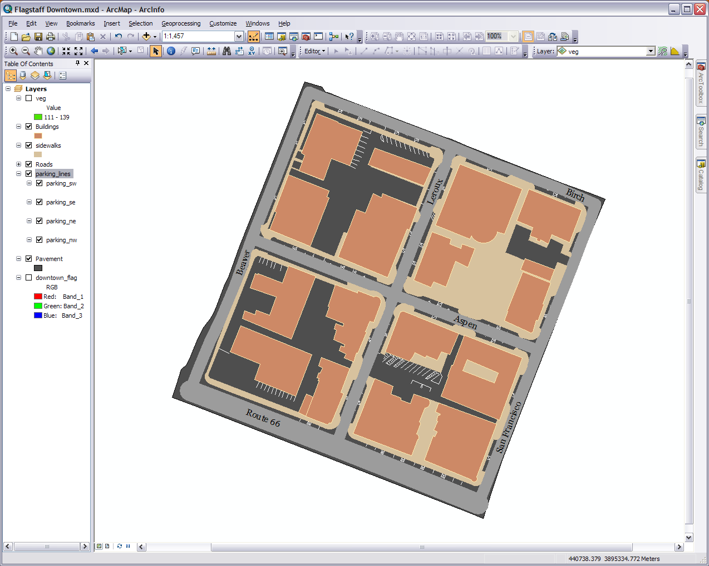
Parking Lines
Notes:
In your feature dataset in ArcCatalog create four new line features. One for each block. By creating them separately then grouping them they will be easier to manage and work with later. Use names like parking_NW or Parking_1 to designate each one. Bring them into Arcmap and group them together (name: parking_lines?). Use the Editor just like you have in the past. Your going to have a large bunch of little lines. You’ll at least want to turn off the pavement, vegetation, and roads layers but feel free to turn off the others as well. Don’t worry about getting every single line, perfect lengths, spacing, or straightness. This exercise is not worth that much stress.
In the top left (northwest) block for this and all blocks try and get the parallel parking areas between the streets and sidewalks. For the inside of the block the only well marked parking lines are off the top side of the upper right building. There are actually some between the two buildings (off the left building) that you won’t see in the base map so add them if you feel like extra practice.
In the top right (northeast) block there is just parallel parking here.
In the bottom right (southeast) block the center has some well marked lines. Watch for parallel parking on Route 66.
In the bottom left (southwest) block in the bottom center next to building there are several. There are some in the lot to the left but I actual had to drive to the lot to see the faint yellow parking lines so I’m not going to add them. There is no parallel parking for this block on Beaver and only a small spot on Route 66. In the parking lot in the upper left corner, even though the basemap doesn’t show it, there are actually parking stalls off the sidewalk next to Aspen that go the full width of the lot. To draw them in you can use the two parked cars as guidelines.

Slide 5
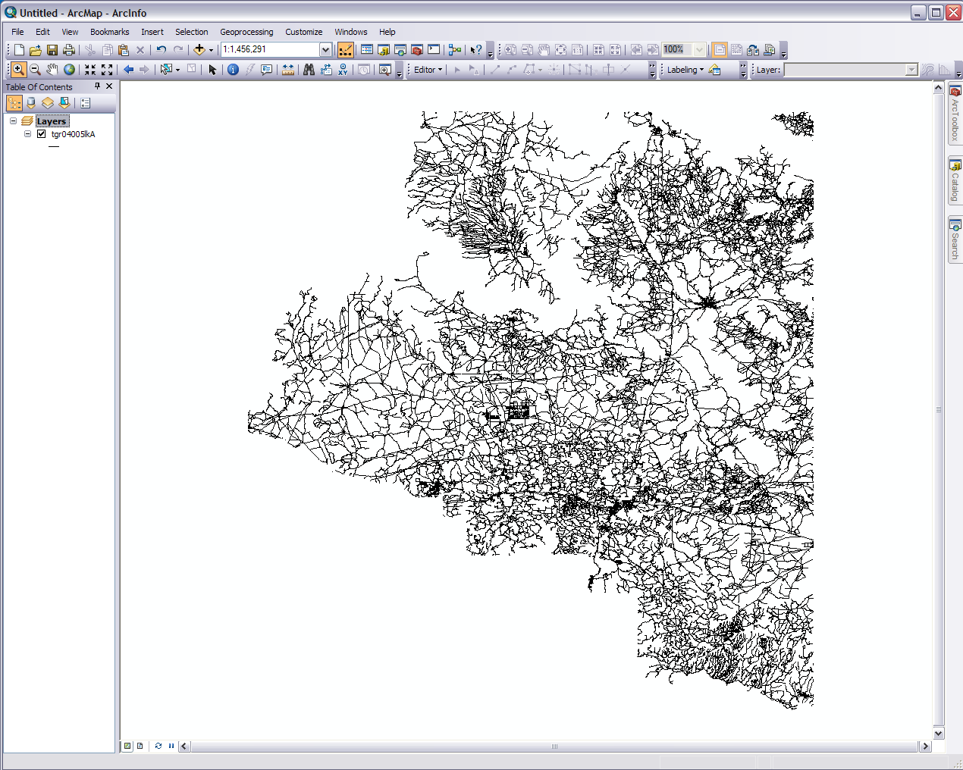
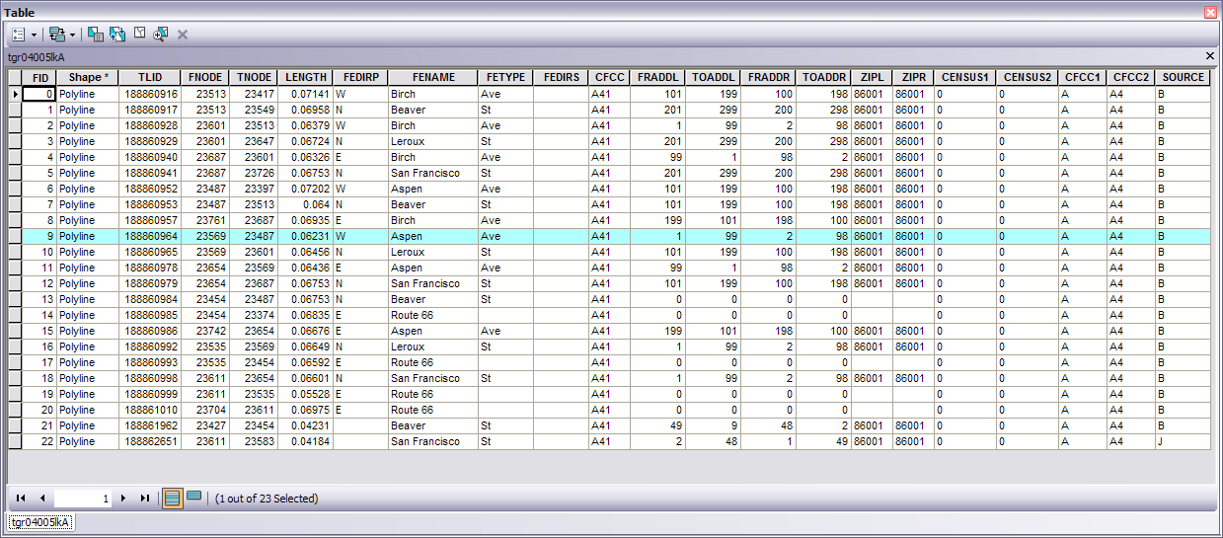
Address ranges with street direction and side for each segment
Flagstaff
Notes:
Now this downtown neighborhood has several businesses. These are important features to the area and so it would be good to display them. We have a list (the Excel table in the folder you downloaded) of a few of the businesses with their addresses and we are going to put them onto the map with an operation called Geocoding.
First save your map (.mxd file) and start a new blank map. Add the shapefile (.shp) from the tiger folder to our blank map. This file was obtained from the US Census and projected in a geographic coordinate system (lat/long). These roads won’t do for our community GIS but they will be a great help for our geocoding. We are going to use this file to create an address locator.
Second zoom into our four downtown blocks. If your not sure where to zoom to you can bring in your pavement layer, zoom to that, and then remove it. What we are trying to do is reduce this file to a manageable size. Once you are there use the select features tool and draw a box around our roads to select them. Its OK if you go beyond our extent. The roads may or may not appear to have the familiar blue highlighter. Either way open the attribute table. If you click on show selected at the bottom you’ll see that our roads are indeed selected. You’ll also notice that instead of one long line for say Aspen you’ll have several segments. Each segment is a street block. Looking down the table you’ll see a couple of fields called FRADDL and TOADDR. These are the range of address numbers on either the left or right side of the street. Click back on the show all.
Third we are going to eliminate all the other roads. You should be familiar with this step from the other workshops. There are over 68,000 roads and to make it go faster we’ll delete small chunks one at a time. Zoom to the full extent and start the Editor. Select a section of roads and press delete. Keep doing this till your down to just Flagstaff (near bottom center) or the greater downtown area. Bring in a basemap for reference help if needed. Zoom in, select our roads again, and open the attribute table. Switch the selection in the table options menu on the top left. Right click on the gray squares on the left side of the table and delete the selection. Wait for it. Save your edits and stop the editor. Refresh the map and table as needed. If you mess up download the file again and start over. What we want is the roads for our area of interest (AOI).

Slide 6
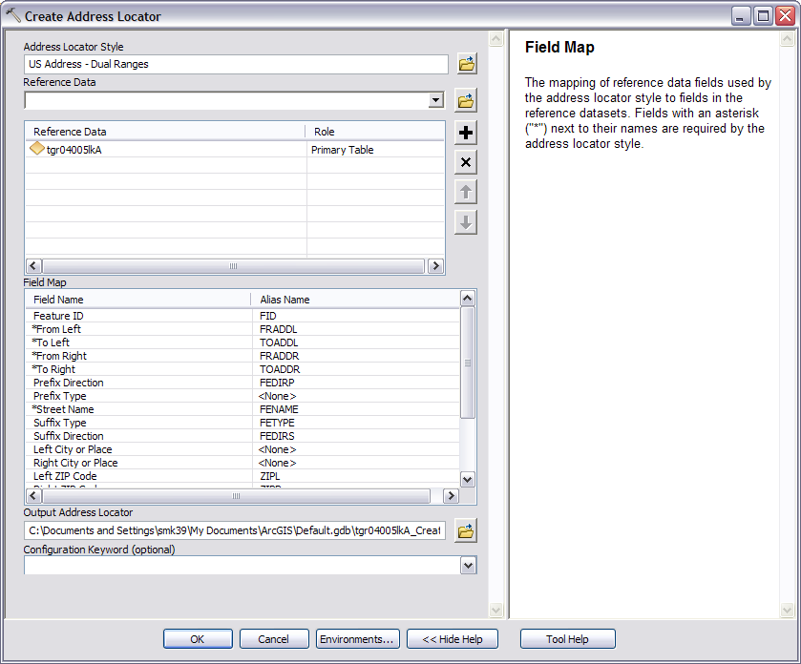
Notes:
Next we will create the address locator. ArcGIS 10 and ArcGIS Online already have access to several public address locators however these don’t provide the accuracy we want. Hence another need for our community GIS.
1) Go to Arctoolbox>Geocoding Tools>Create Address Locator. 2) For the Address Locator Style choose US Address – Dual Ranges (for Arc 9.3 choose US Alphanumeric Ranges with Zone). 3) For the reference data pick the roads file you just edited. Make sure it is set as the primary table role. 4) The field map should automatically populate and the error messages should go away. The alias names should match up with the field names. For example the From Left in the style is the same as the FRADDL in your file. If they don’t match up you can manually adjust the alias to the right name. Not all alias names will exist and only the ones with an asterisk are required to actually have data in them. 5) Set your output location as our geodatabase and give it an appropriate name (FlagDT_AL?). 6) Press OK and let it run. Your new address locator will appear in your geodatabase with a house icon.

Slide 7
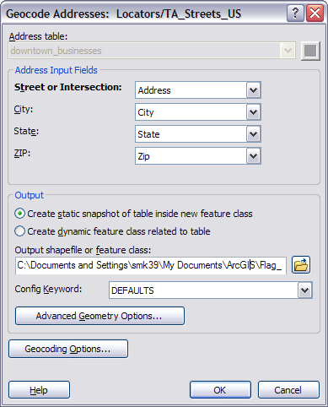
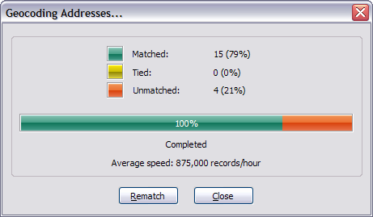
Notes:
We are all set to geocode our table of addresses. 1) Close out ArcMap and Open the community GIS we have been working on (.mxd file). 2) In ArcCatalog import the Excel file with the business addresses into our geodatabase. It’s a single table, you’ll have two options (take your best guess, it usually is DTB$), and after you pick one the field map should have Business, Address, City, State, and ZIP. If needed cancel the wizard, start again, and choose the other option. 3) Choose an output name (downtown_businesses?) and press OK.
4) After it is done importing right click on the table and go down to geocode addresses (or do it in ArcToolbox). 5) Select the address locator we just made. Browser for it if necessary. Again the field names should auto populate but change them as needed. 6) Choose an output location and name (our geodatabase and businesses? Not our feature dataset yet). What we are making is a feature class of points that (hopefully) will represent our business locations. 7) Press OK and let it run. 8) After it is done you’ll get a dialog box telling you how many points matched or tied for more than one possible location and you will have a new point feature class in your geodatabase. Just press close on the dialog box for now, move the feature class into your feature dataset. You will have to import it because the geocoded points are in Lat/long and the feature dataset is in UTM. Maybe call it a different name, delete the old file, and then bring the new into your map.

Slide 8
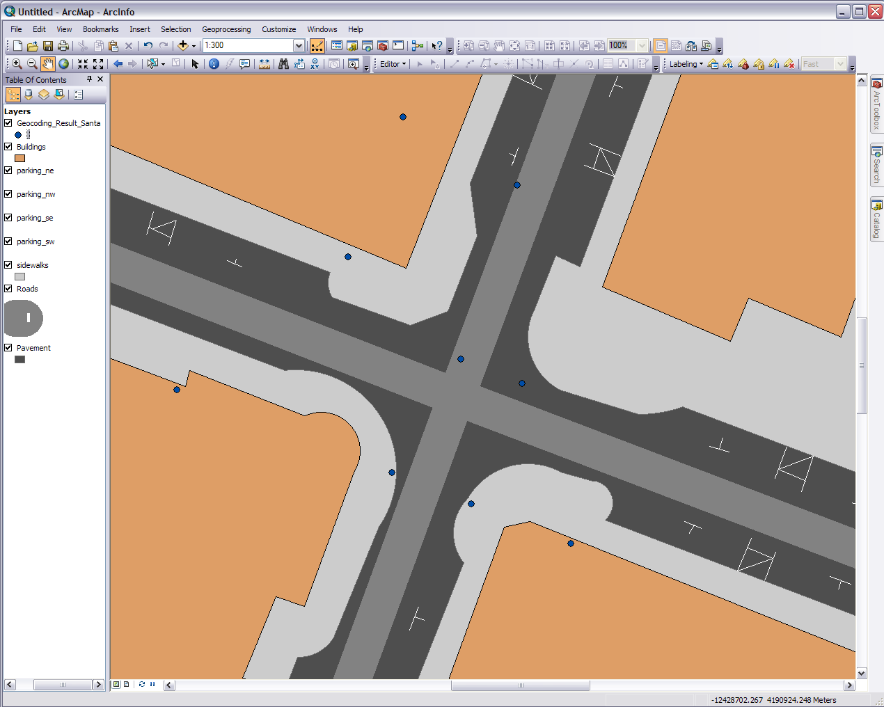
Obviously businesses aren’t located in the middle of the street and this dot, Golden Aspen Toys, belongs over here
Notes:
OK so we have some good news and some bad news. The good news is our all our businesses, even the ones that were unmatched, got put into a feature class and are relatively near the correct locations. The bad news is those locations a significantly off from where they should be.
What is going on here is several things. If you were to go back and look at the attribute table of the file we used to create the address locator you’ll see the Route 66 had no address number ranges. They were all 0’s so our businesses on Route 66 couldn’t be matched. Additionally the file we used to create the address locator was in a different projection and had different center lines for the streets then what we have with our geodatabase. There are a number of other factors but in a nut shell geocoding isn’t always 100% fault free.
The way it should of worked is the address locator is used to place an address or list/table of address in correctly assigned spot on the correct side of the street. As we know this is not always the case. Things don’t always match up and some places, like the ones in the plazas here, don’t have direct street contact. Also be careful because with what we just did because reverse geocoding (extracting an address) for our new points layer isn’t necessarily valid.

Slide 9
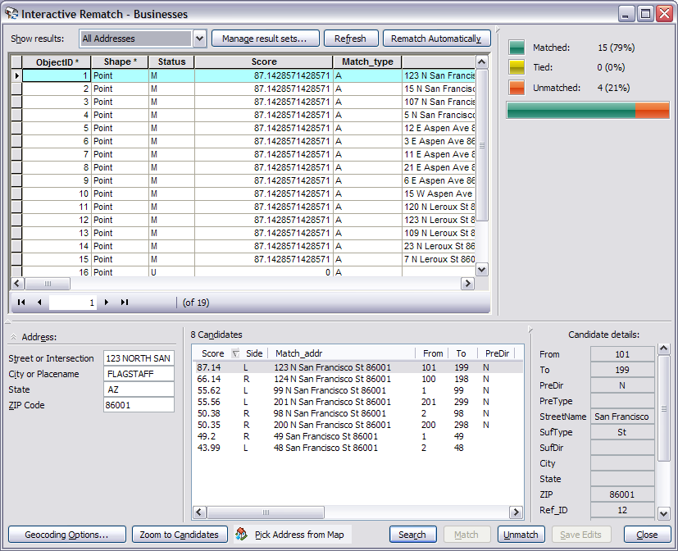
Our desired tool
Notes:
So here’s what we do. Go to where you can open up your toolbars and open up the geocoding toolbar. Move or close some toolbars if they are getting in the way. Make sure you businesses layer is highlighted then select the right most mailbox icon on the toolbar for rematch and review. It knows your business layer was created via geocoding so it has the information it needs. To select a point click on the gray square for that row. In the Status field it will give an M for matched or U for unmatched (T for tied). On the bottom left you’ll see it’s recorded address and to the right you’ll see the candidates of possible locations and their likelihood score out of 100. On the bottom center you’ll see a button called Pick Address from Map with a little house icon. That is the button we want.
1) Select the first point and press the Pick Address from Map button. Scroll to the right of your table to see what business it is. If you’re unfamiliar with downtown Flagstaff look at the screen captures in the next two steps to see where each business is located. 2) After you punch the button move the cursor onto the map and it will turn into a set of crosshairs. Resize and move the window as needed. 3) Pick the location of where the business actually is. 4) Right click and choose Pick Address to set the new location of the point. Rather than pick the assigned street position for each business I am going to pick the approximate front door location. Notice the business address doesn’t change but the address of the location of the point does. 5) After you have gone through all the points press close in the dialog window. You can also get rid of the geocoding toolbar if want.

Slide 10
Notes:
Now lets label our points. First I want to change the our point from just plain colored dots to something a bit more representative. You should know by now if you click on the symbol under the layer name you’ll get the symbol style tool. Go to style references. Check the boxes for Business, Civic, ESRI, Public Signs, Real Estate, Web216, and Win256 if they aren’t already. Press OK. Now scroll down your list and pick an appropriate symbol, modified if desired, to represent the downtown business locations. Be as fancy or as simple as you like.
Second open the label manger on the Labeling toolbar. Labeling points is a little different than labeling lines. Make sure both your businesses layer and the Default under the layer are checked and select Default. You should use the business names as the label field. You can do what you want with the rest. Press Apply and adjust till you get it how you want it. You can really manipulate the text by going to symbol>edit symbol and for Arc 10 users in the labeling drop down menu you can turn on the Maplex Label Engine (the extension must be turned on in the customize menu) Press OK. Note because they are labels and not annotations the only way to manipulate them is with the tools in the toolbar.

Slide 11
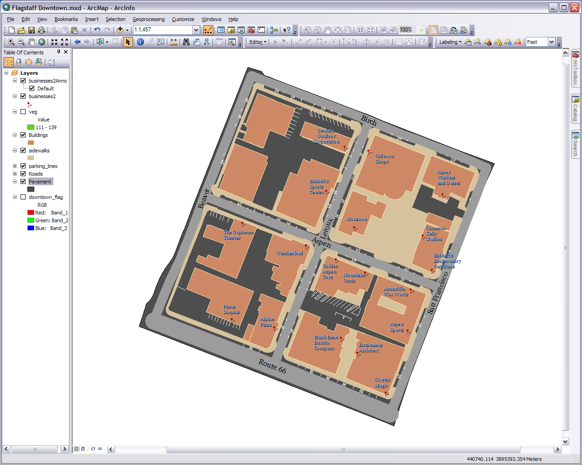
Notes:
Third with the number of points we have the labels are taking up quite a bit of space and they get in they way of other things. It is also difficult is manipulate each one individually so let’s turn them into an annotation layer. Right click on the layer name and select Convert Labels to Annotation. Store the new feature class in the feature dataset in our geodatabase, let it be linked to our businesses (which creates a relationship class in our dataset), leave the other defaults, and press Convert. You now have a new layer. It automatically turns off the labels in the Label Manager.
Annotations are feature classes. You can now use the Editor on them the same way you would any other vector layer. The point icons may disappear while your editing but they will return to their spots when your done. I’m going to place my annotations in more convenient spots and you can remove some if you want. You can go through the who procedure and create several copies of the annotation layer. The annotations have a special follow features/edit window with a toggle button for different tools. Just keep messing with it and try all the possible tools till you get it where you want it.

Slide 12
Notes:
One more quick thing for this module. The open area in the top right block is known as Heritage Square. We should probably make another annotation layer to denote it (right click and new in the geodatabase) but for the sake of showing an additional method we aren’t. This is real simple. Go to the top of ArcMap and do Insert>Text. Type in “Heritage Square” in text box and move it to the center of the plaza in the top right block. Double click and format it how you like.
In most cases anything from the Insert menu isn’t done till you are finalizing things for publication in the layout view. The reason why is the text we just did has no geographic value and therefore is technically not a part of our GIS. When we make an annotation or label it has real word coordinates and is often times associated spatially to another spatial layer. The text isn’t a layer we will find in our table of contents, is only visually associated with that spot on the map, and is always on top of or other layers. Labels too are not layers so they are on top.
So to do a wrap up here; in this module we cleaned and detailed our existing layers, added some more details, learned geocoding, and found different methods for verbally talking about our map features. If you want to do more with your community GIS then let’s go onto the next module and have some fun.

