Slide 1
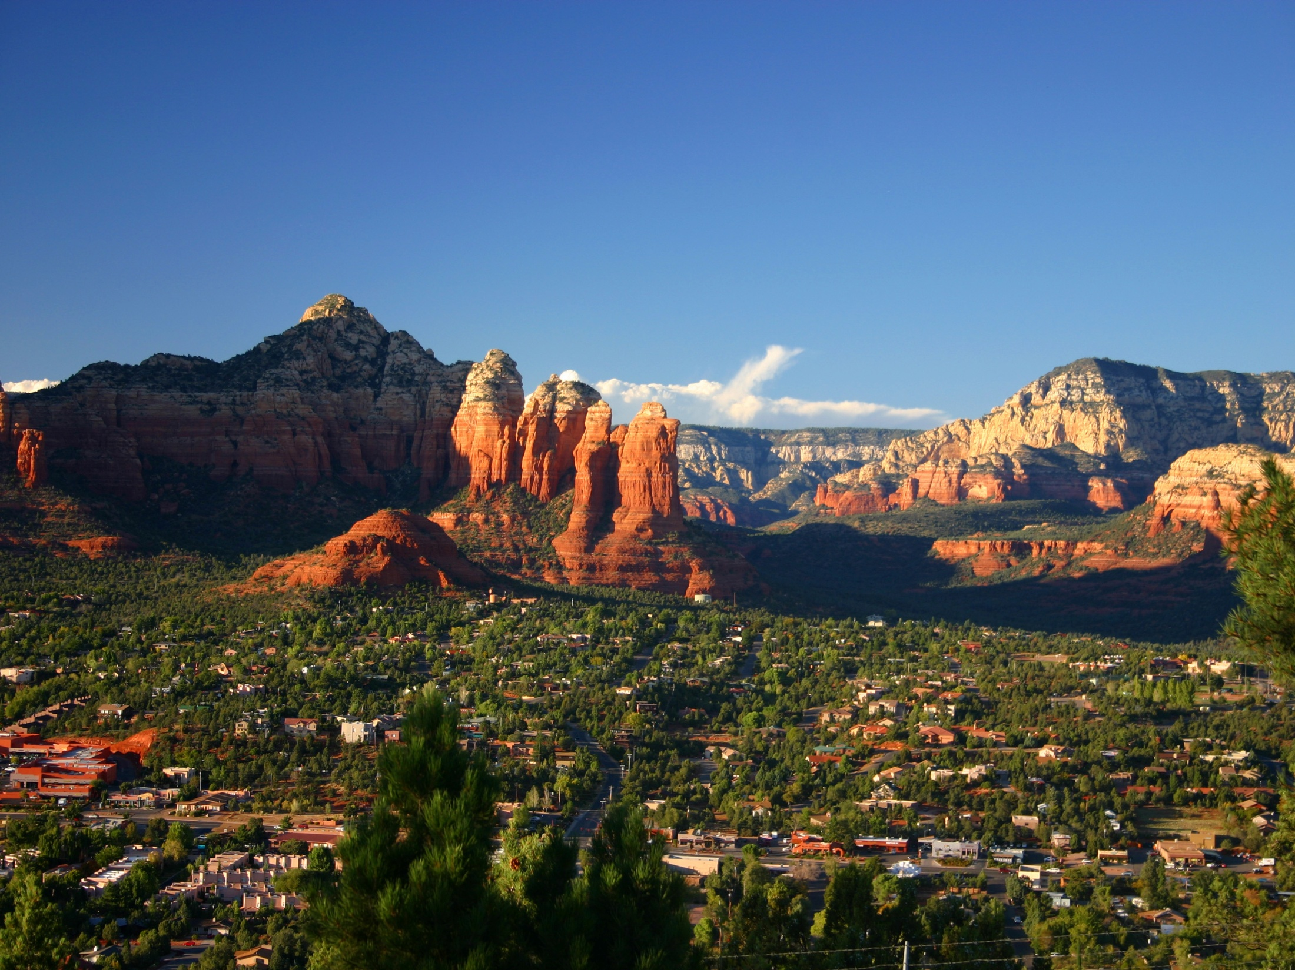
Designing a Community or Campus GIS
Module 2: Let’s start building that community GIS
Created by: Scott Kelly 2010
Notes:
So now that you have an idea of what a community or campus GIS is and what goes into it let’s construct one. The goal here is that you’ll get practice so you can go and make your own. The rest of this workshop will be creating it. First we will construct some basics such as buildings and roads, then go onto into some detailing of the basics, and last add some extra features in addition to what we can do to publish and make it easily accessible by others. As we go along watch for symbolizing and design techniques.
In this example I’m going to create a GIS for a couple of blocks in downtown Flagstaff. Mostly because I have physical access to it and I’m familiar with the area. This just an example of one way to do a community GIS. Once you get the idea and some procedures down you’ll be able to do your own for a neighborhood or campus.
I’ll be working in ArcGIS 10 but for the most part things should be quite similar for ArcGIS 9.3 (any earlier version might give you some trouble). I’m going to try and keep this uncomplicated. Switch back and forth between ArcMap and ArcCatalog as needed. The most daunting part of what we are doing is that it is time consuming so don’t worry about trying to get it all done in one session. I would recommend printing up the PowerPoint(s), go though it, and then try the exercise. It is actually a fun thing to do and a creation you can be proud of.

Slide 2
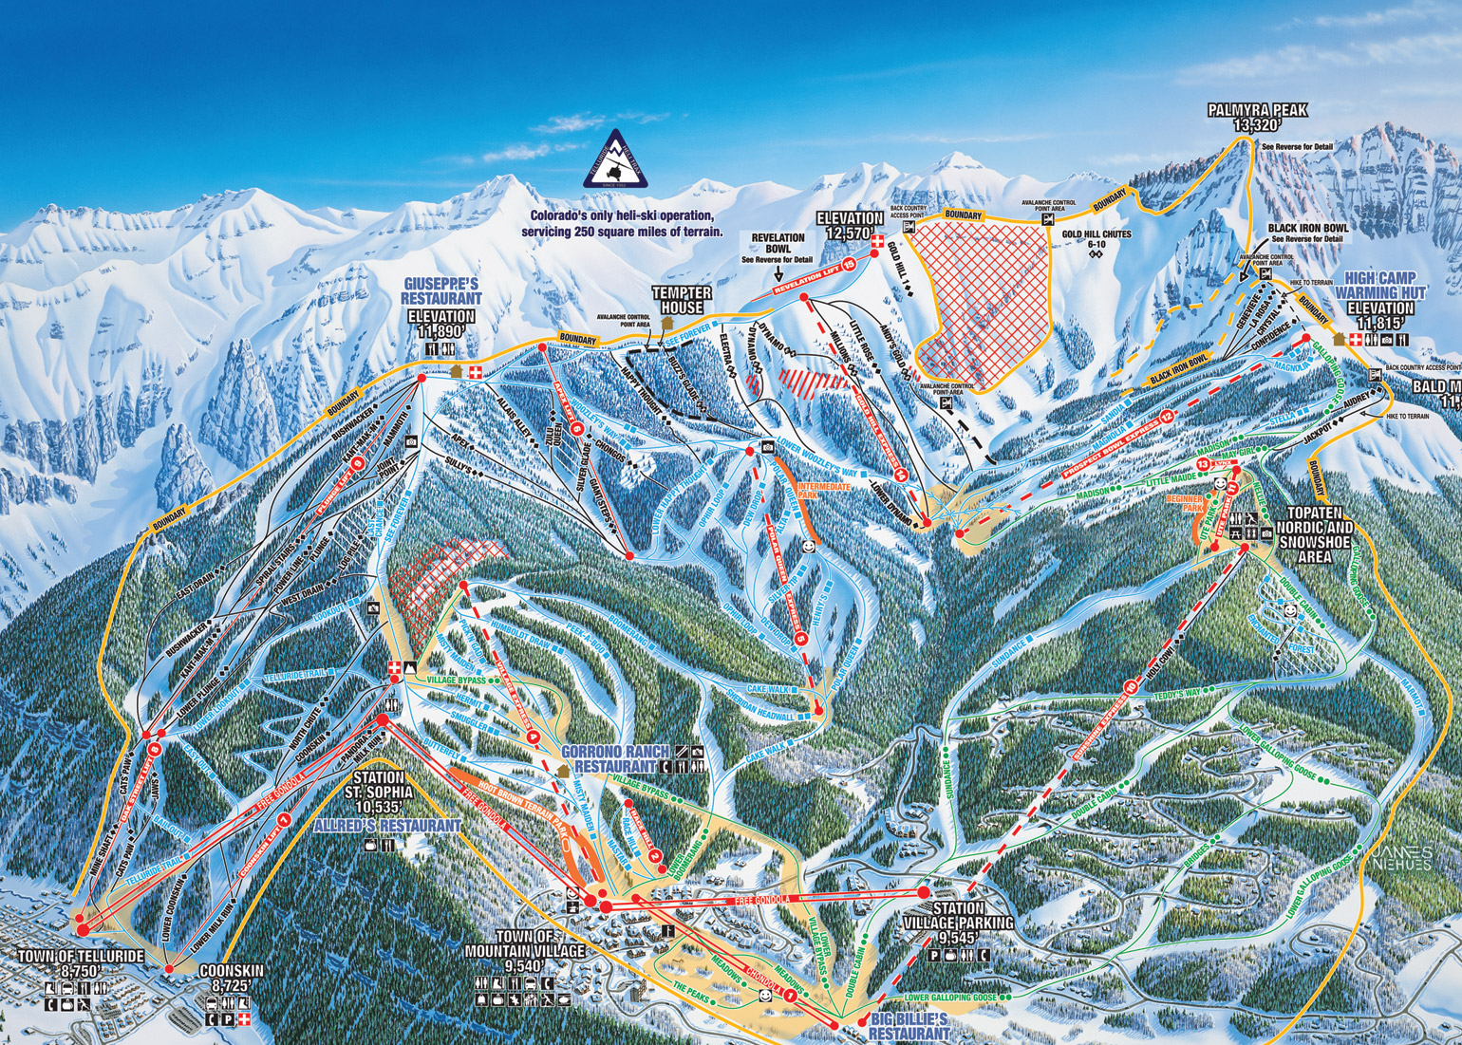
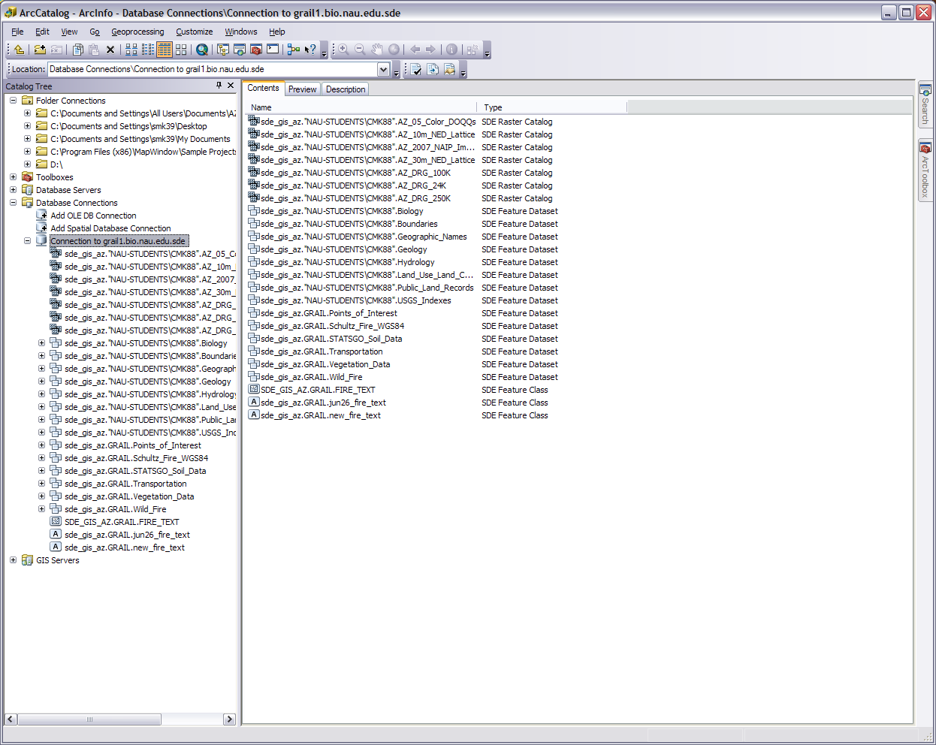
The GRAIL Geodatabase with feature datasets and raster catalogs
Notes:
Like any project we need to plan and set things up. Well the plan here is pretty simple. Have an idea of the area extent/range of our GIS (a few blocks downtown) and what features we want to represent (buildings, roads, vegetation, and eventually others). Of course the plan can be modified as we go along. Remember a community GIS is just a spatial information system of a neighborhood and not particularly of a focused research project.
So let’s set things up. In other workshops I had you work with files in a project folder. In this workshop I’m going to show you how to use a geodatabase. The geodatabase tends to be the preferred format for many people working with GIS. The geodatabase is a file organizer intended specifically for working with GIS projects as apposed to a standard file folder which is for any file regardless of purpose. A geodatabase can be put directly onto a drive but ironically it is most often located in a project/file folder. A geodatabase can get quite intricate but for this workshop we only need it in a basic form. Something to keep in mind is that in a geodatabase all the files are associated and not independent so we will be importing and exporting things. A big advantage of a geodatabase is that if you have a plethora of features, tables, images and other data it will be much more manageable. It also keeps all your data (datasets) on the same page so to speak. It can be single or multi-user depending on the type.

Slide 3
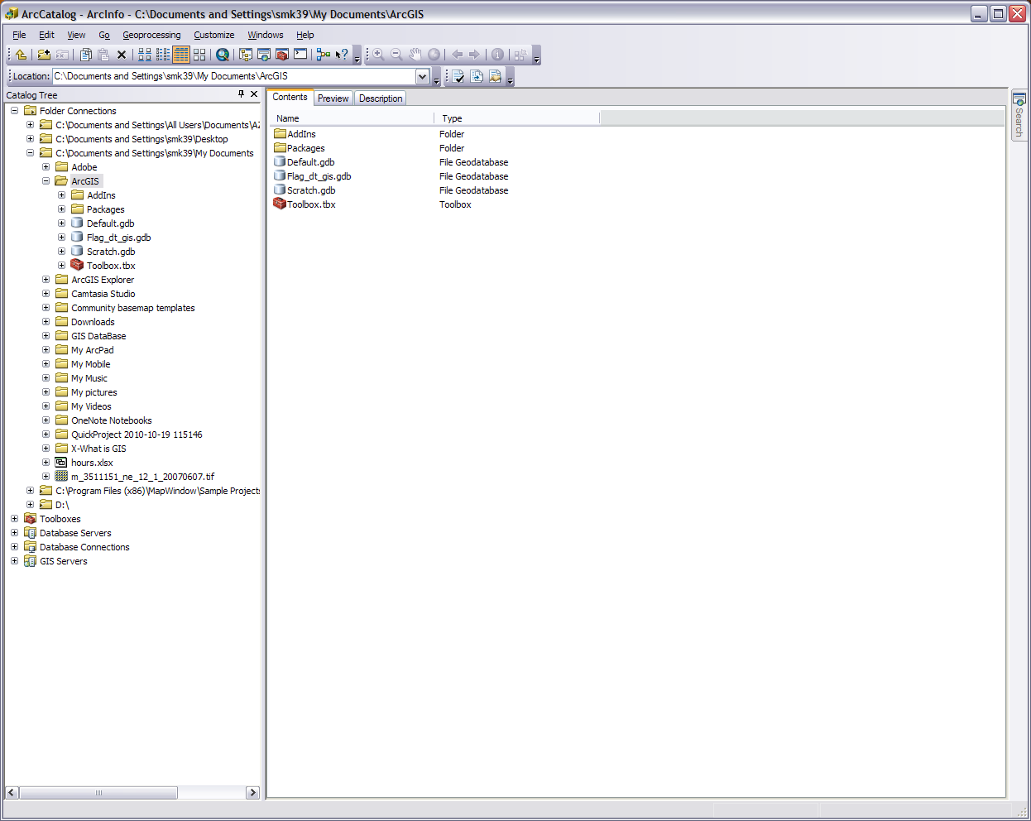
Can click to start ArcMap
My New File Geodatabase between two others
Connect To Folder
and directory tree
Notes:
Open ArcCatalog and locate where you want to put your geodatabase. Right click on the folder/drive or in the Contents tab and choose New>File Geodatabase. The file geodatabase has much more capacity than the personal and we are not yet sure how big our GIS will be. Name your geodatabase what you would like. The symbol will look like a metal can but will have a folder icon in most windows outside of ArcCatalog.
Now the community GIS has basic datasets that need to have some harmony to them. To that end we need to decide on a projection for our geodatabase. While at this stage we can’t set the projection for the entire geodatabase, we will be able to create groups (feature datasets and raster catalogs) for our spatial data and set the projection for the whole group later on.
To keep things simple we are going to use WGS 84 UTM Zone 12N. This is a common projection and zone 12 north covers all of Arizona (and Utah, Idaho/Wyoming, …). Just in case you are wondering WGS 84 is a world datum (i.e. hypothesized shape of the globe) calculated in 1984 and UTM is a grid coordinate system (instead of lat/long).

Slide 4
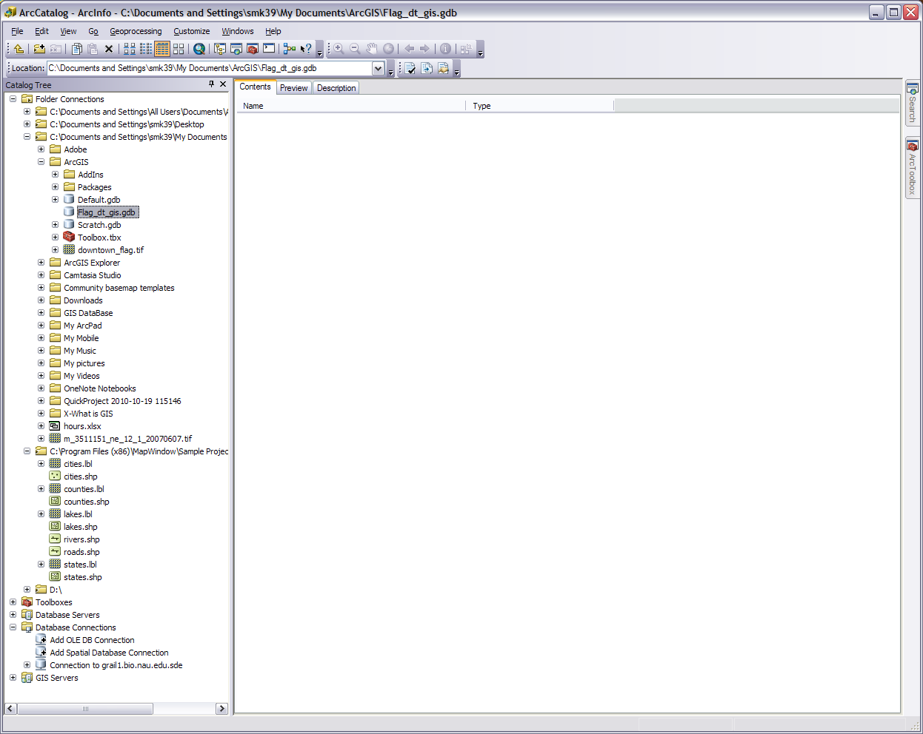
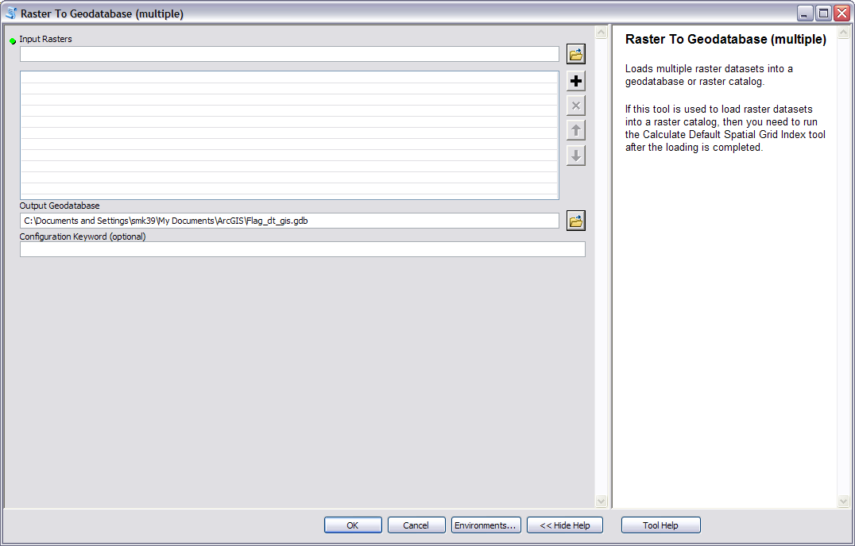
Our File Geodatabase and the raster image
Notes:
Next having some base imagery to start with helps. Just to make things a little easier I went and extracted some imagery of downtown Flagstaff from the Bing Maps Aerial basemap found in ArcGIS 10 (you can access this in Arc 9.3 too but you have to have a special license). If you want to extract this yourself go to File>Export Map save it as a tiff, set the resolution at 600, and in the Format tab check the Write Geo TIFF Tags so that the image can be projected correctly. You can also write the world file if you want. If you look ahead a few slides you can see how far I zoomed in. The XY coordinates I used to get to the right spot were 35.198640 Lat, -111.648180 Long. The whole Bing Maps Aerial basemap can be rather cumbersome and it may take the computer a longer time to redraw everything.
The downtown_flag.tif is located in the compressed folder in this workshop on the webpage. Download the folder and uncompress it. There are several other files in it you’ll also need for this workshop. Save it into the same folder as your geodatabase. The image was extracted with the geotiff tags so it should be where it is supposed to be on the earth but if you can’t get it to work you may have to extract it yourself.
Now to get it or anything into the geodatabase we need to import it (export to get anything out). So right click on or in our file geodatabase and Import>Raster Dataset. Import the extracted basemap imagery. Just put the downtown_flag as input, make sure it is going into the right geodatabase, press OK, and give it a few seconds to process. As the tool implies you can do this with multiple raster datasets.

Slide 5
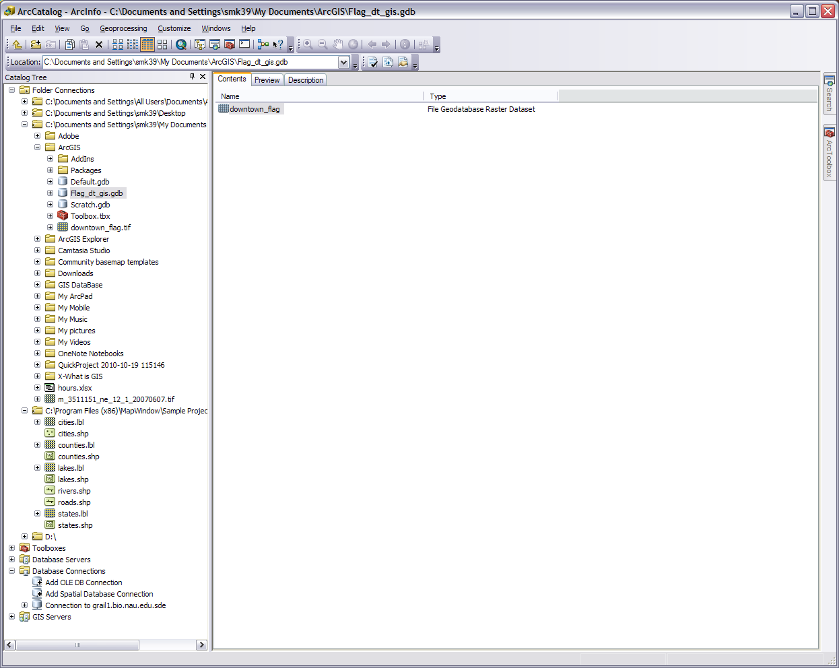
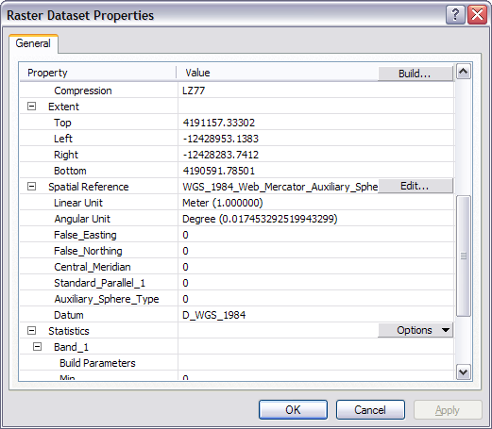
Notes:
We need to get this into our chosen projection so go into the geodatabase, right click on the image, go to properties, and scroll down to the spatial reference line. You’ll see we are close but not quite in WGS 84 UTM Zone 12N. We could just reproject it using the Edit… button but when we bring it into ArcMap we will get an annoying error message.
1) Close the properties window and open ArcToolbox. 2) Drill down to Data Management Tools>Projections and Transformations>Raster>Project Raster. 3) Input our image and it will come up with an output name which I’m going accept now and change later. Make sure it will be put in our geodatabase. 4) For the output coordinates system click the button on the right and drill down with Select…>Projected Coordinate Systems>UTM>WGS 1984>Northern Hemisphere>WGS 1984 UTM Zone 12N.prj. 5) Press add, change the resampling technique to bilinear or cubic if you want for smoother lines, and press OK. 6) Give it a minute and let it process. We are now in the right projection and because we weren’t going from one datum to another such as NAD 27 to WGS 84 we didn’t have apply any extra transformation steps. Once in the geodatabase delete the old and rename the new.

Slide 6
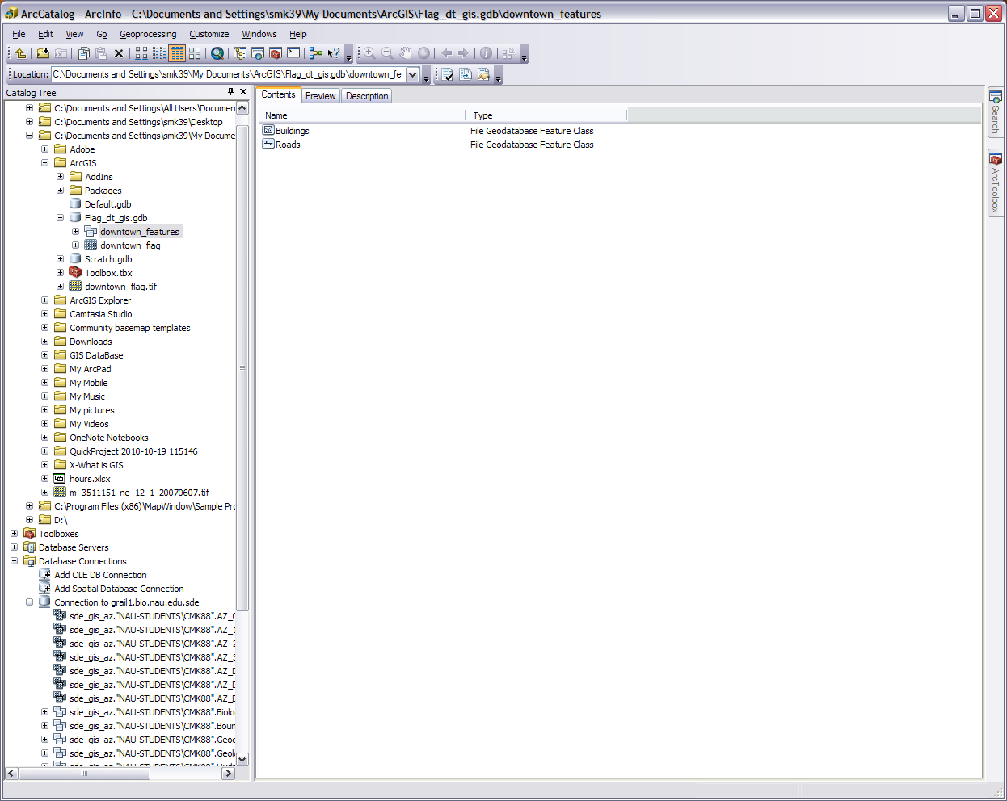
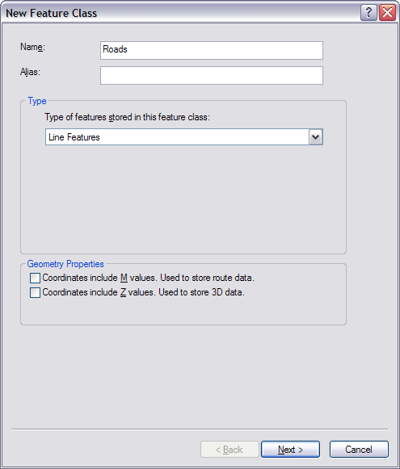
Notes:
One more set up step. Right click in the geodatabase again and do New>Feature Dataset. Name it what you’d like (downtown_features?) and press next. Capitalization doesn’t matter (you’ll see my randomness as we go along) however it is better to have an underscore between words than a space. Set the coordinate system to our WGS 84 UTM Zone 12N projection and press next. For this GIS we don’t need a vertical coordinate system so go ahead and press next. I’m going to accept the tolerance defaults and press finish but you can mess with them if you want.
This feature dataset is where we will keep our feature classes (i.e. shapefiles in a geodatabase). We set it up with a projection so all the feature classes in it will have that same projection. This will also help us with keeping our data organized. We could do a similar thing for our raster images called a raster catalog but we may not have enough raster images in the end to make it worth it.
Go into your new feature dataset. Right click and go to New>Feature Class. Name this one Roads (alias optional) set the type as line features and press next. Accept the keyword default and press next. We don’t need to set up any attribute fields at this time so go ahead and press finish. Later when you are doing your own projects you can set up the fields in this step or when you are editing the attribute table. Do the same thing again and this time make a polygon feature class called Buildings.
Had enough set up? So have I. Let’s open ArcMap.

Slide 7
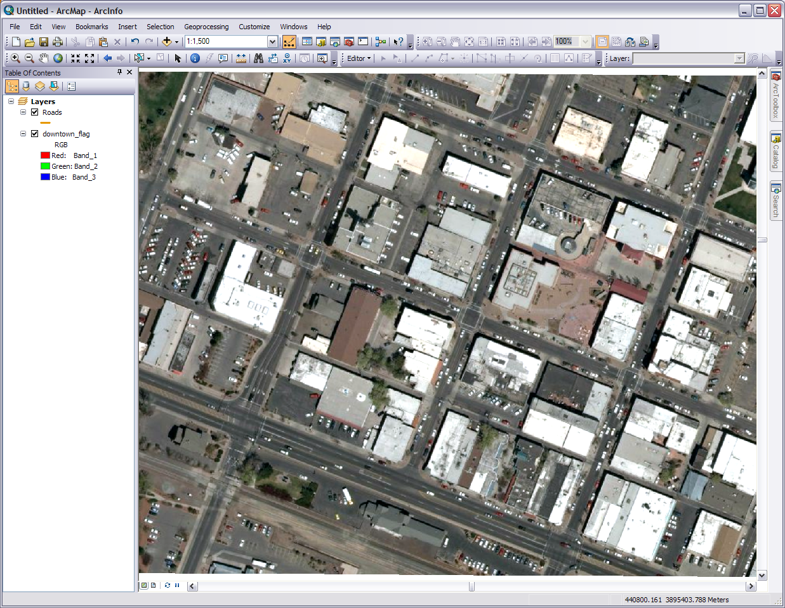
Community GIS for these four blocks
I made this 2 wide with a noticeable color. Just click on the colored line. You can display your layers in a verity of ways. Note the colors I am going to use in the next few slides are more to show you procedure and not proper color layout
Birch
Leroux
Beaver
San Francisco
Aspen
Route 66
Notes:
Let’s start creating data for our feature classes. To do this we are going to be using the Editor toolbar quite a bit. First we are going to start with the roads. Nice and basic. There are lots and lots of road files available on the web for download however I went through several and was unable to find any with a high accuracy for downtown Flagstaff streets. Hence a need for our community GIS. One main reason for a community, campus, or other such GIS is the existing spatial information of an area isn’t adequate enough for such a local scale. We also won’t worry too much about how we are going to display, color, and symbolize our features at the moment as we just need to create them first. Also be aware because our image isn’t 10 cm resolution our accuracy won’t be down to the cracks on the sidewalk. This is only an exercise after all.
Our community is the four downtown blocks in the center of our base image. I’ve included the street names in this slide if you are not familiar with them. In ArcMap add the image. Add on top the roads feature class which currently has no data in it. Now the image is in the right place geographically and that makes the roads and the center of those roads in the right place. This means we can trace off those roads with spatial accuracy. We could even go over the individual lanes if we wanted but let’s keep it simple and just stick with the whole road. There are many ways to extract data from the raster image but again for this GIS let’s keep things as uncomplicated as possible. Also keep in mind the computer has no idea those roads in the image are roads. All it knows is those are a mosaic of asphalt colored pixels. It does know which way is north and hence we are viewing downtown at an angle.

Slide 8
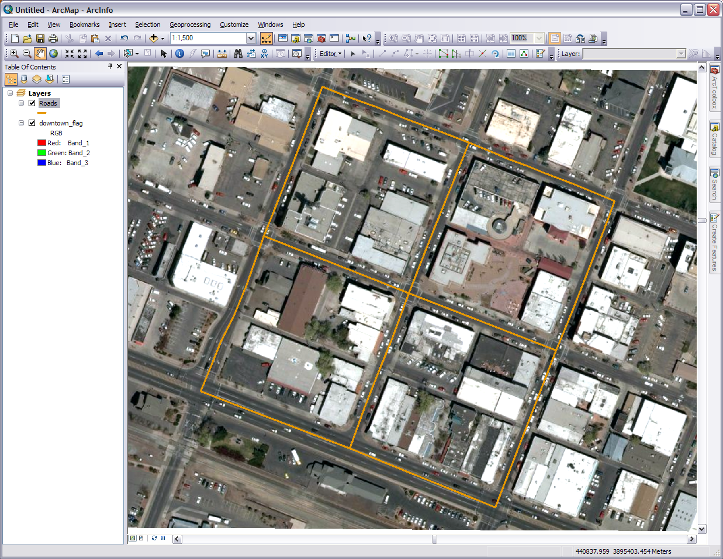
Select and deselect tools
Your six roads will look something like this
I could redo this line for greater accuracy if I want to
Notes:
Now start the editor (if the toolbar isn’t there just open it up). For Arc 10 make sure you select the roads layer and that the Create Features side bar will pop up. It should have the roads layer as the only feature available but it is OK if there are others. The layer must be visible in your Table Of Contents sidebar. Select the roads layer and the Construction Tools at the bottom will show you your options. Pick the Line tool. For Arc 9.3 pick the Sketch Tool (the fat pencil on the Editor toolbar) and make sure your target is on the roads layer. In either version of ArcGIS the tool allows you to pick anchor points and vertices with each mouse click to create additional features of the same type as your layer.
If your roads layer (or any other when editing) does not show up in ArcGIS 10 then you need to create a new template for it. Click on the Organize Templates icon just to the left of the search box in the Create Features editor sidebar. Select the roads and click New Template. Make sure the roads layer is checked and press finished and close. Select your roads layer and carry on.
A few editing notes. Zoom in and out to comfortable scales. We want this as centered on the road as possible but zoom in too far and you might get disoriented or over correct. The lines you add won’t be made permanent till you go back to the editor and Save Edits. It you make a mistake press control+Z to remove the last segment or select the line at anytime the editor is running and press the delete key. For greater accuracy we want to get as close to the center of the intersection and on the center of the road as possible. However to get the exact center is almost impossible because the raster can’t tell a road from a pixel. We do want to have the smallest margin of error as possible though so give it your best shot.
With your line creation tool pick the first point at the center of the intersection of Route 66 and San Francisco. Continue to pick points tracing San Francisco up till the center of the intersection of San Francisco and Birch. Put your last point there and double click. Add as many vertices as needed to make it a accurate as possible. If you add a point at the center of an intersection later you’ll be able to snap to that point. The double click will end the sketch and a line representing the road will exist and be selected. You can leave it selected or deselect it now but each new sketch we add will become the new selection.
Draw a line for each of our six roads (six lines) connecting each road line at the interesections. Make each road one line, not two or more segments. Once they are drawn and you are still in editing mode, open the attribute table. In the options in the top left corner add a field called Road_Name with the type as text and press OK. You can left click on the small gray square on the left and it will select that object. Then you can click in the Road_Name cell and type in the respective name for that road. Do it for all six. Close the table.
Save all the edits and stop editing in the Editor toolbar. Look at the image here to see what I mean. Watch out for the intersection of Route 66 and Beaver as Beaver has an extra turn lane.

Slide 9
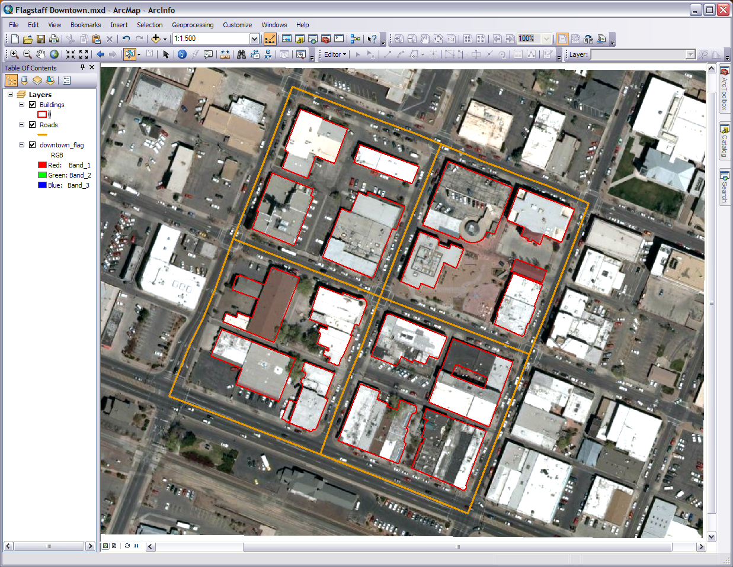
This tool also moves the selected item
I included this separate structure with the buildings
To create these arcs I used the arc endpoint tool. You can switch drawing tools in the middle of a sketch
You can cut out the courtyard with this cut polygon tool. Be sure to close up the polygon
For this courtyard I used the cut polygons tool and then deleted the polygon that had been cut out (select it then press the delete key)
Two adjacent but individual buildings
Notes:
Now we are going to do a similar thing for our buildings. Bring in the buildings feature class from our geodatabase. What you are going to do is trace the outline of each building. Thus creating building footprints in vector format. Yes this is time consuming but you don’t have to do it in one sitting or need to rush through it. Again zoom in and out as needed. You’ll run the Editor in pretty much the same way, however now you will be making polygons and instead of lines. Arc will close up the shape when you double click your last point. Turn on the Editor and go for it. You don’t need get it right the first time and practice is good. One strategy is to do a block at a time. The top left block is pretty easy. Start with the default polygon tool. You can leave your roads layer on or off, just make sure they aren’t in the way and you know which layer your editing. Again be as precise as you can but remember in this simple method we are using you’ll won’t be millimeter accurate.
One challenge you’ll have here is adjacent buildings. Is it one building or two or three? Well that is kind of up to you. Sometimes there is an obvious distinction such as different colored roofs. Sometimes you want to make them one building because for all intents and purposes there is no need to make them separate. Sometimes it is hard to tell where one ends and the other begins or the edge of the building and sidewalk. What about shadows? What if a building corner or edge is under a tree or distorted by other means? Use your best judgment and remember this GIS is just so you can get some practice at making a community GIS. When making your own keep in mind the purpose of your GIS. Feel free to use other sources as reference. The street views on Google Earth and Google Maps really helped me.
Other challenges may include courtyards and arcs. There are additional tools in the Create Features sidebar, the floating toolbar, (Arc 10) and on the Editor toolbar (Arc 10 and dropdown next to sketch tool in Arc 9.3). There is a cut polygon tool to cut out a hole for a courtyard. Just be sure the end points match up exactly. You end up with the polygon you want and the piece you cutout. Select the unwanted piece and delete it. Another way is to make a second polygon and use it to clip the building polygon. The clip tool is available in the editor dropdown when both polygons are selected and the distance set to 0. The arc endpoints tool is next to the straight line tool on the toolbar(s).
We want just the footprints for the buildings and structures. Any parking lots, sidewalks, patios, vegetations, or others we will get later. We are just starting with the basics and we will work up to the others. Also mess around with the different editing tools. You cannot make anything permanent till you save it and even then you can always select the feature, delete it, and start over.
I came up with 18 buildings. I prefer to create the polygons unfilled and then filled after completion. I’ve shown here both ways. Do what works for you. Want to get more accurate when doing you community GIS? Get to know the physical features for the area (you probably already do), such as if a shape is the edge of the building or just a temporary awning. You could also go around with a GPS unit and pick up certain points and lines that you can download to your geodatabase.

Slide 10
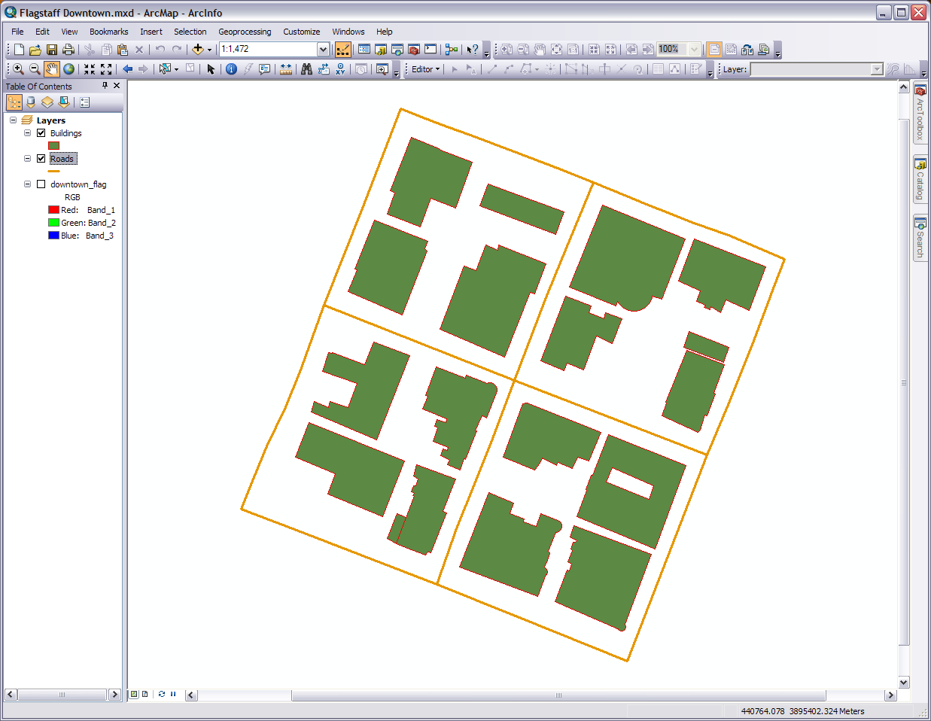
N
Birch
Beaver
San Francisco
Aspen
Leroux
Route 66
Notes:
So now you have two foundation layers filled with data. At this point I saved it as an .mxd file. Remember to save often so you won’t have to reconstruct your map. I turned off the base image for this screen shot to show you our progress. Displayed is the unique footprint of each building that has meaning to the community of users. Each road shows it’s individual path. There is more data to be added but you can see how our community GIS is taking shape. The two layers we have right now don’t physically touch in this screen shot, however in the next few steps we are going to create some layers that not only touch but overlap. So as in reality one feature type is placed over another. The buildings are on top of the pavement and so on.

Slide 11
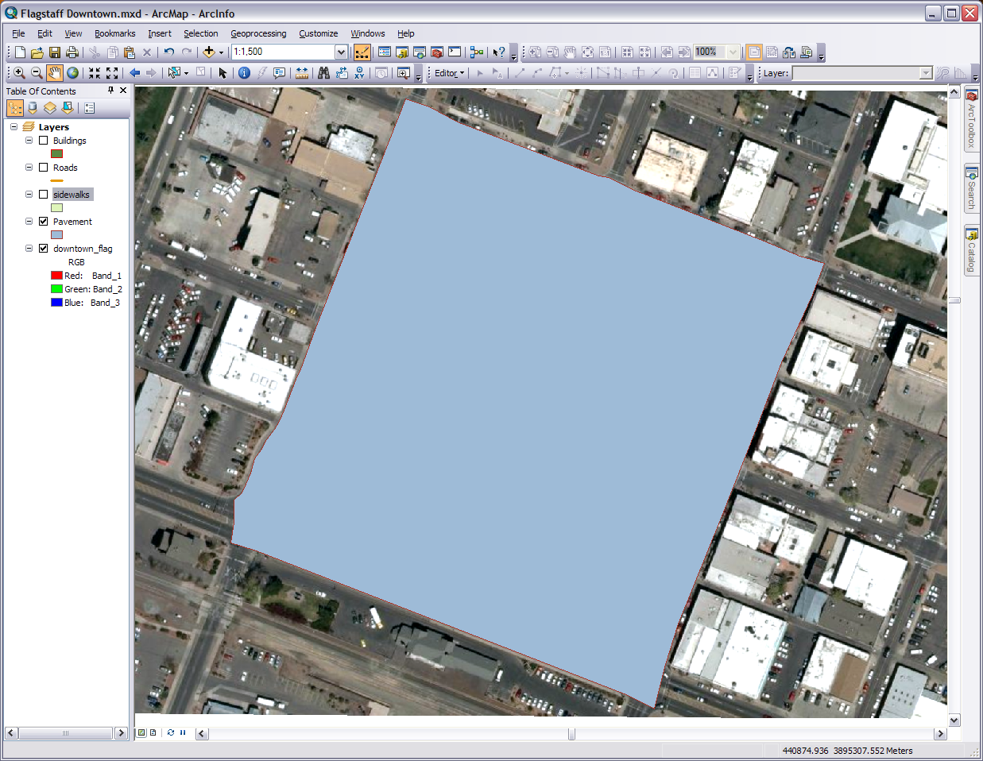
Start and end up here
Notes:
Go back to ArcCatalog. In our feature dataset create two other polygon feature classes called pavement and sidewalks. Bring them into ArcMap if they don’t come in automatically. Probably best to have them under the roads and buildings and on top of the visible base imagery. Turn off you buildings and roads layers.
First we are going to sketch the pavement. Nice and easy. This the ground layer everything is built on top of. When we are done any unoccupied space in our downtown community GIS will be pavement. Turn on the Editor and make sure the layer we are editing is the pavement layer. If in Arc 10 you may have to start a new template and the layers that are turned off won’t show up. We are going to make one big polygon of our extent. 1) Let’s start by going to where our roads meet in the upper left side (intersection of Beaver and Birch). Using the street/crosswalk markings on the road intersection in the image pick the top left corner for your first vertex. We want our lines to be the outer edge of the streets 2) Now trace the street/sidewalk line all the way down Birch till you come to the respective corner at the Birch/San Francisco intersection. Go down San Francisco, across Route 66, and back up Beaver (get the curve); again tracing the outer street/sidewalk line. 3) Close up the polygon and you have your underling pavement polygon. The idea is to have the pavement under our roads to the full extent. We clean up the details later so don’t worry about being meticulous.

Slide 12
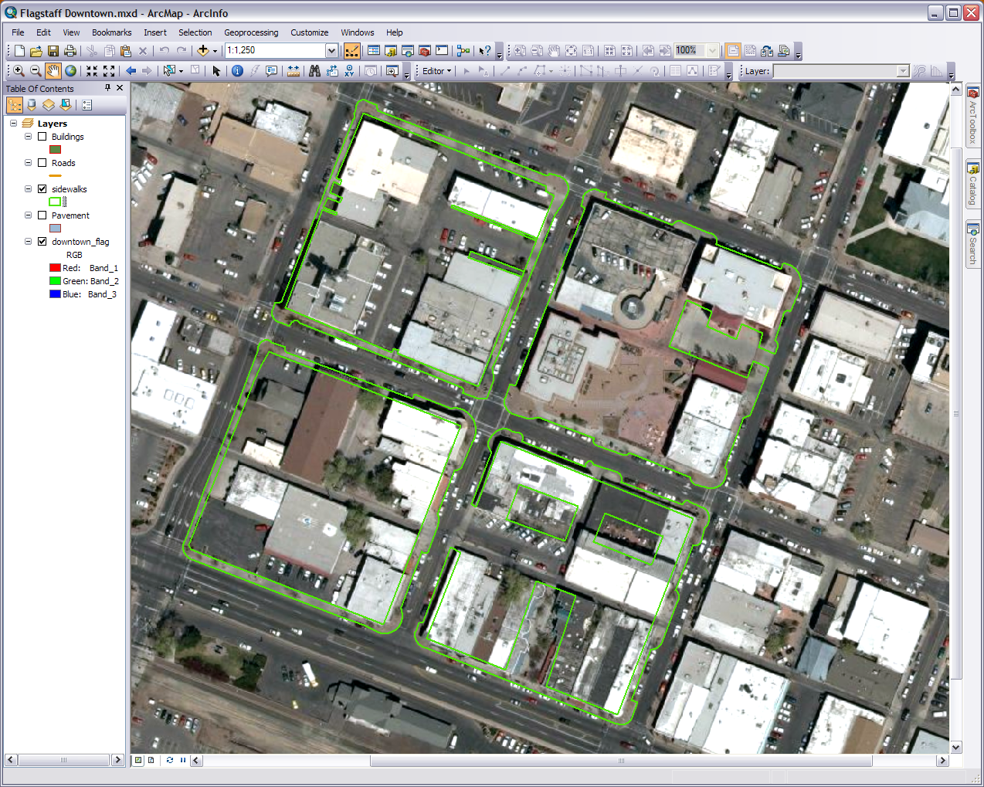
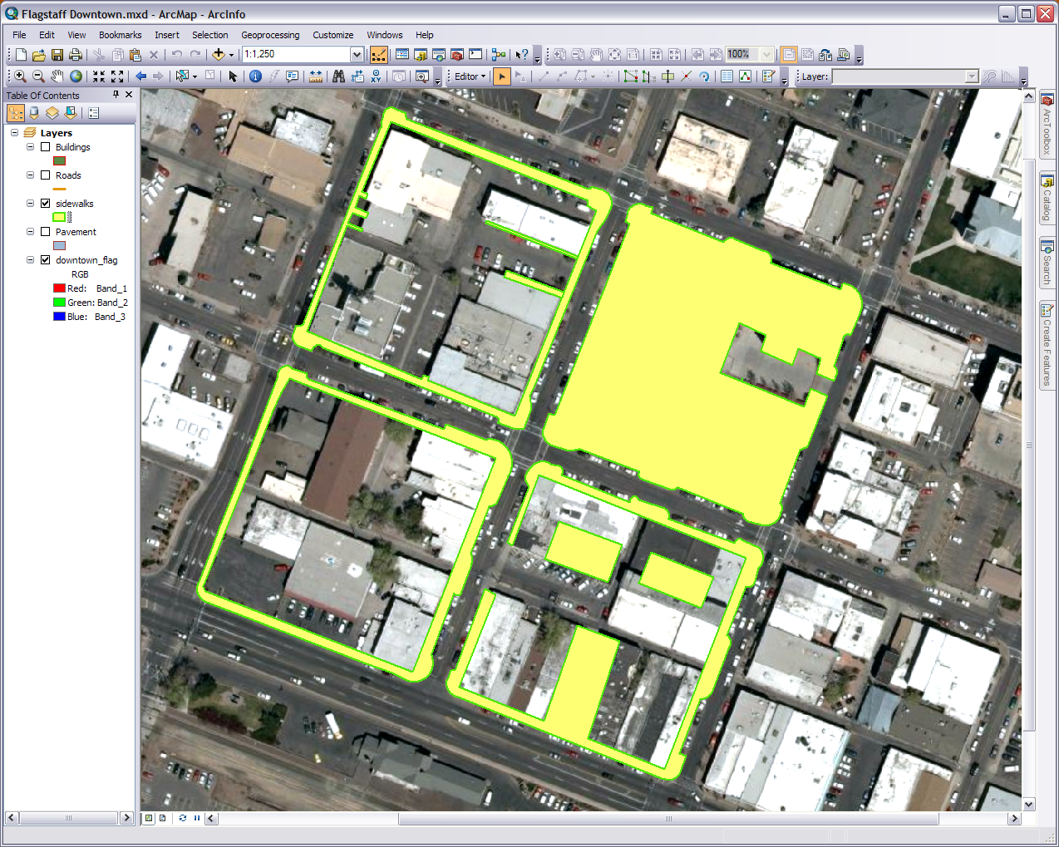
Adjust the vertices and reshape the polygons with these tools
Notes:
Now for the sidewalks, plazas, and other areas of pedestrian use. Turn on the Editor and make sure the layer we are editing is the sidewalks layer. Trace the areas of non vehicular use; don’t get the parking lots, driveways, or drive through alleyways in this layer. Don’t get any lawns, trees, or other vegetation. It helps if you are familiar with the area but either way we are going to create several polygons for the areas on each these four down town blocks. It can also helps to turn the other layers off and on to see how things are matching up.
This may be time consuming and detailed work. Get as much as you can and don’t sweat it if you make a corner is square instead of round or you decide to bypass the parallel parking areas. Don’t overlap into the streets or parking lots. It is OK and actually somewhat good if you spill into the buildings or vegetation. This sidewalks layer is going to go underneath covering up any overlap and holes. Set your colors and fill if any before you start the Editor. There may be some considerations for each block including things like sidewalks under the shadows and rounded curbs at street intersections. Remember this will be done with more than one polygon for each block. Use the arc endpoints tool, cut polygons, edit vertices, reshape feature tool, and other tools to help you get things like the parallel parking areas and cut out the sidewalks. Again if desired or unsure of a detail pull up something like a street view from Google or just use best judgment. Use the Editor tools to adjust the other layers as needed too.
In the top left block that long gray line going up between the buildings is a parking area gutter. On the Leroux (east) side at about the middle that brown part is actually an overhang that is a permanent part of the building so the sidewalk does go under it. You can cut out the sidewalks the same way you did the courtyard in the buildings layer. Remember to delete the unwanted cutout piece.
In the top right block you have what is called Heritage Square, the downtown commons plaza. There is quite a bit of detail in here such as railing, benches, sidewalks within the plaza, and others which we will get to in a later module, but for now just get the general shape of this plaza. The shadow area between the two buildings at the top of the block is a walkway onto the plaza. Make sure to cut out the parking lot for the upper right building. The buildings will be on top of the sidewalks layer so no need to cut out their footprints.
In the bottom right block The area between the two lower buildings is a plaza. Obviously get the courtyard in the top right building. There is an area between the parking lot and the top left building. It is a non-vehicle area (I actually had to drive by and look) so go ahead and grab it. Remember the buildings will be on top of this layer so feel free to overlap the buildings if it makes it easier.
In the bottom left block it is mostly parking/vehicle areas. There are building overhangs on the Leroux (east) side and some other sides so watch for those. On Beaver and Route 66 for this block there are no parallel parking areas cut into the sidewalks. The gray concrete block on the Beaver (west) side is a parking area.

Slide 13
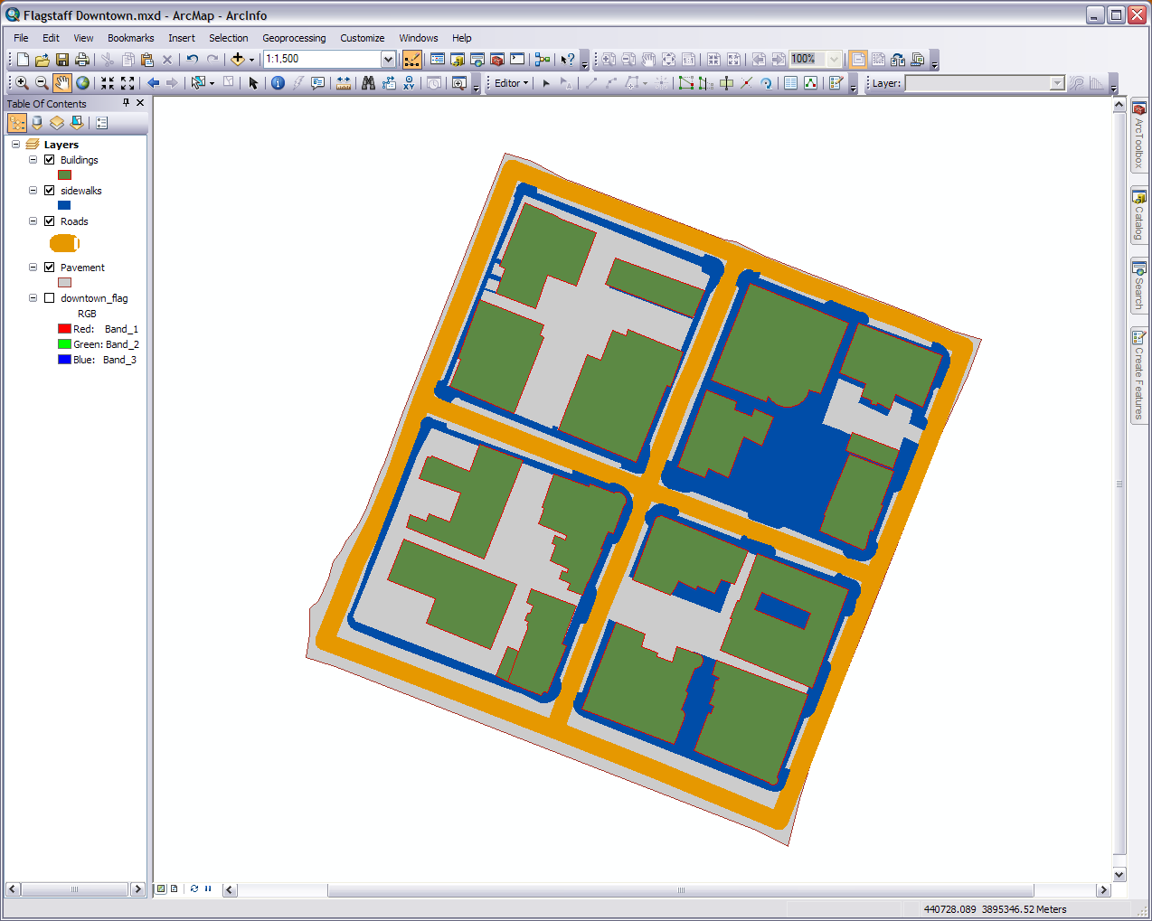
N
Birch
Beaver
San Francisco
Aspen
Leroux
Route 66
Notes:
When we look at our progress here we see different downtown elements interacting and coming together. We can also notice that some details will need to be cleaned up in later modules; Route 66 needs to be fatter than the inner roads, some curbs don’t quite come to the street, and others. In this screen capture of our current map it shows I adjusted the roads layers to be the approximate width of the streets in the basemap image. The roads only look this full at this scale/zoom level. You can set up the display of your layers for different scales. If you are interested we talk about it in Module 4.
We are going to include one more layer in this module. The vegetation in these four blocks is mainly trees but they have some grass and shrubs here and there. This addition can be a little tricky as in our basemap image the trees are in full bloom making the trunks or centers difficult to decipher. Rather than pin point individual plants to the trunk at this juncture we are just going to pull out the vegetation as one representative layer.
This next process is for ArcGIS 10 users. We are going to create a NDVI file. If you are in ArcGIS 9.3 you can create the same NDVI file if you have the Image Service Editor Toolbar or you can try the raster calculator in Arctoolbox>Spatial Analyst Tools> Map Algebra (I haven’t tried it, the NDVI formula is (IR-R)/(IR+R)). You can also use the software ENVI (available in GRAIL) to create the NDVI layer and then bring it into ArcMap (Transform>NDVI). If you can’t create the NDVI file just create another polygon feature class in the feature dataset called veg and trace what trees and other vegetation you see in the basemap image.
From the folder you download pull out the flag_nir image and import it into your geodatabase. It is a raster dataset and NIR stands for near infrared. Note the image you are importing has the datum of NAD83 and everything we are doing is in WGS84 so there may be some temporary visual discrepancy till we get it into the right datum. Also note our original image we were tracing off of had three bands (RGB) where as this image has a fourth infrared band. We’ll use this band to bring out the vegetation (it’s a remote sensing technique). This new image noticeably has a lower resolution but it is high enough for our purposes. If you are looking for other four band or color infrared images try http://datagateway.nrcs.usda.gov/

Slide 14
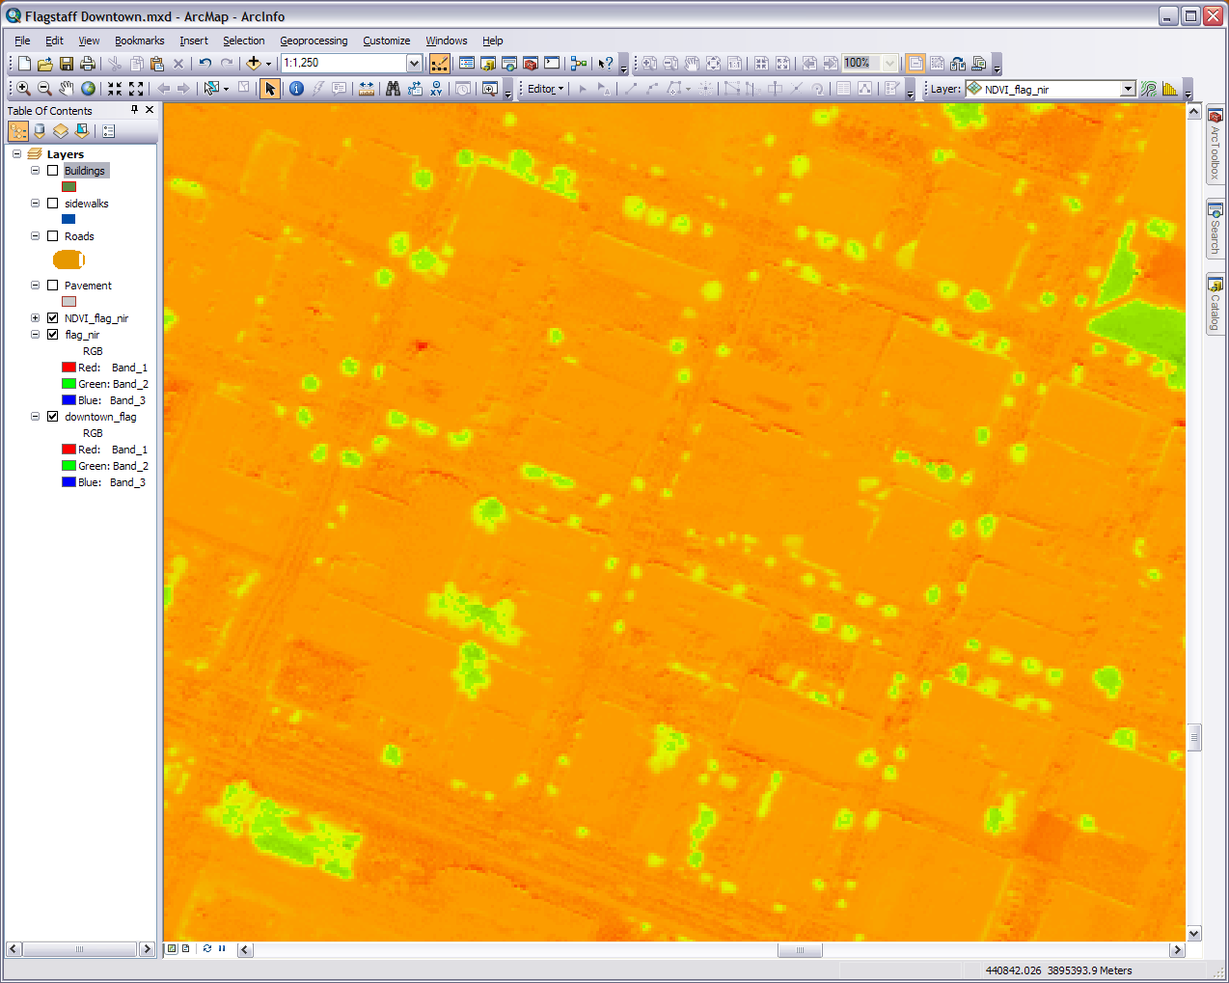
The vegetation stands out in the NDVI layer
Notes:
Add flag_nir to your map, hit close when the spatial reference window comes up, and turn off the other layers. 1) Go to the Windows menu on the top menu, open the Image Analysis window, and highlight the flag_nir layer. 2) In the options on the top left check the NVDI tab to see that the red is band 1 and the infrared is band 4. 3) Press OK, hit the NDVI (the leaf) button at the bottom, and wait for it to process. NDVI stands for normalized difference vegetation index and measure the “greenness” found in plants. 4) A new NDVI layer will show up on your map and in your table of contents window. Close the Image Analysis window.
Our goal here is to get an NDVI layer. If you got by other means that’s just fine. Make sure the NDVI layer is added to your map and proceed to the next step.

Slide 15
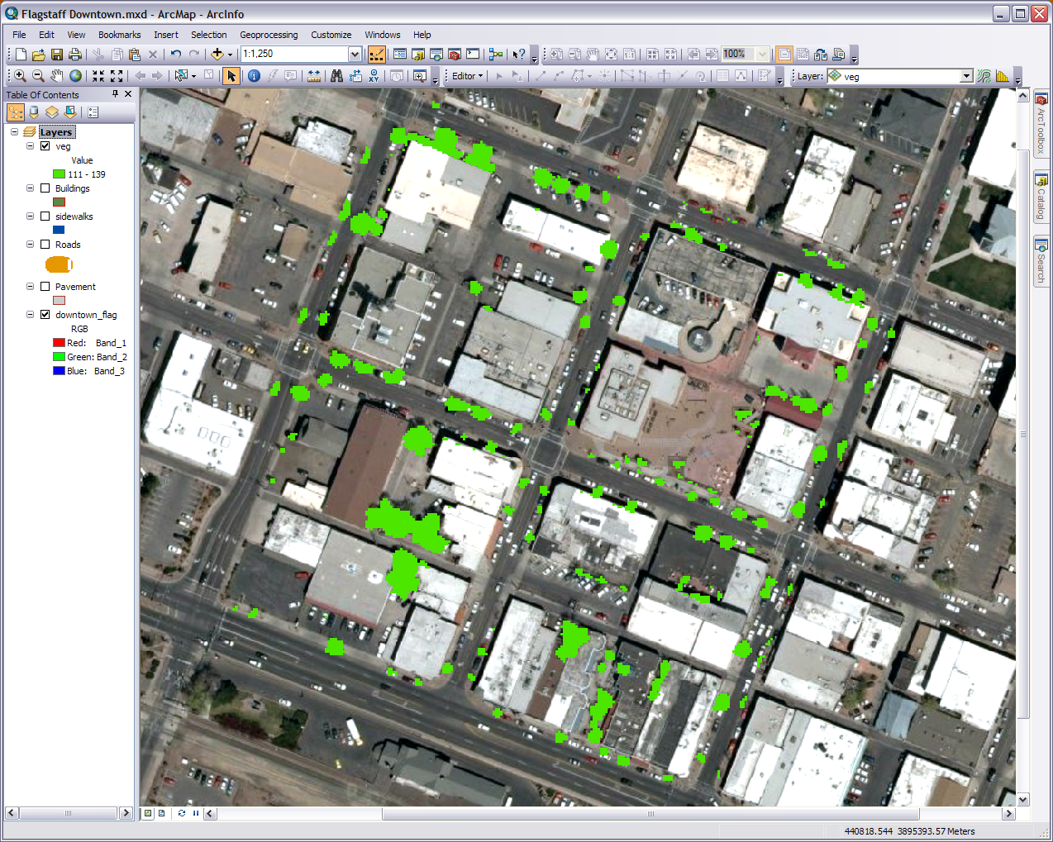
The end result: the downtown vegetation layer
Notes:
1) Right or double click on the NDVI layer name for the properties. 2) Go to the functions tab, right click on the colormap function, and remove it. Press OK. 3) Right click on the layer and Data>Export Data. Export the data to the geodatabase (assuming you’re zoomed to our four blocks), choose the data frame which will put the new image in our WGS84 spatial reference, leave the others at the default, and press save. I called mine downtown_ndvi.
Remove the old NDVI and the four band image you brought in. Turn on the basemap image we have been using since the beginning. If you want you can use the identify tool in find out the pixel values of the vegetation in the new NDVI. You’ll find the lowest at about 102. 1) In the properties of the new NDVI go to the Symbology tab. 2) Choose classified and set the classes at one. Press the Classify… button. You’ll see in the histogram (graph) that the pixel values in this image range from about 0 to over 100 and most are crowed together in one area of values (if you created the NDVI in ENVI the values will be different). The pixels representing our vegetation go from about 102 and up. 3) Press the Exclusion… button, exclude values from 0-110, press OK, and OK again. The reason why is if we set it at 102 we will get 100% of the vegetation but will also pick up other pixels such as roof or ground parts that are not vegetation. At 110 we at least get 90% and pick up much fewer false vegetation pixels. 4) Double click on the symbol and set the color to a green. Press Apply and if it looks good press OK. 5) Go back to the properties, the Display tab, switch the Resample during display to Bilinear for smother edges. Press OK. The rest of the pixels in the image still exist but we’ve made them invisible.
Now we will cut it down to our four blocks. Go to the ArcToolbox, make sure you have the Spatial Analyst extension turned on (under customize>extensions), and drill down to Spatial Analyst Tools>Extraction> By Mask. For the mask input put your pavement layer and name the output what you’d like (I called mine veg). Press OK and give it time to run. Make the classes one again and the same excluded values. Remove the old and leave the new. Save the map otherwise you’ll have to reset the exclusion values each time you add the vegetation layer.

Slide 16
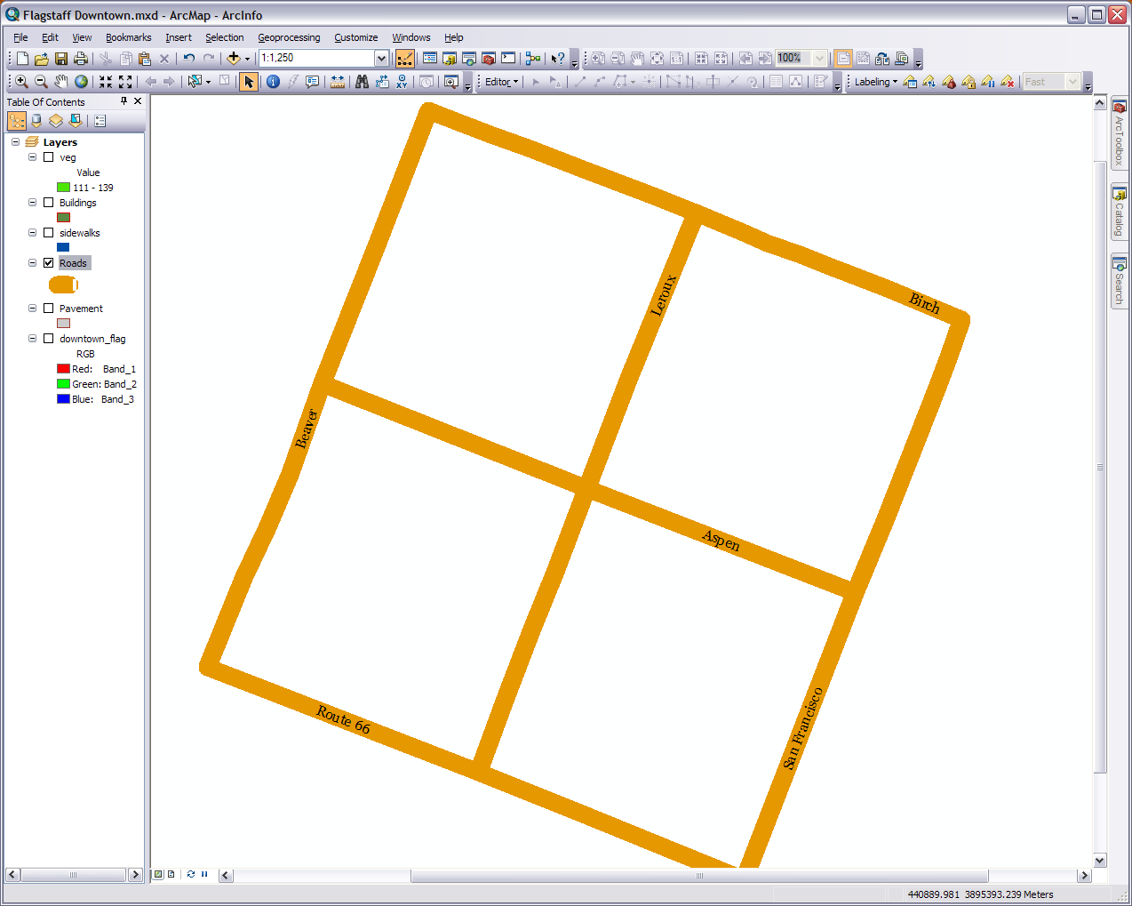
Notes:
Next let’s label our roads. Turn on your Roads layer and all the others off. Turn on the Labeling toolbar and turn off other toolbars as needed. Click on the label manager (first icon to the right of the dropdown arrow). Make sure both the Roads and the Default under the Roads are checked and select Default. For the label field choose Road_Name and the position on the line. You can do what you want with the rest. Press Apply and adjust till you get it how you want it. Press OK. Note because they are labels and not annotations the only way to manipulate them is with the tools in the toolbar

Slide 17
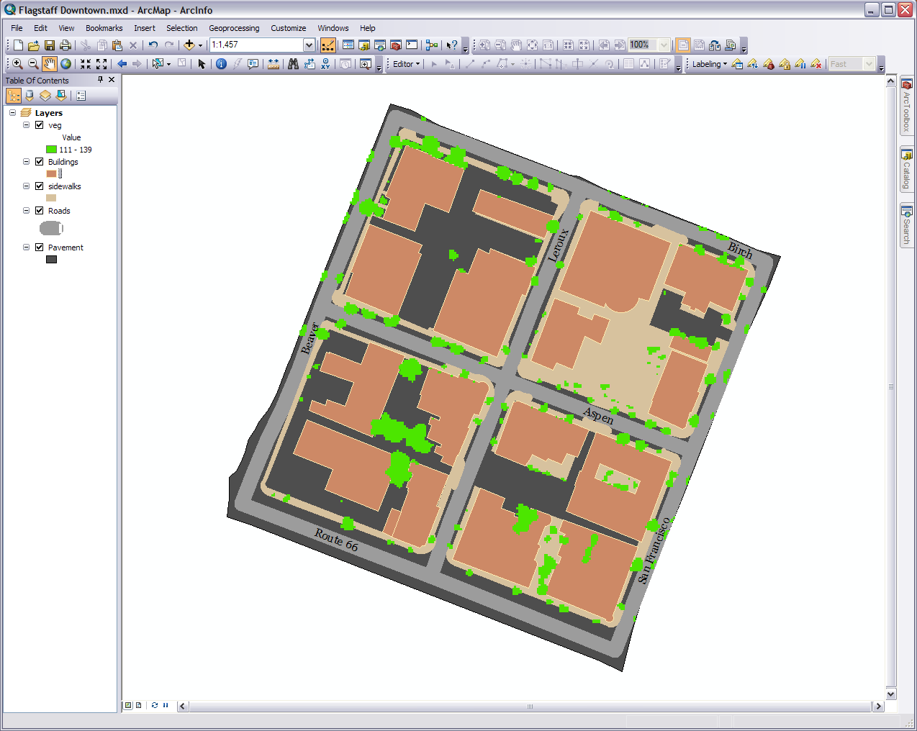
The vegetation layer is raster and the rest are vector feature classes
Notes:
One last thing. Color Balance. First off remove or just turn off the basemap raster image we were using to trace things (will bring it in again later). Have your layers arranged with the vegetation on top, over the buildings, over the sidewalks, over the roads, over the pavement. Zoom in to your pavement layer.
I suggest you leave the roads as thick as they are in the basemap image (bring it in for a moment if needed) and have the vegetation a shade of green. Other than that play with the colors, outlines, and fill till they look agreeably balanced. If you need some suggestions you could try http://colorbrewer2.org/ or look at other maps.
Save your map. Congrats. You have a simple community/campus GIS. Obviously you can add much more details and features. When your ready we will continue this GIS of downtown Flagstaff in the next module.
________________________________________________________

