Slide 1
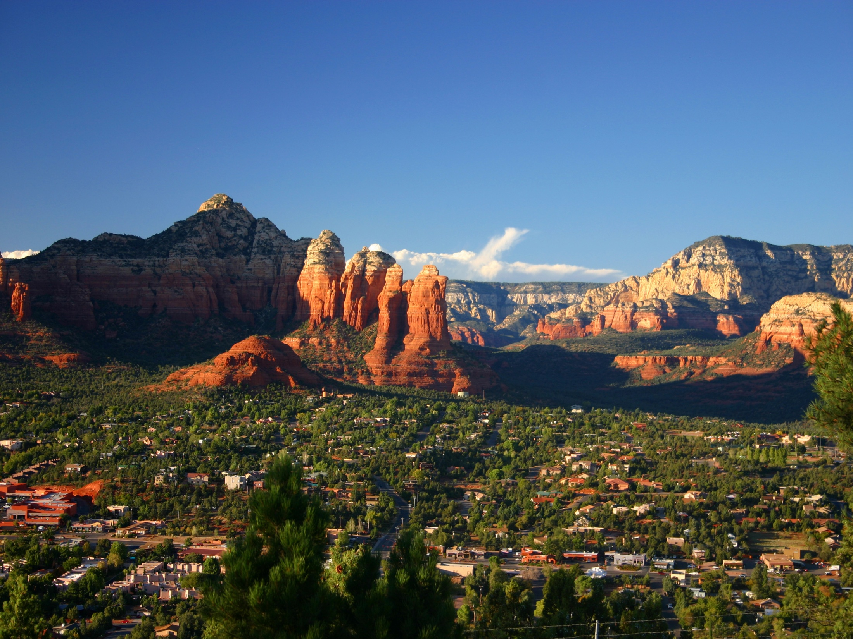
Designing a Community or Campus GIS
Module 1: The makings of your community GIS
Created by: Scott Kelly 2010
Notes:
Welcome to the Designing a Community or Campus GIS workshop. This is for anyone who wants to design a GIS for a local area or interest. It doesn't take a degree in geography and a simple community GIS is actually pretty straightforward. Maybe you have a geographically diverse neighborhood. Maybe your school could use some spatial understanding. Maybe your business has satellite locations across the state. Maybe you just need a GIS of an small region and there isn’t anything available that fits your needs.
In this workshop we will build a simple GIS for an area and talk a little bit about what we can do with it. This first module talks about what a community or campus GIS is and some of what goes into one. In the next and each successive module we will build on our GIS. This is a bit more advance than the other workshops. I recommend that if you are new to GIS you go through at least the Introduction to GIS workshop first.

Slide 2
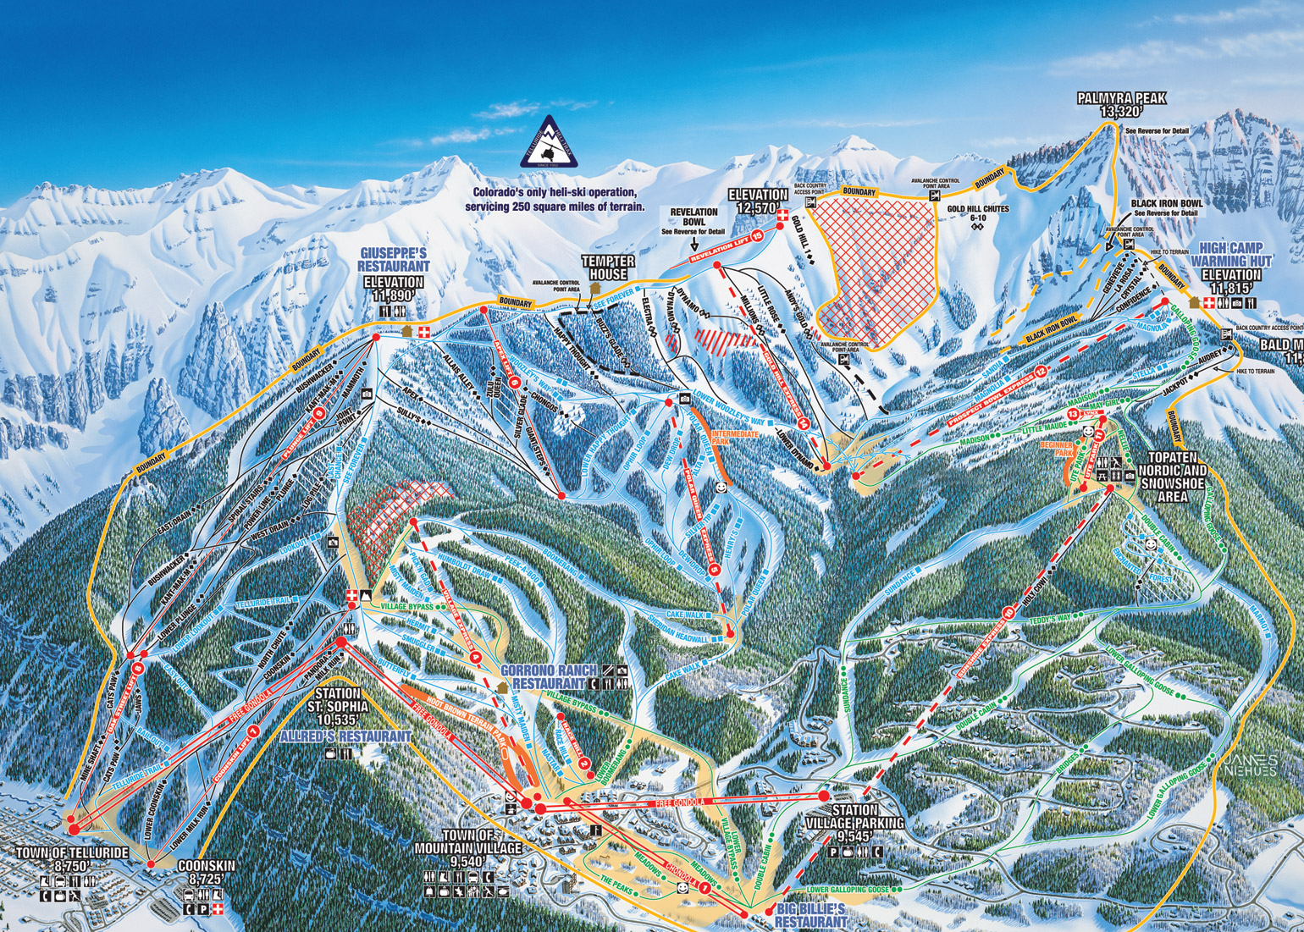
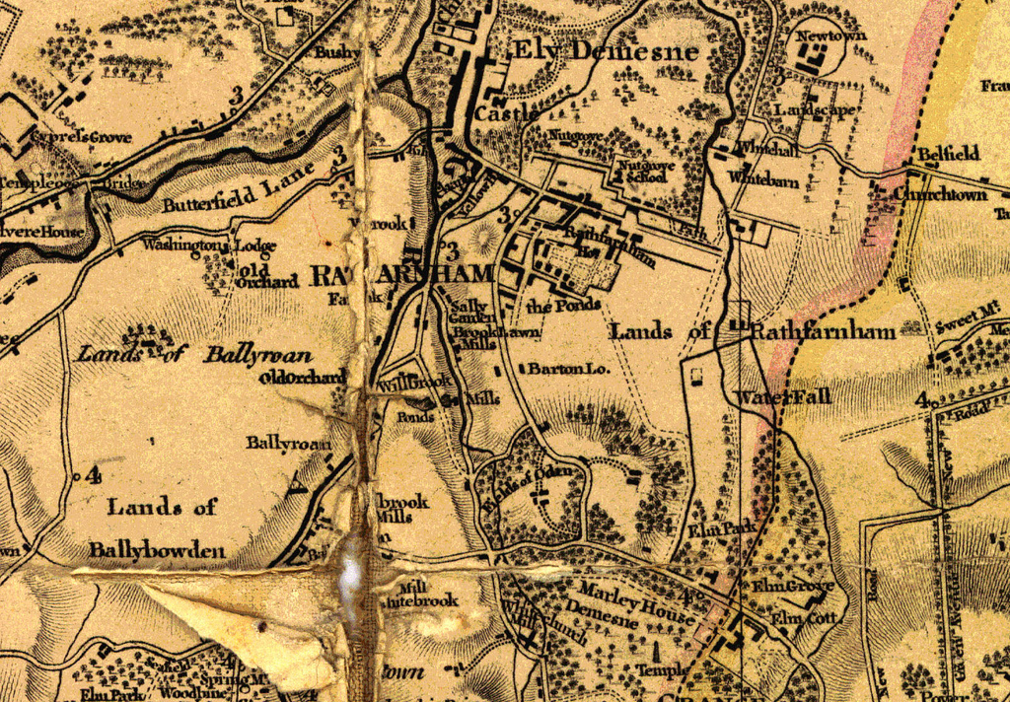
Notes:
When we make a community GIS it is more for an encompassing spatial understanding of a location, organization, or theme than for a specific project. You might make a community GIS for the campus or campuses of your medium size business where as you would do a different type of GIS to monitor the squirrel migration patterns on your property. What you are doing essentially is creating a GIS that tells you and others about the area as a whole. The idea is to communicate spatial information to a general community of users rather than a specific client. It is a multiuse spatial kiosk.
A community GIS has local spatial details that can be simple or complex. It contains foundation data that users can build on. In contrast an aerial photo, satellite image, or static map will only show a snapshot of the spatial data for an area. Remember a GIS is much more than just a map. The GIS is the working comprehension of the continuous spatiality. Somewhat like live action verses a permanent pose. You are spatially describing the area with characteristics, features, and factors that at an aerial photo won’t reveal or a specialized study won’t pay much attention to. (Image Source: flicker.com and others [Taylor’s Map of Rathfarnham 1816])

Slide 3
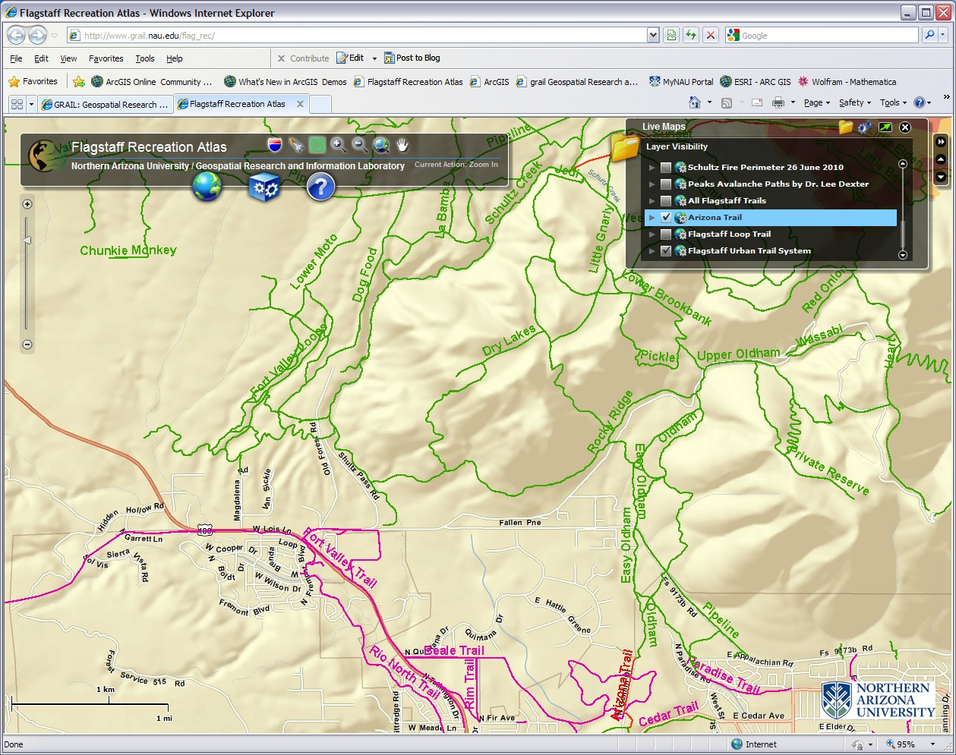
Notes:
This is an example of what I mean. The Flagstaff Recreation Atlas (www.grail.nau.edu/flag_rec/). This GIS wasn’t put together to be a onetime overview picture of the area. Nor was it made for the sole purpose of cataloging the mountain bike habitat in the Dry Lake Hills. It was created for anyone who wanted to look at the back country or urban trails in the Flagstaff area. It also contains other layers of community interest such as the extent of past wildfires in the region. Layers can be turned on and off, you can have a street view, topographic, or satellite imagery basemap, and you can use certain tools to draw, print, bookmark, and search. It is meant for the community of interested users, not exclusively to an elite group and is just simple local information. Being a GIS, data can be added, updated, and taken away throughout its lifetime.

Slide 4
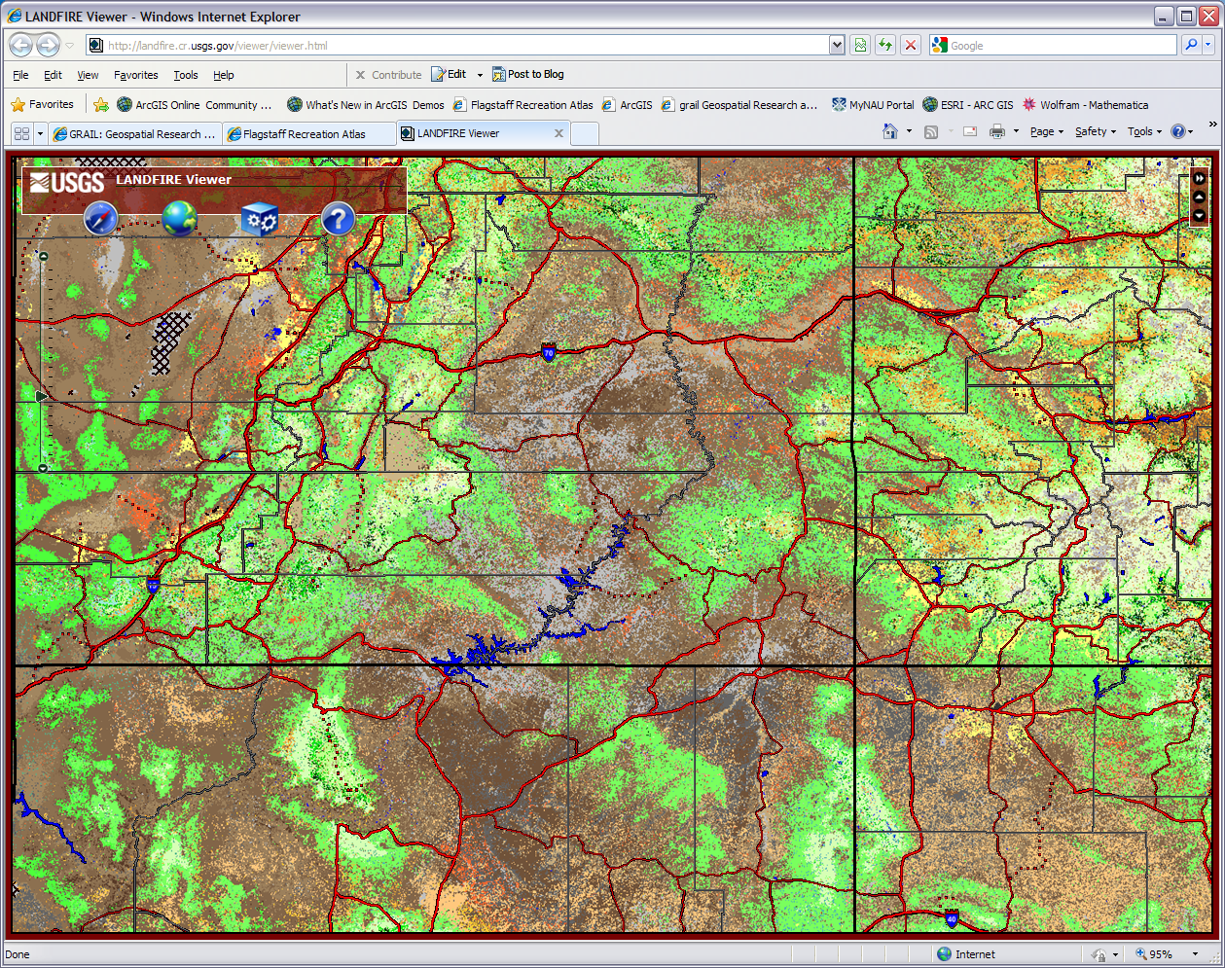
Notes:
Here is another community GIS with a similar interface. The LANDFIRE GIS was put together by the USGS and National Forest Service for vegetation and wildfire spatial services and targeted to the community interested in those services. Zoom into any spot in the U.S. and it can give you local information. Even though it covers an entire nation it can be called a community GIS because it contains several basic layers and themes that can be used by anyone for any purpose. A community GIS doesn't have to be limited to a campus or neighborhood. What we are looking for is a simple understanding of the spatial aspects of an area. Again it is not for a client but a community of users. (http://landfire.cr.usgs.gov/viewer/viewer.html)

Slide 5
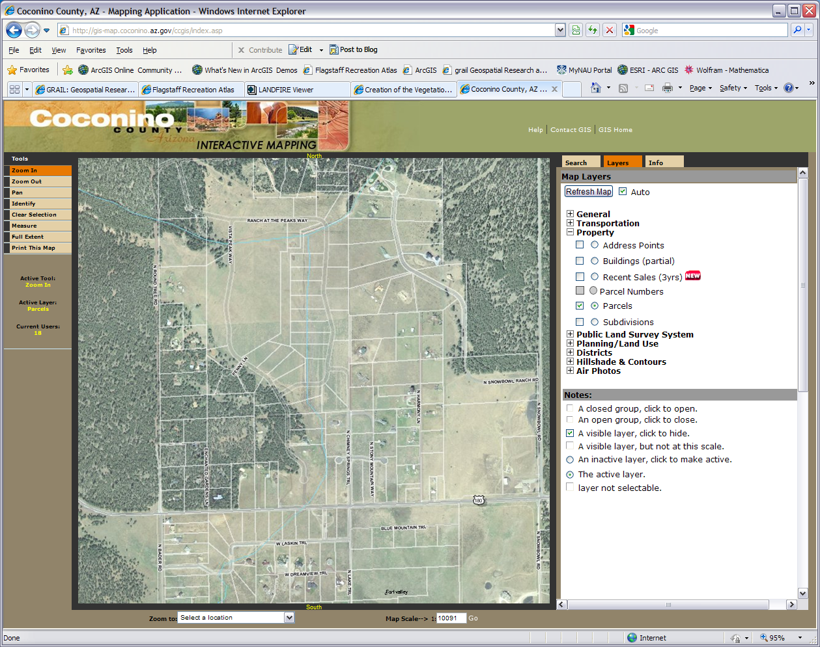
Notes:
Community GIS projects are run by anyone from homeowner associations to corporations to governments. It can be run as a student project or marketing logistics tool. In this Coconino County GIS it shows parcels of land to a community of users involved in Coconino County property boundaries. While I said earlier a community GIS might not be for a particular task, it often does have a specific purpose. Some are more specific than others.
What a community GIS is trying to do is show people that a range of certain spatial characteristics and features is important to an area. They can be a simple as the network of roads in a neighborhood or as daunting as the individual blossoms and species of flowers growing on campus. The community GIS is created with the user in mind so those who produce it do so with the intent of people using it for a specific purpose. Again that specific purpose can vary in scope and distinctiveness. (http://gis-map.coconino.az.gov/ccgis/index.asp)

Slide 6
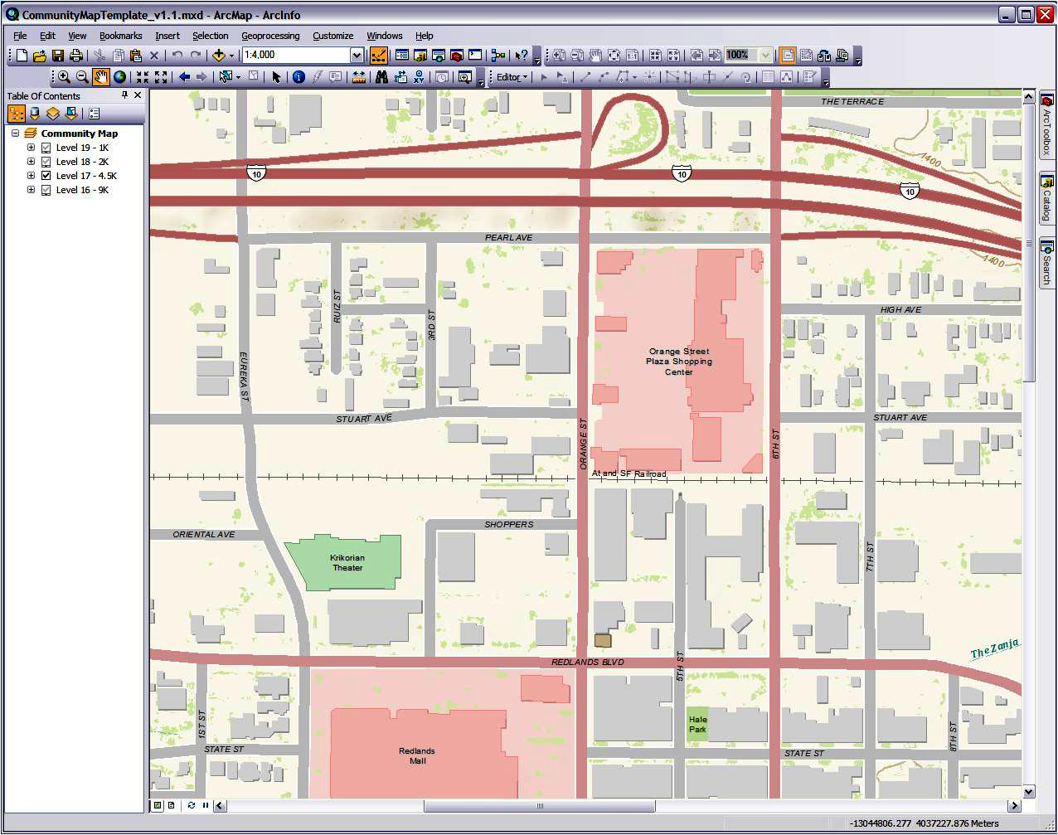
Notes:
Community GIS projects can be very large in scope. The ESRI Community Maps Program encourages user contributions of local spatial data from around the globe. The goal is to make widely available high content basemaps of local areas all over the planet. The program adds more detail and coverage to already existing basemaps that ERSI offers for free. When the data is sent in and properly formatted it is published to ArcGIS Online and can be used by anyone.
Even if you don’t have access to high end ArcGIS software you can use ArcGIS Explorer online or download it to your desktop. The ESRI Community Maps Program allows you to quickly get your base layers up and running giving you more time to work on your other layers. Plus you reduce some costs of data acquisition. Contributors range from city governments to universities. If you create a local community GIS you could contribute to this community GIS too. (http://www.esri.com/software/arcgis/arcgisonline/community-maps.html)

Slide 7
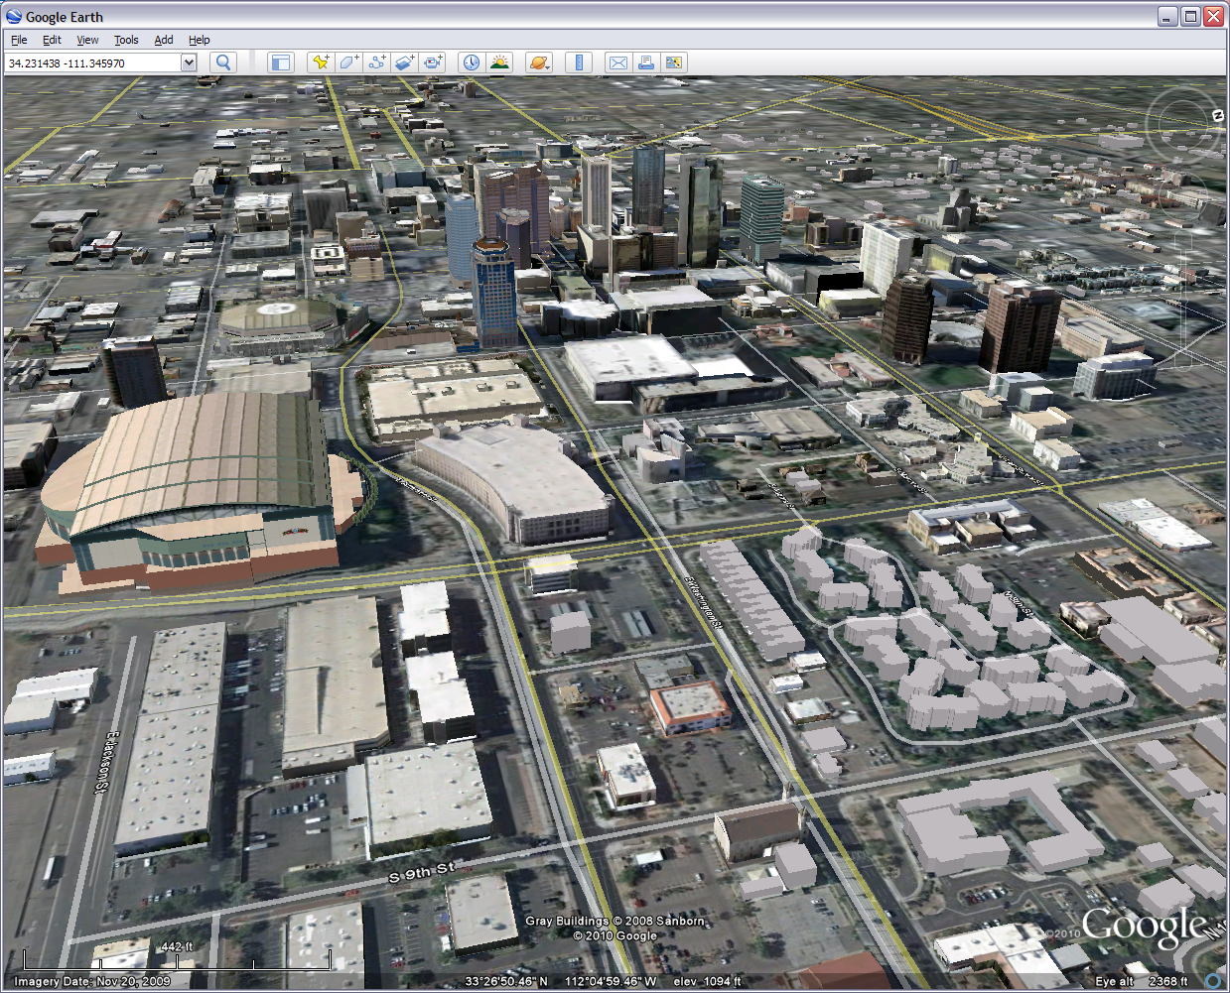
Notes:
Community GIS projects can go beyond 2D overhead views. Many people are familiar with Google Earth and its capabilities to display three dimensional buildings. Google Earth acquires and assembles its geographic information from a community of providers. This includes everyday people as well as imaging corporations and government data. Ever wonder where all those photo links come from?
Since it would be rather cumbersome for Google to create 3D models of every building world wide it relies on the community of Google users to contribute. Through Google’s free CAD software, SketchUp, people can create models of buildings in their hometowns or favorite vacation spots and submit them to Google for publication. A small town like Williams isn’t likely to have a corporation model and submit their buildings to Google anytime within the foreseeable future. It would need to rely on a community of interested everyday citizens to do it. (http://sketchup.google.com/support/bin/answer.py?hl=en&answer=36241)

Slide 8
Real time info
Interactive layers
Simple lines & shapes
Notes:
So what exactly goes into a community or campus GIS? Well earlier we said what a community GIS is trying to do is show people that certain groups of spatial characteristics and features are important to an area. This can be simple filled in building shapes and wide road lines. It can also be detailed graphics of landscape features and photographic elements of plant diversity. The thing is a community GIS contains elements that give the general user a general spatial understanding of an area. No matter the purpose it will almost always have basic lines, shapes (polygons), and points representing the layout of the land.
For example take this trail map of the Mammoth Mountain Ski Area. While this interactive geographic information system lacks some professional GIS ingredients, it has simple spatial features relating spatially to each other and the users. It contains plain lines of well known colors that most anyone can see are paths from A to B. Downtown Tucson could have a simple GIS with similar lines to represent streets and various colors to represent traffic intensity.
Additionally used in the Mammoth GIS are straightforward orange peach shapes used to show areas of certain activities. Simple polygons are commonly used to represent nonlinear features such as buildings and areas. In a basic community GIS you will have simple lines, points, and polygons for plain paths, locations, and places with significant area. Here you also have simple interaction turning the different layers on and off as well as getting information on current conditions. (http://www.mammothmountain.com/MountainActivities/WinterActivities/Maps/)

Slide 9
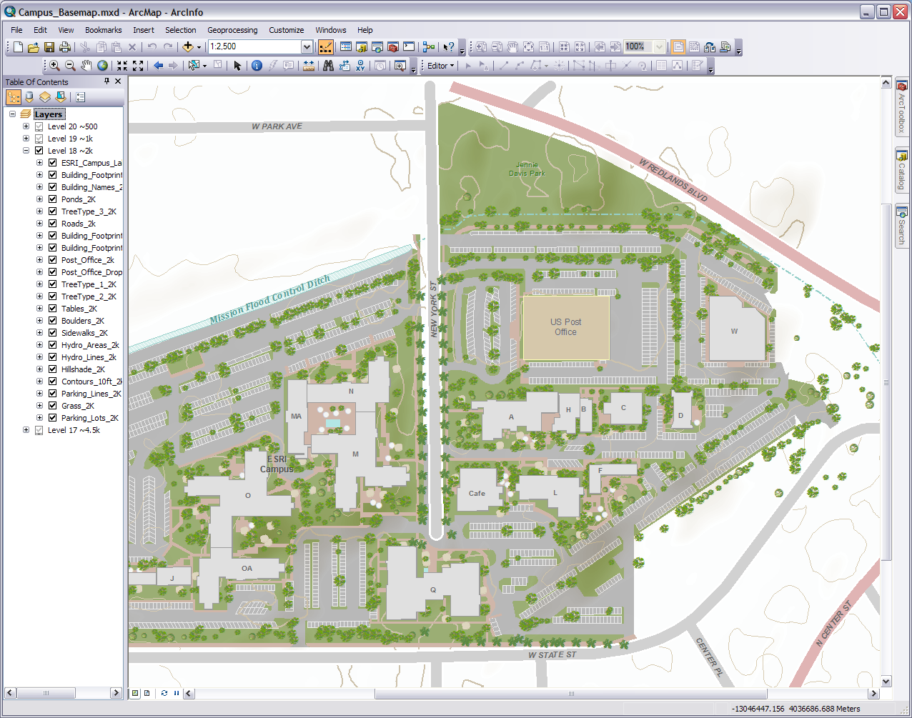
Hill shading and contour lines
Polygons for parks, buildings, and parking lots
Lots o’ Layers
Different point styles for different tree types
Sidewalks and parking lines
Thick road lines with different colors for different types
Notes:
When looking at what goes into a community GIS we see basic information but it is not always straightforward and plain. In the example here we do have simple polygons for buildings and lines for roads but as we begin to increase and deepen the information the GIS gets a bit more complex. Suddenly our buildings are differentiated by colors and styles. Polygons no longer represent just buildings but pavement, grass, and other areas that have square footage. Our lines too are diversified with colors, thickness, and representation. For features such as trees, boulders, and picnic tables it is simple to represent them as points. An intersection of latitude and longitude or other XY coordinate with no particular dimension. That point however can be represented by any graphic or icon. The more assorted the points the more intricate the representation can get.
A community GIS can be made up of layers as complex as you like. In this example underneath all the other layers are hill shading and contour lines made from elevation calculations. These give the user an elevation dimension to work with. In our last example the underlying imagery gave us an angular perspective of the mountain. Being more tactical than a straight down overhead view, it gives the targeted community a better understanding of what they are trying to get from the GIS. The imagery was also quite detailed in the last example were as the background for the example here is a bare white canvas. Whether the data is raster imagery, vector graphics, or 3D digital rendering, in a community GIS the complexity doesn’t matter as long as the community of users are able to benefit from the data. Just keep in mind the GIS is intended for multiuse and open spatial understanding.

Slide 10
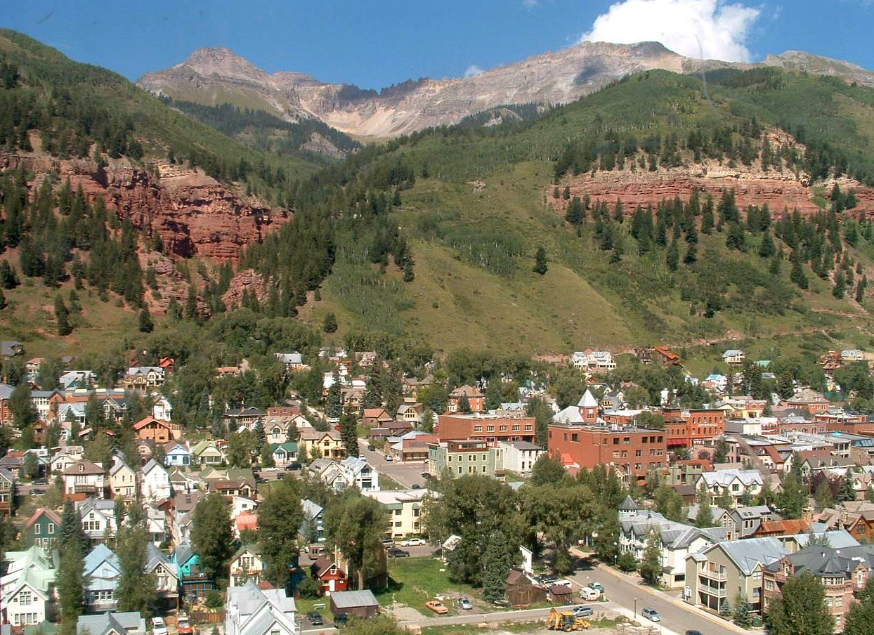
Notes:
One of the first and larger tasks of creating and maintaining a community or campus GIS is to acquire the spatial data. This is a commonality with all GIS’s but in our case the task is usually less in-depth than a specialty study would be. The kind of data we are collecting falls into the concept of “base” data where again, it really isn’t headed to a particular goal but is focused on the purpose of the GIS. The acquisition of data can be done in several ways.
One method is to acquire secondary data. For those of you not familiar with it we are collecting data someone else has already produced. One of the most common ways to do this is find a website with a collection of spatial data and download it. Often this is free from government or association websites like the U.S. census or the GIS Data Depot. Sometimes you do have to pay for it. If you have the budget you can pay for someone to go and fly or aim their satellite over an area and get you some up to date, preformatted, high resolution photos and images. Perhaps a colleague or contact has the data on hand. You could also linkup to some else’s database, such as the one at GRAIL, and download it from there.
Another method is to collect primary data. This is where you go out into the field and get it first hand or you take secondary data and process it to the point where it becomes something new. You could walk around campus and mark on a GPS unit where all the large boulders are. You could take a list of business addresses downtown and using a procedure called geocoding have them all properly placed in the GIS. You could take some satellite imagery or aerial photos and using different techniques extract and derive all kinds of data.

Slide 11
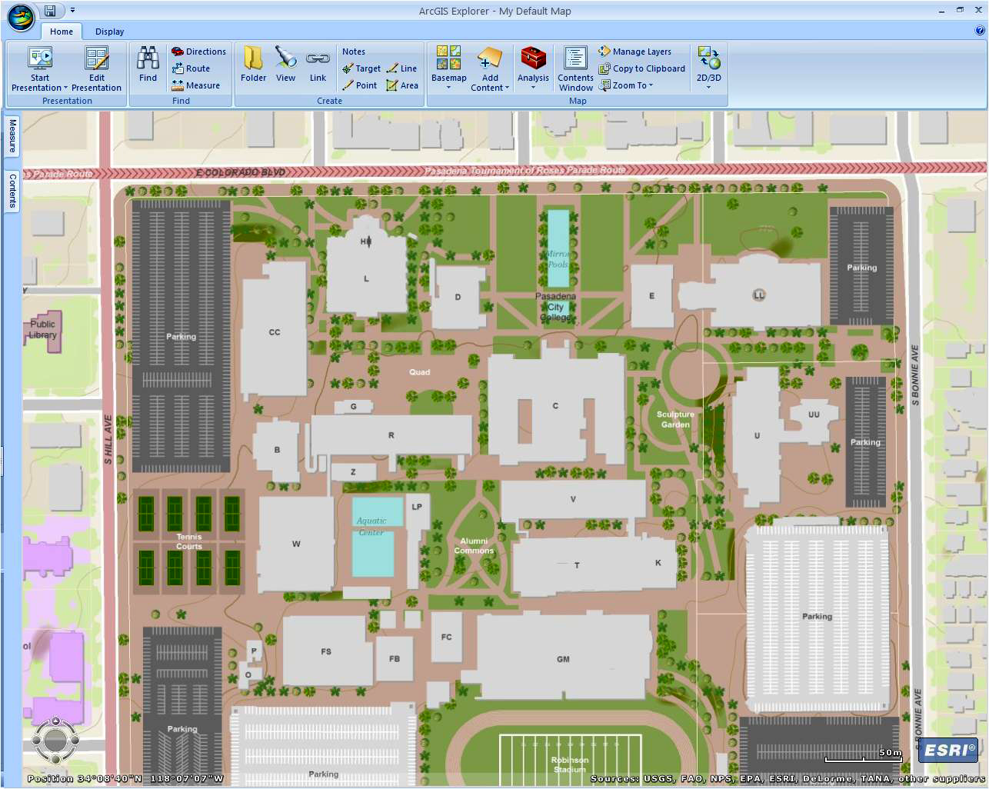
Notes:
Another large task is to display and symbolize the data. In any GIS we have to decide how we are going to represent features and characteristics of the real world. Should we use a fat line or a long thin polygon to represent a trade route? Would a point or circle outline be better for a giant boulder? This is important because it is often what distinguishes one element or type from another. Generally there are standard conventions, such as a blue polygon for a pool, for displaying and symbolizing data but even then there are many variations. It seems easy but it really can be time consuming and sometimes tricky to get everything to balance just right.
As we talked about earlier, our community GIS contains base data that can start as simple plain jane lines and shapes but increase in complexity. In our example here the sports field on the bottom of the screen shot could be displayed as just a grass green polygon with a label in its simplest form. You can then add a grid of yardage lines and an oval track to give it greater distinction and display more information. No matter the depth of data in our GIS we need display and symbolize it in a distinguishing way. There is of course many ways to do this and even with conventions personal style can play a role. Is that an earth green or moss green? Is that track a thick line, an empty polygon, or a cutout in a grassy field?
How we display and symbolize is also how we communicate to the community of users. If we want the GIS for our home owners association to show what yards are classic grass, rocky landscape, or underdeveloped to communicate neighborhood diversity we need to distinctly represent each feature. The success of our GIS is dependant on how we communicate our data to the user community.

Slide 12
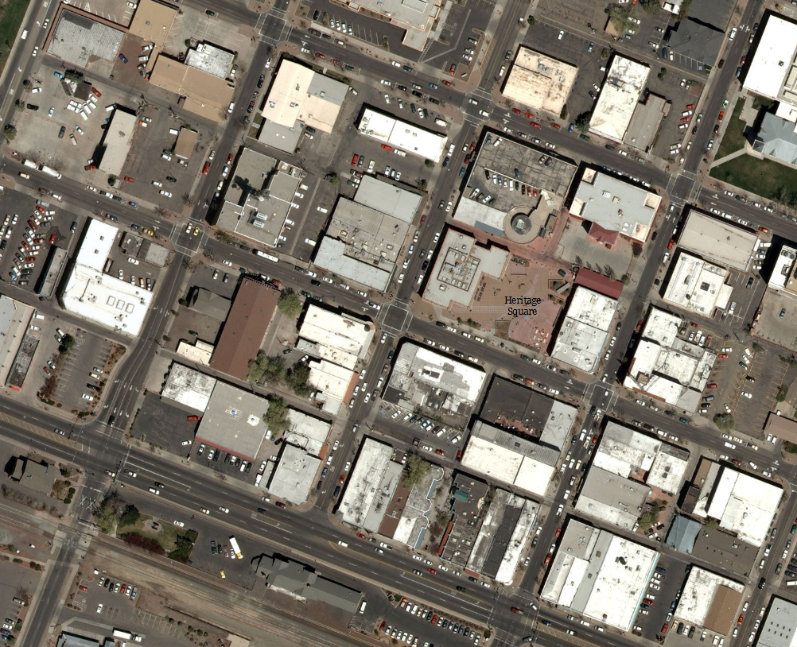
Notes:
In conclusion a campus or community GIS is a basic production of neighborhood spatial data with multiple uses. It helps people to have the general local data they need to build other projects. To help gain a better understanding of this type of GIS we’ll go through and progressively build a community GIS in the next few modules.

