Slide 1
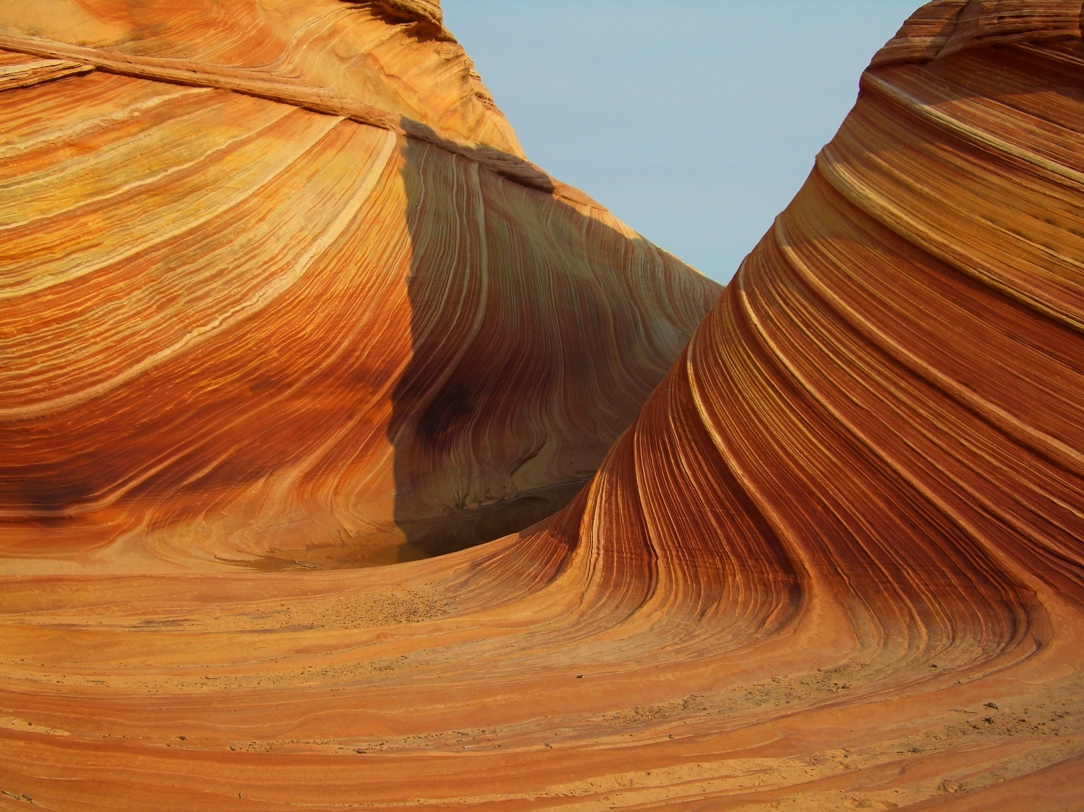
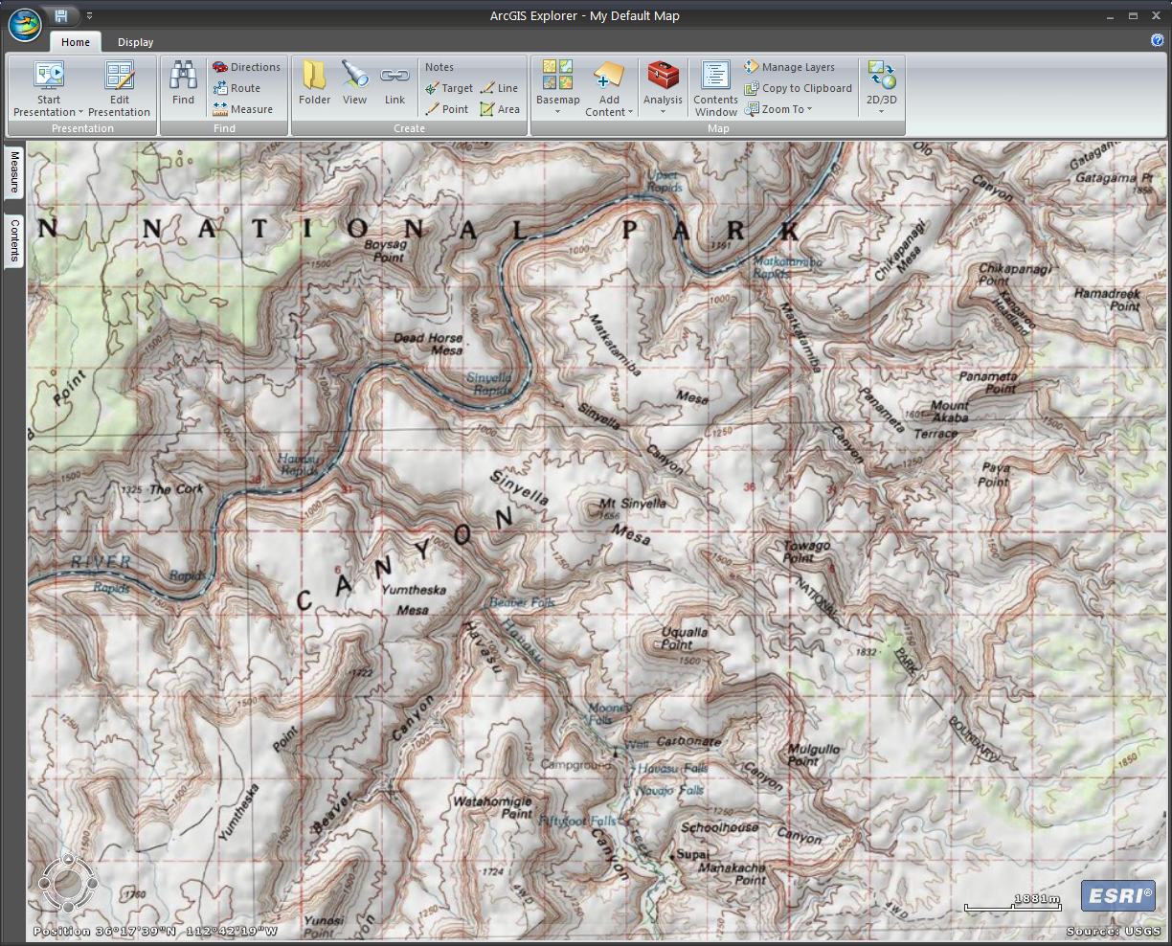
What is GIS?
ArcGIS Explorer: Module 4
Created by: Scott Kelly 2010
Notes:
For this last module we are going to show you how to use some GIS specific software in your teaching or business environment. Again it is nice and simple with free software.
Important note: GIS can have quick changes in data and technology. This module has more guiding thoughts than hard and fast procedures. For example in this exercise you will download some data from the cloud/internet at ArcGIS Online that will be similar but different from what you see in the PowerPoint. So what you see is not exactly what you will see when you perform the work. I update this when I can but what you need to do is be able to look at the module and apply the skills to the data you are working with.

Slide 2
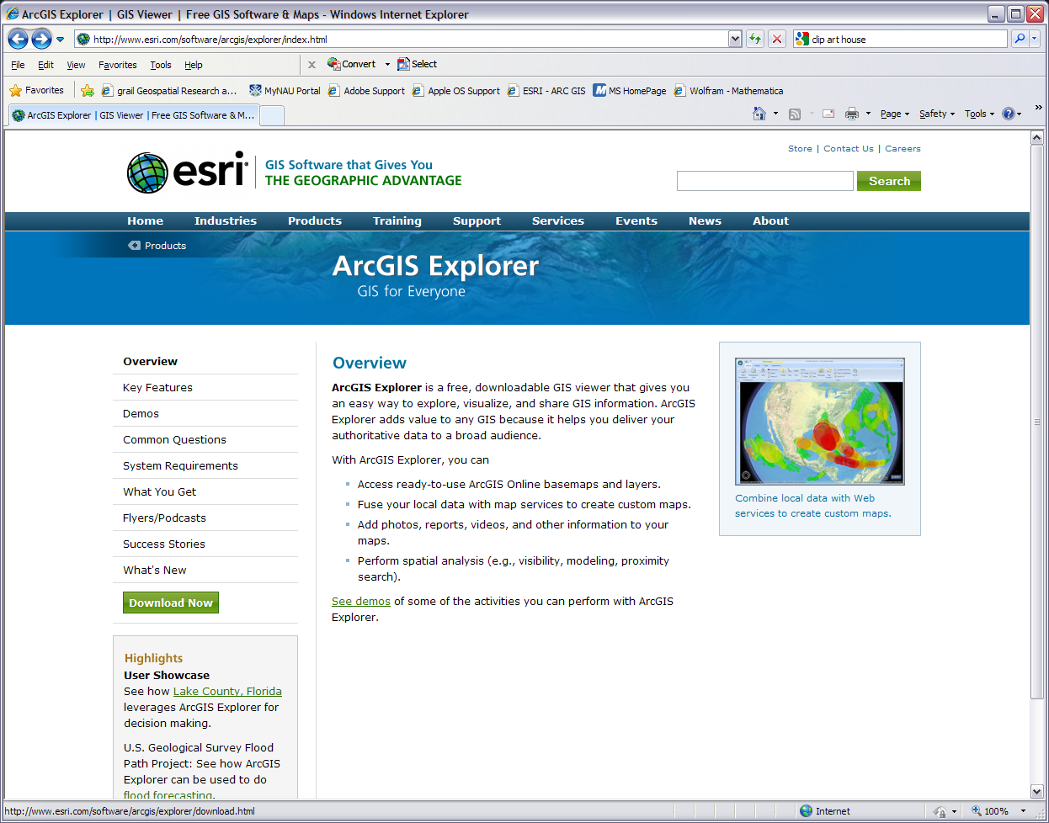
Notes:
The first tool we will need is ArcGIS Explorer. There is an online version and a desktop version of this. The Online version is limited and won’t work for what we want to do, so lets download the desktop variety. Google ‘ArcGIS Explorer download’ or go to http://www.esri.com/software/arcgis/explorer/index.html and click on the green “Download Now” button. Do step one if you don’t have it. If in doubt, chances are (assuming your computer is up to date) you have it so go head to step 2. In step 2 just pick your preferred language. Click on “Run” and ArcGIS Explorer, which I may refer to as just Explorer, will automatically install. It is safe to install and only uses a small amount of storage.

Slide 3
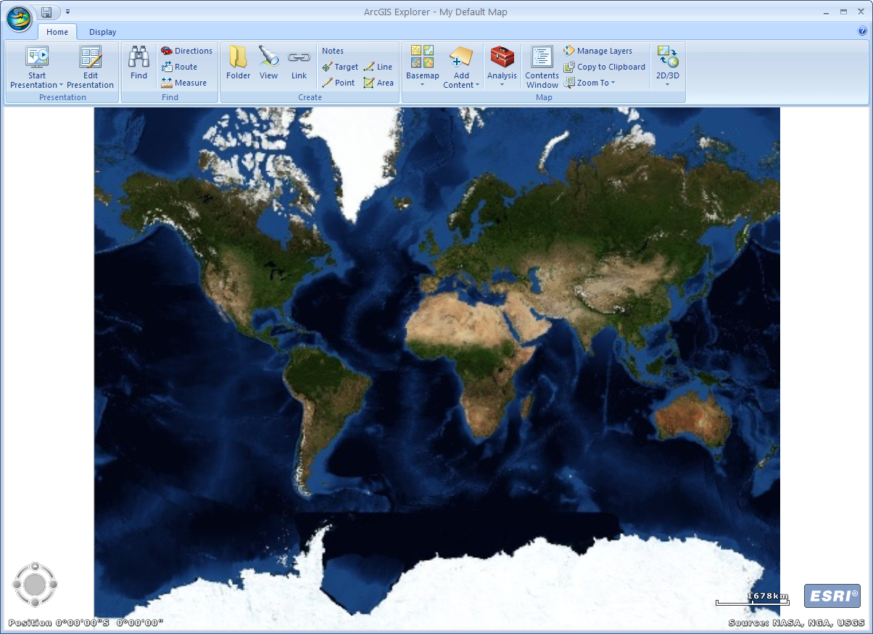
Notes:
Now that you’ve downloaded ArcGIS Explorer and it installed itself, open it up and here’s the first screen we see or something very similar. You may need to enlarge your window a bit to get the tool/menu bars looking the same.
We have some basic imagery of the world with some menu bars. On our Home tab menu starting on the left are tools for setting up and running presentations right from Explorer. To their right is the find tools for simple queries and measurements. Then we have the create tools for applying our imagination to the map followed by the map tools for setting up and configuring our map. Click on the small triangle dropdown arrows below or next to the icons to see more options and tools.
On the Display tab menu we have some technical tools that of course affect our perspective of the imagery. Navigating the imagery is very similar to Google Earth. For our map here we are going to be using Flagstaff so let’s zoom in to the general area. You can do this by using your mouse wheel and/or the navigation tools in the bottom left corner which can fine tune your zoom. You can also use the find binoculars tool on the find toolbar.

Slide 4
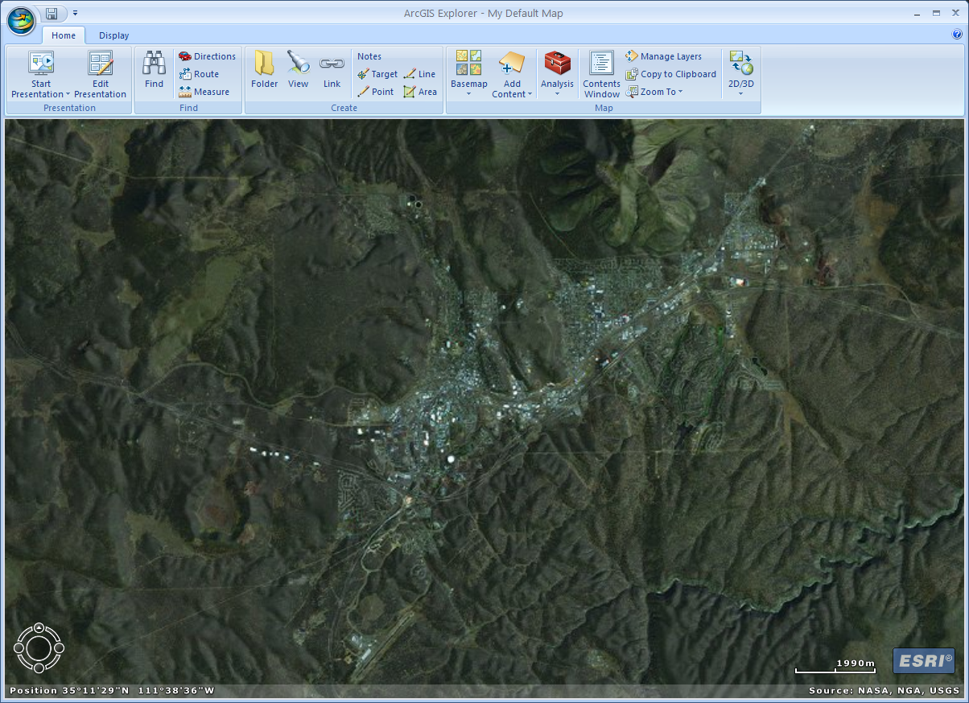
Notes:
The two tools we need to focus on now are the Basemap and Add Content. Notice both have little downward arrows that pull out some dropdown menus. If you pull out the Basemap dropdown you’ll see you have the option of changing from the World Imagery which we are currently viewing to any of the available basemaps (the spatial imagery that acts as our background, foundation, and reference data). Some basemaps work better than others for your particular set of map layers and the type of map we are trying to create (see the screen in Module 1 on map types). You can change the basemap at anytime.
The Add Content dropdown tells us the kinds of geospatial data we can add to our map. We can’t add just any data to the map. The data we add needs to be georeferenced (also known as registered) which means if we want to add a photo taken from the air or other data about the density of prairie dogs in the area it needs to have some extra data with it telling the program where it fits on the map. This data is the projection data. For this module everything we will be working with will already be projected so no worries there. These are two primary tools of ArcGIS Explorer and ones we will use to get our map setup.

Slide 5
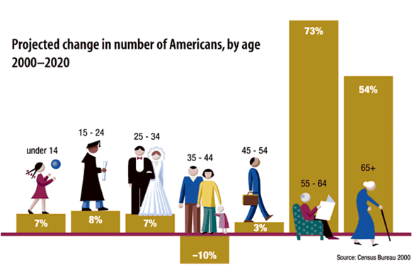
Notes:
Now that you have ArcGIS Explorer and are a bit familiar with it let’s setup the scenario for this module. In the last module we took a business approach. This time we will take a classic urban/green approach and use some creativity. Let’s imagine you work for the city of Flagstaff and your department is in charge of rezoning some areas of town so that the places people work , shop, and play will be close enough to where people live for them to ride their bikes or walk. Your boss wants you to present to the rest of the department a report about where the population is expected to be located & how it will change in the next few years. A good map would definitely help with that report. Oh by the way, the staff meeting is in an hour.

Slide 6
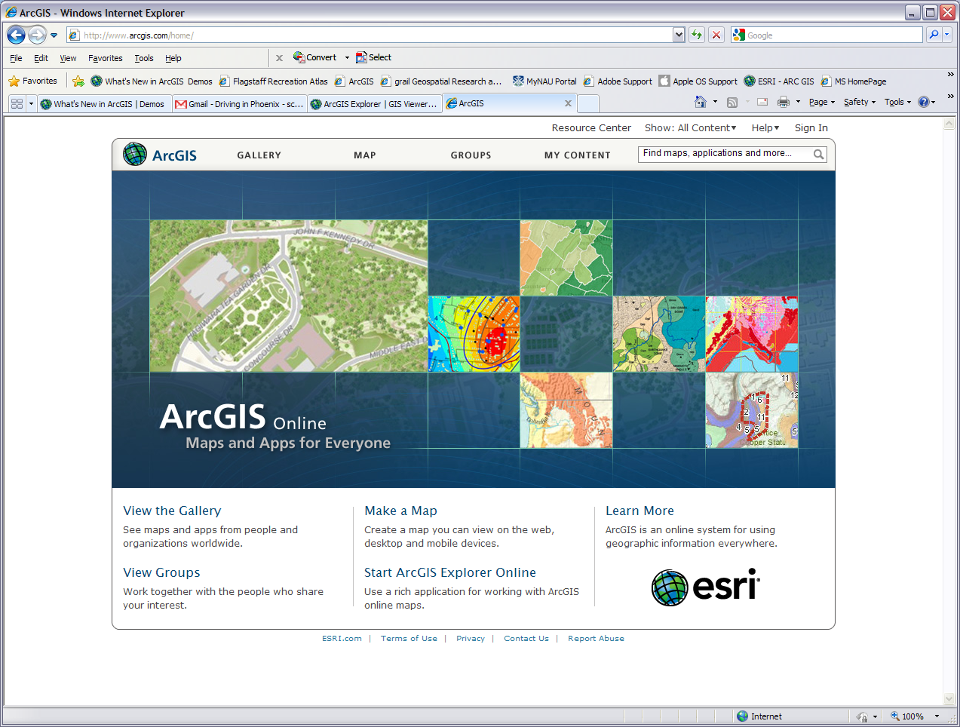
Notes:
To accomplish the task before us and show our co-workers and boss how awesome we are lets go back to Explorer. When we get to Explorer click on the Add Content button and click ArcGIS Online… which will open up a window in Explorer or your web browser.
A similar window or page to what you see here is where we want to be. ArcGIS online’s purpose is so anyone who can access the world wide web can have access to a quality global community GIS. It has what we need to get the data for our population projection report. As a side note and future reference, if we were to click the word “Map” in between “Gallery” and “Groups” we would access the online version of Explorer. Let’s go find that population data. In the search text box where it currently says “Find maps, applications, and more…” type in “Demographics”, “USA projected population change”, or something similar, press enter or the magnifying glass, and click “Search for Maps” in the menu that drops down.

Slide 7
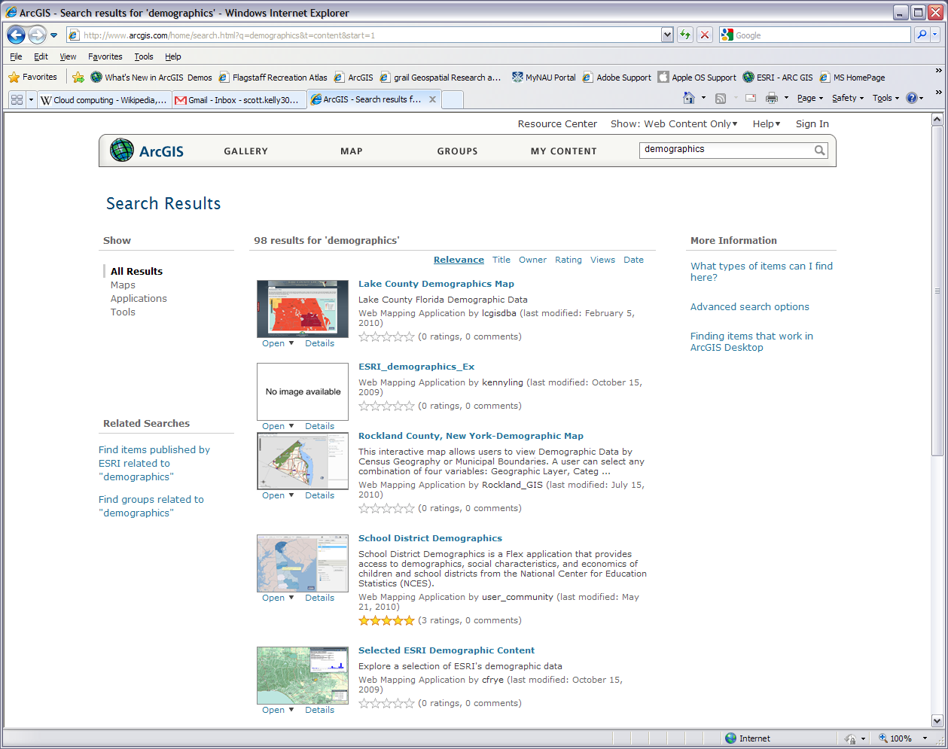
Notes:
When I first did this I got 38 results for “demographics” but you will probably get something different (I tried it again a month later and got 81 results now you’ll find them in at least the hundreds and maybe thousands). As ArcGIS.com is a global community web site and the data involved with maps changes often, things will come on and off this website.
In our case ArcGIS.com probably won’t have Flagstaff specific data so we just picked demographics knowing it would probably come up with results for the U.S.A. From here let’s look through our results till we find something that will work for us. Scroll down and flip through the pages till you find “USA Projected Population Change” or a similar layer will work. Unfortunately because ArcGIS is always changing I can’t say where in this group you will find the layer.

Slide 8
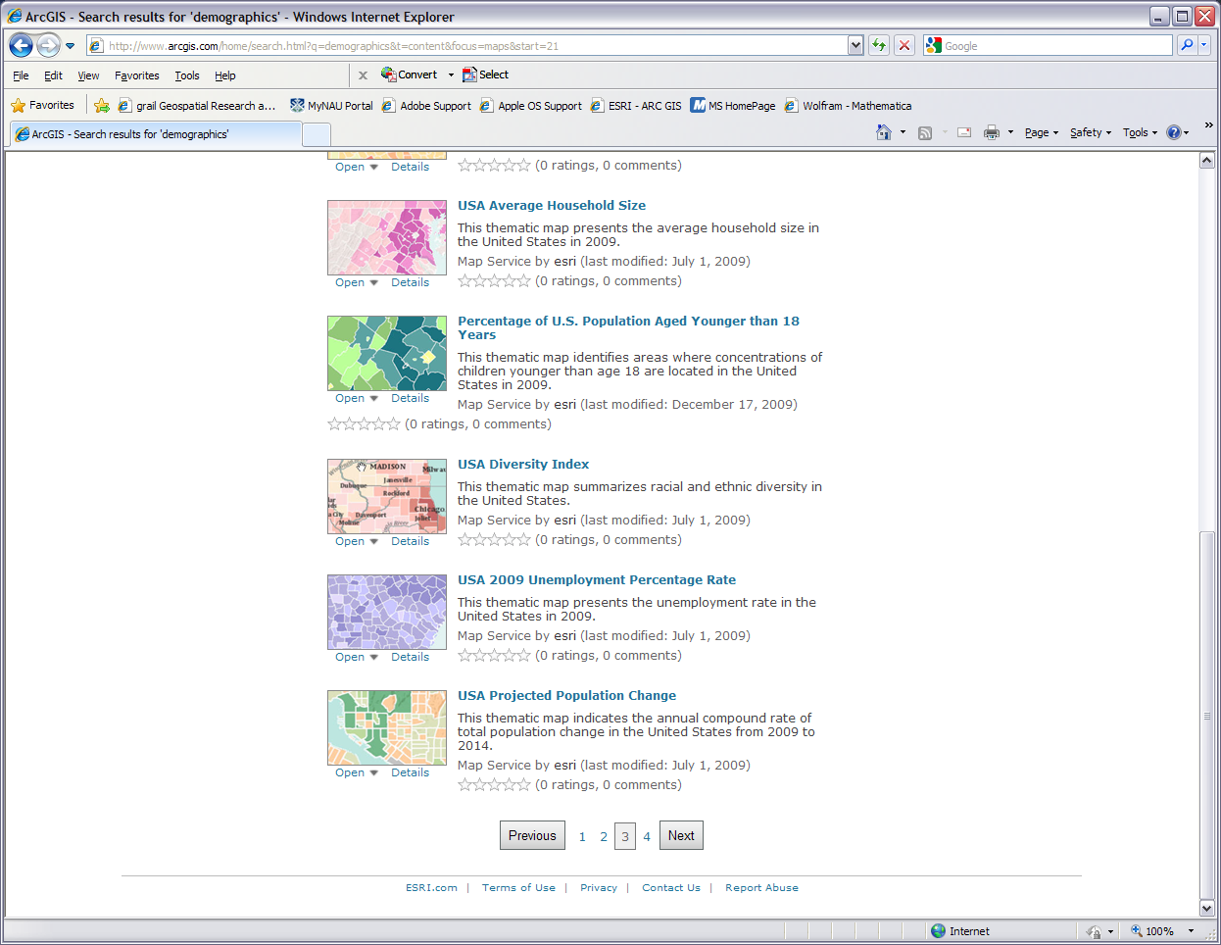
Notes:
Underneath the thumbnail image for “USA Projected Population Change” the word “Open” has a dropdown arrow next to it. You can click on “Details” if you want but in either case click the drop down arrow next to “Open” and select “Open in ArcGIS Desktop”. Make sure ArcGIS Explorer is open on your desktop before you do. Just click “Open” when it asks or if you want you can save it. If you have ArcGIS Explorer running as it should be, our new map layer will show up. Maybe not how we expected it but we will fix that in the next step. For simplicity let’s refer to this new layer pop change.
Not everything can or will download from ArcGIS.com. If you click the dropdown arrow next to open and it says “Open in ArcGIS Desktop” it will most likely, but not always, open in the desktop version of Explorer. If says “Open in ArcGIS.com” or “Open in Explorer Online” it should open in the online version of Explorer and if it says anything else such as “Open in ArcGIS Desktop 10” you won’t be able to open it in ArcGIS Explorer. At least not as of the making of this workshop. The website is dynamic and the content comes from a variety of sources so don’t expect things to always be the same. At this point you can close your web browser if you want.

Slide 9
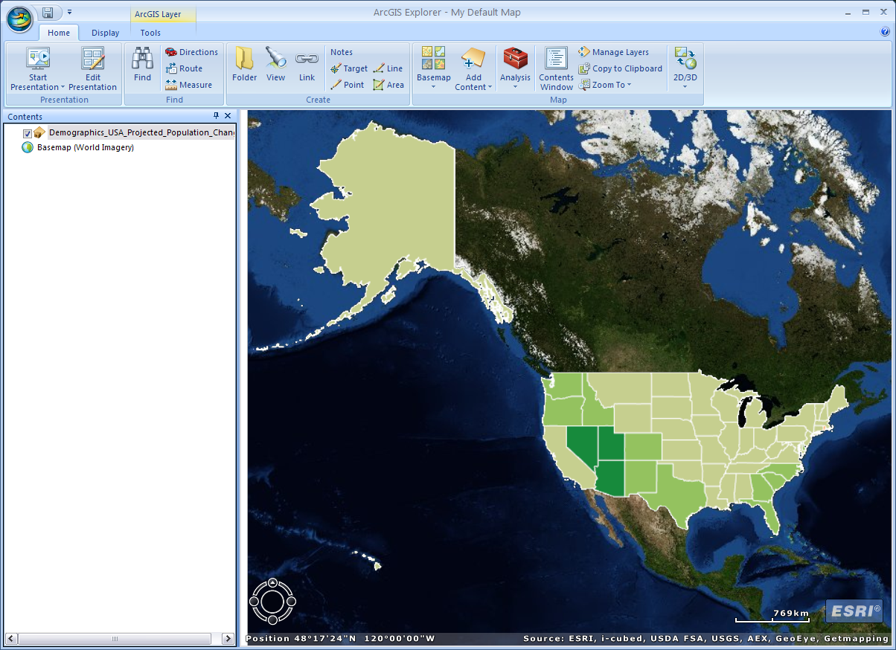
Notes:
Adding the new layer may bring your view to the whole of USA, Canada, and Mexico. If the Contents side bar didn’t pop up when you added the new layer click the Contents Window icon on the right side of the menu bar. This side bar will show what layers you have on your map and what order they are in. Right now we just have two layers: the base map and the pop change layer. The base map is fixed on the bottom. You can close out this side bar or minimized/hide it when you don’t need it or it gets in the way.
Let’s zoom back into Flagstaff. For me the easiest way to do this is turn off (click the check mark) the pop change layer and zoom into Flag. Also notice when we added the layer two new tabs popped up on top. This is actually one tab and we will use it later for manipulating our pop change and other layers we will add.

Slide 10
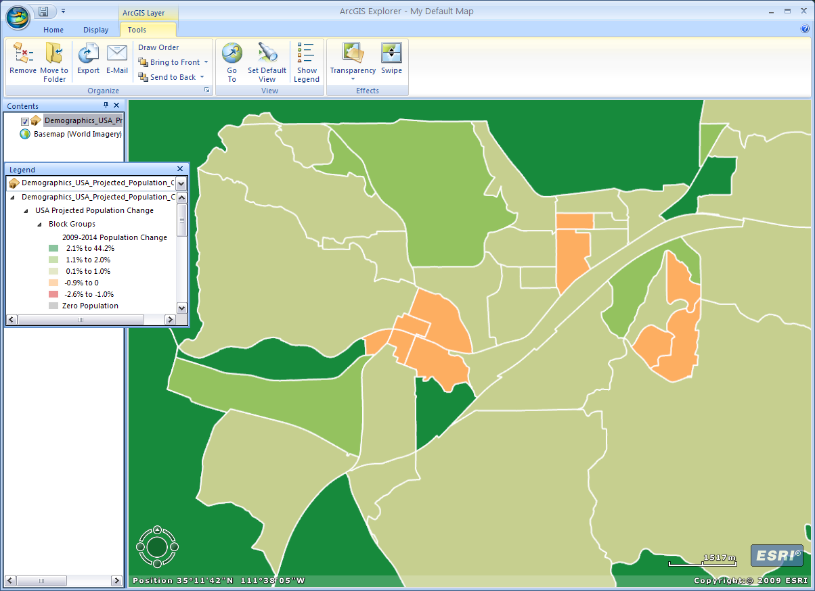
Notes:
When you get to Flagstaff turn back on the pop change layer and you will get a similar picture to what we see on the screen. You can click on the Tools tab and then the Show Legend button to get the legend. This helps you know what you are looking at. When we view this layer at this zoom we are looking at the Tracts or general city level so scroll down on the legend to the Tracts. The pop change layer is on top of the base map but you cannot see through it. We will take care of this later but first let’s review our objectives.
We want to show (1) where the population is expected to be located & (2) how it will change so we can (3) do some rezoning to help businesses and things be near the residents. From the pop change layer we see, based on census tracts, where the change will take place and if at a given location the population is expected to increase or decrease. This takes care of 1 and 2. We will take care of 3 in a moment. For now we need to do a little tweaking with our map.

Slide 11
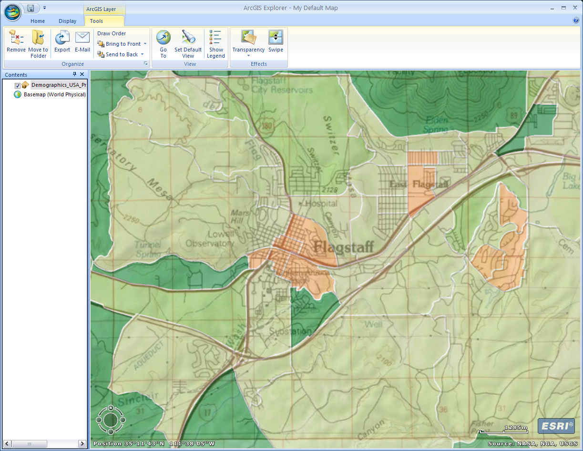
Notes:
For the moment I am going to close my legend but I’ll leave the side bar up. Makes sure you are on the Tools tab click the Transparency button. A vertical slider will pop up. Adjust this to about 50% or somewhere in the middle.
Now Click the Home tab. We want to make our map esthetically pleasing and easy to read so that we communicate clearly what we are presenting. Our current base map doesn’t really work with the colors in the pop change layer so we need to find a different one. Click on the Basemap button and pick one that works for you. As always adjust views and windows as needed.

Slide 12
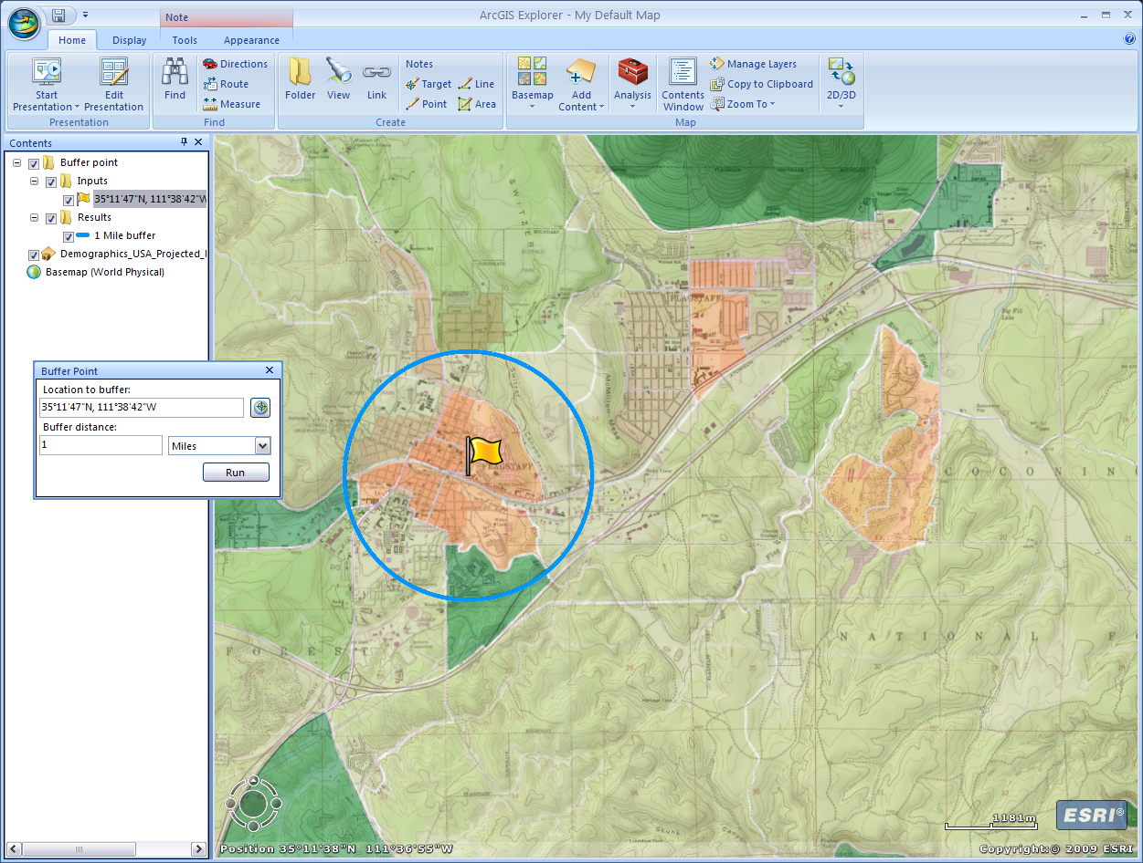
Notes:
Here’s where we get to number 3 in our objectives and talk about rezoning. You are only doing an overview presentation for your department so no need for us to get into high end figures and technicalities with this map. We just going to talk about the possibility of rezoning some areas. We know from the legend that the darker the green areas the greater the increase in population. The redder the area the greater the decrease. We can see on the map that there are three areas, downtown, mid East Flag, and out by Continental that are in the red (well, more orange at this point). To show that there might need to be some rezoning in or near these areas let’s put a mile buffer around each of these three areas.
First I am going to zoom in a bit so there is a little more focus on our three friends. Second while on the Home tab I’m going to click on the Analysis button (the big red lunch/tool box on the right). At the moment it only contains one tool called Buffer point, which is what we want. If you continue to use this program you can add other tools or later versions may start off with more tools. So third click on the Buffer point tool and a window will pop up on the left. For our buffer distance enter 1 and make sure the units are in miles. Fourth click the click the circle crosshairs square button on the top right of the Buffer Point window. Fifth put the cursor over the map and it becomes a set of crosshairs. Estimate the middle of the downtown (left most) orange spot and pull the trigger (press your mouse button). A stickpin will drop right on the spot. Sixth go back to your buffer tool window and hit the “Run” button. This will draw a 1 mile buffer circle around the stickpin. Your stickpin may disappear but you can turn it back on in you contents side bar (Inputs). On the side bar your buffer point will show up as a new layer with a couple of sub-layers. If you select the line with the stickpin icon and coordinates or the line with the colored dash and ‘1 Mile buffer’ then on the top menu bar there will appear a new tab. You can click on the Appearance tab to change the way your icon and buffer looks and right click on the feature name for renaming and the properties..

Slide 13
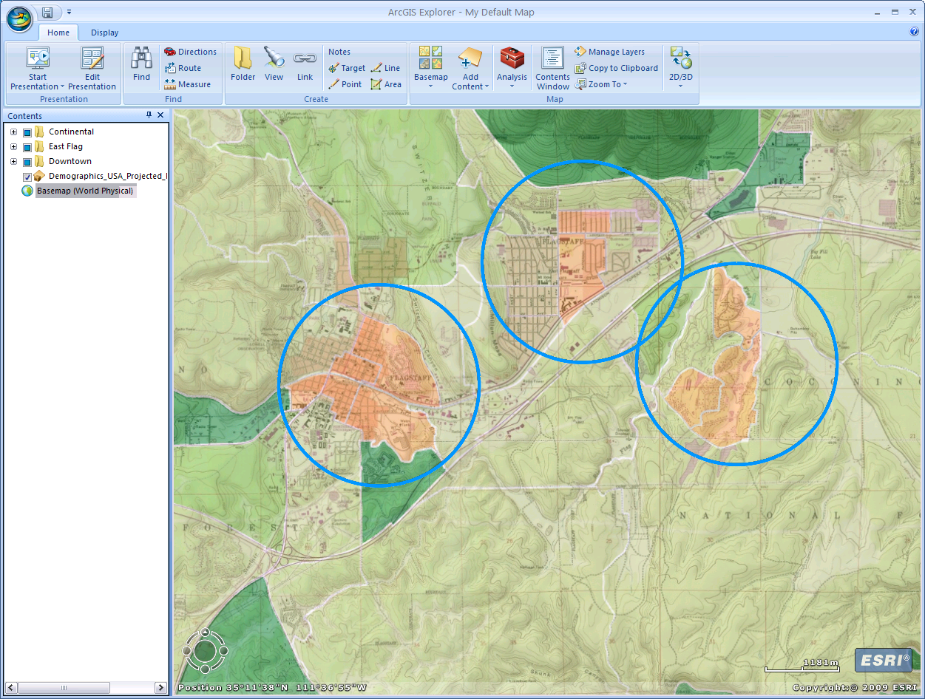
Notes:
We will add 1 mile buffers for the other two orange spots. Go ahead and do this now. Depending on where you pick the center points these two buffers may overlap. Afterward close out the Butter Point tool window as this is no longer needed. At this point I elected to turn off my center points (unchecked on the sidebar) because I felt they weren’t relevant for the presentation. If you want You can rename the buffers by right clicking on the current name and pull up or minimize the sub-layers by clicking on the minus symbol in the square on the left of the name.

Slide 14
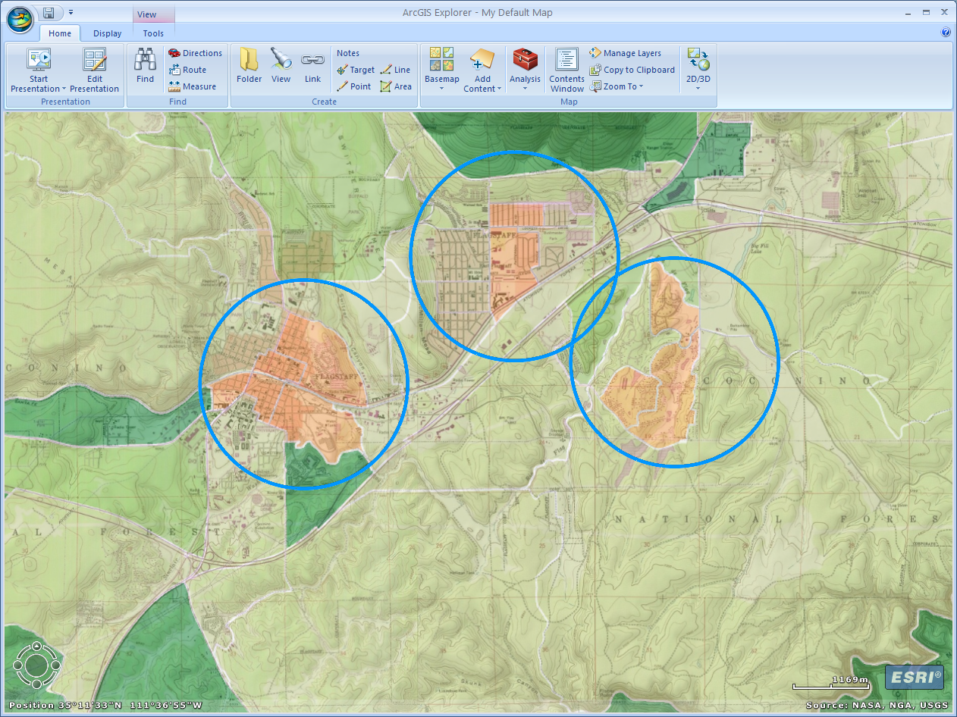
Notes:
Now lets move this map into PowerPoint or your preferred program that will work with graphics, and put on the finishing touches. Keep Explorer open as we have more than one thing to cut and paste from it. Start a new document in PowerPoint and turn off the sidebar on the left (we will only be working with one slide). Go back to Explorer and turn off the sidebar on the left (Contents Window). Our layers are still there we just can’t see their names or select them.
Reshape the entire ArcGIS Explorer window so that it looks like it has the same proportions as a landscape PowerPoint slide. The idea here is that as we move it into PowerPoint we can keep the scale in proportion and save ourselves a few extra brain processes. Click on the “Copy to Clipboard” button on the right side of the menu under the Home tab. Paste it into PowerPoint and resize and move as necessary using the corner handles to keep the image in proportion. We want to have enough room on top for a title and on the bottom for other elements.

Slide 15
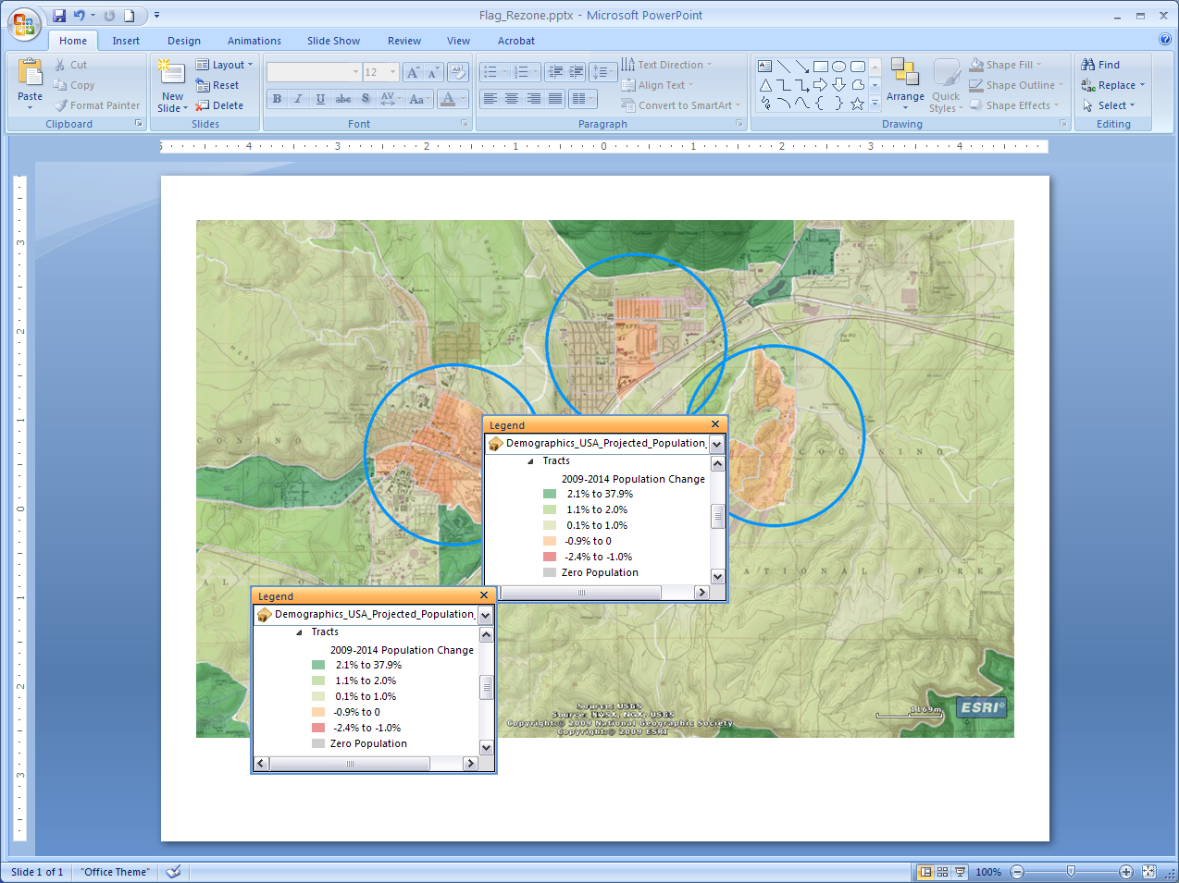
Notes:
The next two steps are not tricky but do require a bit of cutting, moving, and grouping. If viewing this in Power point you might want to look at the next few slides to know were we are headed with this. What we are trying to do here is take the legend from Explorer and put it in PowerPoint in a way that works for our layout. First in Explorer turn back on the sidebar (Contents Window), select our pop change layer, click on the Tools tab, and turn on the legend. Second click on the legend making it the active widow, scroll and reshape so the Tracts colors are the only ones showing, and grab a screen shot of it (alt + print screen). Third paste the legend twice into your PowerPoint map. Fourth crop one legend so that just the orange, red, and gray lines are showing. Fifth crop the other legend so the “2009-2014 Population Change”, darker green, lighter green, and the ‘wants to be green when it grows up’ lines are showing. Look at the red dashed boxes and on the next slide for what I mean. The nice thing about PowerPoint is you can both crop and un-crop with the same tool if you make a mistake.

Slide 16
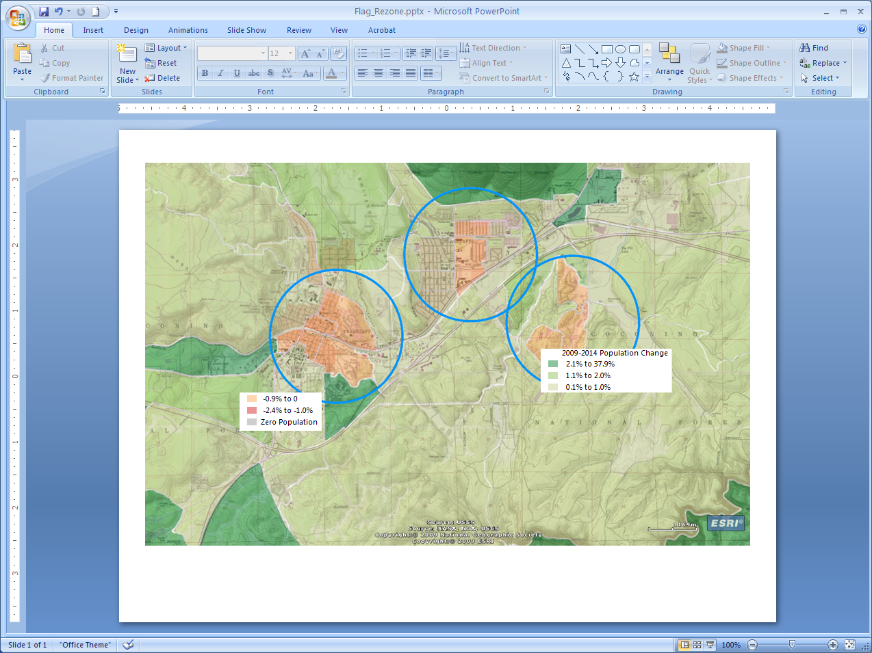
Notes:
If we did our cropping right we will have two pieces of our legend floating around on our screen. We are going to put the two together, add some more, group everything, and move the new and improved legend to where we want. Find an area on your map where you can work and we will get moving.
First put the red piece on top on the green one on the right side. You may need to do some more resizing and cropping. Second make a box and put it behind the two pieces reshaping the box so that there is room above the pieces for the word “Legend” and room on the right to put in something. Third in the space we left on the right side of the legend put the text “1 mile” on top of the line “buffer” and make it the same or similar size as the text in our first two pieces. Fourth under the “1 mile buffer” text put a circle/oval shape and make it a no fill out line with a blue color the same or similar as the three buffers on our image. Fifth add the word “Legend” to the top and make it the appropriate size. Sixth make the box fill white and the outline black. Group everything together. Now you have your legend. Congrats. Lastly I’d add a simple black data frame to the image. We could of done this as soon as we moved the image from Explorer but I was focused on getting the legend done.

Slide 17
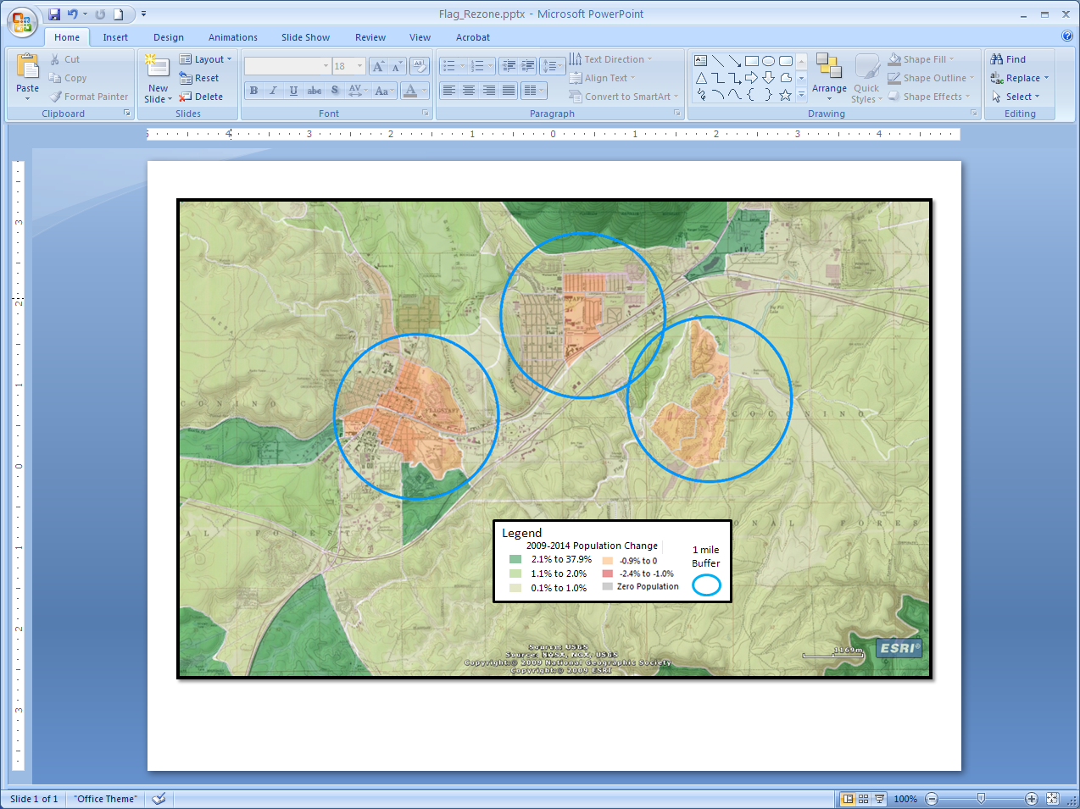
Notes:
Alright we have our legend. Select all the parts of the legend and group them together if you haven’t. I like to have mine in the bottom right corner so I’m going to move it there. Resize and move things as needed but be sure we can still read them. I’m also going to add a black neat line to our whole map.

Slide 18
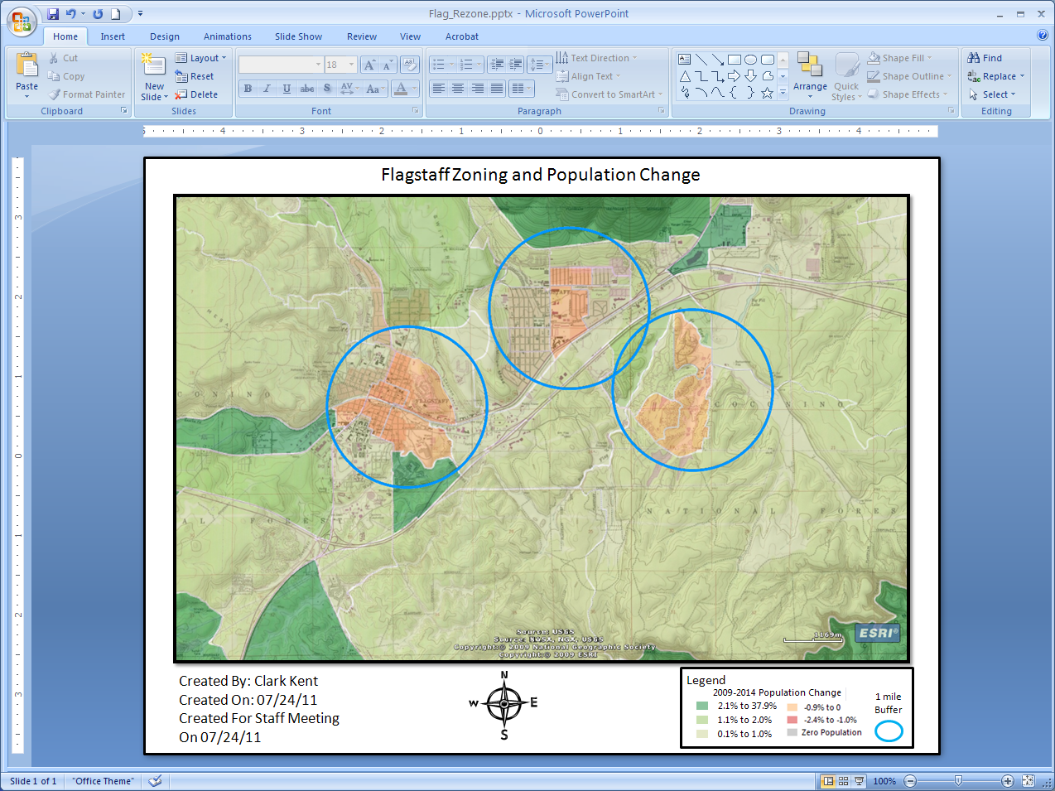
Notes:
Since we are familiar with the other map elements from earlier modules we will take care of those pretty quick in this step. First let’s add some documentation. I’m going to put “Created By”, “Date Created”, and “For Rezoning Staff Meeting” in the bottom left corner. Second I’ll add a compass and put it bottom middle. You can do a star shape or arrow with an N, find one in clipart, or pull a picture off the internet (please respect copyright laws). We can know which way is north by going back to ArcGIS Explorer and hovering our cursor over the navigation tools in the bottom left corner. Third put a title on top. What ever you feel is appropriate.
We can put a scale on it like we did in the last module if we want to, but I’m not going to. We do have a somewhat readable scale bar that came over from Explorer. Also remember in this scenario our audience knows the area well so already in their minds there is a scale. For those same reasons I’m not going to go to the effort to put on a grid.

Slide 19
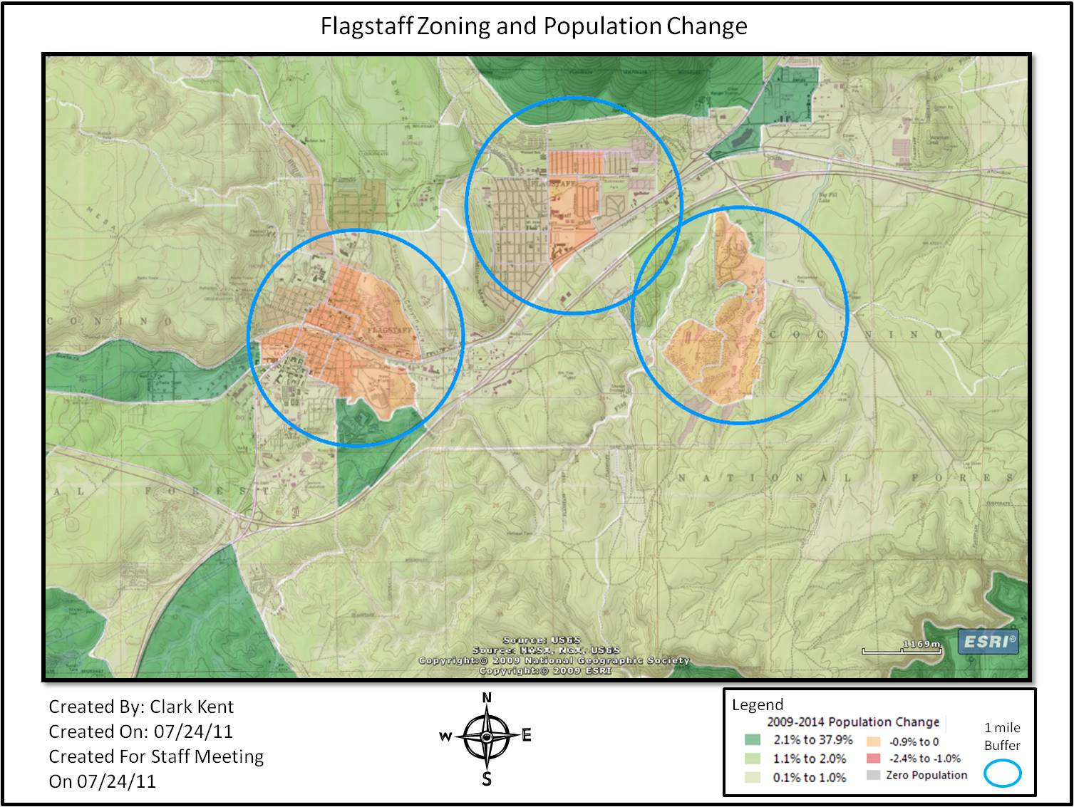
Congratulations! You have an awesome map
Notes:
So now you know how ArcGIS Explorer works. You can whip up a cool map in 15 minutes, still have time to do the write up, and get a cup of hot chocolate before your meeting. Then you can knock the socks of everyone there with your ever awe-inspiring presentation.

