Slide 1
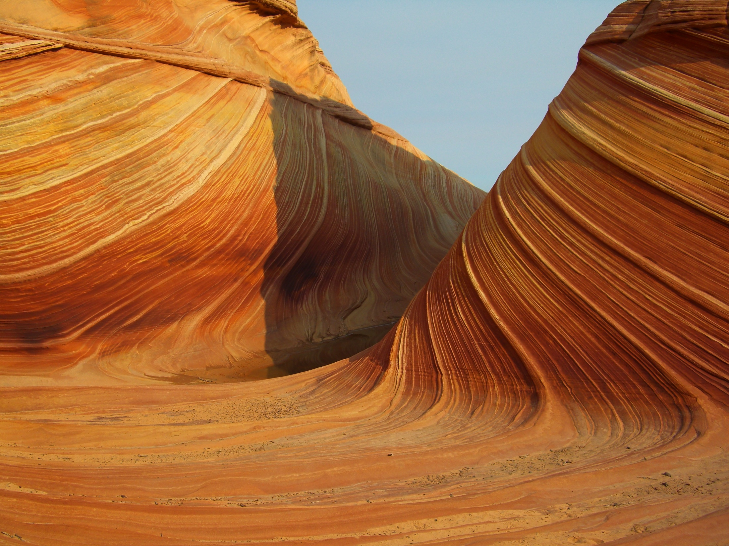
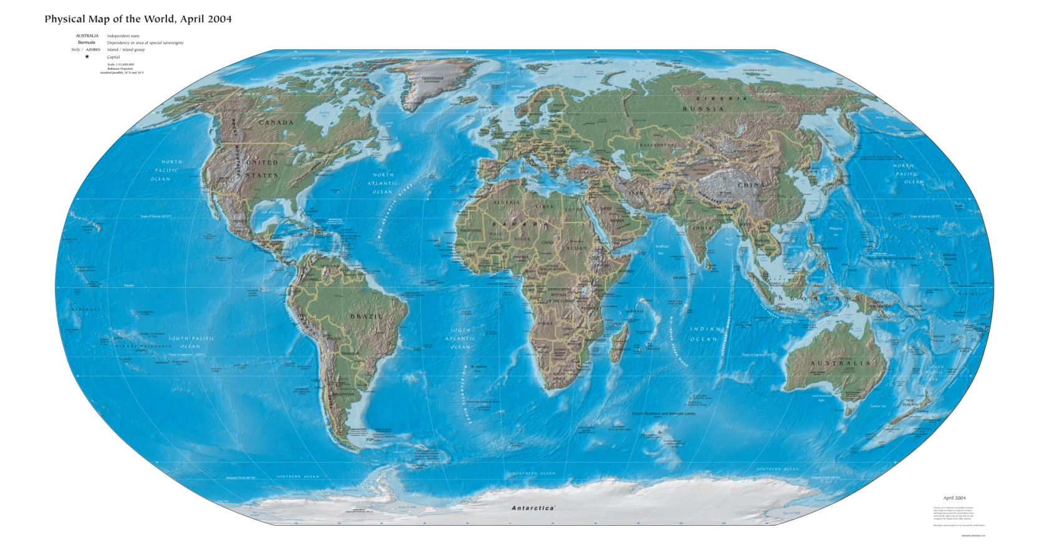

What is GIS?
More Google Earth GIS: Module 3
Created by: Scott Kelly 2010
Notes:
Let’s make another simple fun GIS product. In Module 3 we will use Google Earth again only this time we’ll switch the focus more on product creation than data processing (since we did that in Module 2). The purpose of this is to show you how to do some feature editing and very elementary spatial analysis.

Slide 2
Bull n’ Bean
“Put your business on java”
Notes:
You can make a map for almost anything in almost any situation. There are possibilities from politics to environmental studies but let’s try a business scenario. Imagine that you or your class works for a nation wide small business consulting firm/coffee shop called Bull n’ Bean. Bull n’ Bean is looking for a spot to open up a new shop in Flagstaff, and knowing you are from there (even if you aren’t really), want you to have a report to present to them this afternoon (after mentioning it to you this morning). They’ve done their homework and are familiar with the layout of the town so they don’t need much community info. They just need you to propose three possible locations, near some high traffic intersections, and some routes from near by neighborhoods. You already know how to do a quick write up so lets make a map so they can understand what you are talking about.
{note the bull icon is just Microsoft clipart & Bull n’ Bean is an imaginary business}

Slide 3
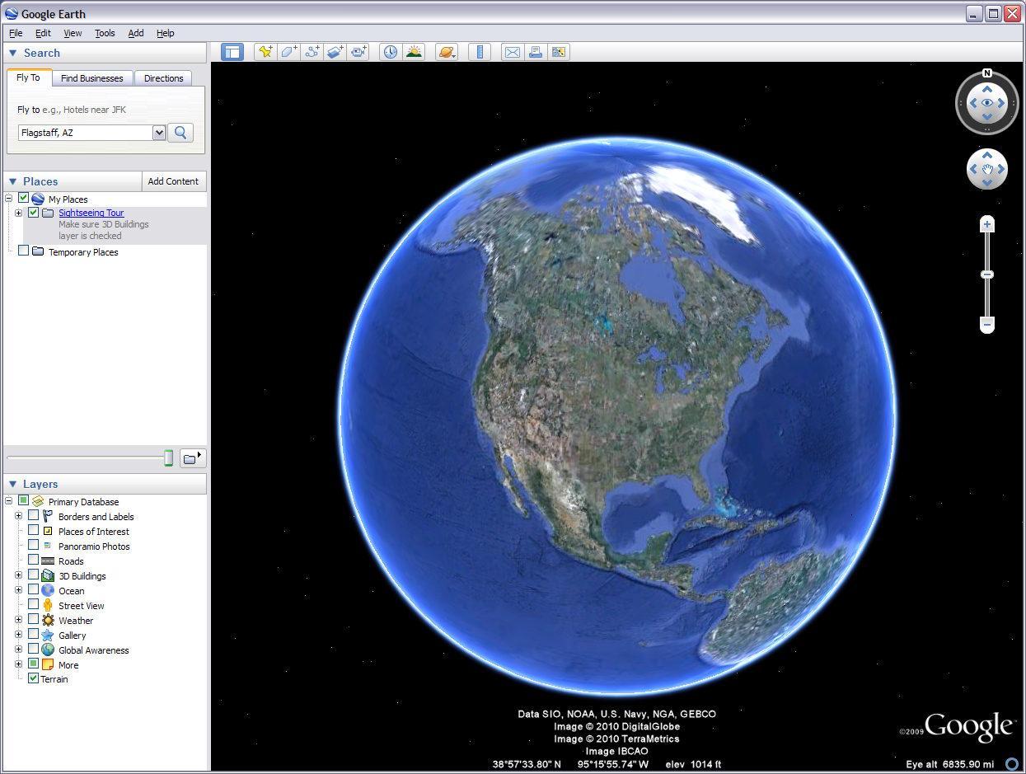
Notes:
To start we need to open Google earth and zoom into Flagstaff, AZ. No particular spot yet but just Flagstaff. If you remember from the last module you can type in Flagstaff, AZ in the Fly To box and it will take you to town.

Slide 4
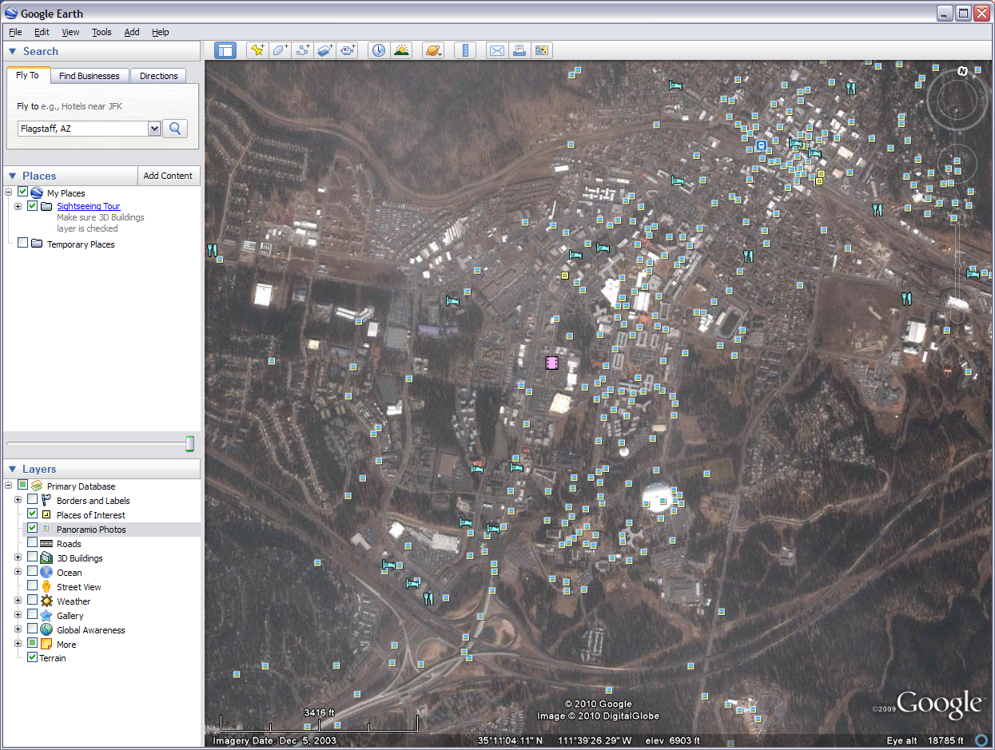
Where you can turn on the scale bar
Turn off some things
Leave this one on
Notes:
As with the last module the viewing area might show a bunch of icons and photo links. Those are fun and useful but for our purposes they are not needed. You can turn them off by unchecking the boxes under “Layers” on the left. Go a head and leave the “Terrain” box checked if it is there. Now go to the menu bar on top of the viewing area and click the blue page like icon on the left. This removes the sidebar which we won’t need for this map. Also you will want to go to the top most menu bar and click View>Scale Legend to turn on the scale bar if it is not already visible in the bottom left of the viewing area. The red and later yellow arrows are for drawing your attention to something and are not to be included in your map.

Slide 5
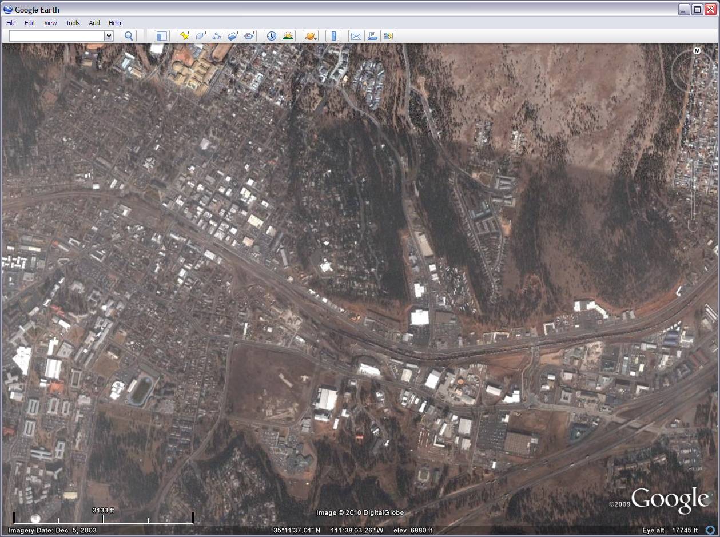
Notes:
Now Bull n’ Bean wants an area with high traffic and easy access from some neighborhoods. Zoom in to the Switzer Canyon and Route 66 intersection at approximately this extent. I’ve temporarily marked the intersection with a red circle so we will all be on the same page.

Slide 6
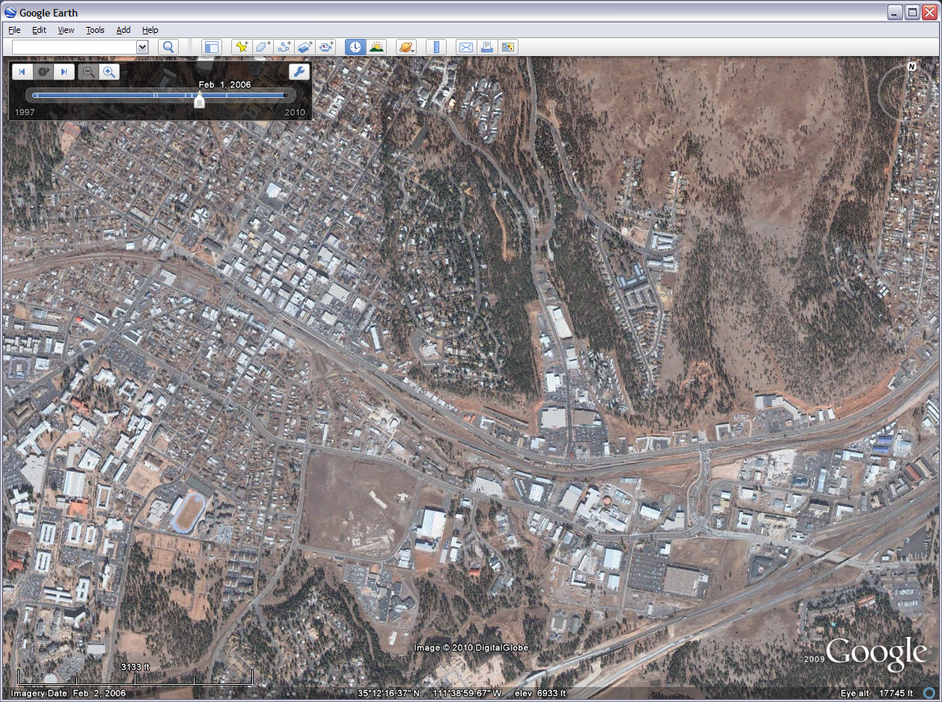
Notes:
Now the current imagery Google Earth has showing isn’t the most appealing. Especially for a professional presentation. Luckily Google Earth has a tool to help us find some other imagery for the area. On about the middle of the viewer’s menu bar is an icon that looks like a clock. Click on this Historical Imagery tool and use the slider that pops up in top left corner.
Set the date back to 2006 data and you will get an image like this which is much more inviting. You do need to be careful when using this tool because the older imagery may not show newer features such as new buildings or parks. In this case there is no change in the features in our images. When you move the mouse away the slider bar is ghosted but the data remains. Don’t worry about it as we will take care of it later.

Slide 7
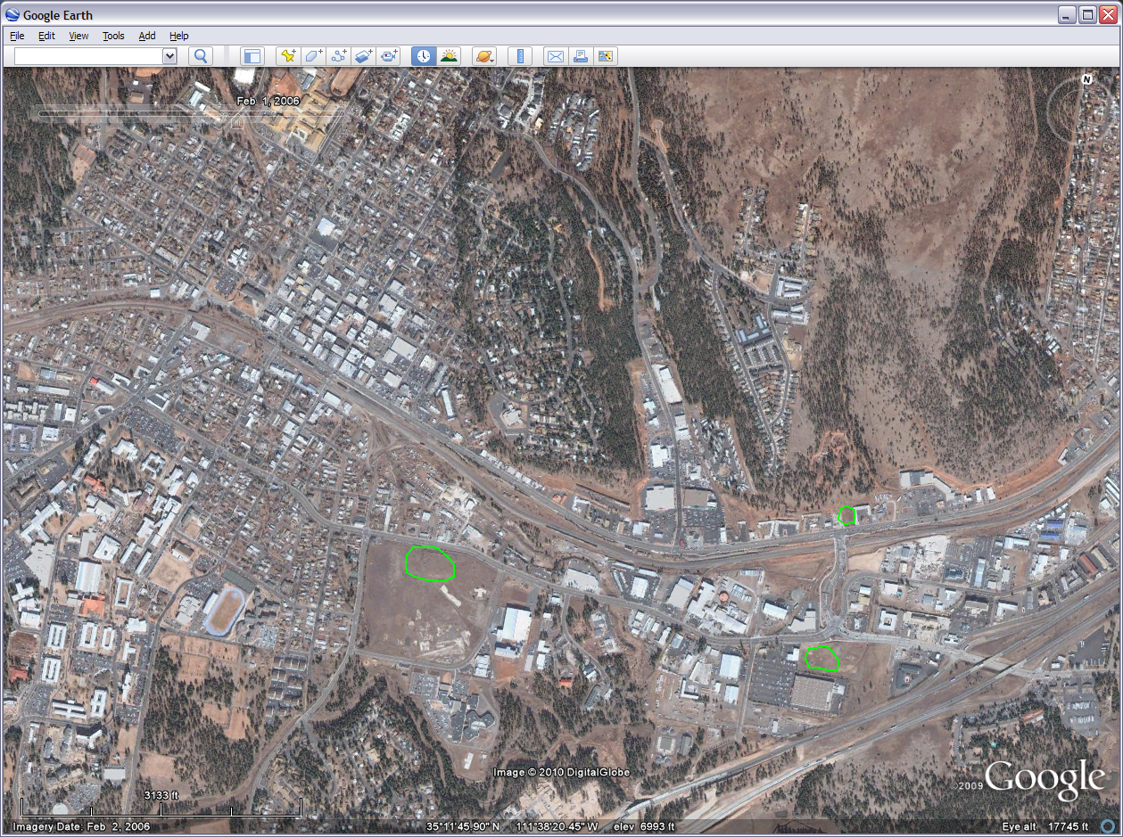
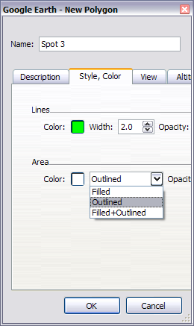
Polygon tool
Jiffy Lube
Aspen Place
Sam’s Club
Notes:
Now we are going to add 3 sites we think might be good to put a Bull n’ Bean. Even though it doesn’t show up in even the most current imagery let’s do a spot at Aspen Place shopping center, the bare spot north of Sam’s Club, and the empty spot (well simi-empty) next Jiffy Lube. If you don’t know where these places are just use the screen shot here or feel free to do your own locations and variations. Click on the “select polygon” icon right of the yellow push pin and the window on the left will pop up. Resize it and move it around as necessary. Click on the “Style, Color” tab, in the drop down under “Area” choose “Outlined”, Make the line width 2.0, Name it what you would like (this is a temporary name), and I decided to do an apple green for the color. No other settings are needed. Now the cursor has become a box with crosshairs. Use this drawing tool to scribble a polygon around an area.
It may take some practice and if you need to edit or delete and start over you can right click on the shape and Choose “Properties” or you can reopen the left sidebar, scroll down the Places window, and right click (don’t double click) to get the properties. If at any point you move from the area you are working with use the zoom in/out tools and the hand to pan back to the work area. Draw some shapes around our three areas. Once you draw the first one Google Earth usually keeps those setting for others you want to draw.

Slide 8
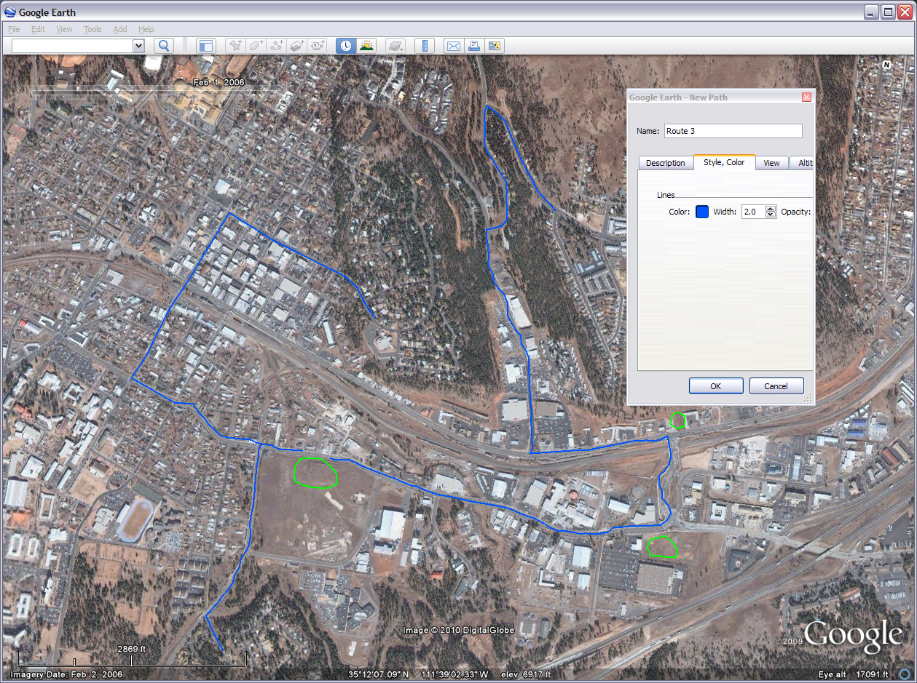
Path tool
Notes:
Bull n’ Bean wants to know some routes residents could take to your pick of the three site. So let’s select the add path tool & and add paths from 1 south & 2 north neighborhoods. If you aren’t familiar with any neighborhood here that’s OK. Just pick what you think might be a neighborhood and run with it. To draw paths click the icon right of the polygon tool and you will get a similar properties pop up window and drawing box. I put my settings for this 2.0 wide with a royal blue color (left side, four to the top.
We need three different routes from three different neighborhoods to you choice site (I picked Aspen Place). Just trace the roads you would take. You can do this by holding down the mouse button and drawing or click to place a point and a line will be drawn. Make it look nice and neat for your presentation but don’t worry about millimeter accuracy as this map is not going into a sensitive GIS. My lines swerve like a drunken sailor and for the neighborhood on Cherry Hill I had to go all they way to Beaver Street because San Francisco Street goes one-way the wrong way. Look at the last slide if you need a reminder on how to edit features.

Slide 9
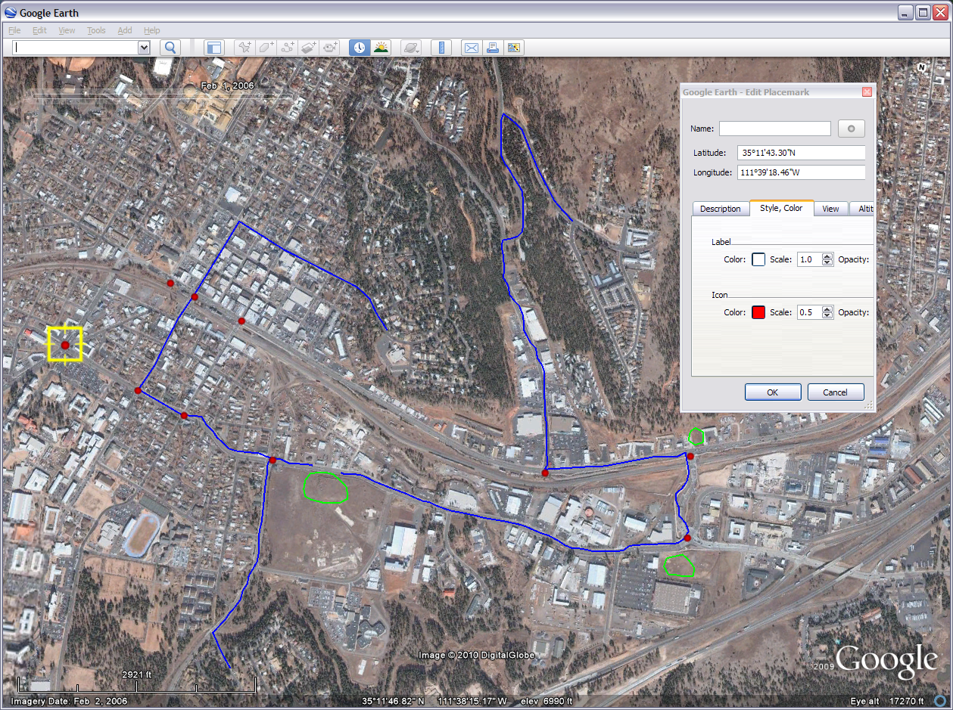
Placemark tool
Notes:
If you’ve come to this step it probably means you where able to get past the first two drawing challenges. Now we need to show Bull n’ Bean that the areas we picked are near some heavy traffic. Let’s do this by putting down some dots at some busy intersections. Click the placemark tool to the left of the polygon tool (the pushpin icon). When the properties window pops up click on the icon button to the right of the name box. Choose the shaded dot next to the knife and fork and press OK. Now clear anything in the name box so we don’t have labels showing up next to each dot. We don’t need to name the dots and we will have several. Next under the Style, Color tab pick the bright red flame color. We will then scale this down to 0.5. Your red dot should be in a flashing yellow box. When you move the hand cursor over the dot it will point the fore finger at the dot. You can now grab the dot and move it to anywhere you want. Add some dots and place them in some relevant busy intersections. Dot the land. Again if you are not familiar with the area just use your imagination.

Slide 10
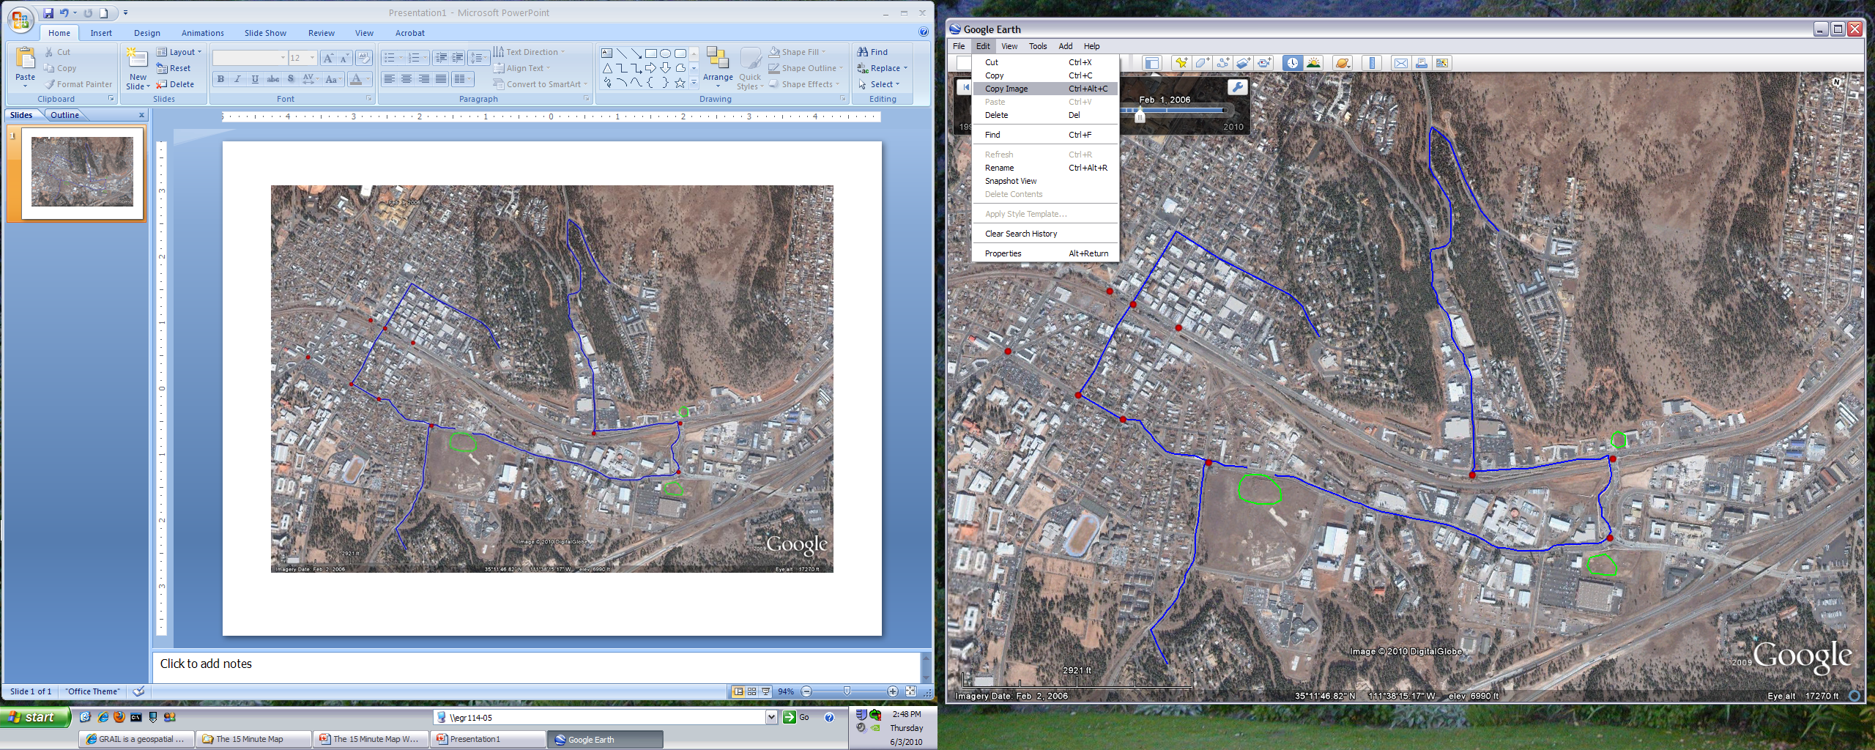
Notes:
The next step is to move the image from Google Earth to PowerPoint. We are going to be working in PowerPoint so if you are viewing this in PowerPoint you will need to be able to switch back and forth between the two PowerPoints. In Google Earth go to edit>copy image on the top menu bar. Then open up PowerPoint and paste in the image onto a blank slide (it is currently on that invisible clipboard). Move it around by the grabbing it with the mouse till you can find a corner. Resizing it with the corner and holding down the shift key keeps it in proportion. Size it down till it fits on the slide with some extra elbow room. You can set up the layout of your image and map in a number of ways but I’m going to show you a way I picked. This your map so you can be creative. Crop the image if/as needed but keep the features you drew in.
We will be doing some more manipulation in the next slide. DON’T close out Google Earth just yet as we might need it to refer back to the original image. You probably wont have dual screens but that is what I am showing here so you can see the transition. If the image does not copy the problem probably lies with the mode Google Earth opened up in. In this case do close Google Earth (the dots and other features will be there when you open it back up) and open it in either DirectX & OpenGL. If one doesn’t work try the other. DirectX usually works best for me. Repeat the process till you get the image into power point.

Slide 11
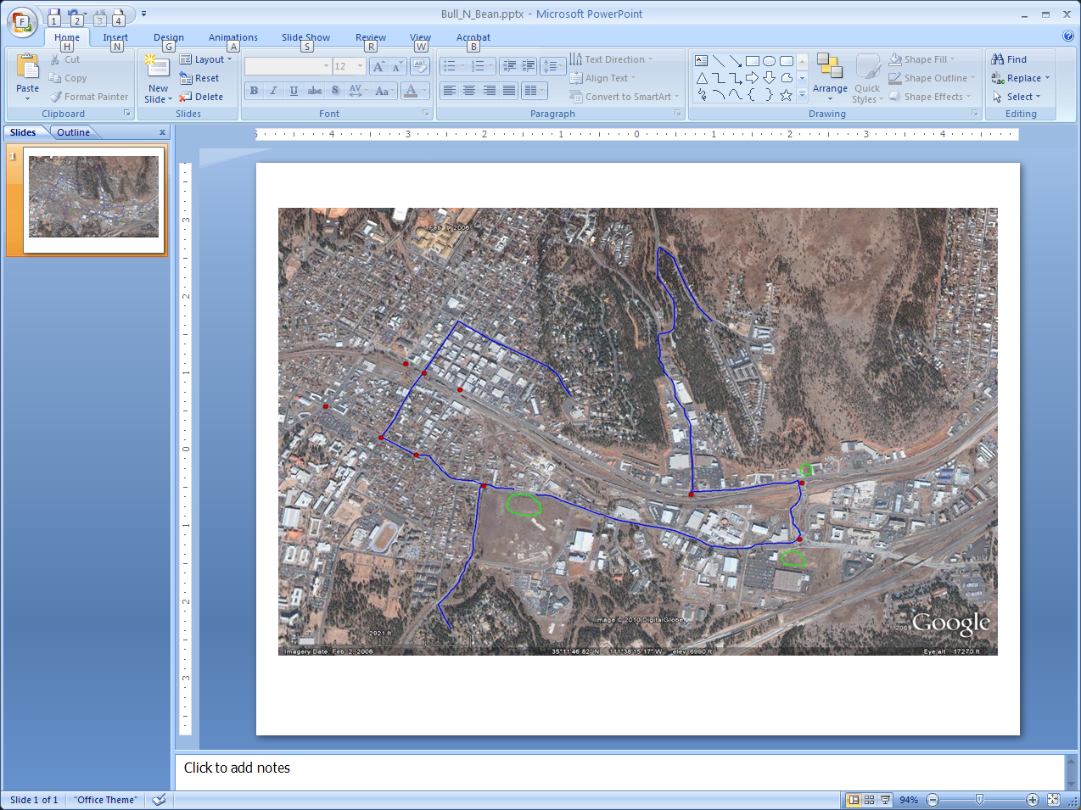
Notes:
Now we have a bit of a sticky wicket. To make this thing we need to take a three dimensional object, the earth, and put it on to a two dimensional surface, our map. Due to the curvature of the earth all maps have some distortion to them. There is all ready some distortion with what we see on Google Earth. To get where we want it we will have to distort it a little more. The good news is that it is still a very usable map and when we copied it over we took that scale bar with us. The scale bar will change in proportion with the rest of the image.
This also a point of imagination and personal preference. We can set the image like it is here, we could set it up with the image occupying the left ¾ of the canvas and put our elements in the white space on the right, or do it in some other way. I’ll show you one way to set this up in a familiar professional format but this is your presentation so use your imagination. So the instructions here are move it to the center and reshape so that we can put some map elements around it.

Slide 12
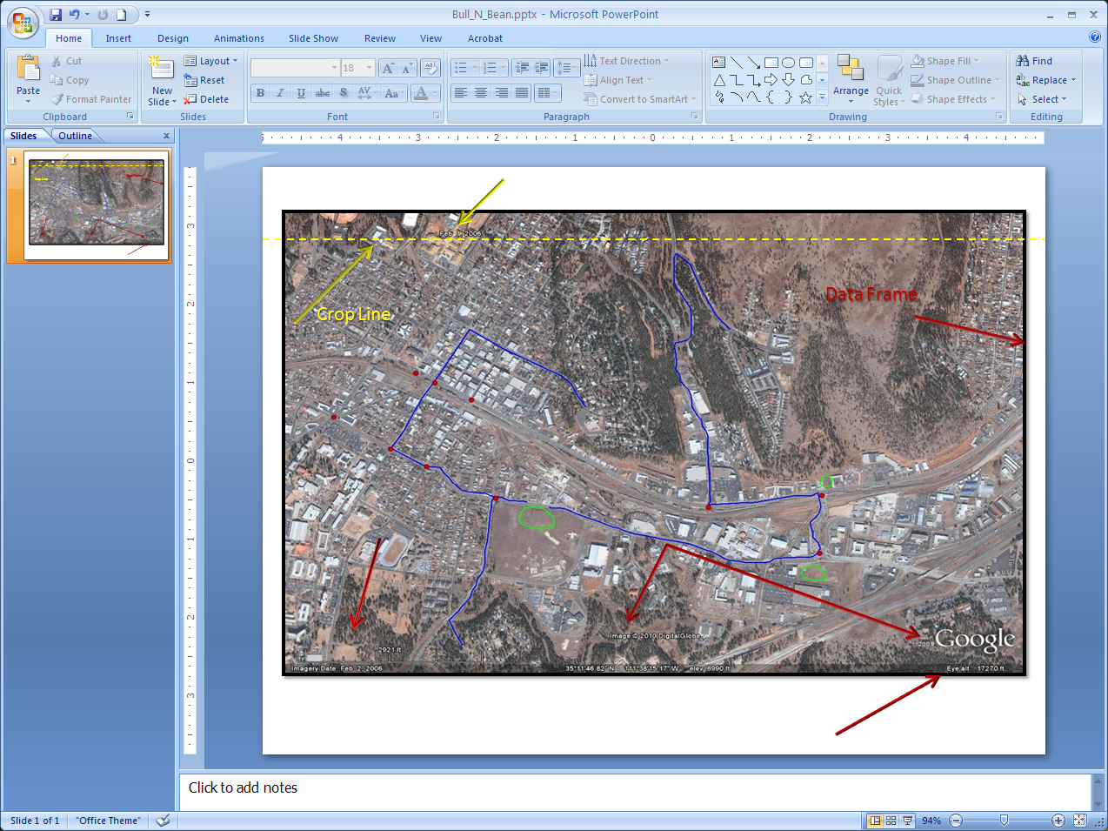
If you didn’t copy the map elements on the bottom for the image or need to crop them off you need to at least note the image source in your documentation
Notes:
First we need to do a little more prep work. Notice how when we copied the image the Image history slider that was ghosted out (or not) didn’t copy over but the date on the bar did (something like Feb 1, 2006). Easy enough fix. There should be enough room to crop the image right below that annoying date at the top but make sure you don’t crop that blue line you need for the presentation (click on the image, from the menu bar Format>Crop).
Now we can put on a data frame by adding a simple black boarder (click on the image, from the menu bar Format>Picture Styles>Simple Frame, Black). Move and resize as needed. Also notice as we are starting to add map elements some copied over from Google Earth. There is the scale bar on the bottom left with the documentation of the imagery date underneath. The bottom center has the copyright info (good for keeping our integrity) and underneath that is our latitude, longitude, and elevation grid. The grid which is the coordinates system, doesn’t always need to be visual net over the image and this one gives an idea of the general coordinates of our the area our map covers. On the bottom right we have the eye level. This uncommon element tells us high up we would be if we were viewing this from a glass bottom airplane. We may duplicate or manipulate some of these in order to make it fit our presentation.

Slide 13
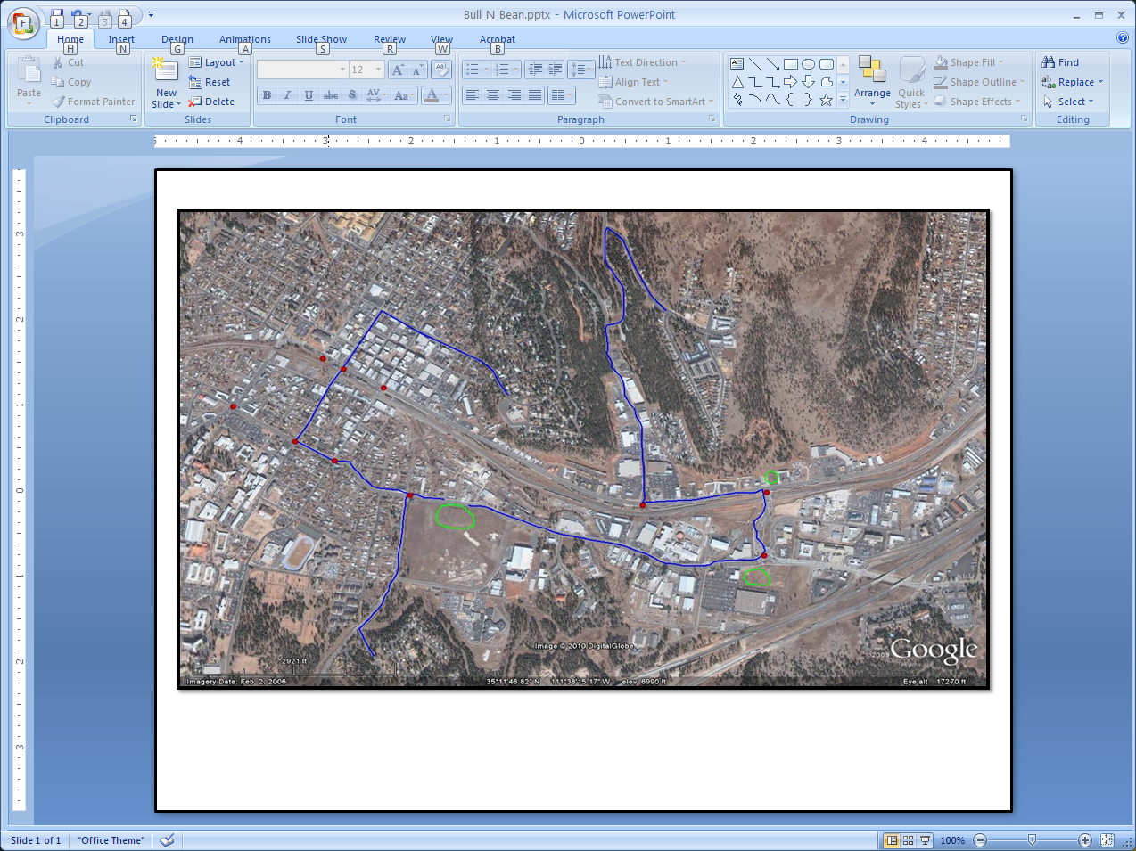
Notes:
Next add the neatline or the boarder for the whole product. Basically a thin black line around the edge of your canvas. A simple step but important for the same reason you would frame a picture. For this I just selected the rectangle shape tool (Home tab> the shapes in the drawing menu) and drew a rectangle over the whole thing. I right clicked, sent it to back, right clicked again, picked Format Shape, selected no fill, and made the outline a basic midnight black. Remember this is YOUR presentation so use your imagination. If you want the fill to be purple with pink polka dots then go for it! I also turned off the slide bar on the left because I’m only working with one slide and the bar gets in the way.

Slide 14
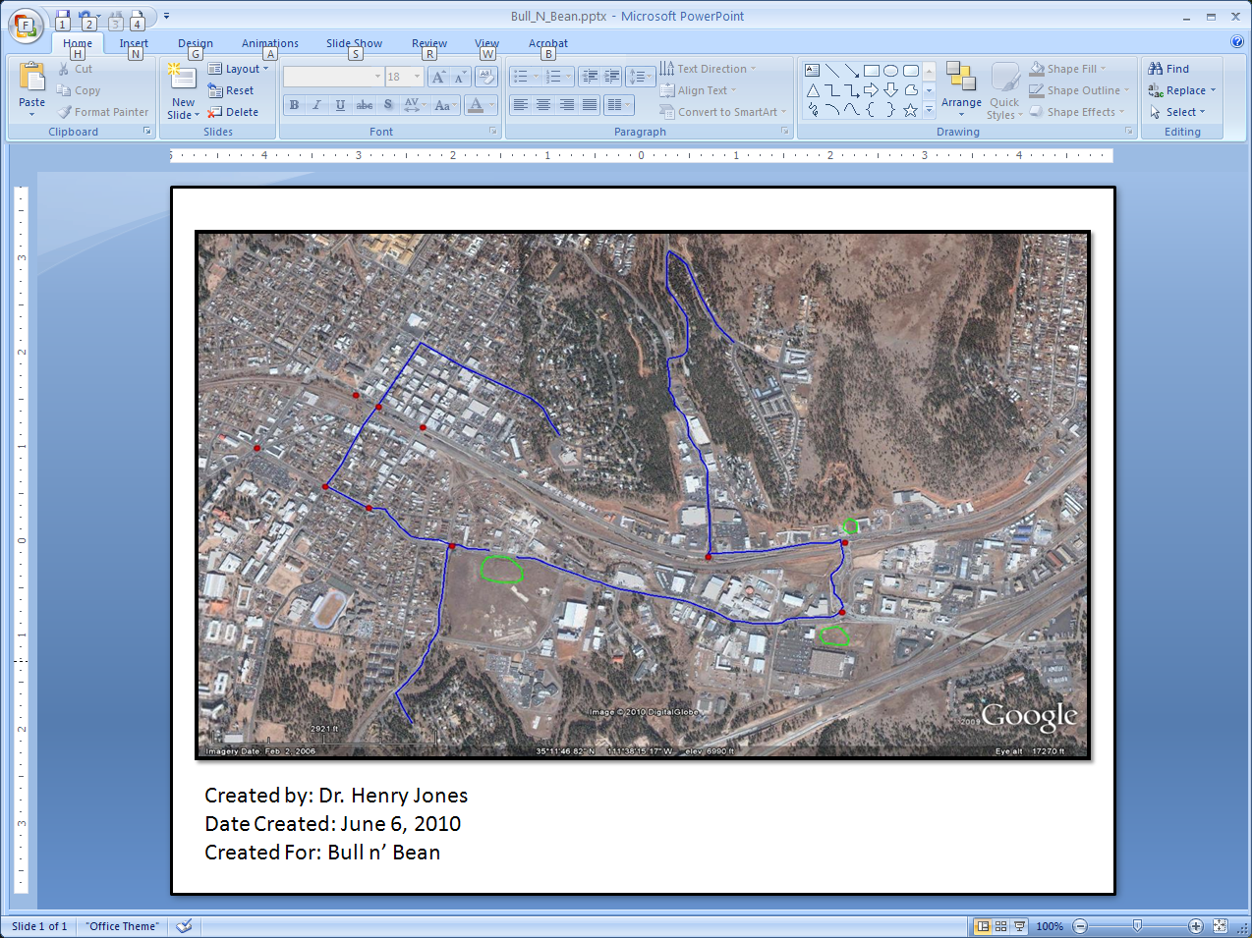
Notes:
Now lets do some documentation. I’m going to put some on the bottom left of our map. I’ll put who created it, the date of creation, and who the map was created for. Add what documentation you would like and feel is relevant. Probably a good idea to keep it professional.

Slide 15
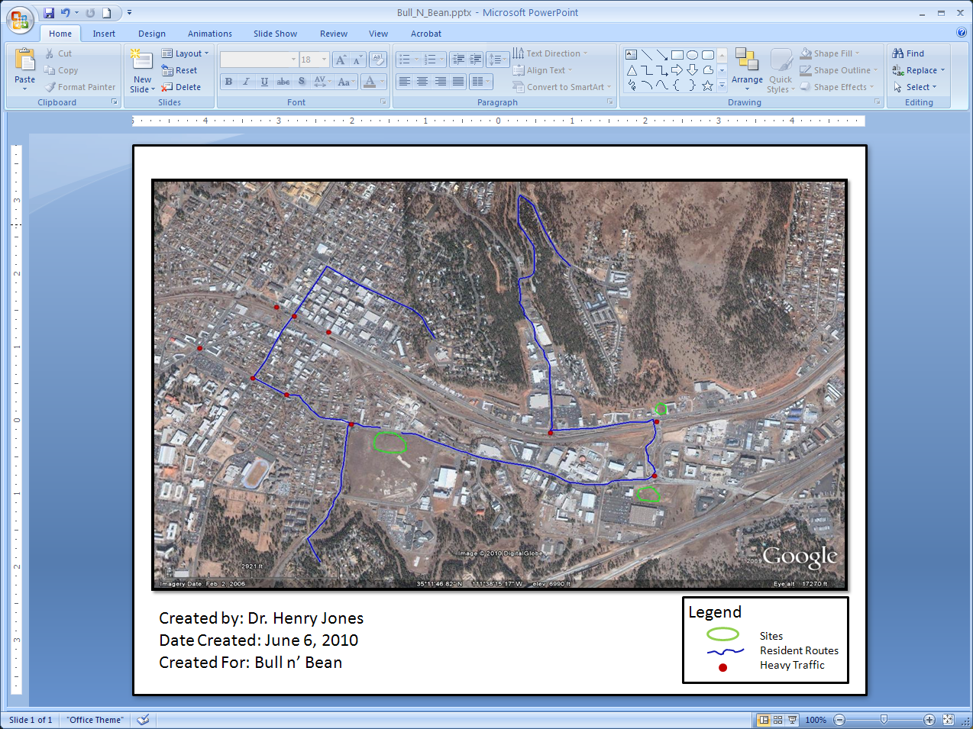
Notes:
At this point I am going to put in a legend. We need to let those reading the map know what those lines, shapes, and dots are. You can create this in several ways but here is how I’m going to do it. It may take some time but isn’t complicated, especially if you are used to creating things in PowerPoint. First I’m going to make an empty box in the same way I made the neatline and put it in the bottom right corner. Everything goes inside this box and I’ll be resizing it as I go along to fit the contents. Next I’ll have the word “Legend” as it’s own text in the upper left corner of the box. As a separate text block I’m going to type the names “Sites”, “Resident Routes”, and “Heavy Traffic” on three lines. Simple descriptive names are best. Adjust font sizes as needed. I’m doing 18 & 12. I’ll put these names on the right side. On the left side off the box I’ll draw an apple green circle over a royal blue line over a fire red dot. You may not be able to get every thing to match what you have on the image but get it as close as you can. Now take the box and stuff in it and move it around so everything looks organized. When you are ready select the box and contents and group them together (under Format menu). Place the legend where you thing it might go best. Keep in mind we still have a north arrow and other things to add so make room and keep things balanced.

Slide 16
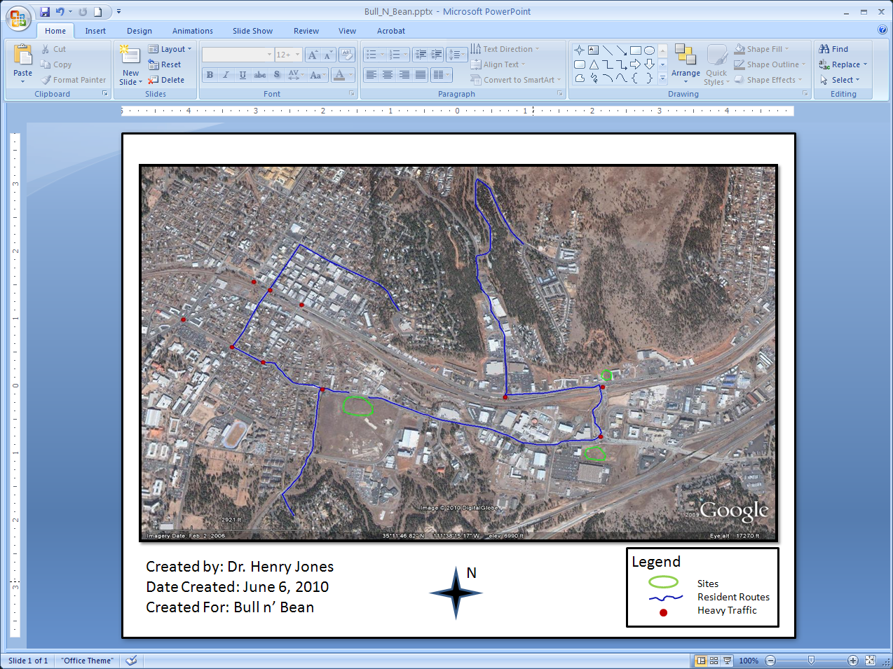
Notes:
Alright, our map is definitely taking shape. Just a few more steps. Remember I told you to keep Google Earth open? Go back to Google Earth and see which end of the map is north. There is a compass in the top right corner. If you copied the same image I did then you can see the top of our image is north. This is not always the case but it is for our image and map.
Back to PowerPoint. You can add just a north arrow if you would like but I’m going to add a compass rose. I feel it’s more astatically pleasing than just a plain arrow with a capital N beside it and I like to add enjoyable elements to my work. Imagination is a good thing. Not wanting to got too fancy I’ll pull down the menu for the shapes and pick a simple star. I’ll put that on the map and add a capitol N to the top right corner. I’ll group the star and the N together and wah-la! We have a compass rose. Move it where it fits best. I also added some color to mine.

Slide 17
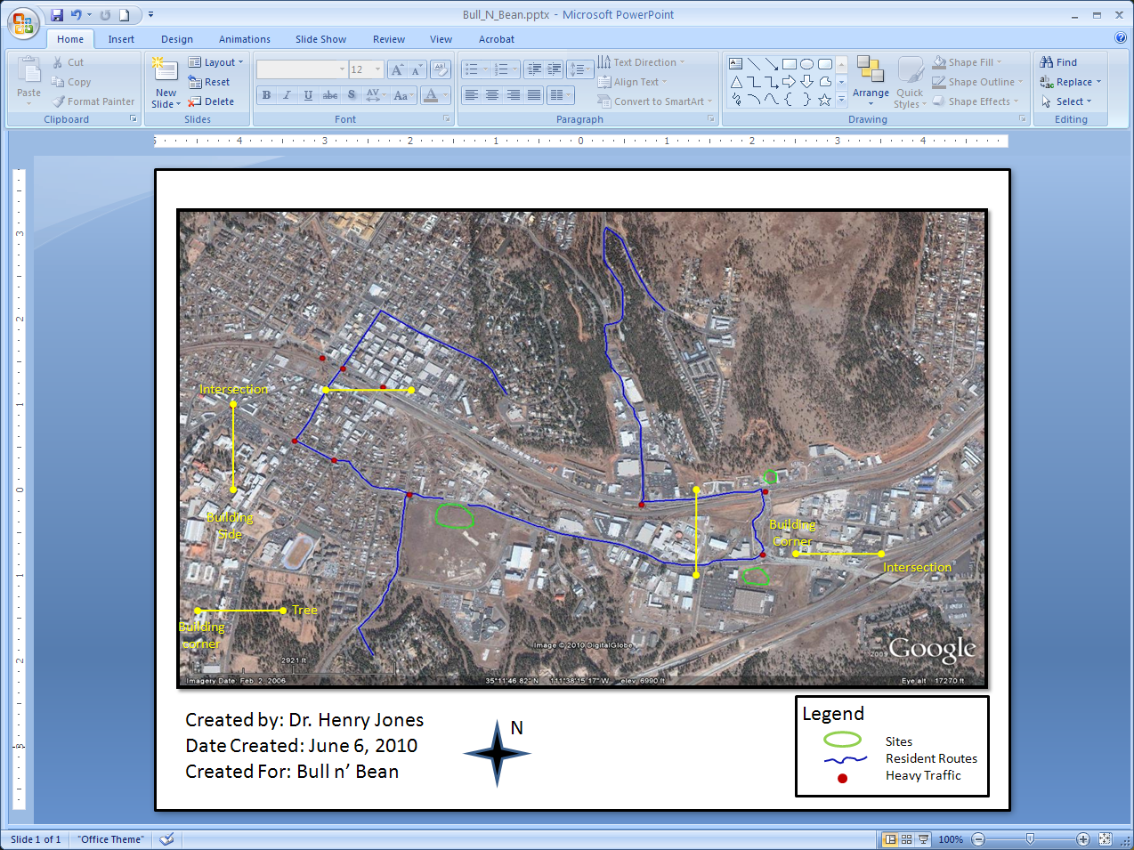
Notes:
If you didn’t crop it off then we already have a scale bar on our image so we’re legitimate, but it is difficult to read. That makes this step optional so you can skip to the next step if you want (2 slides). In this step we are going to create an addition scale bar that hopefully is a bit more clear. To create this scale bar we are going to do some simple calculations. Don’t worry I’ll talk you through it. It is important to know and mark on the map that this going to be an approximate scale because of the programs & processes we are using aren’t exactly high end GIS and the image has been stretched so it is not proportional as it was on Google Earth; but that’s OK because we aren’t going for sub-meter accuracy in this map. The thing to keep in mind is that your extent/view determines your scale. If we were viewing this location from five miles up we would have a different scale than if we were viewing it from one mile.
First look at the image on the map we are making and find a straight line an inch long. It could be an intersection to tree, building corner to intersection, point A to point B, or something else. The more precise the better. Be careful if you decided to zoom in as the zoom can distort what is 1 inch and what is a half inch in our map. Be aware that the area around Switzer Canyon has quite a bit of elevation and that can mess up our lateral scale bar; so stay away from slopes and ridges. The rulers in PowerPoint can help if the line is perfectly horizontal or vertical. The red dots you already made can help too. Don’t put a measuring tape or ruler up to the screen as this can really mess things up. I found a few lines and marked them in yellow. You don’t need to draw this line but you can for reference. Just be sure you delete it after we have created the scale bar. Once you’ve pick out one or more inch long strait lines lets move to the second half of this step.

Slide 18

Notes:
Now that you have your line of attack switch to your image in Google Earth. Make sure you are at the same eye level/extent as your PowerPoint image. Find that same line on Google Earth. On the Google Earth image menu bar there is an icon/tool that looks like a ruler between an envelope and a planet. Click on this and a window will pop up in the top left corner. In that ruler window keep it on the line tab and use the drop down menu to select the units you want to represent. As we are dealing with relatively short distances I’m going to choose yards. You will have the same crosshair box you used to draw the other shapes. To use this measurement tool pick one end and single click. Now without anymore clicking take the box to the other end of the line (a measuring tape will follow). Back in the ruler window the length will show up. Write down this number!!!. Your image may be at a different extent than mine so you may get a different number. Make it simple and round off the decimal.
Since this is an approximate scale and our measures are not 100% accurate, you can measure multiple lines and take the average for more precision (you can use the calculator on your computer; the total of the lengths divided by the number of lines). I got an average of 438 yards for my five lines. Now switch back to PowerPoint. We now know that that 1 inch on our image is actually 438 yards (or whatever number you wrote down). In PowerPoint make some text that says “1 inch = (your number & units) in an area you can read it. This is your verbal scale. I’m moving my compass to the side and placing the scale next to it.
We are now going to make the scale bar. Unfortunately PowerPoint doesn’t have a good shape for a scale bar so we will just draw a simple horizontal line 2 inches long (you can use PowerPoint’s rulers to measure). In the middle of the line add a short vertical line for a tick mark. On the left side of the line put 0, under the center tick mark (should be 1 inch from the start) put your number, and at the end of the line (2 inches) put double your number. Now line up the verbal scale with the scale bar and on top or below it add the text “approximate scale”. Move things around and adjust fonts as necessary. Group all these together and you have your scale.

Slide 19
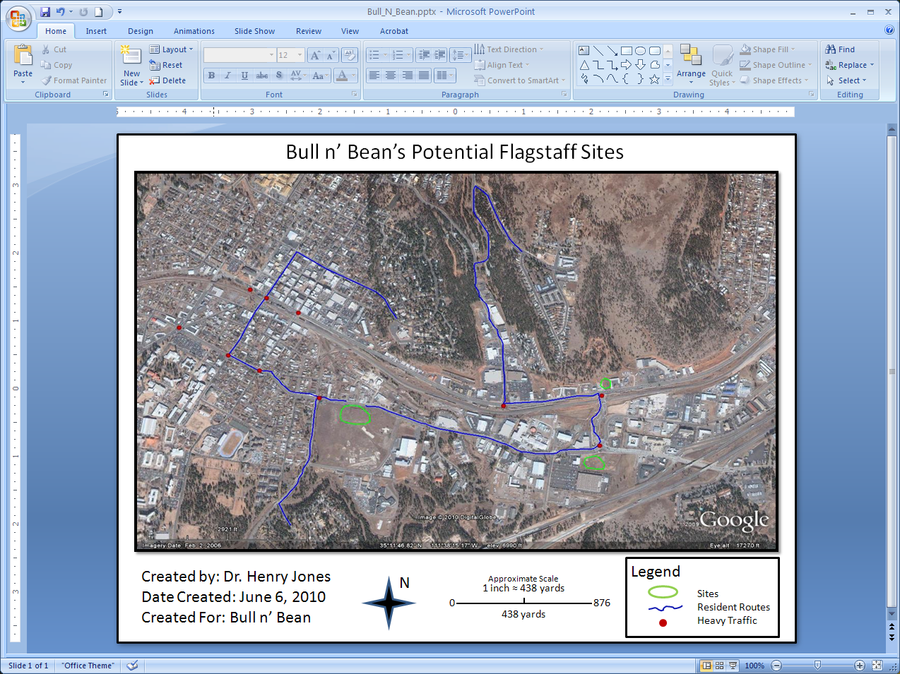
Notes:
Now we arrive at the final element (drum roll please). The map title. This should be professional and say what the map is about, what area it covers, and what you want the reader to know. Simple but effective. For my title I put “Bull n’ Bean’s Potential Flagstaff Sites” keeping in mind our client and mission objective. I also had to move all the elements down one to fit in the title the way I wanted it. For those of you who skipped the scale bar step your map may look a little different.

Slide 20
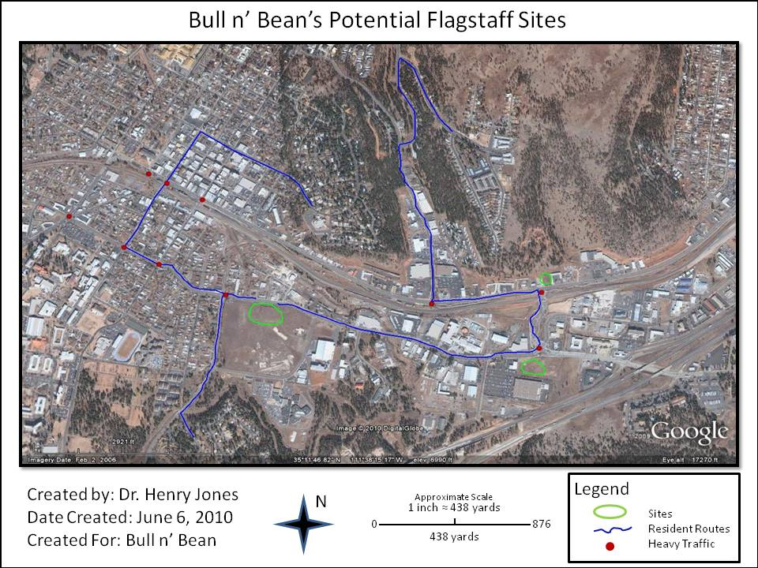
Congratulations!
You now know how to create a easy professional map
You can now:
Put it in a report
Use it in a planning meeting
Take clients on a site visit
Use it as a teaching tool
Frame and put it on your wall
And much more
Notes:
Any questions?

