Slide 1
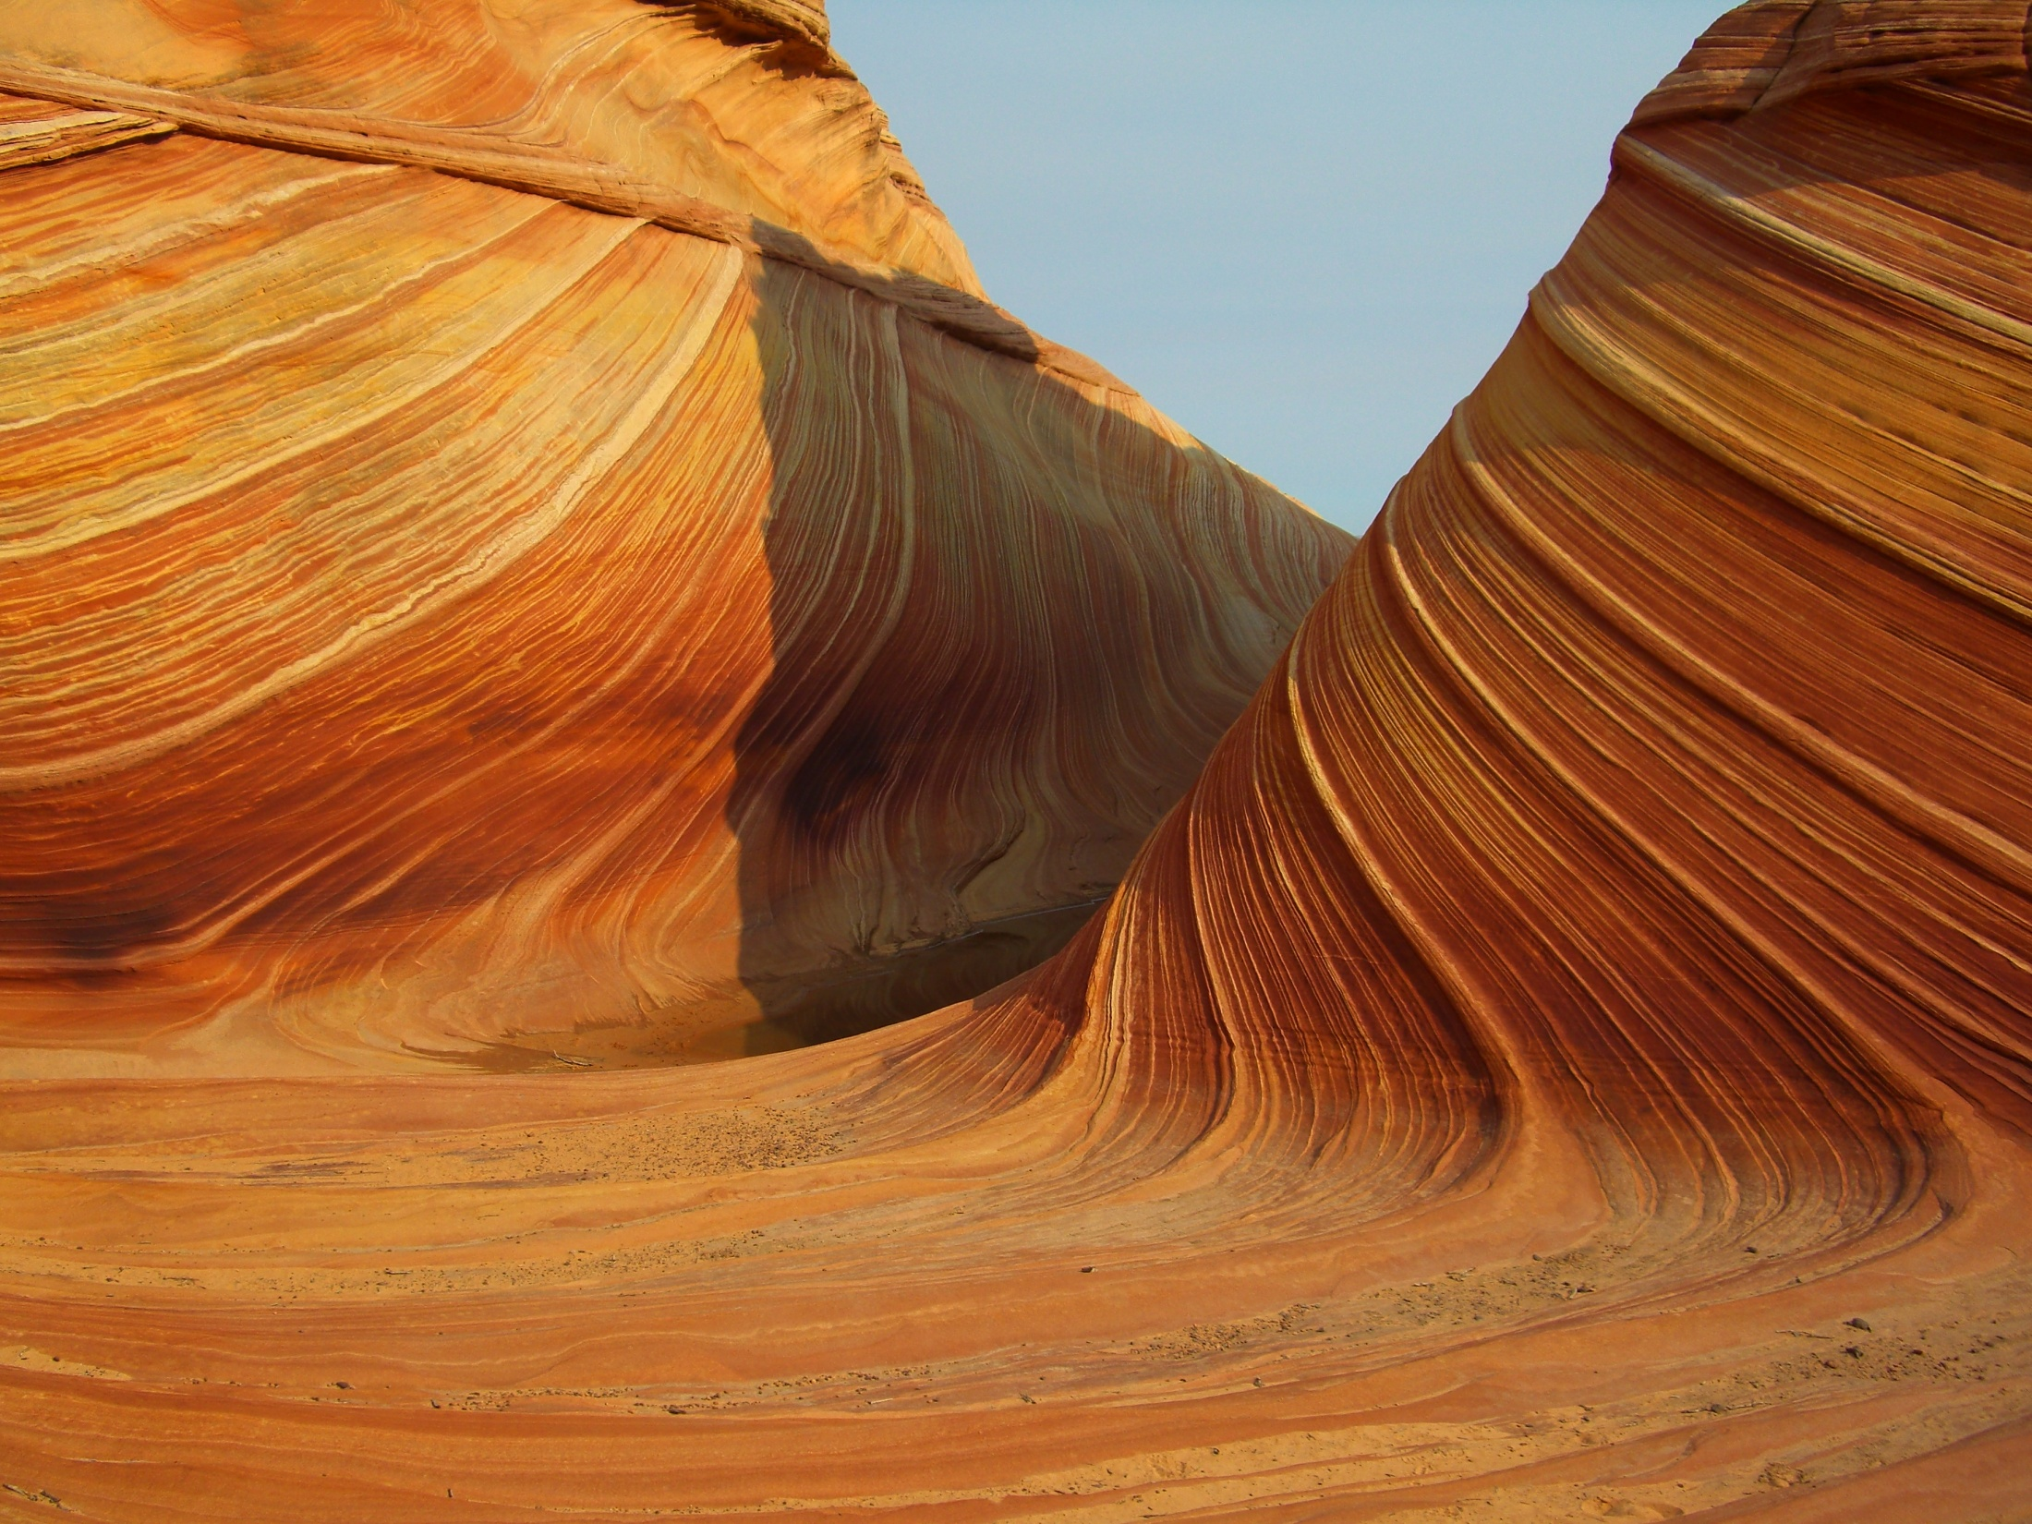
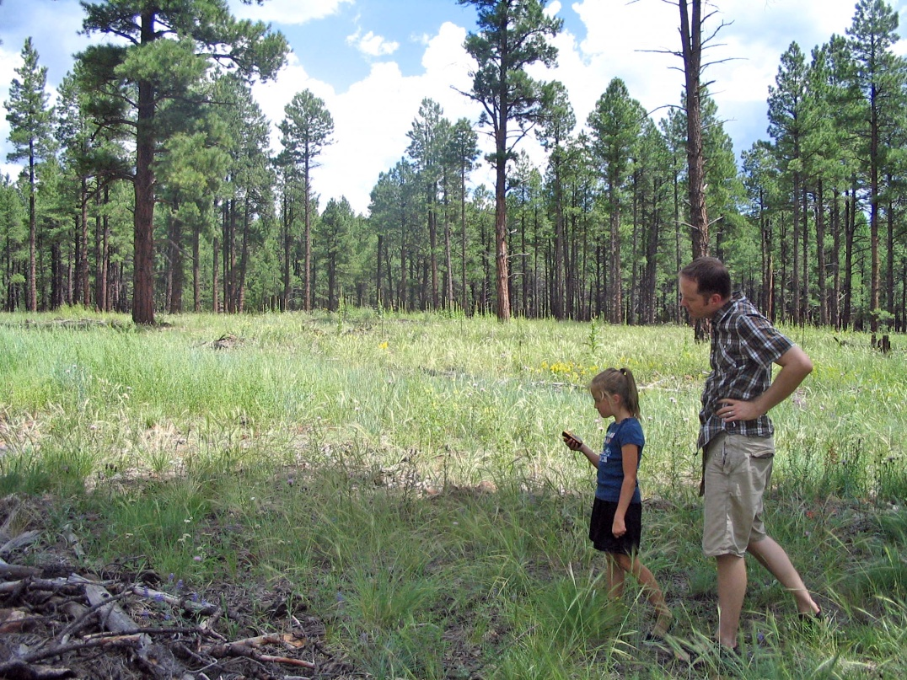

What is GIS?
Simple/Fun/Easy: Module 2
Created by: Scott Kelly 2010
Notes:
In our second module we will show how easy, simple, and fun GIS can actually be. It is so easy a… well you get the idea. All we need to start this project is a computer with Microsoft Excel and an internet connection. We will be downloading a few programs so make sure you hard drive has space. Yes some GIS projects are quite complex however you can make some professional GIS creations with only a basic set of computer skills. This is even easier if you have an imagination and sense of adventure. If you don’t have those talk to a 6 or 7 year old.

Slide 2
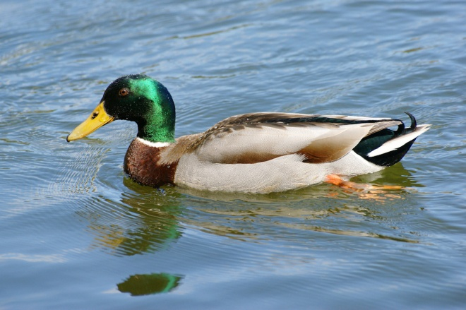
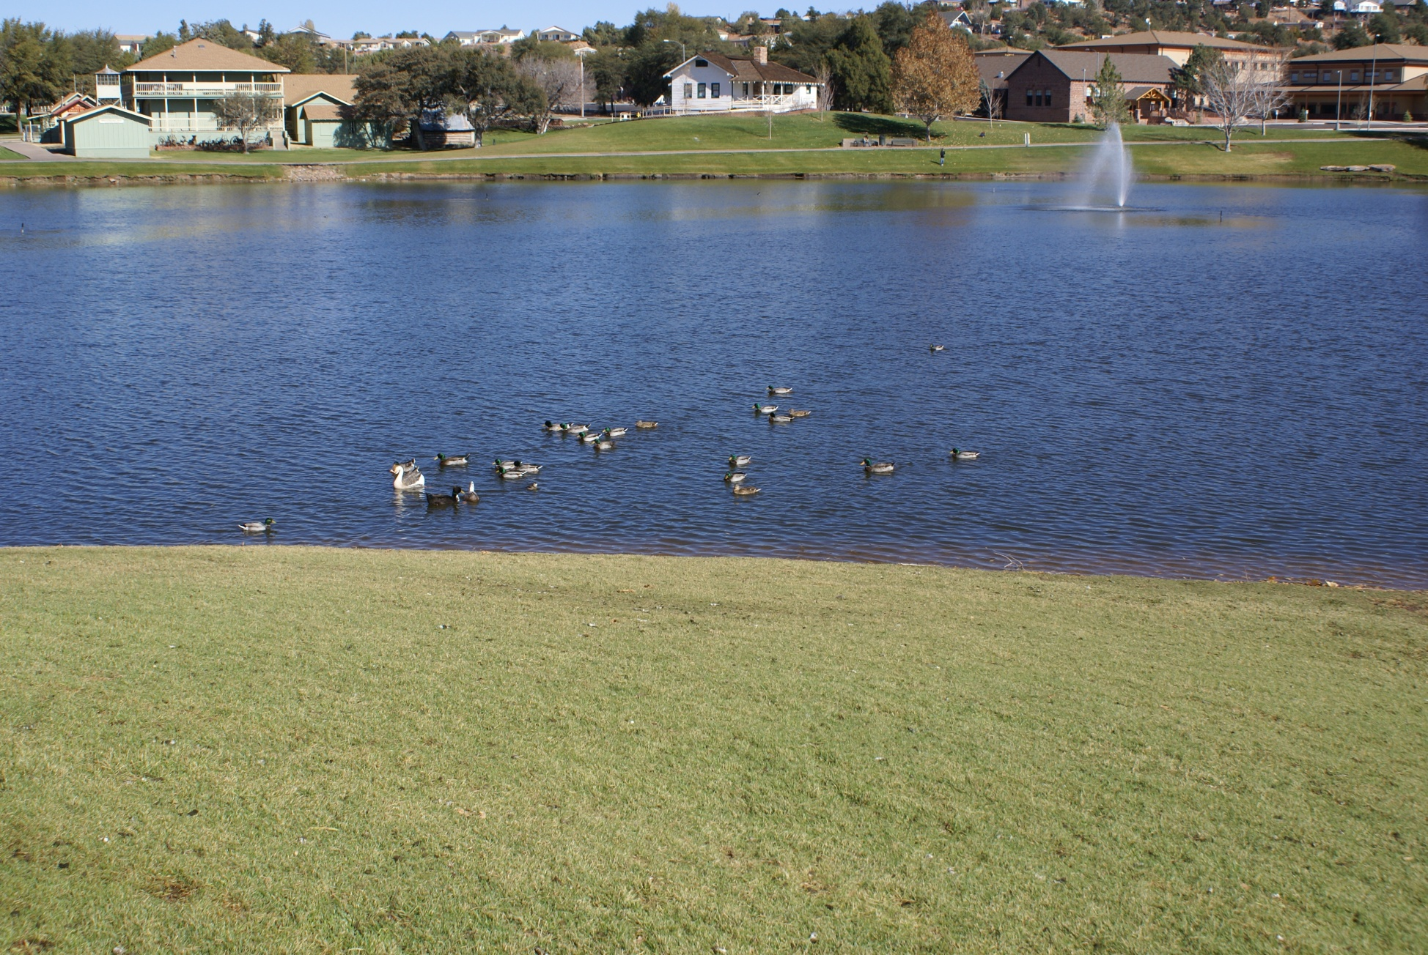

The Payson
Ducks!
Notes:
One of the best ways to show GIS is in application. Let’s imagine you are teaching a class (or conducting a study at work) about the duck population at Green Valley Park lake in Payson (simple but a good basic example). You have your students (or coworkers) record data once a week for three weeks. You run the data through some simple spatial software and put it on Google Earth. From there you can put it into a report or other presentation. I’ll show you two ways to do this.
You may already be familiar with it, but let’s take a screen or two and look at Google Earth. If it is not already on your computer, do an internet search for it and download it to your computer. This should be a pretty straight forward process. Just click Run, Next, and let it go. Remember to uncheck anything you don’t want downloaded with it. When it opens it will have a Tips window that you can go through or just close.

Slide 3
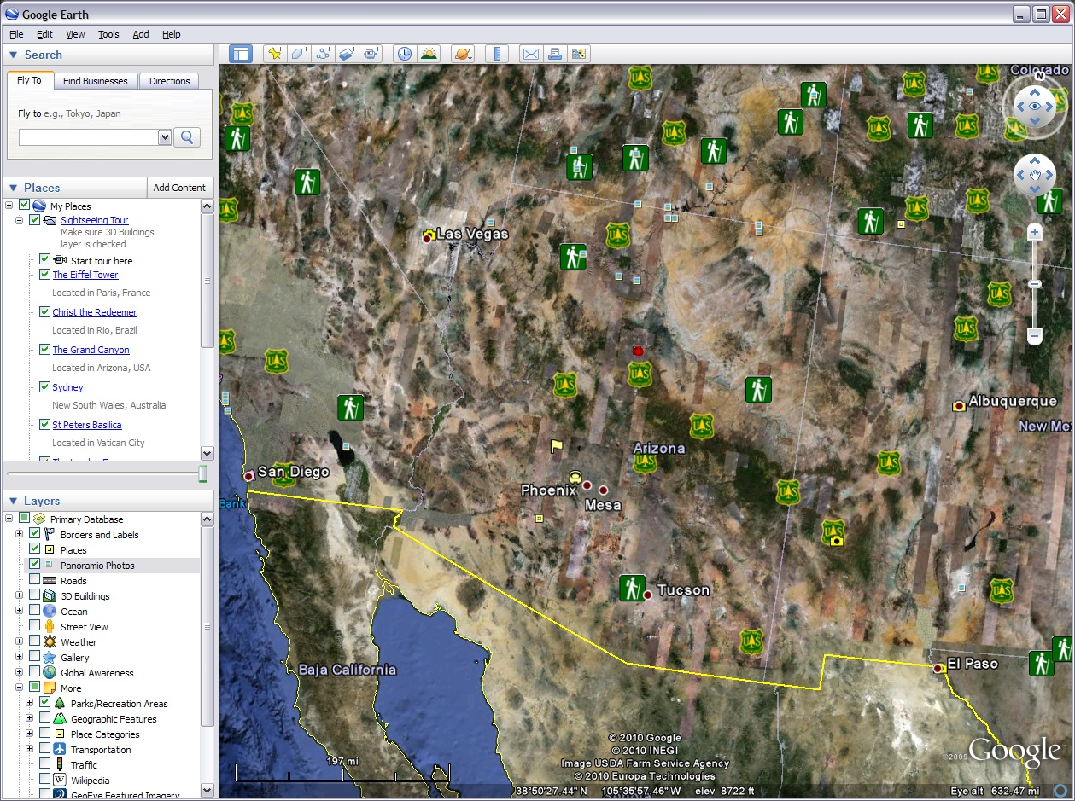
Drafting Tools
View Tools
Additional Tools
Spatial Orientation
Menus
Map Search
Pan
Zoom
Places (from Search)
Or
Layers Uploaded
Google Data
Layers
Imagery Source
Coordinates & Elevation
Altitude
Notes:
If you are new to Google Earth you can zoom in on the image/map with your mouse wheel, use the +/- slider on the right, or the “Fly To” search box in the upper left corner. You can use the hand icon to grab what’s on the screen and pan or move around. You can turn off and on layers by checking and un-checking boxes and use the +/- boxes to expand and collapse.
In the “Fly To” text box type in Payson, AZ and hit the magnifying glass next to it. Green Valley park is in the southwest part of town right before the golf course.

Slide 4
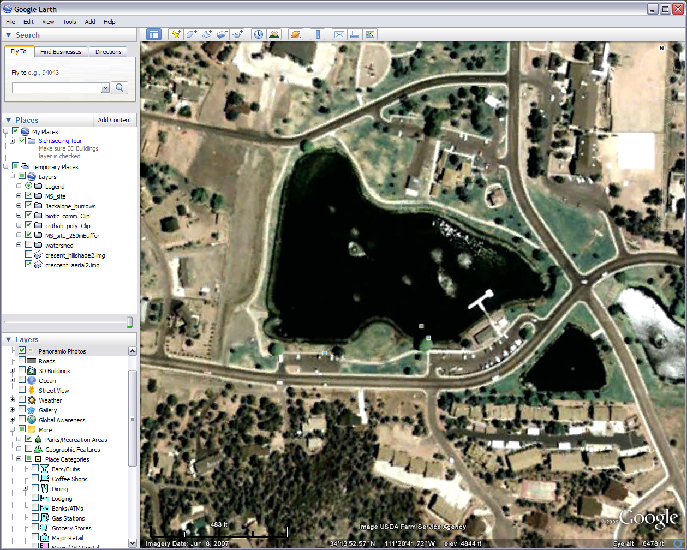
The lake in Green Valley Park
Click on these icons for pictures people have posted
These are the coordinates of where ever your cursor is on the map
Notes:
Reasonably zoom in on the lake and we will leave Google Earth set up as it is for the moment. We are switching gears now to the data collection. Let’s say the students (coworkers) are gathering information about the various groups of ducts and their activities as they get ready to migrate south for the winter. Maybe observations walking once around the lake during the end of September/beginning of October once a week for three weeks at 2pm.
What we want to know is where the groups are, how many are in the group, about how far is it to the next nearest group, are they quacking, are they responding to your presence, and what are they doing. What we are collecting is points, where the duck groups are, and attributes that go with those points. There are several ways to do this but what we want in the end is a table in Excel. As it would be difficult to recognize the same groups of ducks each week especially as some begin to fly southward we are just collecting data on the ducks at the lake in general. Also keep in mind this is a hypothetical situation as I have not been formally introduced to the ducks at this lake.

Slide 5
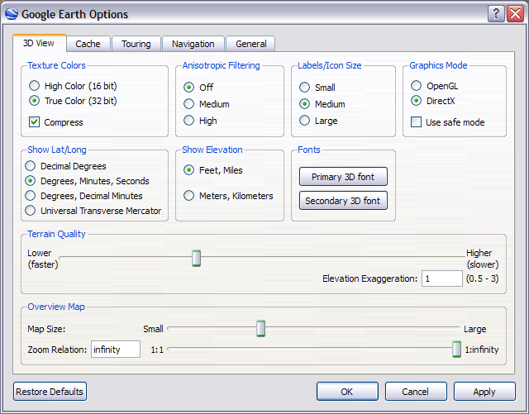
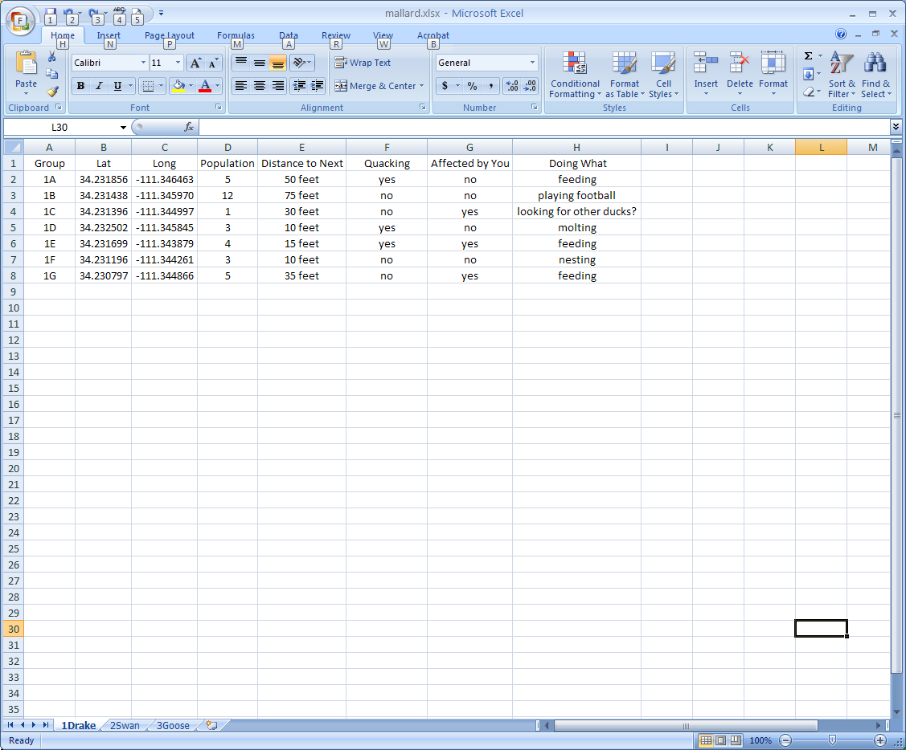


1A
Marking the first duck sighting on our map image
Group | Dis To Nx | Quack |
1A 50 Feet Yes
First week, Third group. Not weekly congruent.
Notes:
Now the ideal situation would be to go out with GPS units and range finders but all we need is a pen, clipboard, question sheet, and a simple map with a rough drawing or image of the lake and surroundings. As the students (coworkers) see a group have them stop, fill out the question sheet, and mark approximately on their map where the ducks are before moving on. Ducks move around so have them pick a general hang out point. Even if they have a GPS it is difficult to mark a waypoint in the middle of the lake.
When they get back to the computer they can hover the cursor over the spot in Google Earth and get the latitude and longitude coordinates. They are there on the bottom of the image. Have them go into the options in the Tools menu and change the coordinate display to decimal degrees. All the coordinates will be latitude 34.23 something and longitude -111.34 something (the – means it is west of the Prime Meridian). Count the number in the group and derive a best guess estimation for the distance to the next group. As this is just an exercise we won’t get persnickety about 100% accuracy. Just fill in the blanks for the other fields.
Then take the recorded observations and put them into an Excel or other spreadsheet. Remember to have the latitude before the longitude in the first couple of columns and keep the – on the longitude or you might end up in China. For this module I just made up about seven records on three different spreadsheets so you may want to do that while we go through this module and learn the process. You can do that now. For more information on GPS take a look at GRAIL’s intro to GPS workshop.

Slide 6
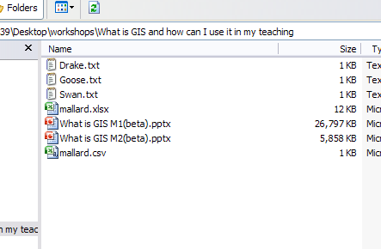
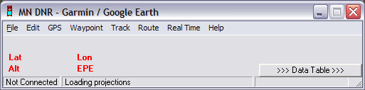
Change each file extension to .txt
Keep the Excel file(s)
Save each spreadsheet as a .csv comma delimited.
If you have Google Earth open DNR will know it
Notes:
So what we want is three spreadsheets. One for each week/set of observations. Save them as one single or three separate Excel files. Additionally each of the spreadsheets will then need to be saved as a separate comma delimited file. If your unfamiliar with it, all that means is we are going to save each week into a plan text file where the fields are separated by commas. When you have everything set up in Excel go to Save As>Other Formats and on the Save as Type drop down scroll down to CSV (.csv) comma delimited and save each sheet in that format. Press Yes and OK after you have read the cautions. You should now have three .csv files. Close Excel. In Windows Explorer, the place where you can look at and organize your files, change the file extension of each file from .csv to .txt and say yes to the warnings.
Now we are going to download another program called DNR Garmin. This program was made by the Minnesota Department of Natural Resources to be a bridge between a Garmin GPS unit and a GIS and it works just great for our purposes. Google ‘DNR Garmin’ and go to the program site. Scroll down to the downloads and download the latest version. If your unfamiliar with downloading programs like this click on the download link, save the .zip file, extract the zip file, and run (click on) the setup.exe. Do the full install on the hard drive if it asks. If you get a warning when you first open it that you are not connected to a GPS press OK because you are not working with a GPS. This program will read our .txt files and put them on Goggle Earth however there are some little steps to get there. If we were doing any other GIS project the first thing we would need to do in DNR Garmin would be to set the right projection so the computer knows how to display our data correctly; however because we are taking this into Google Earth, Google Earth will take care of this for us as long as we provide the coordinates. Open up the original spreadsheet file(s) again in Excel because we are going to be using it.

Slide 7

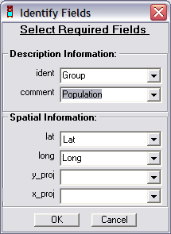
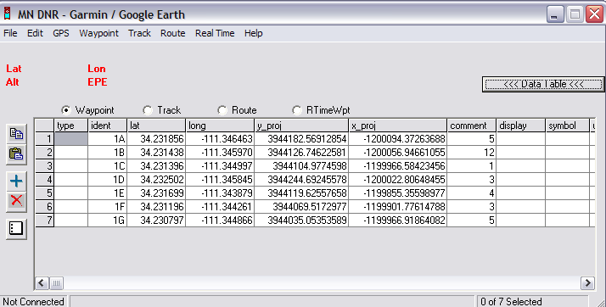
Notes:
In DNR Garmin click File>Load From>File. Load the first week. An Identify Fields window will pop up. 1) If in the spatial information it does not identify lat/long as your lat/long either find them in the drop downs or go back and change your spreadsheet. Look at the example two screens back if needed. If the lat/longs match up fantastic, that is what we want. 2) In the ident drop down choose what you used to identify each observation. My field is called Group. 3) In the comment drop down add the population field where the number of ducks in the group was counted.
Of course these are not all our fields but this is what DNR Garmin will let us put in. The program was set up for GPS units that weren’t capable of showing more fields but that is OK for now. You can furthermore see the data table in DNR Garmin shows more available fields but even if we filled them in they still wouldn’t show up in Google Earth. Some other fields also auto populated but they won’t show up either. The table it comes up with is what we want.

Slide 8
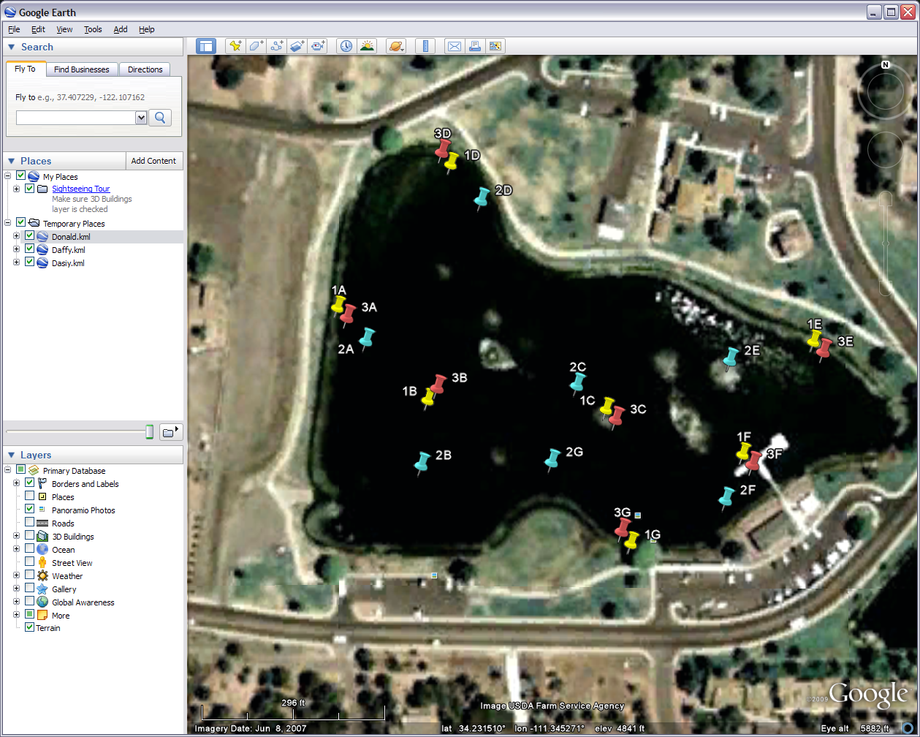
Notes:
When you have everything filled out go to File>Save To>File. We don’t want to go to Google Earth my places because it won’t give us a file we can work with outside of Google Earth. In the Save as Type drop down select the Google Earth Format (*.kml), name it what you’d like, make sure you are in the right folder, and press save. DNR Garmin will let you know if it worked. Whether you have it already open or not go to Google Earth and File>Open and open the .kml file you just created.
Once you open it Google Earth will take you right to it and all your points will show up as yellow pushpins, the default icon. The pins will have whatever it is we used to I.D. them and if we click on an individual pin or open its properties we will see that population number we collected. Do the same procedure for our other two weeks. Change the icons or their colors so each week can be distinguished from the other two. You do this by right clicking on the icon>properties>click on the icon. the When all three .kml files are viewed together in Google Earth you can compare the observed locations and see the populations numbers change during the three weeks as the ducks fly south for the winter.

Slide 9
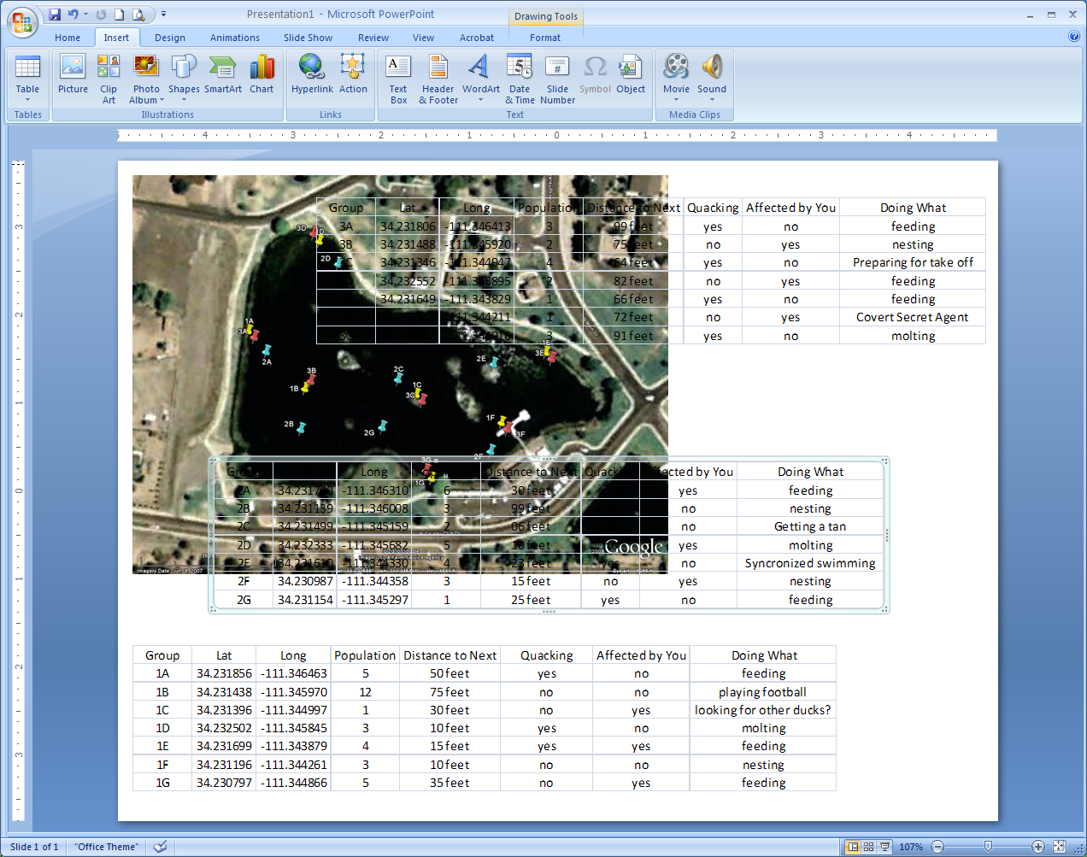
Notes:
We can now take the tables (spreadsheets) of data we collected and the image we have created on Google Earth and put them into a presentation, poster, or other report form. Let’s open up PowerPoint and start with a blank slide. From your image in Google Earth that shows the three weeks of points on the lake go to the edit menu and copy the image. It will copy to the clipboard and you can paste it right into your presentation.
You can also bring in your Excel spreadsheets by doing a simple screen capture (alt+print screen) and paste each one in or a cleaner way that imports it as a table is while you have the file(s) open in Excel go to PowerPoint and go to Insert>Object>Create from file. You’ll have to do it for each spreadsheet (if all of them are in the same file in Excel, the tab showing will be the one imported). Crop and resize all as needed. You can do what you want with the Google Earth image but if you do reshape it out of proportion you may want to get rid of the scale bar in the bottom left corner as it will be some but no longer 100% accurate. Hold down the shift key and resize from the corners to keep it in proportion. Also please be considerate and leave the Google and image source information on there so you can properly cite your source.

Slide 10
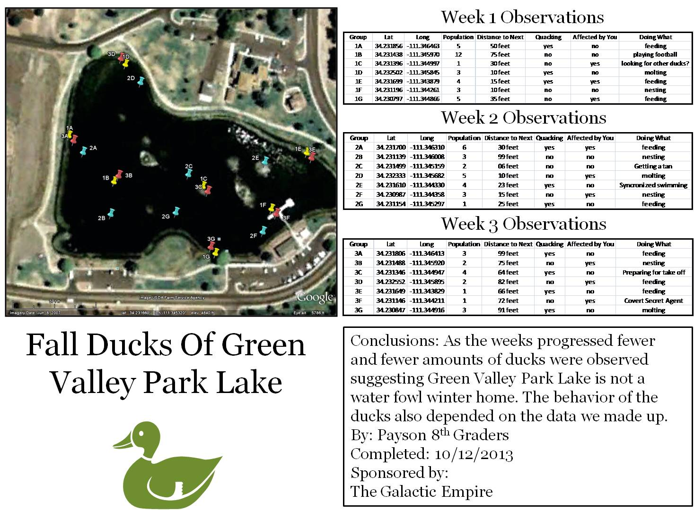
Notes:
Now that you have all your data displayed as information let’s clean up the layout and have ourselves a GIS presentation product (Note: PowerPoint does presentations, programs like Publisher and InDesign do posters). Use your imagination. This is your project. You should also probably include a title, author, date, and other documentation.
Keep in mind my example here is fictional and while the latitude and longitude may be correct the rest of the data is fabricated. So all you need is a map/image program (Google Earth), a simple GIS program (DNR Garmin), a table of data (Excel), and you have a GIS product. Nice and easy. This is fine but there is more than one way to do things.

Slide 11
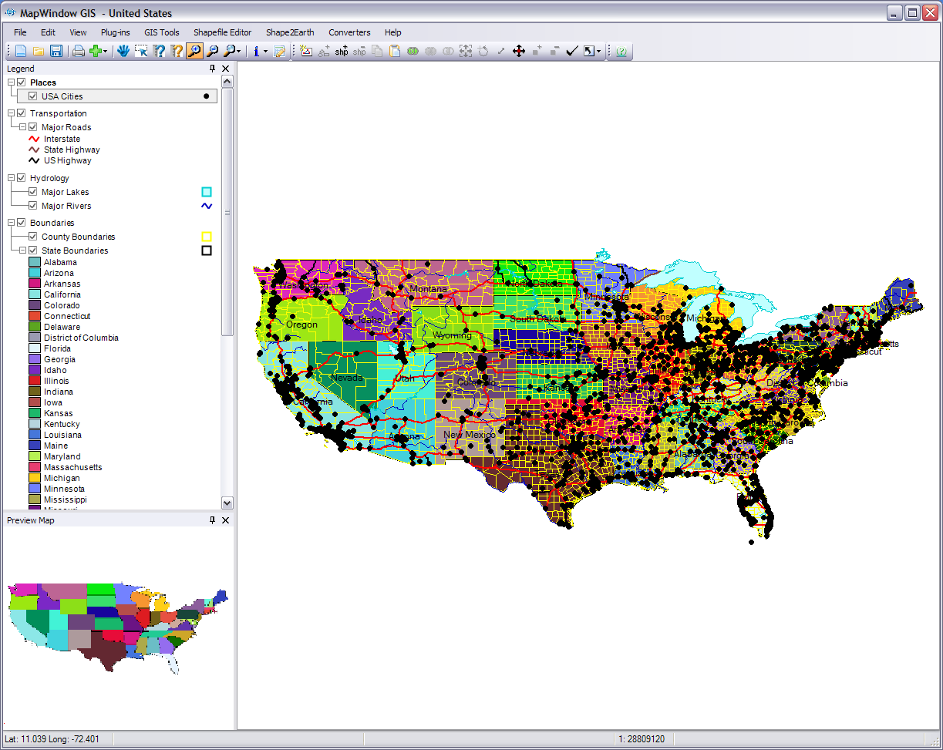
The Shape2Earth and CSV to Shapefile Converter menus show up after you activate the plug-ins
Drops down with the available plug-ins
The sample USA project
Notes:
Let’s try a variation on the ducks that involves an interactive presentation with Google Earth. We already have the duck data in our Excel file(s) so again export each spreadsheet as a .csv comma delimited file. Once you have your three new .csv files it is time to get some more free GIS software off the internet.
For this variation we won’t be using DNR Garmin. Go to http://myshape2earth.appspot.com/Guide#install, scroll down to Installing Shape2Earth, and first download and install MapWindow GIS. This is an open source GIS program that is capable of many things however we only need some simple easy tools from it (so don’t be intimidated). Open up MapWindow GIS and if you want to you can play around with it. At the start you can click on Open a project and pull up at some sample GIS projects. Otherwise just close out the start up window.
Next, from the same web page, download and install Shape2Earth for MapWindow GIS. While some plug-ins do, this one didn’t come with MapWindow GIS so we had to bring it in separately. Once it is installed go to the Plug-ins menu on the top of MapWindow GIS and click the puzzle piece next to the name Shape2Earth to activate it. Also turn on the CSV to Shapefile Converter plug in. Close out any projects or data you have open as we want a clean slate to work from.

Slide 12
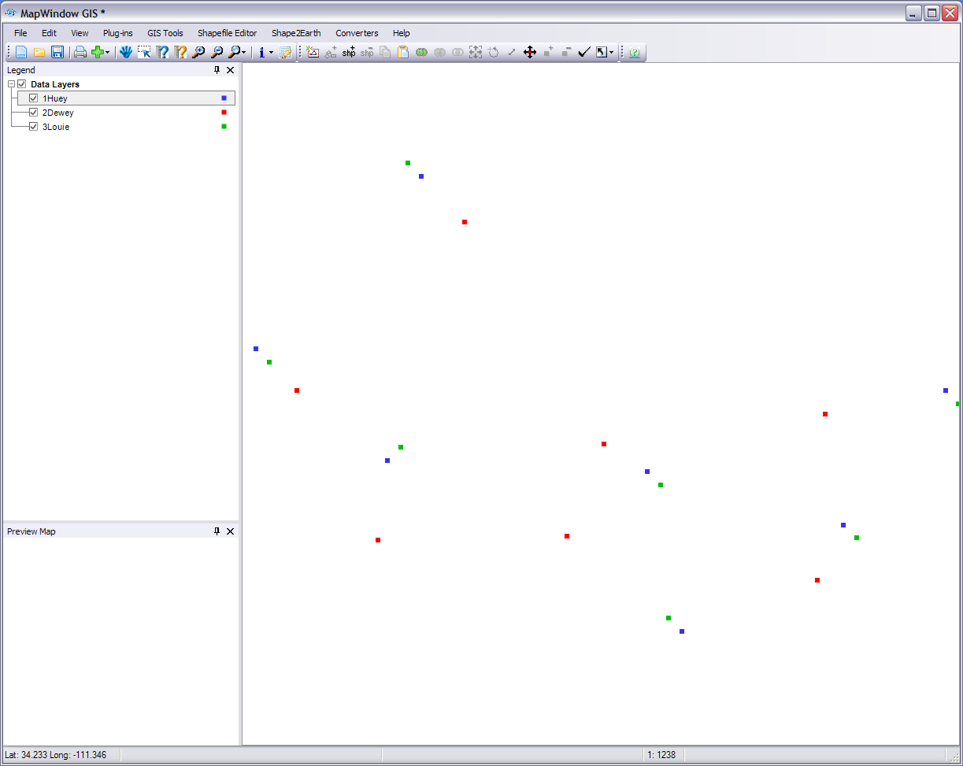
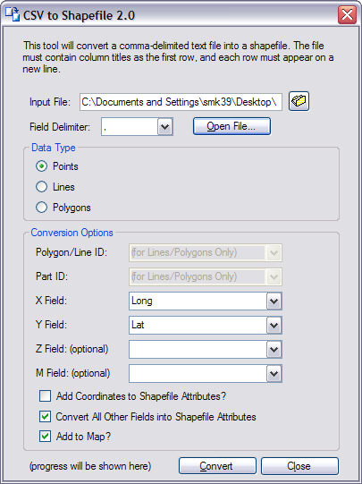
The shapefiles will show up as three different layers on your map. If you highlight one and press the attribute table editor you can see all our data fields are in the shapefile.
Notes:
Click on the Converters>CSV to Shapefile in the menus at the top. You will get this wizard window. In the input file put your first spreadsheet and make sure the field delimiter is a comma. Press the Open File… button and it will load your file. Check to see that the X and Y fields are your latitude and longitude fields (X is longitude and Y is latitude) and that the Add to Map? and Convert All Other Fields into Shapefile Attributes are checked. Press Convert, choose a name and presto! Your spreadsheet is now a bunch of dots with attributes (a type of shapefile).
Convert the other two spreadsheets and then close the converter. You can grab and drag the different shapefile layers and put them in the order you want. If you double click on the shapefile you will pull up the Legend Editor. Scroll down to the Symbology group and if you click on the Point Color field you’ll have a drop down with some color options. You can change the Point Size too.

Slide 13
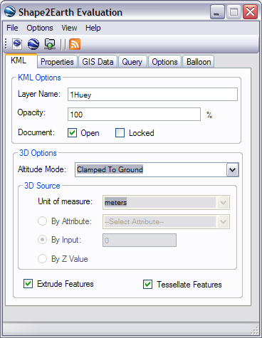
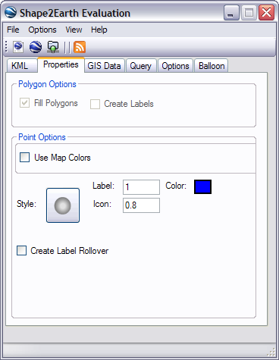
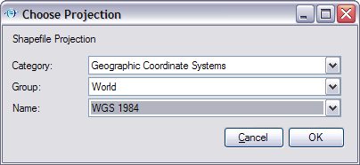
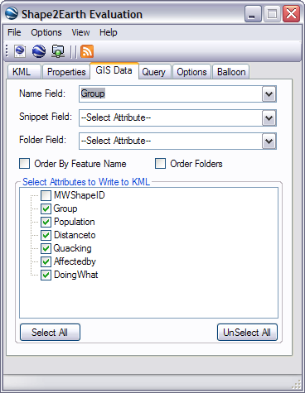
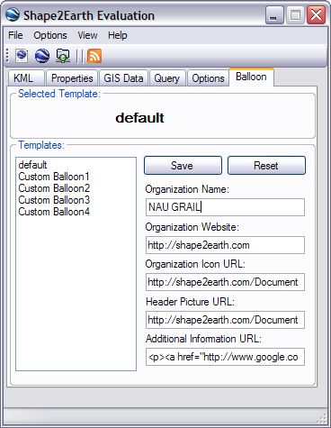
Projections tell the computer where in the world those dots are
Click here to convert the shapfile to KML
Notes:
We have our shapefiles so highlight the first one in the legend sidebar on the left and in the Shape2Earth menu choose Export to KML. The first thing we see is the Shareware License Information. Shape2Earth was developed by different people than MapWindow GIS so it will only let us run in the evaluation mode until we pay for the whole enchilada. Unfortunately this evaluation mode has something like a 90 day limit from when first activated. We can run it unregistered and be just fine because we definitely have less than 500 points; so hit that button and let’s continue. Say Yes to setting the projection information. See GRAIL’s Intro to GIS workshop for more information on projections and datum but basically these are the models we use to project our 3D world onto a 2D surface. Keep the category on Geographic Coordinate Systems (it means lat/long), put the Group at World, and the Name should be WGS 1984. Press OK and we get the Shape2Earth evaluation window.
The defaults for this are OK but we do want to change some things. 1) In the KML tab check the Open boxes so we can open the folder in Google Earth. 2) In Properties tab you can check Use Map Colors if you want or set the colors in Google Earth. Click on the yellow pushpin icon (style) to change to how you want your points displayed. You can also change the icon size (default 0.8), label size, and label color. I picked a round spot icon and royal blue label for my first file. You can create a label rollover so in Google Earth when you move the cursor over a point it changes but I’m not going to. 3) In the GIS Data tab for the Name Field drop down to your identification field, it is the name that will show on Google Earth, and press Select All to write all the attributes/fields to your Google Earth KML file. I’m going to uncheck the MW Shape ID field that MapWindow GIS put in when we converted to a shapefile but you don’t have to. You will notice some of our field names are cut short. This is because this particular app only lets us have a certain number of characters. I decided to leave them as is but you can change them in the shapefile attribute table or back in the spreadsheet. You can leave the rest of the settings in this tab alone or mess around with them. You don’t need to worry about the Query or Options tabs if you don’t want to. I’m not going to do anything with them. 4) On the Balloon tab select what ever template you like or leave it at the default. This is how our fields will look when we click on a point in Google Earth. Change the Organization Name to the name of your organization. 5) Of the four icons between the tabs and the menus click the left most one to export the shapefile to Google Earth’s KML format. You’ll have to tell it again to run it unregistered. Yes we could hit the blue and white sphere and send it directly to Google Earth but we have two other shapefiles to run and I prefer to have the files in my project folder before I go into Google Earth. 6). Run the other two shapefiles through Shape2Earth.

Slide 14
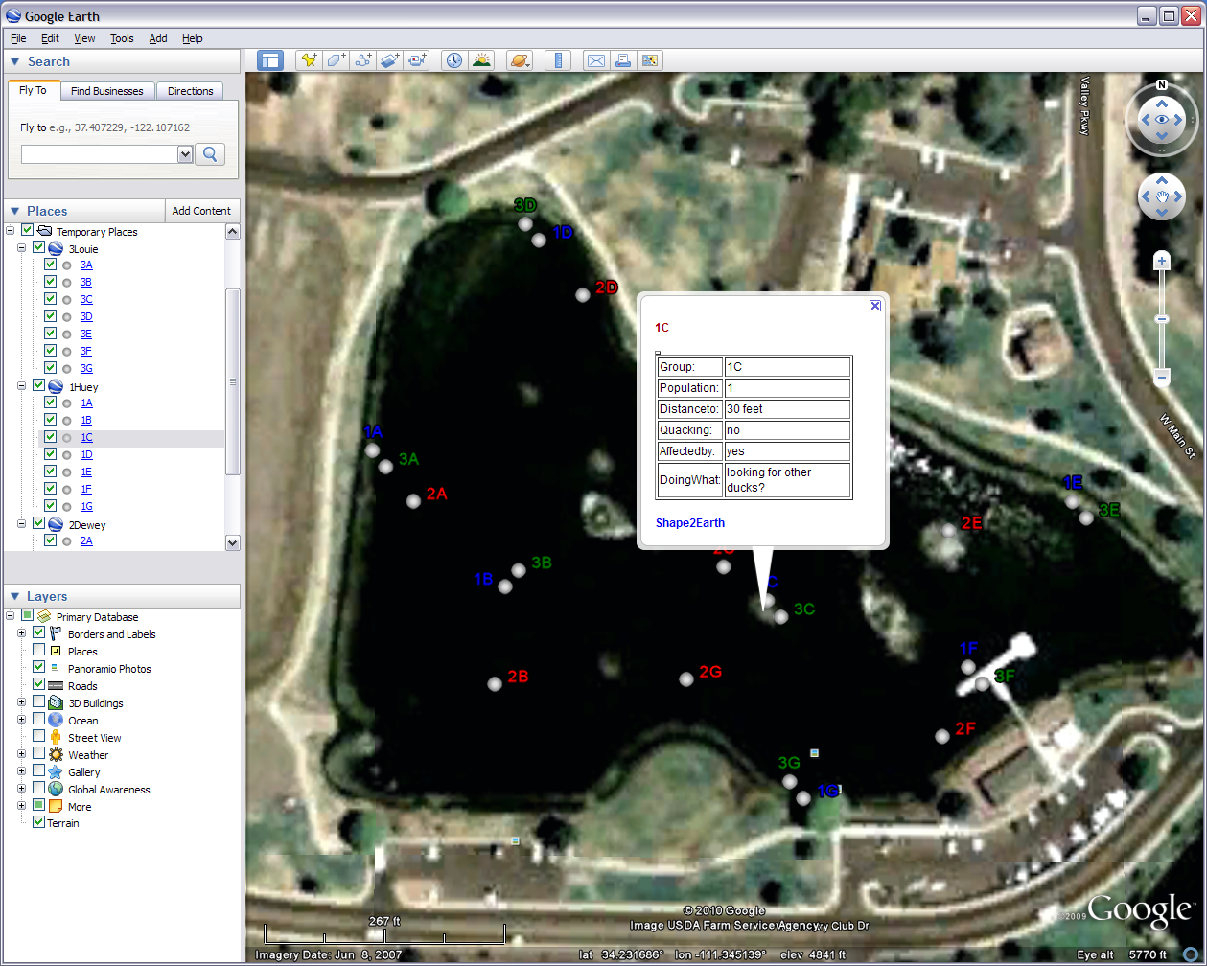
Click here to turn off the side bar for a better presentation
Notes:
All righty open up Google Earth. If it has your three .kml files from the first method we did either turn them off or remove them. Go up to file and open our three new .kml files. You can open all three at once. Google Earth will fly right to the spot. You can see that each point is labeled by the ID field we selected in the drop down of the Name Field when doing the Shape2Earth conversion.
Now here is where we get interactive . Every time you hover the hand cursor over one of the points it turns into an arrow. If you click the arrow on the point an attribute table of that point pops up. While giving a presentation for a class, report, workshop, or something else you can interactively be presenting and comparing the attributes of each point visually and spatially. Unfortunately only one table can be viewed at a time. If you want to change the colors or icon just right click on the point and chose properties.
With the Shape2Earth’s evaluation license being temporary you may be looking for another alternative. Take a look at the next two slides.

Slide 15
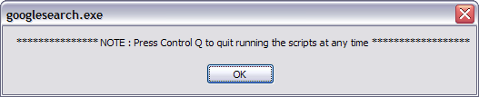
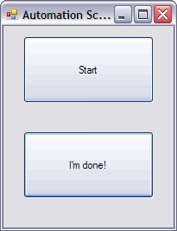
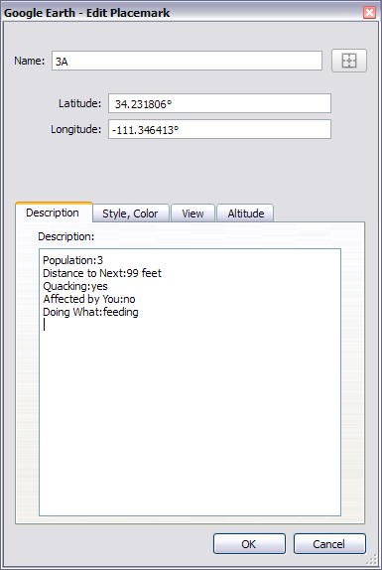
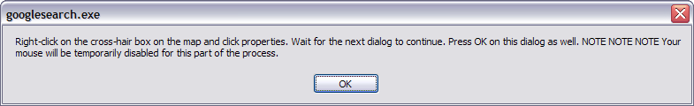
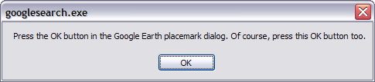
The work flow of the app
↓
↓
↓
↓
↓
↓
Notes:
I had trouble finding a free program or app to take all my data to Google Earth so I got one of the programmers at GRAIL to write one. Download this app in the zipped (compressed) folder from this workshop on the webpage. Please keep in mind this a beta version of a homemade app. It doesn’t even have a real name. It works great but don't expect perfection, technical support, or all foreseen technicalities. So use it with the knowledge that it may have some bugs. It takes time to run through the whole process and requires you to interact with it. Other than that it should get you the results you want
Download and uncompress the zip file wherever you would like. There are four program files and one readme file. Make sure both Excel and Google Earth are open and the sidebar in Google Earth is turned on. In Google Earth make sure you are zoomed into the area of study. In our case Green Valley Park lake. Keep your spreadsheet in the same format we’ve been using throughout the module with the field/column headers in the first row and the Lat/long in the second and third columns. Clear out all the search information and have the cursor blinking on standby in the empty Fly To box. At a later stage in the process you'll delete data from the Fly To box and you need to have the cursor blinking then too. Click on the RUNME.exe to start the program and be ready to go to Excel. It will prompt you for each step. Follow each step precisely. Note you can press the control+Q at any time but only when there is a pause in the process. It will also process only one sheet at a time. If you mess up, the program doesn’t work they way it should, or Google Earth crashes the first few times keep trying.
It will put each of your points in the search window. When the app is done you can right click the My Places in the Places window and do add to create a new folder. You can move each of your new placemarks one by one into the folder under My Places to keep them permanent. Note this app has only been tried with Excel 2007 and Google Earth version 6.

Slide 16
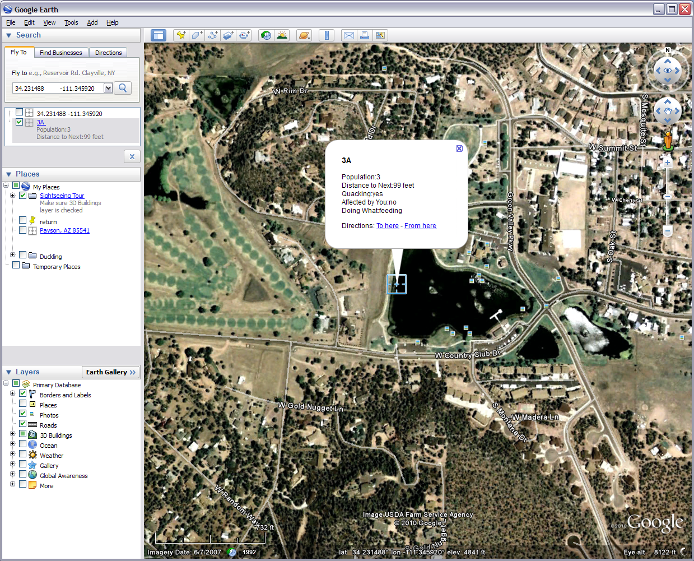
The app result
Move these to here to make them permanent
Notes:
All you really have to do to get your data into Google Earth is type the coordinates into the Fly To box and when a placemark is created just put all the other information in the description (right click and go to properties). It is that simple. If you know HTML you can make the data you put in the description look fancy when you do an interactive click on the map. Another way is if you have access to ArcGIS there is a simple tool in that that will convert your data to Google Earth’s .kml or .kmz.

Slide 17
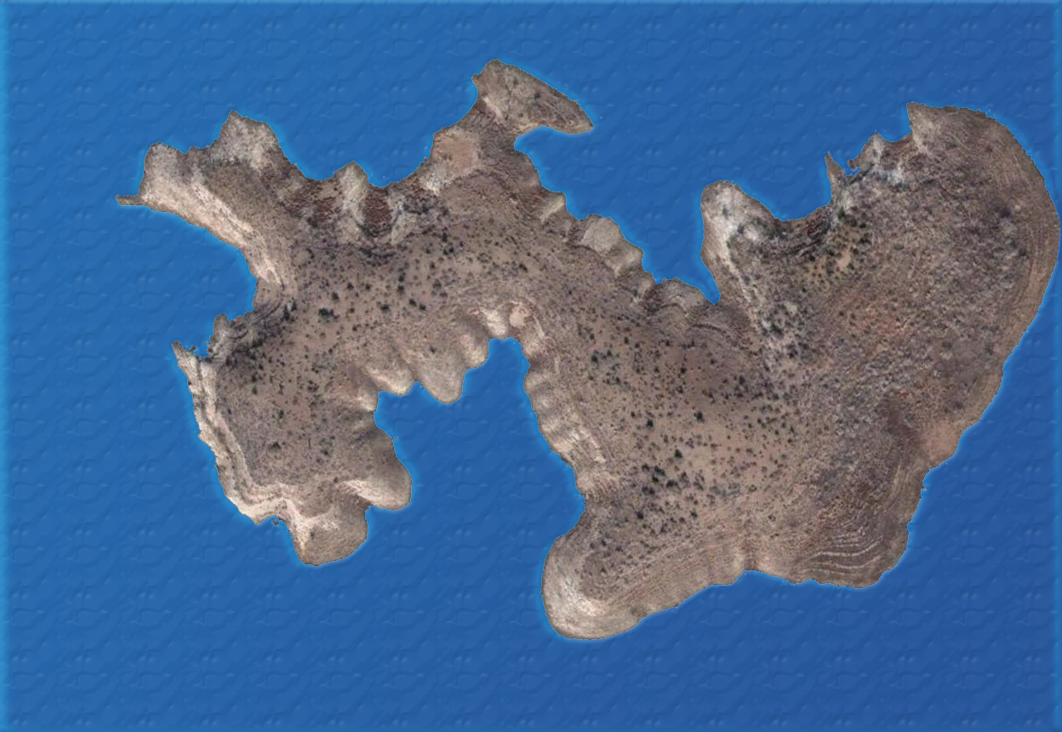

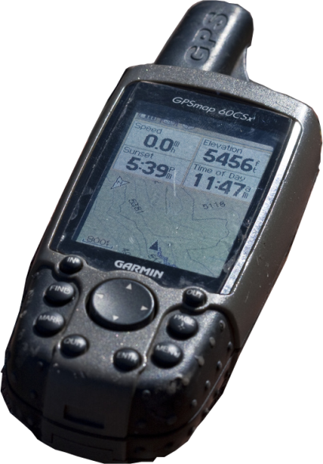
GIS is Applying Adventures Spatially
Notes:
So now you have an idea of how GIS works and how you can apply it. You can even do some simple GIS processes. Everything we do has some relationship with a spot on earth so you can use GIS with almost everything to help understand whatever it is you are studying. The other two modules in this workshop will also show you how you can apply GIS to your teaching or profession so take a look. Have fun and good luck with you GIS adventures.

Slide 18









Appendix
Graphics, Presentation, GIS, and Remote Sensing Software
Notes:
You may already know this information or not. There are several different types of programs involved with map making, GIS, and digital graphics. Sometimes it is a matter of preference and sometimes a program or suite of programs does things others cannot or just can’t do things as well. The ones in this appendix are just some of the ones available on the market.
We will start with the ever popular Microsoft Office software. The good news is Publisher and PowerPoint can do some basic stuff with graphics pretty well. This works great for what we’ve been doing. The bad news is, contrary to popular belief, neither one is a graphics program. PowerPoint is a presentation program and intended for showing things on a projector not for image processing. Like I said however it works well for simple graphics procedures and is what most people have. Publisher is a step up from this. It is a publishing program whose key function is layout and design. It does a little better with graphics and is better for printing, especially large posters, than PowerPoint. It doesn’t come with the standard Office suite and isn’t as intuitive as PowerPoint both of which makes it less well know than it’s brother. Another publishing program is Adobe’s InDesign. This layout and design program is use by professionals and novices alike. It’s capabilities include doing layouts for the most popular magazines on the market to doing a home scrapbooking project. InDesign is apart of Adobe’s productivity suite of software. Included in this suite are Photoshop and Illustrator. Both of these programs are graphics programs. Their primary function is to design and edit graphics and images. While they can work wonders with both types, Photoshop’s focus is working with digital photos and other raster images. Illustrator is geared for vector graphic creation and manipulation. Google Sketchup, Solid Edge, and AutoCAD (not all icons shown) are also graphics programs that belong to a family of software called computer aided drafting/drawing (CAD). None of the programs mentioned so far do GIS but they are good for working with a map or other GIS product.
One of the most well know GIS programs is a suite of applications from ESRI called ArcGIS, which includes ArcMap, ArcCatalog, ArcToolbox, and others. There is a free and simple ArcGIS version called ArcGIS Explorer. ENVI is another popular GIS program. ERDAS has a suite of programs that do their fair share of GIS work. What makes this unique is that ERDAS’s programs, most notably Imagine, are designed for Remote Sensing, a separate but highly related field that works with things like satellite images and aerial photos that GIS uses.
So the point is when making maps or any other digital product for that matter, it is good to understand what a program is intended for, what it is capable of, and that using multiple programs can produce a better product.

