Slide 1
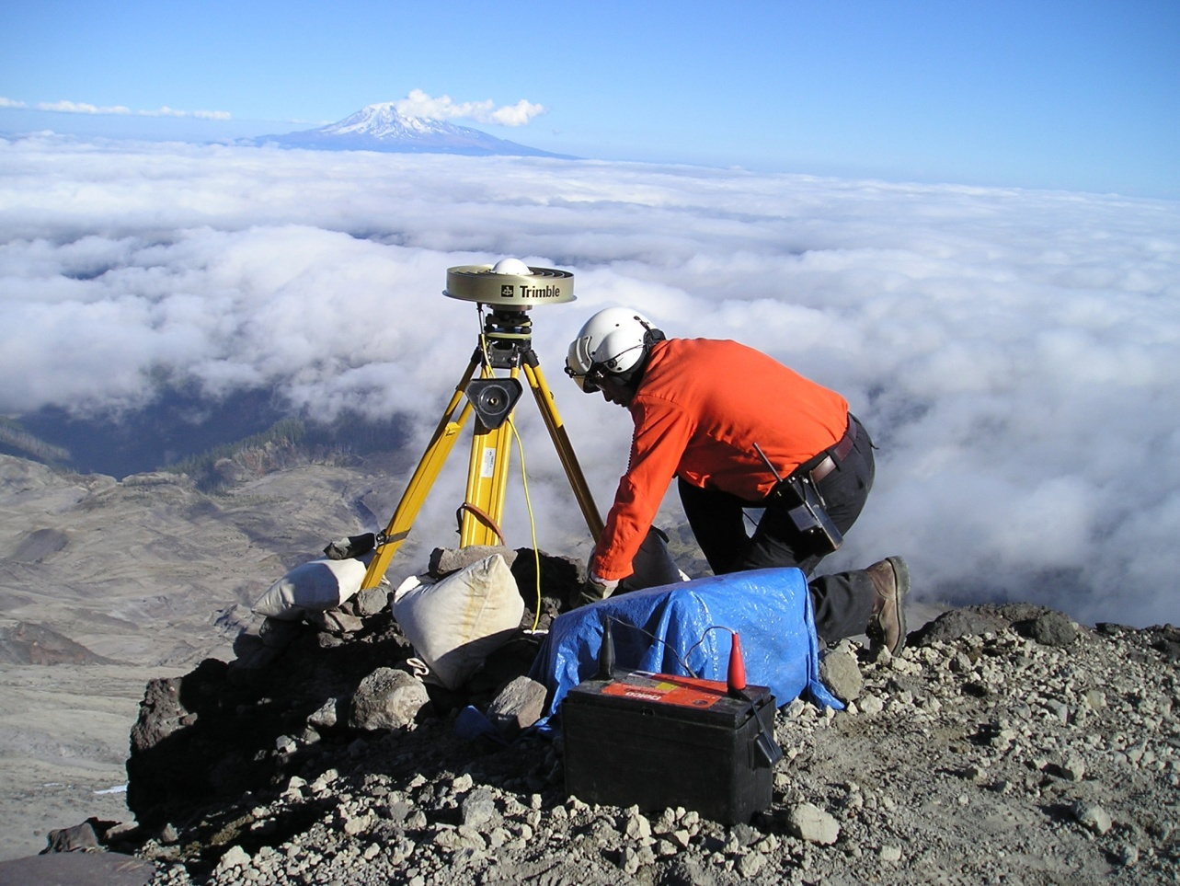
What is GIS?
How can I use it in my teaching and profession? Module 1
Image Source: USGS
Created by: Scott Kelly 2010
Notes:
Welcome to NAU’s Geospatial Research And Information Laboratory’s What is GIS workshop. According to the big cheese ESRI, GIS or geographic information systems are “an integrated collection of computer software and data used to view and manage information about geographic places, analyze spatial relationships, and model spatial processes. GIS provides a framework for gathering and organizing spatial data and related information so that it can be displayed and analyzed.”
So what? Well everything we do from going down the road to running a global empire takes place on the earth with relation to other places and their attributes. So no mater if we are a democrat or dentist we need to understand the spatial relationships going on around us in order to get the most out of what we do. Why don’t we first go over some ways GIS helps us and how you can use it, and then we’ll take a look at how it works. With that in mind lets jump into things.

Slide 2
Notes:
First off I keep using the word spatial. You can probably get the idea from the context but what we mean is the relationship, location, and space that objects have. In our case we can loosely say spatial data is the same as geographic data. Which brings us back around to the fact that GIS has many geography elements. For you teachers, current, or former students you know geography is a class we all take. How can we understand the world around us if we don’t learn it’s geography?
The connection between geography and GIS is that GIS provides the technical power to geography. For example, you can explain to your class all about the conflict of land ownership between the Israelis and Palestinians but without a map, a common GIS product, it isn’t the easiest thing to grasp. In any profession or discipline understanding the geography involved in the relationships between you, clients, associates, people and places helps you to be productive. GIS strings and helps us understand the threads in those relationship and their geography. You can use GIS in the classroom or office to associate data to a real location on earth.

Slide 3
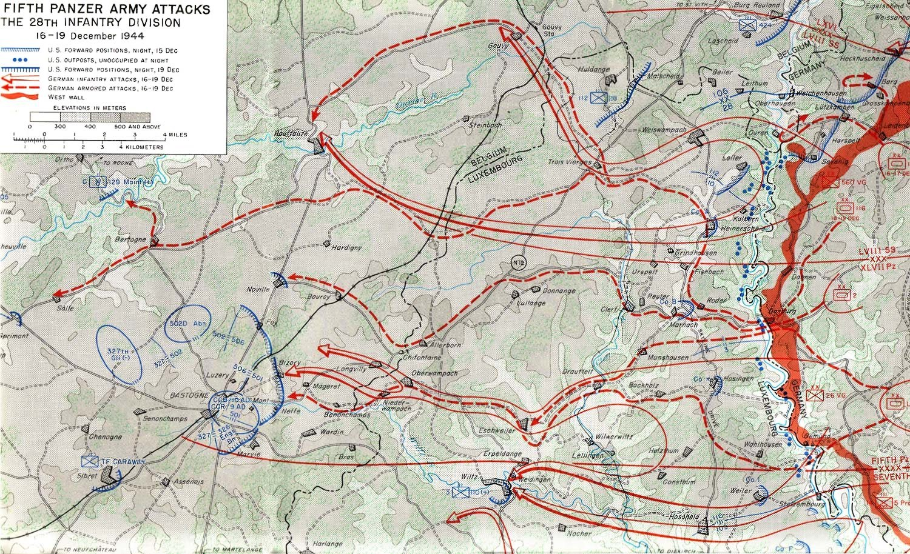
Notes:
As GIS in geography helps us with contemporary threads and people, it also helps with the past. GIS is a prominent tool for studying history. In our map here students can have a spatial understanding of the Battle of the Bulge. It is much more than just a pretty picture. GIS can help us understand the terrain challenges of the area and what it takes for certain unit types to overcome and use those challenges. GIS will tell us what and how many troops, munitions, officers, and unit types are in each colored line. GIS can also calculate and analyze the battle with the given geographic environment. Hence GIS gives a more in depth understanding than just looking at a wall decoration.
In the professional world a GIS and history combination can be very powerful in looking ahead. For example, if an area has a history of people who buy a specific brand a company can use GIS to understand the attributes of that area and why they buy that brand; thus giving their marketing plan for that area some significant variables to work with. You can use GIS in history by connecting past people and happenings with contemporary locations and spatial events.

Slide 4
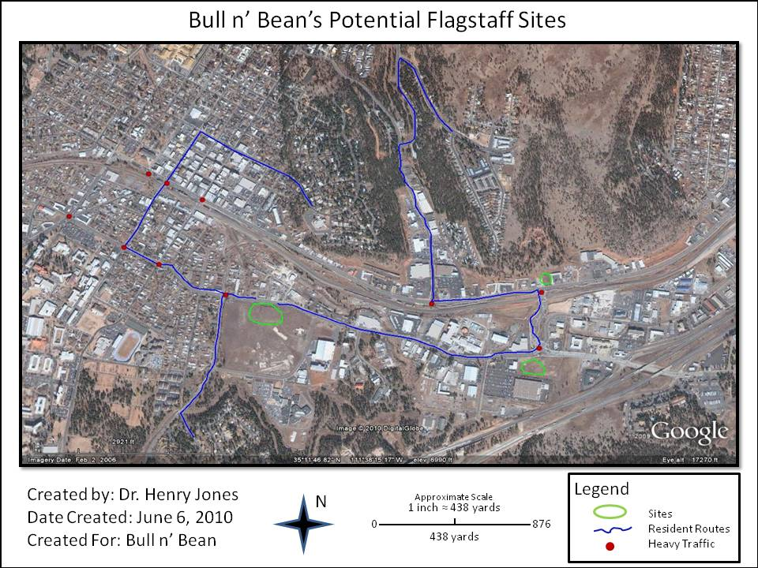
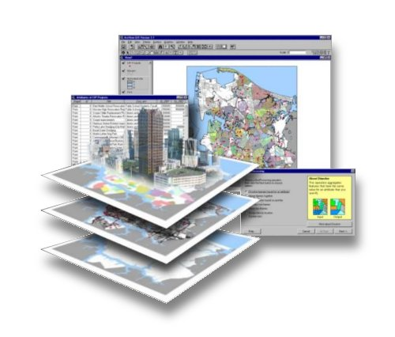
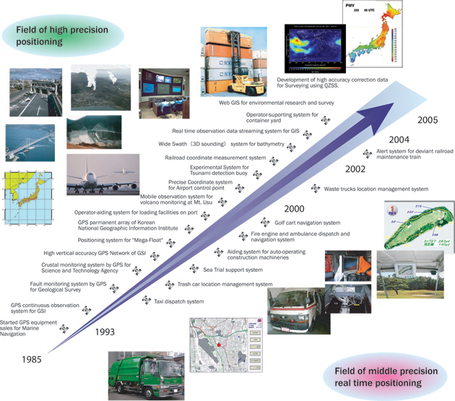
Image Source: pubpages.unh.edu/~cms56/
Notes:
GIS is a great tool for business and learning about how business works. In a recent article at spatialroundtable.com they discuss how GIS “sure looks like a good weapon against the miseries of the Wicked Witch of the Great Recession.” Merchants in current economic times shift to doing business locally and “with detailed, local knowledge, retailers can go beyond segmentation and customer profiles to individual characteristics, localized assortment management, and product-level stratification.” This localization is accomplished by using the tools of GIS. The analysis and organization tools found in a GIS allow businesses to know customer base locations, customer spatial culture, and location marketing. (http://www.spatialroundtable.com/post.cfm?entry=retail-gis-localization-not-just-location).
A business success story reported by ESRI talks about how Nike learns about its customers through GIS. Nike uses GIS for distribution, planning, and sales but it also uses GIS business analyst tools for point-of-sale data, customer profiles, and customer focus. (http://www.esri.com/news/arcnews/summer10articles/nike-learns.html).
Businesses such as utility companies and hospitality corporations need to use GIS regularly because of the nature of their industry deals with spatial distributions of employees, capital assets, and customers. You can use GIS to teach and learn the concepts of how business and customers relate spatially and how all business operations have a spatial component to them.

Slide 5
Notes:
All kinds of science disciplines use GIS. Geology would use GIS to gain spatial concepts of different rock layers in an area. For example, you can draw a profile of the different rock layers of the Grand Canyon but a GIS will help you know just where those rock layers interact at different parts of the canyon and how those rock layers affect their surroundings.
Biology would use GIS for studies such as migration patterns, species distribution, and habitat management. For example, a biologist in the Saguaro National Park might want to know where the desert tortoises have burrows, what is the range of their territory, what other biologics do they interact with, and so on.
Environmental science would use GIS to gain an understanding of various impacts on the environment of an area. For example, if a power company was planning on building a field of wind generators out by Two Guns just south of Route 66 near Flagstaff they would use a GIS to compile data on the environment for the area and build spatial models for the different ways it could be affected by the wind generators. You can use GIS in science to teach how scientific elements have real locations and interactions with the landscape. Likewise any occupation needs to understand the science of where their business is located.

Slide 6
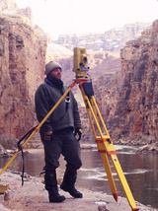
Notes:
Industries involved in engineering, facilities management, farm management, landscaping, environmental work, and other related spatial design and organizational fields use GIS everyday. If an engineer sets out to build a bridge he or she needs know where the anchors and foundations of that bridge are going to rest and what kind of terrain that resting place has. If a department managing the buildings on the main NAU campus wants to put in a light rail system between north and south campus a GIS would be used in the design to interweave the rail system through the buildings.
A large farm in Mesa has quite a bit of land to manage. They would use a GIS for what parts of the property have been treated for pests, soil and crop rotation management, and labor management during harvest time. GIS can be used to teach that use of land requires spatial design and organization. When we build on and work the land we need to analyze, plan, and use spatial variables to make good decisions about how we use it. A profession involved in spatial design and organization would benefit from a GIS in a similar way.

Slide 7
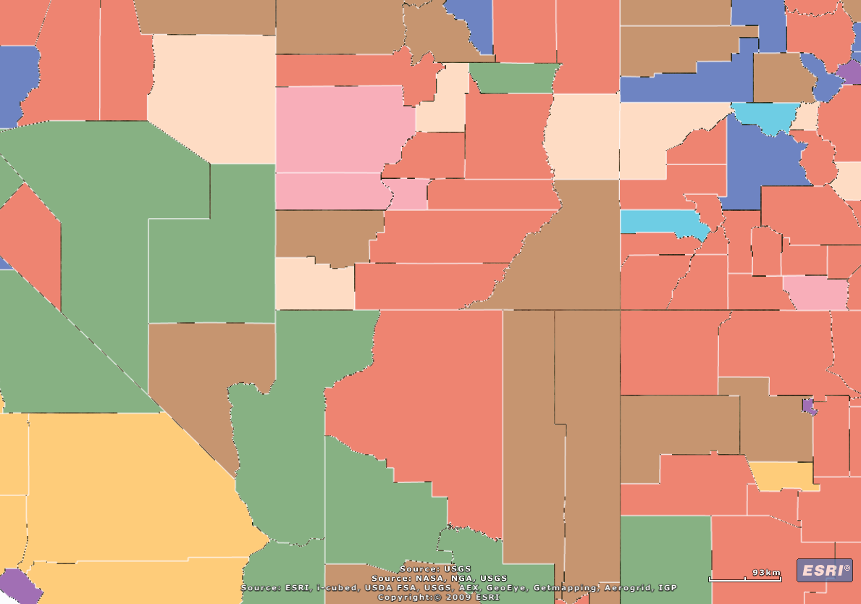
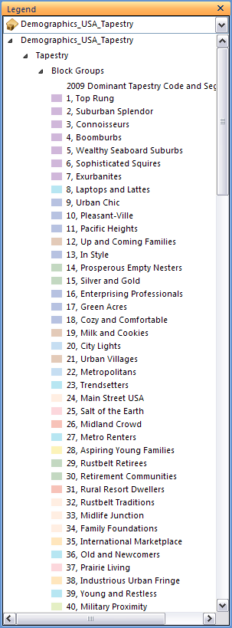
Notes:
Governments and economies use GIS too. Economist will use GIS to track indicators such as the housing market and unemployment. In a rough example an economist can use GIS to see new home construction is rising in Tombstone and a large number of unemployed persons are in Casa Grande. From there they can forecast population migration and economic growth in southeastern Arizona.
Governments use GIS in everything from political campaigns to emergency management. FEMA needs real time spatial data management to know how to distribute supplies and resources and Senator McCain needs to know what districts are for him and which need a little more attention. One of the U.S. Census’ main tools is GIS. It not only has to know how many people are in the country but where those people are and how those populations relate to one another.
The U.S. military uses GIS extensively for its operations around the world. You can use GIS to teach about governments and economies by showing that operations in both areas have social and spatial elements. You can use this in your profession to help you understand national and local trends and how the location of your business might be affected.

Slide 8
Elements of a Geographic Information System (GIS):
Spatial or Geographic Data
Raster
Vector
Tabular
Hardware
Computer
GPS
Satellites
Others
Software
Desktop
Online
Database
World Wide Web
Human Element
Users
Clients
Outputs
Maps
Posters
Response Info
Notes:
So now that you know a little bit about how GIS can be applied to almost any discipline let’s talk about how a GIS works. Our old friend ESRI says “A geographic information system integrates hardware, software, and data for capturing, managing, analyzing, and displaying all forms of geographically referenced information. GIS allows us to view, understand, question, interpret, and visualize data in many ways that reveal relationships, patterns, and trends in the form of maps, globes, reports, and charts.” If the list here looks a bit daunting its really not.
Basically a GIS is spatial information or data you have collected, that you then process, and you present to others. In a classic GIS project you might go out to a site in the desert east of Yuma, count and mark on your GPS unit all the jackrabbits you see, bring the data back to your computer and run it through the software, and present to your class or co-workers a map and poster of your studies about the jackrabbit population in that area.

Slide 9
Image Data
Points Lines Polygons
Raster
Notes:
In GIS when you make a map or other product you do so by placing shapes or polygons, lines or paths, dots or points all on top of a picture from a camera on a satellite or aircraft. The picture is in a category called raster and the points, lines, and polygons are called vector. The big difference is when you zoom into raster imagery it eventually becomes pixilated or becomes blurry and shows up as a mosaic of colored squares. No matter how much you zoom into a vector it never becomes pixilated.
With any digital imaging including GIS you will use vector, raster, or both depending on your project. You could represent where your customers live as points, show their streets as lines, have an aerial photo of the neighborhood, and put it all together to get a model of the real world. The vector graphics are good for representing specific geographical features and their attributes. The raster images are good for showing the overall area, area trends, and area orientation. When you have a bunch of points representing the prairie dog holes in the Petrified Forest National Park they are all put together in a group called a shapefile or feature class.
The third type of spatial data is data organized in a table (tabular). For example, each of those prairie dog holes has a list of attributes to it that are put in an associated table. Let’s take a look at the next screen to see how they all work together.

Slide 10
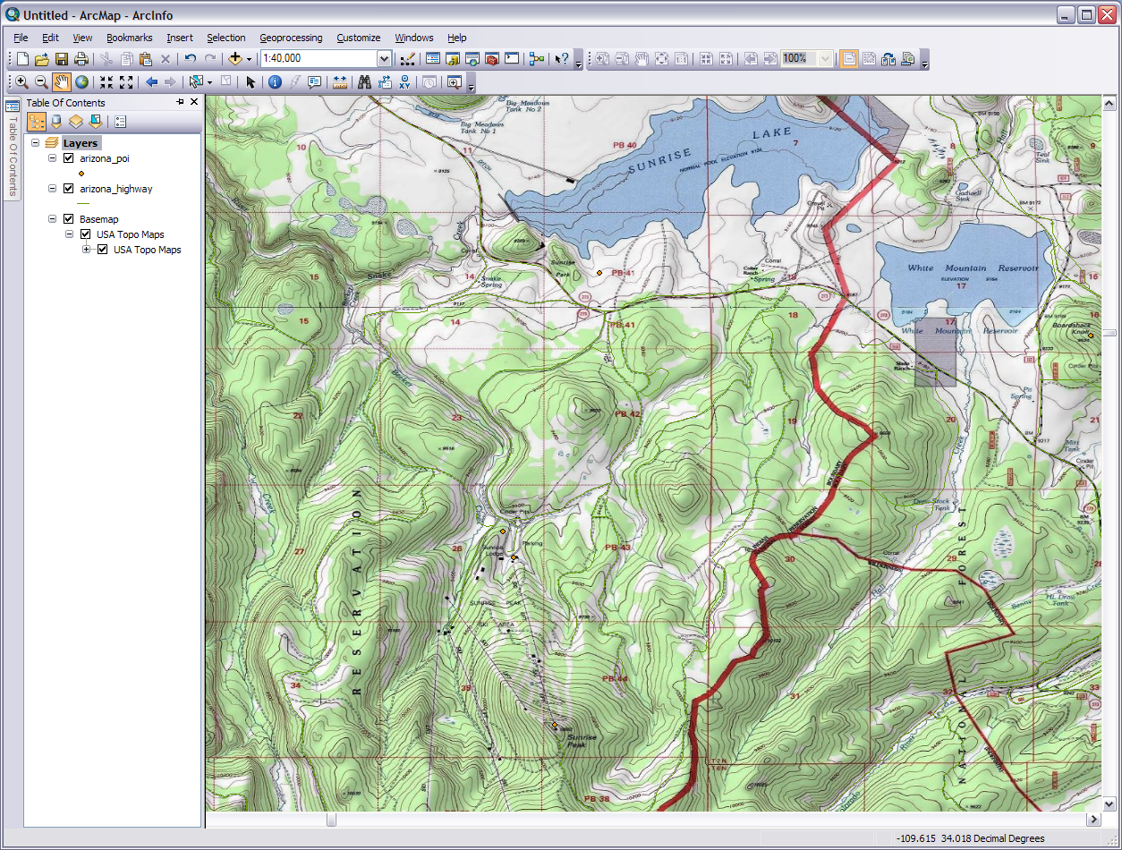
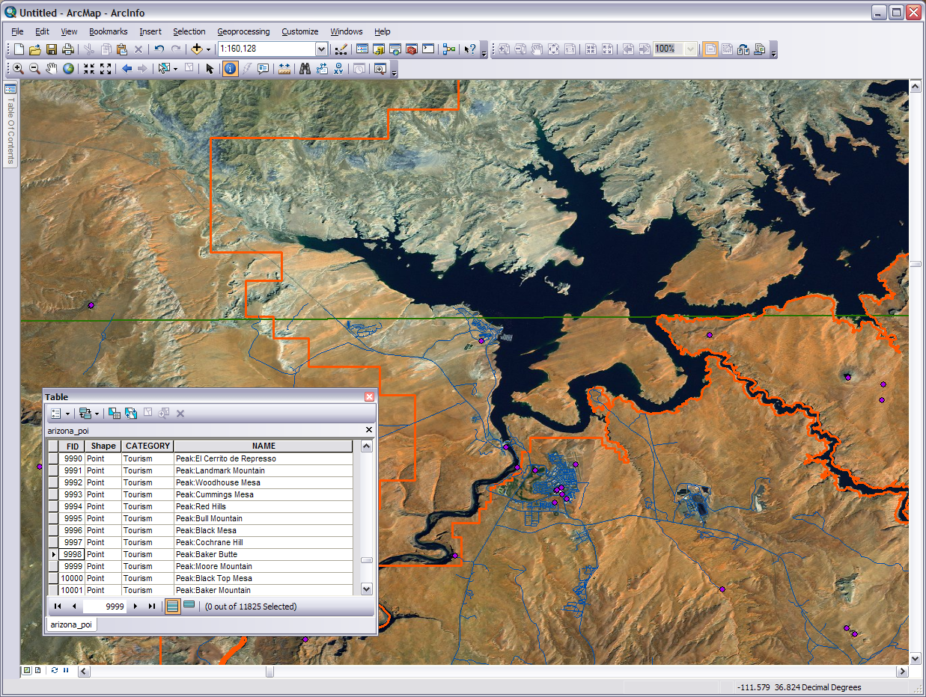
Polygon feature class of the state boundary
Polygon feature class of Glen Canyon National Recreation Area boarder
Raster image basemap
These point feature classes represent locations of interest such as Cummings Mesa. All spatial objects have an attribute table
Line feature class of Arizona roads
Notes:
So this is how the data can look in a GIS. Wow there is quite a bit going on here! We have several vector features, a raster basemap, and an attribute table all relating geographically. This screen was to put together to show you how spatial data looks visually when you put things in concert. It’s much more than just a map. You can see how the state and National Recreation Area boundaries interact and layover the different features in the terrain. This can be helpful for jurisdictions on landscape clean up projects in the area or knowing what authorities you need to talk to if you are planning on setting up a hotel on the north tip of Antelope Island. Those blue lines will certainly help with knowing how close to certain features of the landscape you’ll get while working or playing in the region. If you are looking for a particular Arizona point of interest you can search for it visually on the screen or in the attribute table . Just select the right one and the software will take you right to it. You can manipulate and edit each of the layers to run ‘what if’ scenarios, compare different sets of data, or use any of the many GIS analysis tools to derive answers from the data.
I should also mention at this point that there is a fourth category of data behind all the others. Metadata is basically data about data. This is the background documentation about your GIS data or any data. For example a picture might have information in its metadata about when it was taken, by whom, with what camera, the settings of the camera, and so on.

Slide 11
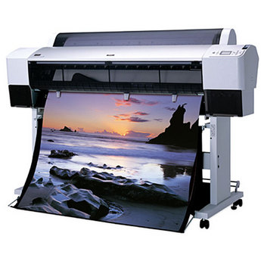
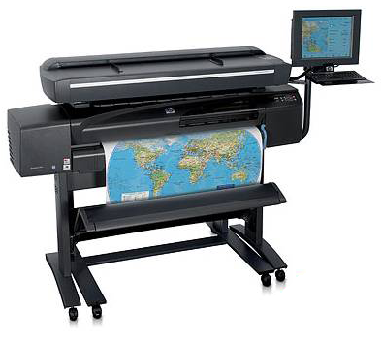
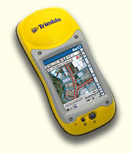
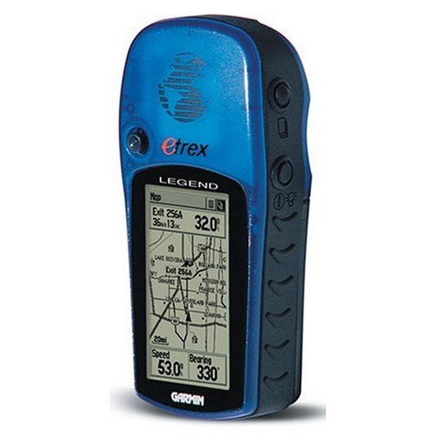
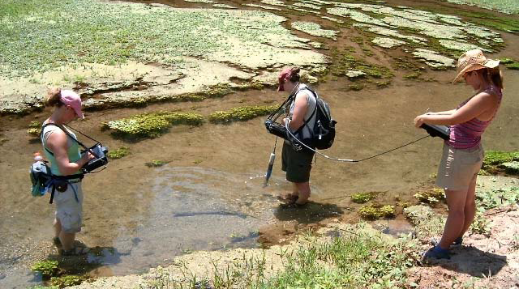
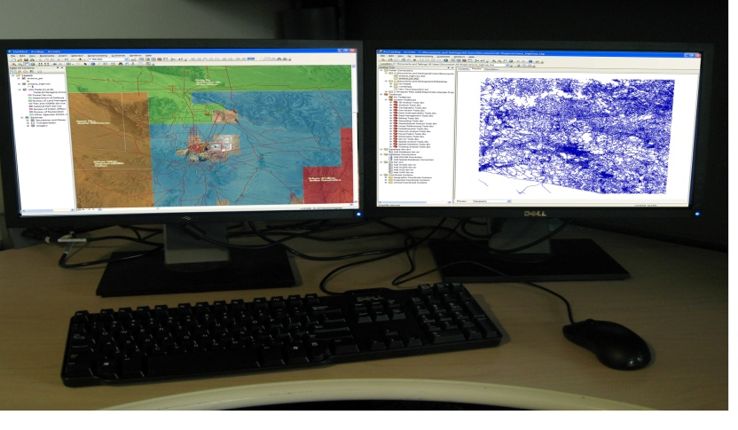
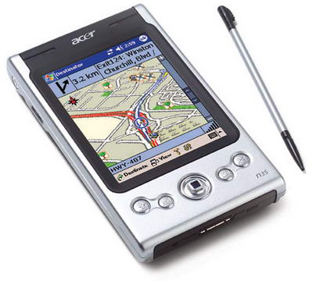
Hardware
Collection, Process, Delivery
Image Source: Trillium Wood Golf Club
Notes:
Most GIS operations today are digital and that requires some technical equipment. A GIS incorporates hardware for three different functions. The hardware may be standalone, multifunctional, and interactive. There is hardware for data collection, processing, and delivery methods. Gear such as satellites, GPS units, scanners, digitizers, PDA’s, mobile PC’s, rangefinders, survey equipment, and ground monitoring stations are used to discover and collect primary or new data by means of field work and remote access. By having access to the internet or a database secondary or established data can be collected.
Perhaps the most familiar and used hardware in GIS is the office or home computer. These computers are where ²/₃ of all GIS work is done. Most of the major editing, organizing, interpreting, analyzing, transcribing, and other data/information processing is done with this hardware. This group of gear also includes handheld and field computers. Spatial data/information collection and processing is good but a GIS becomes valuable when it has a deliverable product.
The most common and recognizable of GIS deliverables is the map. This comes in either electronic or print form. Posters for presentations are also frequent in GIS. Printers of large and small formats are used to turn out maps, posters, and other GIS products. Other hardware can be used to convey GIS results. For example: A dispatch director operating a GIS from a base location can use radio communications and field equipment with real-time updating to help search and rescue personnel coordinate efforts during a disaster. The hardware can be as simple as a handheld GPS or as complex as sub-meter accuracy survey suite.

Slide 12
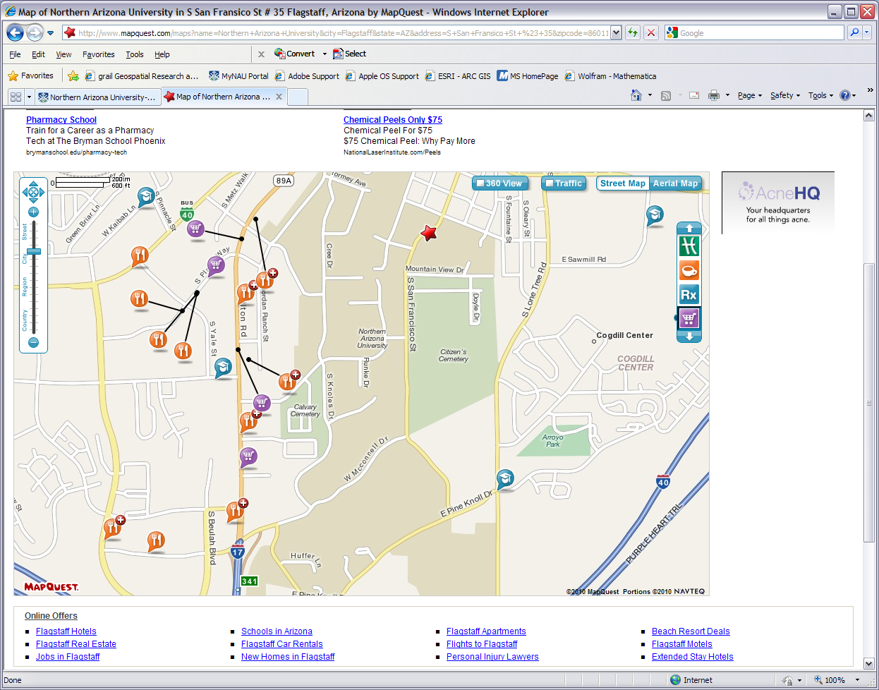
MapQuest & Google Maps
Notes:
Our next category, software, covers the heart of modern GIS. This ranges from simple map makers to industry tools. Starting with simple online GIS let’s look at Google Maps and Mapquest, the familiar place finders. Simple to use. You just type in the address or what you know of the address and the program pops up with a plain-jane street map. Press the print button and you have your map. You can zoom in & out, place an aerial base map under the streets, sometimes get an idea of traffic in the area, and possibly a 360 degree street view. You can also turn on & off different place locator icons for things like restaurants and schools.
Some downsides are the advertisements off to the side, you can’t edit or add data, and the directions you get from Mapquest and Google Maps are not always the best or accurate. Some of the layers you can turn on here are the same and some are different than Google Maps. The maps made by Google and Mapquest may appear a little different because they display things differently and the data may come from different sources. Sometimes it’s just a matter of preference which one you use. With any map program you are using for navigation it is best for you to use the map to plan out a route on your own and do it before you leave the house.

Slide 13
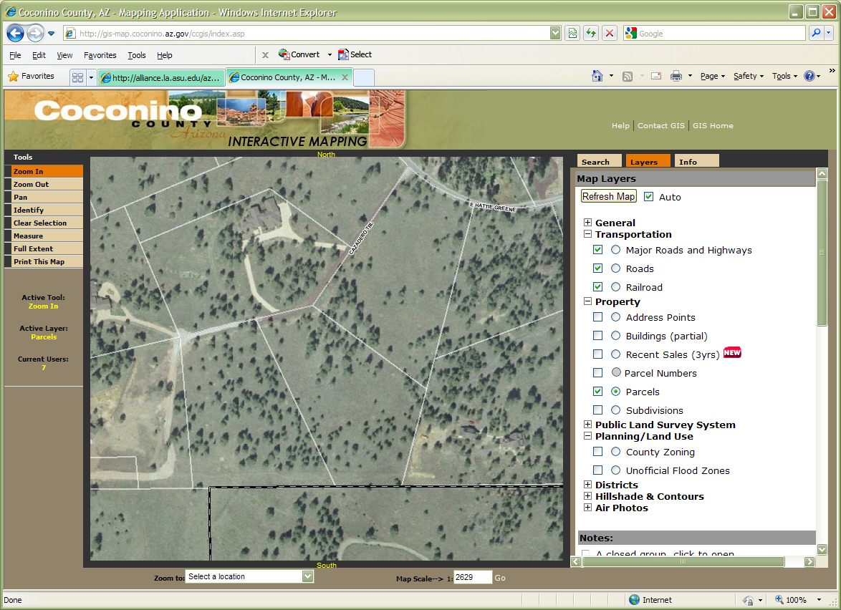
Coconino County GIS
http://gis-map.coconino.az.gov/ccgis/index.asp
Notes:
Many cities, counties, and states have their own mapping or GIS engines. These are usually limited in their capabilities but do allow you to make a quick 15 second map and often have local information that other map programs will not. This map maker from Coconino County has layers for property parcels you could use to know the extent of a plot of land you are looking to buy or where your land ends so you can build a fence. It is fairly easy to use and can be more relevant to your area than a basic street map.

Slide 14
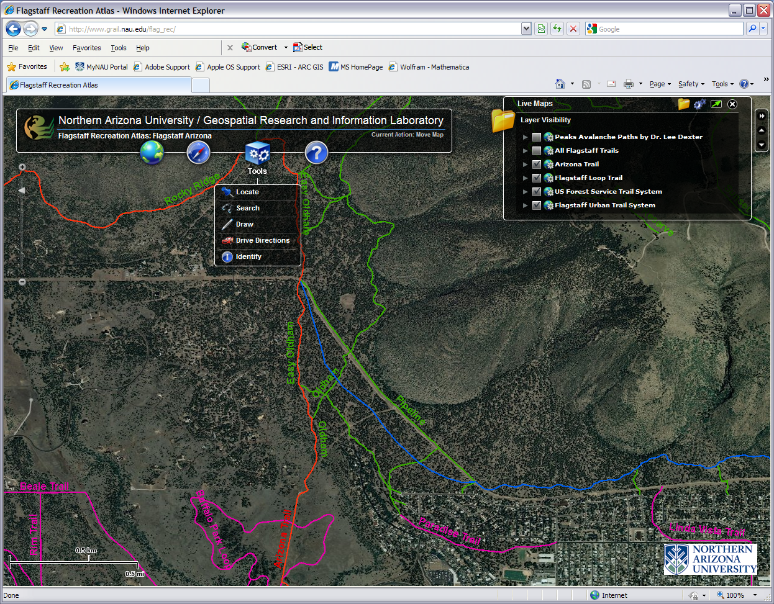
Flagstaff Recreation Atlas
http://grail.nau.edu/flag_rec/
Notes:
Quick online map making machines are being developed all over the world wide web. Here is a fun and useful product recently made available by NAU’s GRAIL. With the Flagstaff Recreation Atlas you can turn on & off different layers, have satellite, topographic, or street map backgrounds, and the tools let you draw on the map. There is an environmental layer about the Peaks’ avalanche paths and one for wildfire perimeters. This app is just getting started and more layers are forthcoming.

Slide 15
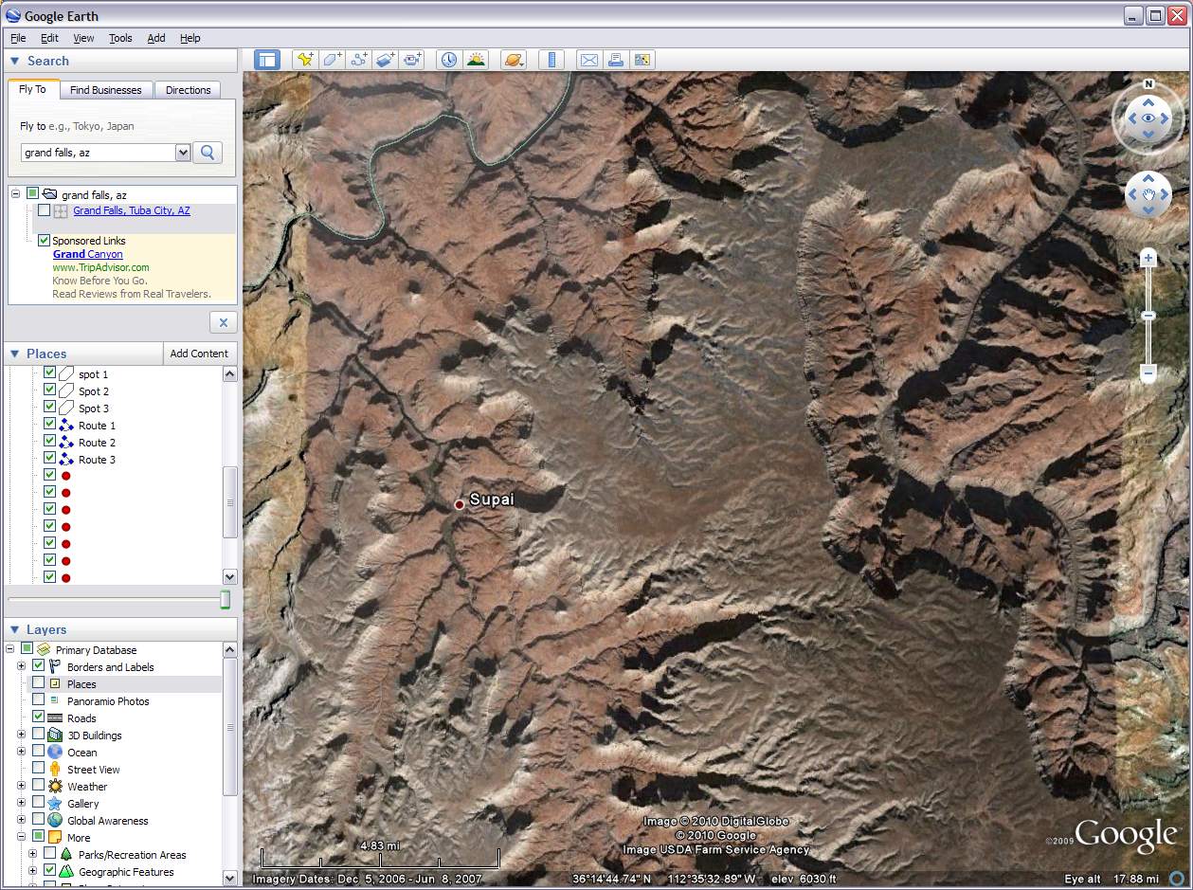
Google Earth
Notes:
GIS software also combines online database servers and desktop applications. From the friendly folks at Google this free download provides more than just a pretty picture. This popular app that many of you may already be familiar with is actually very useful in light cartography and other GIS projects. You can turn off & on different layers like others we have discussed but there seems to be more general interest layers here than most offer. There is also much to play with on the top tool bar from drawing to comparison of past imagery. Some of the 3D things you can do with this are out of this world, literally. You can explore the night sky, make maps of the Moon, and have your own rover mission on Mars. But coming back down to earth, Google has some simple tutorials for most of the fun things you can do with this digital globe. In the professional versions you pay for you can export data that can be used by high end GIS software.

Slide 16
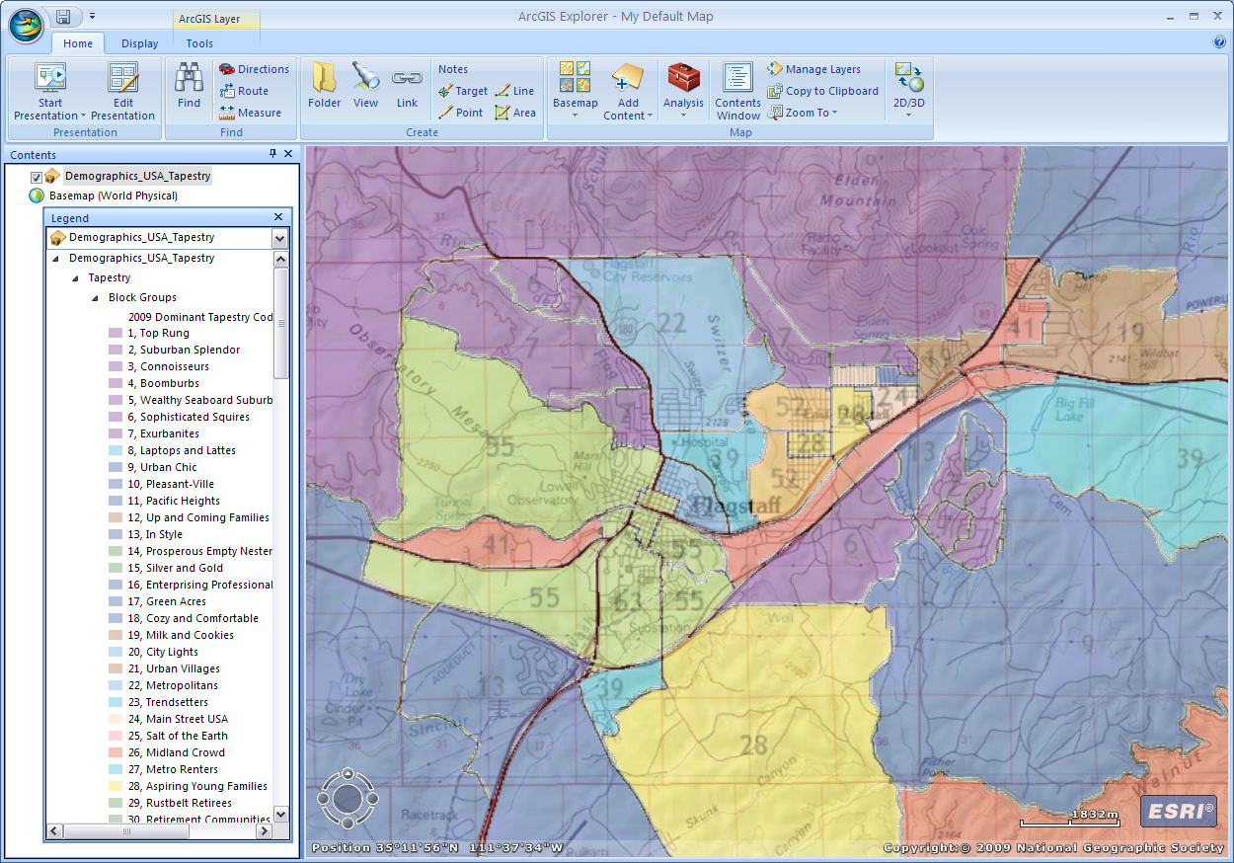
ArcGIS Explorer
Notes:
ArcGIS Explorer is a free download from ESRI or can be used online at arcgis.com and clicking on the word map. The online version is a bit more limited so I prefer to download the desktop version. This is a very simple GIS program. It comes with online access to some basemaps when you download it. When you click on the add content icon you can add your own data and also add data from the arcgis.com community. You can draw your own lines, points, and shapes as well as run the map in a presentation mode. It is a useful tool anyone can use and the program has access to free data. It does export data to small degree in proprietary or its own unique format.

Slide 17
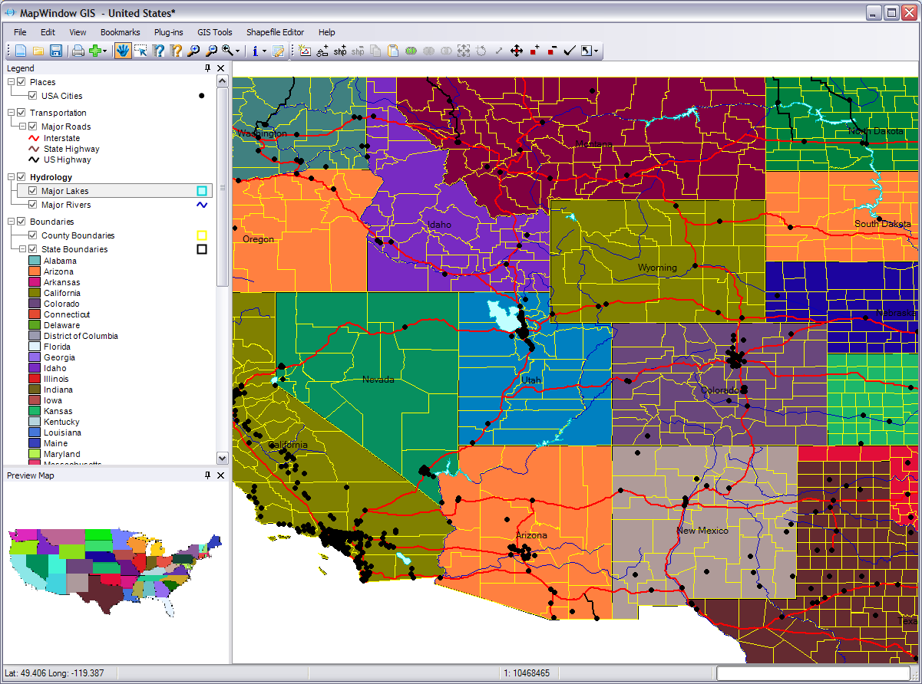
MapWindow GIS
Notes:
MapWindow GIS is a professional desktop GIS software. It is open source software that can be downloaded and run for free. With MapWindow GIS you can edit shapefiles, run various geoprocessing tasks and analysis, and create some GIS products. Many simple GIS projects can be done using this software. It is useful if you are not able to get access to higher end GIS software and does more than the software previously discussed. It does come with some simple datasets but for the most part you need to add you own data. There is a similar open source product called Quantum GIS that also does professional GIS.

Slide 18
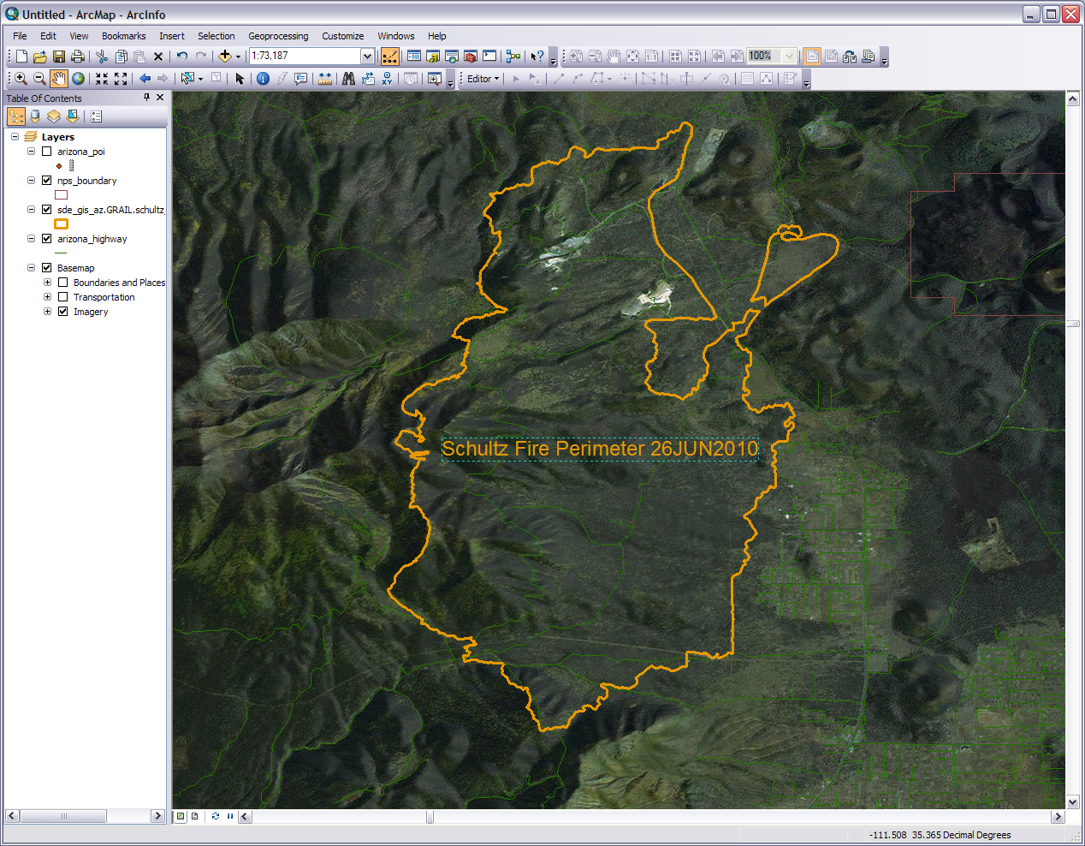
ArcGIS
Notes:
Top of the line full on professional GIS software. ArcGIS users range from small businesses to national governments. This does everything from a simple map to high end 3D geospatial visualization. You can access some basic datasets for it from ESRI but it is made for you to manipulate your you own spatial data in a thousand and one different ways. Some parts of it are rather easy to operate and others are beyond the comprehension of mere mortals.
ArcGIS is actually a suite of programs. Shown here is ArcMap where much of the visualization and analysis work is done. You also have ArcToolbox, ArcCatalog, and others that are used for processing spatial data before, during, and after work in ArcMap. The software can technically be obtained for free but you need a costly annual license to operate it.

Slide 19
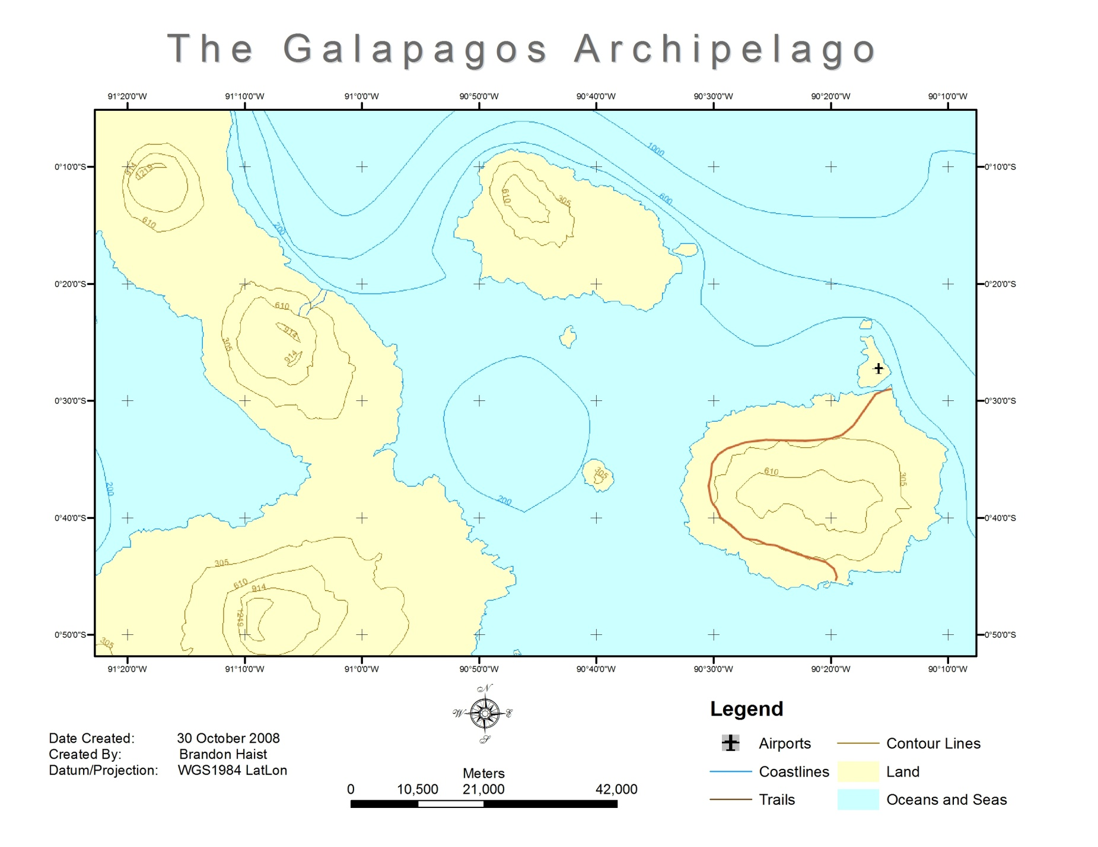
Map Title
Map area
Data Frame
Neatline
Grid
Legend
Documentation
Scale Bar
North Arrow
Notes:
We mentioned maps in GIS several times. Let’s cover each of these common map elements starting at the top. First off we have the map title. Simple and intuitive. This of course tells us what we are looking at and gives an idea of the purpose of the map.
Next, moving to our left, is the data frame. This marks the boundary between the data and the metadata or if you will, the main entrée and the supporting side dishes. Regarding the metadata, in this map everything inside the data frame might be able to stand on its own but without the stuff outside the data frame you lose quite a bit of background and interpretation about the main data including how to understand and use it.
Moving on we go next to the neatline. The frame of the whole product keeps everything organized and focuses our attention. Simple but effective.
Now we’ll take a look at the documentation. The documentation is important because it is raw and specific metadata that verbally gives the map’s background information. When someone refers to a product’s metadata they usually mean the documentation, especially in GIS. Here is a user case example: if we were tracking the customer base for a business using a map with “date created: 5 May 2001” we might not be able to track those customers who live in a new housing subdivision that was build in 2006. In this simple case if the documentation wasn’t there we might be using a map that was irrelevant for our purpose. You will want to document any pertinent information the reader of the map is going to need. The more technical the map the more documentation is needed.
Moving to our right we find the familiar scale bar. This friendly element can be a graphic as show here, can be stated with text such as 1 inch = 21,000 meters, or both can show up together on the map. So on our map here if were to measure a 1 inch distance between one point and another it would be equivalent to 21,000 meters on the actual earth.
Next up is the popular North Arrow or compass. This of course tells us what direction on the map is north. It can also orient us with east, south, and west. Even though it usually is, DO NOT make the mistake of assuming that the top of the map is always north. Always take at least a quick glance at the north arrow or compass (sometimes called the compass rose). Case in point: I have a trail map of the Paria Canyon, a really long canyon. The map is folded into several sections and it is easier to hold and read if done horizontally. This makes north on the left or right side of my Paria map depending on which way I am headed. On some maps the north arrow or compass will point in a direction other than the top of the paper or you rotate the map yourself like I did with my Paria map.
So Rounding the bend we have the Legend or key. This explains what the lines, areas, and points on the map mean. We can probably figure out that the blue areas on the map represent oceans and seas, but without the legend we could easily be puzzled regarding that curving brown line on the big east most island.
Now we come to the grid also know as the gradicule or coordinate system (not to be confused with the projection which is another story). Most people are familiar with latitude and longitude and that is the grid you’ll most often find on a map you by at the store. They may also have simple coordinate system for that specific map of letters up one side and numbers across the top or bottom. The grid or grids (there may be more than one) allow the user to locate specific points and areas on a map and relate them or the whole map to the rest of the globe.
Lastly we arrive at the map area. This is the meat of the map, the whole purpose for having the other elements, and where you communicate to your target audience. The map area contains your image, mountains, valleys, trails, rivers, lakes, streams, overlays, population data, traffic data, contemporary and historical battles, points of interest, locations of endangered rocks in Safford, the distribution of starving cats in Kingman, and other spatial relevance. In the map area you are visually presenting the spatial relationships of the physical components of a spot on earth and data connected to that spot. There are additional elements that can be included such as a small reference image off to the side, a magnetic north arrow, a zoomed in inset map of a certain spot, or others but the ones shown here are the basics.

Slide 20
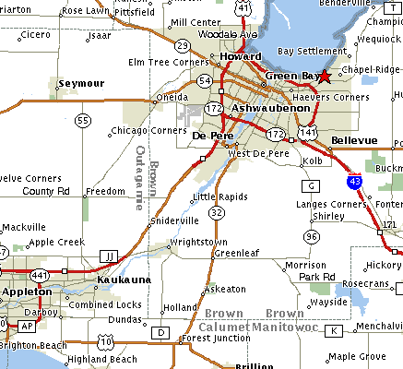
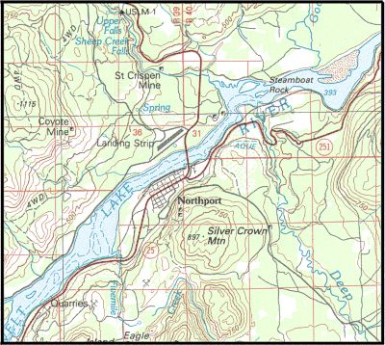
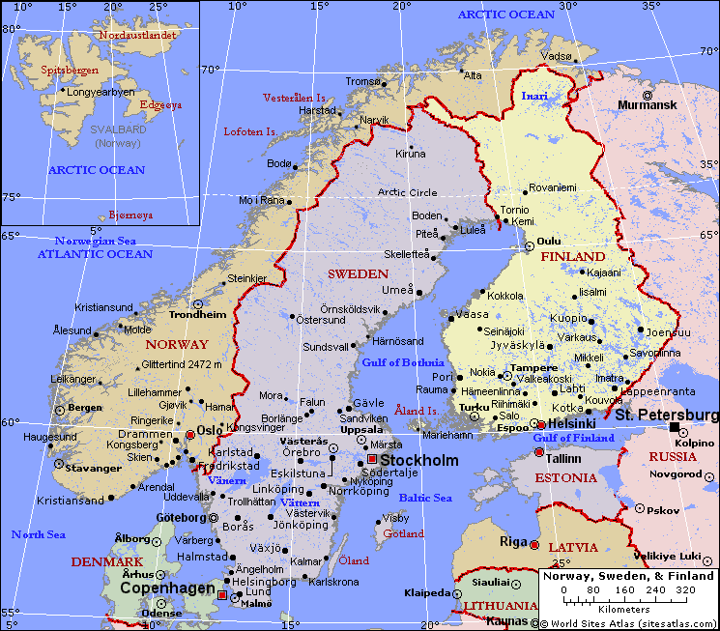
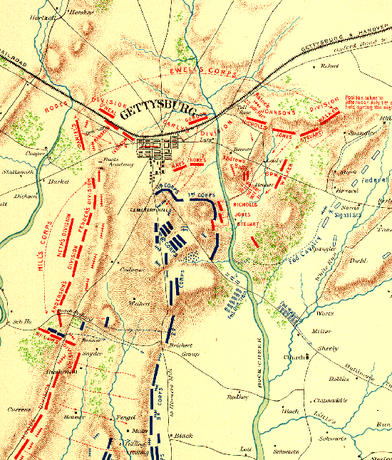
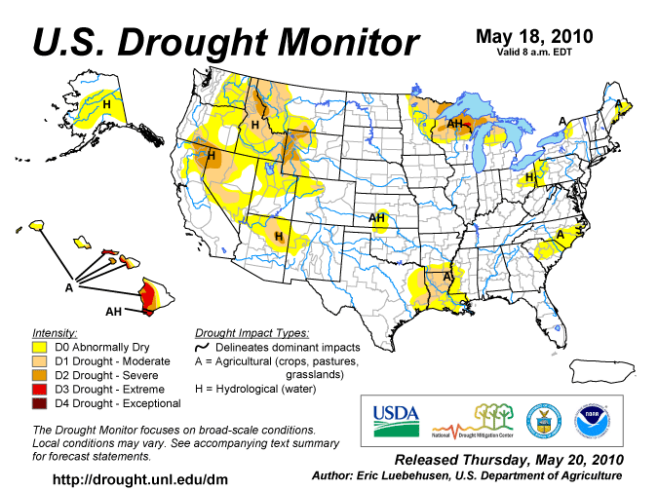
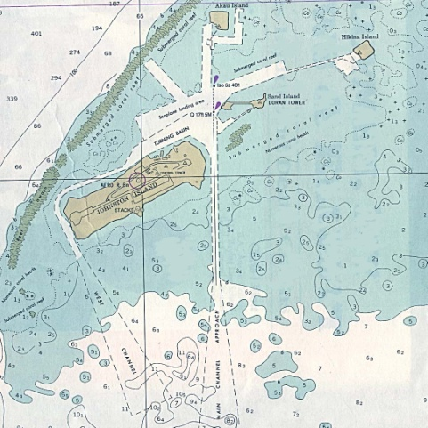
m
Map Types
Street/Directional
Topo/Physical
Political/Reference
Historical
Thematic
Charts
Notes:
The elements in your map also determine the type of map you are creating. For example, if you were to prepare a report for the county commissioner or your political science teacher you might want to use elements of a political or street map. Different people use various names and categories but here we are just trying to help you see there are many unique map types. Most of these are familiar if you’ve ever looked at a map.
First is the ever popular street or directional map. These show of course streets and where they are relative to each other. They won’t show much about the physical terrain other than blue for water and green for relevant park and tree areas. The street map usually has a have a plain background and may also show some points of interest like post offices and theme parks.
Second you have the topographical or physical map. The defining characteristic element of these maps are the contour lines that show elevation. These are meant for understanding trails, non-major roads, rural areas, topography (hence the name), basic hydrology, and the general lay of the land. They aren’t to good at showing urban areas but they do make good basemaps and are very good at helping people understand the shape of the land. They are often used with GPS units. The GPS units tells you where you are and the topo will tell you about the area. If you plan on adventuring outside of the city take one or more of these along and study it.
Third we have the political or reference map. These maps have the purpose of showing political boundaries relative to one another. They may show some major roads, cities, lakes, and rivers. They are good for understanding where places are in the world without being cluttered with contour lines (like in topos), detailed grids, insignificant points of interest, or every single road and town in the country. Like street maps, they too are not much good for understanding the terrain or elevation.
Fourth in line is the historic map. The historic map’s purpose of course is to help us understand the spatial conditions of an event or place in history. These can contain any of the defining elements of the three previously discussed map types as well as the next two maps types we will discuss. Historic maps have their own category because their unique element is the event or time they communicate. This type of map is a snap shot about a specific spatial happening. This can be as old as The Battle of Gettysburg shown here or as recent as the oil spill in the Gulf of Mexico. Also included in this category are vintage maps. The vintage may not show a specific event but because of the way maps were made back then we can learn something about the era in which it was made.
Fifth is the thematic map. I suppose any map could fit in this category as all maps have some sort of theme in them, but what makes this type stand out is that they are made to communicate specific contrasts in data distributed spatially. In other words the thematic map shows the different amounts of certain types of data spread out over a geographic area. This can be anything from the population growth in a county over the past year to the number of guest on the different waterslides at Sunsplash. Sometimes part of the theme includes change over time. In the example here the map shows a theme of drought across the U.S. on May 18, 2010. Notice if you can, in the legend the color comparison of possible levels of drought and the distribution of those colors in the map area.
Last we have charts. These cartographic products are important technical navigation tools for boats, ships, planes, and helicopters. The one shown here shows specific depths in the water at certain points as well as shorelines, sandbars, and other obstacles.

Slide 21
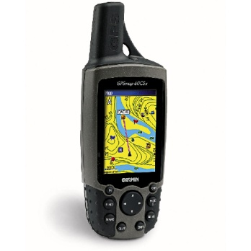
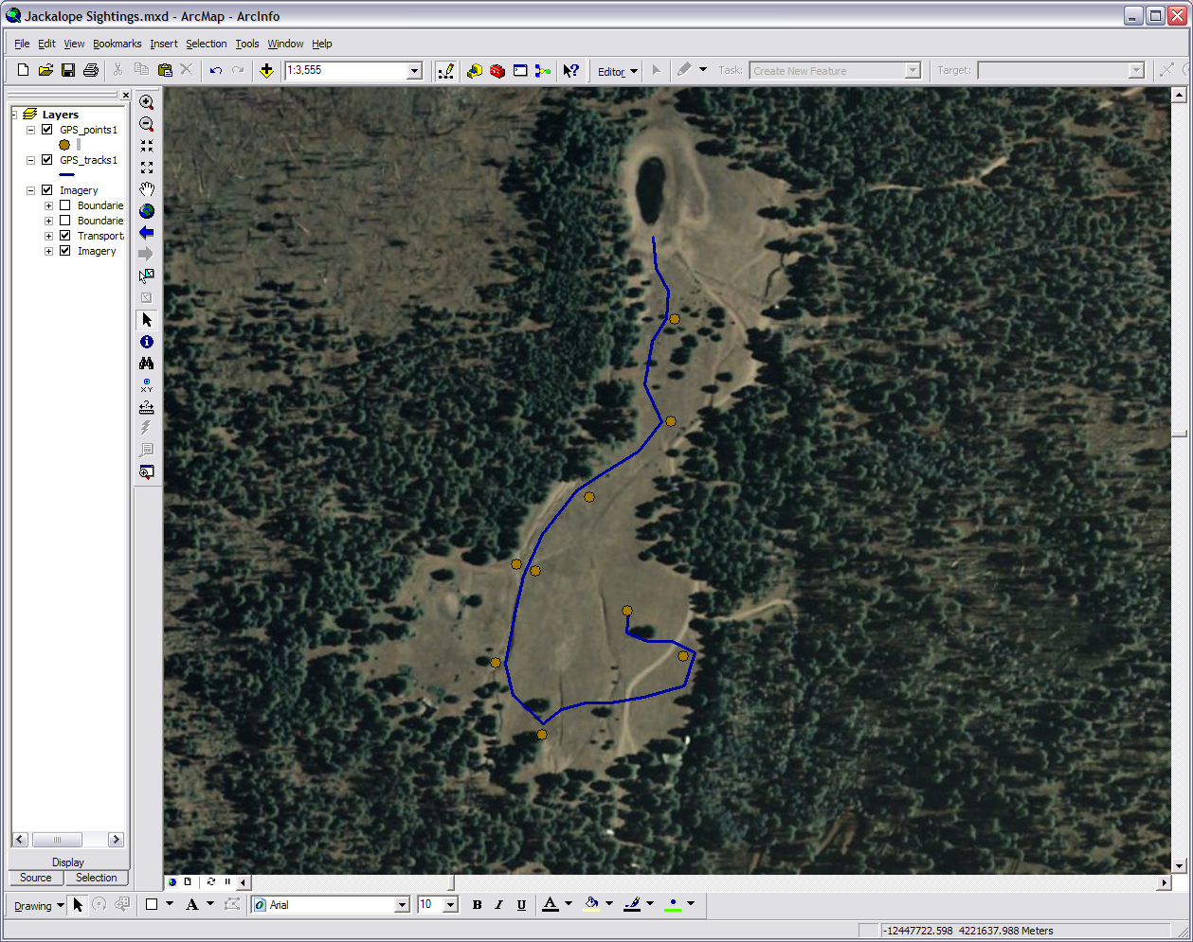
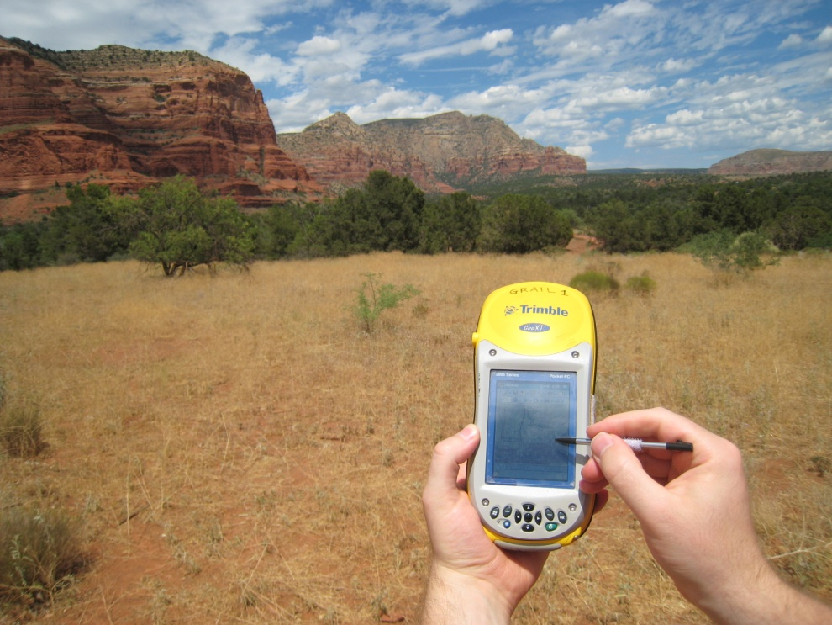
Satellite A
Satellite B
GIS
GPS
Satellite C
Satellite D
Notes:
Before we end this module let’s take a moment and look at GPS. A GPS (Global Positioning System) is a common tool in GIS. Techniques for gathering data in the field often use a GPS receiver unit in some form or another. The way GPS works is there is a constellation of GPS specific satellites orbiting the earth that are constantly sending out signals. Your GPS unit picks up those signals. Using a method called triangulation or trilateration the satellites and unit can pinpoint your position.
If you will look at the satellites and their signal spheres in the upper left image you see A and B overlap at the large white area. Bring in C and you have a more precise location at either the red or green dot. With D all four only meet at one point: the green dot. That is where you are. The GIS program on you home or office computer interacts with the GPS unit.
In the image on the bottom right I went out on a run near Kendrick Mountain and marked all the spots (waypoints) where I saw a jackalope burrow. The unit also created a record of my running path. I took my unit back to the office, download the waypoints and the running track, used a GIS program to put them on top of an image, and made a map.

Slide 22
Any Questions?
Please Contact:
Mark Manone Training Facility Coordinator Mark.Manone@nau.edu (928) 523-9159
“To map out a course of action and follow it to an end requires courage”
Ralph Waldo Emerson
Notes:
So basically a GIS is a tool to help us understand how anything relates to locations on the earth. In the next module we will do an exercise where we work your data into Google Earth using simple GIS techniques and in the last two modules show you how to make simple maps. Please also take a look at our Introduction to GPS, Introduction to GIS, and the 15 Minute Map for more ideas on how GIS can help you in your classroom or workplace.

