Slide 1
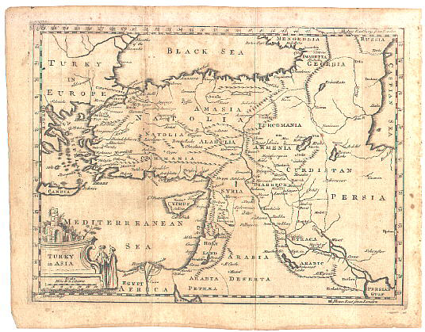
The
15 Minute
Map
Module 4
Created by: Scott Kelly 2010
Notes:
In Module 1 we introduced you to mapping programs and elements. In Module 2 we showed you how to make a 15 minute map using nothing but Google Earth, PowerPoint, and your imagination. Module 3 introduced us to a little more professional map making. Now we are going navigate into some clear GIS territory and show you how you make a map in about 15 minutes with some industry standard software.
For this Module what you will need is ArcMap and ArcCataolg, both are part of ArcGIS Desktop. This will work with Arc 10 or 9.x. If you don’t own or have access to these programs you can still go through this module as it will help you to get familiar with ArcGIS for when you are able to get access. If you can get to GRAIL or any other GIS lab then you may get more out of this workshop. NAU users can access the campus’ virtual labs and they will have ArcGIS. Do a connect to virtual desktop and connect to windows.cefns.nau.edu. These programs are not free and are not cheep. In this module we also assume you know some basic computer skills such as managing files you have downloaded from the internet. So whether or not you are able to use ArcGIS lets get started.

Slide 2
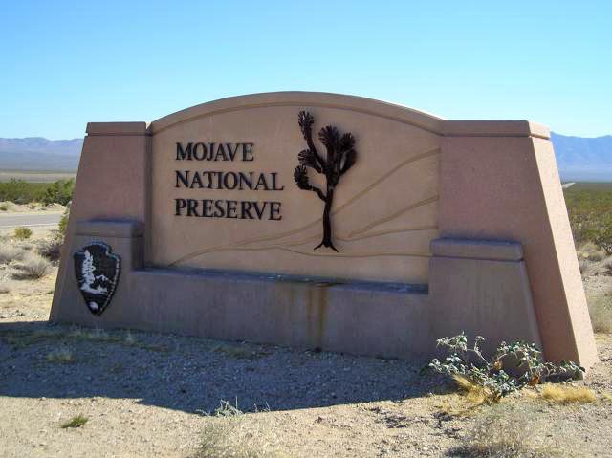
Notes:
The scenario we will use for this 15 minute map comes from a real life GIS project. A history professor was doing a research project on the historic Mojave Road in the Mojave National Preserve. The professor needed a map for the study but was unable to find one of just the Mojave Road and the data desired. With the use of GIS and data from the National Park Service the professor didn’t have to settle for a general tourist map of the area. This map may take us a little more than 15 minutes but when we are done you can say “wow” at the awesomeness of your creation. The map is intended to take around 15 minutes; the module is intended to take about an hour.

Slide 3
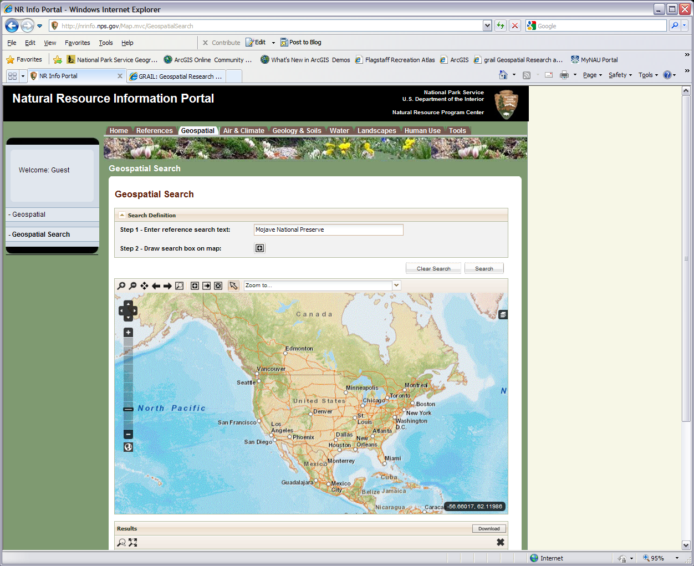
The preserve is between I15 and I40 south/ southwest of Las Vegas
Notes:
The first thing we need is to get some data to work with. Make a project folder in My Documents, on your desktop, or somewhere else to keep all the files together. Since we are working with land under the jurisdiction of the National Park Service (NPS) then the logical first place to try for data is the NPS. Here we are in luck. Sometimes in a GIS project the most time consuming task is searching for and finding data.
If you Google “Natural Resource Information Portal” and click on the Geospatial tab or go to http://nrinfo.nps.gov/Map.mvc/GeospatialSearch then you should end up on the web page shown here (formally the NPS Data Store). You can use the interactive map or type in a text search and press the search button on the right (recommended). No matter which way you choose, go to the Mojave National Preserve (where the red arrow is pointed in California) and take a look at the available sets of data (datasets).
Note: please try downloading the shapefiles listed in the next slide. This is to help you learn about how one part of online spatial data works. As with all technology things change and don’t always work. If you are unable to download the shapefiles feel free to download the support package associated with the module. It contains the shapefiles needed.

Slide 4
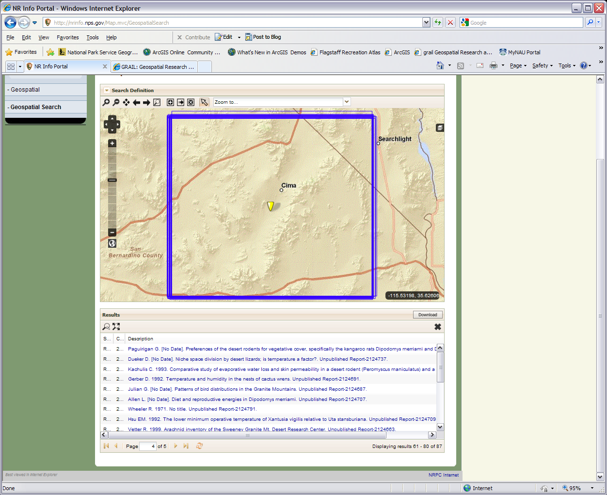
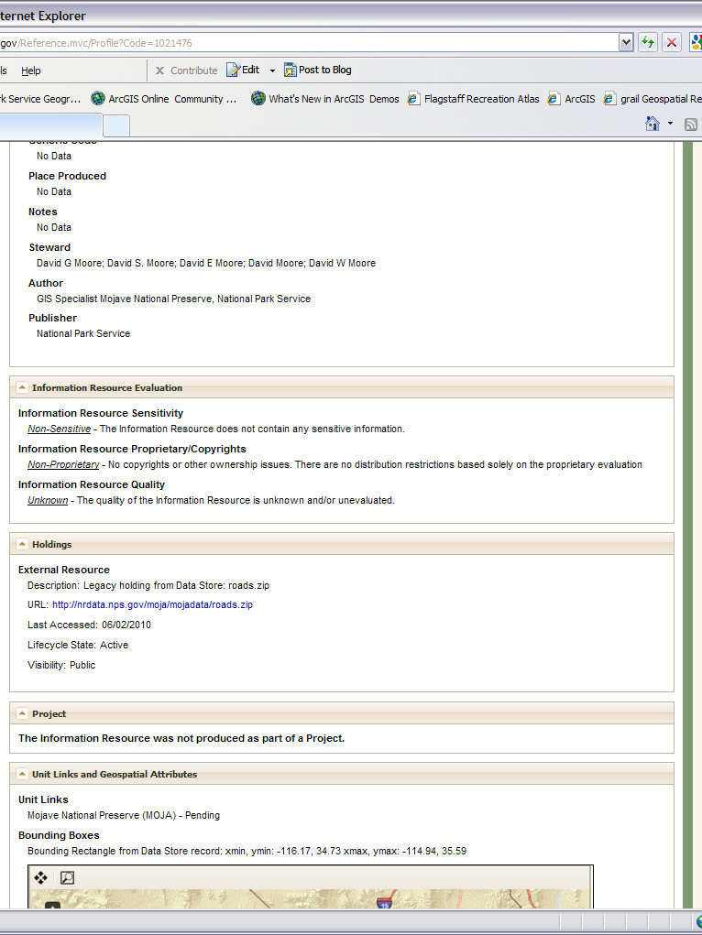
Scroll down to here and click this link to download the zip file. Sometimes you will get to this page and the zip file isn’t there so you have to find another source outside the NPS
Click on one these links to bring up a reference page like the one on the right
Be Sure
and have a
decompression
program
Notes:
After you press the search button and press OK the results will be shown at the bottom. This is just like any other table so adjust the columns so that you can read the full description of each one (hover the cursor over the lines that separate the columns to get a resize handle). You can also eliminate columns with the dropdowns. We are trying to get it where we can read the full descriptions. Use the slider bar as needed.
The Our goal is to make a map of the Mojave Road. We need to download the roads shapefile usually on page one of the results list (called GIS Specialist Mojave National Preserve, National Park Service. [No Date]. Roads of Mojave National Preserve, California). Click on it and you’ll be sent to a reference/metadata page that has the actual download item in the Holdings. Sometimes when working with this NPS site there is no actual download item. Let’s also download the park boundary shapefile on the same page (called GIS Specialist Mojave National Preserve, National Park Service. [No Date]. Boundary of Mojave National Preserve, California. National Park Service). For the boundaries, even if you have the shapefile that covers the boundaries for all the places under NPS it will work just fine. Both of these are compressed as .zip files.
If you are not familiar with shapefiles you might want to pause for a moment for a brief explanation. Shapefiles are the digital designation (.shp) a GIS uses for individual standalone points, lines, and polygons (vector imagery, see the appendix for Module 2). The shapefile is accompanied by some necessary support files that do things like tell that computer what coordinates are in that vector element. So when you download the roads and the boundaries there will be several other files you DO NOT want to erase or modify. When we add the two files we just downloaded to ArcMap they will show up as lines and polygons overlaid on our basemap. Also note for future reference: If a vector image is inside of a geodatabase it is called a feature class (instead of a shapefile) and uses many of the same support files the rest of the geodatabase uses.

Slide 5
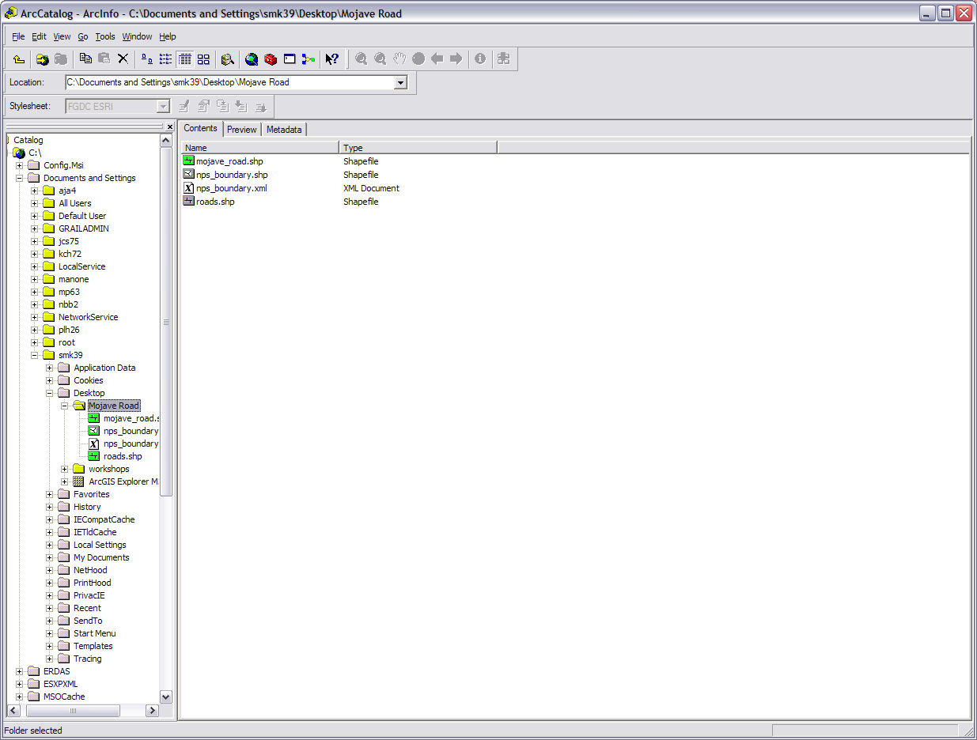
ArcMap access
File tabs
New copied and renamed
roads shapefile
Connect to Folder &Up One Level
Folder of shapefile location
Notes:
We need to do a little more prep work so the next step is to open up ArcCatalog. In Arc 10 you can open it up as a separate window as shown here or work with ArcCatalog inside of ArcMap. Once ArcCatalog is open drill down to where your shapefiles are located. You can use the “connect to folder” button on the left side of the icon menu or use the directory tree on the left sidebar. We want to be at the folder where the shapefiles are located (not all the way into a specific shapefile yet). You can use the yellow bent arrow on the icon menu to go up one level if needed. When you are there ArcCatalog will show your road.shp and nps_boundary.shp in the main window with maybe an extra file or two. Unlike windows explorer, ArcCatalog shows only the files you need to work with. It doesn’t show all of those support files because you don’t need to and shouldn’t do anything to those. When you change the shapefile or another file in any of the ArcGIS programs the support files are automatically adjusted.
Now select the roads.shp file in the main window and click on the preview tab. You will see a bunch of colored lines that represent the roads in the Mojave National Preserve. Well we are only concerned with one specific road, so we are going to need to edit this file at some point. Let’s make a copy so if we make a mistake have a back up. (1) Click back on the folder where the shapefiles are located and on the “Contents” tab. (2) right click on the roads.shp and copy/paste it in the same folder. If we were to do this in windows explorer we'd also have to make copies of all the support files but by doing it in ArcCatalog all of those are taken care of in the background. (3) Right click on the copy to rename it. Since we are going for the Mojave Road let’s call it that. Be sure to use an underscore between the words as ArcGIS doesn’t always take kindly to spaces. In the background ArcCatalog also renamed the support files appropriately.
If we want to we can preview the nps_boundary.shp file. The preview shows that this file contains polygon boundaries for places across the nation. We are going to be zoomed in on the Mojave National Preserve so it is highly unlikely we will need to edit this file or make a copy of it. We can just leave it as is. At this point our prep work in ArcCatalog is done and we need to open up ArcMap. Go ahead and close ArcCatalog or leave it open after you have opened ArcMap.

Slide 6
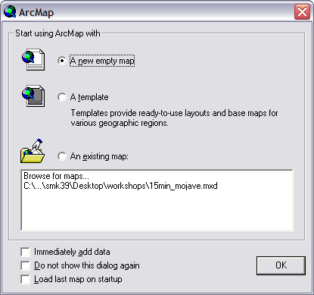
Editor
Add Data
Standard
Layout
Tools
Data/Layout
Views
Drawing
Notes:
If this is your first visit to ArcMap let’s pause the timer and do a quick orientation tour. Your view may not be the same as mine as ArcMap is customizable but you should be able to recognize different things even if the placement isn’t similar. The toolbars you will need to be aware of for this module start with the Tools toolbar I have in between my sidebar and main window. On the top left underneath the menus is the Standard toolbar with the “Add data” button (a black cross over a yellow diamond). Immediately to its right is the Editor toolbar. Right underneath that is the ghosted out Layout toolbar. On the bottom of the screen is the Drawing toolbar which we won’t be using. Just above the Drawing toolbar tucked in the corner of the main window are the data and layout view buttons. If you don’t have any of these tool bars showing you can go to the menus and click view or customize>toolbars after we have gotten started. You can also grab the handles at the end of the toolbars and move them around. In Arc 10 there may also be tabs on the right edge for ArcToolbox, Search, and others.

Slide 7
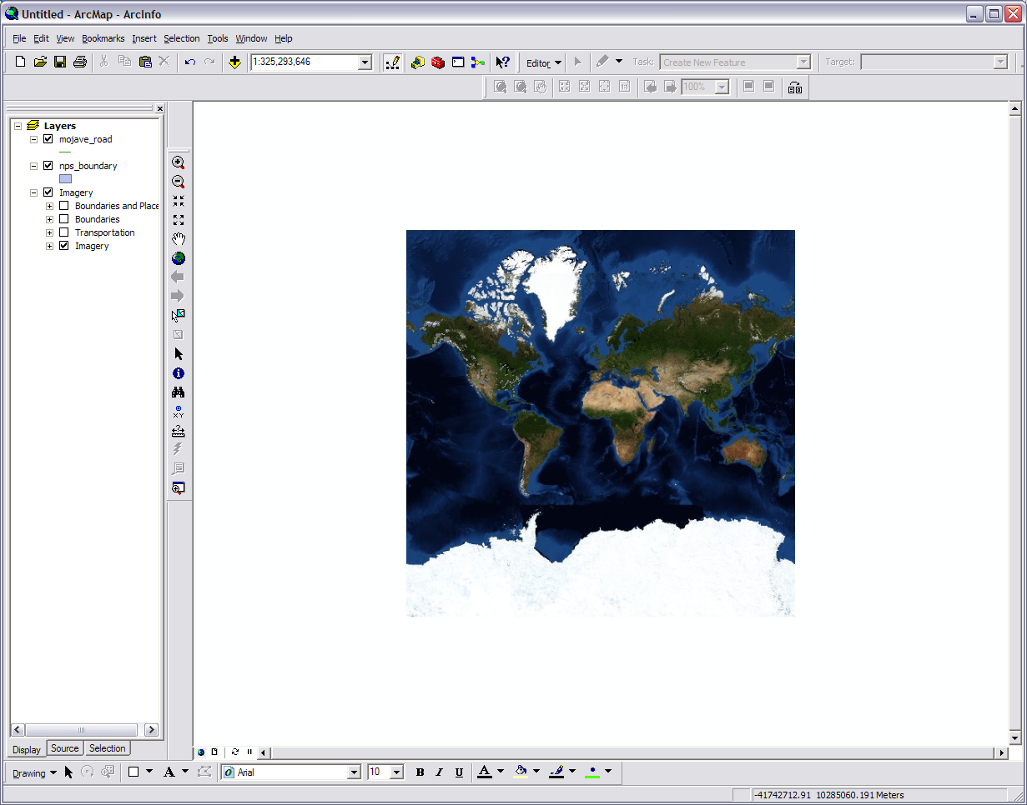
Add Data
Notes:
OK now that you have expert knowledge of ArcMap you can start your timer again and we will start building our map. Let ArcMap stay on the default of “A new empty map”, and click “OK”. First up we need to get our basemap. If you are in Arc 10 the basemaps are in the Add Data drop down. Add the “Imagery” basemap. If you are in Arc 9.x go to File>Add Data from ArcGIS.com online and download some basemap imagery. once you are at the ArcGIS Online website click the “Imagery” link on the far most left and click “open” when the download window pops up. It will put on our map the same reasonably high resolution world imagery that we started with in ArcGIS Explorer in the last module.
Next go to the “Add Data” button on your standard toolbar, find where our mojave_road.shp and nps_boundaries.shp are, and add them to the map. Alternatively you can drag and drop them from ArcCatalog. You may get a pop window called Geographic Coordinate Systems Warning. All this is saying is that the new data layers you are adding are in different geographic coordinate system and the computer will adapt them correctly. Just click “Close” and the shapefiles will show up in your layers on the left sidebar. The computer will assign them colors so they may not be the same colors as the ones here. You can change the order of any of the layers by just dragging them around.

Slide 8
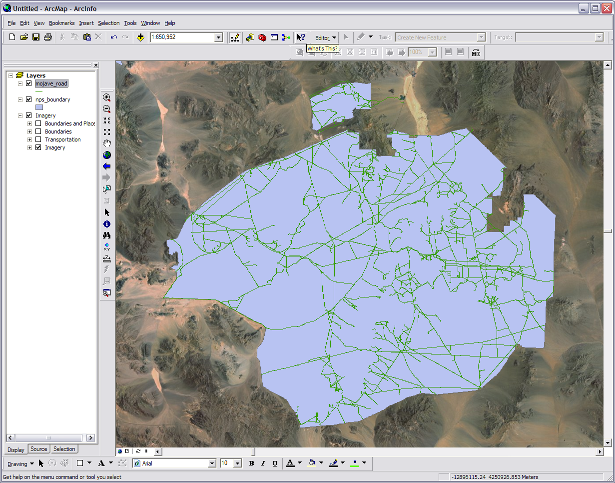
Notes:
Right click on the mojave_road shapefile layer name and click on “zoom to layer” to zoom in on the Mojave National Preserve. You will see our network of roads on top the filled in nps_boundary all over our world imagery basemap. Our good looking basemap is provided by a proprietary source so we need to take it as is, but modifying the appearance of our other two will help with working with the map and the appeal of our final product.
Put the cursor over the colored box under the nps_boundary name in the layers sidebar. Left click the box and a window will pop up. This window is pretty intuitive so go ahead and set things the way you want. The thing we do want is no fill and just an outline color. Make it thick and colorful enough to be visible, presentable, and readable. Do the same thing for the mojave_road layer. Work with the colors in the roads, boundaries, and basemap. Use your imagination. If you want you can click the check box next to transportation in the imagery layer to show I15, highway 95, and I40 on your map. Also a quick note about saving in ArcMap. The normal save/save as in ArcMap saves your work as a .mxd file. The .mxd file has what layers are in your map, where they are located on your computer, how they are configured on your map, what order they go in, and so on. What is being saved is the definitions found in your map; not the images of your map. Several different types of programs do this so that a map or other product is kept down to a manageable memory size, it makes the product very workable, and the product isn’t duplicating the images already on your computer. If you want to have your map saved with the images you need to export the map which we will do. You usually wouldn’t do that till the very end because then it becomes a just an image without layers and is no longer directly useable by a GIS. You can of course save the map at any time and it is very good to have it in a .mxd file so that you can make changes to it.

Slide 9
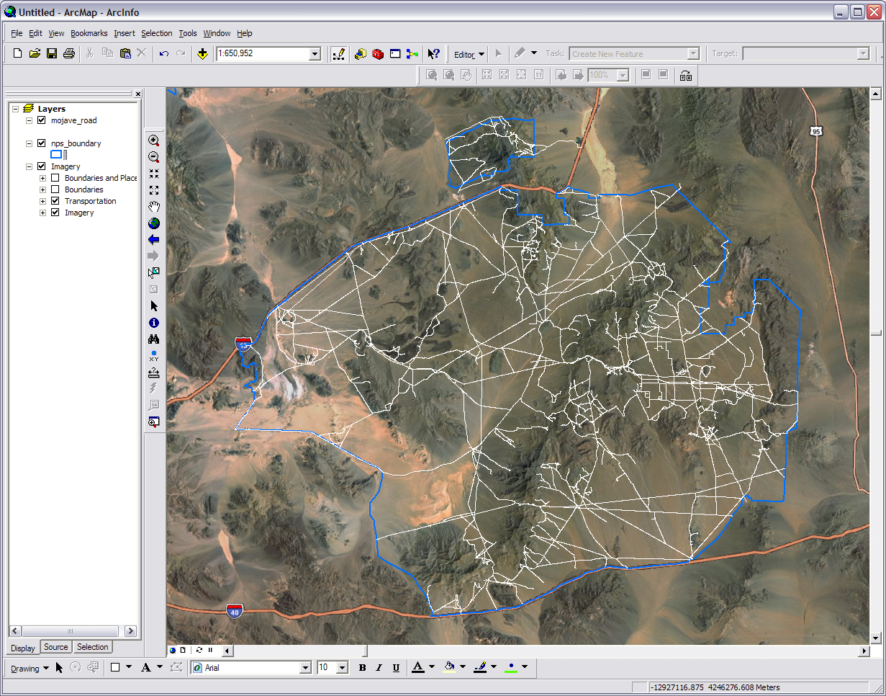
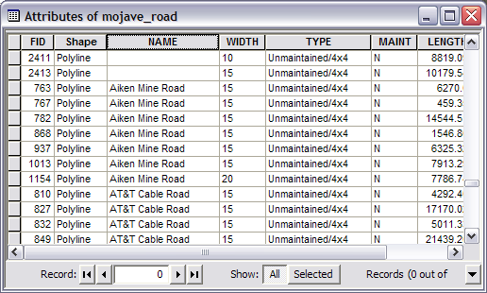
Right click on the name
Notes:
The next thing we need to do is something about all those extra roads. If we right click again on the mojave_road layer name we can open the attribute table which list all the name of all the line segments (roads and part roads) for that layer as well as other things like type and length. Scrolling down you can see this layer has 2,417 records. If we click on the square on the left side of the road’s ID number it will select it on the map. The item selected will be highlighted with a light blue in the table and on the map. You can select multiple road segments. If you click the field name “name” it will arrange the table alphabetically according to each road’s name. If scroll down again you will see that some of these road segments are called ‘Mojave Road’ so those are records we want to keep. The history professor also knew that the ‘Cedar Canyon Road’ was built over a large part of the east side of the Mojave Road as were a few parts of the ‘AT&T Cable Road’ which has fragments all over the preserve. So we know to make this map we are going to need the ‘Mojave Road’, ‘Cedar Canyon Road’, and some ‘AT&T Cable Road’ road segments. All the others need to be vanquished.

Slide 10
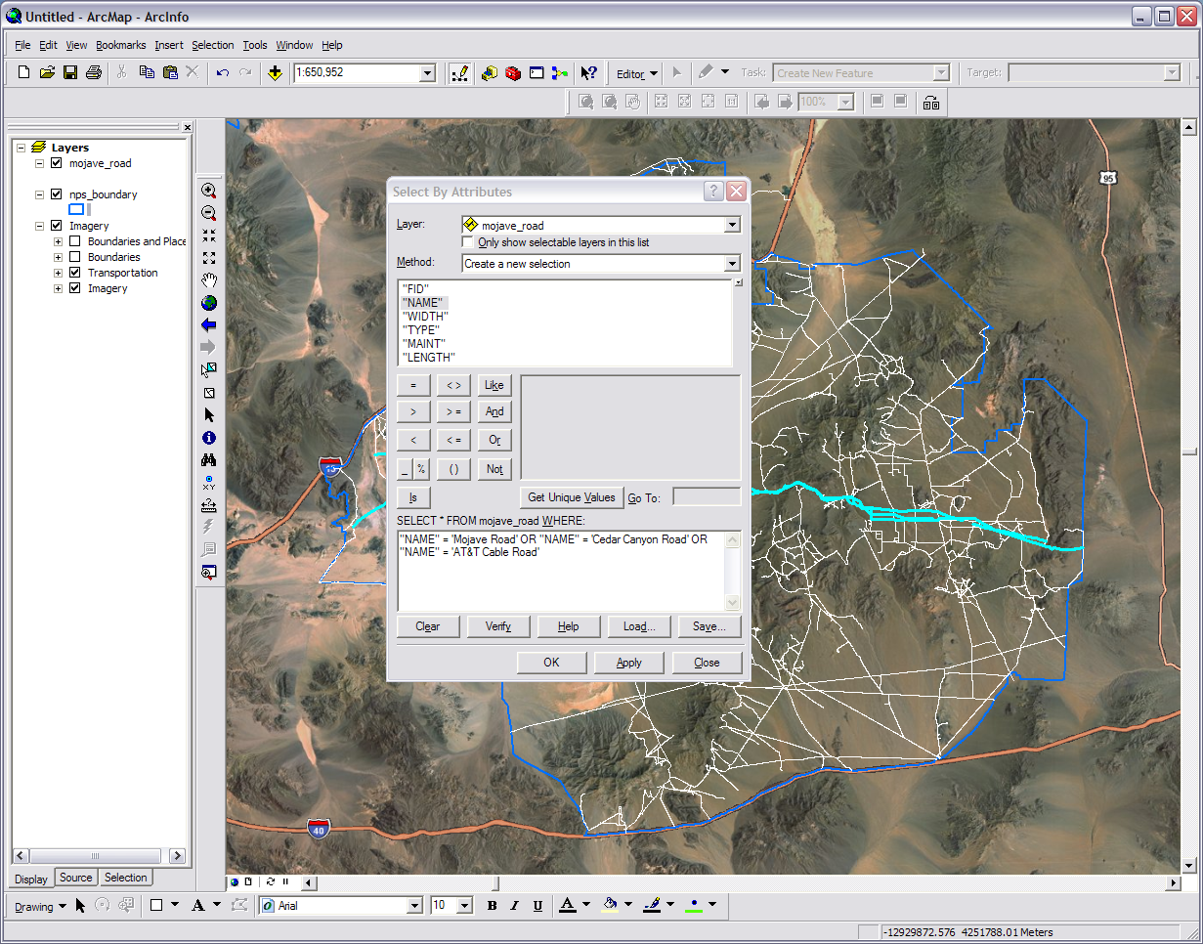
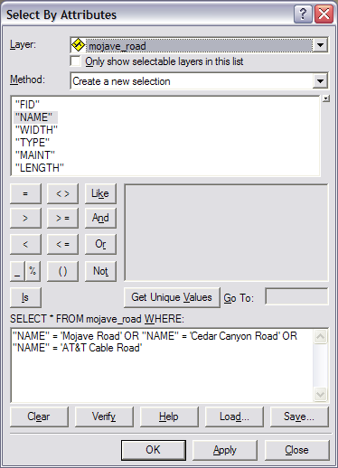
The segments of our roads are selected
Verify lets you
Know if your
Syntax is correct
Apply runs your query
before you close out
Notes:
The first step to narrowing down our roads is selection of the right ones. This can be done in many different ways but the fastest way to do this is to select by querying. Querying, however, can be like opening a titanium can of soda with a stick if you don’t know what you are doing. Querying, if your are not familiar with the term, is asking the computer or database for an answer using specific syntax. You can close the attribute table if you want but we will need to open it up again later. Sometimes if you have to many things open it can get confusing.
So the first step is to go up to the menu and punch Selection>Select By Attributes. Now we have our query window. Remember for our query to work we to put in a specific syntax, and I emphasize the word specific. Second double click on “NAME” as we are going to be selecting by name, and it will be put in the formula window. Add a space. Third single click on the = button and add a space. Fourth type in ‘Mojave Road’ and add a space. When typing text, also know as strings, they must always be enclosed in single quotes and have exact capitalization, spelling, and spaces. Fifth single click the button Or and add a space. Sixth go back to step two and repeat the process using 'Cedar Canyon Road’. Seventh do the process a third time using ‘AT&T Cable Road’ but end it right after the text. In the end the formula window will have the following:
"NAME" = 'Mojave Road' OR "NAME" = 'Cedar Canyon Road' OR "NAME" = 'AT&T Cable Road‘
(don’t cut and paste this as Office uses a slightly different text method than the query window and it doesn't always work)
Eighth Check your spelling and hit the Verify button to see if you got the syntax correct. If you got it right press the Apply button. The three roads we want will be selected and show up on the map. Press OK or Close. If the query didn’t verify or select the roads then go back over the steps and correct. Even a missed space can mess the whole thing up.

Slide 11
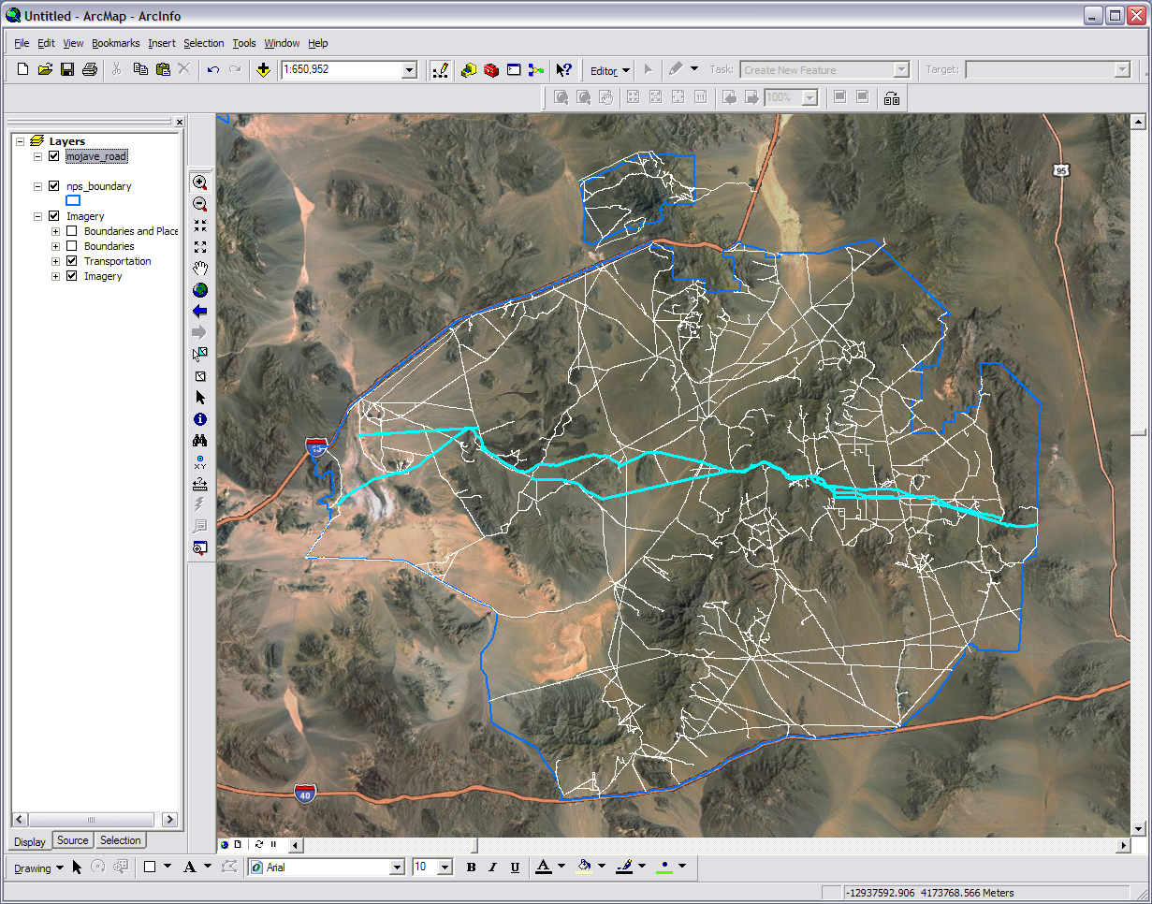
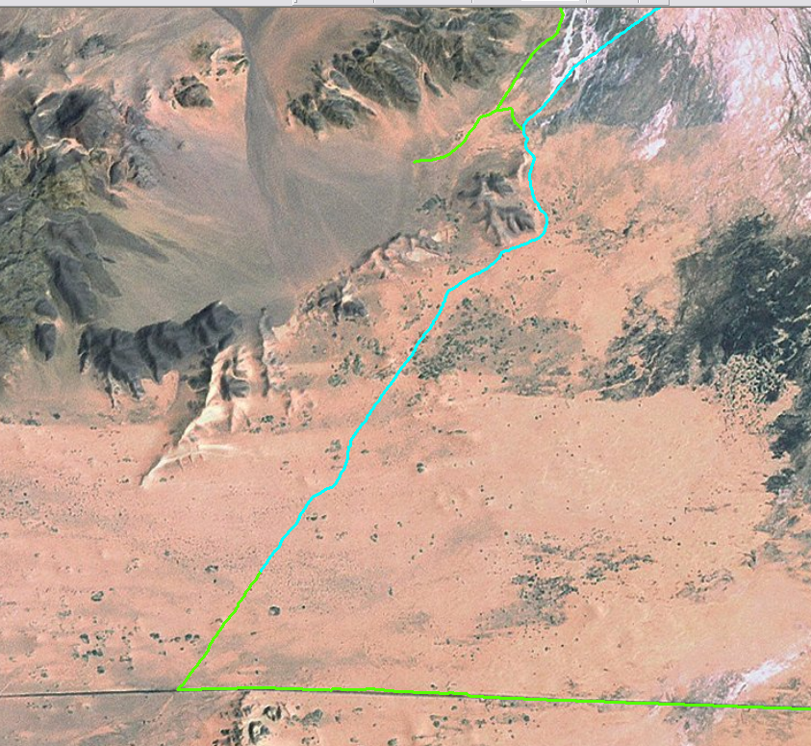
Go down
this side
We don’t
Want this road
Notes:
The history professor also knows that the western most leg of the Mojave road extends all the way to the edge and along the park boundary. So to get that last little leg we are going to select it by hand. Zoom into to the end of our current selection, the boundary line, and the end of the roads layer as marked. Turn off the boundary layer and uncheck the transportation box in the Imagery layer to make this selection easier. I’m also changing my particular layer color and size for the moment just so I can work with it better.
Click the “Select Features” button in the tools toolbar. Going back to your map, making sure you HOLD DOWN THE SHIFT KEY, start clicking the road segments from the end of your current selection as they go off to the right and down. The last one you will click intersects the road you can see at the bottom of the imagery. Unfortunately this also selects that other road and goes off to the right beyond the end of the Mojave Road. So, holding down the shift key, click that last segment again to deselect it. To get that very last bit of road we will manually put it in later. If your selection gets messed up you can clear the selection and repeat the steps. The query you used should still be in the formula window even if you closed it. Now that we have selected as much of the Mojave Road as we can it is time to do some editing.

Slide 12
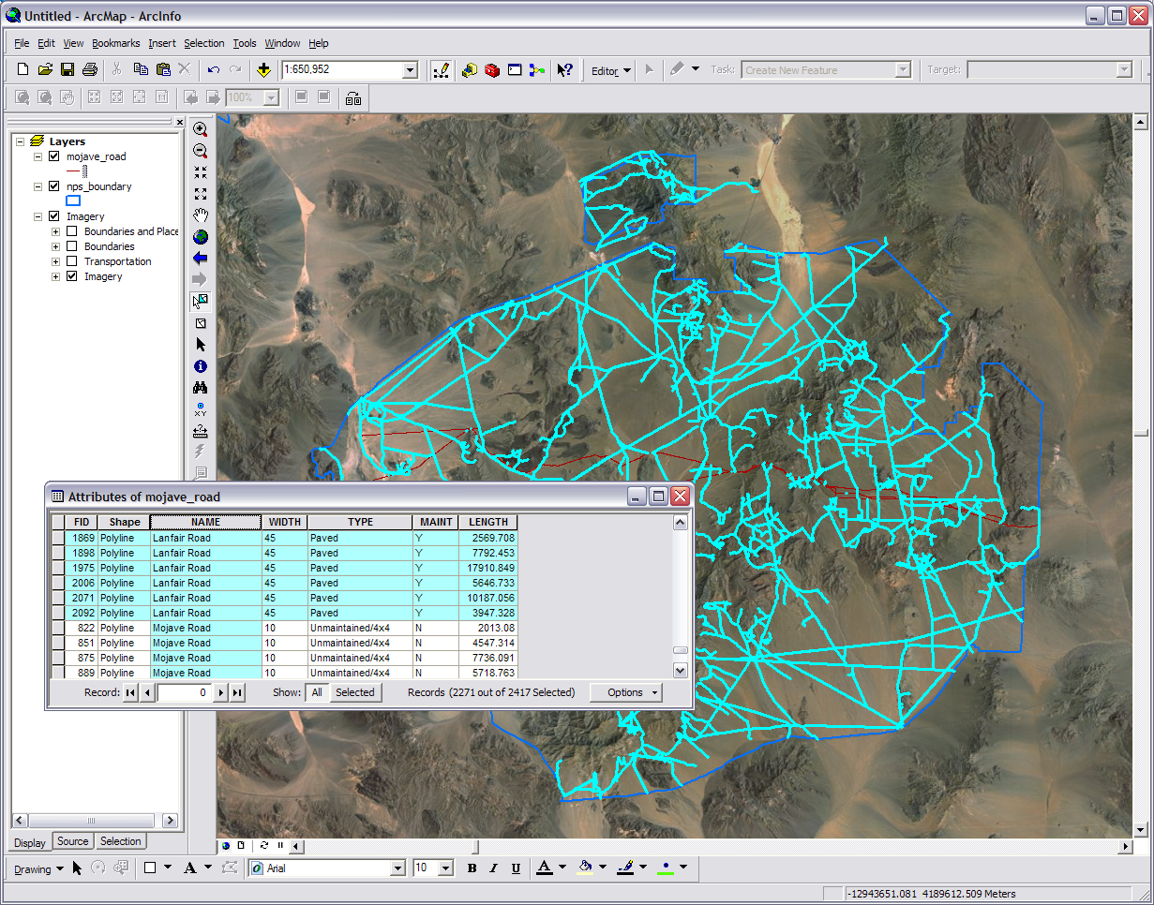
Selected
Not Selected
Switch Selection
Notes:
Zoom to the mojave_road layer. You can changes colors and turn back on the boundary layer and transportation if you want. You will see the extent of our selection. Open the attribute table for the mojave_road layer by right clicking on the name. On the bottom it will show we have 146 out of 2417 records selected. Hit the “Options” button in the upper left corner in Arc 10 or in the lower right corner of the table window in Arc 9.x. Click the “switch selection” button. Now all roads but our three and the extra we picked are selected.

Slide 13
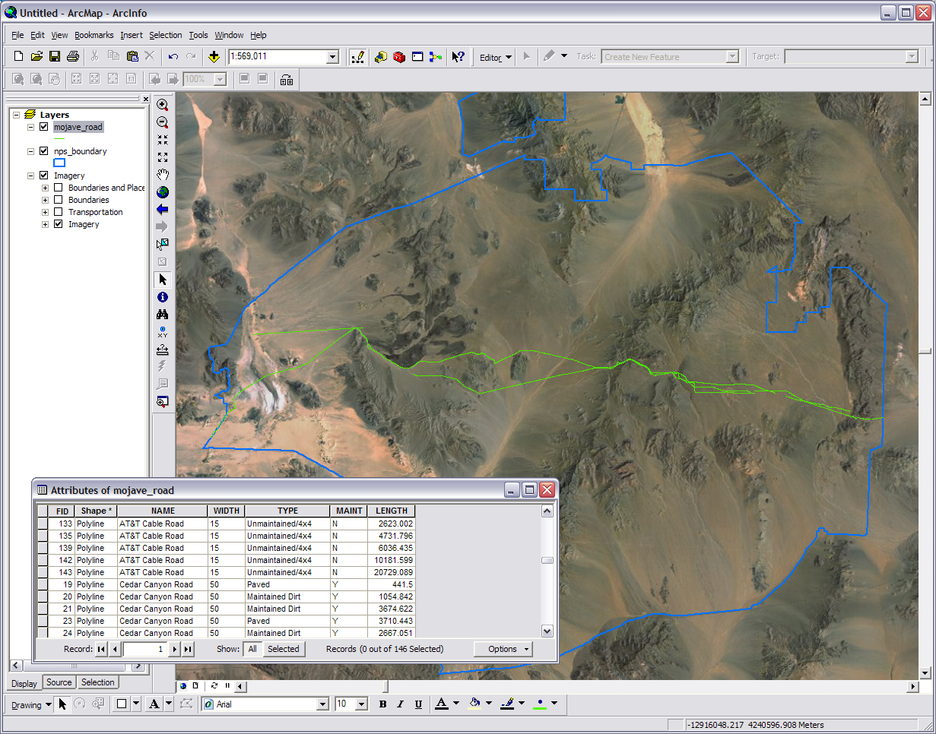
Right click to delete selection
Refresh
View
Button
Notes:
Keep the table open. Click on the word “Editor” on the editor toolbar and a menu will drop down. We want to delete all the extra roads (the ones we now have selected) so punch “Start Editing”. A window warning you about different coordinate systems and which layers you can edit will pop up. Choose the mojave_road to highlight it and press the “Continue” or “Start Editing” button on the bottom. You are now in the editing mode. In Arc 10 a side bar will pop up on your right. We don’t need to worry about this for the current procedure. If you are in Arc 9.x make sure the Target at the end of the toolbar is set for the layer we want to work with.
Back to the table. Remember those gray squares on the left of each road’s ID number? Right click on anyone one of them to pull up a menu. Press “Delete Selected” and all those extra roads will be gone. If we have done everything right and are ready to lock in what we have done go to the “Editor” menu on the editor toolbar and “Save Edits” then “Stop Editing”. Note this will make our edits permanent. If a warning window pops up just press OK and try again. The table may act a little strange but just close and open it and it will look just fine. The results will first show up in your attribute table but for them to show up on the map it may need to be refreshed. Press the Refresh Button (the circle arrows at the bottom next to layout and data view buttons) or give ArcMap a command that affects the map. And yes, I changed my colors yet again.

Slide 14
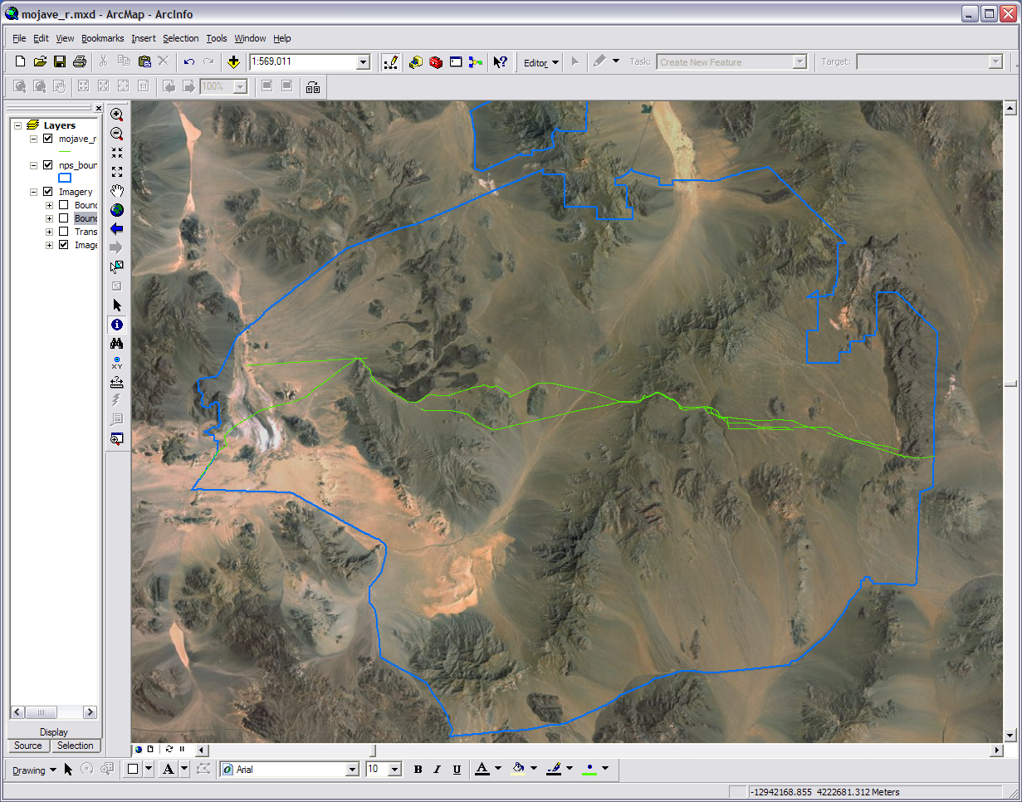
This shouldn’t be here. Should it?
Let’s not mess with these comfuddled knots right now
Which one is the Mojave Road?
Notes:
Up to this point I haven’t saved my map but I am going to do so now and call it mojave_r.mxd (see back when we first opened ArcMap for notes on saving). Now we need to roll up our sleeves and get down to wiping out the unwanted road segments we have left. How do we know what is Mojave Road and what is not? Remember we have some road segments that are parts of the Mojave Road but have a different name in the attribute table. We can also see from our current road layer that our road runs from the east boundary to the west so we have a pretty good idea that if a segment is not a section of our main corridor then it needs to be deleted.
Before we have to zoom in and look at each section of the road bit by bit let us see if we can identify some of the larger and outspoken segments. (1) Activate the Identify tool (the white ‘i’ in the blue circle on your Tools toolbar). (2) Start the editor (we need to do that to delete the roads) for the layer we are working with just like we did before. Make sure the target is set for the right layer. (3) let’s start by identifying that horizontal road above the main line’s left side. If we have the ID tool selected and we click our new ID cursor on that road then a box will pop up that will tell us what the attribute table tells us but only for that segment. It will only ID one segment at a time. It looks like we have a line of AT&T cable road segments that are not part of the Mojave Road. (4) After you have identified some unwanted segments you can select them by activating the Select Features tool and selecting one or multiple segments. If it also selects something you didn’t want, such as the boundary, then do a click while holding down the shift key to unselect it. (5) We are still in editor mode so we can delete the segments we have selected. When you have selected what you want press the Delete button on your keyboard and *poof* the segments are gone. If you want to make the disappearing act permanent then just save your edits. If you accidently delete a segment you wanted to keep do not save the edit but do a control + Z to undo or just stop editing without saving and start again. (6) Continue with the ID, select, delete procedure along the rest of the road. It shouldn’t take very long. Don’t worry about getting every bad segment right now. We are just going for the big obvious stuff and we’ll get the other segments later. Save the edits and stop editing when you are done.

Slide 15
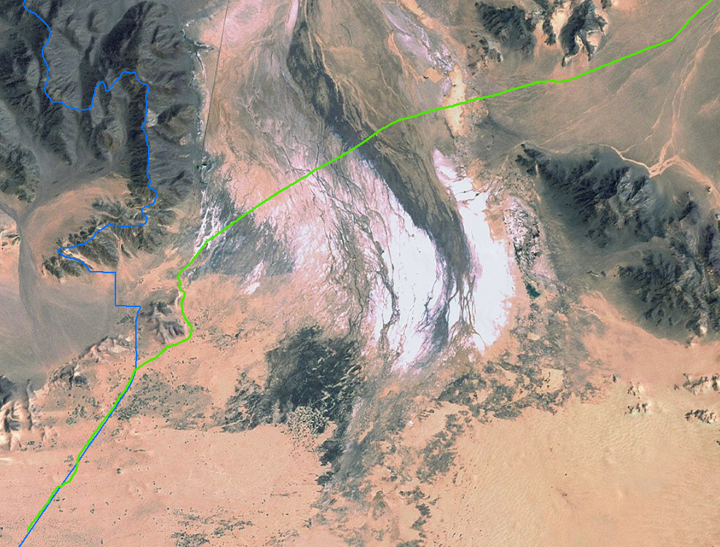
Notes:
Zooming in and running the length of the road is what we need to do next to get rid the rest of the non Mojave Road segments. Zoom in to the western end of the Mojave Road and we will start there. I’m again going to temporarily adjust my mojave_road layer so I can work with it better. If you have trouble, like I have, with the selection tool also selecting the nps_boundary layer then you can just remove the layer (right click on the name) for this step and bring it back in later. You want to zoom enough to see individual segments but not so much that you can’t tell where you are headed. I’m going to start my zoom at about the zoomed view shown here. You can of course adjust your zoom as you go along.
Choose the Pan tool on the tool toolbar (the white hand). Use it to move along your map. Start moving along the Mojave Road and look for stray, crossed, or other out of place segments. You’ll also find breaks in the road. Just leave those for now and we will take care of them later. When you find a bad segment go into editor mode and get rid of it with our ID (if necessary), select, delete procedure. Note you can also select by drawing a box with the selection tool. The earliest one I found was a stray segment just around our first mountain corner near a small break in the line.
All too soon you will run into an area where segments are crossing segments multiple times. Keep in mind our main line and if have to make a choice the priority is Mojave Road>Cedar Canyon>AT&T. Use your ID tool to make sure you are eliminating the right ones. Zoom in and out as necessary. Another way to check is turning off and on your mojave_road layer (or open the effects toolbar and use the swipe method). The road shows up on parts of the basemap so you can use it as a guide. We will use it to trace the road when we fill the gaps later. If you miss a few don’t worry because we will go over it again later. A tricky part is near the eastern NPS boundary. Take a look at the next step.

Slide 16
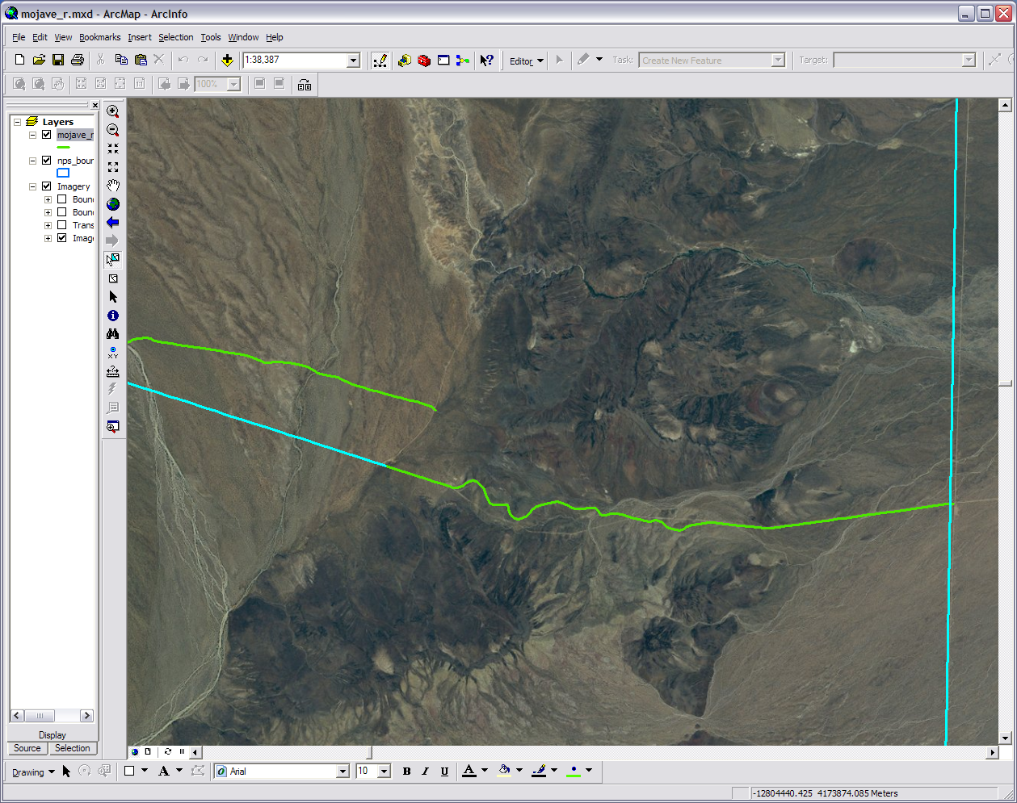
Mojave Road segment
You can see the road that connects the segments on the background imagery
Delete this
AT&T segment
Keep this
AT&T segment
Notes:
Near the eastern boundary it looks like the Mojave Road ends at the base of some hills (Piute Range/Fort Piute). Our history professor however, tells us that the road goes all the way to the boundary. We are further told that that last segment of the AT&T cable road is actually the last eastern segment of the Mojave Road. So let’s leave that last segment of the AT&T road and delete the segment before it. We will connect that end segment of the Mojave Road to the AT&T segment later. If you removed the boundary layer then you may need to bring it in for a moment to see where the east end is. Once you are done zoom to the mojave_road layer.

Slide 17
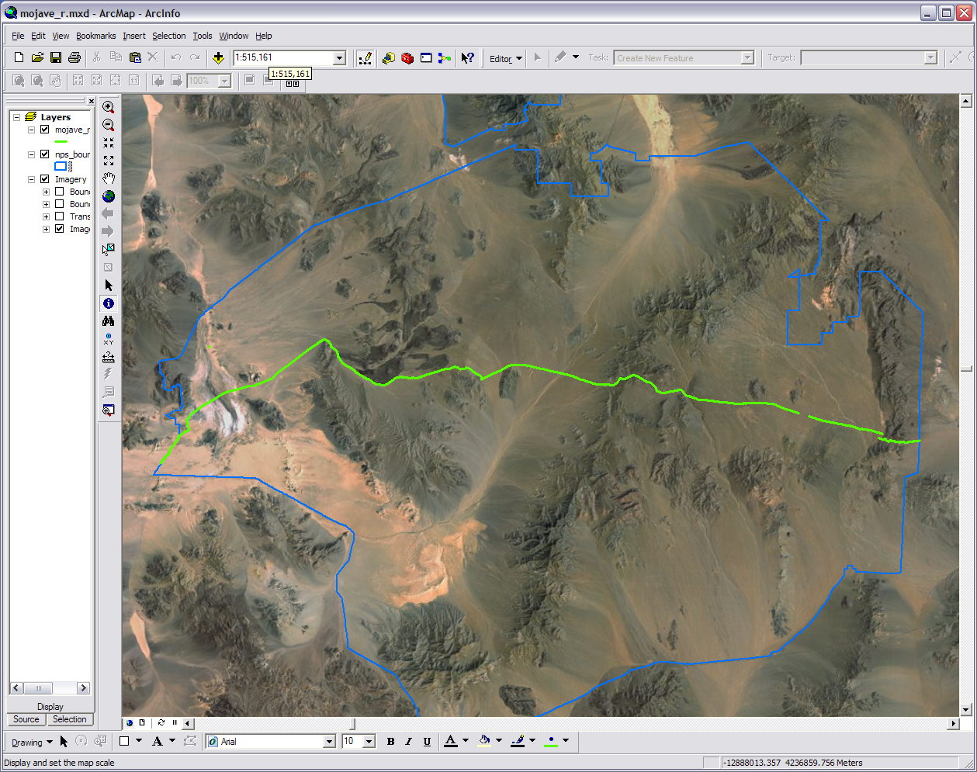
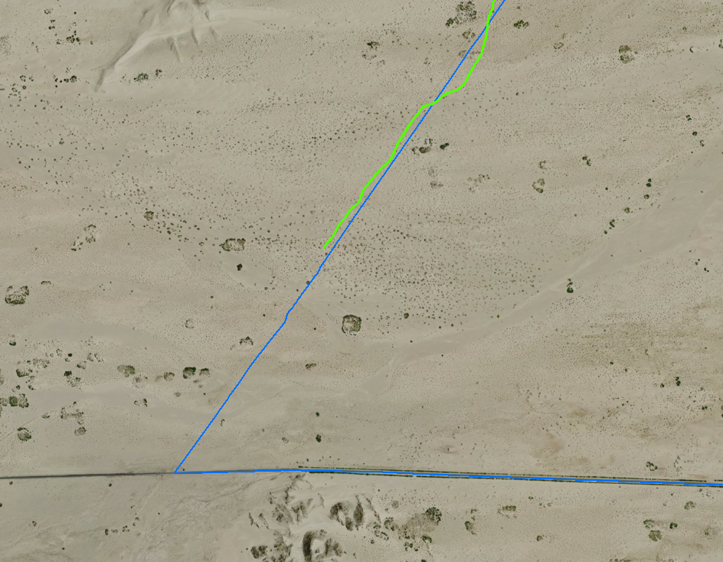
Editor & Sketch Tools
Hard to see the road with low contrast of the desert
Start & end points of the new segment
Notes:
I told you earlier that we would zoom in and go back over our road and now we are. This time we are going to fill in the gaps. We are also going to be deleting any rogue segments we missed the first time around so you may or may not want to put the boundary layer back in. Remember it is an independent shapefile so if make a mistake you can go back to the source and just make another copy. Zoom again into the west (left) end of our road. This time zoom in much closer as we will use our base map as a guide (the inset image is ≈ 1:26,700).
We will start with putting in the west end segment of the road. You may not be able to see it here or on your map in ArcMap but there is a very faint road on the basemap that runs from the end of our current last road segment to the horizontal paved road at the bottom of the map; parallel to the boundary line. Start the Editor. For Arc 10 make sure you select the mojave_road layer and that Create Features side bar will pop up. It should have the mojave_road layer as the only feature available but it is OK if there are others. Select the mojave_road layer and the Construction Tools at the bottom will show you your options. Pick the Line tool. For Arc 9.x pick the Sketch Tool (the fat pencil on the Editor toolbar) and make sure your target is on the mojave_road layer. In either version of Arc The Tool allows you to pick anchor points and vertices to create additional vector graphics of the same type to your shapefile layer.
Pick the first point at the end of the current last segment and continue to pick points tracing as much of the road as you can see on the basemap. Even If you can’t see the road at all put your last point on the horizontal paved road at the bottom and double click. The double click will end the sketch and the new segment will exist and be selected. You can leave it selected or deselect it now but each new sketch we add will become the new selection. It may not be a perfect trace of the road but remember this is a 15 minute map that doesn’t require 100% perfection.
From here just go along the road like we just did before and fill in the gaps with the Line/Sketch Tool, basemap, and connecting points A to B. Along the way you may find some out of place segments we missed the first time so go ahead and get rid of those. An easy road to trace is at the east end where we connect the Mojave Road segment with the AT&T one. Save the edits as you go along or at the end when you feel things are set in stone. When you are done zoom back to the mojave_road layer.

Slide 18
Oops! I miss a stray
The layout view button
Notes:
We have deleted the rogue segments and filled in the gaps. At this point we just need to double check and clean up anything we missed. Put the boundary back in if you haven’t yet. When that is done make sure your lines and colors are they way you want them. You can also turn back on the Transportation layer if desired. I elected not to. In the layout view you can do some of the same things to the layers you can do in the data view (current). If everything looks good switch to the layout view (the bottom left button next to the globe).

Slide 19
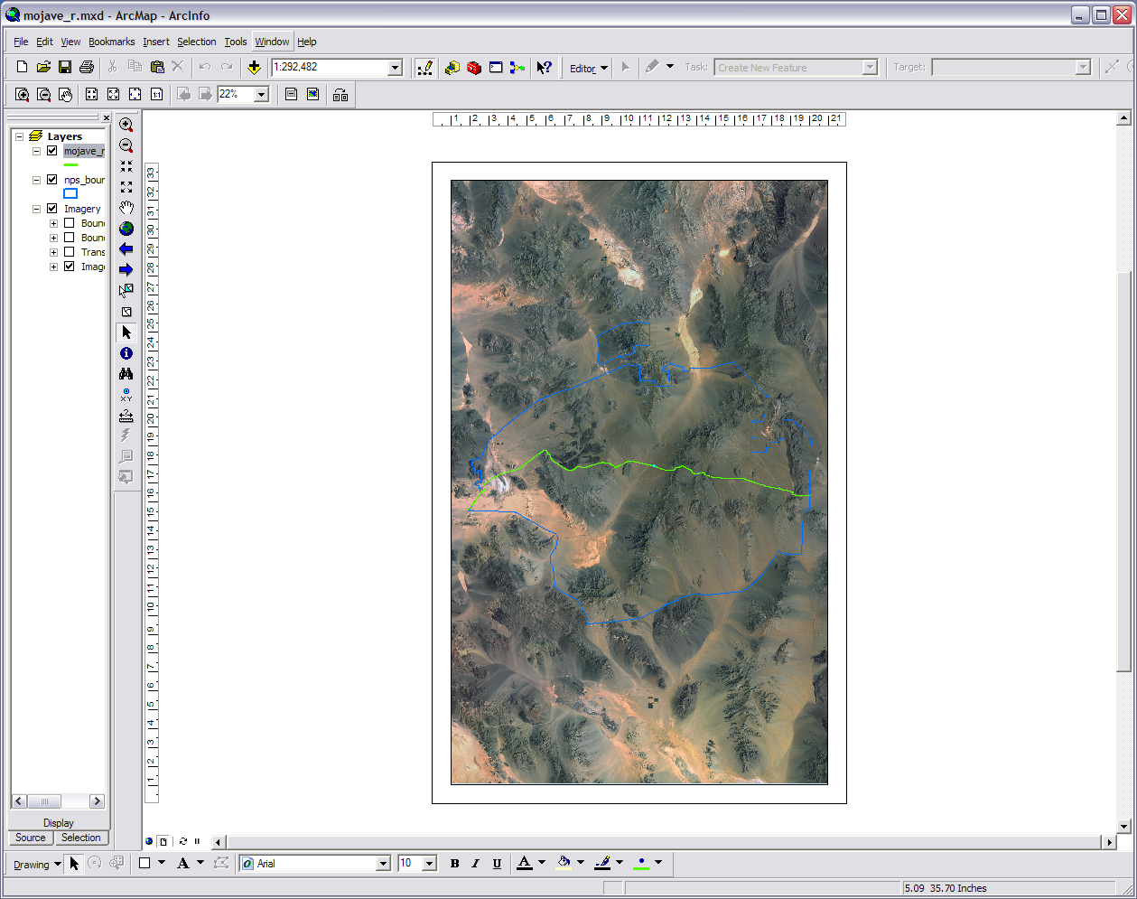
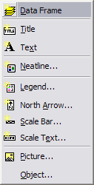
Change Layout Button
Zoom Whole Page
Notes:
The sight you will probably see first in the layout view is your map on an 8½ by 11 portrait piece of paper. This layout view works in a similar way to a presentation or layout and design program in that you add objects, move them around on the page, and edit their appearance. It is just what you have done before in the last two modules. Now all we need to finish off our map is elements such as a legend and scale. We could add each of these one by one by going up to the Insert menu and getting the items off the drop down, however this is a 15 minute map and I bet the clock is getting close to the line. So the quick and easy way to do this is going to the Change Layout button on the right end of the Layout Toolbar. If you need to, move the other tool bars out of the way, close them, or use the drop down at the end. Clicking this brings up a small plethora of layout templates we can choose from. Since the Mojave Road goes from west to east (or east to west) I’m going to pick the LandscapeClassic.mxt. Pick whichever one you like best and press the Finish button. This particular layout isn’t 8½ by 11 but that’s OK. Move things around and change the way they look just like you would with any other layout on the screen (right click on them to access the properties). You can also use the insert menu for individual map elements. Remember ArcMap is not a graphics program so it won’t look as pretty or manly as it could be.

Slide 20
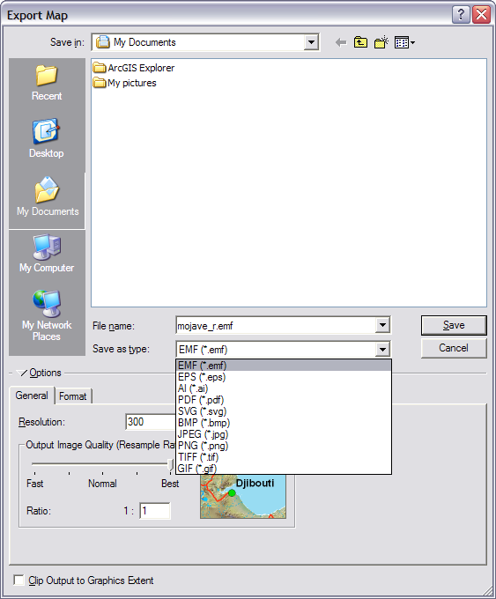
Notes:
One last step. Now you have to get your map out of the ArcGIS programs. Save it as usual in case we need to go back and change things. Now go to File and go down to Export Map… and the export window will pop up. As you can see we have several image types and output options we can export it as. I’m going to export mine as a jpeg at the default 300 dpi and call it ‘Mojave Road 23Jun2010’. This with make a flat image file readable by most any program.

Slide 21
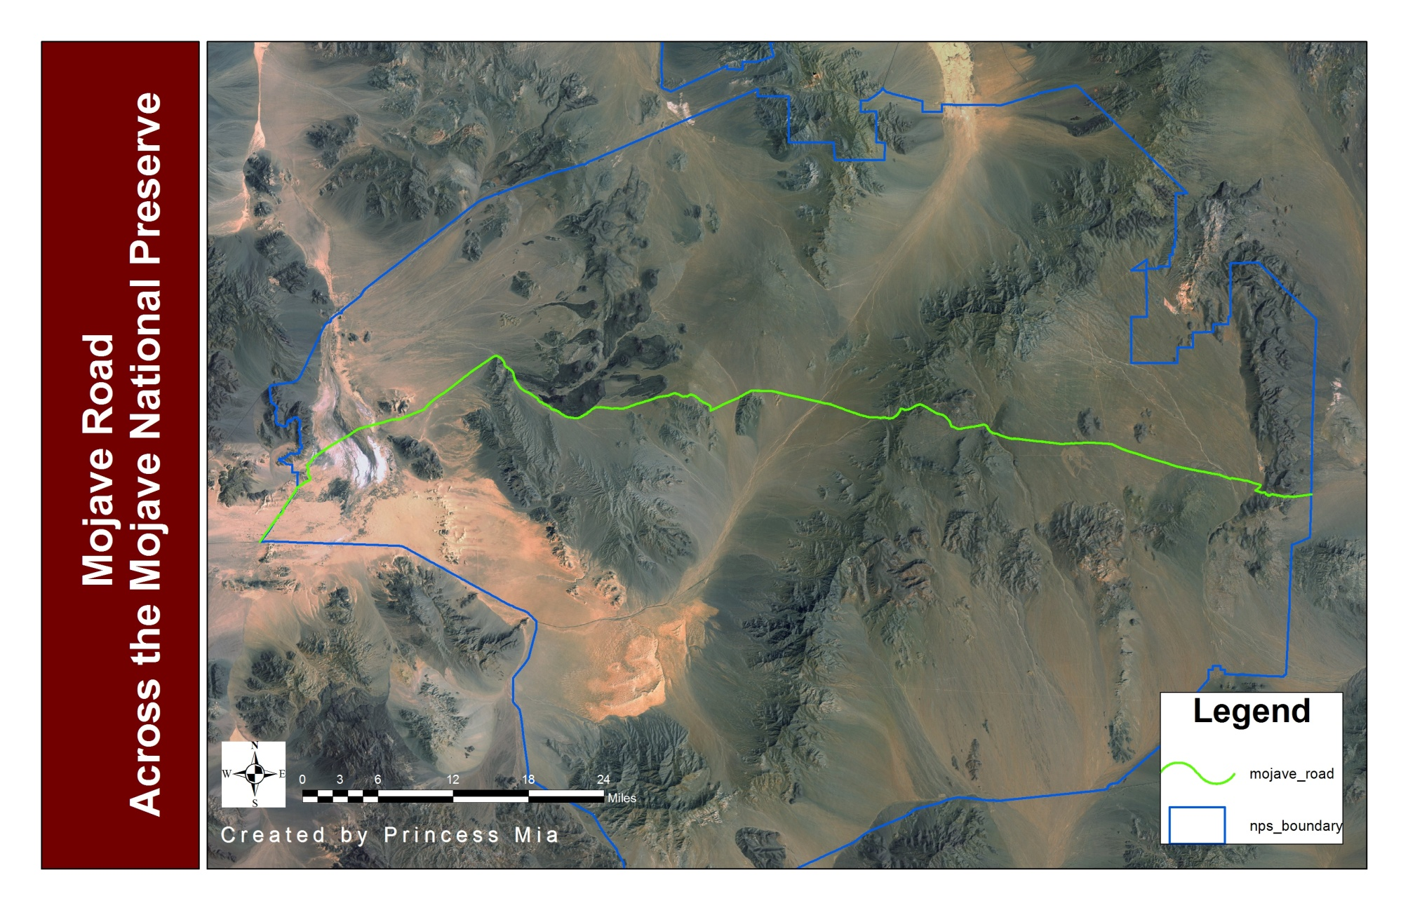
Your Mighty Mojave Road Map!
Notes:
Congratulations! You have just made a professional map in about 15 minutes using an industry GIS program. You also have taken a large step into the world of GIS. Additionally you have made a history professor very happy.

Slide 22
Appendix
Notes:
Throughout this workshop I have been using a map of Asia Minor from "A New Geographical and Historical Grammar" by Thomas Salmon, 1767. Map making is as old as writing. Maps have even been found in prehistoric cave drawings. While today’s maps don’t tend to have the artistic style that cartographers of yesteryear used they still have incredible importance in our everyday lives. From the mental map you carry to get to home at night to the vectorizing of satellite images for natural disaster relief we need a spatial understanding of how to work, live, and enjoy this world we live in.

