Slide 1
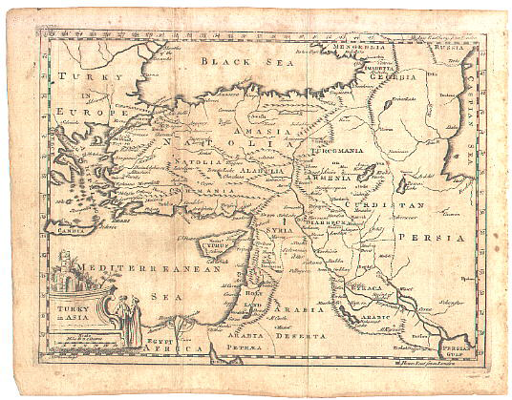
The
15 Minute
Map
Module 1
Created by: Scott Kelly 2010
Notes:
Welcome to GRAIL’s, NAU’s Geospatial Research And Information Lab’s workshop entitled The 15 minute map. We are going to show you in this workshop how you can make a simple map in roughly 15 minutes. This useful for anything from a football team that needs get a fix where their next game will be, a business that needs to track customer location and demographics, or simply a report for a class, client, or boss that needs some visual explanation. Of course sciences, engineering, medical, and government need to use spatial data, meaning the geographic location of data relative to another set of data, all the time.
This is an introductory workshop intended for faculty, teachers, students, members of the community, and anyone who wants to make a nice map quickly to integrate into a report, PowerPoint, presentation, recreation, and so on. This simple map making or cartography does not use any heavy GIS techniques but it does provide a introductory look into geographic information systems. We will show several different ways to do a 15 minute map but to start off in Module 1 we are going to cover some basics to get you oriented. You may already be familiar with some or all of the material covered in this module but hopefully we can add to what you already have or have not.

Slide 2
Common Elements
Of
The Modern Map
Good Stuff to Know
Notes:
First we will look at some common elements found in the modern map. This is good stuff to know because, as we hope you’ll see, a good map is more than just a satellite image or aerial photograph. The elements are what defines the map. What I mean by this is the elements that go into the map give the map shape and dimension so that it is useable to those reading the map. We are just going to go over some of the basic elements for a basic cartographic product. We will start with the kind of elements you will see on maps in a Rand McNally road atlas, a USGS topographical map, a Mapquest map, and the like. We’ll then talk about map types and other elements. Something to keep in mind while we go over the elements is the map is a creative product. How the map turns out depends quite a bit on how you manipulate and layout the elements.

Slide 3
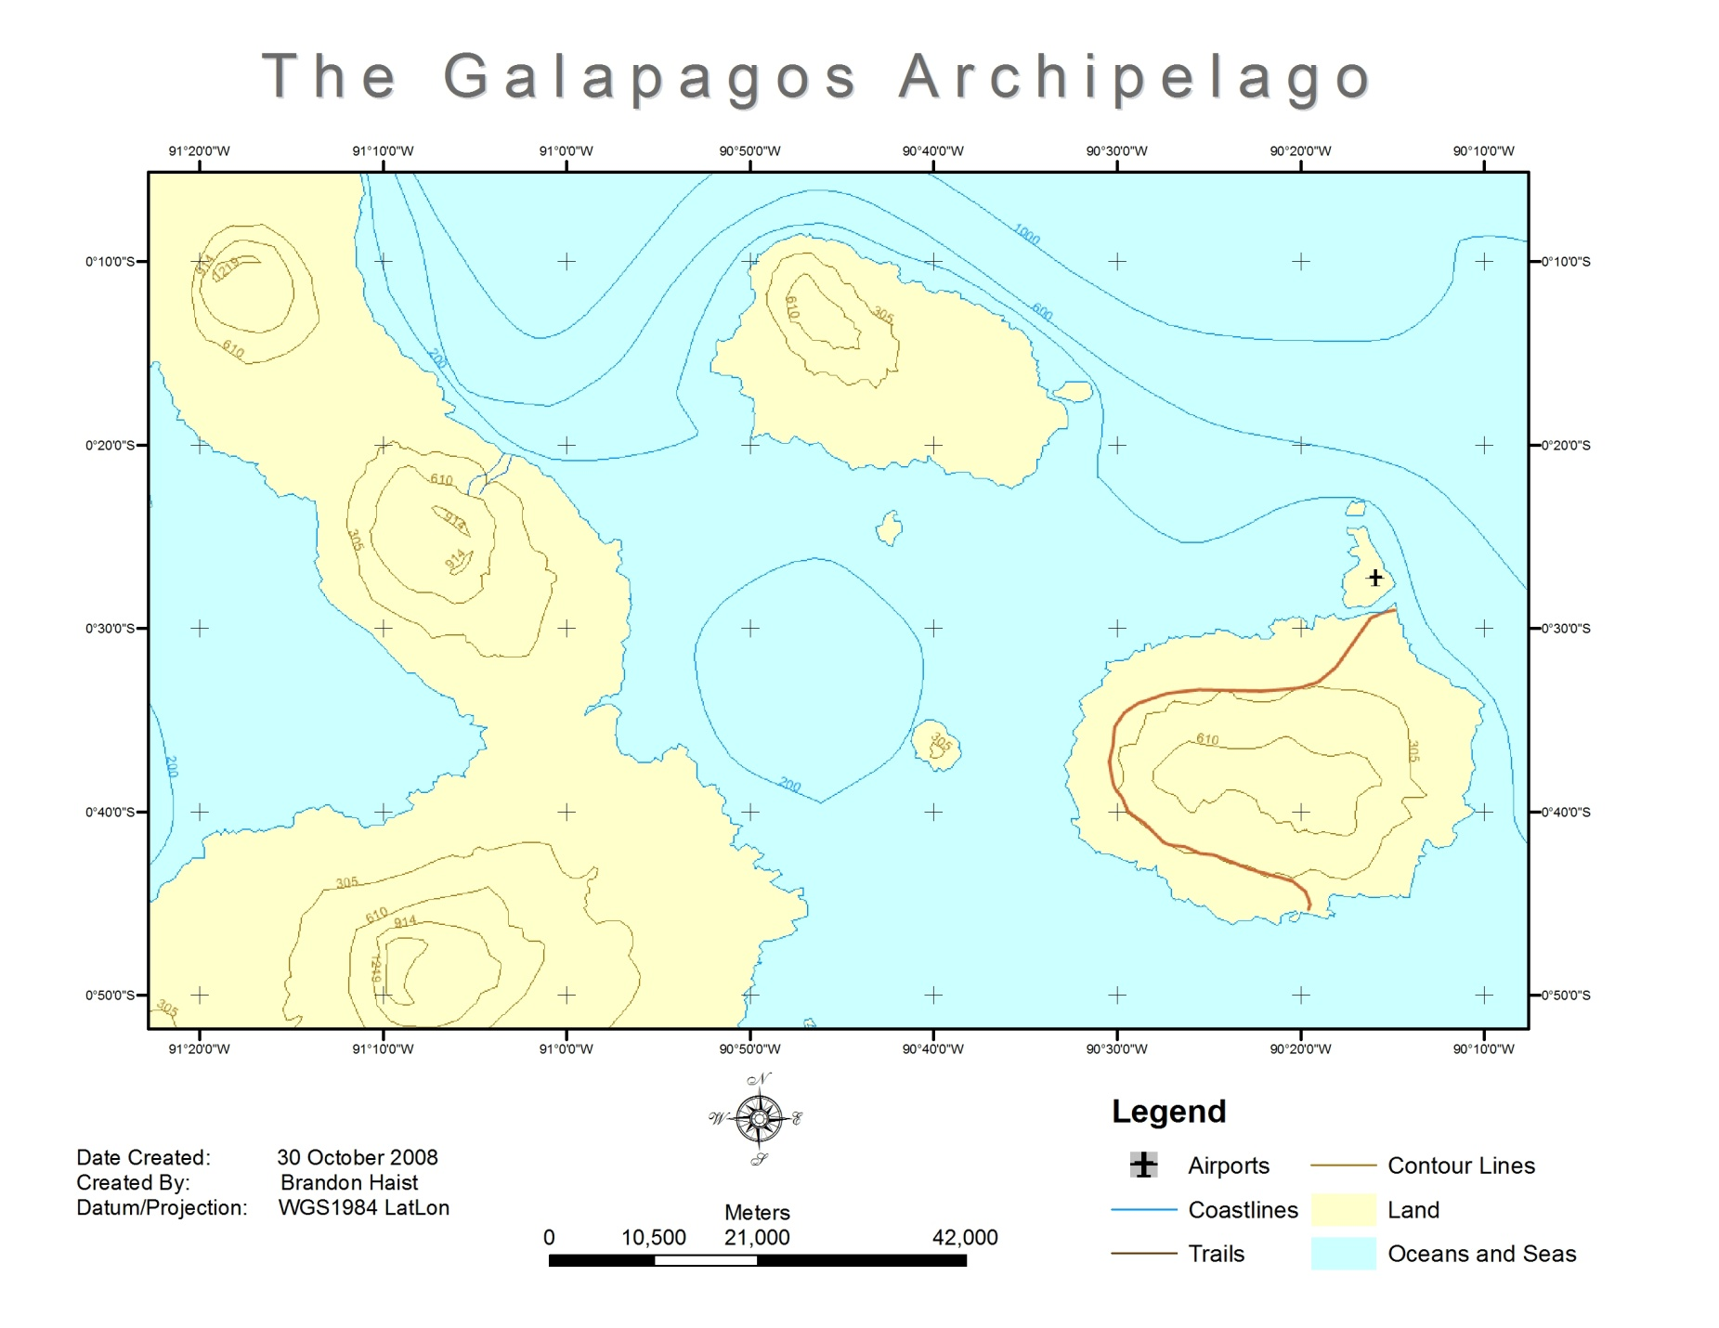
Map Title
Map area
Data Frame
Neatline
Grid
Legend
Documentation
Scale Bar
North Arrow
Notes:
Let’s cover each of these elements starting at the top. First off we have the map title. Simple and intuitive. This of course tells us what we are looking at and gives an idea of the purpose of the map.
Next, moving to our left, is the data frame. This marks the boundary between the data and the metadata or if you will, the main entrée and the supporting side dishes. A quick explanation here if you are not familiar with metadata, particularly spatial metadata. Metadata simply is data about data. In this case everything inside the data frame might be able to stand on its own but without the stuff outside the data frame you lose quite a bit of background and interpretation about the main data including how to understand and use it.
Moving on we go next to the neatline. The frame of the whole product keeps everything organized and focuses our attention. Simple but effective.
Now we’ll take a look at the documentation. The documentation is important because it is raw and specific metadata that verbally gives the map’s background information. When someone refers to a product’s metadata they usually mean the documentation, especially in GIS. Here is a user case example: if we were tracking the customer base for a business using a map with “date created: 5 May 2001” we might not be able to track those customers who live in a new housing subdivision that was build in 2006. In this simple case if the documentation wasn’t there we might be using a map that was irrelevant for our purpose. A simple map like this one and the ones we will create later in this workshop won’t need much documentation. You will want to document any pertinent information the reader of the map is going to need. The more technical the map the more documentation is needed. Some GIS products may have several pages of documentation/metadata.
Moving to our right we find the familiar scale bar. This friendly element can be a graphic as show here, can be stated with text such as 1 inch = 21,000 meters, or both can show up together on the map. So on our map here if were to measure a 1 inch distance between one point and another it would be equivalent to 21,000 meters on the actual earth.
Next up is the popular North Arrow or compass. This of course tells us what direction on the map is north. It can also orient us with east, south, and west. Even though it usually is, do NOT make the mistake of assuming that the top of the map is always north. Always take at least a quick glance at the north arrow or compass (sometimes called the compass rose). Case in point: I have a trail map of the Paria Canyon, a really long canyon. The map is folded into several sections and it is easier to hold and read if done horizontally. This makes north on the left or right side of my Paria map depending on which way I am headed. On some maps the north arrow or compass will point in a direction other than the top of the paper or you rotate the map yourself like I did with my Paria map.
So Rounding the bend we have the Legend or key. This explains what the lines, areas, and points on the map mean. We can probably figure out that the blue areas on the map represent oceans and seas, but without the legend we could easily be puzzled regarding that curving brown line on the big east most island.
Now we come to the grid also know as the gradicule or coordinate system. Most people are familiar with latitude and longitude and that is the grid you’ll most often find on a map you by at the store. They may also have simple coordinate system for that specific map of letters up one side and numbers across the top or bottom. The grid or grids (there may be more than one) allow the user to locate specific points and areas on a map and relate them or the whole map to the rest of the globe.
Lastly we arrive at the map area. This is the meat of the map, the whole purpose for having the other elements, and where you communicate to your target audience. The map area contains your image, mountains, valleys, trails, rivers, lakes, streams, overlays, population data, traffic data, contemporary and historical battles, points of interest, locations of endangered rocks in Montana, the distribution of starving cats in New York, and other spatial relevance. In the map area you are visually presenting the spatial relationships of the physical components of a spot on earth and data connected to that spot.
There are additional elements that can be included such as a small reference image off to the side, a magnetic north arrow, a zoomed in inset map of a certain spot, or others but the ones shown here are the basics.

Slide 4
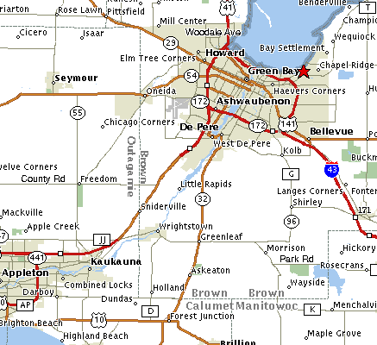
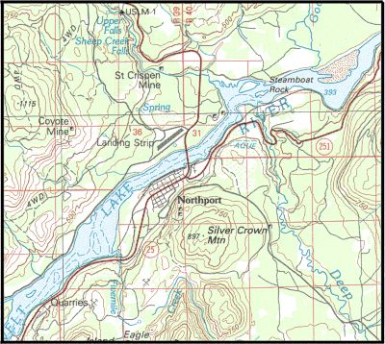
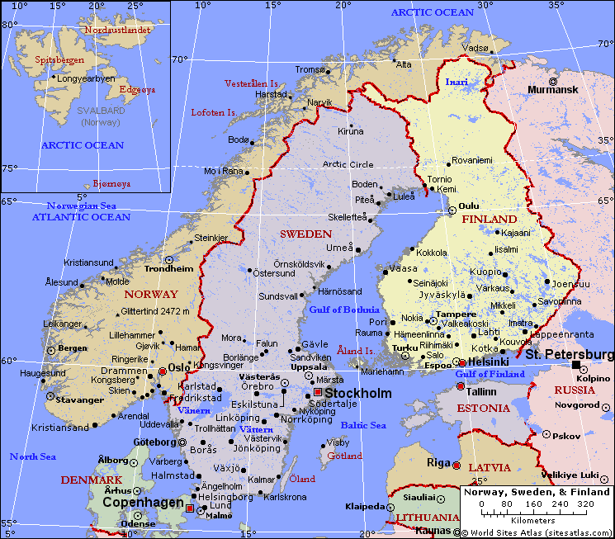
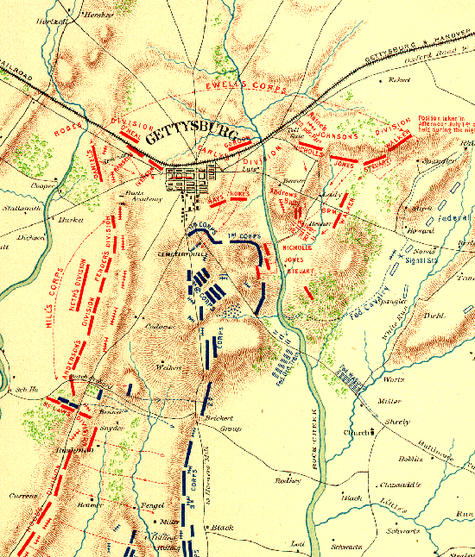
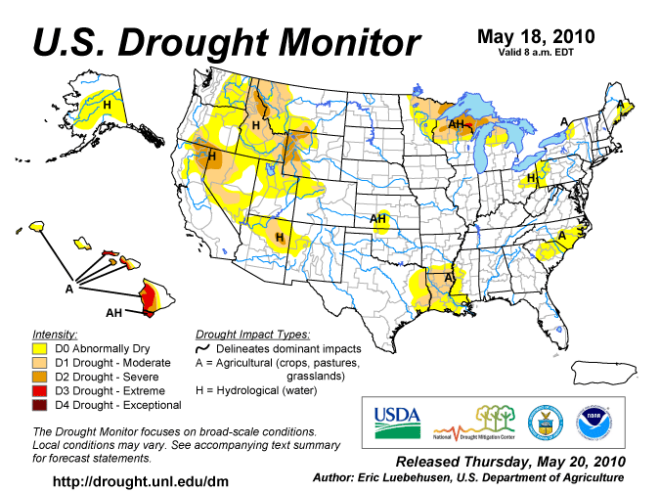
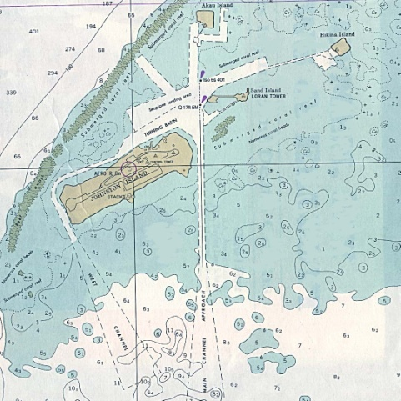
m
Map Types
Street/Directional
Topo/Physical
Political/Reference
Historical
Thematic
Charts
Notes:
The elements in your map also determine the type of map you are creating. For example, if you were to prepare a report for the county commissioner or you political science teacher you might want to use elements of a political or street map. Different people use different names and categories for different map types but here we are just trying to help you see there are different map types and the elements in them. Most of these are familiar if you’ve ever looked at a map.
First is the ever popular street or directional map. These show of course streets and where they are relative to each other. They won’t show much about the physical terrain other than blue for water and green for relevant park and tree areas. The street map usually has a have a plain background and may also show some points of interest like post offices and theme parks.
Second you have the topographical or physical map. The defining characteristic element of these maps are the contour lines that show elevation. These are meant for understanding trails, all roads, rural areas, topography (hence the name), basic hydrology, and the general lay of the land. They aren’t to good at showing urban areas but they do make good base maps and are very good at helping people understand the shape of the land. They are often used with GPS units. The GPS units tells you where you are and the topo will tell you about the area. If you plan on adventuring out side the city take one or more of these along and study it.
Third we have the political or reference map. These maps have the purpose of showing political boundaries relative to one another. They may show some major roads, cities, lakes and rivers. They are good for understanding where places are in the world with out having being cluttered with contour lines (like in topos), detailed grids, insignificant points of interest, or every single road and town in the country. Like street maps, they too are not much good for understanding the terrain or elevation.
Fourth in line is the historic map. The historic map’s purpose of course is to help us understand the spatial conditions of an event or place in history. These can contain any of the defining elements of the three previously discussed map types as well as the next two maps types we will discuss. Historic maps have their own category because their unique element is the event or time they communicate. This type of map is an snap shot about a specific spatial happening. This can be as old as The Battle of Gettysburg shown here or as recent as the oil spill in the Gulf of Mexico. Also included in this category are vintage maps such as the one used as background for these slides (originally made in 1767). The vintage may not show a specific event but because of the way maps were made back then we can learn something about the era in which it was made.
Fifth is the thematic map. I suppose any map could fit in this category as all maps have some sort of theme in them, but what makes this type stand out is that they are made to communicate specific contrasts in data distributed spatially. In other words the thematic map show the different amounts of certain type of data spread out over a geographic area. This can be anything from the population growth in a county over the past year to the number of guest on the different rides in Disneyland. Sometimes part of the theme includes change over time. In the example here the map shows a theme of drought across the U.S. on May 18, 2010. Notice if you can, in the legend the color comparison of possible levels of drought and the distribution of those colors in the map area.
Last we have charts. These cartographic products are important technical navigation tools for boats, ships, planes, and helicopters. The one shown here shows specific depths in the water at certain points as well as shore lines, sandbars, and other obstacles. For this workshop we aren’t too concerned about charts or historical maps but it is good to know what they are.

Slide 5
Other Elements:
Target Audience
The Map Maker
Setting
Tools
Notes:
There are other elements or factors in cartography that will affect your map but may not show up on the final product. The Target Audience should be kept in mind throughout the map making process. If you keep mind who the map is intended for you will be able to create the map in such a way that the target audience can understand you message. Consideration of The Map Maker is also important. As human beings we all have our own creative style and list of priorities. As the author of the map your way of doing things affects the people involved with the map and the product.
The setting is a factor. For example: you may have created a wonderful map of elk movements in the Rockies but if you are presenting it to an environmental group that only has 10 minutes to meet with you, you might want to scale down the details in the map. The different Tools you use also affect the map. Using the paint program that came with your computer will produce a different map than a GIS program will, so be sure to use the right tool for the map you are trying to create. One final reminder before we leave the elements, while things like your image, points, lines, and polygons may have been precisely calculated by a computer, map making is a creative process because you are the author.

Slide 6
Online Mapping
a.k.a.
Simple Internet Cartography
The 15 Second Map
Notes:
In reality a map can be any spatial visualization. A map could be something like the examples previously shown, a heavy GIS product, a hand drawn scribble that hopefully will help your kid get to the corner store and back, or a verbal map such as when you are giving directions over the phone to you in-laws. In this part of Module 1 we will take a look at some free online utilities for making a map. I call this part the 15 second map because by using these utilities you can create a very basic map in less time than it takes to decide an ice cream flavor.

Slide 7
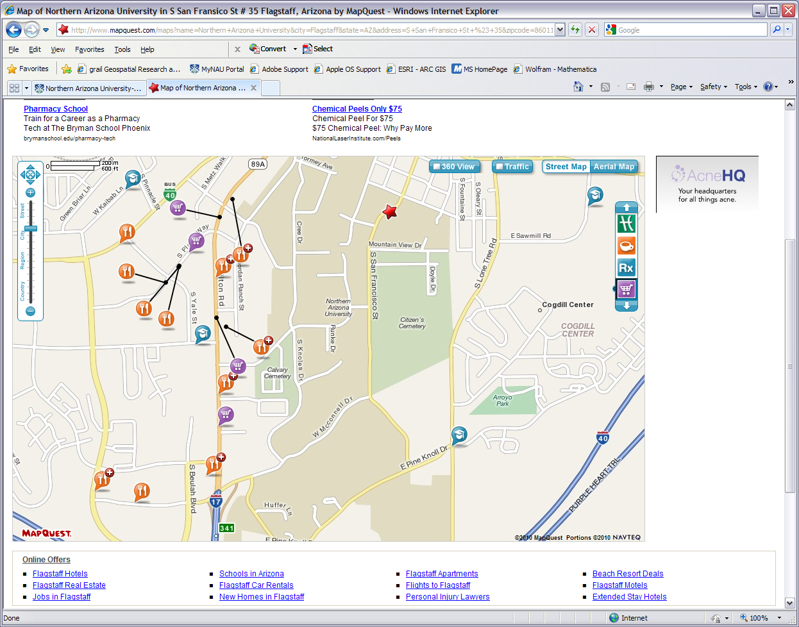
MapQuest
Notes:
Mapquest, the familiar place finder. Simple to use. You just type in the address or what you know of the address you are looking for and Mapquest pops up with a plain-jane street map. Press the print button and you have your map. You can zoom in & out, place an aerial basemap under the streets, sometimes get an idea of traffic in the area, and possibly a 360 degree street view. You can also turn on & off different place locator icons for things like restaurants and schools. Some downsides are the advertisements off to the side, you can’t edit or add data, and the directions you get from Mapquest are not always the best or accurate. With any map program you are using for navigation it is best for you to use the map to plan out a route on you own and do it before you leave the house.

Slide 8
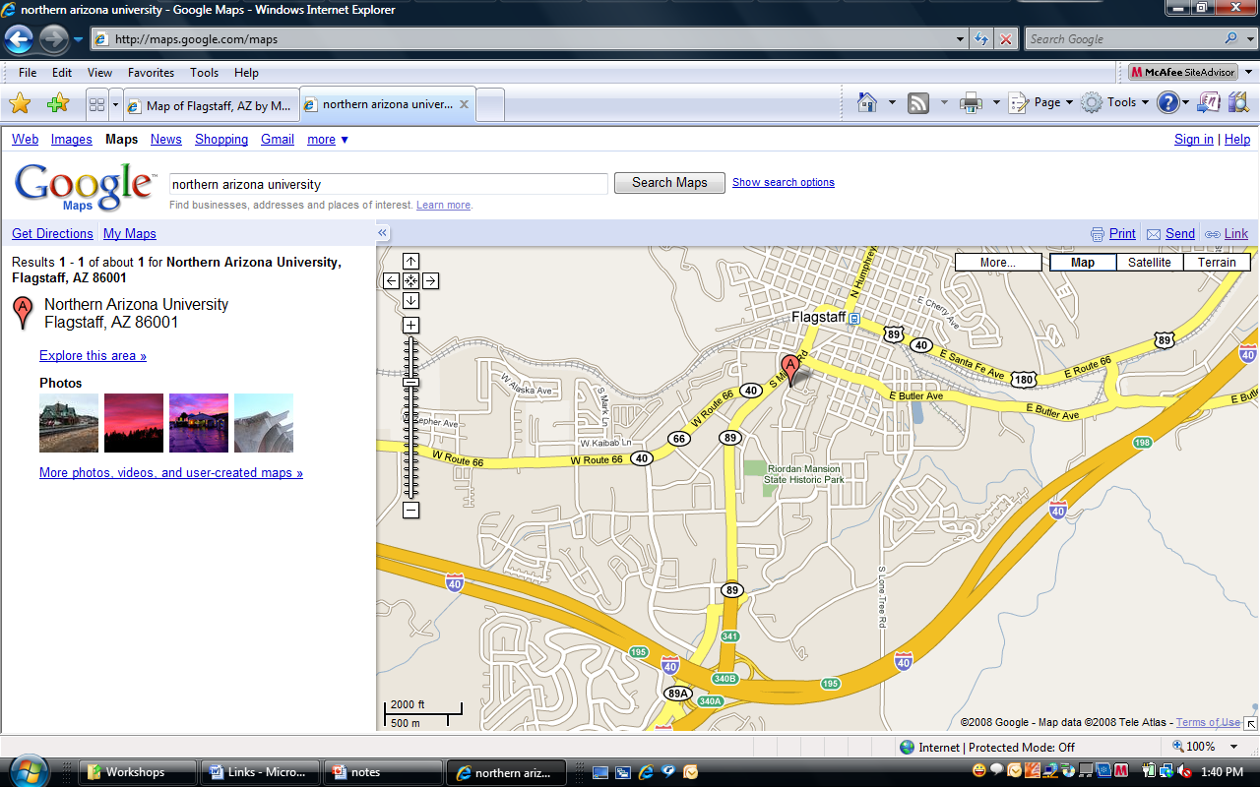
Google Maps
Notes:
Another familiar face. Google Maps does a similar basic street map product. Some of the layers you can turn on here are the same and some are different. The maps made by Google and Mapquest may appear a little different because they display things differently and the data may come from different sources. Even though both web applications are very similar we are showing both to point out that a map of one location can appear differently from dissimilar map makers. Sometimes it’s just a matter of preference which one you use.

Slide 9
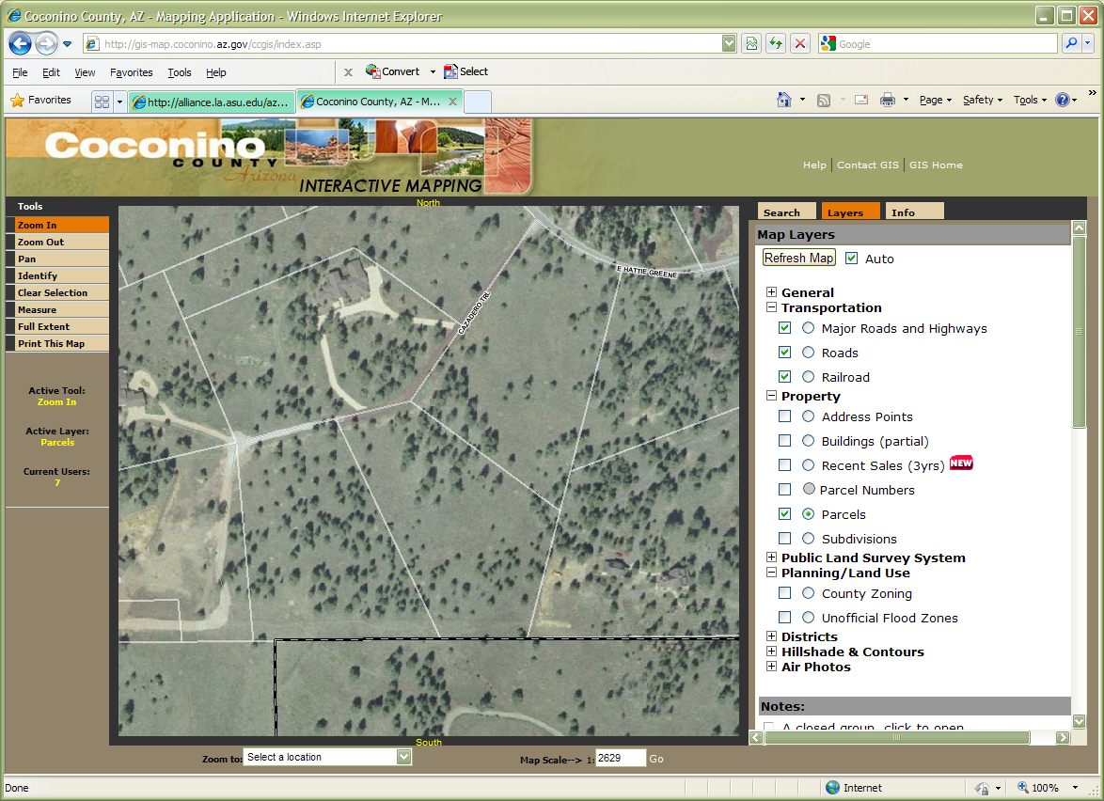
Coconino County GIS
http://gis-map.coconino.az.gov/ccgis/index.asp
Notes:
Moving onward and upward many cities, counties, and states have their own mapping or GIS engines. These are usually limited in their capabilities but do allow you to make a quick 15 second map and often have local information that other map programs will not. This map maker from Coconino County has layers for property parcels you could use to know the extent of a plot of land you are looking to buy or where your land ends so you can build a fence. It is fairly easy to use and can be more relevant to your area than a basic street map.

Slide 10
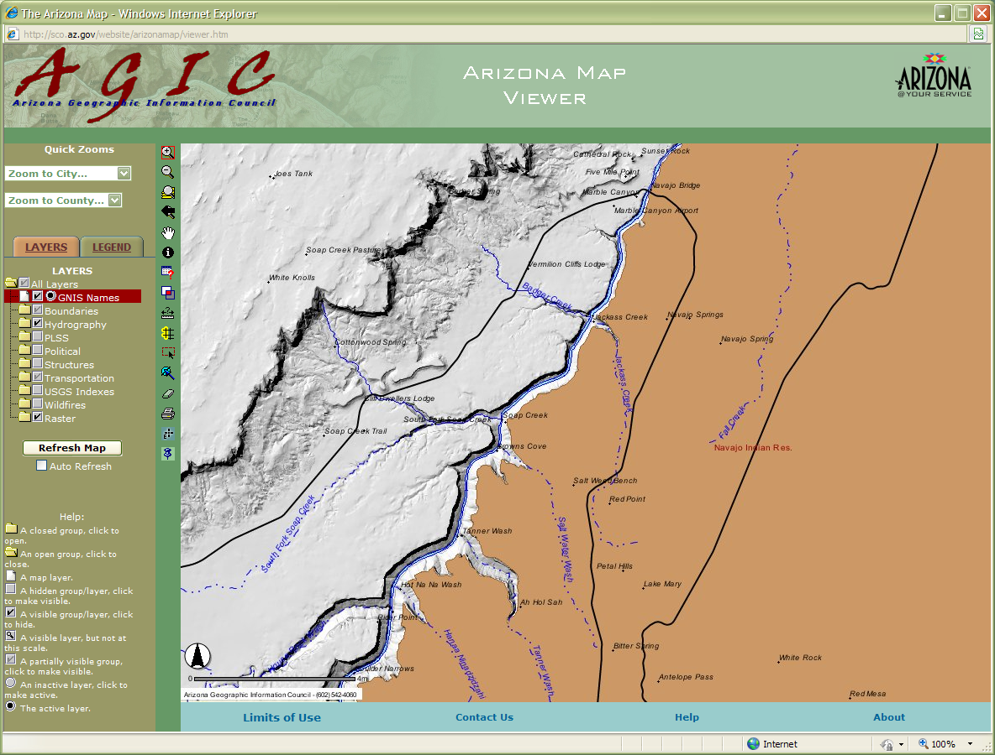
Arizona Geographic Information Council
http://sco.az.gov/website/arizonamap/viewer.htm
Notes:
Here is another government sponsored map maker. It has a few more bells & whistles than our last few examples but isn’t too hard to figure out. We still can’t do things like export data yet but this one has even more layers to turn on & off, a legend tab, and tools for querying and identifying spatial data. In the screen shot here it didn’t take long to turn on the layers and zoom into the area. We now have a quick map of several side canyons off the Colorado River right below Navajo Bridge. We can print this off from our inkjet or screen shot it into our report for tributary canyons southeast of the Cliffs of Vermillion.

Slide 11
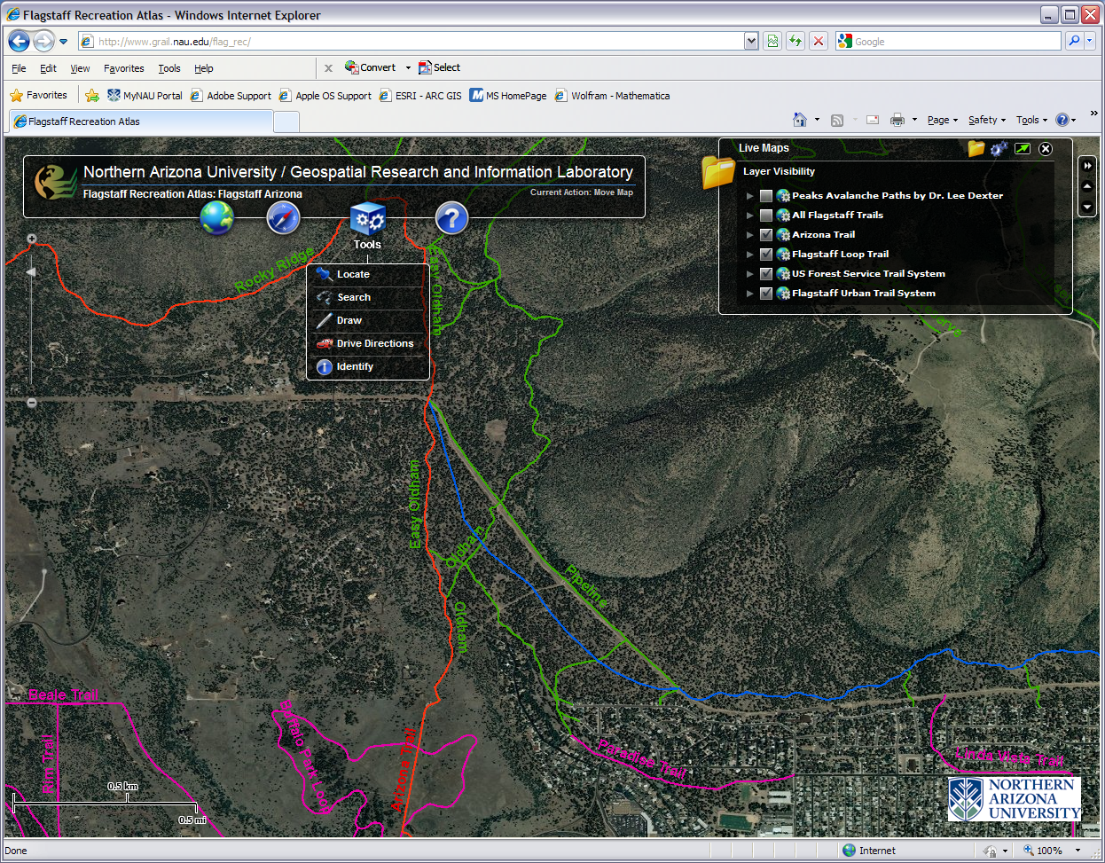
Flagstaff Recreation Atlas
http://grail.nau.edu/flag_rec/
Notes:
Quick online map making machines are being developed all over the world wide web. This a fun and useful product recently made available by NAU’s GRAIL. With the Flagstaff Recreation Atlas you can turn on & off different layers, have satellite, topographic, or street map backgrounds, and the tools let you draw on the map. Right now there is even an environmental layer about the Peaks avalanche paths and one about the summer 2010 fires. This app is just getting started and more layers are forthcoming.

Slide 12
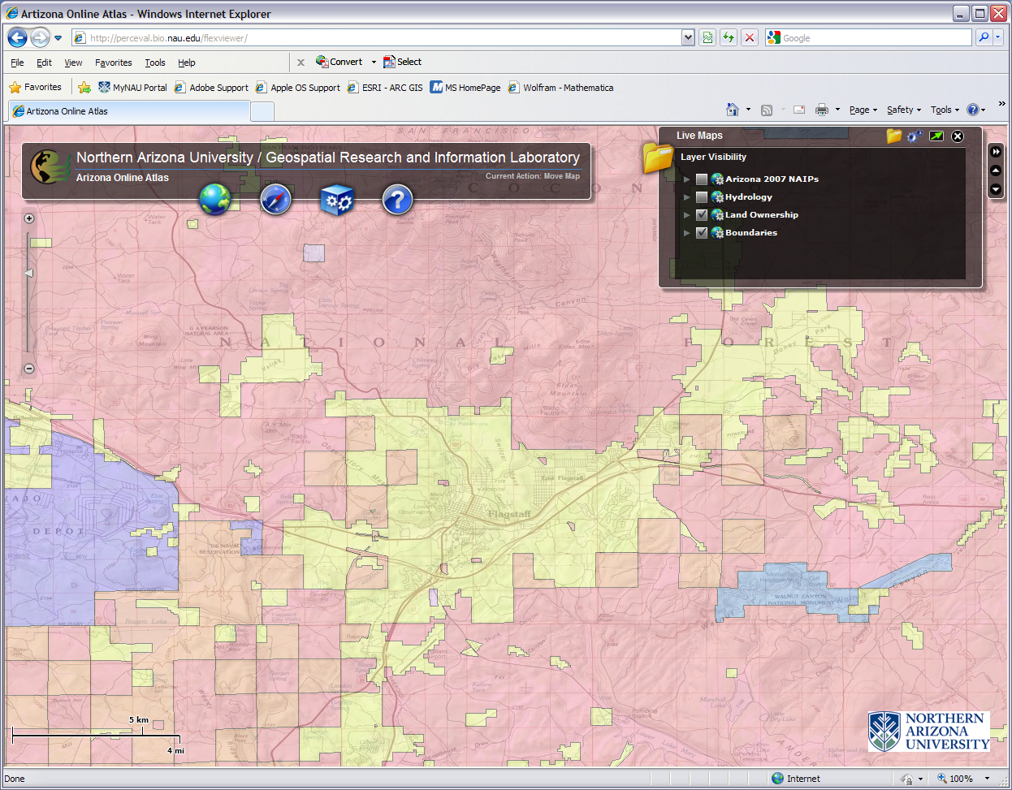
Arizona Online Atlas
http://perceval.bio.nau.edu/flexviewer/
Notes:
Currently being built at GRAIL, is the Arizona Online Atlas. The web address will change soon but the one on this slide is active & accessible. It covers the entire state and more data and tools will be added. Right now you can turn on & off different layers and print form it. Up at bat we have the land ownership layer on top of a topographic map layer of the area. It doesn’t have a legend yet, but if you know the area you can guess the rose color is national forest, the orange peach is private land, the blue turquoise on the right is national park, and so on. So if you need a map a.s.a.p. to give a client an idea of how much government land there is around the Flag, the Arizona Online Atlas would be a good choice to create it.

Slide 13
Mapping Software
&
Spatial Data
Professional tools for anyone
Notes:
This last section of module 1 talks about computer and internet tools to help you go beyond the 15 second map. Some of these are free and others will cost you. Some are fairly easy to operate and others take some time and patience. Later in the workshop we will use some of the easy ones to create a good 15 minute map.

Slide 14
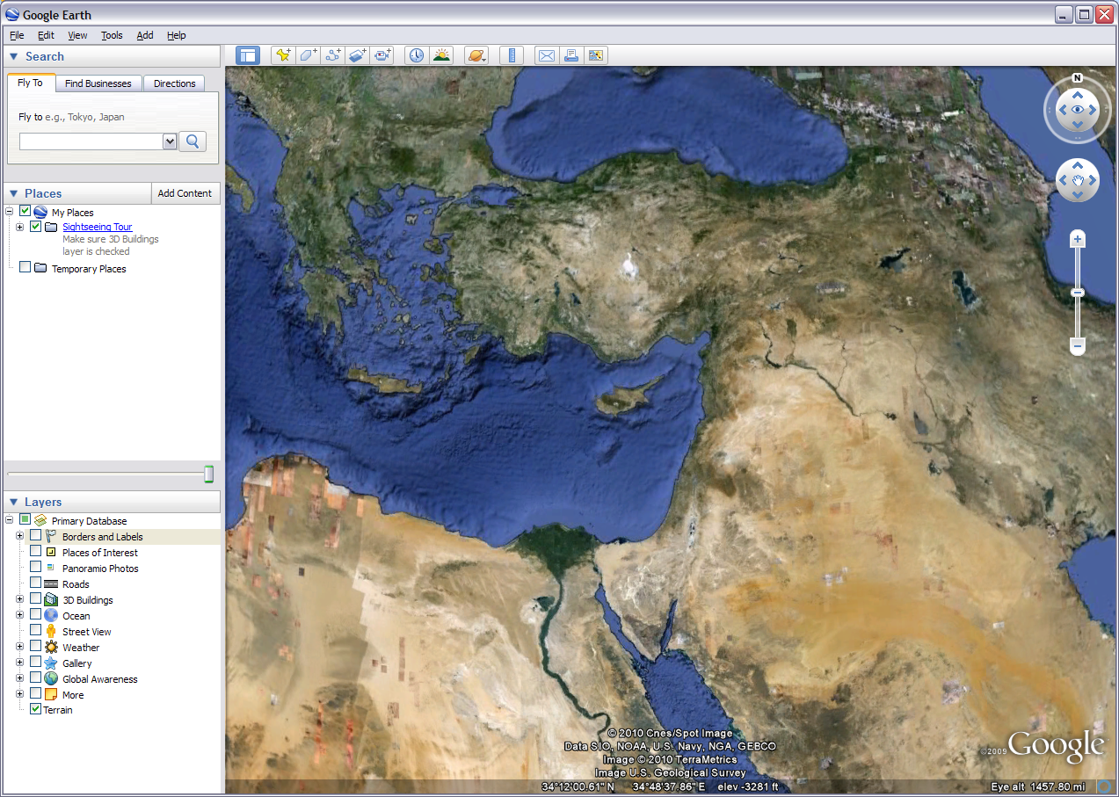
Google Earth
Notes:
From the friendly folks at Google this free download provides more than just a pretty picture. This popular app that many of you may already be familiar with is actually very useful in light cartography and other GIS projects. You can turn off & on different layers like others we have discussed but there seems to be more general interest layers here than most offer. There is also much to play with on the top tool bar from drawing to comparison of past imagery. Some of the 3D things you can do with this are out of this world, literally. You can explore the night sky, make maps of the Moon, and have your own rover mission on Mars. But coming back down to earth, Google has some simple tutorials for most of the fun things you can do with this digital globe. In the professional versions you pay for you can export data that can be used by high end GIS software. We will show you how you can use this tool to make a good 15 minute map in the next module

Slide 15
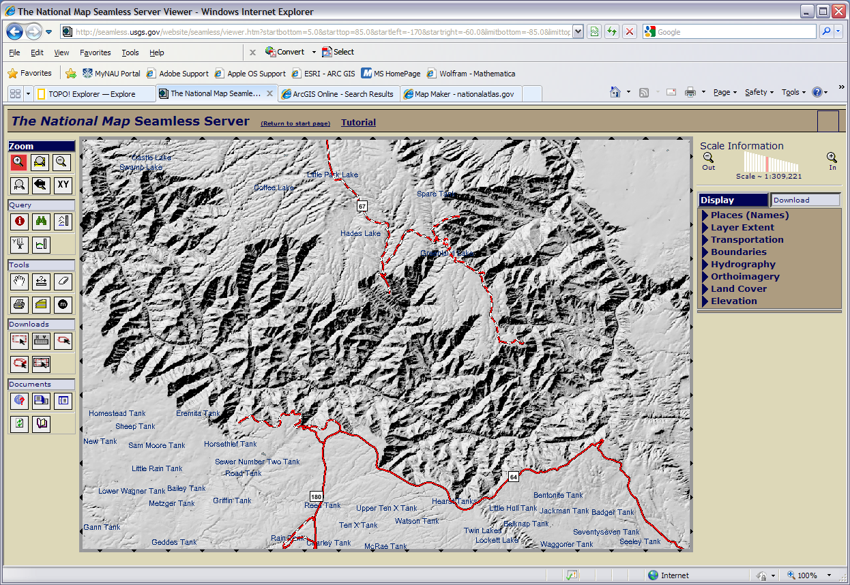
The National Map
Notes:
The Death Star of online mapping! The National Map Seamless Server is awesome because it has a ton of nation wide free data that can be downloaded for use on anything from making a map for a day hike to developing a heavy 3D GIS project of Sycamore Canyon. I also call this the Death Star of online mapping because it is complicated, cumbersome, slow, and takes quite a bit of patience. This is one computer product where I would suggest going through the tutorial easily found on the top of the viewer before you start messing around and getting frustrated. Overall it is a fantastic product. It just takes some time to learn and patience with the server speed. Now don’t confuse this with the National Map Viewer. Similar with almost as much data but an easier and faster product. It too has a learning curve but makes a good map. For an even easier product try the National Atlas. Not as much data, but for some basic layers of a large region it might do the job.

Slide 16
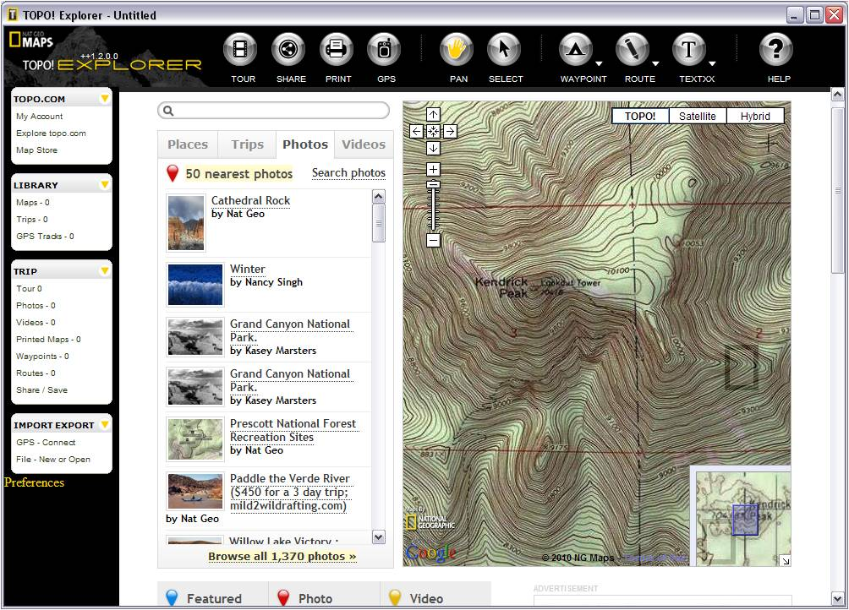
TOPO! Explorer, TOPO! State Series,
& Dalorme Topo USA
Notes:
National Geographic came out a few years ago with the TOPO! Series. The first to come out was the State Series which is still a high quality product (and my personal recommendation). You can buy a digital seamless version of all the USGS topographical maps for a state, zoom in to the level you want, draw, mark, and measure routes and waypoints, and then print or download the map onto your GPS unit. There are many other functions too. Although TOPO! Is targeted for recreation interest it can be use for other light to medium GIS/mapping projects and topographical maps make good base maps. TOPO! Explorer operates in a similar way. With TOPO! Explorer you download the viewer or view online, set up an account, find the topo you want and order it for either download or print. Delorme makes a similar product called Topo USA for both urban and rural general mapping needs.

Slide 17
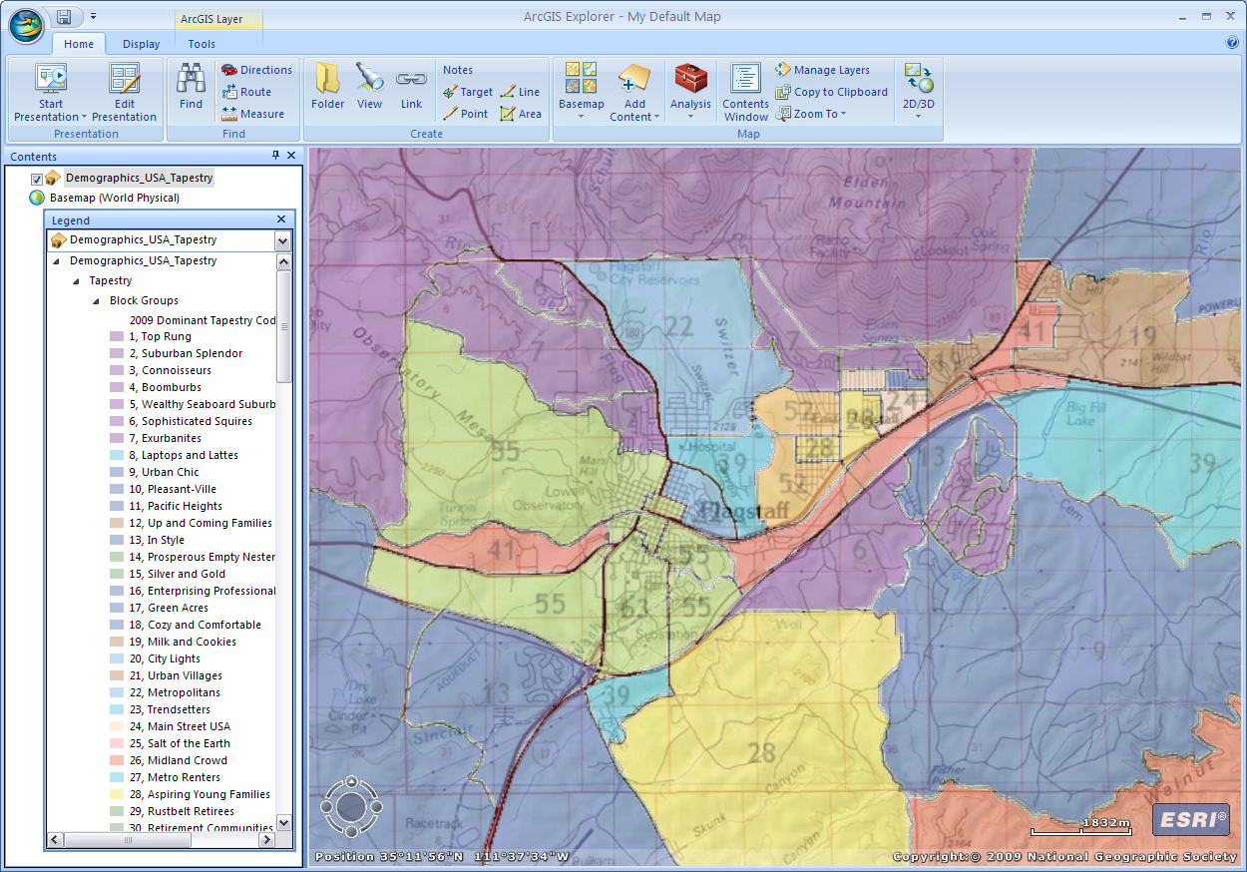
ArcGIS Explorer
Notes:
ArcGIS Explorer is a free download from ESRI or can be used online at arcgis.com and clicking on the word map. The online version is a bit more limited so I prefer to download the desktop version. This app is a very simple GIS map maker. It comes with some base maps when you download it. When you click on the add content icon you can add your own data and also add data from the arcgis.com community. You can draw on your own lines, points, and shapes as well as set the map in a presentation mode. It is a useful tool with access to free data with out having to be a GIS professional. It does export data to small degree in proprietary or its own unique format.

Slide 18
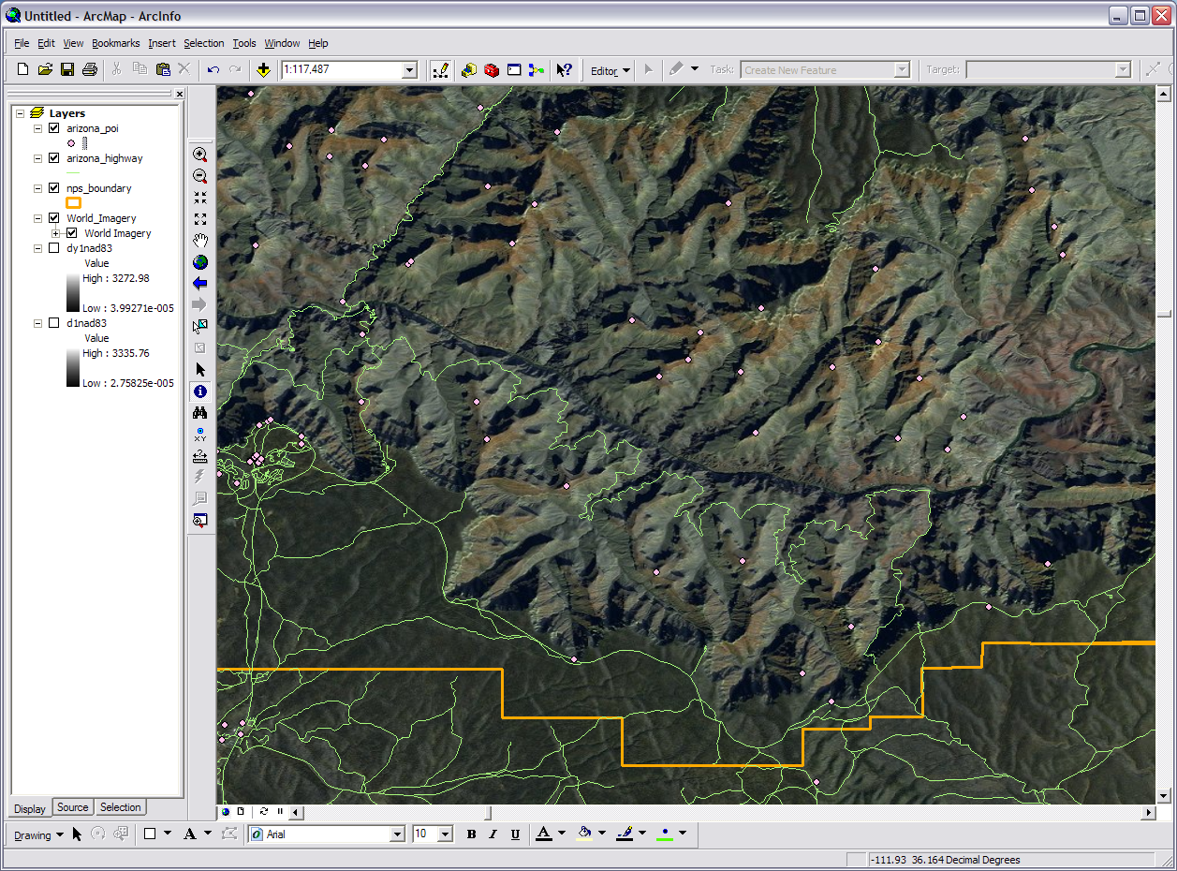
ArcGIS
Notes:
Full on professional GIS software. ArcGIS is used by small businesses to national governments. This does everything from a simple map to high end 3D geospatial visualization. You can access some basic datasets for it from ESRI but it is made for you to manipulate your you own spatial data in a thousand and one different ways. Some parts of it are rather easy to operate and others are beyond the comprehension of mere mortals. ArcGIS is actually a suite of programs. Shown here is ArcMap where much of the visualization and final work is done. You also have ArcToolbox, ArcCatalog, and others that are used for processing of spatial data before, during, and after work in ArcMap. The software can technically be obtained for free but you need a costly annual license to operate it.

Slide 19
Wrap Up
Map Elements (what makes a map)
Online Quickies (15 second maps)
Map Makers (professional tools)
Notes:
In a quick recap of what we covered let’s remember a few basic things. A good professional map contains more than just an image. It includes several elements working together to communicate to the reader of the map the relationships of the spatial data displayed. On the world wide web several quick map making applications can be found. These contain limited basic spatial data and are mainly used for creating some of the simplest digital maps. Software and internet service are available for quality map making. These vary in capability and cost. They produce useable professional maps for communicating spatial data and ideas to a target audience.

Slide 20
Any Questions?
Please Contact:
Mark Manone Training Facility Coordinator Mark.Manone@nau.edu (928) 523-9159
“To map out a course of action and follow it to an end requires courage”
Ralph Waldo Emerson
Notes:
Please feel free to contact us at GRAIL with any questions

