Slide 1
Projections, Datum, and Coordinate Systems
Module 1
Created by: Scott Kelly 2010
Notes:
We live on and in reality see our earth in three dimensions. We comprehend distance, elevation, and expanse. Often times to understand our world we take those three dimensions and make them two. We cast our understanding of the earth onto a two dimensional printed medium, digital screen, or other canvas.
Spatial data (data about geographic locations) carries information with it that tells the interpreter where in the world that data is and fits. Even when we virtually simulate a three dimensional surface there is a piece of projection information behind it. Kind of like this background picture I pulled off of Google Earth. It is a real world location (Hunt’s Mesa) that a camera (interpreter) reproduced on to a flat screen. In this workshop we will talk about some of the ways we take an image or graphic and arrange it so it is geographically correct.

Slide 2
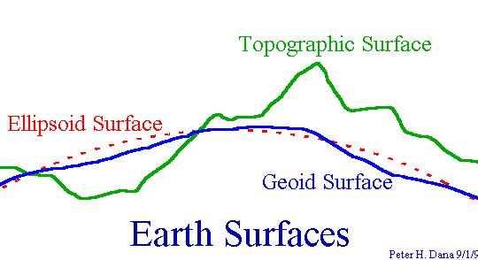
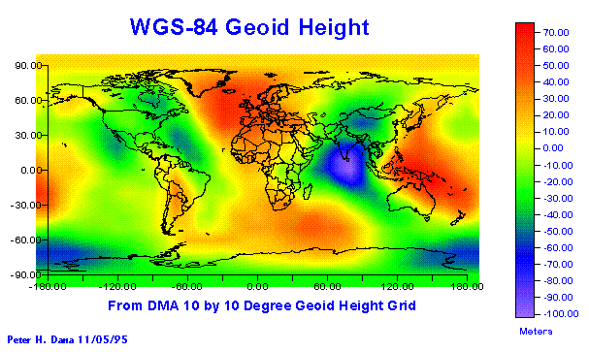
Geodetic Datum: What are they?
Define the size and position of the earth relative to its center
Used as basis for coordinate systems
Variety of models:
- Flat earth
- Spherical
- Ellipsoidal
WGS 84 defines geoid heights for the entire earth
Notes:
We start with Geodetic datum which define the size and shape of the earth and are the origin of the projections and coordinate systems used to map the earth. Hundreds of different datum have been calculated and used since the first estimates of the earth's size were made by Aristotle.
Datum have evolved from those describing a spherical earth to ellipsoidal models derived from years of satellite measurements. Modern geodetic datum range from flat-earth models used for plane surveying to complex models used for international applications which completely describe the size, shape, orientation, gravity field, and angular velocity of the earth. While cartography, surveying, navigation, and astronomy all make use of geodetic datum, the science of geodesy is the central discipline for the topic.
In a nutshell datum are what provide the reference foundation for the coordinate system of your spatial data. You should also be aware that unless proper transformation happens while working with two or more datum in one project it may show the data layers added to the original layer as slightly off because each datum has a different way of taking the measurements of an irregular 3D earth and putting them on a uniform 2D surface.

Slide 3
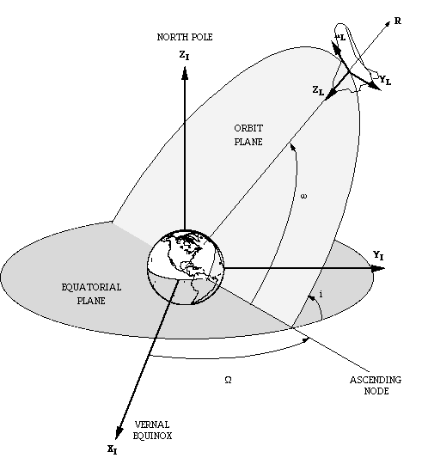
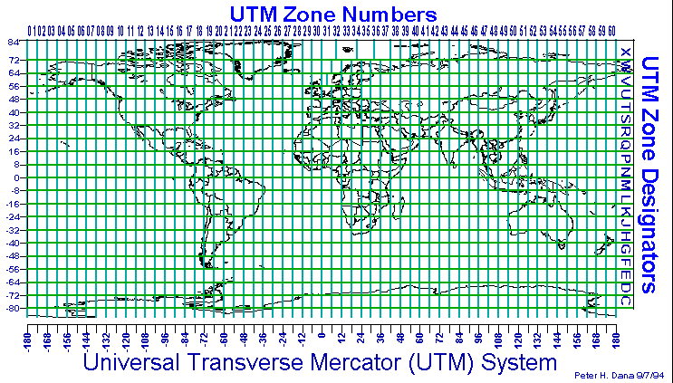
Coordinate Systems
Based on Geodetic Datum
Describe locations in two or three dimensions (ie. X,Y,Z or X,Y)
Local and Global
Common systems
Geodetic Lat, Long (global)
UTM (local)
State Plane (local)
Variety of transformation methods
Notes:
From the datum we get projections; from the projections we get coordinate systems. All three of these combined are often generically referred to as the projection. The projection is what develops the datum into a coordinate system. The coordinate system is a calculated grid integrated your data to put the data in the right place. Based on what datum are used you can come up with several different coordinate systems.
Most people are familiar with latitude and longitude but there are many others commonly used in work from engineering to marketing. Some are focused on the entire globe while others are for a local area (geocentric). Even though the coordinate grid may be geocentric it may be able to work for the entire world. The U.S. State Plane grid system was set up in the 1930’s for state, county, and city governments and won’t work outside the United States but the UTM grid system developed by the United States Army Corps of Engineers works great world wide (except at the poles).
When the Geographic Information System (GIS) software knows where your data is located via a datum based coordinate system it can project it onto other geographic layers such as a map and put it in the right place. Even though everything is in the right place the difference in projections may cause some visual misalignment.

Slide 4
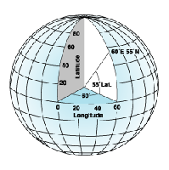
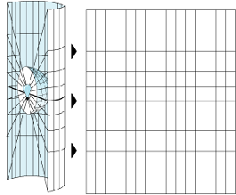
Geographic Coordinate Systems
Projected Coordinate Systems
Coordinate Images Source: ESRI
Notes:
So we have measurements of the earth and its surface. We take those measurements and illustrate our very tangible world on a visual surface. Creation of these projections comes using two basic methods. Geographic coordinate systems and projected coordinate systems. A geographic coordinate system creates a framework calculated from three dimensions and the center of the object. The designed net covers the object’s surface. This allows us to come up with grids such as Latitude and longitude. A projected coordinate system is based off a geographic coordinate system but instead of the spatial web wrapping around the surface of a three dimensional object, it projects the three dimensional surface onto a two dimensional canvas. This can be done in a variety of ways.
Image Source: ESRI (http://resources.esri.com/help/9.3/arcgisengine/dotnet/89b720a5-7339-44b0-8b58-0f5bf2843393.htm)

Slide 5
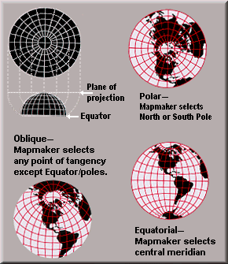
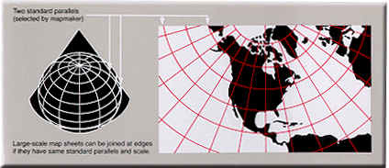
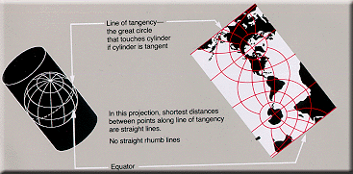
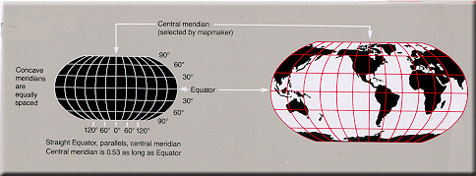
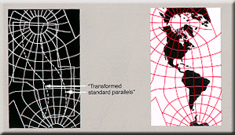
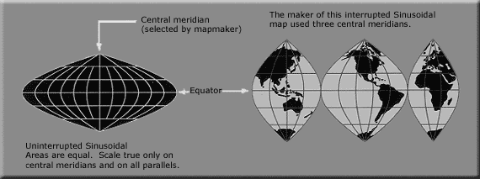
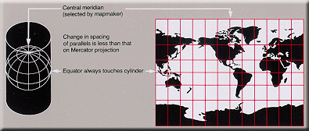
Image Source: http://commons.wikimedia.org/wiki/Category:USGS_projections
Notes:
From cones to cylinders to flat planes we can project the world in a plethora of views and interpretations. You can peel an orange but in order to make those peels lay flat there needs to be some tearing or cutting. When the 3D earth gets projected onto a 2D visualization we can choose to preserve some elements but others will get distorted. The elements of scale, shape, area, distance, angles, and others need to be considered.
If you want to preserve distance when making your interpretation of the world then you may need to sacrifice the true shape of places. Sometimes this isn’t even noticeable but other times it can be a big problem. We also need to factor in the center or origin of the projection and pay attention to line and angle parameters. For example if we are doing a study on the endangered yeti in Mongolia a projection that preserves area and is centered in Asia might be more useful than one that is centered at 0°Longituted, 0° Latitude and focuses on scale.

Slide 6
Data in Google Earth
(Plate Carree)
Data in ArcMap
(AZ State Plane)
Common issue of working between different databases, Datum, and Projections – Data sometimes does not line up or has conflicts
Notes:
As I mentioned earlier when talking about datum, when we use two different projections you can get slightly off data. Polygons of buildings on the west side of central NAU main campus were overlaid on raster images with the projections Plate Carree on the left and Arizona State Plane on the right. As you can see two different projections are close but may not match up.
The polygons on the left are not necessarily wrong but are in a projection that may have measured the earth differently enough from the projection of other map features to cause a visual discrepancy. This can easily be fixed by simply re-projecting either the raster or polygon layer with GIS software. Occasionally the problem may also lie in the database where the layers are stored and it may take some more technical work to get things to line up.

Slide 7
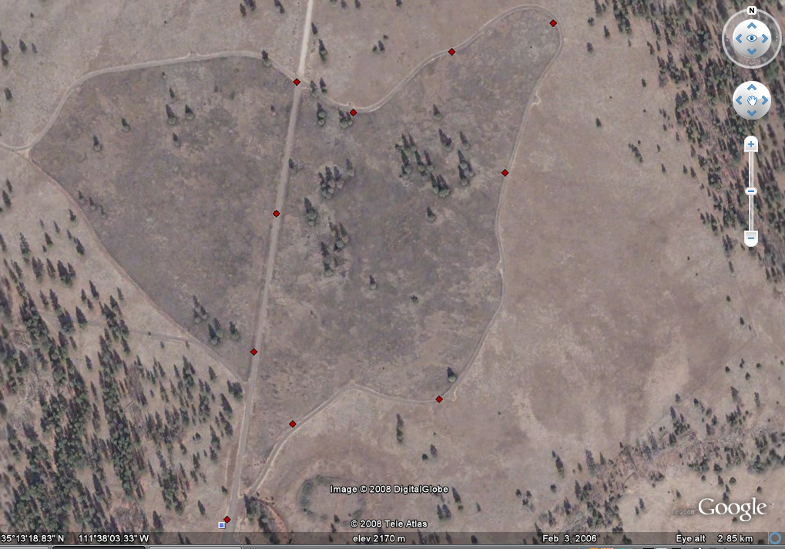
Data in ArcMap
(AZ State Plane)
Data in Google Earth
(Plate Carree)
Notes:
Here is another example of the same two dissimilar projections. Notice however this time you have to look a little closer to see that the points don’t match up. That tree or rock is going to be in the same place on earth no mater how we project it but we can look at it from different view points. From the diverse view points there may only be a half meter variation. You may be doing a project where that half meter is the factor between right and oops or you may be doing a project where the distinction between NAD1983 and WGS1984 datum is insignificant.

Slide 8
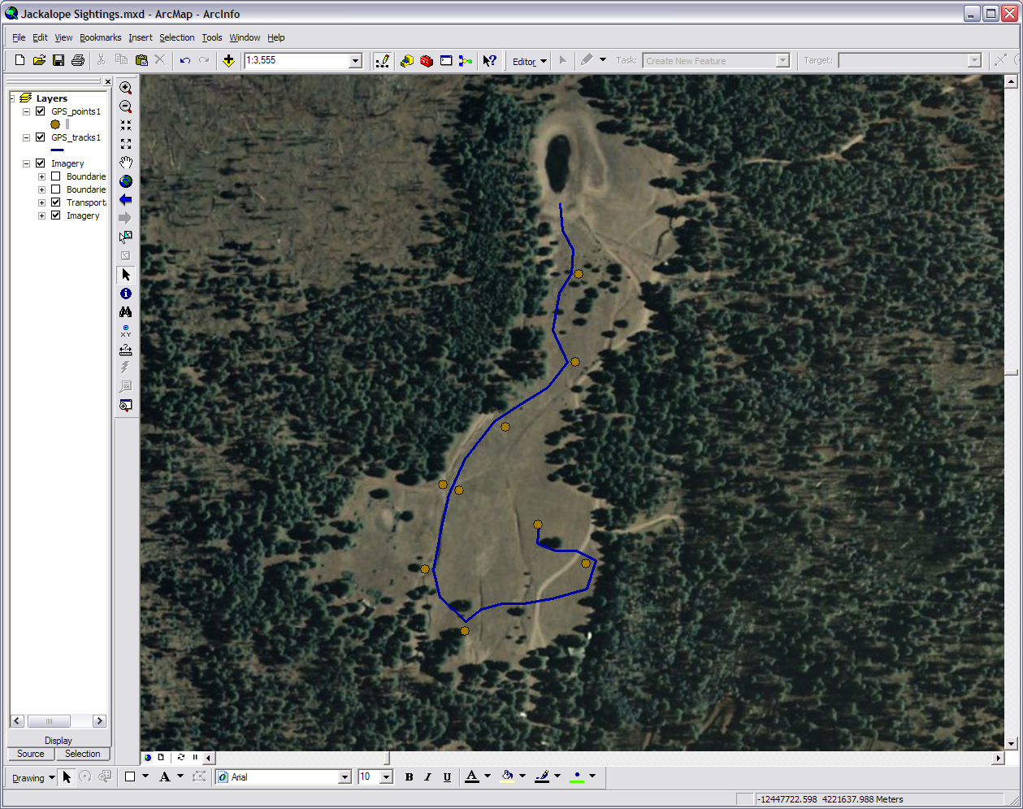
Notes:
It is the projection that places the spatial data in the right spot. We can take a picture of a piece of land or record the number of porcupines in an area but unless we add projection data to our information the computer or other interpreter won’t know where to put it on the earth.
In the example here I went out on a run near Kendrick Mountain and marked on my GPS unit all the spots where I saw a jackalope burrow. The unit also created a record of my running path. I took my unit back to the office, download the waypoints and the auto created track, used a GIS program to put them on top of an image, and made a map. When my GPS unit recorded my running path and the jackalope burrows it attached projection information to each piece of data. I placed the line and points on an image that also had projection information. When I opened the image the computer knew where in the world to place the image, lines, and points.

Slide 9
Global Positioning Systems (GPS) Spatial Location Method: Triangulation
Satellite A
Satellite B
Satellite C
Satellite D
Notes:
Don’t confuse what we have been talking about with the way a GPS works. Projections operate by putting recorded spatial data on a 2D canvas, however a GPS is working with spatial data in real time and real 3D. What happens is while you are looking at the GPS unit you will see your coordinates on a 3D surface but when you record a waypoint the computer in the unit assigns projection information to that data. In GPS the satellites, unit receiver, and unit computer use a method called triangulation or trilateration to calculate where things are. For simplicity sake, we calculate our position by understanding where satellites are in orbit and then further computing how far we are from those satellites (because angles, motions, and positions we are not always the same distance from the same satellite all the time).
Here is how it works: if we know we are a certain distance from satellite A (10,000 miles) this narrows down where we are in the whole universe. This one range of the signals the satellite is broadcasting tells us we are located somewhere on the sphere of the range. At the same time we also know that we are 13,000 miles away from satellite B. This narrows where we are in the universe even more. The only place we can be 10,000 miles from A and 13,000 miles from B is in the area where the two spheres intersect. By adding a third satellite we can pinpoint our location in that area. If we know that we are 12,000 miles from satellite C then there are only two points where all three spheres intersect. In some cases the software built into the GPS receivers have various techniques to determine which point is correct and which point is ridiculous. For example if one of those two points is in outer space the GPS knows you probably aren’t floating around up there.
Technically, trigonometry says we really need four satellites to range and unambiguously locate ourselves. In other words the fourth satellite can be used to determine which of the two points derived from three satellites is the correct choice. Hence we bring forth another satellite. Even though just four satellites will give us a fix on our location bringing in more satellites will give us greater accuracy. Increasing the satellites you’ve locked onto from five to six may mean the difference from 10 to 3 meters of accuracy. The geometry of the satellites and their signals is how the GPS calculates where you are.

Slide 10
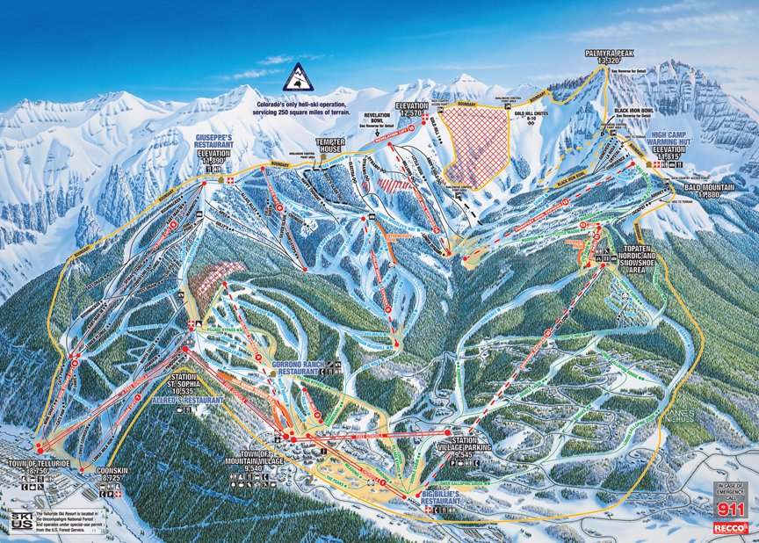
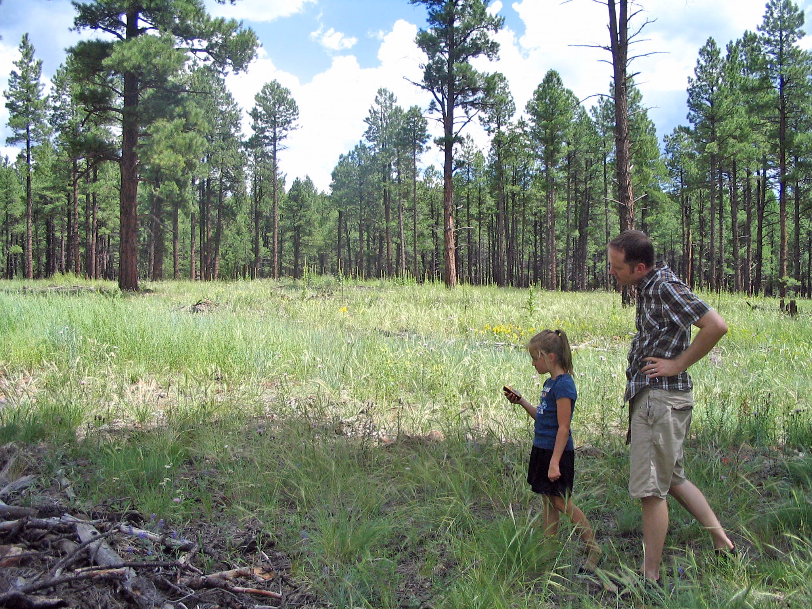
Image Source: Telluride Ski Area
Notes:
So what does all talk of projections mean to you? Well these map projections are a medium of spatial communications. When we study our world and the events, places, and people it entangles spatial data is used to help us and others understand what is going on. We can only do so much with that spatial data when it is not projected onto the right spot on the earth. We are unable to communicate to others the findings of our research and studies. So whether you are analyzing consumer data across Tucson for a marketing firm or working on elk herd movements across the Colorado Plateau you need to be able to project your data on to real earth locations.

Slide 11
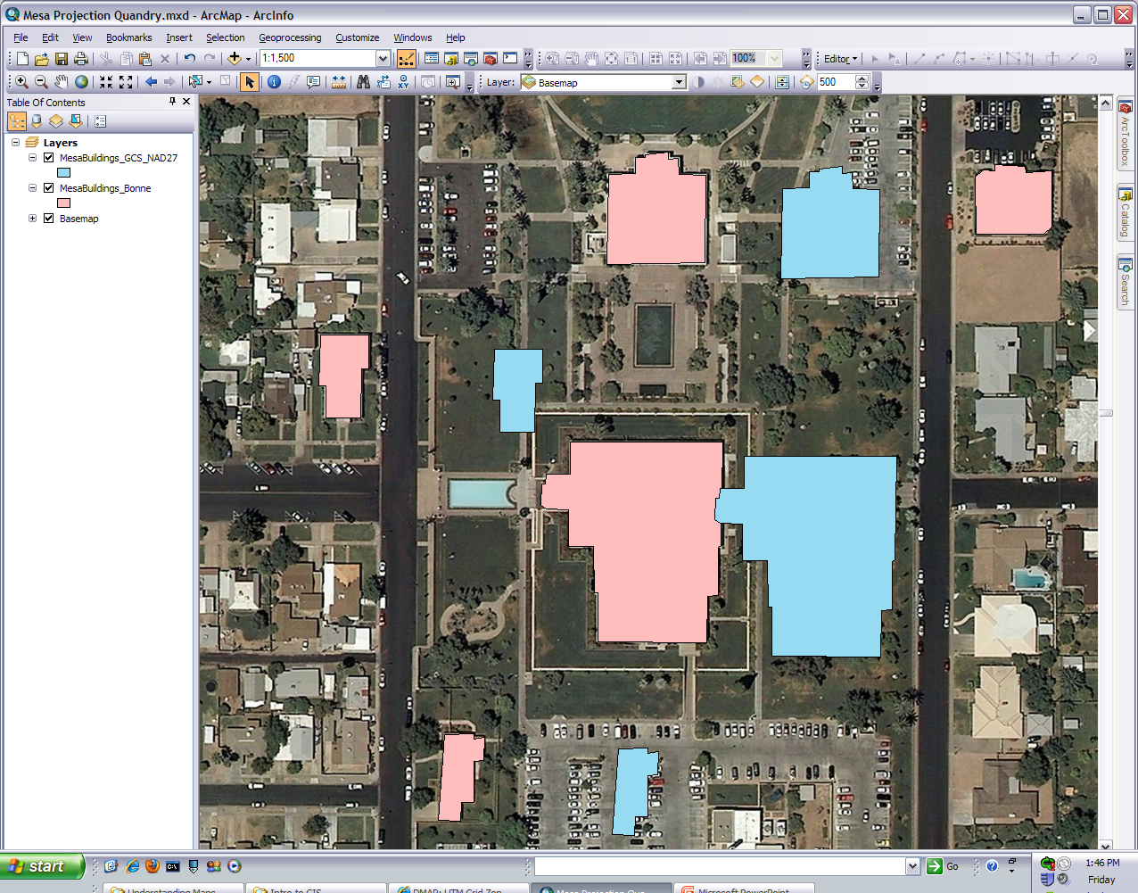
Arctoolbox
These aren’t too bad
These are way off
Notes:
As you do GIS projects you will run into projection challenges. If you do the other online workshops here on the GRAIL website we’ve taken care of any projection adventures for you but in the next slide or two let me show you how you might address this using ArcGIS (many other GIS programs can re-project too).
Here we have polygons of some buildings in Mesa. Just like in our previous examples, you can see the rose colored polygons in the Bonne projection match up with the buildings in the basemap imagery and the sky blue ones in the geographic coordinate system NAD27 do not. Well we want the blue ones to match up too so we are going to re-project the map layer they are in.

Slide 12
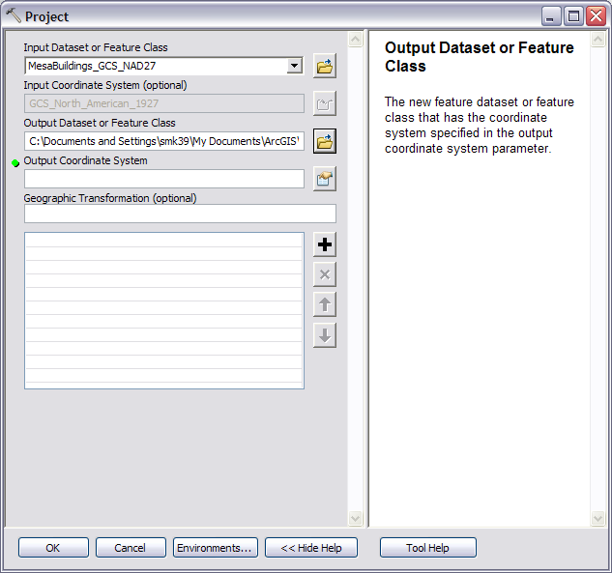
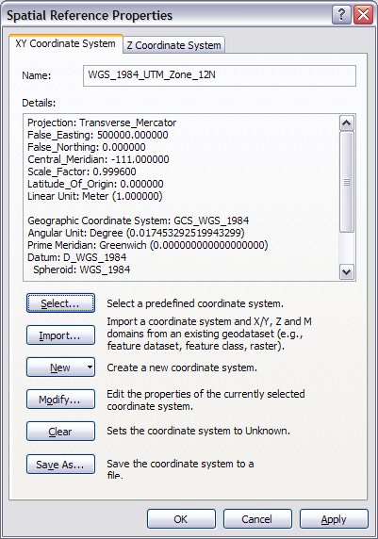
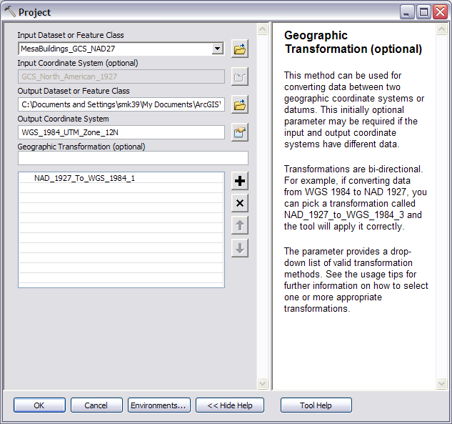
Notes:
(1) In ArcGIS I’ll access the ArcToolbox and drill down to Data Management Tools>Projections and Transformations>Feature>Project. If I had an picture like the basemap, aerial photo, or satellite image I’d pick Raster>Define Projection.
(2) The Project tool window comes up and for the input I add the feature I want to re-project and choose a name for the output. The pivotal moment is when I choose the output coordinate system.
(3) This brings up another window and if I press Select I have the option of choosing any projected or geographic coordinate system ArcGIS has on file or if I choose Import I can copy the projection from a feature or raster that I already know lines up with the rest of the map layers. Just for the fun of it I’m going to press Select>Projected Coordinate Systems>UTM>WGS 1984>Northern Hemisphere>Zone 12.
(4) After I add that .prj file it takes me back to the Spatial Reference Properties window and shows me the projection info for the feature I’m going to create (just a re-projected copy of the original).
(5) I then Press OK and it’s back to the Projection tool. My input, output, and coordinate system are now all set. I’m also going to choose an optional Geographic Transformation to help with the geometry during the projection change. When changing from one datum to another, such as NAD1927 to WGS1984, a mathematical model is often needed because you are changing from one geometric shape to another. I then press OK and let it process.

Slide 13
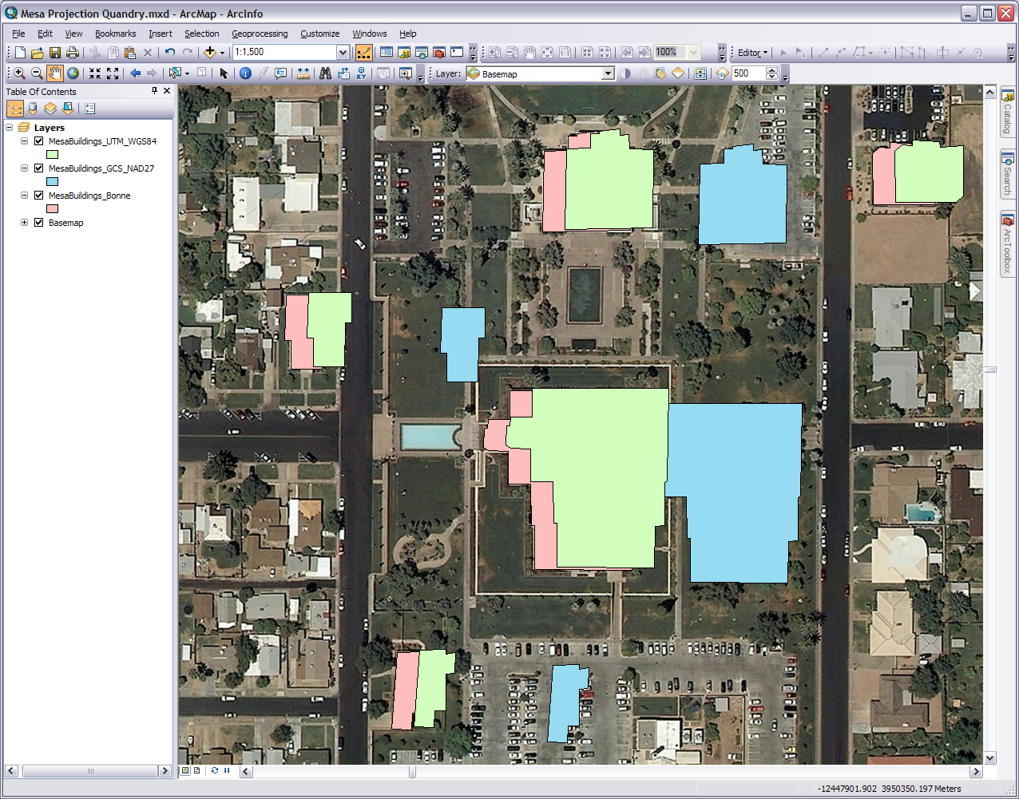
Notes:
Wow these are much closer to matching up however they are still not there. I can keep messing around with the projections or what I should have done was just projected it the Bonne projection like the original and everything might have had better chance of matching up. Even then It might take a few tries because we need to find the correct geographic transformation to account for the difference in the reference datum. So the point is projections are critical details in GIS and can make everything be in concert or as synchronized as a bunch of hyper 6 year olds.

Slide 14
Any Questions?
Please Contact:
Mark Manone Training Facility Coordinator Mark.Manone@nau.edu (928) 523-9159
“To map out a course of action and follow it to an end requires courage”
Ralph Waldo Emerson
Notes:
If you get anything out of this workshop just remember when working spatial data projections are important. Please feel free to contact us at GRAIL with any questions

