Slide 1
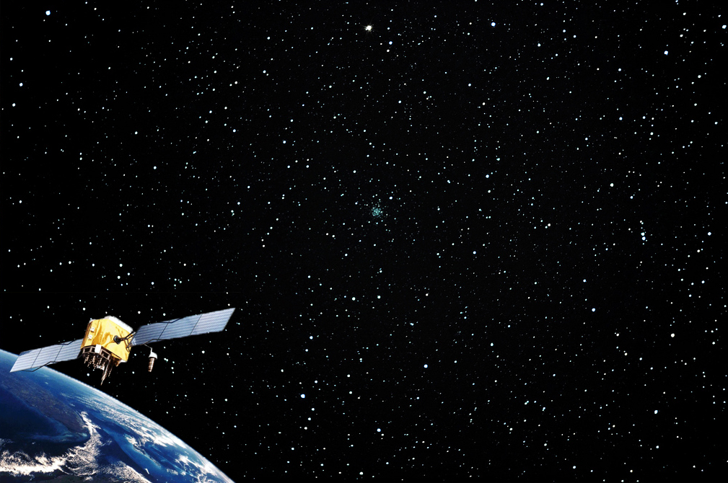
Introduction
to
Global Positioning Systems
(GPS)
Module 2
GRAIL’s In Town & Wilderness GPS Adventures, Geocaching, and The GPS Spy Adventure
Created by: Scott Kelly 2010
Notes:
In the first module of GRAIL’s Introduction to GPS we talked about what makes up a global positioning system, how it works, and how we can use it as a tool. So now that we know all that let’s have some fun with it. In Module 2 we are going to take the GPS unit outside and see what we can do. I suggest you go over the steps relating to the particular exercise before you take off on the adventure. These events can all be used in a variety of formats from education and training to recreation. The three activities in this module are GRAIL’s In Town & Wilderness GPS Adventures, Geocaching, and The GPS Spy Adventure. These can be done as a group or solo.
You will need a basic handheld GPS unit for each team or individual and a map or general knowledge of where you will be doing the activities. If you don’t own a GPS unit see if you can check one out from a friend, school, university GIS lab (GRAIL has several you can check out if you are in the area), local/community recreation center, or other source. The GPS found in phones or other multiuse devices may or may not work for these activities. If your situation is agreeable, a GPS unit is a good investment. It can be extremely useful and last a long time (the mountains, plains, and valleys on earth aren’t moving that fast). A good simple unit is around $100 and all you need for this module. Whether your owning, buying, or borrowing don’t worry about high accuracy. Anything 10 meters or less will do. Dr J. J. Kerski of ESRI adds “Before using these courses, it is helpful to have a discussion with the participants about coordinate systems, how a GPS works, and the accuracy of GPS receivers, and to navigate to the first point with the participants, if possible.” Take a look back at the first module to reorient yourself with these topics if needed.

Slide 2
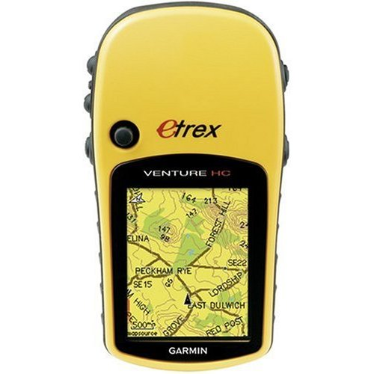
GPS
Antenna/
Receiver
In/Out
Zoom keys
Exit,
Page key
Menu,
Find key
Enter Key,
Joystick/Rocker
Power,
Backlight
key
Notes:
First let’s go over some unit basics if you are not familiar with them. For this module I’ll be using a Garmin Etrex but the operations are somewhat standard across models and brands. The newer touch screen modules have some of their keys right on the screen. The nice thing about GPS technology is that it was made to be simple.
Starting on the bottom right is the power and backlight key which allows you to turn the unit off and on and adjust the backlight. Moving up is the exit and page key. Anytime you are in a menu pressing this key will exit you out moving up to the next level menu or next page. There is no key for it, but it is good to know that the top forehead part of the unit is where the GPS antenna/receiver is housed. Going around to the other side is two keys on the top for zooming in and out. The bottom key on the left side is the menu or find key. This of course brings up the menu for that page and in some cases allows you to select a geographic location. Finally on the face is the joystick and enter key. Think of this like the mouse on your computer. You move it around to move the pointer or selector on the screen and press down on it to execute a command. Unlike the mouse on your computer it won’t always let you switch to a new page though. Of course your unit may have a different way of navigating pages and menus so if you have not oriented yourself with it, take the unit out under a clear sky and mess around with it.

Slide 3
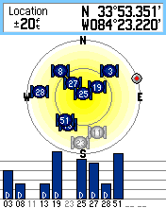
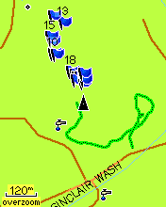
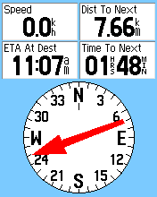
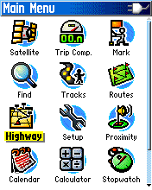
Notes:
We went over the basic screens on most basic handheld units in Module 1 but this is a good spot to review. Each GPS unit displays their functions differently on their screens. Starting on the top left is the satellites page. You may see what satellites are in your sky, what ones your unit has picked up and locked on to, the strength of their signals, your coordinates, and some other info.
To the right on the map page you can see in real time where you are on the earth (see the black triangle in the center) with other places of interest. Many units will also let you view other windows on the page such as speed, trip odometer, or distance to a selected waypoint.
Waypoints and Tracks are on the map page in this screen capture of my unit. Simply put; a waypoint is a digital point that marks the spot where you are at. Tracks are the line segment version of waypoints (see the dark green line in the image). You can manually set the unit’s computer to start tracking your movements or it may do it automatically.
On the bottom left is the navigation page. The page contains a digital compass, destination pointer, and any other window you wish to have on it. The way it works is you tell the unit that you want to go to a point of interest stored in the unit’s memory and it will point you in the direction you should go. Don’t expect turn by turn directions from most handheld units though. Please keep in mind when navigating from point A to point B that a GPS does not have a brain and you should use yours.
Last is the menu page. If you want to do anything with the GPS unit other than navigate, look at satellites, or where you are on a map go to the menu page. The menu will have settings, track & waypoint management, and can contain any number of applications from calendars and calculators to hunting, fishing, and geocaching programs.

Slide 4
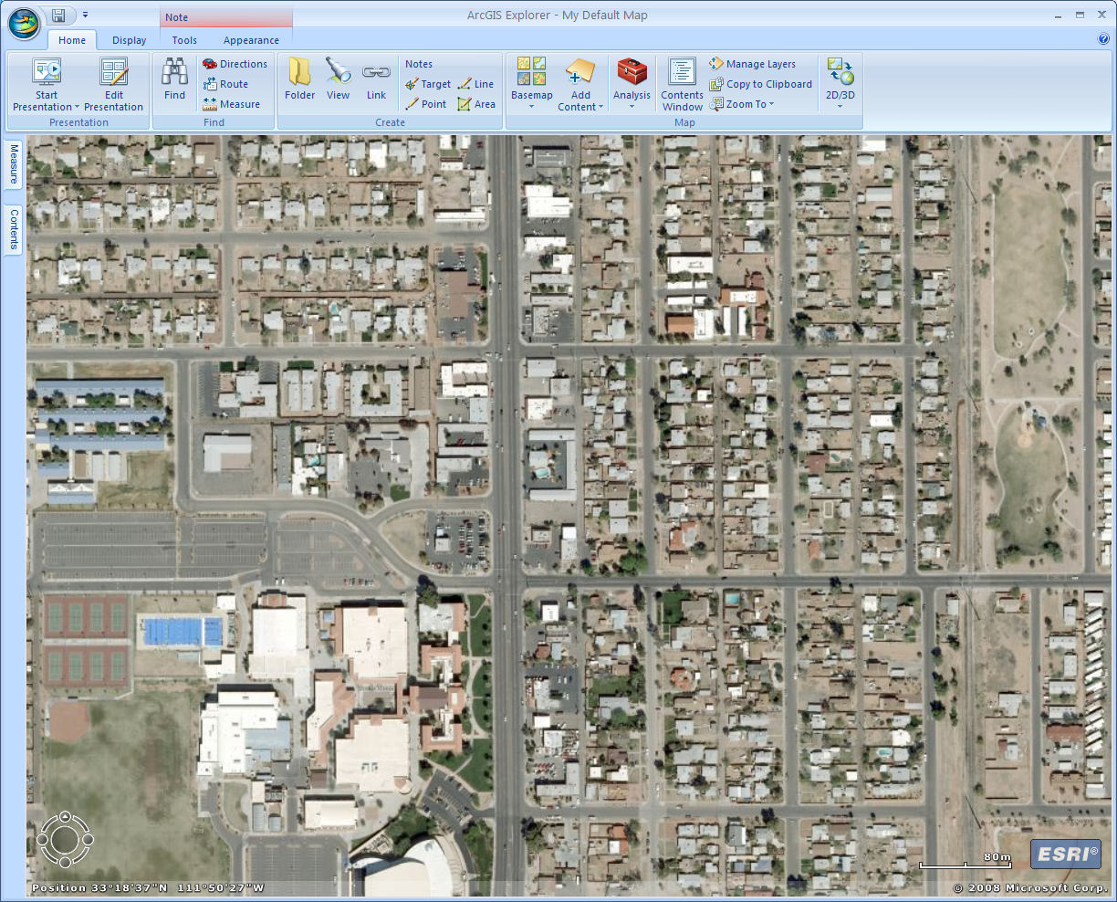
Path to other corner
Path to a southwest street corner
Imaginary line to complete the triangle for navigation (triangulation)
Above: The Royal Observatory in Greenwich, England
Left: The Adventure as run from the front of Chandler High School
Starting point
GRAILS’s In Town GPS Adventure (activity sheet on webpage)
Notes:
Our first activity is GRAIL’s In Town GPS Adventure and is intended to help folks get outdoors and active while learning about and using technology. In this activity participants will gain a basic knowledge of how a GPS unit can help with science, math, navigation, land use, environmental studies, and various other subjects. It is a simple and not too time consuming GPS orientation exercise. An in town and outdoor version were made so you could set it up based on your situation. The activity sheet can be downloaded from the link on the webpage and can be done solo or as a team(s). Participants will pick a starting point, such as a school parking lot, athletic field, or park and follow the questions on the activity sheet. At the starting point participants will take a few readings from their GPS units, answer some knowledge questions, mark a waypoint, and proceed at least to a southwest street corner (if you have several teams or people you might want to have them go in different directions. Just make sure their next path is 90° from where they were).
To mark a waypoint with Etrex Garmin units like the one I’m using all you need to do is hold down the joystick/enter button while on the map, satellite, or navigation page popping up window that will mark the point. If you are unable to figure out how to mark a waypoint on your unit see the unit’s instruction manual. For some of the knowledge questions that might not come to you right away, #2 is the horizon, #4 is the equator, and #5 the Prime Meridian, Greenwich England, or if we want to get technical 0°Lat & 0°Long is just south of Ghana and west of Gabon in the African part of the Atlantic Ocean.
From the southwest street corner write the latitude and longitude, head at least a block perpendicular from your last path, fill out the questions, then make your way back to the starting point using the Go To or Find navigation function on your GPS unit. Answer the next few questions as you go along. For more waypoint practice you can mark the two corners you stopped at. Once back at the starting point fill out the rest of the questions. For question #15: In the window that pops when marking a waypoint you can use the joystick to scroll down to the coordinates field and enter the coordinates manually.
Please remember when walking with the GPS unit to look up and pay attention to your surroundings so you don’t run into someone, step in a dog mine, trip on a squirrel, disrupt traffic, or unwisely encounter any other obstacle. This activity can be adapted in anyway so feel free to use it how you would like. Also don’t worry about the GPS unit(s) being accurate within inches. Common handheld units will only come within three meters at most and that is all you need.

Slide 5
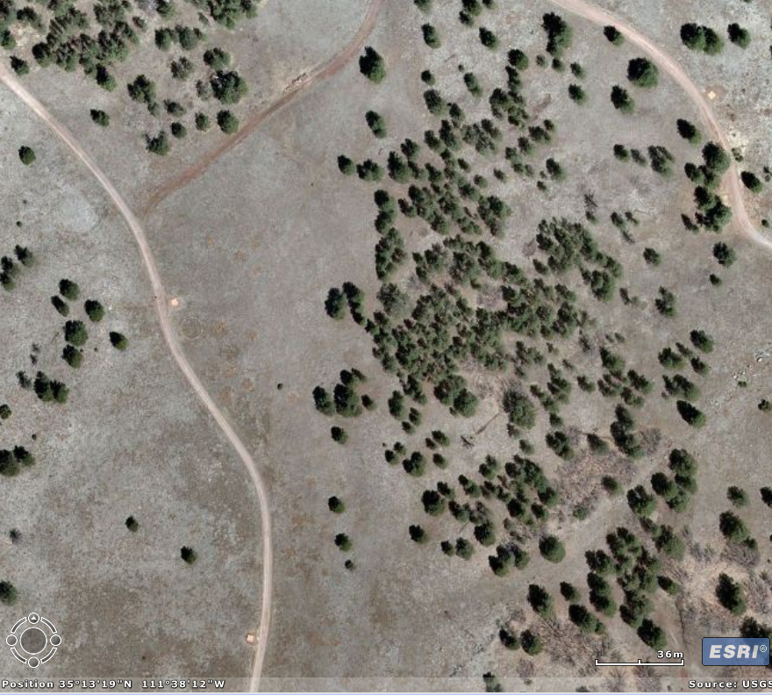
East path
North path
Line used to complete the triangle for navigation (triangulation)
Above: The Royal Observatory in Greenwich, England
Left: The Adventure as run from the west side of Buffalo Park in Flagstaff
Starting point
GRAILS’s Wilderness GPS Adventure (activity sheet on webpage)
Notes:
These instructions may look like the last ones but are adapted for this version. This is GRAIL’s Wilderness GPS Adventure and is intended to help folks get outdoors and active while learning about and using technology. The activity sheet can be downloaded from the link on the webpage and can be done solo or as a team(s).
Participants will pick a starting point, such as a open field or somewhere with a clear view of the sky, and follow the questions on the activity sheet. At the starting point participants will take a few readings from their GPS units, answer some knowledge questions, mark a waypoint, and proceed at least 100 meters to the north or desired direction (if you have several teams or people you might want to have them go in different directions. Just make sure their next path is 90° from where they were).
To mark a waypoint with Etrex Garmin units like the one I’m using all you need to do is hold down the joystick/enter button while on the map, satellite, or navigation page popping up window that will mark the point. If you are unable to figure out how to mark a waypoint on your unit see the instruction manual. For some of the knowledge questions that might not come to you right away, #2 is the horizon, #4 is the equator, and #5 the Prime Meridian, Greenwich England, or if we want to get technical 0°Lat & 0°Long is just south of Ghana and west of Gabon in the African part of the Atlantic Ocean.
From the north point write the latitude and longitude, head at least 100 meters perpendicular from your last path, fill out the questions, then make your way back to the starting point using the Go To or Find navigation function on your GPS unit. Answer the next few questions as you go along. For more waypoint practice you can mark the two points you stopped at. Once back at the starting point fill out the rest of the questions. For question #15: In the window that pops when marking a waypoint you can use the joystick to scroll down to the coordinates field and enter the coordinates manually.
Please remember when walking with the GPS unit to look up and pay attention to your surroundings so you don’t run into someone, step in a dog mine, trip on a squirrel, disrupt traffic, or unwisely encounter any other obstacle. This activity can be adapted in anyway so feel free to use it how you would like. Again don’t worry about the GPS unit(s) being accurate within inches.

Slide 6
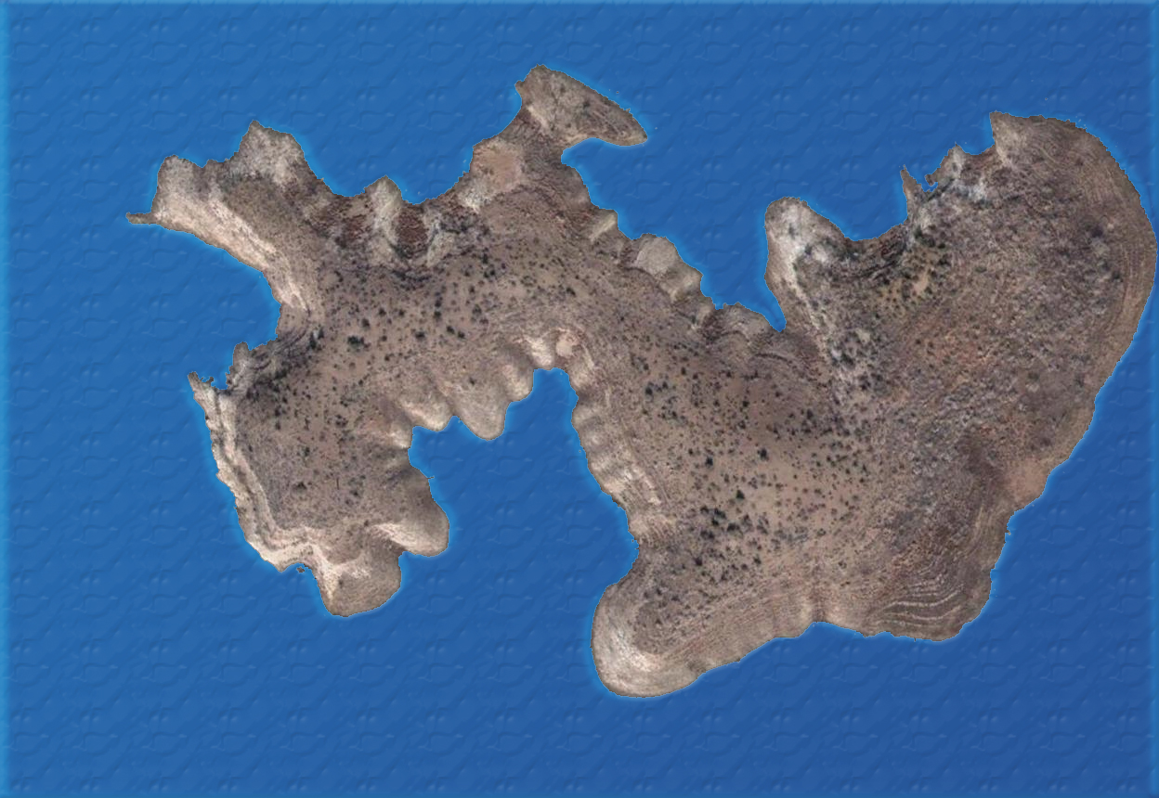
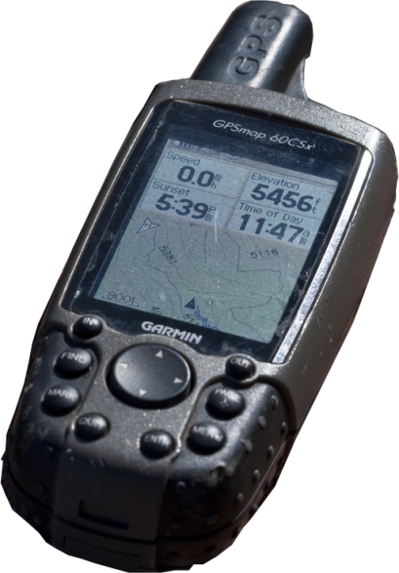
Geocaching
High Tech Treasure Hunting
Rabbit Island in Roosevelt Lake – Not an actual geocache
Notes:
Our next GPS mission is geocaching. In this screen and the next we will talk about how geocaching works and then we will take it outside. Geocaching (pronounced geo-cashing) is the latest new age sport which you’ve probably heard of but may not know what it is. It combines modern technology and classic treasure hunting in a discovering expedition well worth your time.
You download the coordinates of a cache (hidden container of something) off a website to your GPS unit, go outside and journey to the destination, find the cache, sign the log book saying you found the cache, and report the same back on the website. Sounds easy right? Not exactly. Knowing where something is located is one thing, knowing how to get there and getting there is another. That’s part of what makes geocaching fun. You also have the challenge of finding the actual cache as your GPS unit will only get you within one or two hundred feet of the actual container.
Generally caches are hidden but not buried so they are retrievable. A cache may be found in a tree or behind a rock. You may find a metal ammo box or clear Tupperware container with a log book and a dozen dollar store treasures. Sometimes the cache you find may contain clues that lead you to the real treasure cache. Sometimes a cache contains trackables or hitchhikers such as Travel Bugs or Geocoins. When you find one you log it on the website it belongs to and move it to another cache for someone else to find. The treasures are hidden in both wilderness and urban areas.
There are over a million geocaches all over the world and you’d be surprised how many are near your location. Cousin GPS activities include EarthCaches which are caches promoting geoscience education, waymarking which is like tourist travel geocaching, and letterboxing which is like collecting geocaching autographs.

Slide 7
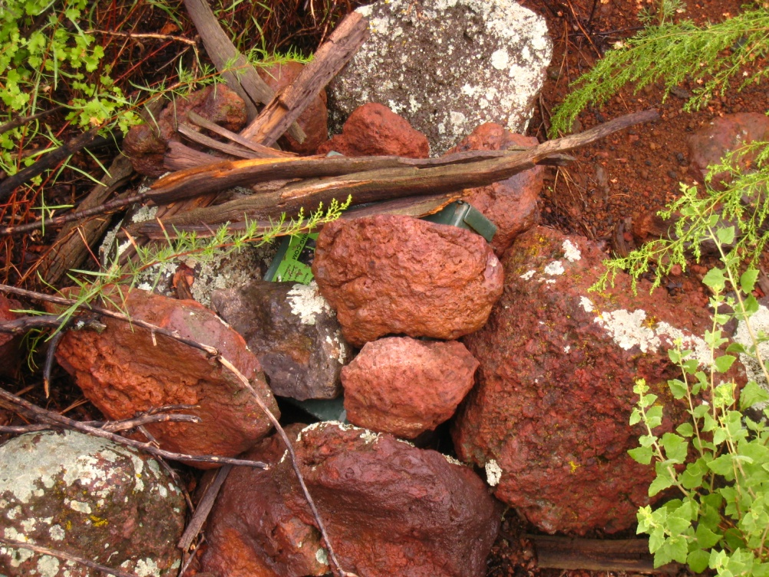
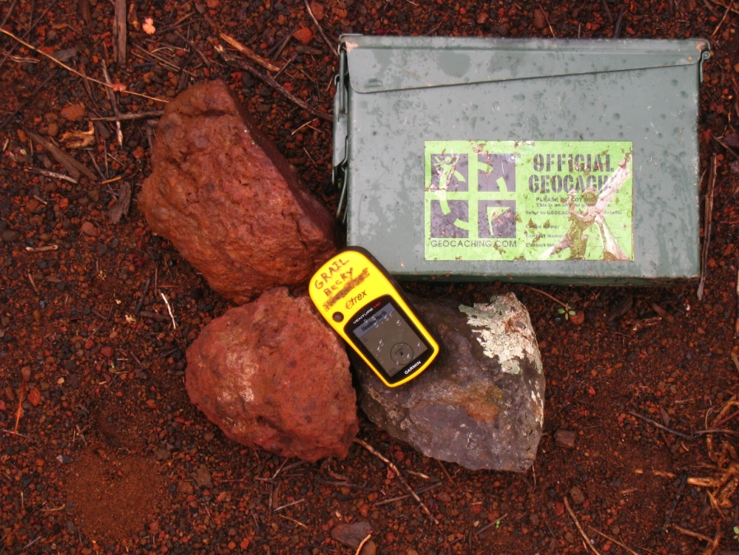
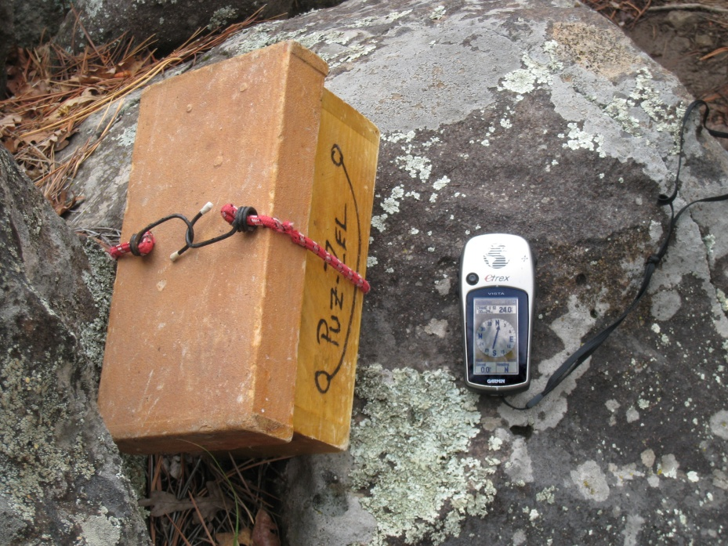
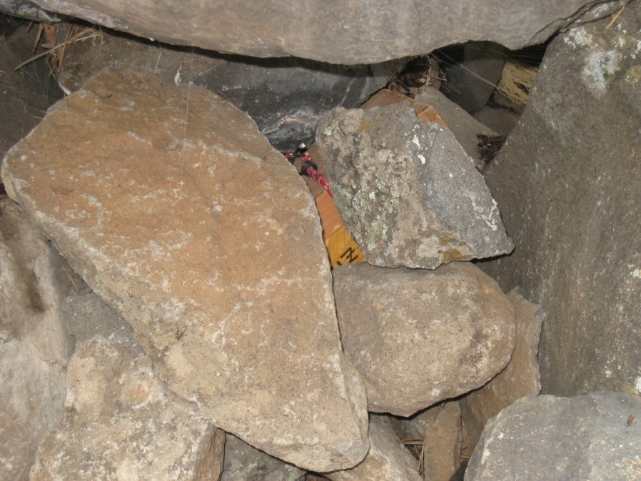
Notes:
Like any sport geocaching has it’s rules, guidelines, safety procedures, and so on. One of the most well known rules of geocaching is if you take an item out of the cache you leave something of equal or greater value. Make sure you sign the cache’s logbook and record your find on the web site that gave you the coordinates. You don’t want to put into (or find in) a cache things that are dangerous, illegal, living, that people might find offensive, or food as animals can find geocaches too.
Be respectful of nature when geocaching. Geocaching.com has a cache in trash out policy similar to the hiker’s guidelines of pack it in pack it out and leave no trace. Things like off-roading and disturbing wildlife are discouraged when geocaching. Geocaching on public lands is the most common. The Bureau of Land Management and Forest Service generally welcome geocaching but would like participants to do so responsibly with respect to the land. The National Park Service may or may not allow geocaching on their land so you need to check with the individual NPS unit before hand, even if a cache you are seeking is located in their territory. Also be courteous when geocaching on private lands.
You are going on a hike. With any adventure you need to be prepared. As the circumstances fit bring things like good hiking/walking shoes, water and food, insect repellent and sunscreen, extra clothing in a pack, rain or other weather gear, flashlight, first add kit, a map of the area, an item to trade in the cache, pen/pencil to sign the log book, extra batteries, anything else you might need, and of course your GPS unit. If your going for a cache in difficult terrain you may need stuff like climbing or water gear.
Be cautious when outside as there may be dangerous obstacles, such as a cliff or swarm of angry bees, between you and the cache. A common mistake is being so focused on you GPS unit you fail to realize you are about trip over a wandering porcupine. Another part of being prepared is doing your research before your trek. Look at maps of the area, know the clues of the cache, have a plan, and let someone know where you are going.

Slide 8
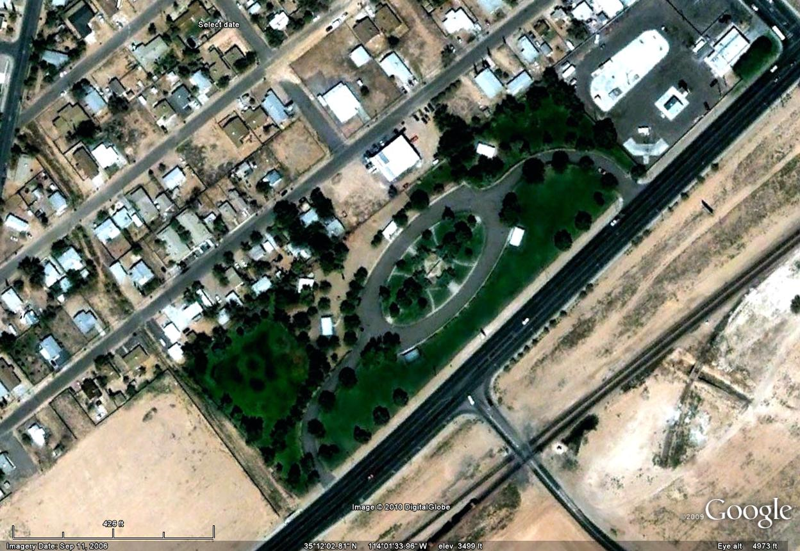
Participant’s Sheet
HUM: X,Y
How high is Humphrey’s Peak:__________
LPW: X,Y
When was Lake Powell at its highest:________
BRD: X,Y
How long is Arizona’s southern boarder:_______
ANN . . .
·
HUM
·
BUN
Participant
Sheet
·
ANN
·
TRS
Leader’s Sheet
HUM: X,Y
Humphrey's Peak, 12,637 Ft (3,852 m)
LPW: X,Y
Lake Powell, 1980
BRD: X,Y
Southern boarder, about 357.3 miles (574.9 Km)
ANN: X,Y
Anne ……
·
LPW
BRD
·
Notes:
Now that you are oriented with geocaching you can go to a website like geocaching.com, sign up, download some cache coordinates, and take off on you own adventure. In this step however we talk about doing a group geocache activity for a class, youth group, office team builder, bunch of friends, community clean up, or any other crowd of more than one person (group date?). Feel free to adapt this however you like. Let’s set this one up for a youth group or class learning about the outdoors and GPS’s. What we are going to do basically is set up some temporary caches in an area with some goals and purposes for the particular caches.
You will of course need to prepare some things beforehand. Pick an area that is of reasonable size for the activity. See that those who have stewardship of land won’t mind your being there and get permission if necessary. Make sure the area has enough terrain variety to hide the caches. In this scenario we want the cashes to be something the participates can use to learn about the outdoors (even if you are doing it in a city park such as this image of Lewis Kingman Park in Kingman). So you could hide information about things in the forest on printed cards, objects that represent different plants and animals, or whatever. Each item of information found can be used to answer questions the participants have on a sheet. Get the coordinates of where you hide or are going to hide the caches and mark them as waypoints on your GPS unit. You may want to encrypt the names so the participants have more of a challenge. If the caches are going to be hidden in the area for more than a few hours mark them as such so a passerby doesn’t stumble on them thinking they are trash.
Once the waypoints of the caches are on your unit you can upload them on to a program like EasyGPS or DNR Garmin (free downloads) and then download them to the units the group will be using. Also prepare some sheets with a list of the caches’ names and any other information so the participants know what they are looking for and getting out of the event. For example if you have a card hidden with facts about elk found in Northern Arizona, the sheet you prepare for participants could say something like “What animal descends from the red deer in Asia” with a fill in the blank line. When they find the cache, they find the answer.
When it comes time for the activity make sure the caches are hidden and then provide some instruction about the activity. Also if necessary how to use the GPS unit. Remind participants to put the caches back where discovered so others can find them and to look up so they don’t walk in to tree or wall. Then let them go and discover the caches. Use the usual guidelines you would use for an outdoor group activity. As the crowd comes in from finding all the caches talk to them about their experiences with using the GPS unit and what they learned about the outdoors. I always think some refreshments after the activity are a good idea but not necessary for success. After the activity make sure all the caches have been recovered, any trashed picked up, and the area is better than when you got there.

Slide 9
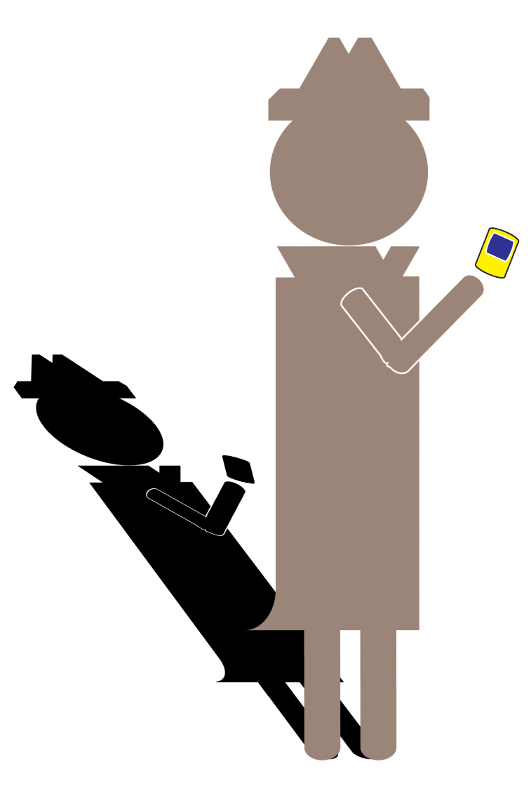
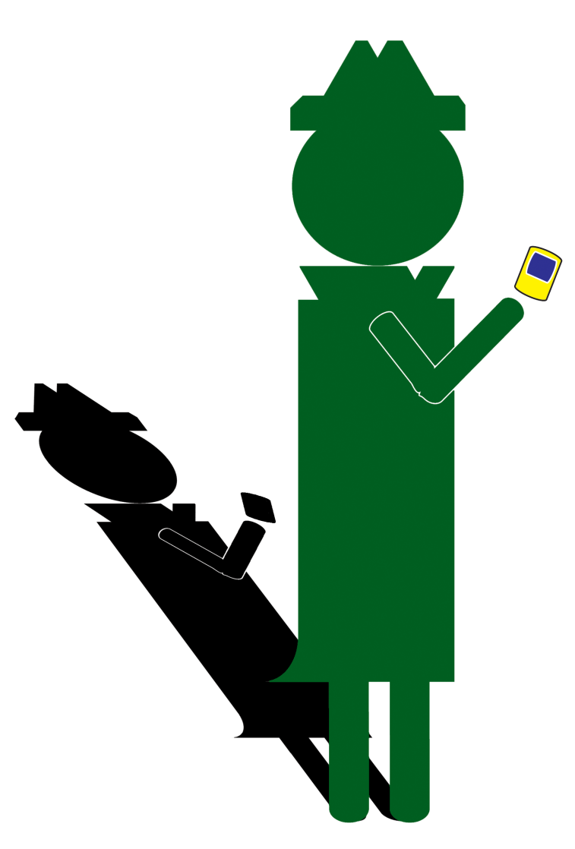
The
GPS Spy
Adventure
Notes:
For our third activity let’s do a little spy vs. spy and take geocaching to the next level. Adapt this as you like but let me tell you how the game works. Two different teams (A & B, blue & red, Pepsi & Coke, Suns & Spurs, or whatever) need to find several different items and make back to headquarters. The catch is they must find the items with clues and their GPS units without being spotted by the enemy agents (other team).
Let’s set up a scenario in the woods just south of Lynx lake near Prescott for a crowd of about 5 to 10 agents. If you have more maybe make more teams and/or more items. We will make headquarters (HQ) the parking lot between the lake and the woods and set a reasonable boundary for our escapade. Each team will be equipped with a GPS unit, digital camera, and a list of items to get. A neutral group leader we’ll call the master spy (and henchmen?) will run the show.
Before hand the master spy will have made the list of items and their locations. In our scenario here the master spy went out ahead of time and marked on his or her own GPS where he or she hid the secret papers (rolls of toilet paper), the valuable jewels (plastic toys from the dollar store), the super weapons (screwdrivers from Walmart), pieces of the embassy (Lego blocks, maybe a Lego person as the ambassador), and the money (Monopoly bucks). There are two (or one per team) of each item in a water resistant container hidden at a location (like a geocache). You can use a program like Easy GPS (free download) for uploading and downloading waypoints on to the GPS units. Also the master spy will put the coordinates to another item in the container. The idea is the spies who discover an item can’t go to another item without new coordinates. More on this soon.
The game starts off with the two teams gathered around the master spy. The master spy tells a story (The embassy in Caucasia has been infiltrated!) and hands each team a list of all the items with the location of one of the items. Each team will have a different item to start looking for. As they take off for their hunt, each team will find coordinates for a new item inside the discovered item’s container. If the master spy has done their job each team will collect the items in sequence by following the coordinates found in the item’s containers.
Depending on how the master spy has set things up each team may cross paths a number of times throughout the round. This is a good thing and where the cameras come in. Each time a team runs across enemy agents they snap a picture. This will cause the opposing team to lose points. Watch out because you could be spying with your camera while an agent is spying on you with theirs! So when searching for the cached items keep in mind covert ops. Again, As each cache is discovered pull one item out of the box and get the coordinates for the next cached item. Being that this a spy game, if agreed upon before hand, the master spy may have put the coordinates into code.

Slide 10
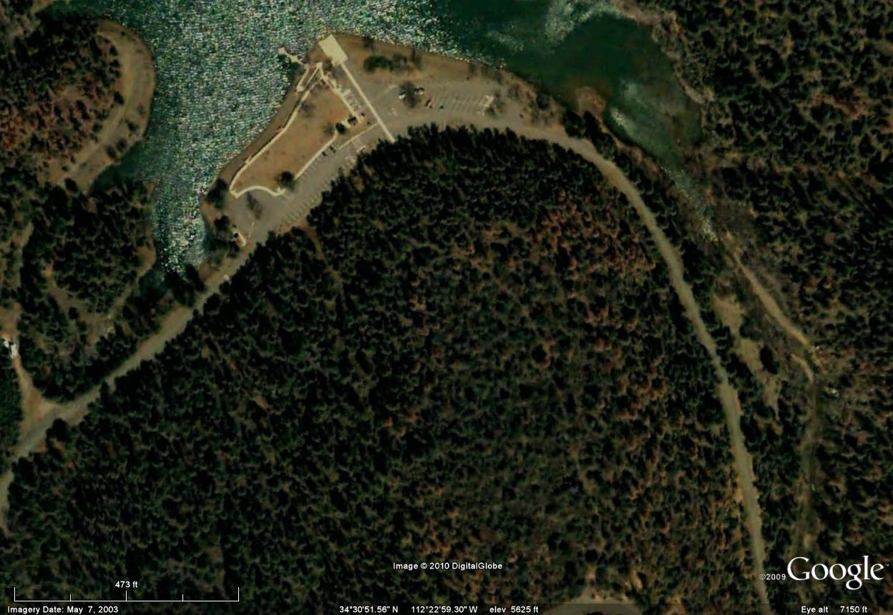
The GPS Spy Adventure at Lynx Lake
Lynx
Lake
HQ
The Secret Papers
Embassy
Pieces/
Ambassador
Valuable
Jewels
Super
Weapons
The
Money
Notes:
The game is played as teams use their GPS unit to find and collect items, get the coordinates for other items, and after all items have been collected (or a time limit has expired if chosen) teams return to HQ. All without being caught by the other team. You may want to bring other things such as a bag or backpack to carry collected items, things like food, water, and gear necessary for outdoor activities, and maybe a laptop for the master spy to review photos with at the end.
Speaking of the master spy, what are they supposed to do while the teams are hunting items and each other? Well in this scenario they are next to a lake so he or she could do some fishing or other leisurely pursuit but they might take off on a secret mission of there own. Giving each team a few minutes head start the master spy (and henchmen?) then purses each team with a camera of his or her own. The master spy can target the teams and in turn the teams can target the master spy for points. Another role the master spy could play is the chief at HQ. Using text messaging as teams find an item in a cache they are required to report back to the chief/master spy in order to get the next set of coordinates (maybe solve a puzzle from the chief). Maybe keep the master spy at HQ and send out the henchmen.
Some rules do need to be followed to keep the adventure fun. 1) All cameras need to be set so they stamp the time on each picture. 2) There must be at least three minutes between each photo. This will be verified by the time stamp and gives the other agents time to get away (please have some maturity and don’t follow the enemy agents like a lost puppy). 3) Only one shot per location. The shot can be any location not just a cache. 4) There must be at least two enemy agents in the photo. A mostly whole person with a partial person (arm, leg, other body part) counts as long as he or she can be recognized as an enemy agent. 5) Last agent or team to take something out of the cache needs take the container with them. Cache in trash out. 6) All agents on a team need to stick together. For example you can not have one or a couple of agents go and snipe the other team while the rest of the agents are looking for the items.
Once everyone is back at HQ the photos and items are counted and points awarded. The master spy (advised by henchmen) is judge and final word. He or she reviews the photos and items and divvies out the points. 3 points for each item found, 2 points for being the first back, and -1 point for each time the enemy agents got a picture of your team. Note you are not required to find all the items. If the master spy or their henchmen were in pursuit then 1 point for each photo your team got of him or her and -1 point for each photo they got of you. The master spy may be awarded 1 point for each photo they got. The team with the most points wins. Before leaving the area make sure all caches are recovered, all trash cleaned up, and the area is better than when you found it. Once you know the basic game adapt it as you like. Anything from night time ops to paintball.

Slide 11
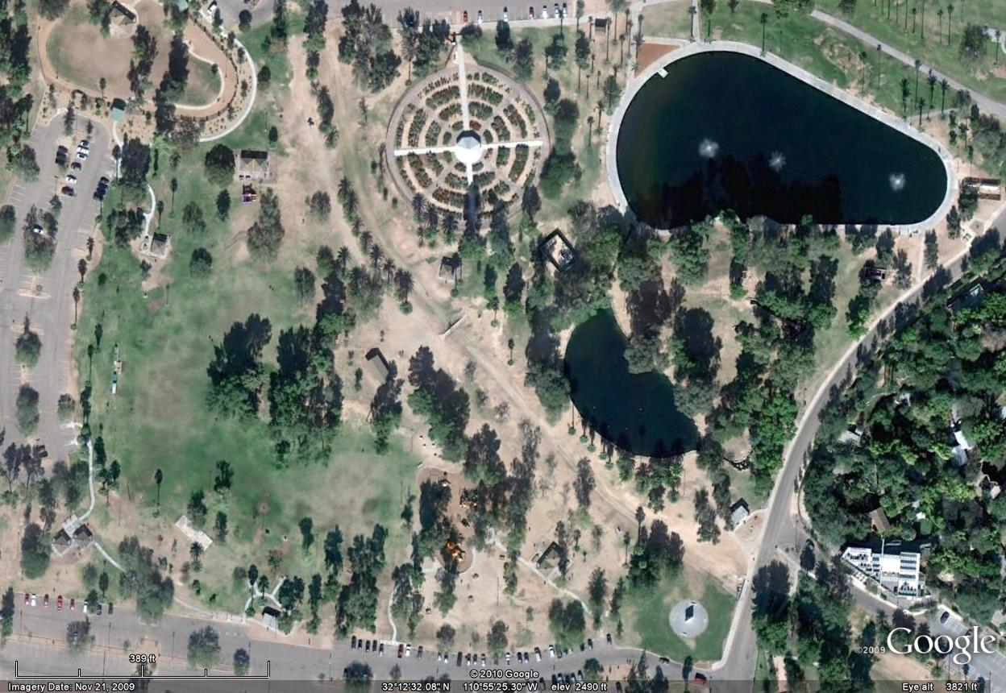
The GPS Spy Adventure Education
How long does a saguaro cactus live?
What do desert tortoises eat?
What lizard has beaded scales?
When was Tucson the state capitol?
HQ
Who’s buried in Grant’s tomb?
Why do we call it Mt. Lemon?
Notes:
The GPS Spy adventure can be easily adapted for education purposes in a similar way to the other group geocache activity we went over earlier in this module. Not only should each team have a GPS unit and camera but also a world almanac or fact sheet of some sort. In the cache boxes have the items and a series (or just one) of clues (questions) about geography, history, or whatever that will unlock the location of the next cache by using the almanac or fact sheet.
Each item in the cache can represent something different from around the globe or just the state of Arizona. For example you could place a small Kachina doll in the cache with some questions about the Hopi and locations on their reservation. The agents have to answers the questions before they can go on to the next cache. The questions could be fashioned to reveal the coordinates of the next cache.
When they have completed their spy adventure and head back to HQ, the agents will have learned about using a GPS unit and whatever subject was used for the caches. In this image we are at Reid Park in Tucson and each cache has a spy item with a question. You could have a plastic bag that contains a card with a question and the coordinates of the next item. The agents have a fact sheet with the answer somewhere in the text, A sheet to write the answer down on, A sheet with the cache location(s), and of course camera and GPS unit.

Slide 12
GPS Uses
Field study of cactus wren habitat
Data gathering for city/county transit projects
Disaster effects analysis
Campus management
Aircraft tracking and navigation
Business geographic needs
Navigation from Kingman to Safford
Discovery of hidden treasure
Much more…
Notes:
Using a GPS is an active pursuit. In this module we explored only three of the many different activities you can do with a GPS. It can be used as much for fun and recreation as for education and professional work. The thing is to go outside and use it.

