Slide 1
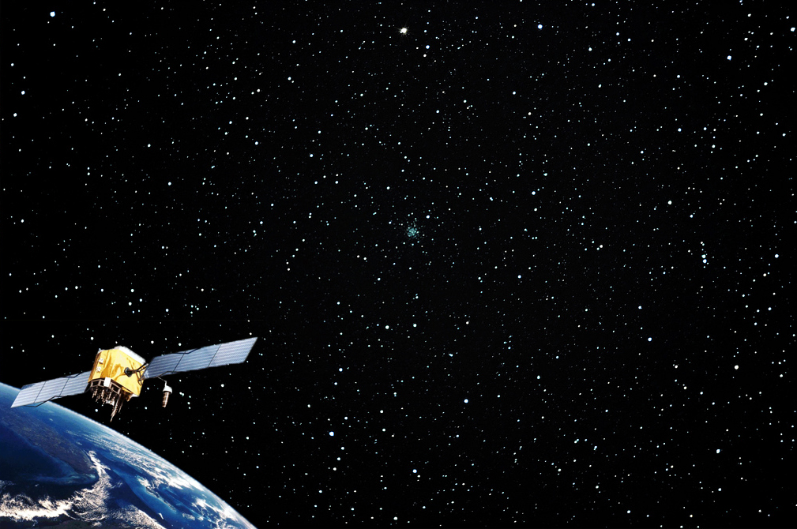

Introduction
to
Global Positioning Systems
(GPS)
Module 1
Created by: Scott Kelly 2010
Notes:
Welcome to NAU’s Geospatial Research And Information Lab, GRAIL’s, Introduction to GPS workshop. As you may be already aware and can seen here, GPS stands for Global Positioning System or Systems. The purpose of a GPS is threefold: navigation, location, and tracking. The system uses an incredibly accurate timing scheme to obtain real-time and reliable spatial or geographical data. GPS has become so common place in the past decade or two that you’ve probably had more exposure to it than you realize. You may have one in your car, there is one in your cell phone, or you’ve gone geocaching with a group of friends. In this workshop we will talk about how a GPS works and how you can use it for mapping, research, and recreation. In this first module we will go over what makes a global positioning system and how they work. Lets get started.

Slide 2
A Global Positioning System (GPS) includes:
Satellites
Receiver/Unit
Ground Control
Computers
Human Element
Notes:
When we say we are using a GPS we are often referring to the mobile device we interact with. GPS is a system that actually has several components. First you may already aware a GPS would not work at all if it were not for the GPS Satellites put into orbit and maintained by the U.S. military. Next, what we hold in our hands, have in the dash of our car, or attached to who or what it is we are tracking is the GPS unit. Third is the Ground Control component which allows for overall system management and greater spatial accuracy. The satellites, unit, and ground control are the basic three components involved in GPS but there are others. Another important component is the Computers both in and outside of the unit. These allow us to apply the spatial numbers going on between the satellites, receivers, and ground control. Lastly to make the GPS have any sort of value the Human Element is a key component.

Slide 3
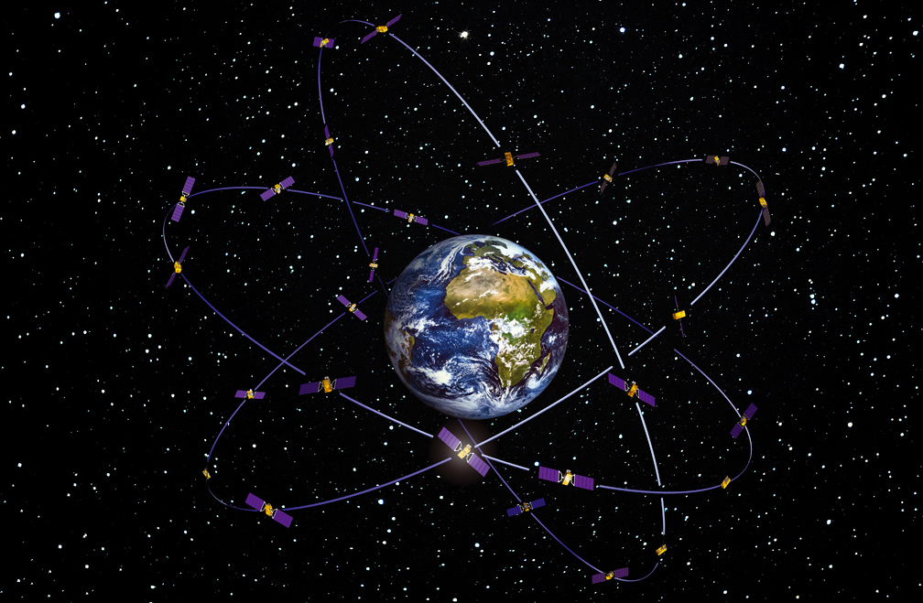
Original image source: ESA
Notes:
For thousands of years people used stars and landmarks to get geospatial data and information. They would look at the surrounding mountains or the constellations in the night sky to figure out where they and other things were and where they were headed. Radio navigation in the early 1900’s improved on past methods. In the late 20th century the U.S. military began launching a set of manmade stars for even better navigation. As the Cold War neared an end, access to these satellites became available to anyone. Civilians from academic professors to wilderness guides found this to be a very practical resource. There are now more than two dozen GPS satellites that have been sent up by the U.S. in a constellation orbiting the earth which are continually sending signals to the planet. Additionally other global navigation satellite systems, such as the Galileo constellation put up by the European Union and European Space Agency, are used by the international community.

Slide 4
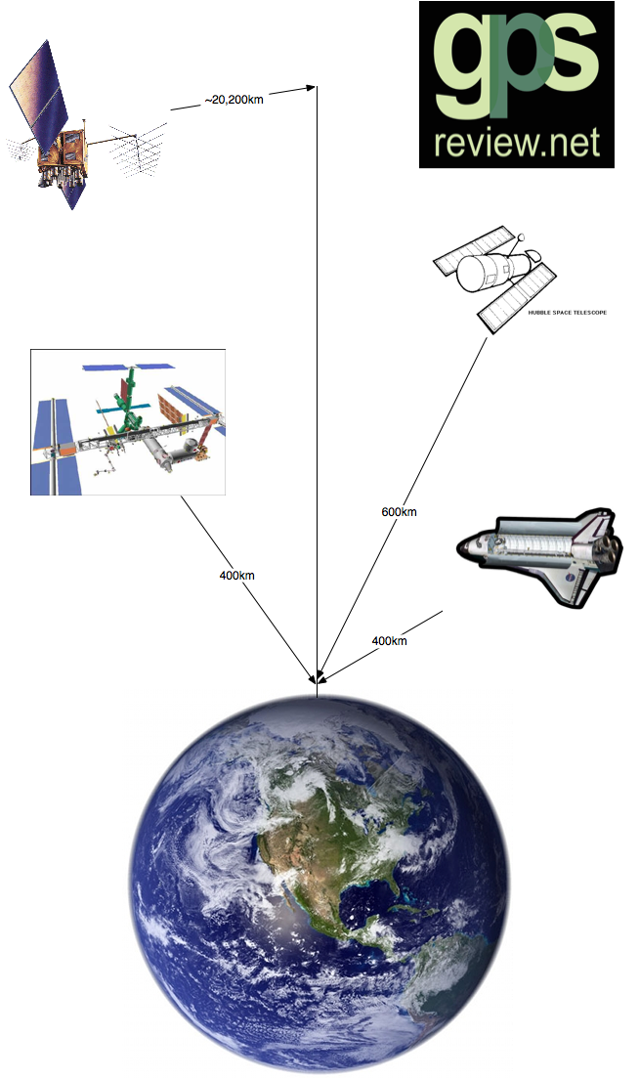
Very high orbit
  12,550 miles (20,200 km)
  1 revolution in about 12 hrs
  Travel approx. 7,000mph
Considerations
  Accuracy
  Geometry
  Coverage
Notes:
GPS satellites operate at a very high orbit in six different orbital planes. This allows the satellites to orbit the earth very quickly. These space vehicles are high enough that they don’t interfere with other celestial voyagers such as the Hubble space telescope or International Space Station. With the number of satellites in the constellation moving at high speeds there can be several above us at any given time. One of the original ideas of GPS satellites was to be able to get a clear and precise signal anytime anywhere, however if you have ever used a GPS you know there are variables to consider.
The accuracy of both the satellites and receiver in your unit is one. While never wanting to exclude civilian use, GPS was set up by the military for their own purposes. Civilian GPS applications are limited to certain signals that tend to have a lesser accuracy than signals meant strictly for military use. Accuracy of satellite signals may also depend on the health of the satellites the unit has locked on to. The unit itself may be of low grade and quality and incapable of picking up highly accurate signals. You may also choose different units for different accuracy. For outdoor recreation use you may only need a unit with 10 to 20 meter accuracy where as a utilities survey project may need sub-meter precision.
The Geometry of the satellites and your present location is another consideration. If the satellites your GPS unit is picking up are arranged so the signals are coming from several different angles the precision is greater than if all the signals came from the same vector in the sky. Much like you would get a better understanding of the San Francisco Peaks if you saw them from all four directions and above than if you only saw them from the classic south view. The terrain’s geometry of where you are affects the satellite signal too. If you are in a place like the Grand Canyon a GPS may or may not work. You will have rock walls that, depending on the incoming angle, will bounce or completely block the signal giving you an inaccurate reading. In a very tight slot canyon like Buckskin near Paria Canyon, a GPS may be completely useless.
As for coverage considerations, if you are deep in the trees near Sunrise Ski Resort below a heavily clouded monsoon sky good luck getting a strong clear signal. If there is something between you and the satellites it can affect the signal. While the technology improves with each generation of satellites, anything from treetops to roofs are barriers for the signals between you and the satellites.

Slide 5
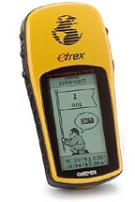
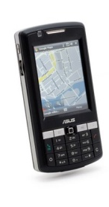
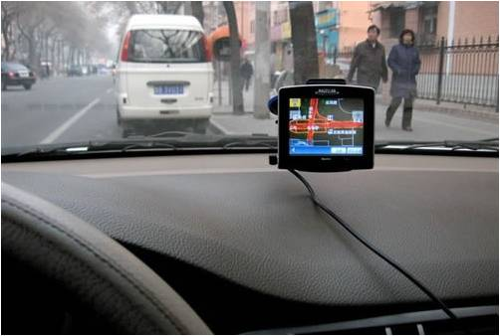
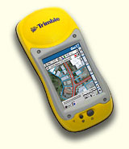
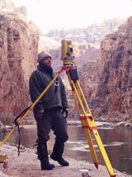
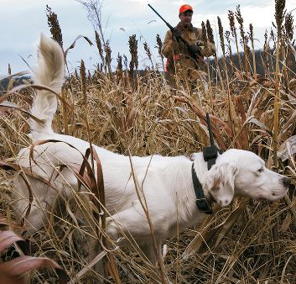
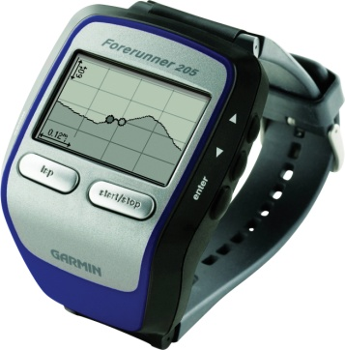

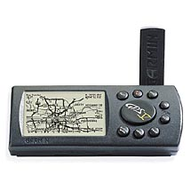
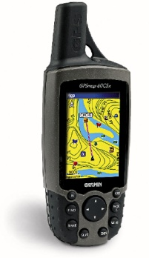
The Omnipresent
GPS Receiver
Image Source: Cabalas
Image Source: Trillium Wood Golf Club
Notes:
When the Global Positioning System technology was released from strictly military use to civilian enterprises it was first picked up by scientists and outdoor professionals. Now GPS units are involved with everything from watches to cars, cameras to laptops, and golfers to dogs. It even has been debated in the past by professional organizations such as the PGA if GPS units were valid in competition. GPS units are a contemporary standard in the vehicles owned by businesses for fleet tracking and parents can know where their kids are through the GPS receiver in their cell phones. The commercial applications of GPS receivers seem to be endless. The units range from a semi-accurate single screen/page that just displaying coordinates to a mobile PC with automatic differential correction giving sub-meter accuracy. What are some other things that you can think of that use GPS receivers?
In a post humorous remark John Desmond said “This is the kind of case where GPS would have been very helpful. Then again, what happens if he decides to cut his bracelet and run?”

Slide 6
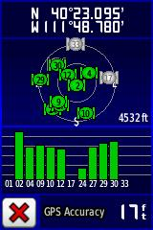
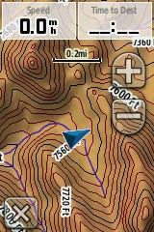
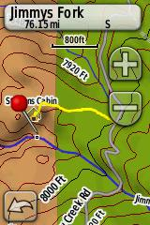
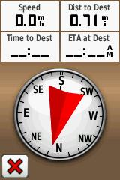
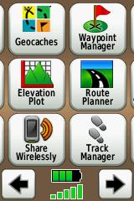
Satellites
Map
Waypoints/Tracks
Navigation
Menu
Image Source: GPSinformation.org
Notes:
Each GPS unit displays their functions differently on their screens. Shown here are some common pages you will see on most basic handheld units, such as the Garmin Etrex you would take on a hike in the Superstition Mountains. Starting on the top left is the satellites page. This usually communicates what satellites are in your sky, what ones your unit has picked up, what ones the unit has locked on to, and the strength of their signals. It will also let you know the coordinates of your unit and how accurate those are.
To the right is the map page. This visualization of the coordinates shows you in real time where you are on the earth. The background could be anything from a detailed basemap to just the icon indicating your position on a blank field. Many units will also let you view other windows on the page such as speed, trip odometer, or distance to a selected waypoint.
Speaking of which, Waypoints and Tracks are next. You may be familiar with these if you have ever used a GPS unit. Simply put; a waypoint is a digital point that marks the spot where you are at and is stored in the unit. Waypoints can show up as a pushpin (such as in this example) or any other icon. Tracks are the line segment version of waypoints (see the yellow line in the image). You can manually set the unit’s computer to start tracking your movements or it may do it automatically. The line like the point is saved as a file in the computer.
On the bottom left is the navigation page. The page contains a digital compass, destination pointer, and any other window you wish to have on it. The way it works is you tell the unit that you want to go to a previously marked waypoint (like where you parked the car or your campsite) or other point of interest stored in the unit’s memory and it will point you in the direction you should go. On a side note please keep in mind when navigating from point A to point B that a GPS does not have a brain and you should use yours.
Last is the menu page. If you want to do anything with the GPS unit other than navigate, look at satellites, or where you are on a map go to the menu page. The menu will have settings, track & waypoint management, and can contain any number of applications from calendars and calculators to hunting, fishing, and geocaching programs. There are many different types of GPS units and they each have their own specialized screens and functions. The thing to remember is they all have satellite interaction, a highly accurate clock, and a computer.
These screen shots are from Garmin’s Dakota 20 unit from GPS information.org (http://www.gpsinformation.org/penrod/dakota/dakota.html)

Slide 7
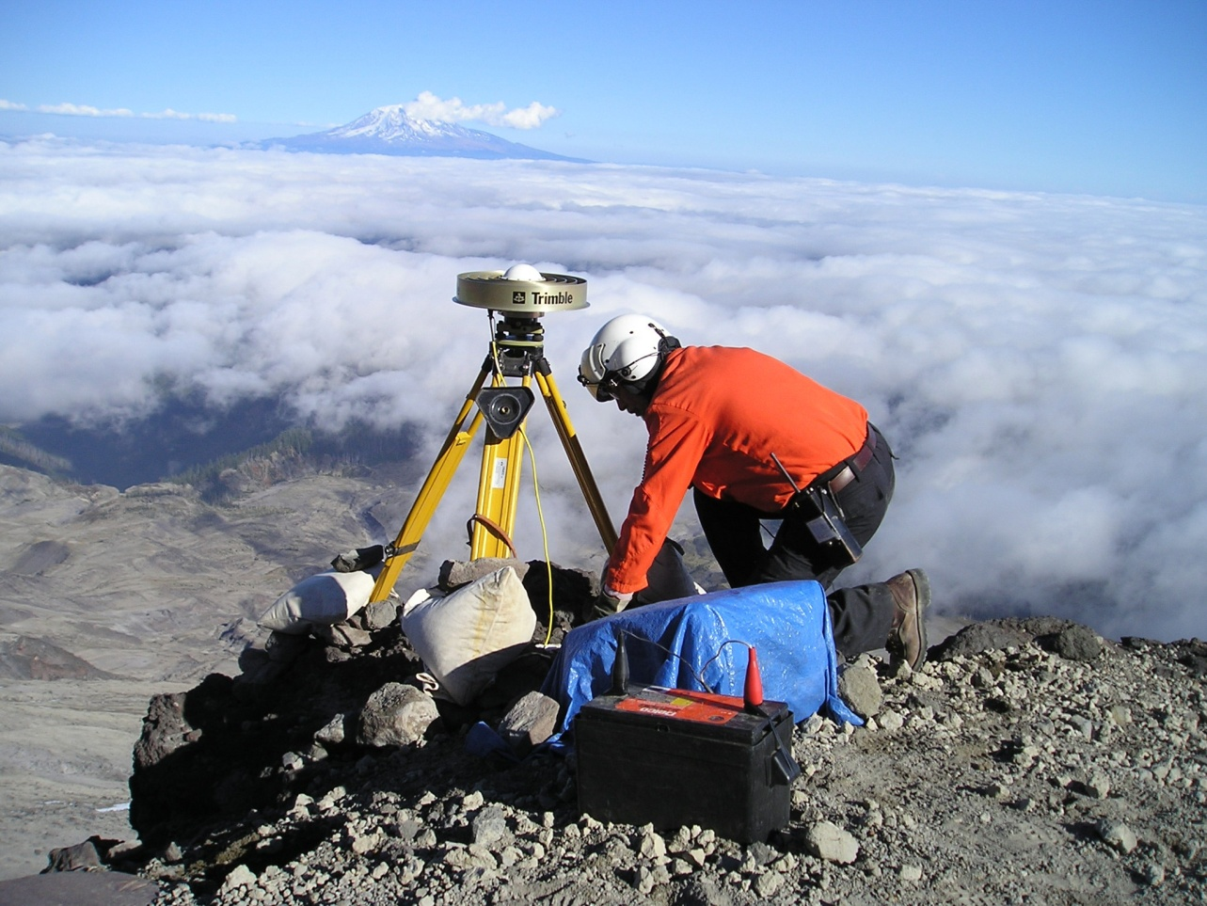
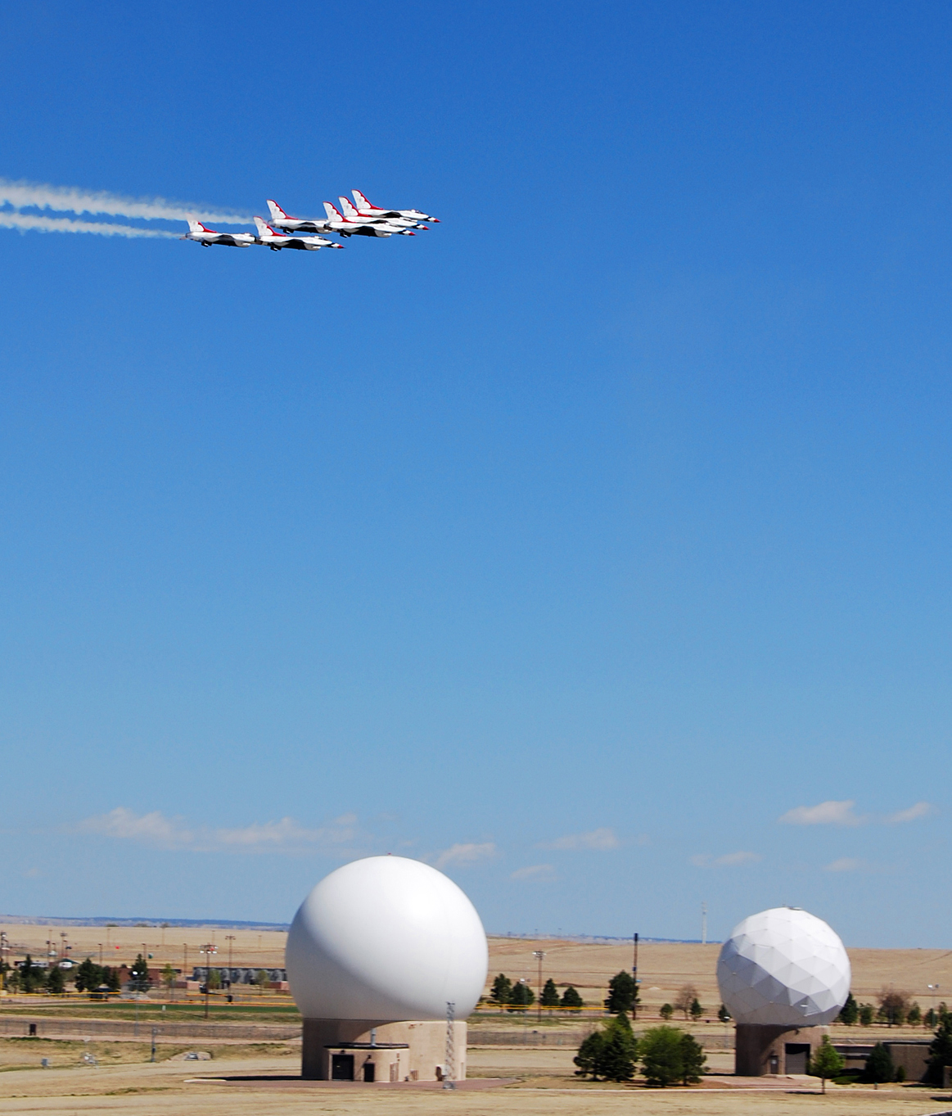
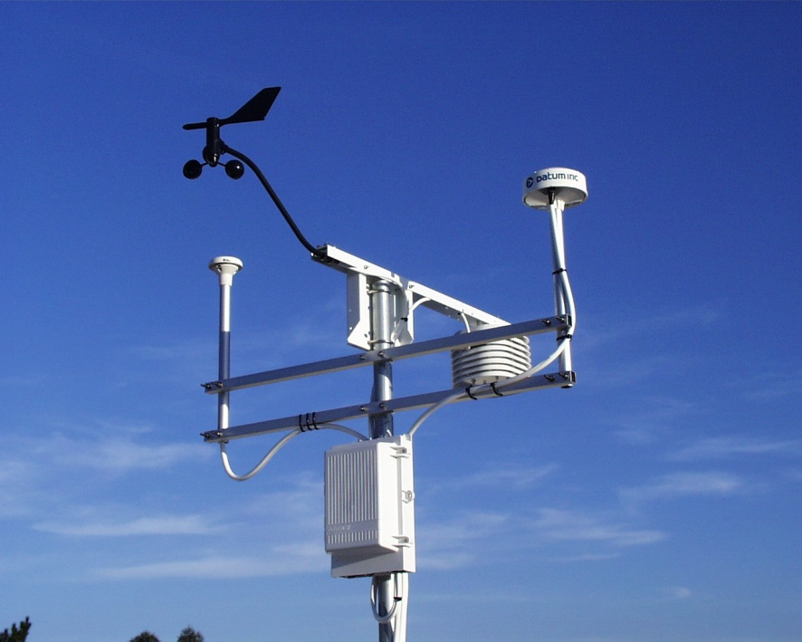
Image Source: USGS
Image Source: Schriever Air Force Base
Notes:
A third part of the GPS that people don’t often think about is ground control. The GPS Satellite constellation has a life like any other technology and needs to be managed and maintained. The constellation is handled by the U.S. Air Force which has a master control station in Colorado Springs. The five main ground monitoring stations operated by the Air Force are located at Hawaii, Kwajalein in the Marshall Islands, Diego Garcia in the Indian Ocean, Ascension Island in the South Atlantic, and Colorado Springs.
Ground stations military, public, and private help with and are an important part of geospatial accuracy called differential correction. Differential correction is a process in a GPS involving a mobile receiver (the unit in your hand) and a stationary receiver (the ground control station). The process takes the information your unit received and the information the ground station received and mathematically using the difference, corrects the information on the mobile unit. This can work well because the stationary ground station already knows its own position. While not all GPS’s can or may take advantage of this, by communicating with ground stations you can apply differential correction to the data from you GPS unit and increase your findings to sub-meter accuracy.
Having a stationary receiver also helps with things like time comparisons and atmospheric distortion. Three types of ground control are the monitoring/managing ground control stations, permanent ground control stations set up for specific functions such as differential correction, and temporary ground control units used in field work such as the one set up by the USGS in the top image.

Slide 8
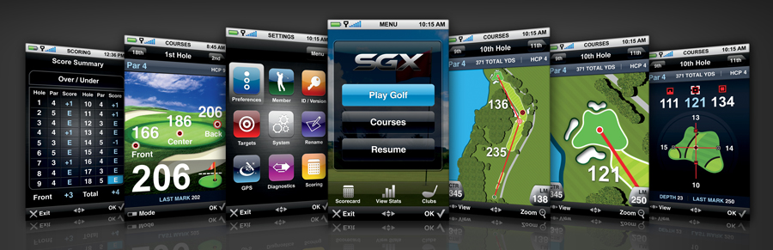
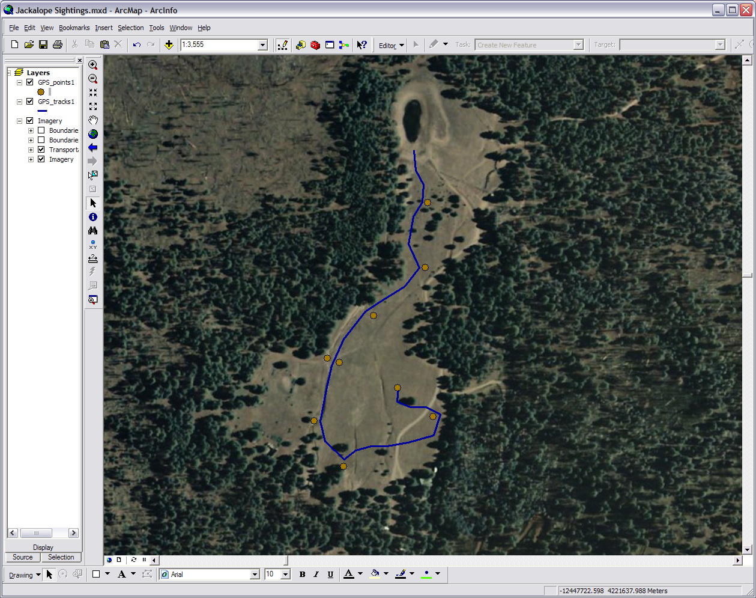

Image source: Golf-Monthly
Image Source: fanpop.com
Notes:
While we often think of a GPS unit as an individual it really is three separate devices working together. The unit has the satellite signal receiver, a very accurate clock, and a computer. As the receiver communicates with the satellites, clock readings in the unit and satellites are compared to get a fix on the unit’s spatial position. We will talk more about this process later in the module.
The computer on the unit is important to us because it is what takes all the data the clock and receiver are processing and displays it as information. The computer has a collection of tools that work with the spatial data captured by the global positioning system. Every new generation of GPS’s seems to come out with more apps but to use a GPS that is larger than just receiving units and satellites we need to get the data and information out of the unit and in to a GIS (geographic information system).
The GIS program on you home or office computer interacts with the GPS unit. It is another component of the global positioning system because it allows you to apply the data and information you gathered to more than what is available on the unit’s computer. In this example here I went out on a run near Kendrick Mountain and marked all the spots (waypoints) where I saw a jackalope burrow. The unit also created a record of my running path. I took my unit back to the office, download the waypoints and the auto created track, used a GIS program to put them on top of an image, and made a map.
Image Source: http://www.golf-monthly.co.uk/imageBank/2/21015.jpg | http://images1.fanpop.com/images/photos/1300000/Chanel-watch-chanel-1391875-1024-768.jpg

Slide 9
The Human Element
Purpose
Tool
Direction
Interaction
User
Notes:
Lastly to make the GPS have any sort of value the Human Element is a key component to a GPS. The whole purpose of GPS is to understand where we are at and where we are going geographically. Computers and gizmos don’t need to know this but as people we do. It is a tool we use to help us understand spatially our world and what is happing with it. The tool helps a hiker to keep bearings on the destination and campsite while it helps an archaeoastronomy researcher at Wupatki measure the spatial relevance of the summer solstice and the ruins.
People provide direction for the tool. As I mentioned earlier the GPS doesn’t have a brain but we do. Like other technologies, a GPS wouldn’t have much to do if we didn’t tell it what to do. Another thing the tool gives us is another way as people to interact. It helps agencies work together to manage the cougar population along the Mogion Rim and for people to post and chat on geocaching websites. GPS requires a human user to tell it to start and stop receiving satellite signals, indicate the direction of a waypoint, and display pertinent information. It is up to the user to turn the GPS data into information.
“The GPS will get visitors within a few feet of the hidden treasure, but from there they have to figure out where it's hidden.” ~ Herb Handly

Slide 10
How
Global Positioning Systems
Work
1. Datum & Projections
2. Data Collection
3. Unit to Computer
Notes:
So now that we know what makes up a global positioning system let’s explore how it works. To start with we will find out about how datum and projections help to construct the way the GPS sees your location on the earth. We also gain some knowledge of what a GPS does to get your location and collect data. We will then take a quick look at how we can interact with this data on a home, office, or personal computer.

Slide 11
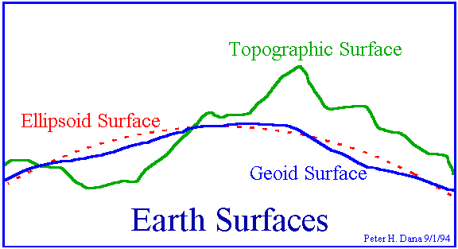
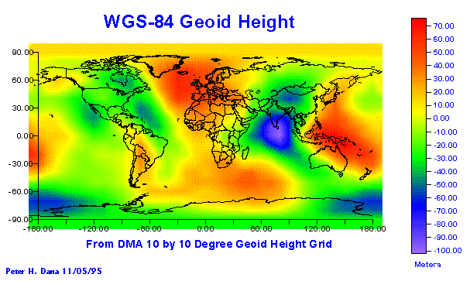
Geodetic Datum: What are they?
Define the size and shape of the earth
Used as basis for coordinate systems
Variety of models:
  - Flat earth
  - Spherical
  - Ellipsoidal
WGS 84 defines geoid heights for the entire earth
Notes:
We first need to know some basic framework of the whole system. We start with Geodetic datum which define the size and shape of the earth and are the origin of the coordinate systems used to map the earth. Hundreds of different datum have been used to describe the earth since the first estimates of the earth's size were made by Aristotle. Datum have evolved from those portraying a spherical earth to ellipsoidal models derived from years of satellite measurements.
Modern geodetic datum range from flat-earth models used for plane surveying to complex models used for international applications which completely describe the size, shape, orientation, gravity field, and angular velocity of the earth. All you need to understand about datum in this workshop is that they are what provide the reference foundation for the coordinate system your GPS unit is taking measurements in. You should also be aware that unless proper transformation happens while working with two or more datum in one project it will show the data layers added to the original layer as slightly off because each datum has a different way of taking the measurements of an irregular 3D earth and putting them on a 2D surface.

Slide 12
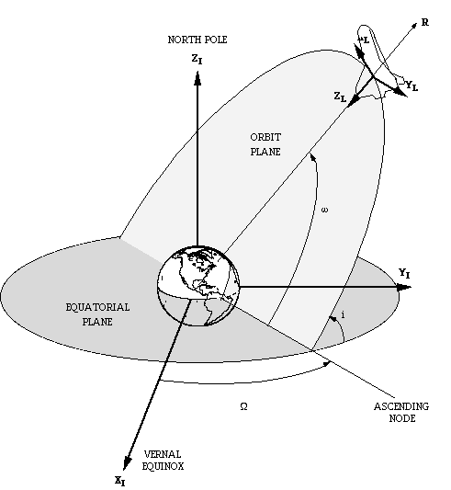
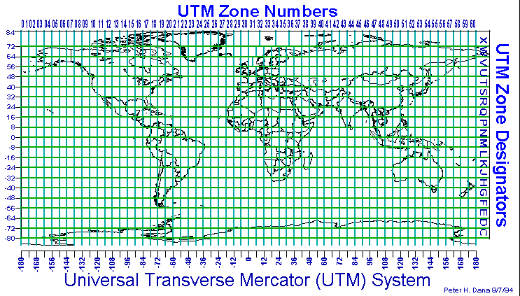
Coordinate Systems
Based on Geodetic Datum
Describe locations in two or three dimensions (ie. X,Y,Z or X,Y)
Local and Global
Common systems
  Geodetic Lat, Long (global)
  UTM (local)
  State Plane (local)
Variety of transformation methods
Notes:
From the datum we get projections; from the projections we get coordinate systems. Often people use the term projection and coordinates system interchangeably. The projection is what develops the datum into a coordinate system. The coordinate system is a calculated grid placed over your data to put the data in the right place. Based on what datum are used to project a two dimensional surface of the earth you can come up with several different coordinate systems.
Most people are familiar with latitude and longitude but there are many others commonly used in work from engineering to marketing. Some are focused on the entire globe while others are for a local area (geocentric). Even though the coordinate grid may be geocentric it can often work for the entire world. The State Plane grid system was set up for state, county, and city governments and won’t work outside the United States but the UTM grid system developed by the United States Army Corps of Engineers works great world wide. When a computer, such as the one on your GPS unit, knows where your data is on a datum based coordinate system it can project it onto other geographic layers such as a map and put it in the right place.

Slide 13
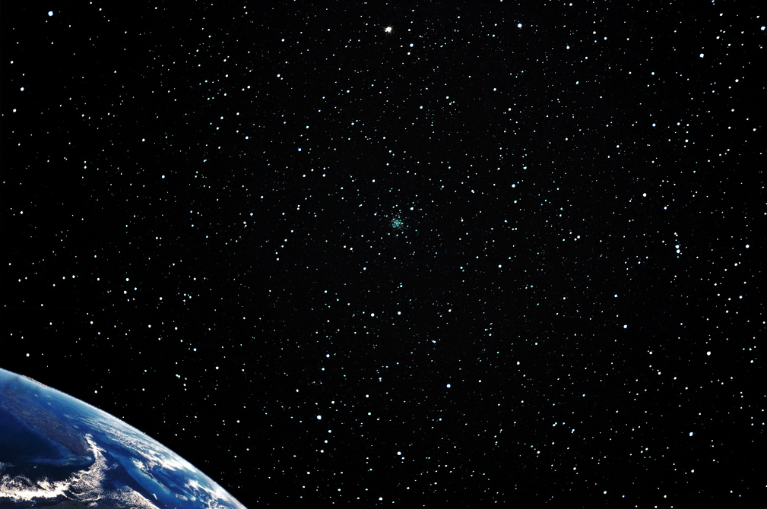
Triangulation
Satellite A
Satellite B
Satellite C
Satellite D
Notes:
As we talked about earlier, the geometry of the satellites is important. The satellites, receiver, and unit computer use a method called triangulation or trilateration to calculate where things are. Due to angles, motions, and positions we are not always the same distance from the same satellites all the time. We calculate our position by understanding where satellites are in orbit and then further computing how far we are from those satellites. Here is how it works:
If we know we are a certain distance from satellite A (10,000 miles) this narrows down where we are in the whole universe. This one range of the signals the satellite is broadcasting tells us we are located somewhere on the sphere of the range. At the same time we also know that we are 13,000 miles away from satellite B. This narrows where we are in the universe even more. The only place we can be 10,000 miles from A and 13,000 miles from B is in the area where the two spheres intersect. By adding a third satellite we can pinpoint our location in that area. If we know that we are 12,000 miles from satellite C then there are only two points where all three spheres intersect and we know we are at one of those two points. In some cases the software built into the GPS receivers have various techniques to determine which point is correct and which point is ridiculous. For example if one of those two points is in outer space the GPS knows you probably aren’t floating around up there.
Technically, trigonometry says we really need four satellites to range and unambiguously locate ourselves. In other words the fourth satellite can be used to determine which of the two points derived from three satellites is the correct choice. Therefore we bring forth another satellite. Even though just four satellites will give us a fix on our location bringing in more satellites will give us greater accuracy. Increasing the satellites you’ve locked onto from five to six may mean the difference from 10 meters of accuracy to 3. The geometry of the satellites and their signals is how the GPS calculates where you are.

Slide 14

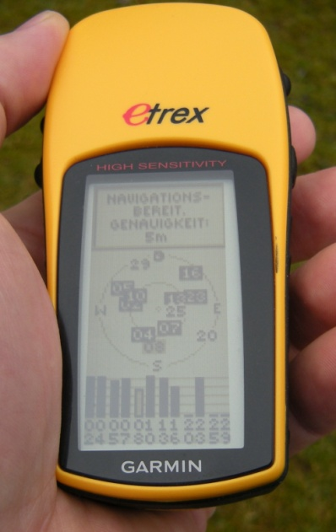
Image Source: topofusion.com/jamboree
Notes:
So how do those GPS signals work? Well remember I mentioned that there was very accurate clock in your unit. There also is a very accurate atomic clock in each satellite. The receiver in your unit compares the time on your unit’s clock to that of the clock on the satellites and gives this data to your unit’s computer. With the satellites moving in orbit, the earth rotating, and you moving with your activities the computer in your unit uses the difference in time to calculate your position. Since the receiver gets a different signal from each satellite, the computer is able to use triangulation to pin point your location. It may sound simple but this satellite/receiver timing needs to be harmonized down to the half nanosecond to be accurate. Hence the less than state of the art clock on a GPS unit costing $100 may only give an accuracy of 20 feet. Speaking of clocks its time to move to the next step.

Slide 15
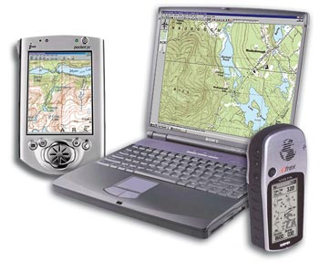
Unit to Computer
Image Source: http://www.4x4books.com/mttngps.htm
Notes:
The third working part of a GPS is moving the data collected to the computer. The computer on the unit, while increasingly versatile with each generation, is limited in its capabilities. If you want to do more than know where you are or where you are going you need to move the data from the unit onto your desktop or laptop. Once onto your home or office computer the data can be used for anything from making outdoor adventure maps to studies of Elk herd patterns on the Colorado Plateau.
The simple procedure involves connecting your turned on GPS unit to you computer via USB or serial port and running software that pulls the collected data off the unit. Your GPS may have its own proprietary software or there are plenty of free downloads to help you retrieve the data. Most of the software works both ways. In addition to downloading data you can upload waypoints and tracks to your unit. So if you were planning on going out to find this year’s prairie dog locations in a mile radius around Canyon De Chelly you could upload the previous year’s collected data. That way you could have the historical data right in hand, know where to look and compare, have an idea where boundaries and patterns are, and so on.

Slide 16
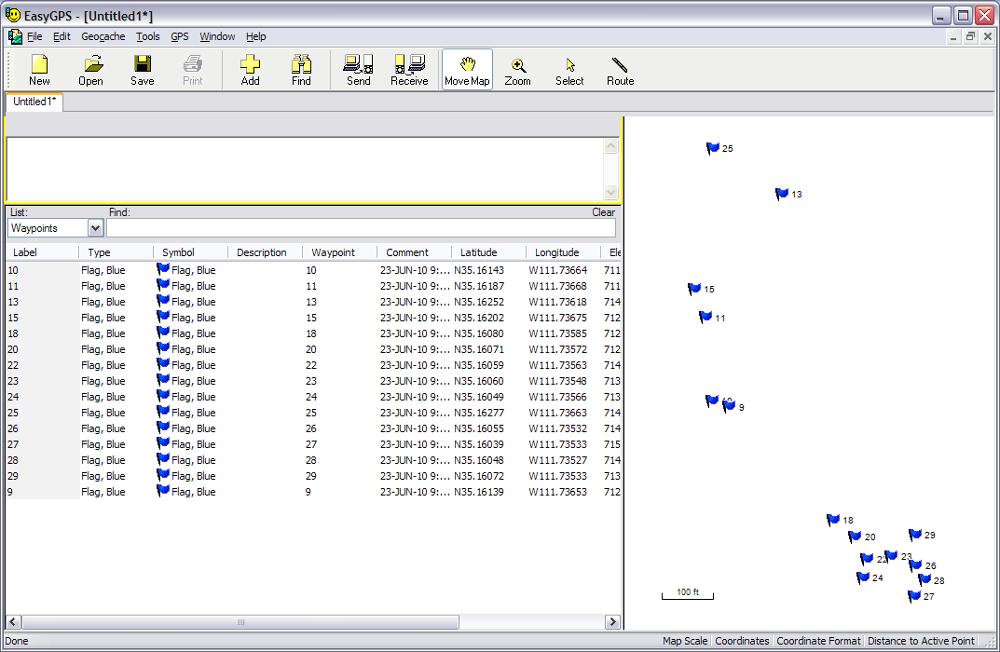
Notes:
As mentioned in the previous step there are many software programs you can download onto your computer for free. A program called EasyGPS shown here allows you to download and upload your waypoints and tracks in one easy step. It will put them on a blank map and a table so you can see all your waypoints or tracks and how they relate to each other. You can save the data in GPS exchange format (.gpx) or send it to a friend or colleague’s GPS unit so they can go to the places you went and studied. The tools in the program even allow for some editing of the data while it is in the program.
A program like this is mainly used for simple GPS work such as recreation, light research, quick data extraction, and community volunteer and youth programs. Due to the waypoints and tracks being simple point and line data you can take them from this program to even the most professional programs without too much trouble. The nice thing is a Ph.D. in geography isn’t required to use a program like this. These type of programs are user friendly and designed to be used by anyone. You can find this and other downloadable GPS computer software online.

Slide 17
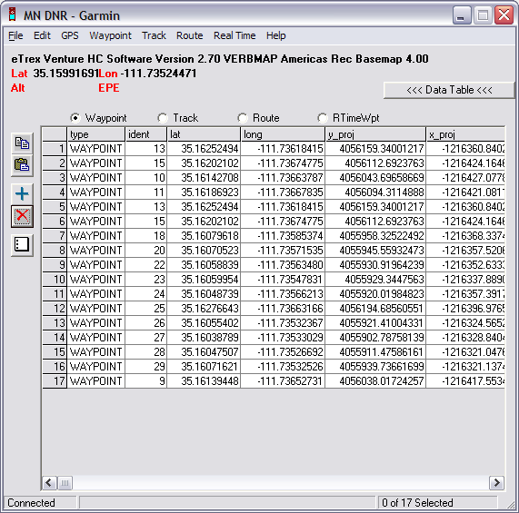
Notes:
A very useful free GPS software program is DNR Garmin developed by the Minnesota Depart of Natural Resources. This program was created for professional GPS work, specifically for transferring data from Garmin brand GPS units to Geographic Information Systems (GIS). As you can see here the data from your GPS unit is downloaded and displayed as a table. It will take the waypoints and tracks you download and convert them into various formats including shapefiles and Google Earth’s .kml. Likewise data can be taken from another program and be uploaded from DNR Garmin to your GPS unit. While in the program the data’s attributes, including the projection information, can be edited. Real time applications with a Garmin GPS unit are also possible. Even though DNR Garmin was developed for professional work this user friendly program can be used by anyone for any reason.

Slide 18
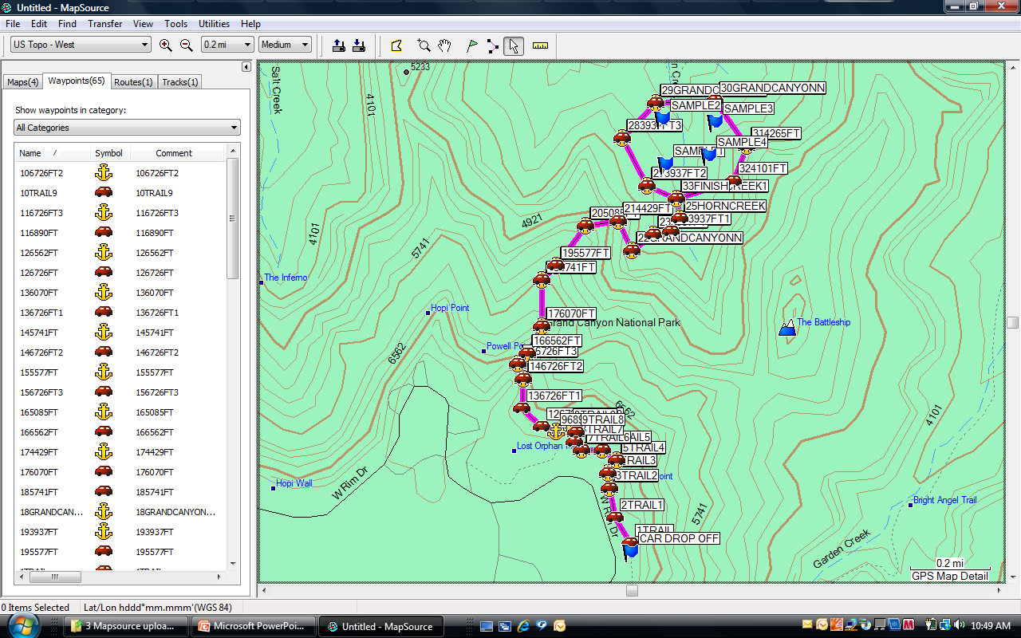
Notes:
Proprietary software is available for most GPS units. You can upload and download data as usual but because the software was expressly designed for your unit it may have some unique features such as creating waypoints and topographic maps specifically formatted to be uploaded to your unit. Shown here is Garmin’s MapSource which allows you to download topo maps, waypoints, tracks, and also upload them with your Garmin GPS unit. The software is also designed with the understanding that many different users with various levels of technological knowledge will be accessing it so it can be operated by most people. Third party commercial brand software such as National Geographic’s TOPO! and Delorme’s Street Atlas USA are also made to work with your GPS for uploading and download waypoints, tracks, and map data.

Slide 19
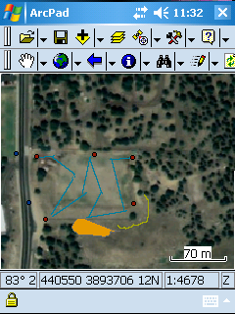
Notes:
At many levels integration with GIS will help you get the most out of your GPS. ArcPad is a hybrid of GIS and GPS software. It works as an extension on your unit of the ArcGIS software on you desktop or laptop. You can upload your data to it, go out in the field and edit it, then take it back to the home or office and download the data back to the original project.
In this made up scenario I run an architectural landscaping company who contracted with NAU to do some upgrading to this sports field on the basemap. This screen shot shows red dots I uploaded to ArcPad on the GPS unit previous to my going out. These were spots I already knew were utility access points. As I walked along the GPS and ArcPad automatically created the blue lines where I planed to put in new pipes for the sprinkler system (i.e. tracks). The lines are broken up because of inconsistent satellite reception and my meandering was a bit random. I used the GPS to mark the two dark blue dots (i.e. waypoints) along the roadway where information signs about the field should be put up. The yellow gold line was where I thought it might be good set up a score board and announcer’s booth. The orange polygon is a good spot to add some bleachers, snack stand, and storage. I can now take these points, lines, and polygon that I have edited in, download them to my computer, and update my projects on my home or office computer.

Slide 20
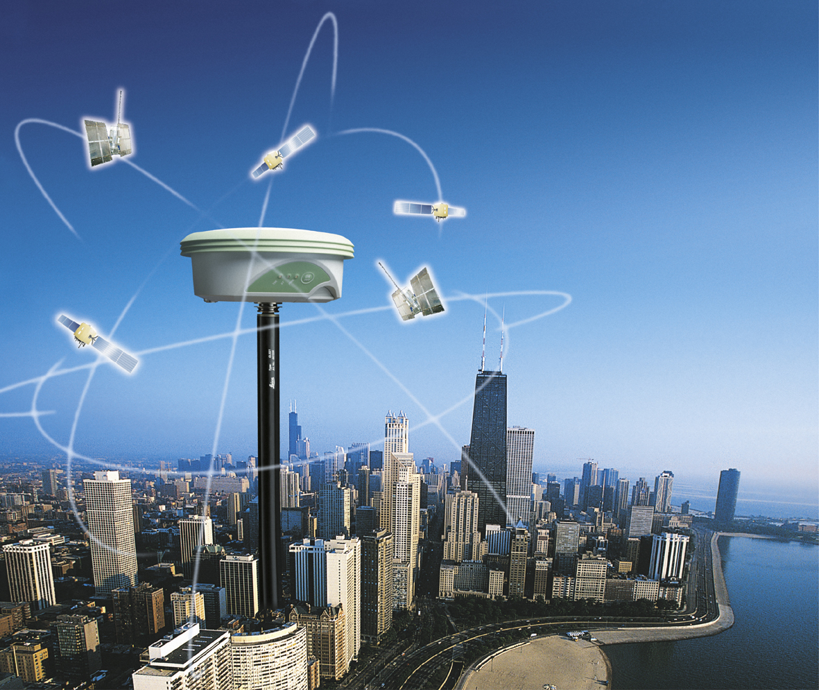
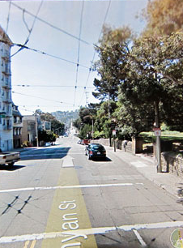
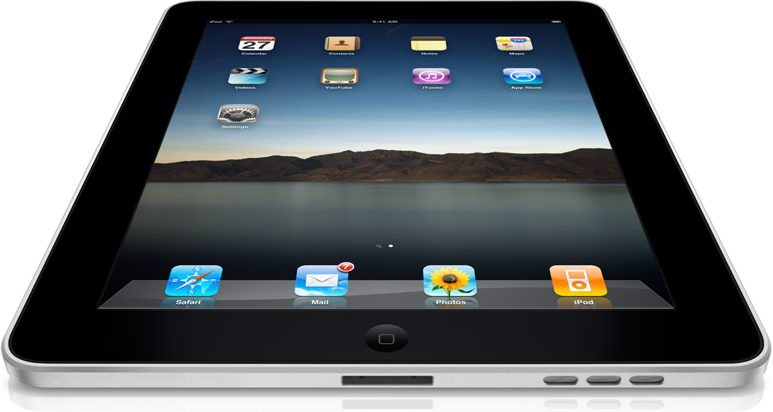
Image Source: http://www.leica-geosystems.com/en/News-Archive_57049.htm?id=1319
Original Image Source: Wired.com
Notes:
In the course of this first module we have discussed mainly GPS in terms of how it works, used geographically, and computer/data interaction. In addition to the continuation of personal navigational devices the future of GPS is wide open. Your vehicle may already have a built in GPS navigation feature with audio directions but that may become outdated in a few years as GPS heads-up displays with voice interaction for the family car are already being produced. It was discussed in the 2010 International Consumer Electronics Show that GPS could be a significant tool in the future for social networking and mobile internet (http://blogs.insideline.com/straightline/2010/01/2010-ces-the-future-of-gps-navigation.html). Already an app for the iphone, with the advent of the ipad GPS applications go beyond just digital navigation. It is foreseeable in the not to distant future that GPS and GIS will be as familiar as checking the time on your watch. Which is not too surprising seeing that it is already in you car and cell phone. I wonder if GPS will ever answer every child’s perpetual road trip question “Are we there yet?” We hope you learned quite a bit about GPS in this module and have some exciting ways you can use GPS in the next module. We also encourage you to take a look at the extras for this module in the next two screens.

Slide 21
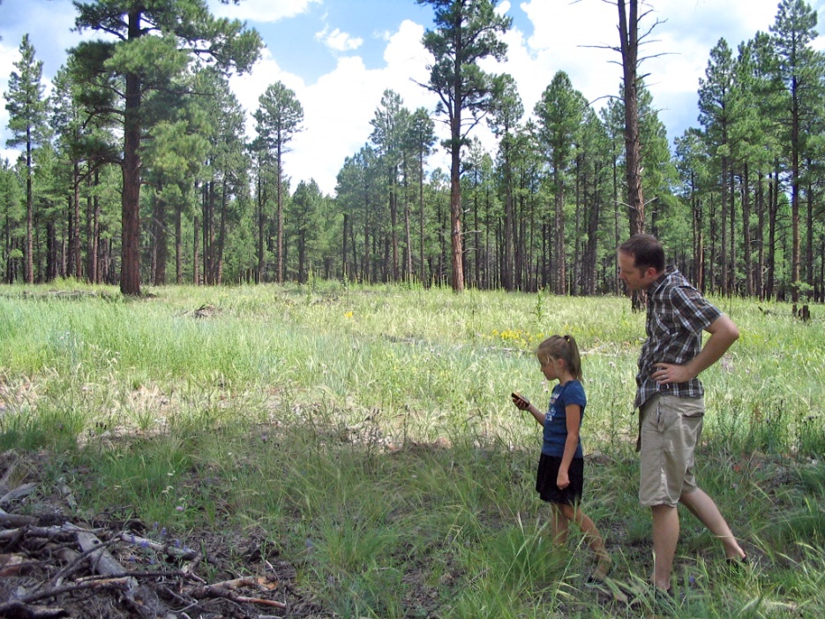

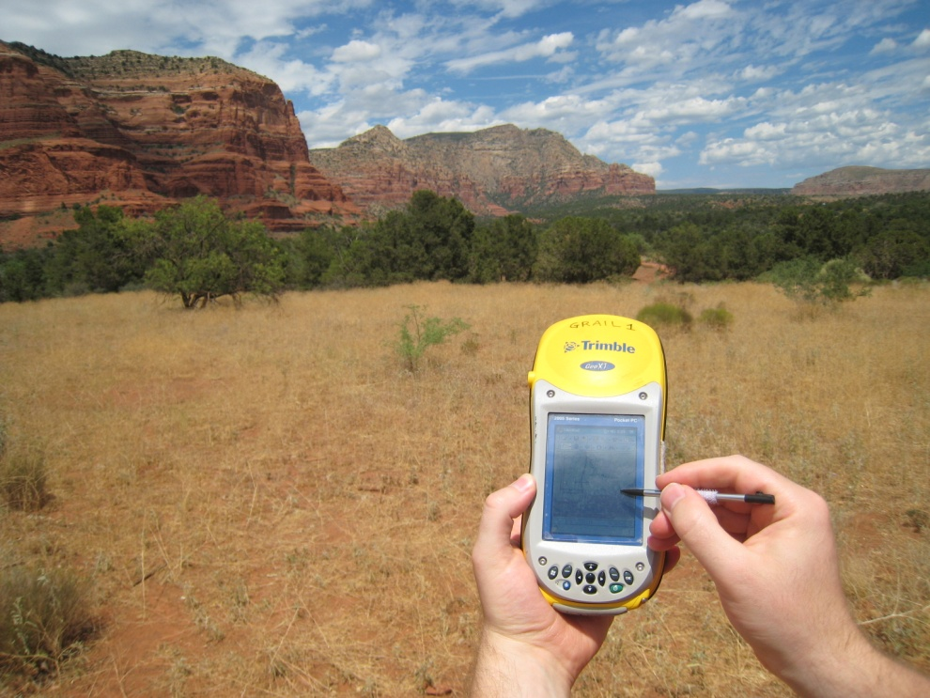
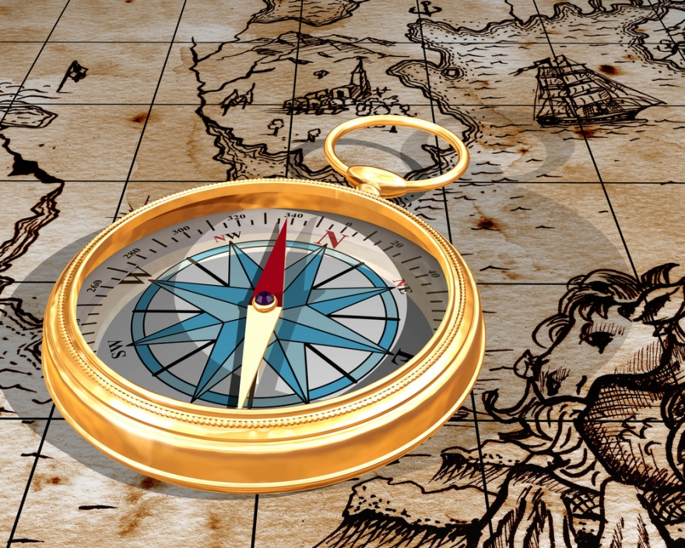
Notes:
Appendix A: Navigation
Back on the part of this module when we were talking about the screens or pages of a GPS unit I said there was a page on your unit for navigation. Most units in whatever form and purpose have this same navigation app. It is probably the feature that gives a GPS the most value and is very easy to use. You simply tell the GPS unit where you want to go and it will point you in that direction. For example: You take your family to Disneyland for the day and park the car in the Goofy lot. Lucky for you the watch you have on features a high sensitivity GPS unit. Before entering the Magic Kingdom you mark a waypoint where you parked. At the end of a day of themed rides and cartoon characters you simply turn on the navigation feature, it points you to your car, and you don’t have to spend an hour looking for it. OK so maybe that’s not the typical GPS unit navigation feature use but you get the idea.
The unit may tell you how far you are from a point, how long it will take you to get there, and what obstacles may be in your path. The technology ranges from units that can give you turn by turn directions to others showing an arrow pointing directly to the destination. This navigation feature is not unique to the latest digital electronics but is a technology that has been a standard from commerce to exploration for centuries. Seafarers and mountain men have been using real time navigation tools from compasses to sextants since the time of the Babylonians. The thing to remember is just that: these navigation devices are tools.
A GPS cannot substitute pre-trip planning, up to date maps, and basic common sense. If you don’t know how to get where your going before you leave you have an increased chance of not making it. While GPS units are incredibly useful and can be easy to use, the search and rescue industry has had a very large increase in business in the 21st century because people let electronic devices tell them where to go. “They are looking at their GPS devices and may not see a collapsed mine and fall into it.” ~ Ginger Kaldenbach

Slide 22
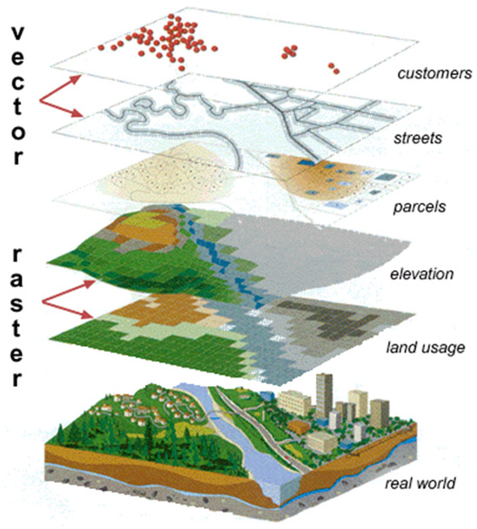
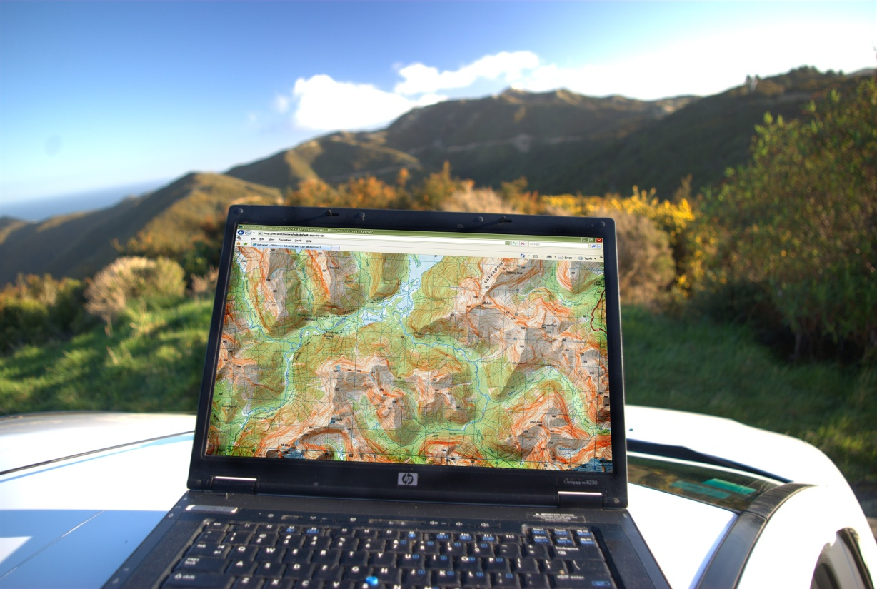
GPS/GIS
Applying the field
Image Source:
http://202.28.94.55/web/322103/2551/work1/g178/home.html
and others
Image Source: blog.doc.govt.nz/2009/08/
Notes:
Appendix B: GPS/GIS
We talked a couple of times in this module about how when we take the data off of the GPS unit and put it onto another computer we are putting it into a Geographic Information System (GIS). A GIS is basically where we manage, edit, and do any other work with the spatial data and information we have. For example: we could take the point and line watershed data we collected with the GPS, combine it with a satellite image we have downloaded, add a table of wildlife statistics, and end up with quite a bit of information formation about an area.
As seen in the top left image we could collect where our customers live as points, represent their streets as lines, then show the land parcels in the area as polygons, add a layer of elevation data, one more layer about how different parts of the land are used, and put it all together to get a model of the real world. We are applying the GPS data we gathered in the field with other spatial data and coming up a geographic information system.

