Slide 1
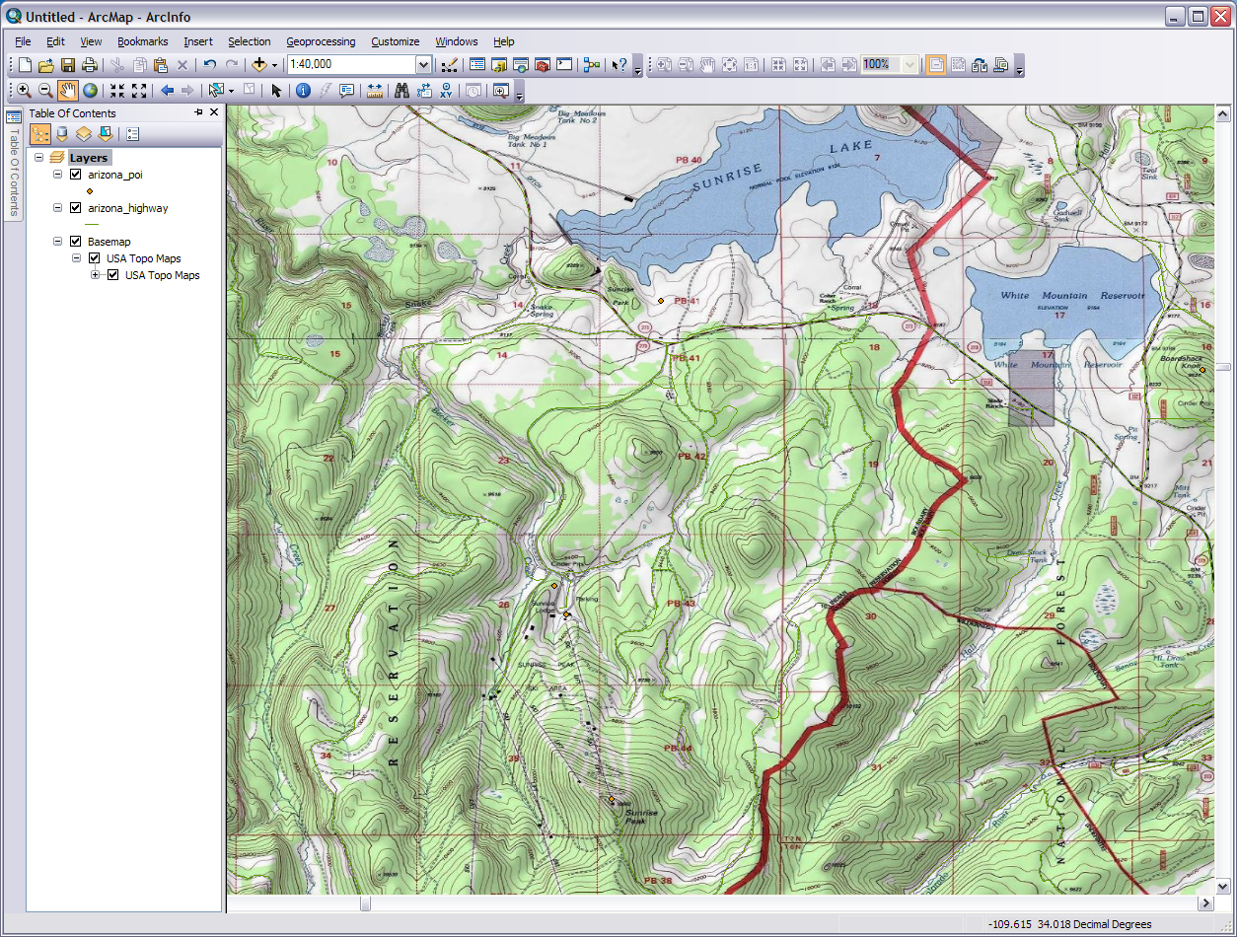
Introduction to Geographic Information Systems: GIS
Module 4: Raster & Vector
Created by: Scott Kelly 2010
Notes:
Welcome to Module 4 of GRAIL’s Introduction to GIS workshop. In this last module we will go over some raster tools and skills 1st then how to work in and use some new vector techniques 2^{ed}.You’ll see quite a bit of data prep before we have what starts looking like a map. I’ve done most of the data searching and gathering beforehand so that should save us some time. This module assumes you have done and/or have the skills learned in Module 3 as there are some things in this module I won’t be going into detail to explain. Let’s jump right in.

Slide 2
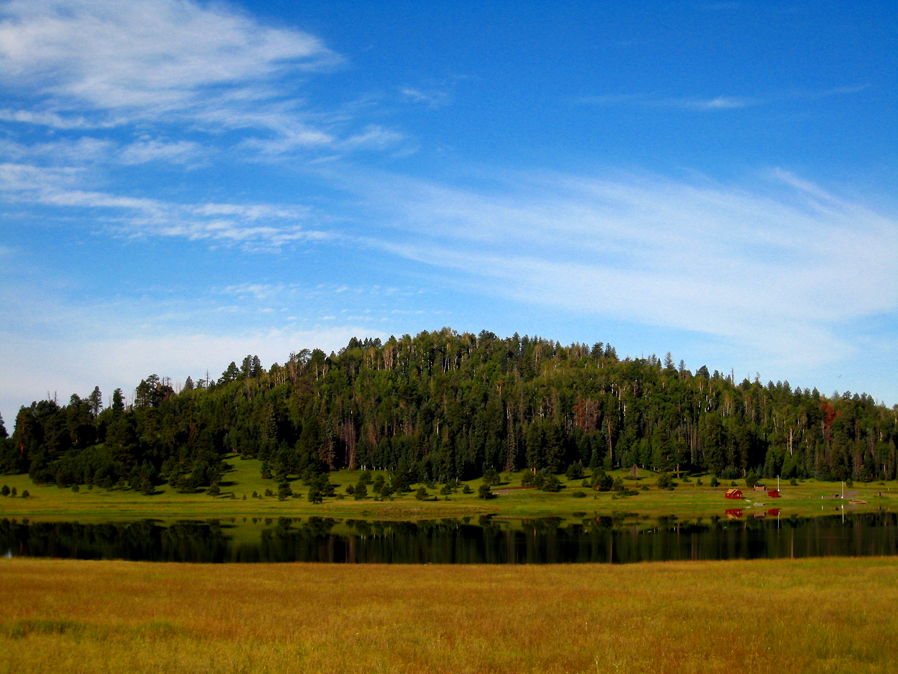
Crescent Lake
Notes:
This is a good shot from Google Earth of Crescent Lake looking across to the west shore in the White Mountains of eastern Arizona. In this scenario let us suppose that the Apache National Forest needs to build a new monitoring station on the southern most tip of the lake. Your EcoSam’s Creations company has been contracted to construct the monitoring station. Before you can present your building plans to the Forest Service you need to do some assessment of the area. This requires a good bit of GIS work. We can’t just use any old raster basemap so we will gather some high resolution aerial imagery of the area and work with a digital elevation model (DEM) to show some regional topography. We will also gather some vector layers to display features of the area. The first step is to create a project folder to store all our data. Create a folder in an easily accessible spot and call it something like ‘crescent_lake_ms’ using ArcCatalog or Windows Explorer. Now Let’s go get some data to put in it.
Note: We are going to be downloading some data from the internet like we did in Module 3. If you are unable to download these because of changes in a web page or things just aren’t working then you will find the files in Optional support files package for Module 4 download on the online workshops web page. I do encourage you to download the data as the steps in this module acquaint you with some data acquisition techniques. Finding and getting data from the internet is an important GIS skill.

Slide 3
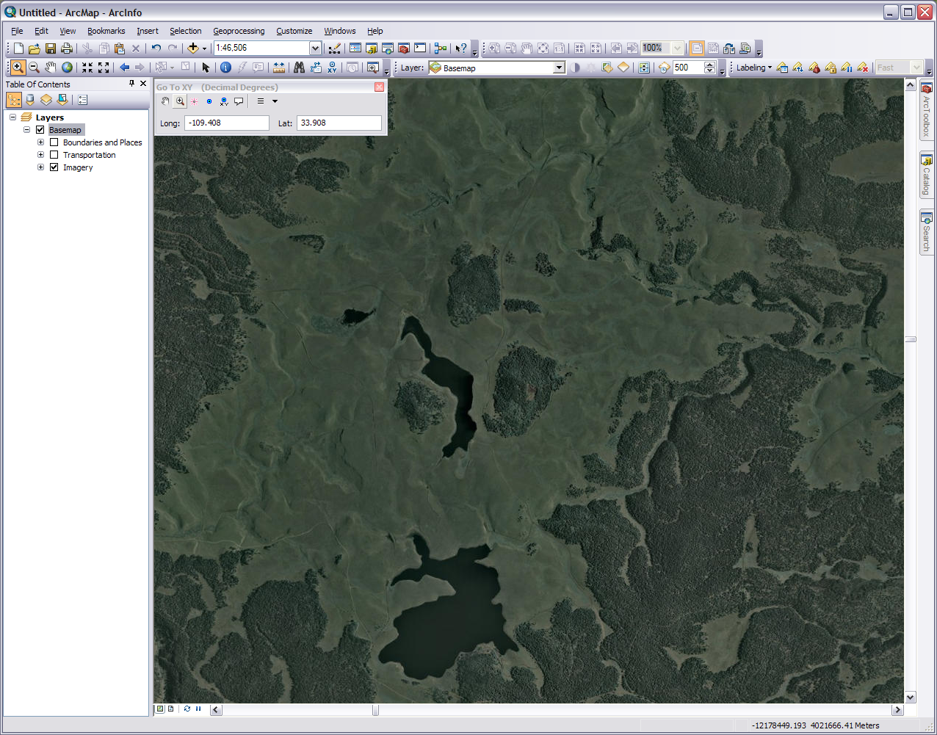
Scale
Go To XY
Crescent Lake
Big Lake
Notes:
A logical place to start building the project is to get is an up-to-date image of the area. If this were a real on the job project and the budget allowed we would probably hire an aircraft, mount a camera to it’s belly, and take a high resolution photo of the lake vicinity. In lieu of that we are going to grab an older aerial photo and pretend like we took it yesterday. Copy into the project folder the Crescent Lake “recent” aerial photo from the link on the GRAIL workshop page. It is compressed so you will have to unzip it in windows explorer. Let’s also say that this image was printed out on film or paper and we had to scan it into the computer. The scanned in aerial photo has no spatial reference. We are going to georeference it so that the GIS software know where to place it on the surface of the earth.
Now we will need an image to georefrence it to. In ArcGIS 10 this is easy. Open ArcMap and from the Add Data button dropdown add the basemap ‘Imagery’ (you can also get the imagery layer at ArcGIS online. For 9.x users you can find it under the file menu or go online). To get to our area use the Go To XY tool on the Tools toolbar, put in -109.408 longitude| 33.908 Latitude, and press enter or the small magnifying glass next the red fireworks or if you know where Crescent Lake is just zoom to it. On the Standard toolbar put in the scale 1:46,506 and press enter. You should now be looking at Crescent and Big Lake.
You may be thinking “well if the basemap image is already projected then why do we need the aerial photo?” There are two good reasons for this. One the aerial photo is “up-to-date” and two the aerial image is (supposed to be) higher resolution. You will also notice when we look at the “current” aerial image the southern tip of Crescent Lake is full of water where as in the “older” basemap the tip is dry. Hence the importance of time sensitive data in some GIS projects. We could probably come up with other reasons but let’s move on.

Slide 4
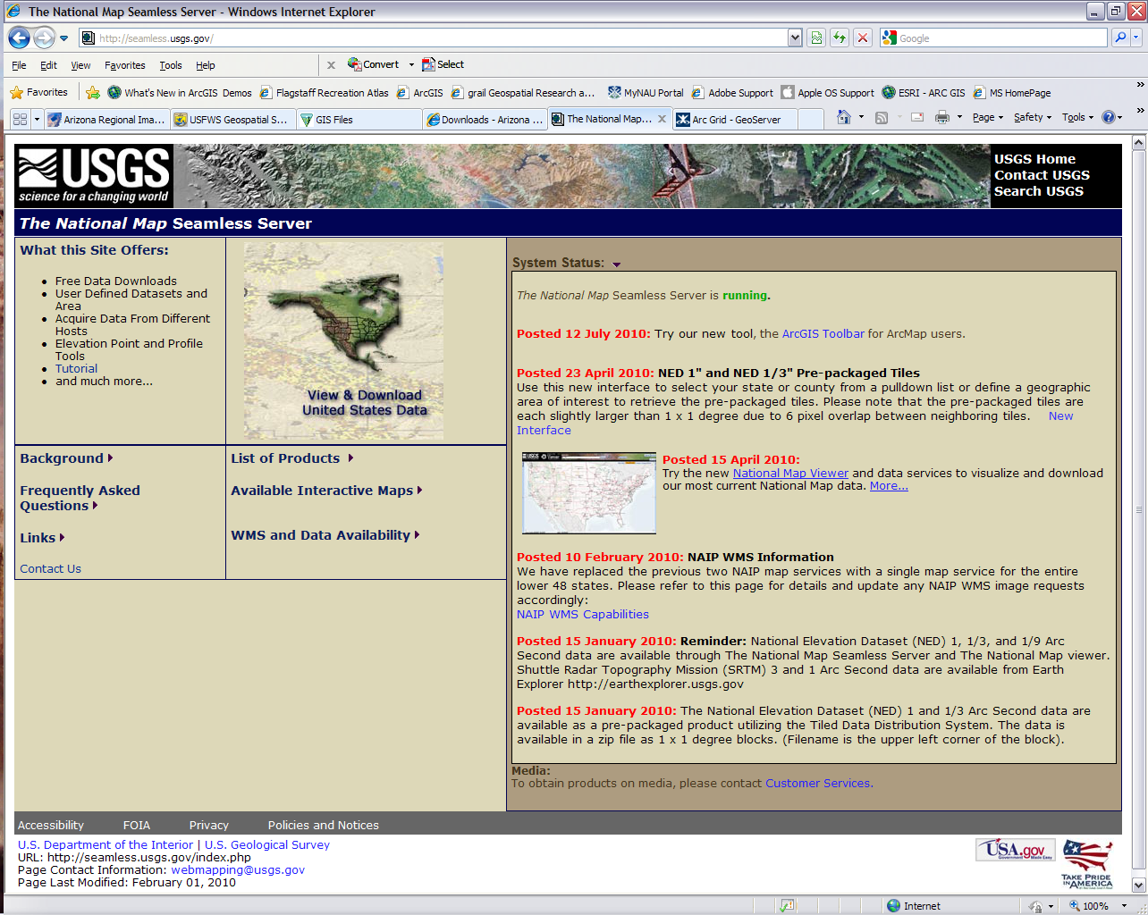
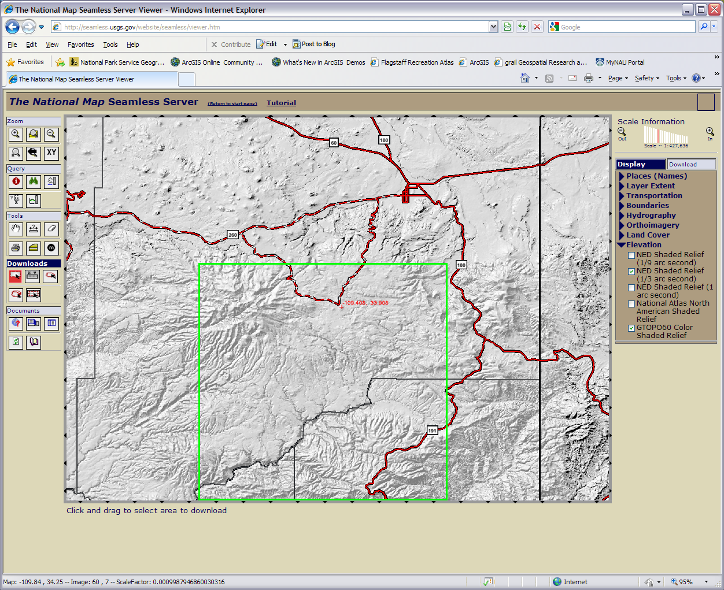
To get the DEM
Notes:
We need to get one other raster. In order for our aerial image to show some good topography we need to forge a DEM to it. Here we have a 8 step data prep procedure.
1) Go to http://seamless.usgs.gov/website/seamless/viewer.htm and the click XY button on the top left. This will allow us to enter coordinates to zoom to a location
2) Enter the coordinates -109.408, 33.908 then press OK.
3) Using the buttons on the top left draw a box and zoom in until you are able to see our location and the immediate region around it. It is OK if you are significantly over or under zoomed just make sure you have the location centered on the map and have a reasonable work area.
4) On the right side panel under Elevation uncheck the NED 1 arc second and then check the NED 1/3 arc second. Give the map time to redraw in between. Look at the image in this slide to see how things should be looking. It doesn't need to be exact,
5) On the Left side panel under downloads choose the top left button and use it to draw quite a large box a little above, around, and under our target area. We want it significantly large than our area. Click download on the results summary page and wait. When the order status is finished you can save the download or your browser may have blocked the download. In this case click where is says click here to get the zipped folder.
6) The downloaded folder will be name something like NED_75913130.zip. Unzip the folder in Windows and keep every thing in it. Our DEM will be in GRID format which is ArcGIS’s native raster format. A DEM can have any raster extension so we are good to go.
7) Open the now unzipped folder in ArcCatalog to view it (it’s confusing using Windows Explorer). Drill down to the DEM (it will be the only raster dataset in there, it will have an icon like a checkered grid and no . extension after it) and you can view it by clicking the preview tab on the right side. When you view it, the DEM will look like a grayscale or other gradient without much detail. This raster image was mathematically created from known points of elevation and was never meant to be a pretty picture. DEM’s are very useful for supplying elevation data to a GIS project.
8) Move it to the project folder if it isn’t already there.

Slide 5
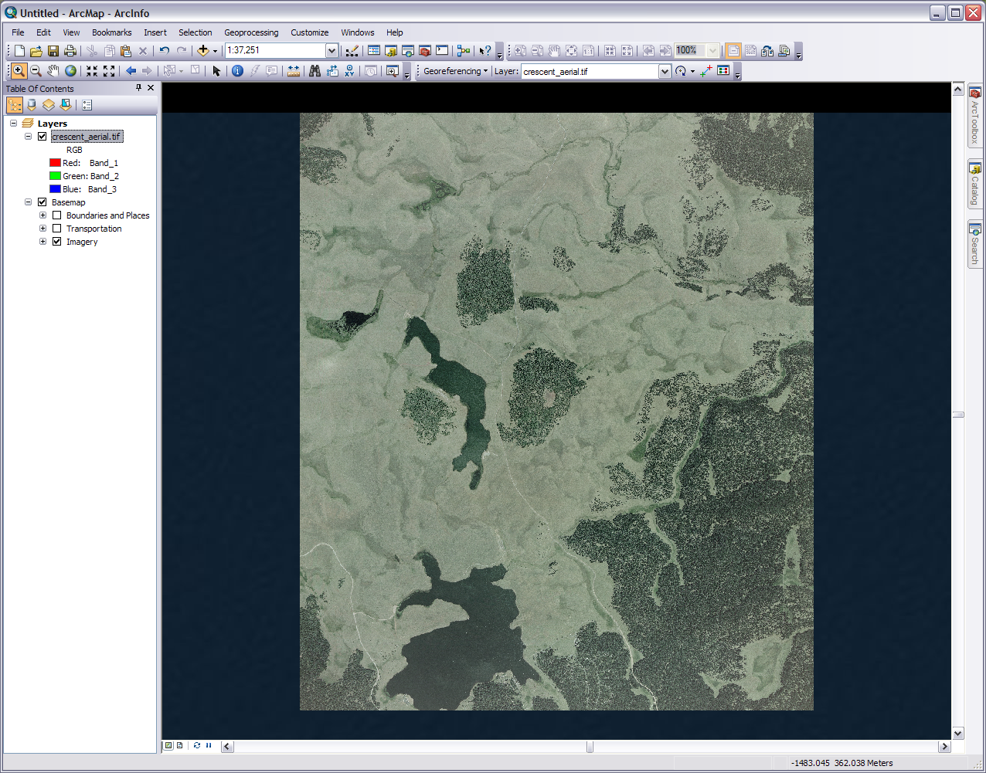
Drop down
Add control points
Link table
Notes:
So if we look at our project folder in ArcCatalog right now we will see our two raster files: the aerial photo and the DEM. Rename them as necessary. If you do it in ArcCatalog or ArcMap then all the support files, if any, will also be renamed.
Our next step is to georefrence the aerial photo in ArcMap (remember it has no projection info). 1) Turn on the georefrencing toolbar. In case you forgot in Arc 10 the toolbars are under the customize menu and in Arc 9.x the view menu. 2) Make sure our basemap view is in the right spot and then add the aerial photo as the top layer. It is your choice if it asks if you want to build pyramids. Arc will give you a warning that the aerial photo is not georefrenced which is OK. Hence we are going to georefrence it. 3) Select and if necessary zoom to your aerial photo layer (right click on the name, zoom to layer). You can see the difference in resolution and why the aerial photo might be better for this project. 4) Make sure in the georeferencing toolbar the ‘Layer:’ drop down box has the aerial photo as the selected target.

Slide 6
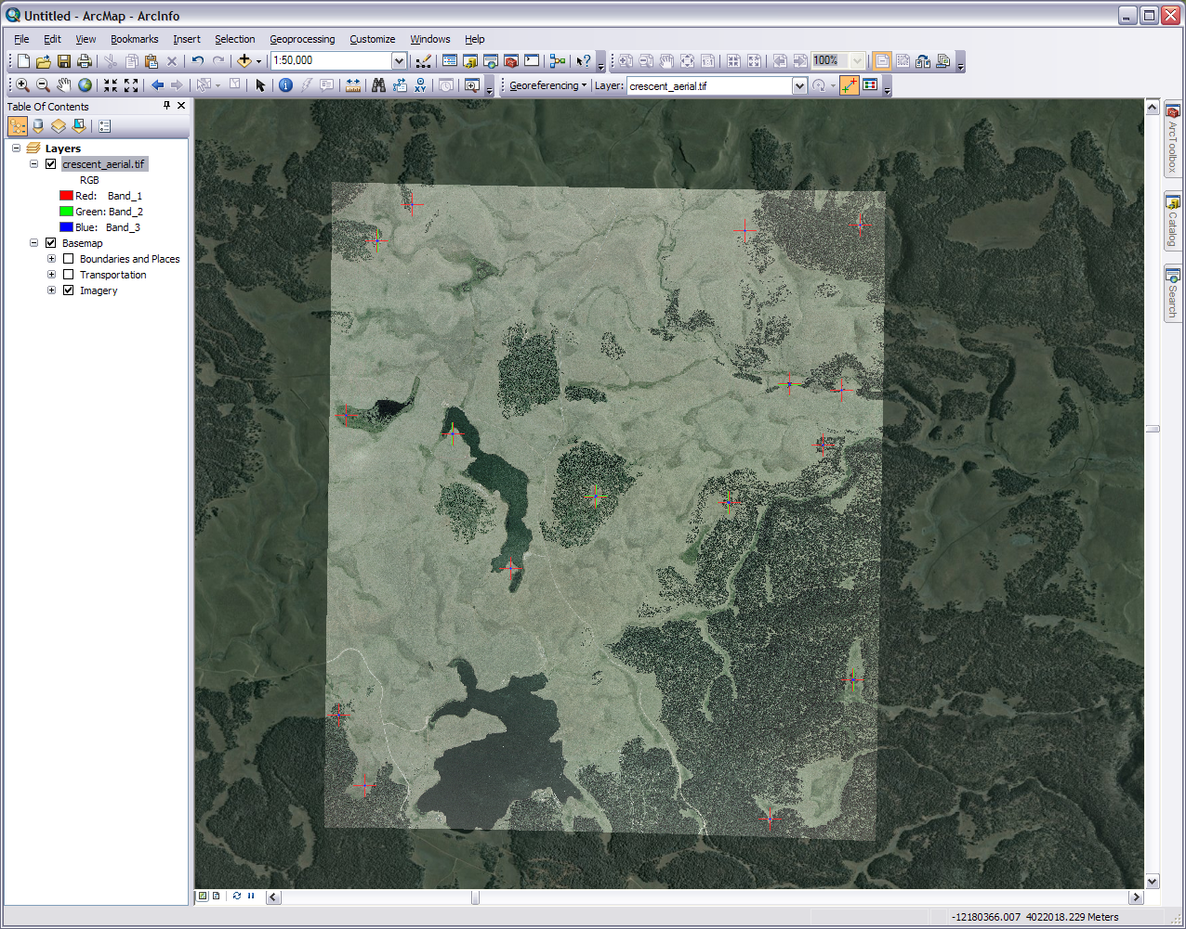
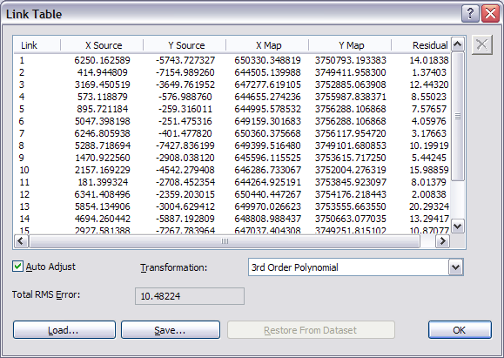
This needs to be the layer we want to georeference
This is the current scale
Control points (GCP)
Notes:
If you are on the aerial photo layer and it is targeted it is time to pick some control points. The ground control points (GCP) or just control points are points on both images that you know match up perfectly. These points become “fixed” when the unprojected image is rectified (transformed) to match the projected image. You can kind of think of it like the unprojected image is a rubber sheet and as you put in nails (control points) in certain places the rubber sheet can be molded around the nails into the right shape.
So here is how we do it: 1) While on the aerial photo layer select the ‘Add Control Points’ tool on the georeferencing tool bar. 2) With the crosshairs pick a point on the aerial photo you know you can find on the satellite image. When you pick it the marked spot will have green crosshairs. 3) Zoom back to the area on the basemap. The zoom to last extent button might help with this (blue arrow on tools toolbar). Don’t use zoom to layer on the basemap. 4) You aren’t going to get it 100% perfect, but on the basemap pick the same point you picked on the aerial photo. The point is marked by red crosshairs on the basemap. Two other things to notice here. There is a connecting string to visually show the correlation between points. As you pick points Arc will try and adjust the aerial photo as we go along. In our case we got lucky and our first control point brought the aerial photo close to matching up with the basemap. It’s not uncommon for it to take four or more points before you get that kind of overlap.
5) Pick another set of points on the other side of the aerial image turning the top layer off and on as needed (click the checked box next to the layer name). Zoom and pan also to get a good view. Only the points will affect the georefrencing. 6) Pick another point… while the rectification transformation will work with a minimum of four points it is best to have at least 10 to 20. More can be good if you can find them and they are well dispersed. If you mess up you can delete points in the links table. It is also best if your points are well distributed across your image. Edges are good and be sure to have some as close to your corners as possible as well as a few in the center. You could have 100 points but if they are all in the same spot the transformation won’t work very well. 7) Once you have 10 or more open up the links table. This lists all the points you have chosen. The Residual column and Total RMS Error are how far off the computer thinks you are. 8) Pick a transformation from the drop down menu. This how the computer will rectify the aerial photo based on the control points you picked. I selected ‘3rd Order Polynomial’ out of personal preference. Try different ones and see what works best for your GCP’s. 9) When you think you have enough points, a good distribution of the points, and a transformation go on to the next step.

Slide 7
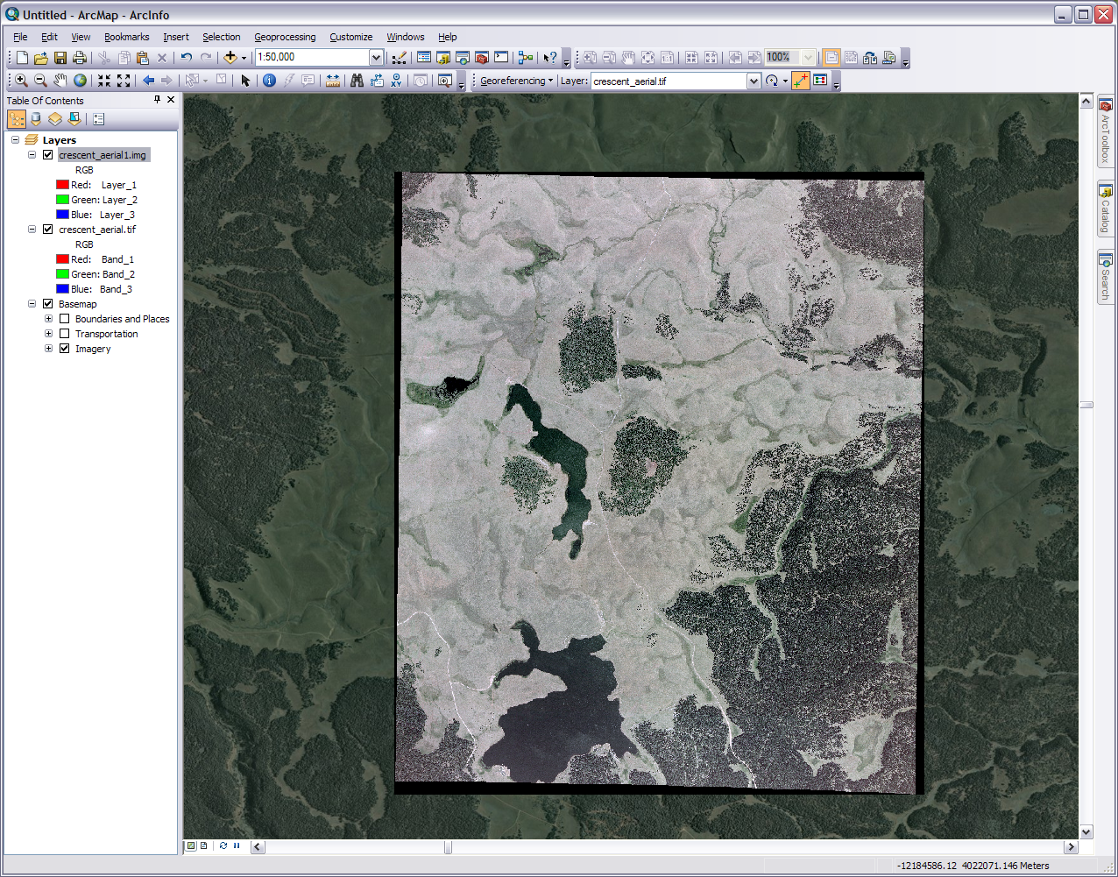
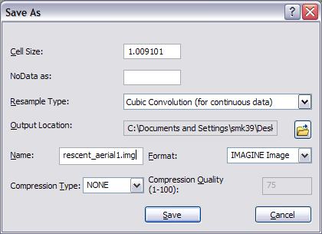
Rectify
New aerial photo
Notes:
When you are ready go to Georefrencing on the tool bar and on the drop down select Rectify. A window will pop up with several options. You can choose a resample type or just go with the default. This is just how transformation you picked in the table will take place. For our image we aren’t too concerned with this but I selected Cubic out of personal preference. Choose the output location and name. For the raster format you have several options. If you have no endearing preference go with Imagine (.img). Leave the compression, cell size, and NoData as is. Press save and the process begins. Like anything else this takes a while.
When it is done add it to your view in ArcMap. If you picked some good points it should match up near perfect to the basemap (you can get rid of the points in your view by deleting them in the links table). You will also see some black areas around the edges. These are there because when the aerial image was transformed the photo no longer conformed to the square image frame but the frame is still present. To make these black phantoms invisible go to the photo’s Properties>Symbology. Check the ‘Display Background Value’ and make sure the Display NoData has the box with the slash through it. Press apply and OK. You can remove the basemap and old aerial photo or I prefer to just restart ArcMap with a clean data frame and add back in your new aerial photo.

Slide 8
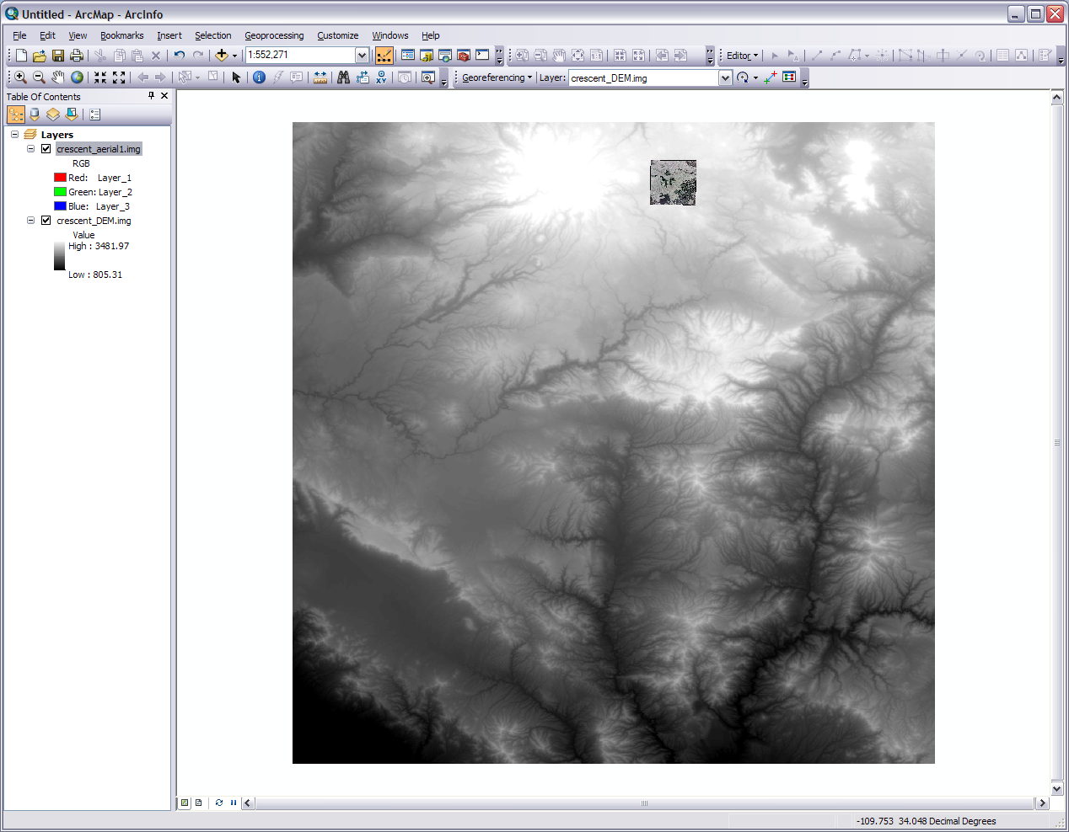
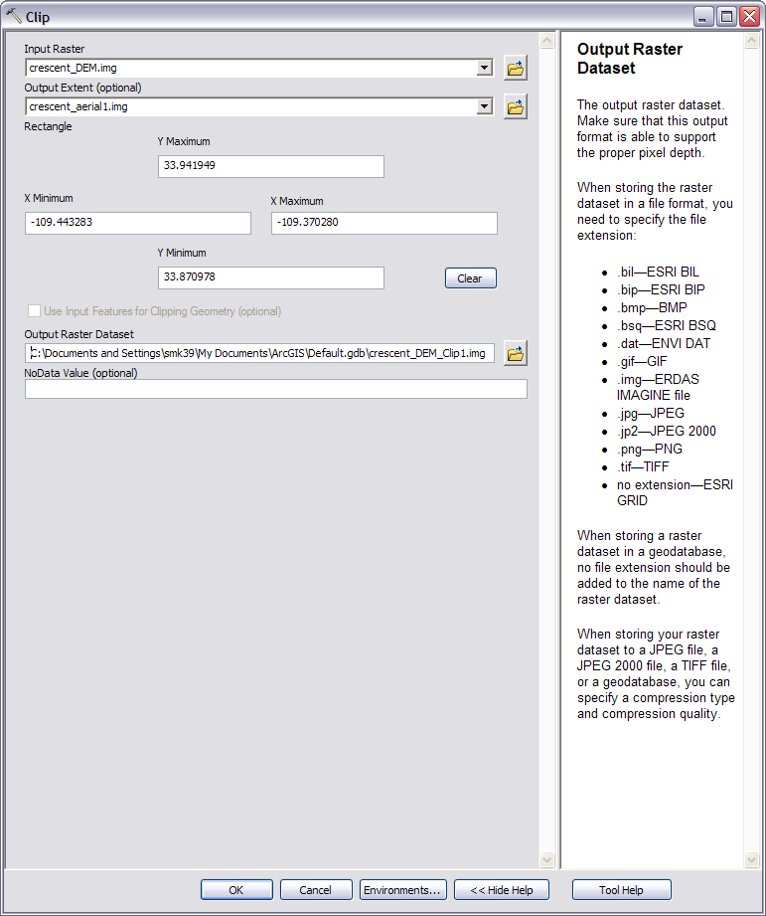
Aerial photo
Notes:
We shouldn’t need the unprojected aerial photo for the rest of this project so you can delete it or what I’m going to do is make a subfolder called ‘data’ to store it and other used data in just in case I need to go back to them.
Now we are going to clip (subset) our DEM down to size. In ArcMap Load the new aerial image and the DEM with the DEM on the bottom. If a message comes up about one or the other being in a different projection just press Close and ArcMap should line things up appropriately enough. The DEM you extracted from the national map is based on the download box you drew so it probably will not look exactly like the one in the slide here. It should however cover the spatial extent your now projected aerial photo does. Zoom to the DEM layer. As you can see this DEM is quite a bit larger and yours should be at least somewhat larger than the aerial image. The now georefrenced aerial photo will line up over the DEM in the right spot. If you zoom out past the extent of the DEM for some reason it may disappear but that’s OK. Just zoom back in and it will reappear.
Open ArcToolbox and drill down to Data Management Tools>Raster>Raster Processing>Clip. For the input add the DEM and the output extent the aerial image. Name, add a format (try the .img format but other will work too), and pick a location for the raster that will be created and press OK. If an error occurs it is most likely due to too long of a name. Just shorten it, take out any special characters (*$#&…), and try again. Once it is done processing the new DEM will show up on the screen. If you put the aerial photo on top notice that the DEM was clipped to the photo’s data frame and not to the reshaped rectified image. That’s OK because eventually we are going to cut things even smaller so this won’t be an issue. Remove the larger original DEM from ArcMap or I prefer to just close and start ArcMap fresh adding in the aerial photo and the new DEM clip. You can delete the older larger DEM or move it to your storage subfolder because we won’t need it anymore.

Slide 9
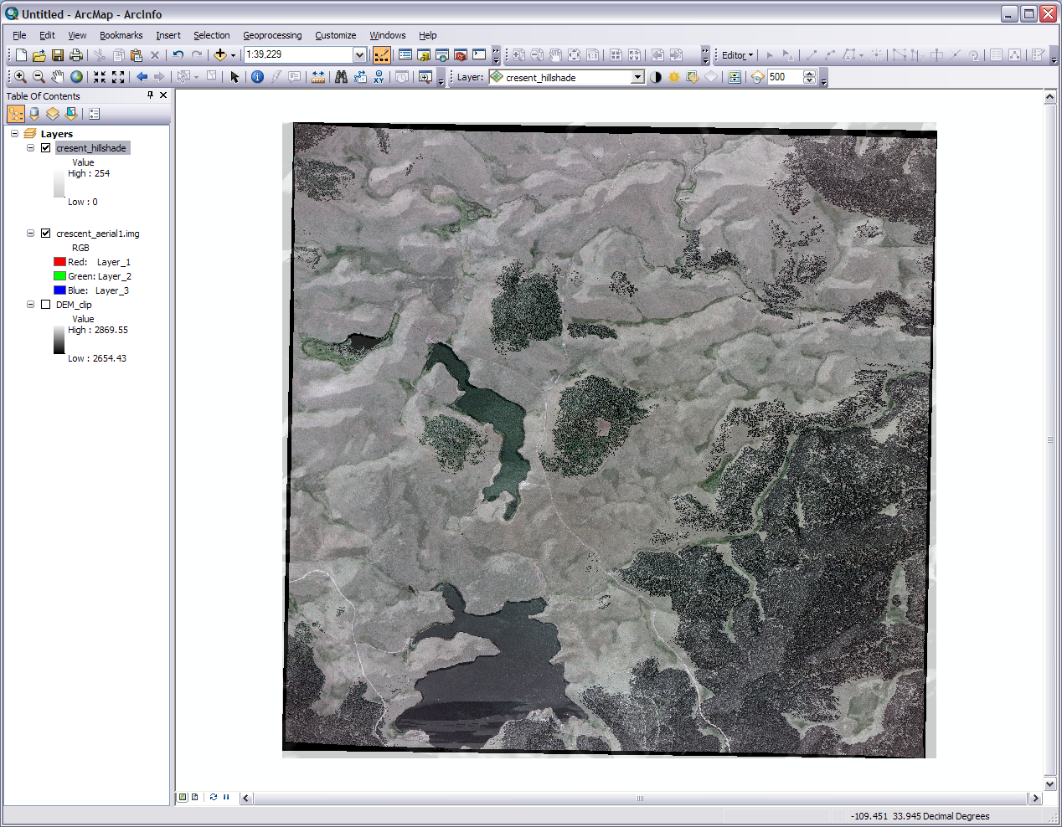
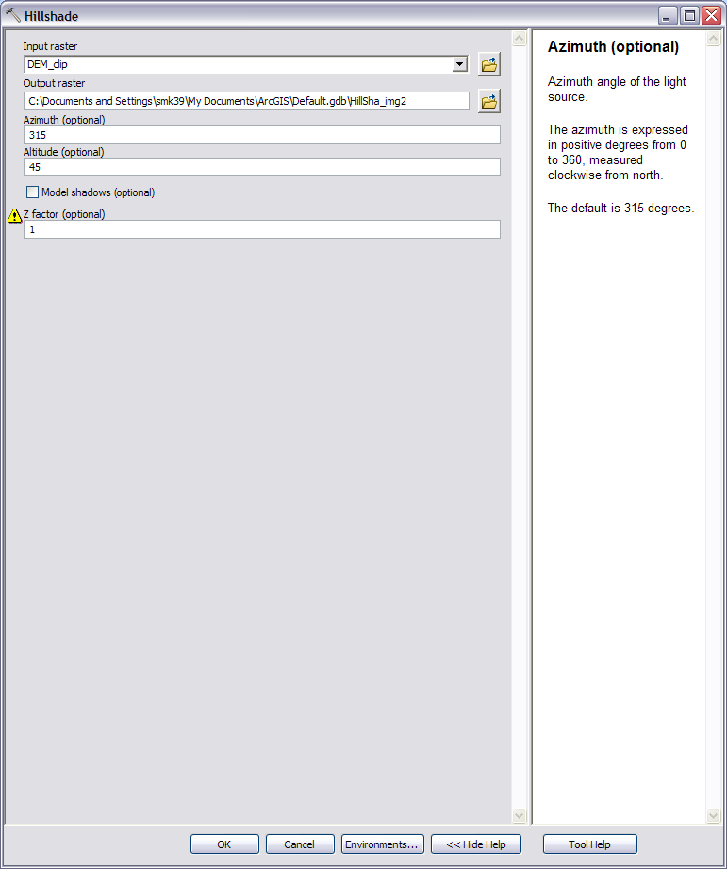
Effects toolbar
transparency
Notes:
Now we are going to use our new DEM to put some topography on our aerial photo. If you turn the aerial photo on and off you can see from the DEM where the hills and drainages are. To mold these into the aerial photo it’s back to the ole’ ArcToolbox. In ArcToolbox drill down to Spatial Analyst Tools>Surface>Hillshade. For the input add the DEM. Leave the Azimuth, Altitude, and Z factor alone (we don’t have this information so just go with the default). For the output add the .img or other format to the name and keep it under 13 characters. Press OK.
Let it process and if it doesn’t do it automatically put the new hillshade layer on top yourself. You will have an image containing a bunch of hills and valleys with dramatic shading. If you turn on the Effects toolbar you can set the transparency of the targeted layer (or do it in the properties>display). Set the transparency of the shaded image to about 80 to 90% or till you can see it overlap the aerial photo. You can also turn off the DEM. Now you have a cool 3D effect for you 2D surface. Bo-yah! We could make them into one image but let’s leave them as two separate layers for now because we are going to add some vector layers and then we will export everything together at the end.

Slide 10
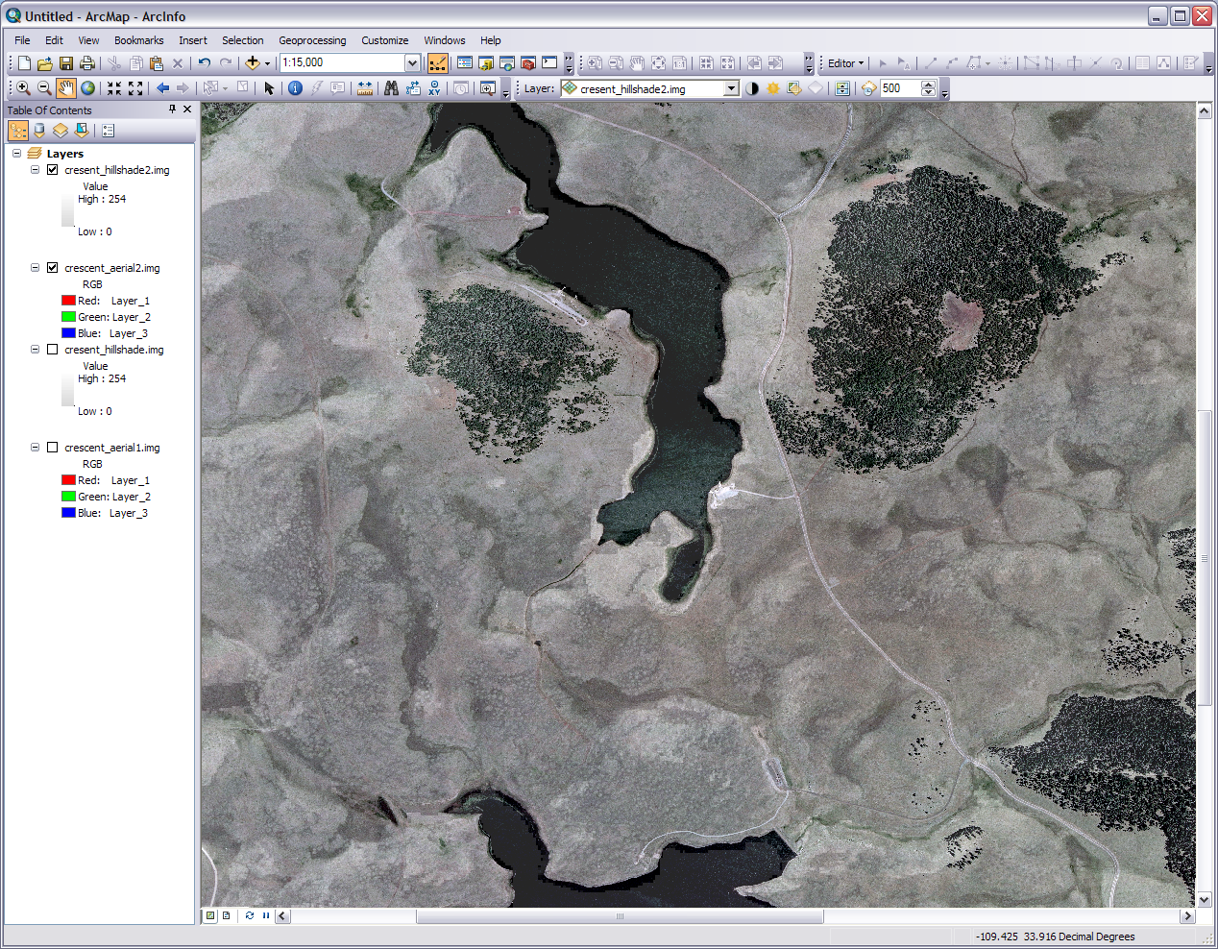
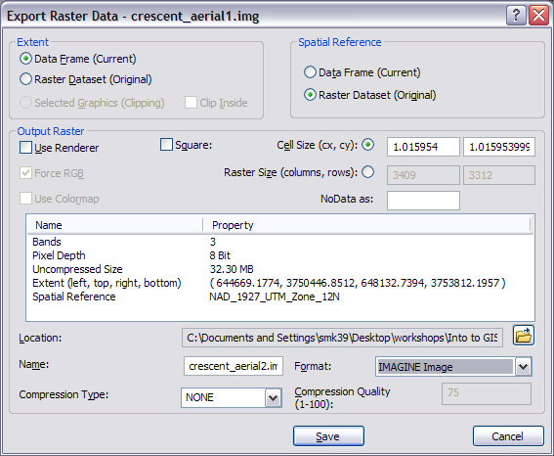
New layers/Desired rasters
Notes:
You can remove the DEM now and delete it or put it in the storage folder. As we are building the new monitoring station on the southern most tip of the lake our present view covers more ground than we need. We are going need to crop both the hillshade and aerial images to a manageable size and the area our focus is on. 1) Zoom in to where you are centered on the southern tip of Crescent Lake and can just see the north shore of Big Lake about 1:15,000 using the scale on the standard toolbar. 2) Right click on the name of the aerial image and go down to the Data>Export Data option. 3) In the Extent section, click the Data Frame radio button. 4) Select the output location for the raster export, the name of the output raster, and the file format. 5) Press the save button and choose if you want display it in ArcMap. 6) Do the same thing for your hillshade layer. 7) You now have a new version of the aerial photo and the hillshade image. These two new images are what we will use to make our map. 8) Restart ArcMap with a new map and add the hillshade image first so that our data frame will be projected in NAD83. Add the aerial photo next. You can delete everything else or put them in the storage folder. Good job with all of that raster data prep!!!

Slide 11
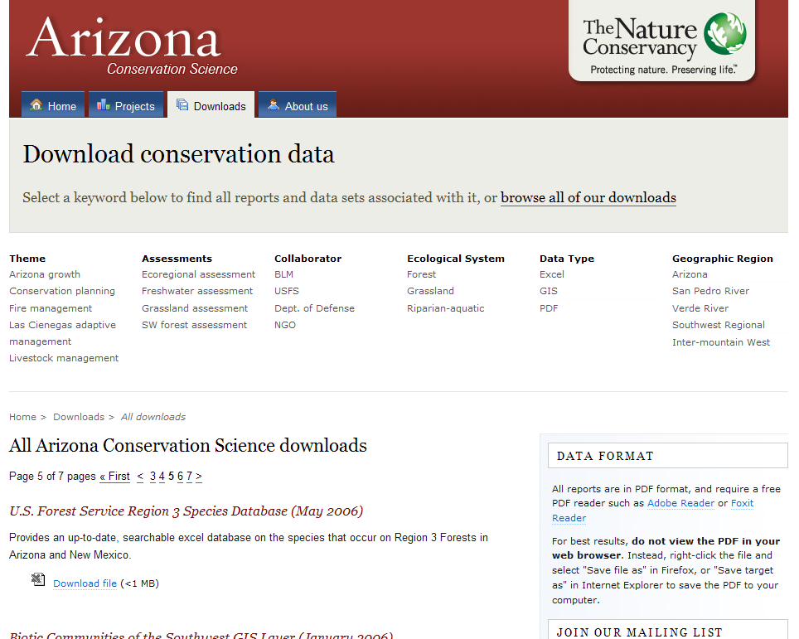
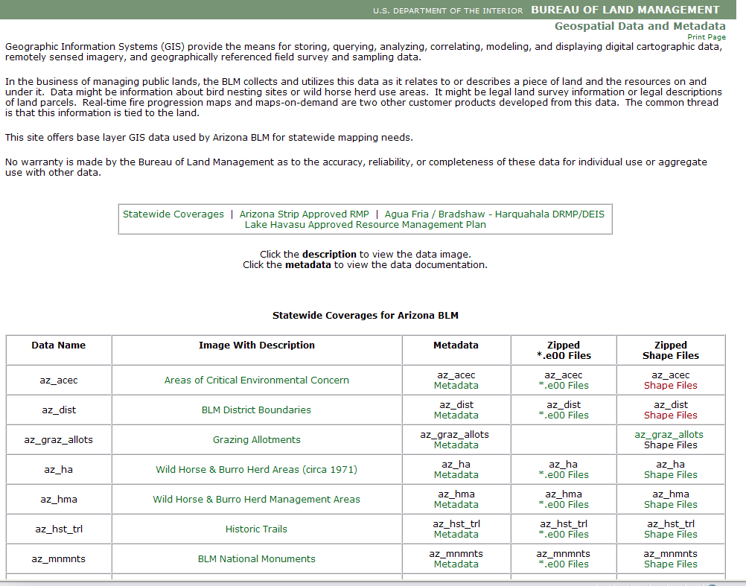
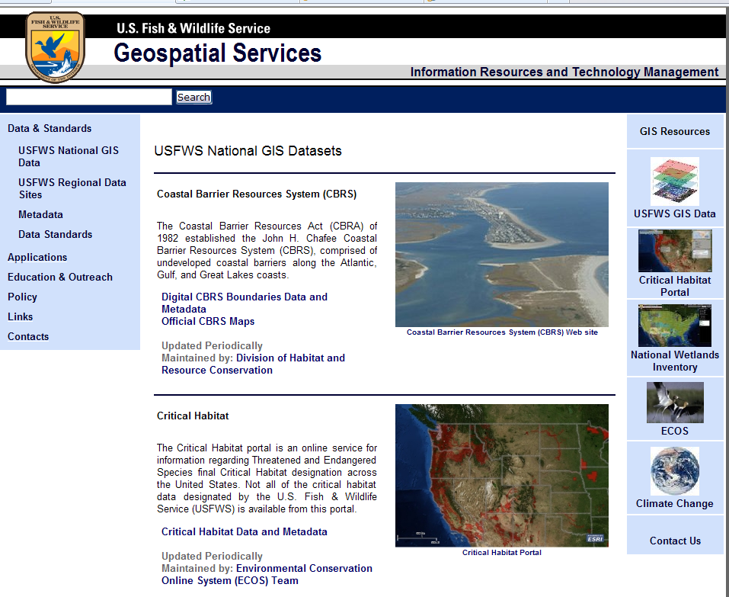
Notes:
Alright we have a good “up-to-date” image of the area and a good idea of the topography around the lake. Before we can present anything to our client however we need to show some of what is going on around Crescent Lake. We won’t get too deep into the relevance because the main purpose is to show you how to do these. We’ll start by downloading the following files. All these are zip files so just extract them in the project folder. Leave them in their own folders without deleting any files but the already extracted zip folders.
1) Go to http://azconservation.org/downloads/all/P20/ and you will be scrolling down to download the Biotic Communities of the Southwest GIS layer. I know this comes from an older map but it will give whoever is looking at our GIS product a better idea of the vegetation types in the area.
2) Go to http://www.blm.gov/az/st/en/prog/maps/gis_files.html and scroll down the statewide coverages list to the 5th level (10digit) watersheds. It is good to know something about the area’s watersheds so when those heavy rains come the monitor station we build won’t get washed away. Download the *.e00 files because for some reason the shapefile didn’t seem to be working when I tried this the first few times.
3) Go to http://www.fws.gov/GIS/data/national/index.htm and click on the Critical Habitat Data and Metadata link. We want to be aware if there are any habitats of concern near our monitor station. Download the zip file containing seamless composite layer and metadata for all species. You can try and add all these downloaded data layers to our map at once if you want but we will whittle down each one of them individually in the next few steps.

Slide 12
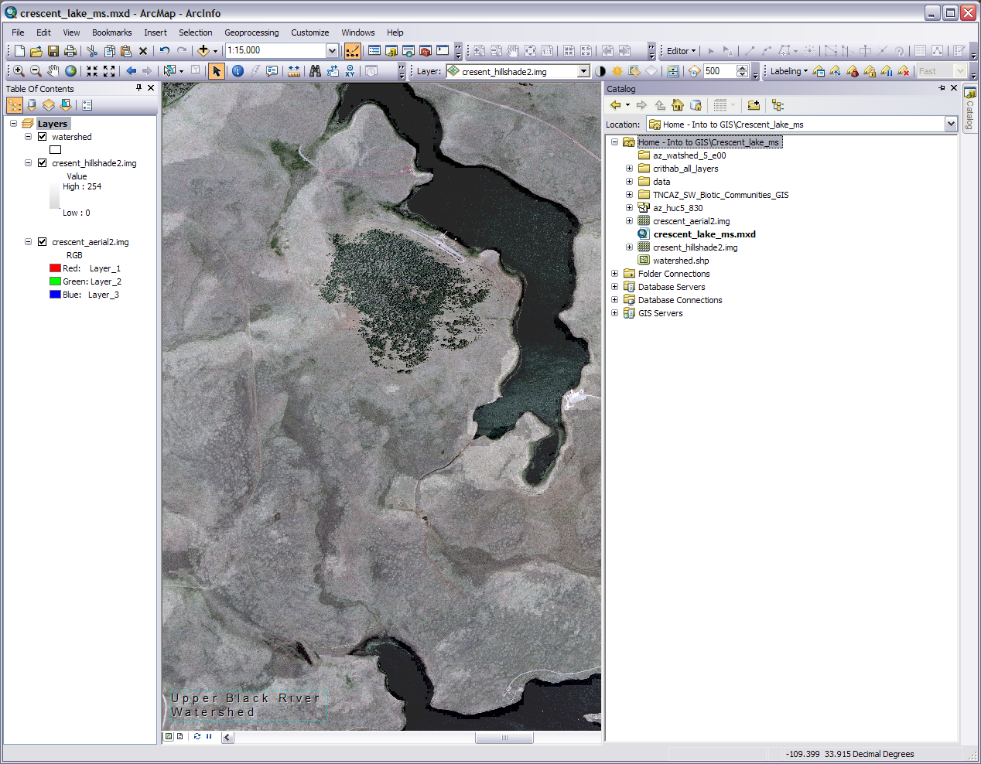
ArcCatalog window for Arc 10
Final watershed layer
Label Manger
Downloaded files (watershed, critical habitat, biotic) with data storage file and converted .e00 file
Auto Hide
Annotation/Label
Notes:
Let’s do the watershed file first. A little explanation about things like the .flt and .e00 file extensions. These each of course have their own purpose but in a nutshell they are just raster and vector files that want to be .img and shapefiles when they grow up. 1) Open up ArcToolbox and drill down to Conversion Tools>To Coverage>Import from E00. This type of tool is known as a script, hence the scroll icon next to it. The tool window is as basic as bread. Input the az_huc5_83.e00 file, choose an output folder, an output name, and let the thing process. Open it in your data frame. The output file is called a coverage which is like a shapefile. As you can see our area fits into just one watershed.
Well what we are trying to do here is show what watershed this is. 2) Right click on the name and go to Data>Export Data. In the drop down export all features in the view extent and use the same coordinate system as the data frame. Add our newly clipped watershed layer and get rid of the original watershed layer as it is no longer needed. 3) Open the Labeling toolbar and click the label manager button (first one next to the Labeling drop down). Make sure in the Label Classes box your new watershed layer and the subclass (Default) are both checked and highlight the subclass. For the label field have ‘HU_10_Name’, set your text preference, check the Only place label inside polygon box, and press apply/OK. The label with the name of the watershed will show up in the middle of the screen. Unfortunately we can’t move it around in this state. 4) Right click on the layer name and ‘Convert labels to annotation.’ Store the annotation in the map and press convert. 5) Zoom to your water shed layer and the annotation will be in the middle. It is not convenient, but move the annotation on to our area with the pointer cursor and panning and zooming in and out. Double click to get the properties window for editing. 6) Place it on the map, like in a corner, where it can serve as a piece of information for whomever reads the map.

Slide 13
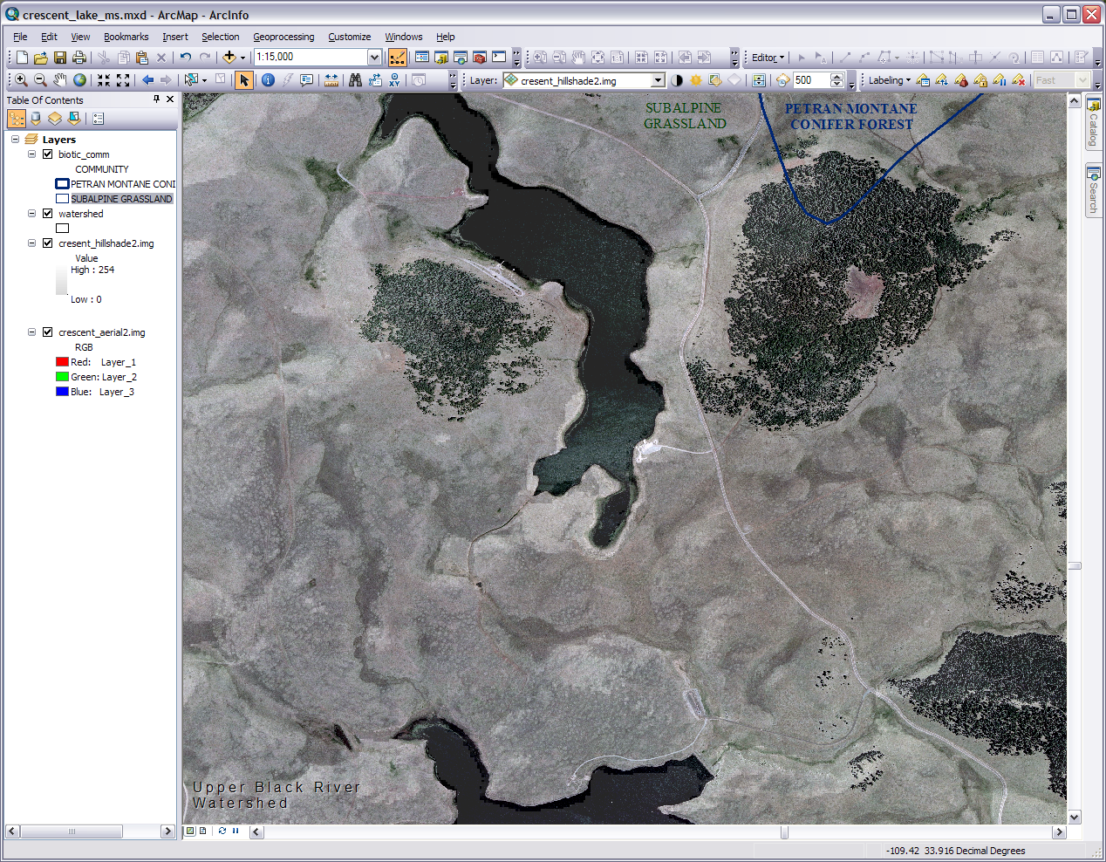
New Biotic layer
Annotation/Label/Boundary
Notes:
The biotic communities layer is next. In the folder for the biotic communities you will find a shapefile and a layer file. They both display the same information. The shapefile has more workability so load it into the data frame. If you put the shapefile on top your data frame it will fill with solid color. Also notice the annotation for the watershed stays on top of everything but more important the black polygon boundary in the upper right part of the data frame indicates that there are two different biotic communities in our area. Let’s start by clipping our biotic shapefile down to size.
In order to keep things simple let do something like we did with the last layer. 1) Right click on the name and go to Data>Export Data. In the drop down export all features in the view extent and use the same coordinate system as the data frame. Get rid of the original biotic layer as it is no longer needed. 2) The area of the shape file still extends beyond our area just like the watershed and other vector layers we will add but that’s OK because our final product will only show what’s in our area. If you look at the attribute table you will see we only have the two features left. Go to the layer’s Properties>Symbology. Click Categories>unique values on the left side and in the value field drop down to ‘Community’, 3) Click the Add All Values button, uncheck <all other values> (and better yet do no fill or outline). Double click the colored squares and make the two features into outlines. 4) Click the label manager button (first one next to the Labeling drop down). Make sure in the Label Classes box your layer and the subclass (Default) are both checked highlight the subclass. For the label field have ‘Community’, set your text preference, check the Only place label inside polygon box, and press apply/OK. The label with the name of the watershed will show up in the middle of the screen. Unfortunately we can’t move it around in this state. 5) Right click on the layer name and ‘Convert labels to annotation.’ Store the annotation in the map and press convert. 6) Zoom to your biotic layer and the annotations will be in the middle of their polygons. Again this is not convenient, but move the annotations on to our area with the pointer cursor and panning and zooming in and out. One is near our area but the other is can be found by searching the right side of the polygon. Double click to get the properties window for editing as needed. 7) Edit and place it on the map in away that designates the two biotic areas

Slide 14
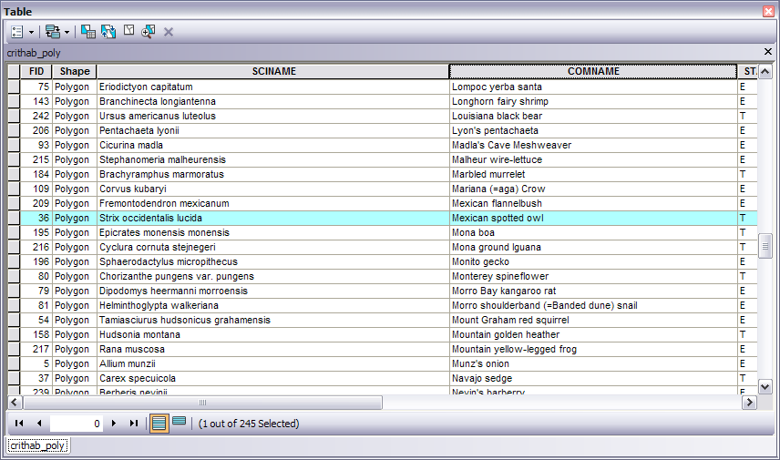
Editor drop down
Select By Rectangle
Table options drop down
Right click after editor start
Notes:
Now we add the critical habitat layer polygons. Do so now. Have the layer display as an outline with no fill. Just to mix things up a bit lets do a procedure we did in Module 3. 1) Click on the Select Features by Rectangle button and select the habitat polygon in our area. If it looks like everything on all layers is selected, drop down the table options in the top left corner and switch the selection. We just want the one selected 2) Go to the Editor tool bar. From the dropdown menu start editing, and when the warning window about spatial reference pops up just press continue. If you are in Arc10 a side bar will pop up on the right or a select target drop down box in Arc 9.x; with either make sure the critical habitat layer is the selected target. 3) In the table right click one the gray square next to one of the selected/highlighted names to bring up a sub-menu. 4) Choose delete selected.5) Go back to the editor toolbar drop down, save edits, stop editing and close the attribute table. 6) Refresh the map as needed and do our label annotation procedure with the field name ‘Comname’. You should now have the Mexican spotted owl on our map.

Slide 15
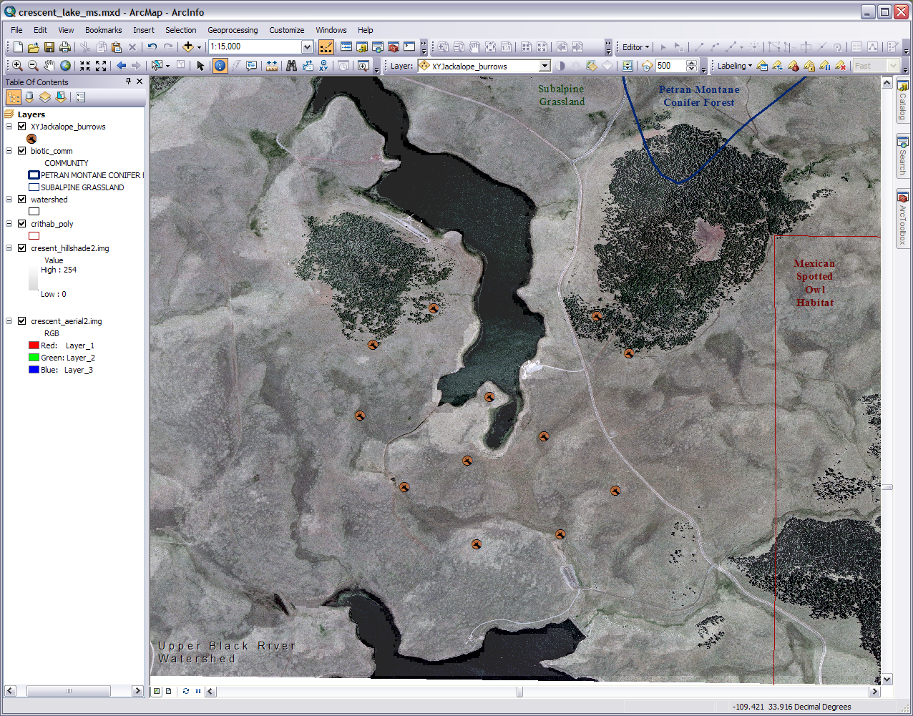
New layer from our GPS
Our collected waypoints
Notes:
It is hard to be planning to build a monitoring station on a site we have never visited. So let’s pretend we went out to the site and did a little bit of a visual survey. Let’s also say that we were also concerned about some of the wildlife near that south tip of Crescent Lake where we want to build. We went out there with our trusty GPS unit and marked (as waypoints) all the jackalope burrows we came across. Now there is third party software that will let us import those points directly into ArcMap as a new shapefile but let’s say all we could get off our GPS unit was a table of the coordinates. Further more because we had just a standard GPS unit any other fields of data wanted had to be entered into a separate table. In the end you were able to get everything into one table that we made in Excel but now the challenge is to get it into Arc (or you forgot the GPS for visit altogether and just have a table of data).
So we have our table, the Jackalope Burrows table from GPS (Jackalope_burrows.csv) link on the GRAIL webpage (note: this a nonsense table for education only). This table was saved from our table we made in Excel as a CSV (comma delimited) file. This a text file that’s separates your fields with a comma. You can look at this in Notepad if you want.
Here’s how to make this table into a spatial feature. 1) In ArcCatalog right click on our .csv file and Create Feature Class>From XY table… and a wizard will pop up. 2) In the X Field put the longitude and in the Y Field put the latitude if they are not already there and pick your output. It isn’t going into a geodatabase so it will come out as a shapefile. 3) Add a spatial reference by clicking on Coordinate System of Input Coordinates… and Select>Geographic Coordinate Systems>North America> NAD 1983.prj or if you want Advanced Geometry Options and use the map’s spatial reference. 4) Add the projection, press OK and OK, and let it process. We have to do it in a geographic coordinate system (GCS) if we are adding XY table data. 5) Once it has processed add it to you map. You can open up the attribute table and see that all the fields we had are now part of the shapefile. Now we know the locations and some things about the wildlife near our project site (OK so I got a little fancy with the icons. You can click the icon in the table of contents to change the display and choose the style environmental).

Slide 16
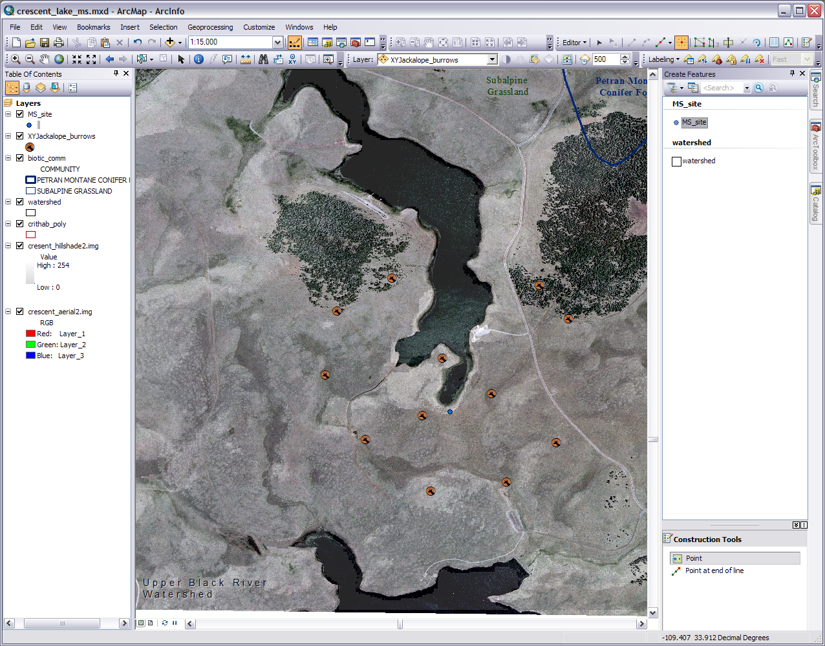
Editor drop down
Site layer
Organize templates
This looks like a good location
Our desired tool
Notes:
For our last layer we will be adding the monitoring station location we want to present to the Forest Service. 1) In ArcCatalog right click on your project folder and go to New>Shapefile. A wizard will pop up. Give it a name like ‘MS_site’ and make sure the feature type is a point. 2) Our data frame is in GCS NAD 83 so let’s use that for our projection (spatial reference). Click Edit>Select>Geographic Coordinate Systems>North America> NAD 1983.prj. Congratulations you just created a new shapefile. If it hasn't shown up move it on to our map and of course it won’t show anything because we haven’t added any data to it yet.
We are going to be using the Editor tool/toolbar again and agin if you are not doing this in Arc 10 you will need to translate these instructions in Arc 9.x speak or see below. 3) Now we can start the editor in a couple of ways but for this step right click on the layer name>edit features>start editing. Don’t worry about the caution widow that pops up and just press Continue. In the window that comes up on the right you probably won’t see our monitoring station layer we want to edit. 4) Click on the Organize Templates button. 5) Select the site layer and click New Template. Select the site layer again and press Finish. Our site layer now shows up in the editor window on the right so close out the templates window. 6) Select the site layer in the editor window and the available construction tools for that layer will appear at the bottom. It should default to Point which is what we want. 7) If you move onto the map we have a phantom arrow for our cursor. Move to a place you feel is suitable for our monitoring station on the southern tip of Crescent Lake and click to add the point. 8) You can now go up to the Editor toolbar and from the drop down save your edit and stop editing. Congratulations you just created a new point feature in your shapefile.
For Arc 9.x go up to the Editor drop down and start editing. Select the fat pencil on the Editor toolbar. Use this to pick a monitoring station location and click to add the point. Go back to the drop down to save the edits and stop editing.

Slide 17
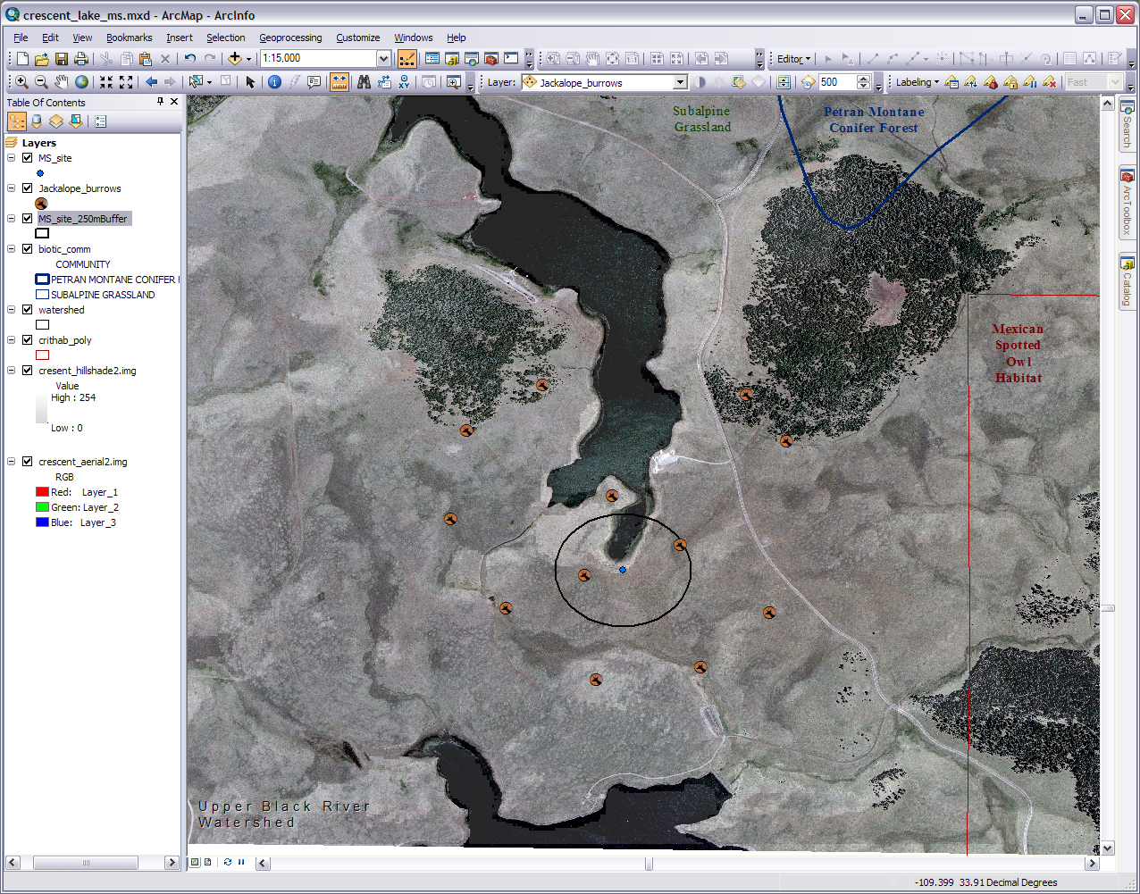
Has buffer tool
Buffer layer
250m Buffer
Notes:
We want to be aware of anything going on within say 250 meters of our monitoring station so let’s create a buffer around our point. In Arc 10 go to the Geoprocessing menu up top or ArcToolbox in any Arc version and select the buffer tool (under Analysis Tools>Proximity). Put the site layer in as the input, choose an output location and name, and for the distance put 250 meters. Don’t worry about the other stuff and press OK. When it is finished processing you’ll have a new shapefile on you map that looks like an oblong disc with your site in the center. Make the fill hollow and the outline the color and thickness you want. Notice the buffer is more of an oval than a circle. This is because Arc adjusted for the topography and landscape when making the buffer.

Slide 18
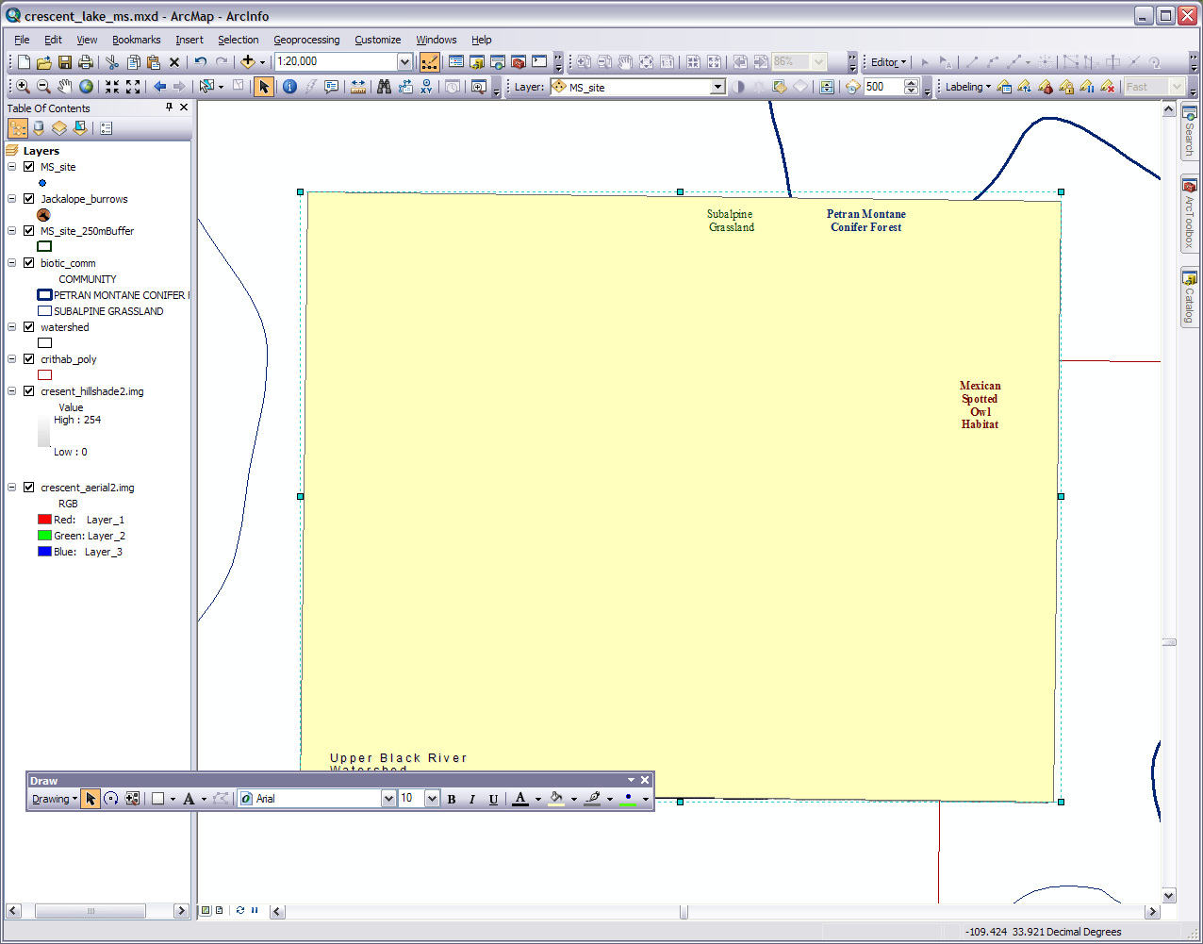
The rectangle I drew
Rotate & Move
Click here to draw the shape
Convert graphics to feature in this drop down
Notes:
One more thing before we go into the layout finishing. If we go into the layout now our critical habitats and biotic layers will be bleeding off the edge of our image. So we need to make a special shapefile to clip them. 1) Zoom out to where you can see the image and some white space about 1:20,000. You should also see our two rogue layers in the white space. 2) Turn on the Draw toolbar. Make sure you are on the rectangle, move the cursor on to the map area making it become crosshairs, and draw a rectangle around the edge of your image. You can rotate and move it to match the edges and angles. 3) Now go to the Drawing drop down and chose Graphics to Features. Use the data frame as the coordinate system, choose an output, and check delete graphics after conversion as we will no longer need the graphic rectangle. Press OK and you can but there is no need to added it as a map layer. Just remember where it is stored in the computer. 4) Go up to the Geoprocessing menu or ArcToolbox where we got the buffer tool and chose Clip. With the clip we’ll use the rectangle to crop our critical habitats and biotic layers. For the input feature chose the critical habitats or biotic layer. For the clip feature chose the rectangle. Pick your output. 5) Do the process again for the other layer. 6) Now add your new clipped critical habitats and biotic layers, make them look like the originals, and get rid of the old ones. Take the rectangle off your map if it is still on there. Don’t worry if things aren’t perfect. 7) Zoom back in and turn off the Draw toolbar.

Slide 19
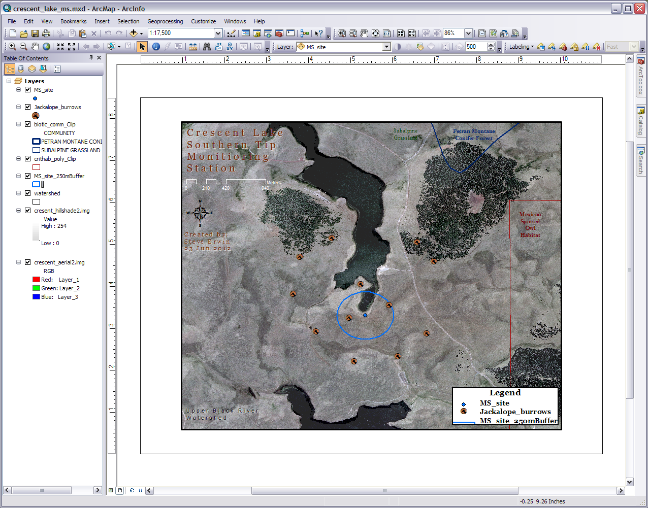
Change Layout
Different zoom/pan tools for data and layout
Switch to Layout
Notes:
So now we are ready to clean things up and present a GIS product to the Forest Service. Switch to the layout view. I’m going to turn off the Editor toolbar so my layout toolbar has plenty of room. At first glance our image doesn't look quite right. Well we’ll fix this. Press the change Layout button on the layout toolbar (second to last) and wizard for layout templates will pop up. Pick the one you want. I picked the letter landscape in the traditional layouts. This one starts me off with a legend (see where it says High Low), data frame scale bar, north arrow, text box, and title. I do need to fiddle around with the data zoom and pan tools and the layout zoom and pan tools in order to get my image correct (I put my layout at 1:17,500). switch back and forth with the data and layout views and move things around as necessary. Move your map elements like you scale bar and legend around till things look right and double click on them to change their properties. You can place elements in or outside of the data frame (right now I have all of them in but I think I will move some out). Look back in Module 3 for some layout tips and instruction. Again don’t worry if things aren’t 100% perfect. Use your imagination and try things out.

Slide 20
Congratulations!
From completing this workshop you now know how to create several professional GIS products
You can now:
Put it in a report
Use it in a planning meeting
Take clients on a site visit
Use it as a teaching tool
Frame and put it on your wall
And much more
Notes:
If everything is all set you can export you GIS product as an image, pdf, or print it. Congratulations on completing this Introduction to Geographic Information Systems workshop!

