Slide 1
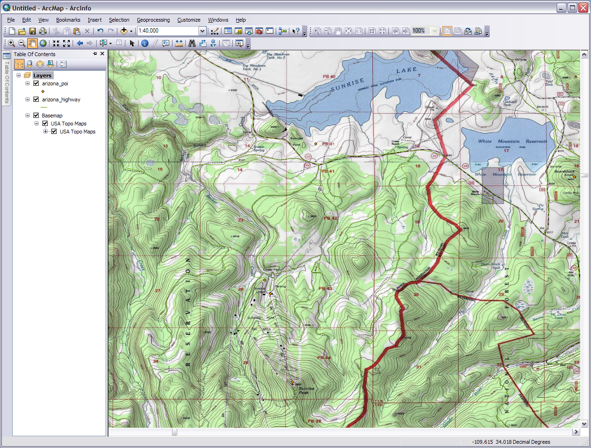
Introduction to Geographic Information Systems: GIS
Module 3: Basic ArcGIS Project
Created by: Scott Kelly 2010
Notes:
Welcome to Module 3 of GRAIL’s Intro to GIS workshop. In this module and the next we will be using the ArcGIS 10 software. For NAU users if you can’t find ArcGIS 10 on a lab machine you can access it by connecting to a campus virtual lab via remote desktop at windows.cenfs.nau.edu. Arc 9.x will probably work also and if you are unable to get to a machine with ArcGIS software and MapWindow GIS or Quantum GIS, free downloads, might work (I don’t know. I haven’t run this module with them and you will have to figure out the transition on your own).
We will learn about ArcGIS tools and interfaces, ArcCatalog data management, shapefile creation and editing, shapefile vs. feature class, and some spatial analysis. This module uses vector graphics and some tabular data but not any raster. We will walk through some of the steps in detail and if it is moving too slow for you just move on ahead. If you have ever drawn a picture of anything before then you shouldn’t have too much trouble here. Just remember that you’re the one drawing the picture. So let’s have some fun and make a GIS product.

Slide 2
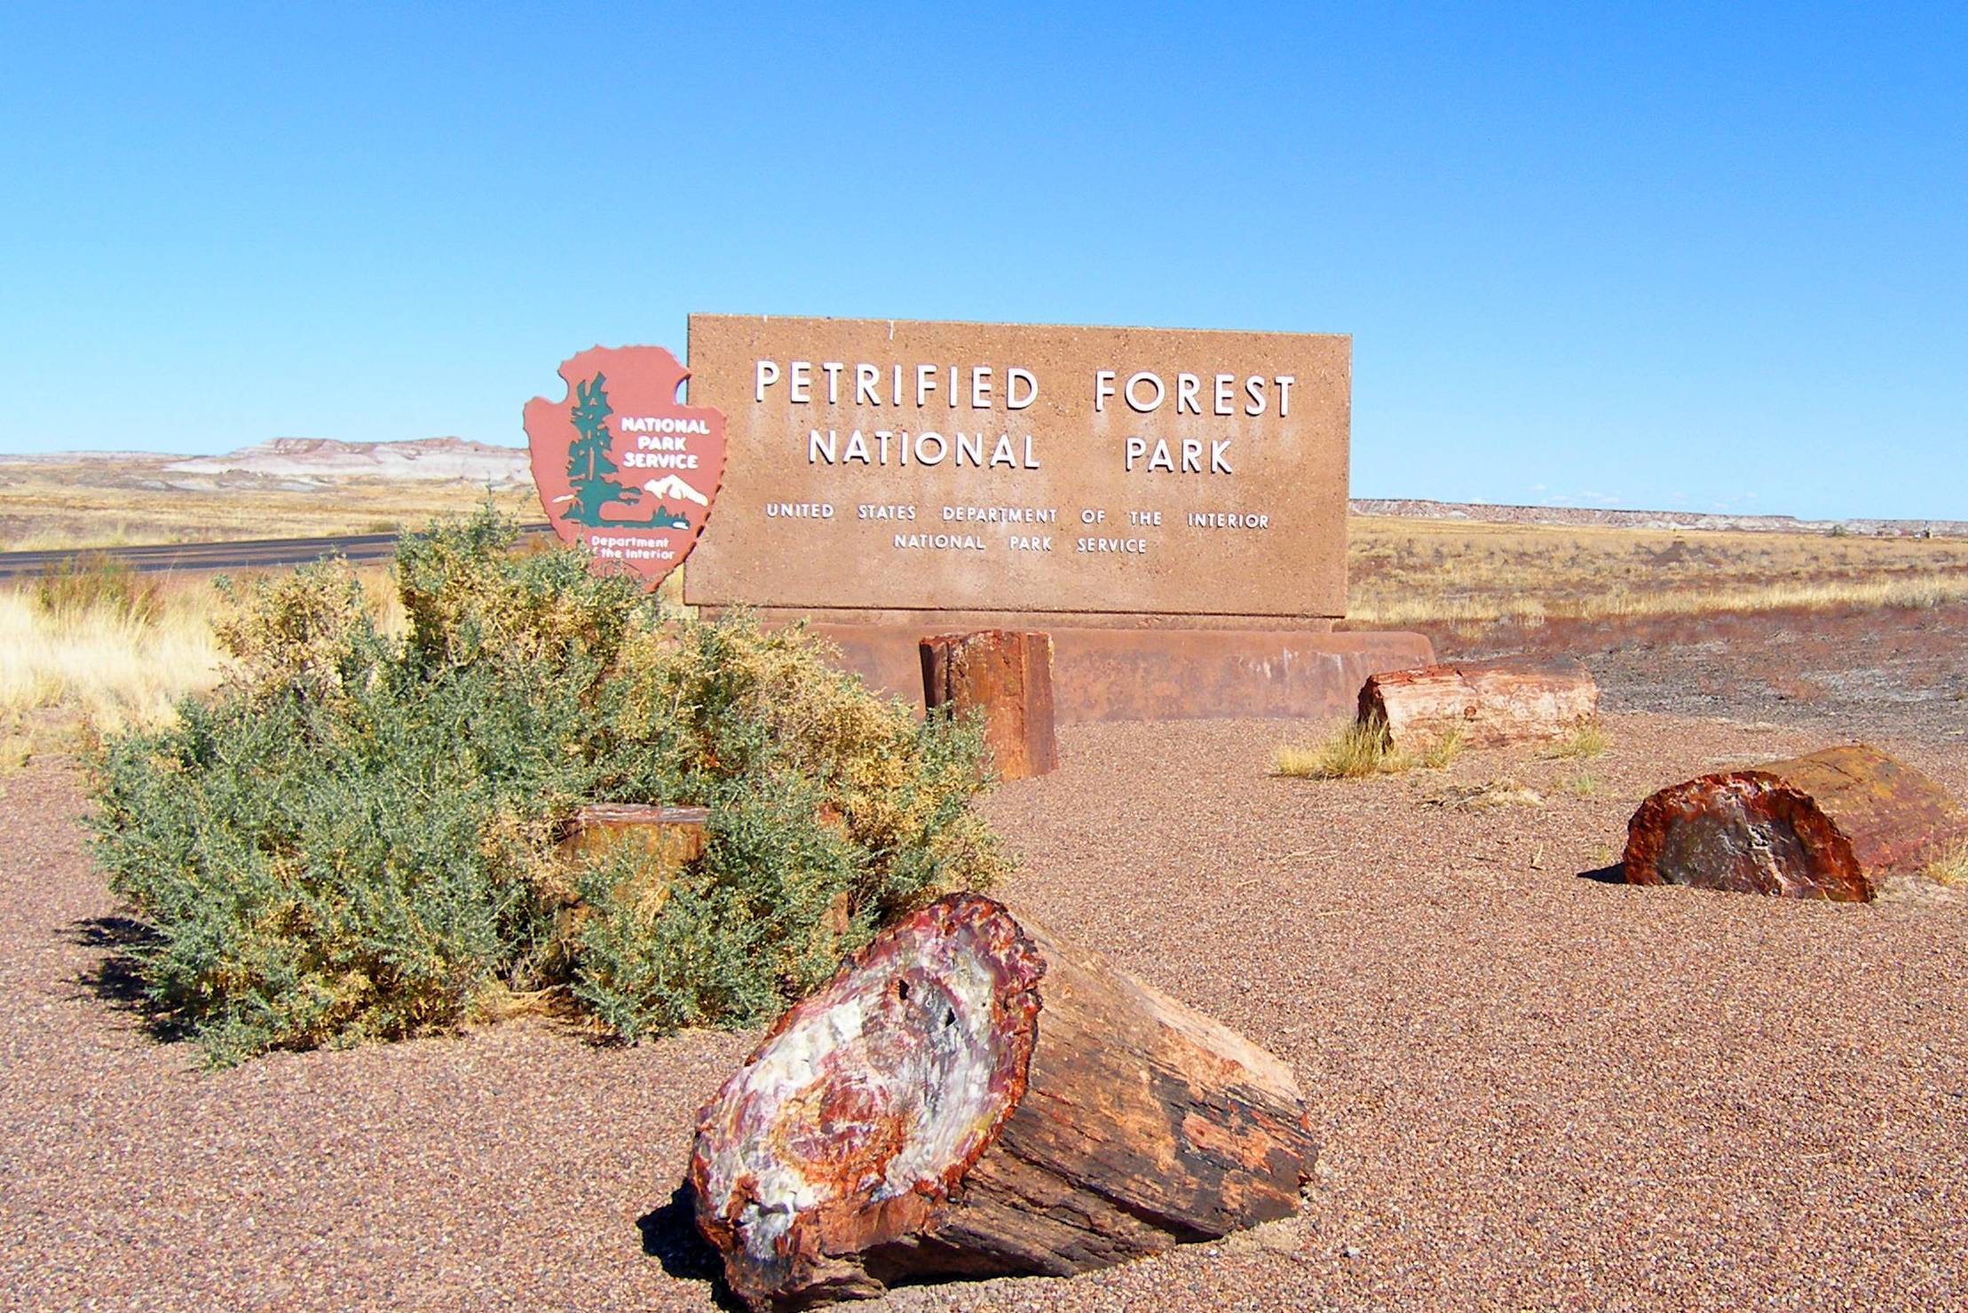
Notes:
The area known as Petrified Forest National Park has a rich history. The famous fossils’ reminisce of wetland antiquity, inner park petroglyphs and pot sherds weave tales regarding ancient pueblo peoples, and whispers echoing Harvey Girls and Route 66 linger in the winds. Today the boundary is bisected by interstate 40 near Holbrook. The park perimeter also contains and is encompassed by land under the stewardship of the Bureau of Land Management, Navajo Nation, state trust, and private American citizens. That is were you come in.
Our fabricated scenario concerns the park’s desire for the rearrangement of property ownership. It needs you and your excellent GIS skills to create some maps showing the proposed land swap. Let’s start by gathering the data we need and then moving to a bird’s eye view of the land situation.

Slide 3
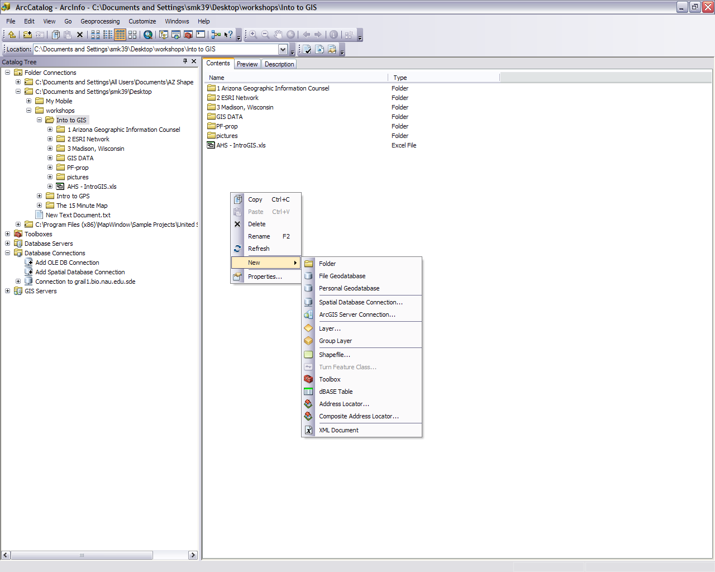
Connect to folder
This is my new project folder
Double click on this icon to connect to a database server
This what it will look like when you are connected to the GRAIL server
Notes:
Our first step is to get some data organized in ArcCatalog. While our scenario may be fictitious the data is real. ArcCatalog has many similarities to Windows Explorer (your basic file viewer window on a PC) but some things are quite different. For example: unlike Windows Explorer, ArcCatalog shows only the files you need to work with. It doesn’t show all of the support files that come with a shapefile because you don’t need to and shouldn’t do anything to those. When you change the shapefile or another file in any of the ArcGIS programs the support files are automatically adjusted.
So let’s Open up ArcCatalog and create a new folder where you want to be working from by connecting to a home folder or drive and right clicking in the contents area. A window will pop up giving you that option. I named mine ‘PF-prop’ and have it in an easily accessible area. We are going to copy some data in there next. We’ll need connect to the GRAIL database server where the data is so if you are already connected you can skip the next step but if you aren’t look at the next screen.

Slide 4
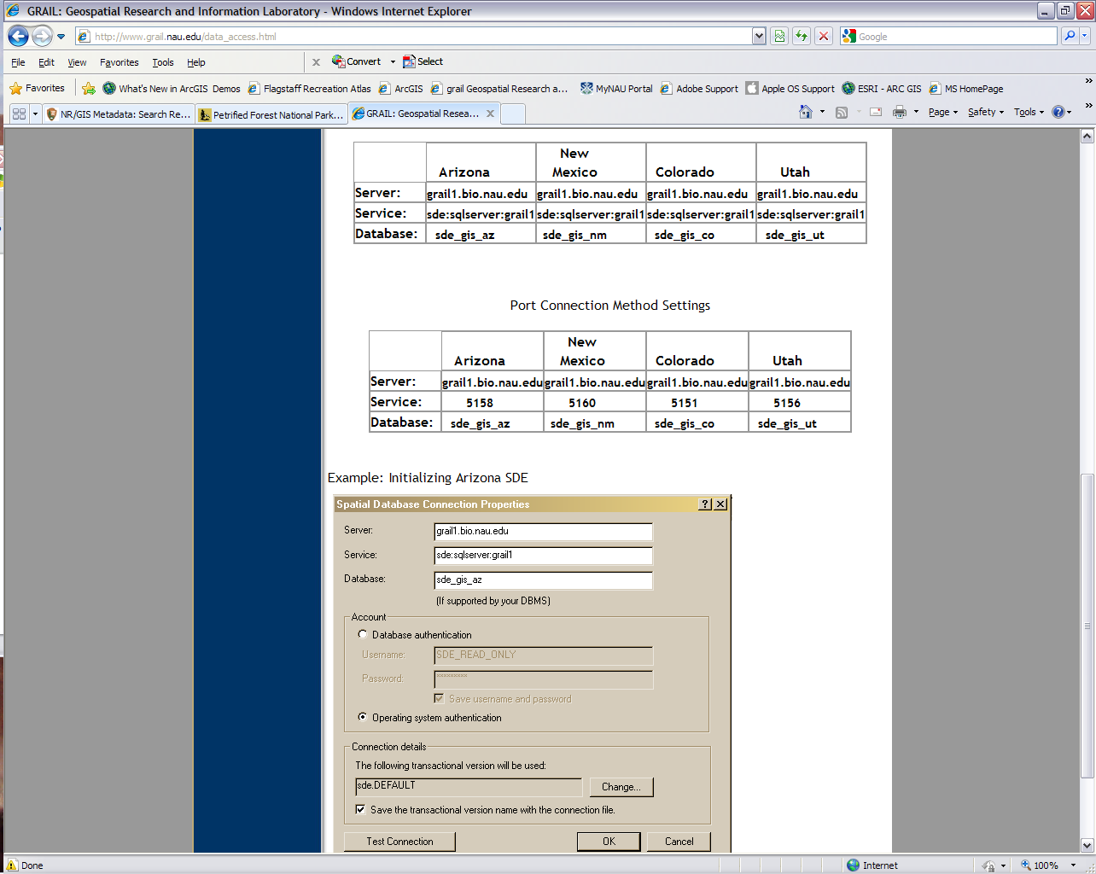
Notes:
To connect to the GRAIL geodatabase open your web browser and go to http://www.grail.nau.edu and then ‘get data’. Click on the ‘How To Connect to ArcSDE Geodatabases’ link. Scroll down and you will see the page that is on the screen. When you connect in ArcCatalog a similar wizard will pop up. Just fill in the blanks with what is on the screen. If you have trouble this, the page you are seeing on the web browser has connection instructions too. Switch back to ArcCatalog and double click on ‘Add Spatial Database Connection’ in the catalog tree to the left to connect. Now you should be connected to the database and have a folder to put everything into and work with.

Slide 5
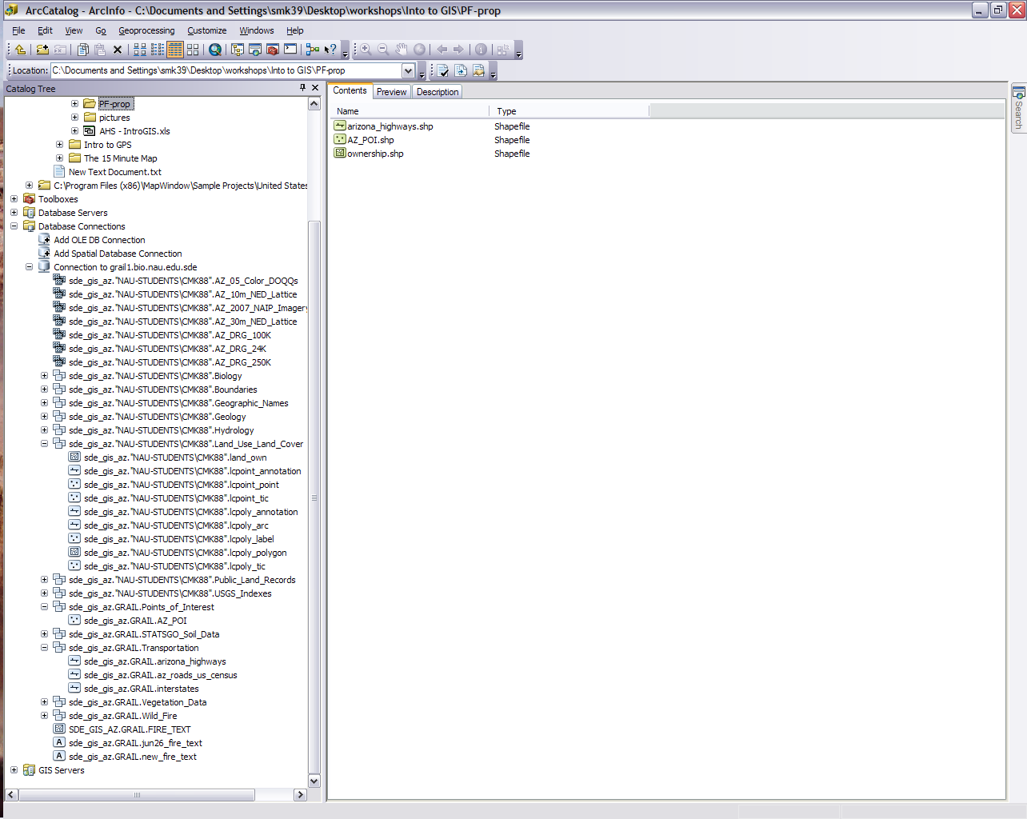
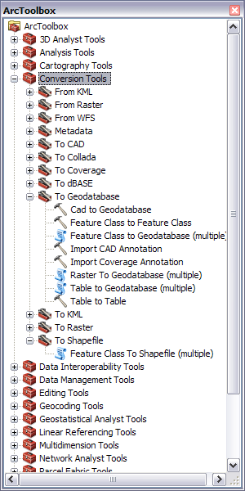
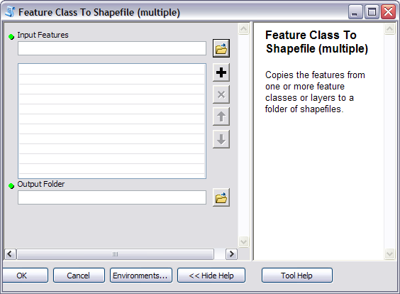
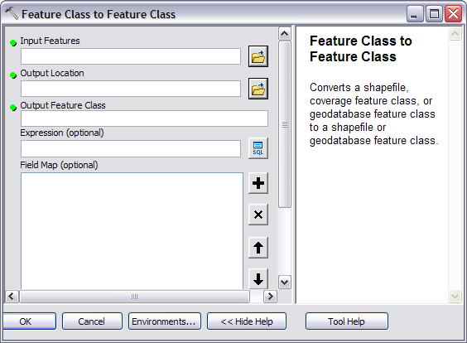
Another method to find tools
My working Folder
The resulting shape files
Finding the tools in the tool box
The 3 wanted feature classes
The tools used
Notes:
We can now to go into the server and pull out some feature classes (and you thought we were working with shapefiles). Well we are working in this project with shapefiles so let me explain. In Module 1 of this workshop we learned that vector images (points, lines, and polygons) are called shapefiles and feature classes in GIS. Speaking in general terms feature classes are vector files inside of a geodatabase and shapefiles are vector files outside of a geodatabase. Whether it is a shapefile or feature class it is still the same point, line, or polygon. For an abstract analogy think of it like feature classes are members of a union and shapefiles are independent contractors. This 10 step process goes pretty quick so here is the procedure.
1) In ArcCatalog open up ArcToolbox. 2) Drill down to Conversion Tools>To Shapefile>Feature Class to Shape File. A tool wizard will pop up allowing you to input multiple features. You will also need to select the folder you are working the project from. Make sure you selected a folder because it won’t let you select a file. You can select things by clicking on the folder icons on the right and drilling down to the destination. The input features we want are in the GRAIL database we connected to which is in the database connections folder. 3) The feature class inputs we need are arizona_highways under Transportation, land_own under Land_Use_Land_Cover, and AZ_POI under points of interest. Be sure you grab the feature classes and not the tables by these same names. 4) Make sure you have the right output folder and press OK. 5) Be patient and wait for the process to work. It may take a moment or two and I have yet to find a highly noticeable processing window for Arc 10. Now’s a good time to answer that text message you just got or get up a get yourself a hot chocolate. 6) When the process is complete your screen will refresh itself and you can open up your folder. 7) You may notice the feature class land_own (or any other) did not go through. Skipping a long explanation of why this happened we are just going to have to use another tool. 8) In the Conversion Tools go to To Geodatabase>Feature Class to Feature Class. The name my throw you off, but because we are putting it in a folder and not a geodatabase it ends up being a feature class to shapefile conversion. 9) This tool will only do one feature class at a time so put the land_own in the input, select your folder for the output, make a name like ‘ownership’ in the Output Feature Class box (no need to put .shp or anything), and press OK. 10) Make sure you have all three shapefiles and move on to the next step.

Slide 6
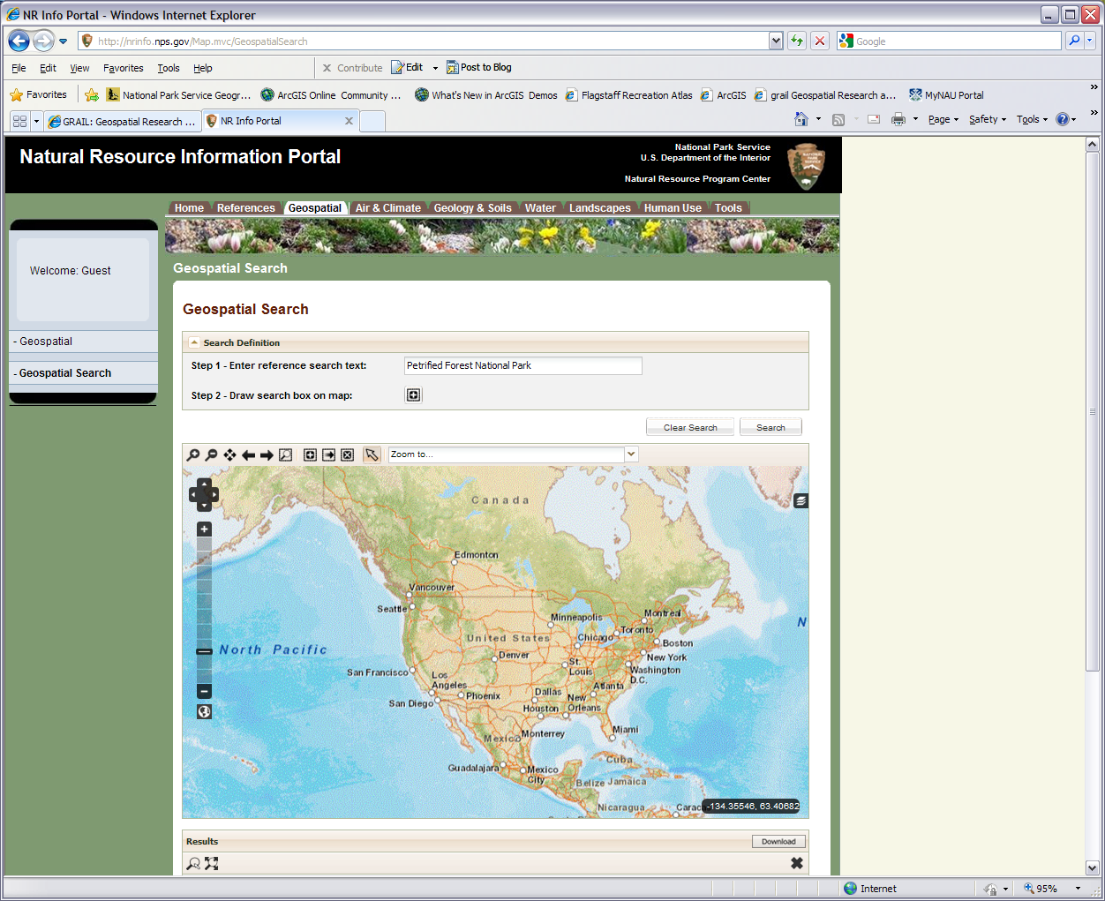
The forest is off of I40, just east of Holbrook, AZ
Notes:
Now let’s get some specific National Park data and we will be working with Windows Explorer for the moment. If you Google “Natural Resource Information Portal” and click on the Geospatial tab or go to http://nrinfo.nps.gov/Map.mvc/GeospatialSearch then you should end up on the web page shown here (formally the NPS Data Store). You can use the interactive map or type in a text search and press the search button on the right (recommended). No matter which way you choose, go to the Petrified Forest National Park (where the red arrow is pointed in Arizona) and take a look at the available sets of data (datasets).
Note: please try downloading the shapefiles listed in the next slide. This is to help you learn about how one part of online spatial data works. As with all technology things change and don’t always work. If you are unable to download the shapefiles feel free to download the support package associated with the module. It contains the shapefiles needed.

Slide 7
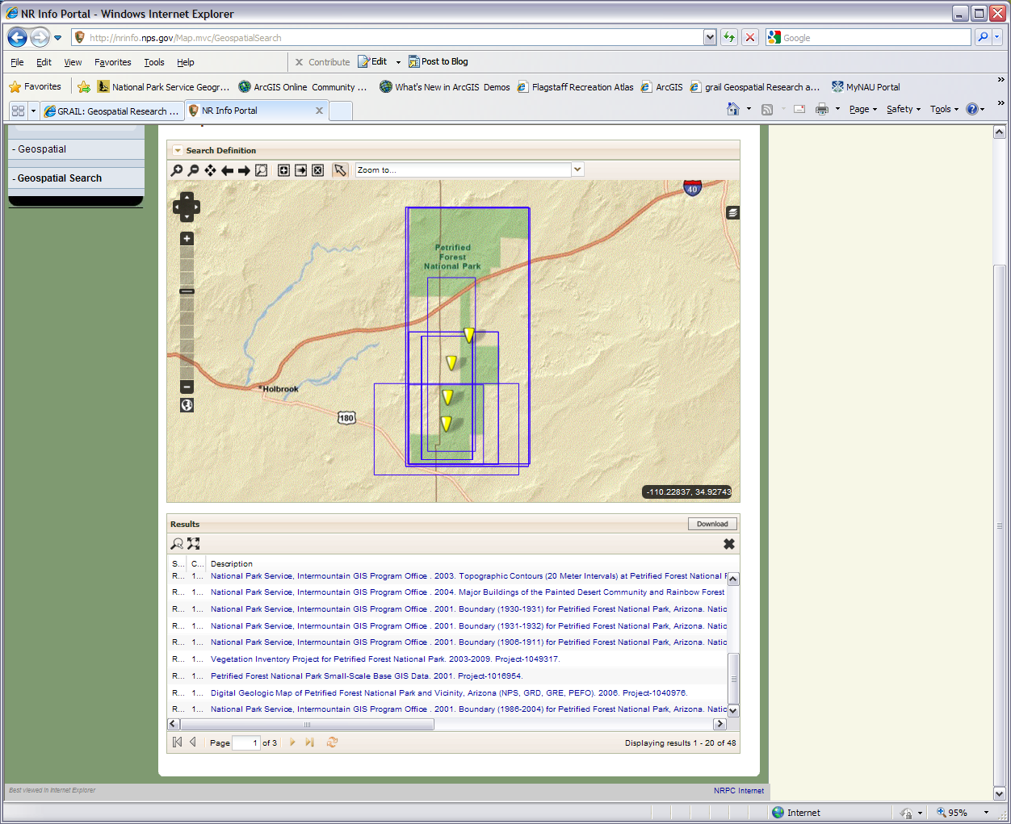
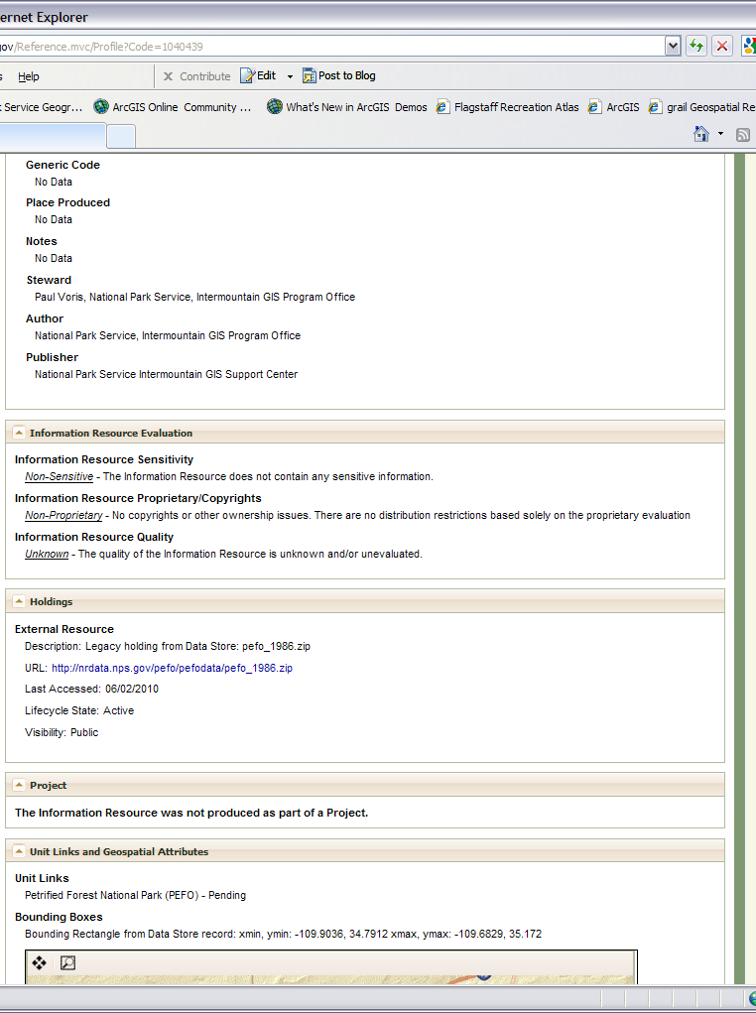
Click on one these links to bring up a reference page like the one on the right
Scroll down to here and click this link to download the zip file. Sometimes you will get to this page and the zip file isn’t there so you have to find another source outside the NPS
Notes:
After you press the search button and press OK the results will be shown at the bottom. This is just like any other table so adjust the columns so you can read the full description of each one (hover the cursor over the lines that separate the columns to get a resize handle, it may be a little difficult to do). You can also eliminate columns with the dropdowns. We are trying to get it where we can read the full descriptions. Use the slider bar as needed. It may take a while but get it so you can read the descriptions.
The goal is to get some data affecting the Petrified Forest and put them in our folder. Click on them and you’ll be sent to a reference/metadata page that has the actual download item in the Holdings section. We need to download the park boundary shapefile (called National Park Service, Intermountain Region GIS Program Office. 2001. Boundary (1986-2004) for Petrified Forest National Park, Arizona) typically at the bottom of page 1, Major buildings in the community shapefiles (National Park Service, Intermountain Region GIS Program Office. 2004. Major Buildings of the Painted Desert Community and Rainbow Forest at Petrified Forest National Park) at about the middle of page 1, and the park’s wilderness designated areas shapefile (specifically called National Park Service, Intermountain Region GIS Program Office. 2003. Wilderness Areas of Petrified Forest National Park, Arizona (Generated in 2003 by the Intermountain Region GIS Support Center)) usually the second wilderness dataset (the first one won’t work) on the top of page 2. For the boundaries, even if you have the shapefile covering the boundaries for all the places under NPS it will work just fine. All of these are compressed as .zip files.
When you have them downloaded we will need to decompress them in Windows Explorer because ArcCatalog won’t do that. In Windows Explorer you see that each .shp shapefile has several other files by the same name that do things like tell that computer what the projection is, the attributes, and so forth. DO NOT erase or modify these support files. These are hidden in ArcCatalog and are automatically adjusted as the shapefile is. When you have uncompressed the three files do some file management by moving all your shapefiles (with their support files) into the same folder and get rid of any unnecessary folders. You can then look in you folder with ArcCatalog and see you have six shapefiles and maybe one or two others like a .xml file which you can just leave alone.

Slide 8
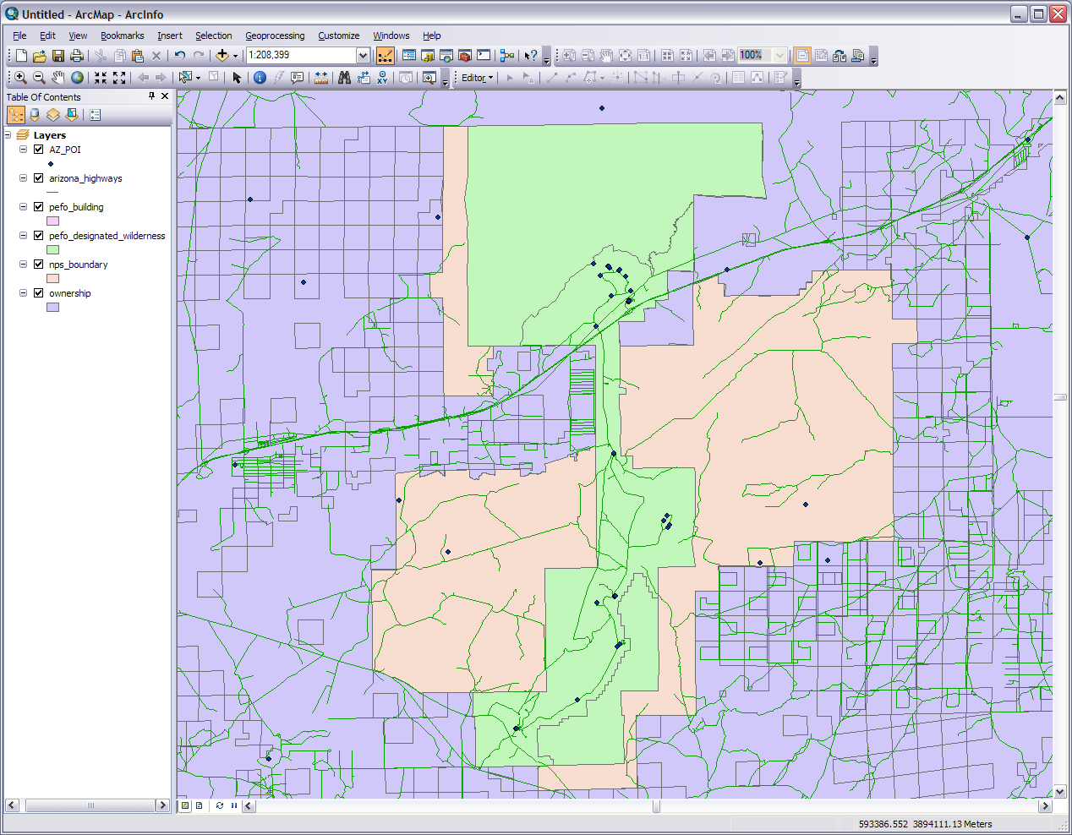
Standard
Layout
Editor
Tools
Add Data
I put my shapefile layers in this order. Just grab & drag to move
Data/Layout views and refresh buttons
Notes:
Let me clarify here why we just did these steps. Obviously we need to get these data files to show the proposed land swap. We copied the feature classes out of the database and off the website so that we could manipulate them without messing with the originals. Those originals are still back there to copy off again if we make an un-repairable mistake. We needed to make the feature classes into shapefiles because the ones we downloaded off the NPS data store were shapefiles and we are not using a geodatabase for this project.
Now that we have the data we need we can take a look at everything together. We may not be manipulating or significantly using every layer but having all the layers gives use a good reference. Open up ArcMap 10 (or the one you are using), close out of the start up window, and add all six shape files. You can do this by drag and drop from ArcCatalog, the Add Data button in the toolbar (+ over a yellow square), or in the file menu. I would recommend adding them one at a time. The entire map (data frame) will take the projection of the first one you added. When you add another that is in a different projection a window asking about projection and transformation will pop up. Just press Close as we won’t get persnickety about projections in this module and everything should line up where it is supposed to be anyway. If you get a message saying a layer has no projection file look at it in Windows Explorer and see if there is a .prj support file. You may have possibly downloaded the wrong .zip wilderness file or just need to reacquire the file. In any case if you are not already, zoom into the Petrified Forest National Park using any method you like. An easy way is to right click on the NPS boundary layer name and open the attribute table. Scroll down to find the park, select it, and ArcMap will zoom right to it. You can also right click on the wilderness layer and zoom to layer. At first it will all look something like the ugly mess we see here. We will take care of this in the next step or two.
If this is your first visit to ArcMap let’s do a quick orientation tour. Your view may not be the same as mine as ArcMap is customizable but you should be able to recognize different things even if the placement isn’t similar. The toolbars you will need to be aware of for this module start on the top left underneath the menus; this is the Standard toolbar with the “Add data” button (a black cross over a yellow diamond).The Tools toolbar I have in between my sidebar/main window and menus/Standard toolbar. Immediately to its right is the Editor toolbar. Right above that is the ghosted out Layout toolbar. Tucked in the bottom corner of the main window are the data, layout, and refresh buttons. If you don’t have any of these tool bars showing you can go to the menus and click view or customize>toolbars. You can also grab the handles at the end of the toolbars and move them around.

Slide 9
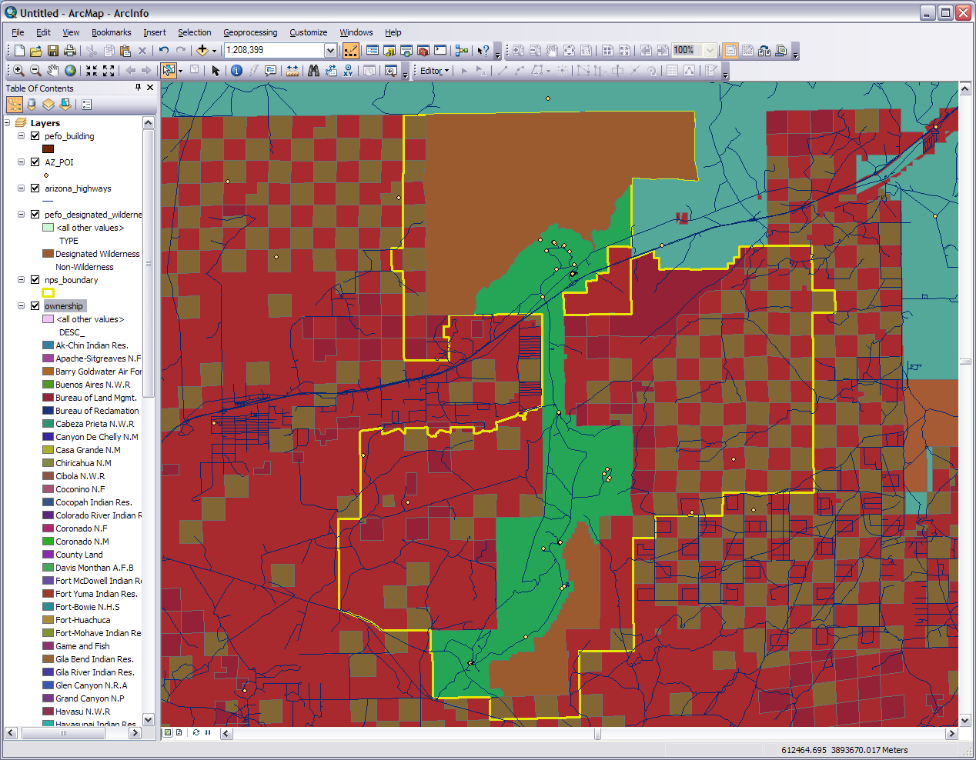
Notes:
Time to clean things up a bit. You can turn on and off the layers by clicking the check marks next to the names but for now let’s leave everything on. Modifying the appearance of layers will without a doubt help with working with the map and the appeal of our final product. Put the cursor over the colored box under the nps_boundary name in the layers sidebar. Left click the box and a window will pop up. This window is pretty intuitive so go ahead and set things the way you want. The thing we do want is no fill and just an outline color. Make it thick and colorful enough to be visible, presentable, and readable. Do the same thing for the other layers. Work with the colors, fills, and outlines in the layers. Use your imagination.
For the wilderness layer we want to show the north and south areas of the park that are designated as wilderness areas. Here’s what you do: 1) double click the layer name to bring up the properties and go to the symbology tab. 2) Click Categories>unique values on the left side and in the value field drop down to ‘Type’, 3) Click the Add All Values button, uncheck <all other values> (or do no fill), and double click the non-wilderness colored rectangle. 4) Make the non-wilderness with no fill. An outline is OK but not necessary and I’m not putting one in. Represent the designated wilderness type however you want. Press apply and if you like the results press OK. 5) For your land ownership layer access the symbology tab the same way. What we want in the value field is ‘DESC_’ and press Add All Values and Apply. Keep the same color ramp, choose another, or choose the same to change up the colors. When everything is good press OK. We’ve cleaned things up somewhat but we need to fix the ownership layer. Go to the next screen

Slide 10
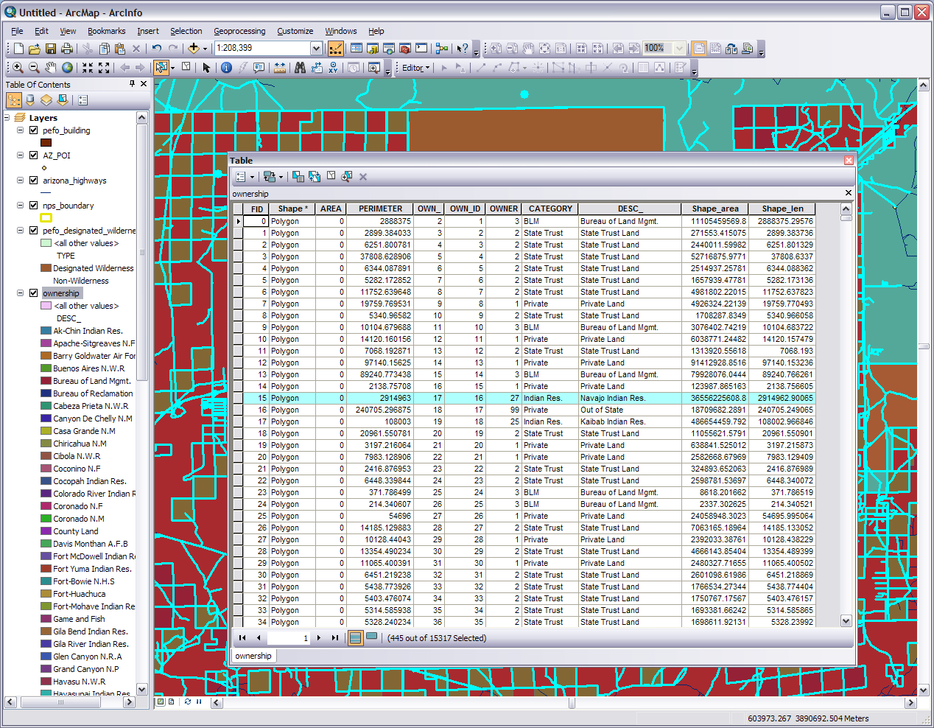
Editor drop down
Select By Rectangle
Right click on the name to open the attribute table
Table options drop down
Right click after editor start
Notes:
What we could have done instead of adding all the values to the symbology was just add the ones for the area we working with, however we may not be entirely positive what they are. In this next procedure we select the ownership types in our area, get rid of the ones we don’t need, and clean up the layer appearance. There is more than one way to peel a potato but this how we are going to do this one.
So 1) Click on the Select Features by Rectangle button and draw a big box to select the entire area. It will look like everything on all layers is selected. 2) Right click on the ownership layer name and open the attribute table. You will see that what we selected shows up in the attribute table with the same blue highlighter. 3) Drop down the table options in the top left corner and switch the selection. 4) Go to the Editor tool bar. From the dropdown menu start editing, and when the warning window about spatial reference pops up just press continue. If you are in Arc 10 a side bar will pop up on the right or a select target drop down box in Arc 9.x; with either make sure the ownership layer is the selected target. 5) In the table right click one the gray square next to one of the selected/highlighted names to bring up a sub-menu. 6) Choose delete selected and because we switched the selection all the ownership types that are not in our area will be ousted. If we weren’t in editor mode this delete option would be ghosted and unavailable. Notice the number of records goes down from 15,317 to about 445. 7) Go back to the editor toolbar drop down, save edits, stop editing and close the attribute table. Congratulations you just edited a shapefile. 8) Go back to the symbology tab in the ownership properties, remove all values, add all values, and mess with the color ramp till it is where you want it. Also mess with the other layers to balance things. Don’t worry if some ownership types around the edge of the data frame got accidently deleted.

Slide 11
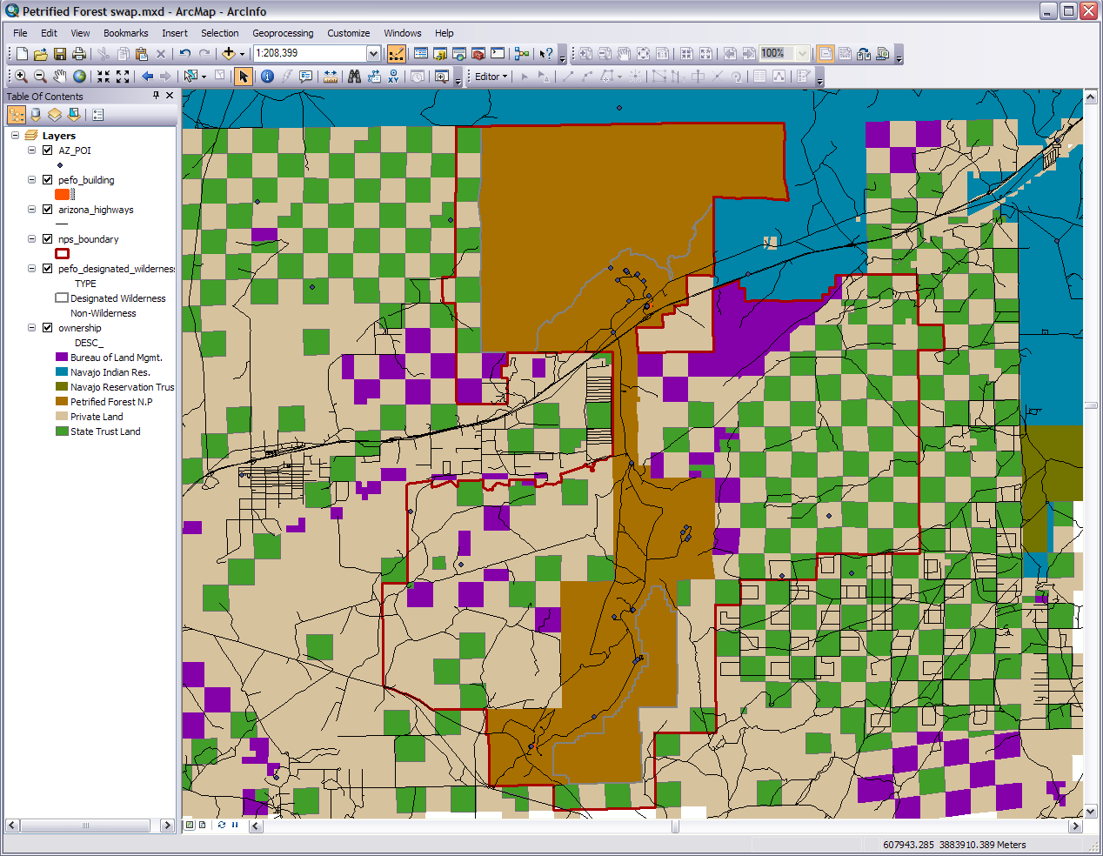
Notes:
Now our data looks much better. I have done a little more color and layer rearranging till it looks presentable. At this time we can tell which tract of land belongs to whom and where the red park and gray wilderness boundaries are. As you can see there is a plethora of parcels in and around the park that belong to various owners.
At this point we might want to save our work if you haven’t already. As with any computer work it is good to save it periodically as you go along. Saving in ArcMap is a little different than say saving in PowerPoint. The normal save/save as in ArcMap saves your work as a .mxd file. The .mxd file has what layers are in your map, where they are located on your computer, how they are configured on your map, what order they go in, and so on. What is being saved is the definitions found in your map; not the images and data of your map. Several different types of programs do this so that a map or other digital product is kept down to a manageable memory size, makes the product very workable, and the product isn’t duplicating the images already on your computer. If you want to have your map saved with the images you need to export the map. You usually wouldn’t do that till near the end because then it becomes a just an image without layers and is no longer directly useable by a GIS. You can of course save the map at any time and it is very good to have it in a .mxd file so that you can make changes to it when needed.

Slide 12
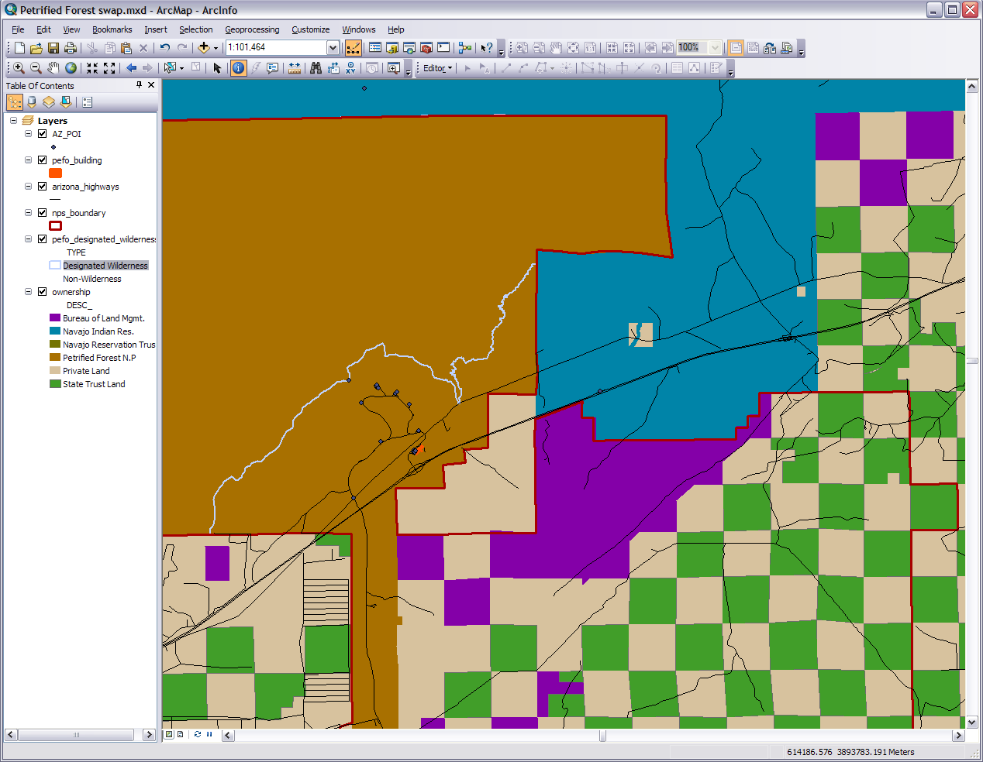
Zoom tools
Zoom to previous extent
Visitor Center & Entrance
Route 66
The Gap
I-40
Notes:
We have our data all set up so zoom in to the northeast area around the park. In this area we can see that there is gap between the park’s land consisting of private land and reservation. The proposed swap is to close at least some of that gap without touching the wilderness areas or decreasing the park boundaries. To keep things simple let’s just focus on acquiring the patch of private land near the north entrance I’ve drawn a circle around. Luckily the Bureau of Land Management (BLM) is our ally in the Department of the Interior so we can use some of their lands to bargain with (in our fictitious scenario of course). Let’s zoom back to our last extent and do some spatial analysis.

Slide 13
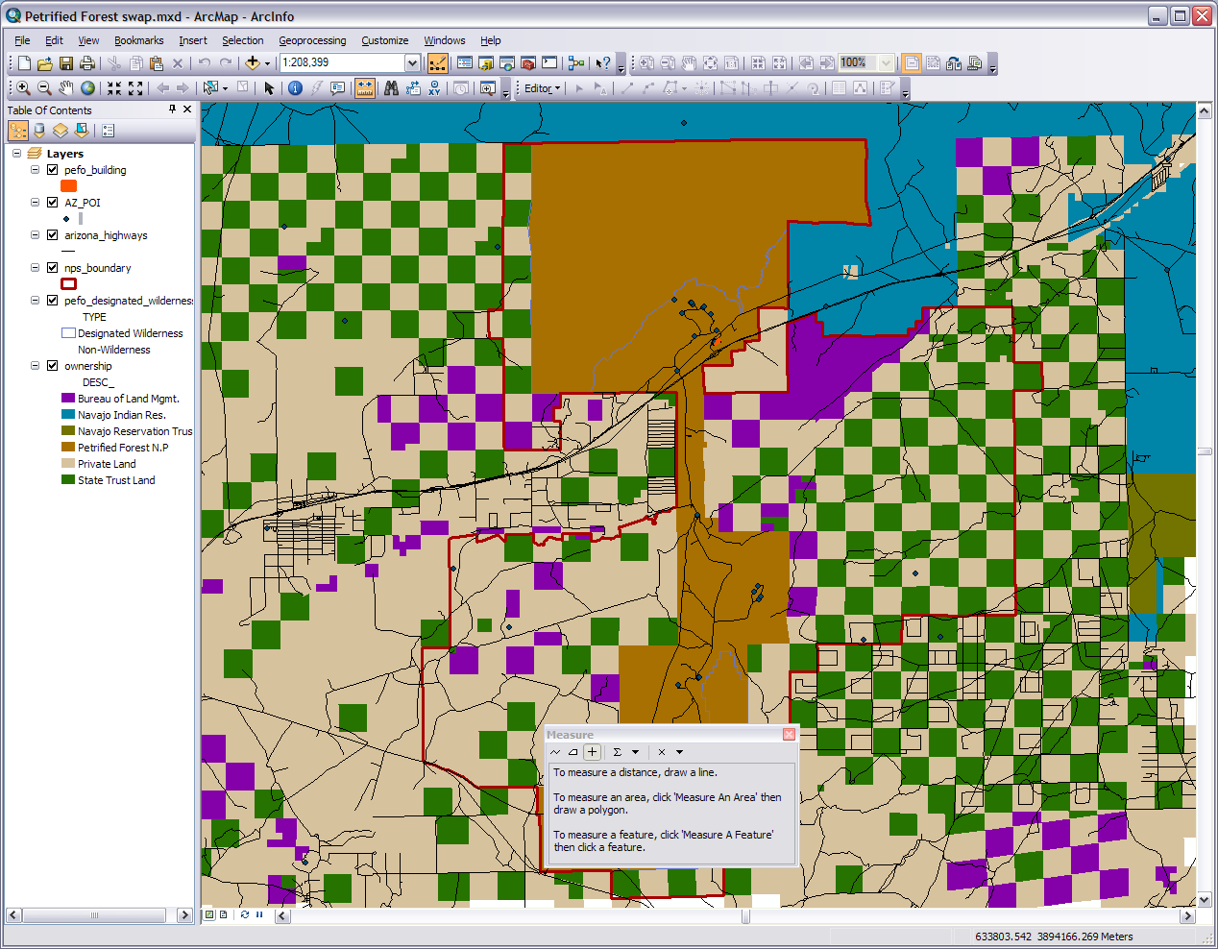
Measure button
“Measure A Feature”
Drop down for unit types
“Measure An Area”
Notes:
First we need to know the area of the gap. At least a good estimate of the numbers We can take the measurement tool and measure the gap. When we click on the measure button on the tools toolbar the window at the bottom of the screen pops up. If we choose ‘Measure A Feature’ all we have to do is put the crosshairs over the feature in the shapefile layer we want to measure and the analysis will show up in the measure window. You can set the unit type in the Σ drop down menu and clear things with the X.
If we put the crosshairs over the private land parcel the measurement is not affected by the park boundary as it is a separate layer. So we get the measurement of that irregular steps shape and the square of private land underneath, which is all one feature in the ownership layer. Seeing as this is Arizona let’s set the area units in acres and round off the decimals. We can just ignore the perimeter measurement. When I clicked in the larger area and rounded the decimal I got about 4,264 acres. We will need to put our numbers in a spreadsheet (table), write them down, store them on a calculator, or record them elsewhere.

Slide 14
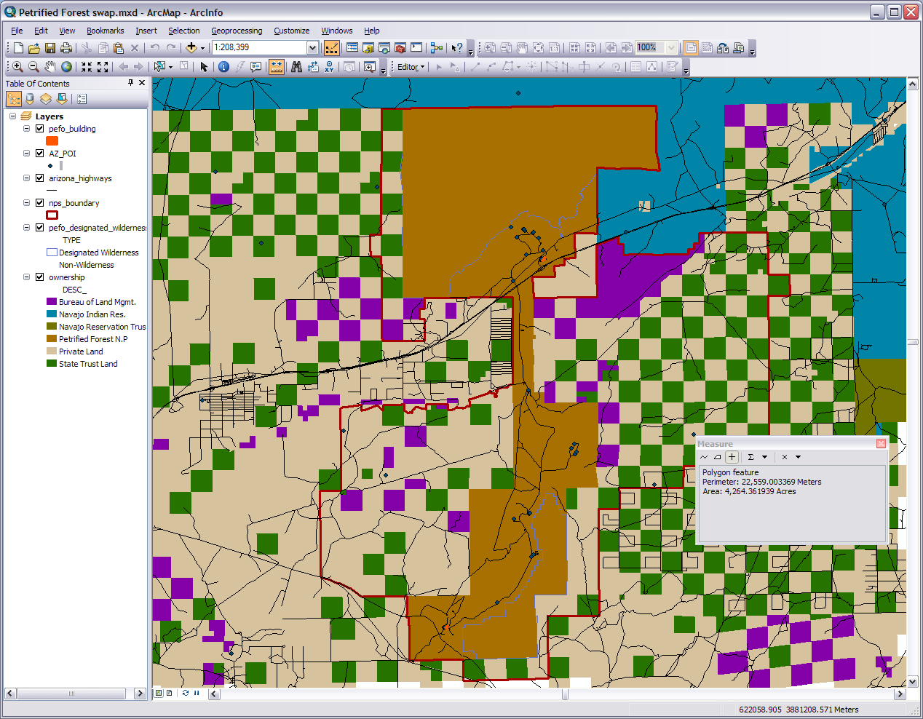
Notes:
Second we are unable to swap any of the national park land so we have to find enough BLM land outside of the park boundaries for the job. Let’s do some more measuring. Since this is a made up scenario we are pretty free to do any horse trading we desire. Any BLM land outside the park for any other. Using any leverage you want but I’ll show you what I’m going to do.
Those four BLM squares just outside the park boundary on the left somewhat upper side might be a good start. From those four I get a total of 2,566 acres, so far so good. Remember we need at least 4,264. Why don’t we add the two shapes next to our first four and those three squares on the bottom left edge of our data frame. If your are having trouble getting measurements or get numbers that don’t make sense try messing with the other layers by turning them off or temporarily removing them. Now we are up to 5,428 acres which is almost 1,200 over. This will definitely help sweeten the deal and we really want this land. Keep track of these nine BLM parcels as we are going to do some moving around. You might be able to come up with a better land swap than this so feel free to try different combinations.

Slide 15
Switches to layout view
Notes:
Now that we know what land we are going to swap for what land, it is time to turn to output focus. For our final GIS product we are going to put a map of current land ownership next to a map of the proposed swap. While another program like Adobe InDesign might be more professional let’s use PowerPoint because that’s one most people are familiar with and it is easy to work with. If your viewing this workshop in PowerPoint then you might want to go through the steps first and then print them out instead of going back and forth.
In ArcMap switch to the layout view with your current map. You can build your first output map by selecting Insert from the list of menus. We and to add a title, north arrow, legend, and scale bar. Adding the title and north arrow is easy but the other two take some figuring out which we will do in the next screen. For the title put something like “Current land Ownership” and for the north arrow take your pick. You can change the title font and other things by double clicking on the title>Change Symbol or just leave the title off and put it in when you move the map to PowerPoint. For the north arrow if you need to change things just double click it for the properties. I also see in this screen capture our 3 pieces of BLM land are not visible. If we select the pan tool (white hand) we can move the map around inside the layout frame. Move it so the three BLM squares are able to be seen on the left and the gap is still visible on the right. You may need to adjust the zoom too. If we select the layout frame with the black arrow pointer we can resize the frame. I pulled down the frame on top a little to add some white space for my title.

Slide 16
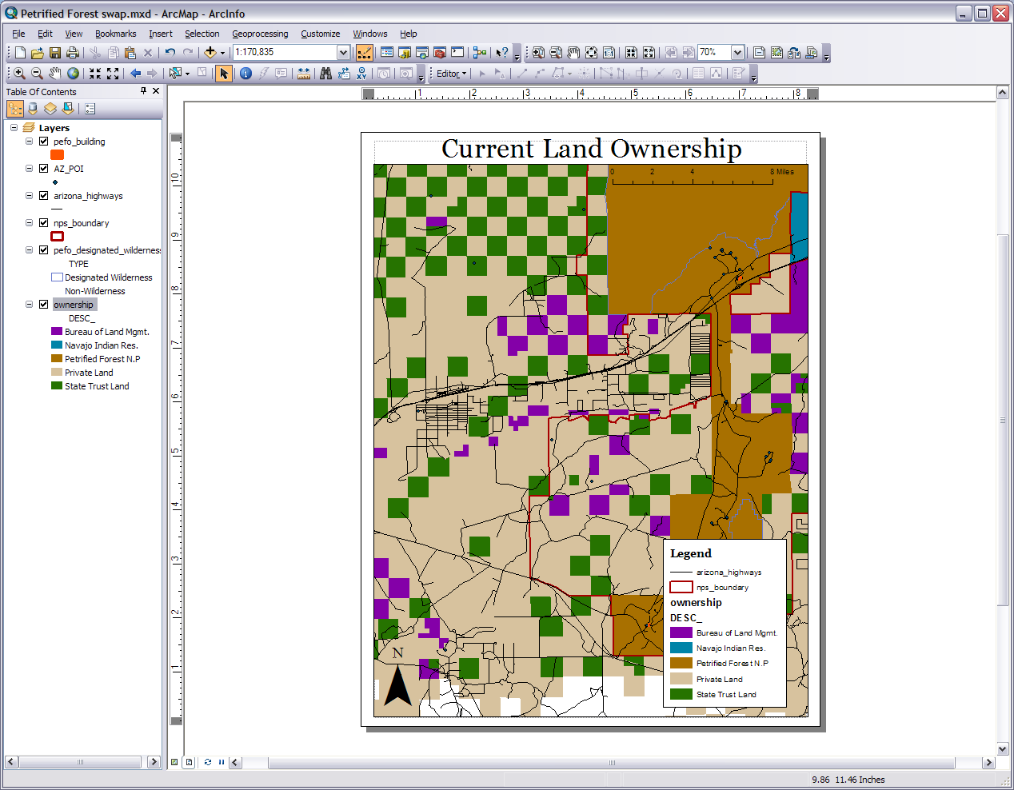
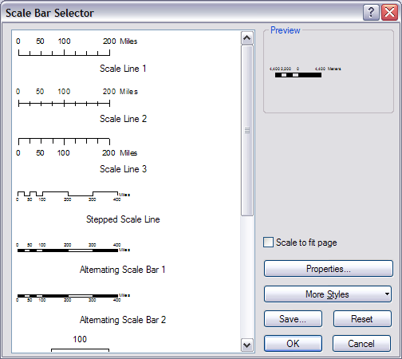
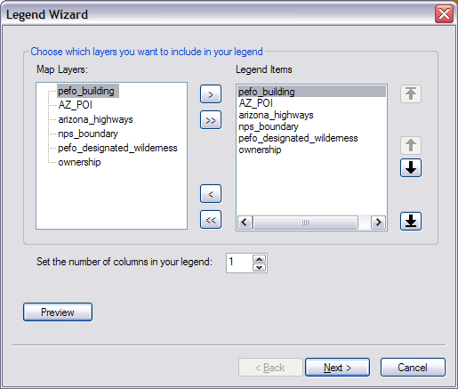
Notes:
When you select the legend a wizard will pop up. It will first ask what layers you want in the legend. Move the layers that will be included as legend items by using the arrow buttons on the wizard. Pick whatever you would like but be sure to include your ownership layer. Press next. Choose the title if you want. Press next. Currently there is no border or background so you have to pick from the dropdowns if you want a black boarder with a white background or whatever you like. I like to wait till this point before pressing preview but you are at liberty to do this at any time. You may have to move the wizard out of the way. I see on my legend the wilderness area is taking up too much space so I’ll press the back button on my wizard and change that. This does not change the other settings. Now I can press preview and finish if I want or there are two settings about spacing in the legend if you desire to mess with those. I put my legend in the corner where it isn’t interfering with the pieces of land I want the focus to be on. I got rid of items on the ownership layer by going back to the symbology and removing them. It will change them in the legend as you change them in the layer.
The scale bar has a pop up window. You can just pick one from the list or click ‘Properties…’ to customize. Once you place it double click to bring up the properties. If you need to make it longer to show more distance measurement just single click and grab the handles to lengthen it. ArcMap will adjust the numbers accordingly. I ended up placing my scale bar over the national park land at the top so I could see it.

Slide 17
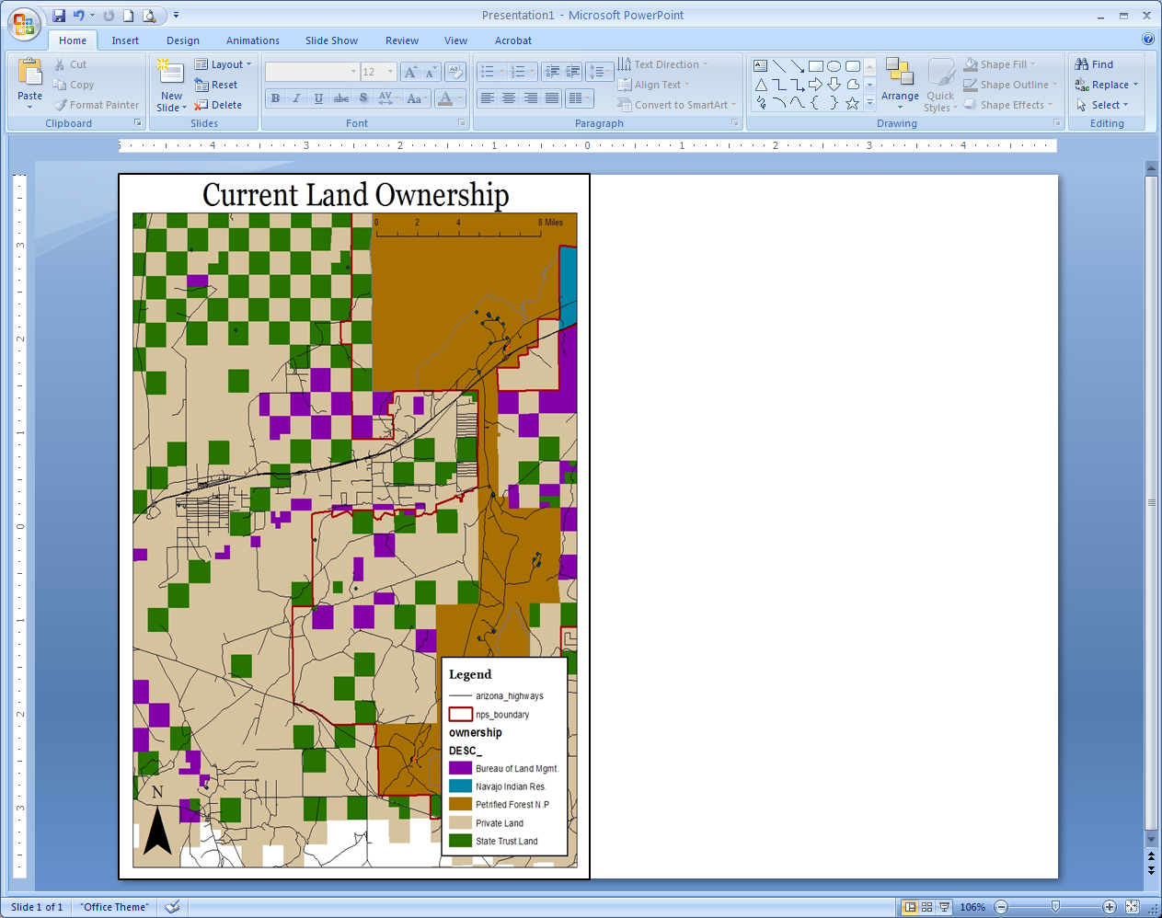
Notes:
Now we will export the map to PowerPoint. Go to file>Export Map. The export wizard will pop up with jpeg as the default. Go head and save it as a jpeg with the default dpi and give it a name. There are also many other options you might want to be aware of for other projects. Remember when you export/save it like this you are turning it into a layer-less flat image that has no geospatial reference. Don’t worry because that is what we want and our .mxd file still exist.
After you have saved it go into PowerPoint and Insert>Picture. Put a boarder on it and adjust it to cover the left half of the slide. Remember to keep it in proportion (scale using the corners) or the scale bar will become inaccurate. We are only using one slide so you can close out the side bar on the left. Save the PowerPoint according to your desires. You can close it or leave it open but we are coming back in just a bit to put in the second half.

Slide 18
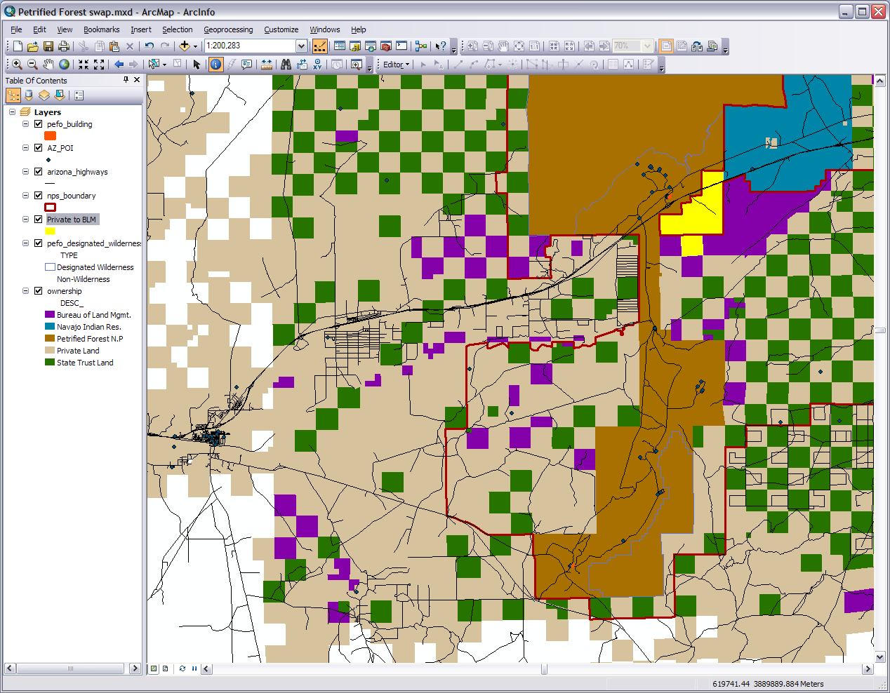
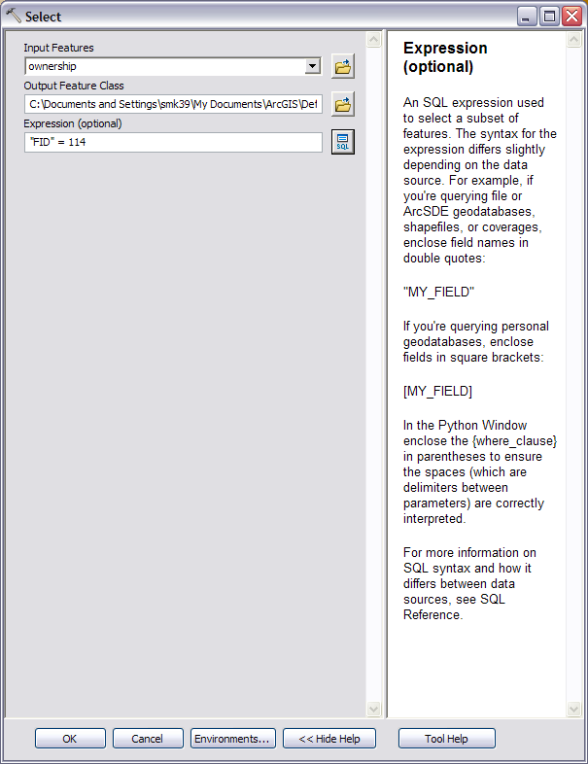
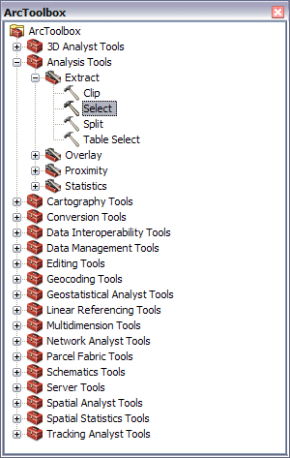
ArcToolbox
ID Tool
Our new layer
Our new layer
Notes:
Go back to ArcMap which should still be in layout view. Leave everything as is in layout view and switch back to the data view. We are going to show the land swap with some spatial analysis. We are going to start with that spec of private land in the gap.
Here is the procedure: 1) use the identifier tool (the white i in the blue circle near the measure tool on the tools tool bar) and click on the private land to get the FID number (it should be 114, you could use any other field but let’s sick with this one). Close out the ID window if you want. 2) Open ArcToolbox and do Analysis Tools>Extract>Select. 3) In the tool wizard do the ownership layer for the Input Feature and for the output name choose something like ‘Private to BLM’ and put it in your folder. For the expression press the SQL button. Double click on the FID field, add a space, click on the = button, add a space, type in114. Your expression must be: “FID” = 114 in order for this to work and cutting and pasting from another program is not recommended. Press verify to make sure it is a proper SQL expression. If it is press OK. 4) If everything is setup for the tool press OK. Be patient as it may take awhile for the tool to process. Again I have yet to find an awe inspiring progress progression window in Arc 10 except the brief one that shows for a moment at the bottom. 5) Your new shapefile layer will pop up in your data frame so make it stand out. Congratulations you just created a shapefile.

Slide 19
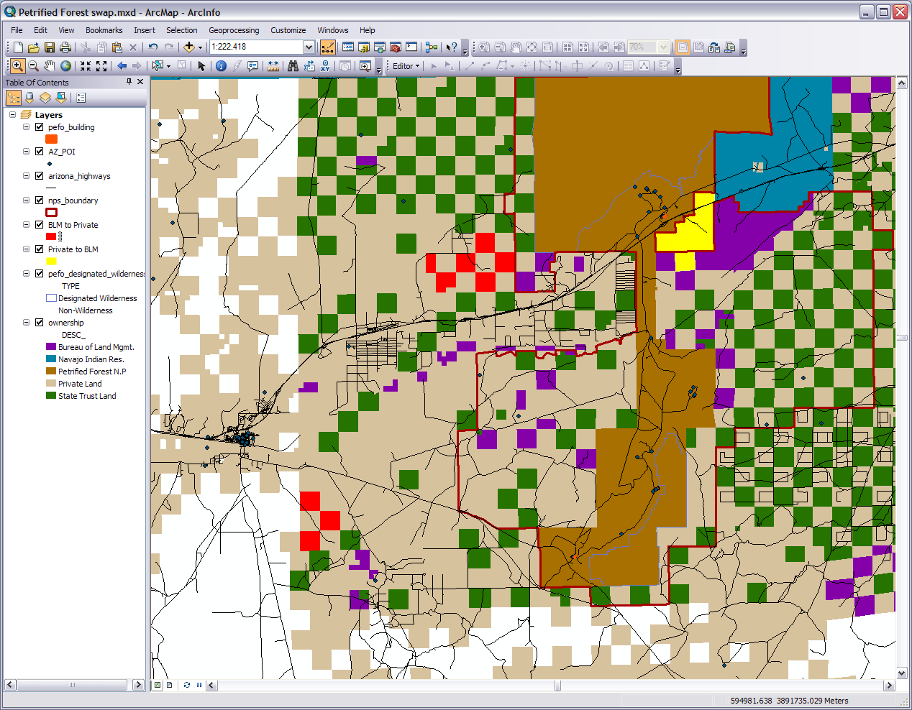
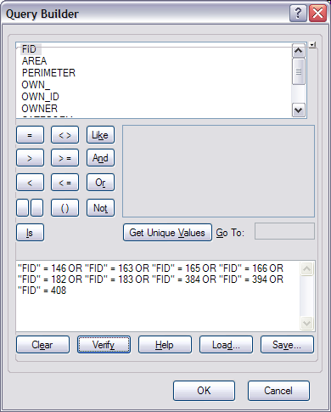
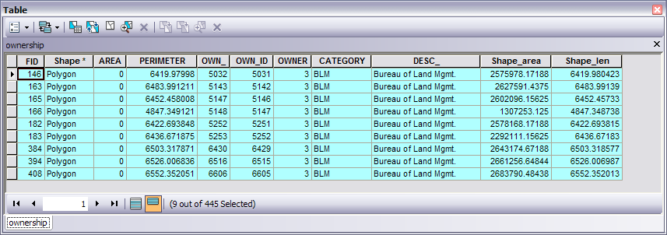
Select By Rectangle/Features
Our new layer
Show selected records
Notes:
We are going to a similar thing for the BLM land we are trading. 1) Choose the Select Features tool on the tools toolbar and click on each of our nine BLM parcels we are trading. Hold down the shift key to select multiple features and click again to deselect. Go back about four or five screens if you don’t remember which ones they were. It was the four squares and two smaller odd shapes on the left edge of the park boarder along with the three squares on the bottom left. 2) Once all nine have been selected open the attribute table of the ownership layer. 3) In the attribute table click on the ‘Show selected records’ blue button at the bottom of the table window. You will only see our nine parcels. 4) Open back up the toolbox if it was closed and go to the Select tool again. 5) Do the input again as the ownership layer and the output with something like ‘BLM to private’ in to your folder.
6) Keep in mind the expression we used in the last step and the one we are typing is a computer query and not an English question because here is where it gets a bit tricky. We are going to use the FID field again with the specifically assigned number to each parcel. Use the table and selected files. In between each parcel we use the operator OR, not AND remembering to put spaces in between. Your expressions will look like “FID” = 146 OR… nine times with each unique FID number and no OR at the end of the last one. You can cut and past inside the query box but remember your syntax must be perfect or it won’t work. Your expression should look like: "FID" = 146 OR "FID" = 163 OR "FID" = 165 OR "FID" = 166 OR "FID" = 182 OR "FID" = 183 OR "FID" = 384 OR "FID" = 394 OR "FID" = 408
Again copy and pasting from another program is not recommended (for me it usually doesn’t work). Press verify to make sure it is a proper SQL expression. If it is press OK. 7) If everything is setup for the tool press OK. Be patient as it may take awhile for the tool to process. 8) Once the tool has processed you should have created a new shapefile representing the BLM lands that are to be traded. Clear the selection (the white box next to the Select tool) and make your new shape file stand out.

Slide 20
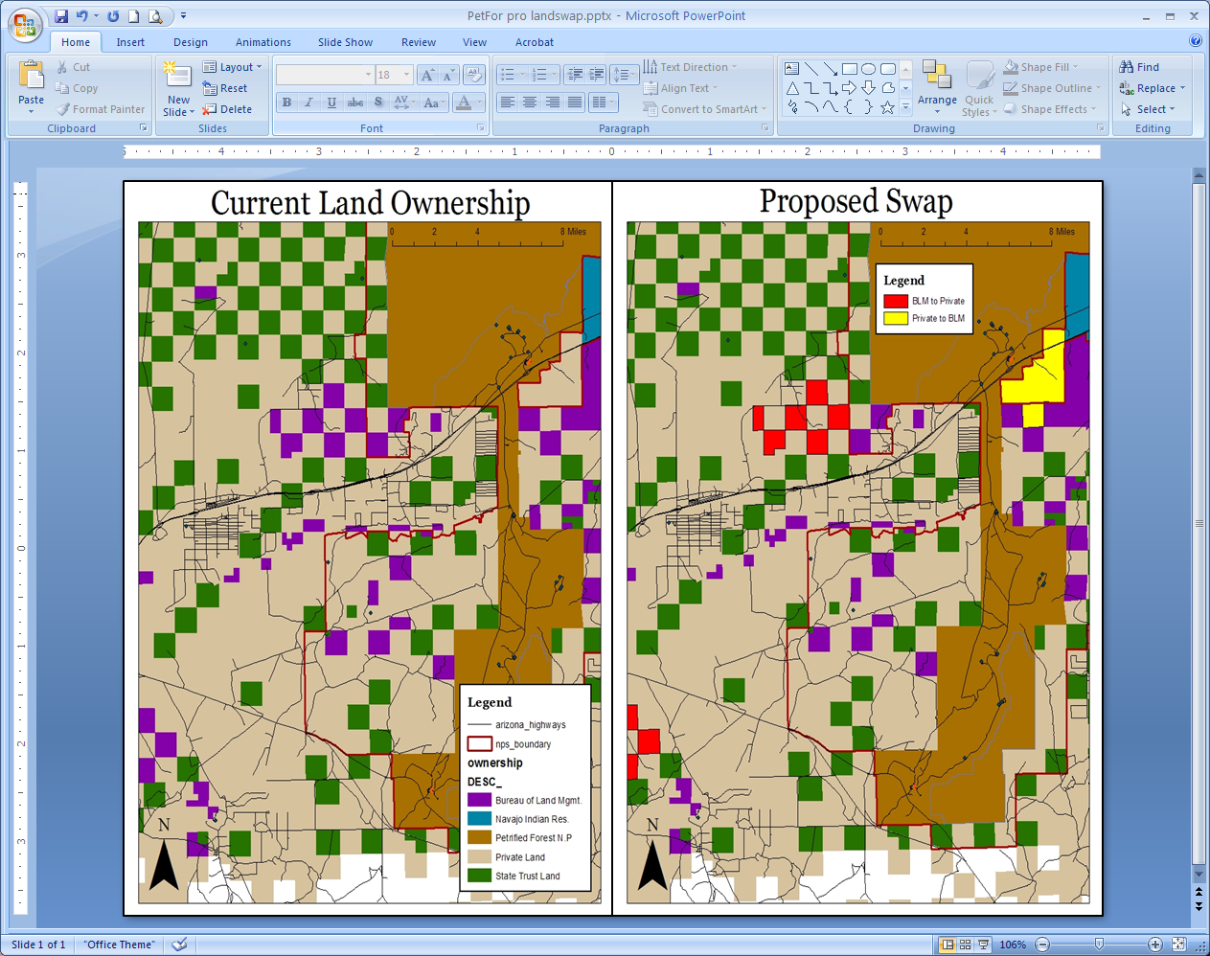
Notes:
Now switch back to the layout view and you will find our two new layers have been added to our legend. You may also have to zoom in or out to get to the extent our last layout was in. Get as close as you can if not right on. Change the title to something like ‘Proposed Swap’ here or in PowerPoint depending on how you are doing it. In the legend reset the items so only the two new layers are showing (remember you can double click to get the properties). I moved my legend up to the top so people would see it better. When you feel the map is ready move it on into the PowerPoint where your other map is. Put it on the right half of the slide and wah-la! You have GIS comparison product.

Slide 21
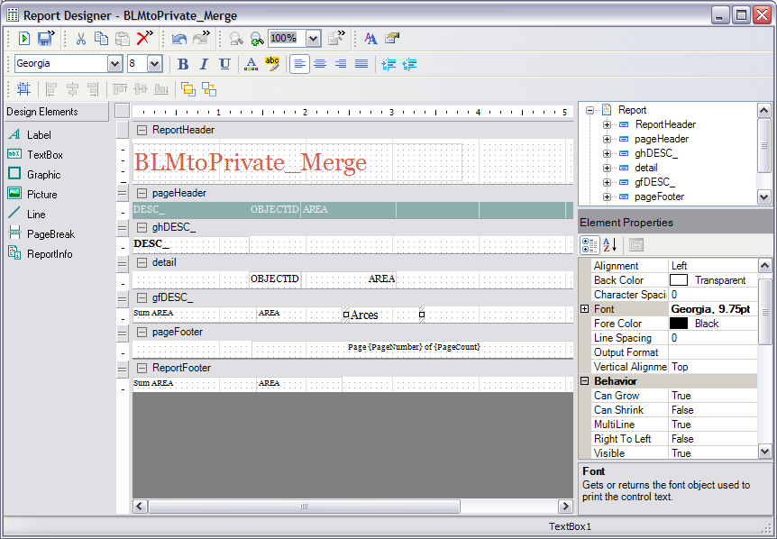
Run the report
Tools to modify/design
Put your textbox here. It is selected when you can see the small square handles at both ends
Scroll down the Data and text field. Type on the right.
Notes:
This looks good however we want to display some more quantitative data with it. Do you remember we took some exact measurements on the acreage exchange of our selected parcels? Well sometimes tabular data is a way of organizing and representing spatial data as much as a map. Look back at those numbers we jotted down. We got those numbers from the shapefiles and they are still there. Now that we extracted shape files for the lands to be swapped we can run reports on them right in ArcGIS. Go back to Arc in either the data or layout views.
It is a bunch of little steps so here is the procedure: 1) For the Private to BLM layer open the attribute table. You see there is of course only one item. 2) Select the field ‘Area’ which at the moment is completely blank. We’re going to fill that. 3) Right click on the name ‘Area’ and select the calculate geometry tool. Say Yes to the warning. 4) Make sure the property is set on area, you use the coordinate system of the data sources, and change the units to US acres. 5) This fills in the area field with even more precise numbers than what we were rounding to. Do the same procedure for the other BLM to Private layer. 6) Open up ArcToolbox and drill down to Data Management Tools>General>Merge and merge our two land swap layers. It will come up with a name which we aren’t particular about. Again be patient and let the process run it’s course.
So far so good. This next part may be tricky so keep at it. 7) From the View menu drop down select the reports>create report option. This will pull up the report wizard. 8) Add the fields OBECTID, DESC_, & AREA in that order and make our target our new merged layer. Press next. 9) Group by adding the DESC_ so it is on top of OBECTID, AREA and press next. No need for sorting but press the summery options button. We want to show the total sum of the areas so check that box and put it at the end of group DESC_. Make sure the sum box is checked and press OK and next. 10) I’m leaving the layout on the default but change it how you like. Press next. Pick a style or go with the default. I like Pensacola. Press next. Decide on a title, preview the report, and press Finish. 11) Not a bad looking report if I do say so myself. Except we don’t see what units those area numbers are in. Press Edit in the upper left or right corner of the report and you will get the design view shown on the screen. This type of view may or may not be familiar to you. 12) Select the TextBox tool under the design elements on the left side. Move the cursor into the white area under gfDESC_ to the right of AREA till it becomes a set of black crosshairs. Draw a box in the white area. 13) With your box selected go to the element properties on the right side. Under the property Data in the Text field type Acres. We can change other text fields this way too if we want. 14) Now run the report again by hitting the white page/green arrow button in the top left corner. Now we have meaning for those numbers. 15) Next export the report to a file by hitting the third button right of the Edit button. Choose the format you like but I am going to do a tiff (.tif) so I easily can put with my maps in PowerPoint. Be sure you know were you are putting/saving it.

Slide 22
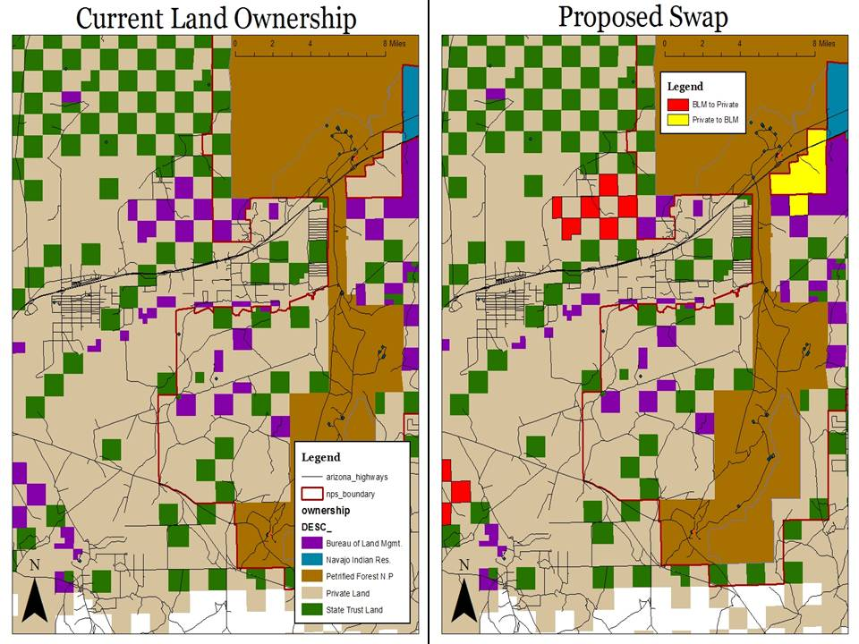
Not Official Business
1
10
4
5
2
6
3
7
8
9
Petrified Forest NP Proposed Land Acquisition
Created by Richard Blaine, 31 Feb 2015
Notes:
Now switch back to your waiting products in PowerPoint. Insert the report you just created. I also manually put in the numbers designating each parcels in PowerPoint and grabbed the NPS and BLM logos off the internet. Be sure to respect copyright laws if you add the logos. Congratulations on your fine GIS project and products! You now have a GIS product that can be used in a business presentation, public showing, or gathering. It can be used as a communication or survey tool and because of the way we created it this product is highly accurate. Arrange the layout however you would like and feel free to put in whatever else you desire. Also note that generating reports in ArcGIS is good especially if we had a project with hundreds of fields of data but if we are in a pinch for a small project like this we could use another program like Excel to help bring in the numbers

Slide 23
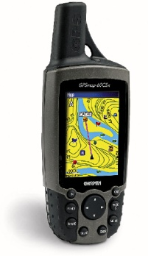
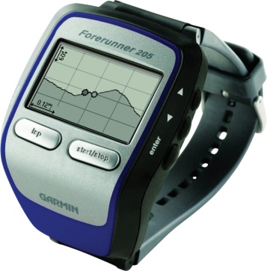
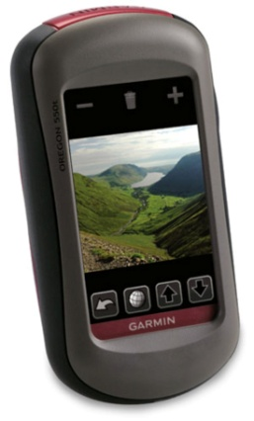
Appendix: Data Searching
Tips
Have a list of sources (i.e. websites & databases)
Have a plan
Be flexible and willing to edit
Know how to convert data
If possible gather your own field data
Get all you data together before you start the project
Have people contacts
Notes:
On any GIS project you can easily spend a large amount of time searching for data.

