Slide 1
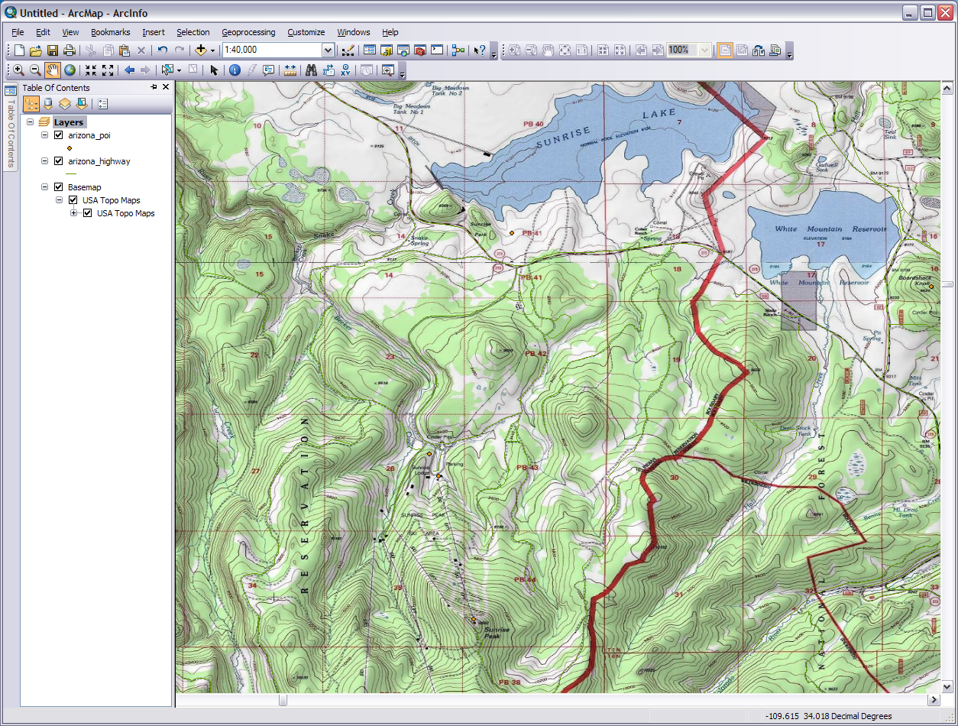
Introduction to Geographic Information Systems: GIS
Module 1: What Makes A GIS
Created by: Scott Kelly 2010
Notes:
Welcome to NAU’s Geospatial Research And Information Lab’s (GRAIL) Introduction to Geographic Information Systems (GIS) workshop. Basic GIS is fairly simple, fun, and can be designed for everything from enhancing outdoor recreation to an in depth study of mountain lion habitats. In this first module of the workshop we will talk about the basics that make up a GIS. Keep in mind a GIS is a system so there are many components working together.
GIS useful for a football team that needs get a fix where their next game will be, a business that needs to track customer location and demographics, environmental studies, emergency services, planning and development, a report for a class, client, or boss that needs some geographic explanation, or anything that requires an understanding of a place on earth. Of course sciences, engineering, medical, and government need to use spatial data, meaning the geographic location of data relative to another set of data, all the time.
This is an introductory workshop intended for faculty, teachers, students, professionals, members of the community, and anyone who wants to understand how spatial data in what whatever they do can help them have a well rounded world. Also note GIS is sometimes called geographic information science. You may already be familiar with some or all of the material covered in this workshop but hopefully we can add to what you already have or have not. So let’s jump right into it.

Slide 2
Elements of a Geographic Information System (GIS):
Spatial or Geographic Data
Raster
Vector
Tabular
Hardware
Computer
GPS
Satellites
Others
Software
Desktop
Online
Database
WWW & Cloud
Human Element
Users
Clients
Outputs
Maps
Posters
Response Info
Notes:
ESRI, one of the GIS industry’s biggest leaders, says “A geographic information system integrates hardware, software, and data for capturing, managing, analyzing, and displaying all forms of geographically referenced information. GIS allows us to view, understand, question, interpret, and visualize data in many ways that reveal relationships, patterns, and trends in the form of maps, globes, reports, and charts.” The data involved in a GIS is geographic which is often termed spatial data. It involves imagery and tables relating to physical locations on earth. Spatial data is collected, processed, and delivered via various hardware. Satellites, computers, and large format printers are commonly found equipment in GIS work. Each piece of hardware of course uses software to manipulate and move the spatial data along; however it is interesting to note that the software dose not need to be specifically designed for GIS work. As some of the data is digital imagery, programs such as Adobe Illustrator, Photoshop, or AutoCAD may be used at certain stages of the processing. GIS specific software can turn field notes collected about a place into a visual 3D presentation. Current with technology trends the GIS industry is using the internet, specifically the World Wide Web and The Cloud, to its advantage. Secondary data can be found and downloaded, current data and projects shared with anyone with an internet connection, and online spatial software is a great help to your overall GIS projects. Of course all this wouldn’t be worth much without the human element. People are this ones who use and benefit from the tools GIS offers. It is our world we are trying to understand geographically. This helps when we have deliverables and products as outputs from a GIS. Maps and presentation materials are a common output from a GIS but there are others too.

Slide 3
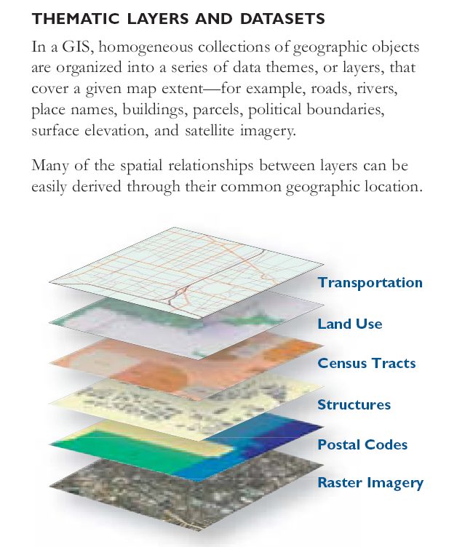
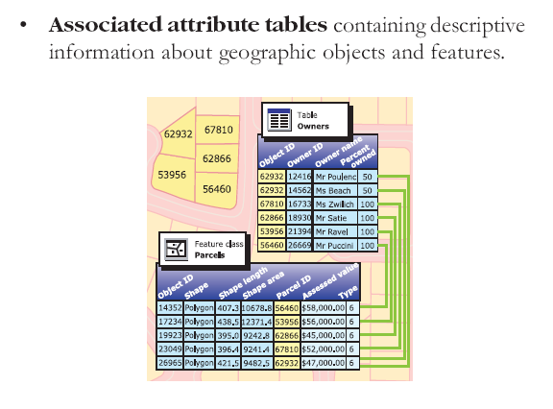
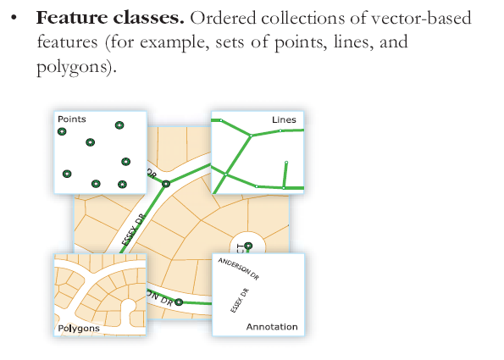
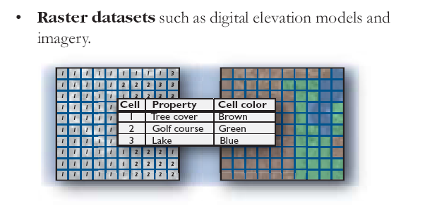
Spatial /Geographic Data
From ESRI’s book “What is ArcGIS 9.2?”
Notes:
A key characteristic of GIS is all the data is connected to a real location on our planet (GIS can be done for other planets too). Spatial data comes in the form of raster images, vector features, or tabular (tables of information). Raster images are collages of pixels. Have you ever zoomed so close to an image on the computer you can see the individual pixels? The computer sees a number in each square of a grid (pixel) and assigns it a color, shade of gray, or black/white fill. All these filled in squares make a picture.
With a vector feature you either have a point, line, or polygon (closed shape). No matter how far you zoom in a vector feature should never be pixilated. The points, lines, and polygons are called feature classes and shapefiles in GIS. Text or annotation are also vector features used in GIS but are generally thought of as separate from feature classes or shapefiles.
Data in tables add ‘words’ to the raster and vector pictures. Special geographic image data such as vector networks and raster digital elevation models (DEMs) can also be found in GIS. The similar themed data is grouped into sets (datasets) and made into layers. The layers are then combined in the GIS to make a product that can be analyzed, interpreted, and displayed. Take a look at the image in the top right corner. A layer of transportation lines is stacked on top of several polygon layers each with a different theme, which in turn is all on top of an aerial or satellite raster basemap image.

Slide 4
Geospatial Data is in 2 main parts:
Raster - “World Viewed as a Grid”
Satellite imagery (radiation bands displayed as a picture)
Aerial photographs (picture in computer)
Digital Elevation Models (each pixel records elevation)
Triangulated Irregular Networks (3D surface)
Vector - “World Viewed as a Graph”
Point
Line
Polygon
Groups of features
Notes:
So our digital imagery is either in raster of vector format. The imagery is very important because it allow us to visually relate to the reality of our visual world. Raster are thought of viewing things through a grid because of their pixel patchwork. Listed here are some common raster image types used in GIS. Raster imagery can be represented in 2D or 3D. Satellite and aerial images are some of the most common layers used for basemaps. This is because they contain elements that are so very recognizable to our earthly home and they tend to be contemporary to whatever the objectives of our GIS project are. Satellite imagery is a composite of different bands along the electromagnetic spectrum even before and beyond visible light. The different bands can be combined in various ways to bring out certain features such as vegetation. For more information on band combination see the Remote Sensing appendix to this module. Aerial photographs are pictures snapped from aircraft usually with a camera that computes curvature angles and registers the picture to coordinates on earth. Digital elevation models (DEM) are created on a computer. The elevation data collected for an area is arrange geographically and the computer assigns an elevation code to individual pixels. You won’t see a DEM in the final deliverable because the DEM is placed under the basemap to give it dimension. However in order to get your product from two dimensions to three you’ll need a TIN or triangulated irregular network. The TIN that is created from calculations of elevation and X,Y coordinates puts the project into to a third dimensional view. Topographical maps that have been digitized are examples of raster imagery used in GIS.
If you have ever see a line or dot on a graph you have seen a vector. A point has no dimensions because it is only a visual representation of where an X and Y coordinate meet. There is no length, depth, or height to representation of a spot where latitude and longitude cross on a globe. You can signify a point with any symbol you choose because you are just representing a finite spot. Technically a line has only the single dimension of length. You can of course make the visual fat and dashed for you project purposes. Like on any other graph you’ve seen the line is a representation of the connection between one point and another or the flow between two boundaries. The third basic vector feature, the polygon, has the two dimensions of length and width. Polygons are two dimensional closed shapes used as simplified representations to outline and fill in real world objects from an overhead view. So you could represent a lake with a polygon by drawing a blue line around the edge and filling in the shape with another shade of blue. When you have, say a bunch of points representing the prairie dog holes in the Petrified Forest they are all put together in a group called a shapefile or feature class.

Slide 5
Geospatial Data: Tabular Data
Attribute tables of vector or raster data
Standalone related tables
Origin of other data, i.e. feature classes
Analysis and Selection
Cross understanding and data organization
Metadata
Notes:
Tabular data is just as significant in GIS as imagery data. Let’s say we have displayed over some aerial imagery on our computer screen multiple game sites on the west side of the Kaibab Plateau on the Arizona Strip. We can see where the sites are located relative to one another, any towns, and the landscape. With a little processing you can show one or two differences such as the amount of Elk with a gradient of colors or the type of terrain with different size symbols. However each site contains much more information and contrast than just one or two fields of data. All the points are grouped into one single shapefile We can bring up the shapefile’s attribute table to view all the information about the sites in addition to what we can get from looking at the imagery. If we look at the table here we see the elk, terrain, snow, and additional data fields for a site while comparing them with other sites.
Most software will let us select and edit the data right in the table which affects the imagery too. We can pull up multiple tables and compare. The tables help in spatial data organization and clarification. The GIS software can read an organized table and make a shapefile from it. The tables can be linked to the imagery data or be related standalone files. Please note the table here is fictional.
Another important variety of tabular data a GIS uses is metadata. Simply put metadata is data about data. For example suppose you are doing a project on real estate locations in Gila Bend. You download some shapefiles from the Maricopa County website and wonder how current the data is. If you’ll look in the metadata for the shapefiles you’ll find the date they where created, how the data was collected, who collected it, how it was verified, the environmental impact of the collected data, and past registrations of each parcel. Actually the metadata can contain anything the author wants to put into it. In GIS though it is important that the author of the data at least puts in the datum and projection information. More on all this later.

Slide 6
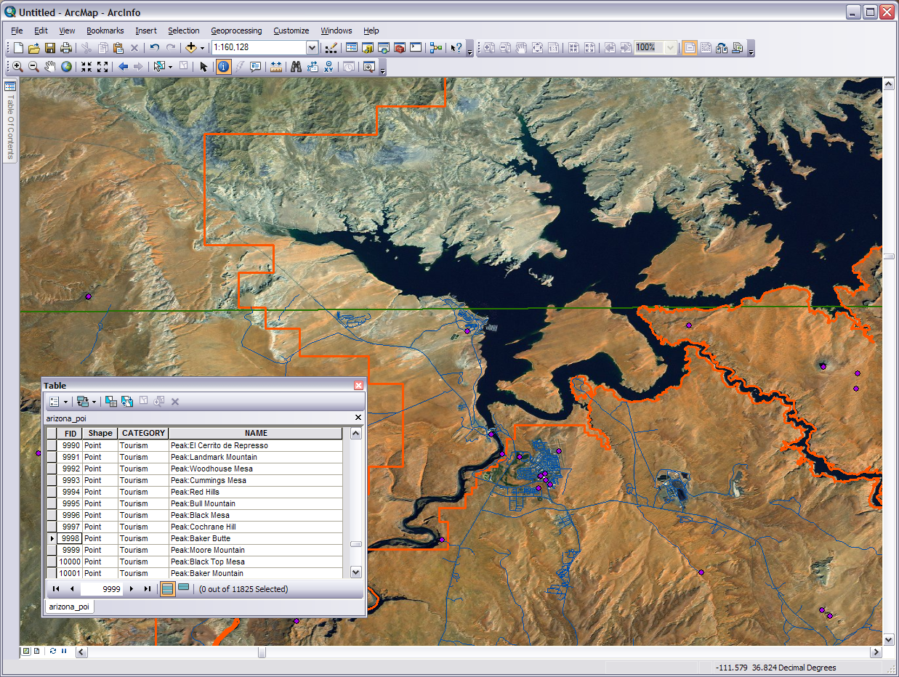
Polygon feature class of the state boundary
Polygon feature class of Glen Canyon National Recreation Area boarder
Raster image basemap
These point feature classes represent locations of interest such as Cummings Mesa. All spatial objects have an attribute table.
Line feature class of Arizona roads
Notes:
So this is how the data can look in a GIS. Wow there is quite a bit going on here! We have several vector features, a raster basemap, and an attribute table all relating geographically. This screen was to put together to show you how spatial data looks visually when you put things in concert. It’s much more than just a map. You can see how the state and National Recreation Area boundaries interact and layover the different features in the terrain. This can be helpful for jurisdictions on landscape clean up projects in the area or knowing what authorities you need to talk to if you area planning on setting up a hotel on the north point of Antelope Island. Those blue lines will certainly help with knowing how close to certain geographic features you’ll get driving while working or playing in the region. If you are looking for a particular Arizona point of interest you can search for it visually on the screen or in the attribute table . Just select the one you want and the software will take you right to it. You can manipulate and edit each of the layers to help with ‘what if’ scenarios, compare different sets of data for study over time, or use any of the many GIS analysis tools to derive answers from the data. I wonder if those points were collected with a GPS unit or other hardware?

Slide 7
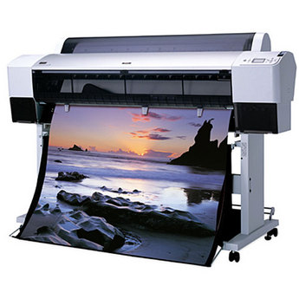
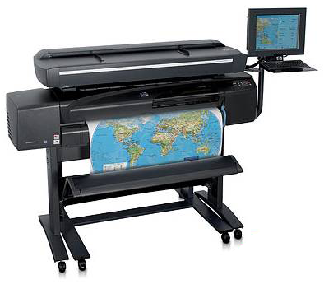
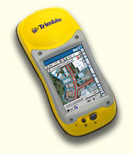
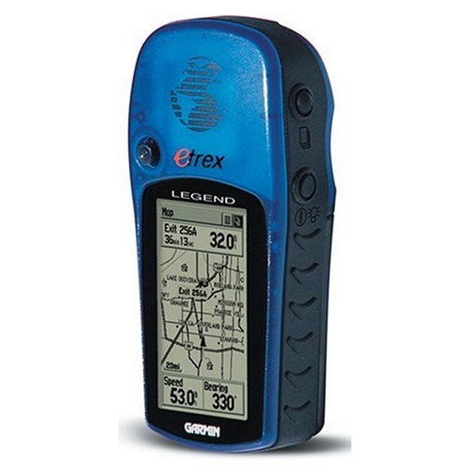
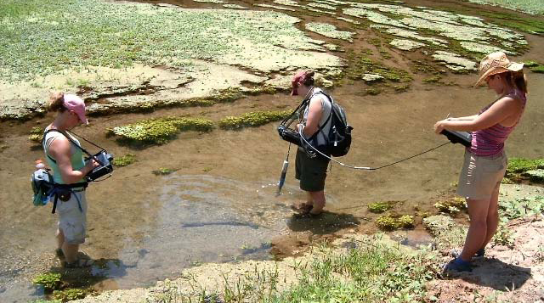
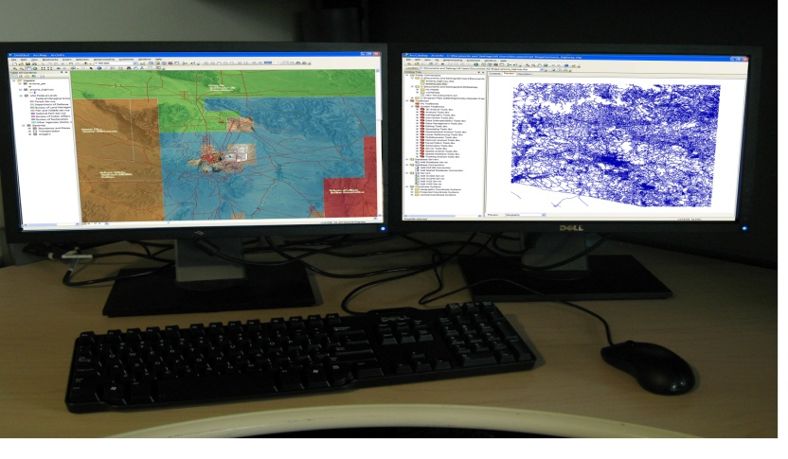
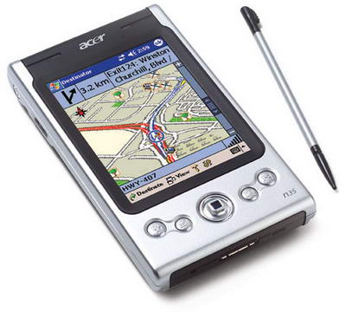
Hardware
Collection, Process, Delivery
Image Source: Trillium Wood Golf Club
Temp
Notes:
Most GIS operations today are digital and that requires some technical equipment. A GIS incorporates hardware for three different functions. The hardware may be standalone, multifunctional, and interactive. There is hardware for data collection and discovery, processing and manipulation, and delivery methods. Gear such as satellites, GPS units, scanners, digitizers, PDA’s, mobile PC’s, rangefinders, survey equipment, and ground monitoring stations are used to discover and collect primary and new data by means of field work and remote access. Perhaps the most familiar and used hardware in GIS is the office or home computer. These computers are where ²/₃ of all GIS work is done. Most of the major editing, organizing, interpreting, analyzing, transcribing, and other data and information process is done with this hardware. This group of gear also includes handheld and field computers. Spatial data/information collection and processing is good but a GIS becomes valuable when it has a deliverable product. The most common and recognizable of GIS deliverables is the map. This comes in either electronic or print form. Posters for presentations are also frequent in GIS. Printers of large and small formats are used to turn out maps, posters, and other GIS products. Other hardware can be used to convey GIS results. For example: A dispatch director operating a GIS from a base location can use radio communications and field equipment with real-time updating to help search and rescue personnel coordinate efforts during a disaster.

Slide 8
Software
Database-Online-Desktop
The Database/Server
Store Data
Distribute/Publish Data
Share/Joint Projects
On The Fly/Batch Processing
Enterprise Management
Data Management
Security of Data
Notes:
So what does all this GIS hardware do? As they say in the movie Short Circuit “It’s a machine. It doesn't get happy, it doesn't get sad it just runs programs.” (Short Circuit, 1986). Cave drawings have shown evidence that people have been making maps and processing spatial data for a long time. GIS software has been around since the late 1970’s. The software is the workhorse of GIS and is the window to the data.
In the background of a GIS you will often have servers and/or databases. These can actually both be software and hardware. Appropriately named, the database is a storage library for the accumulation of spatial data which may add up to very large proportions and the server serves up that data to those who order from the menu. Additionally the database and server can be accessed by multiple users, do some pre-desktop spatial processing, and data networking management. Having a database/server in GIS allows you to control and access yours and others data leaving you and your desktop free to focus on manipulating and processing the entire GIS project. For example let us say you are doing a project on the springs in the White Mountains in eastern Arizona. You can access the GRAIL (see grail.nau.edu>get data) geodatabase which has a significant amount of Arizona data. Just copy the information you need and modify it for your project.

Slide 9
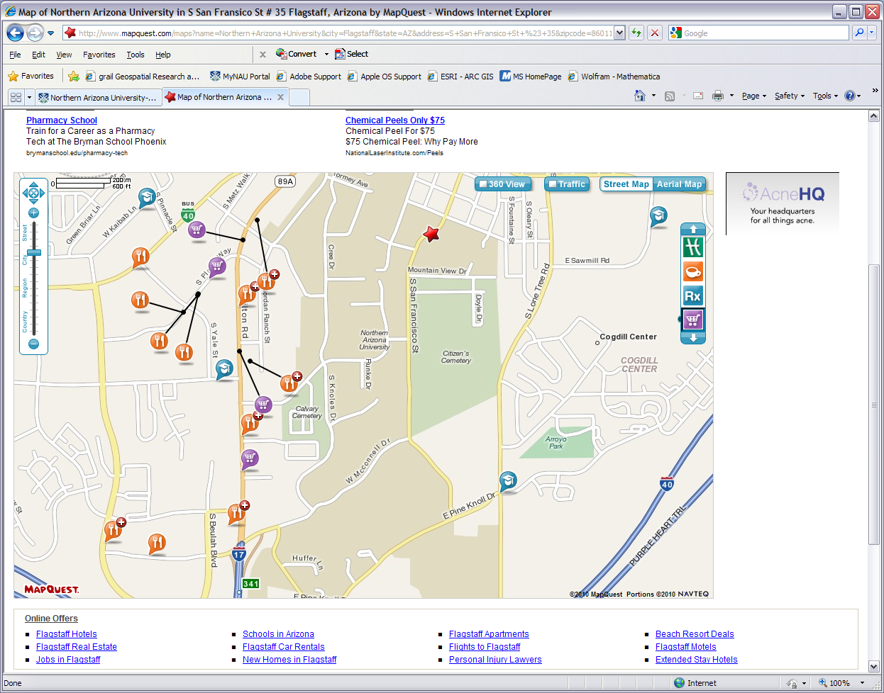
MapQuest & Google Maps
Notes:
Our next category of software covers online/cloud technology GIS programs. This ranges from simple map makers to industry tools. Starting with simple online GIS let’s look at Google Maps and Mapquest, the familiar place finders. Simple to use. You just type in the address or what you know of the address and Mapquest pops up with a plain-jane street map. Press the print button and you have your map. You can zoom in & out, place an aerial base map under the streets, sometimes get an idea of traffic in the area, and possibly a 360 degree street view. You can also turn on & off different place locator icons for things like restaurants and schools. Some downsides are the advertisements off to the side, you can’t edit or add data, and the directions you get from them are not always the best or accurate. Some of the layers you can turn on here are the same and some are different than Google Maps. The maps made by Google and Mapquest may appear a little different because they display things differently and the data may come from different sources. Sometimes it’s just a matter of preference which one you use. With any map program you are using for navigation it is best for you to use the map to plan out a route on you own and do it before you leave the house.
This kind of software can also be seen in mobile apps of course. The advantage is the mobile device can work with things like GPS to give you real time data. Please remember to look up when using them because your smart phone won’t show you that tree 3 feet in front of you.

Slide 10
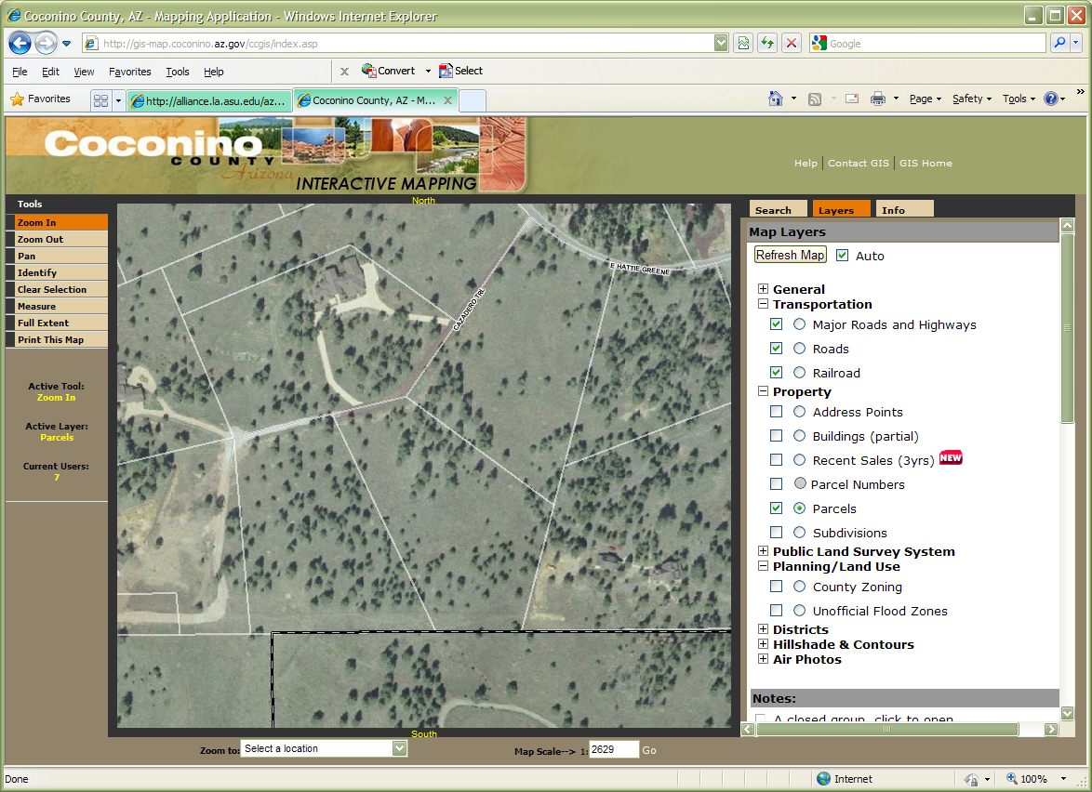
Coconino County GIS
http://gis-map.coconino.az.gov/ccgis/index.asp
Notes:
Moving onward and upward many cities, counties, and states have their own mapping or GIS engines. These are usually limited in their capabilities but do allow you to make a quick 15 second map and often have local information that other map programs will not. This map maker from Coconino County has layers for property parcels you could use to know the extent of a plot of land you are looking to buy or where your land ends so you can build a fence. It is fairly easy to use and can be more relevant to your area than a basic street map.

Slide 11
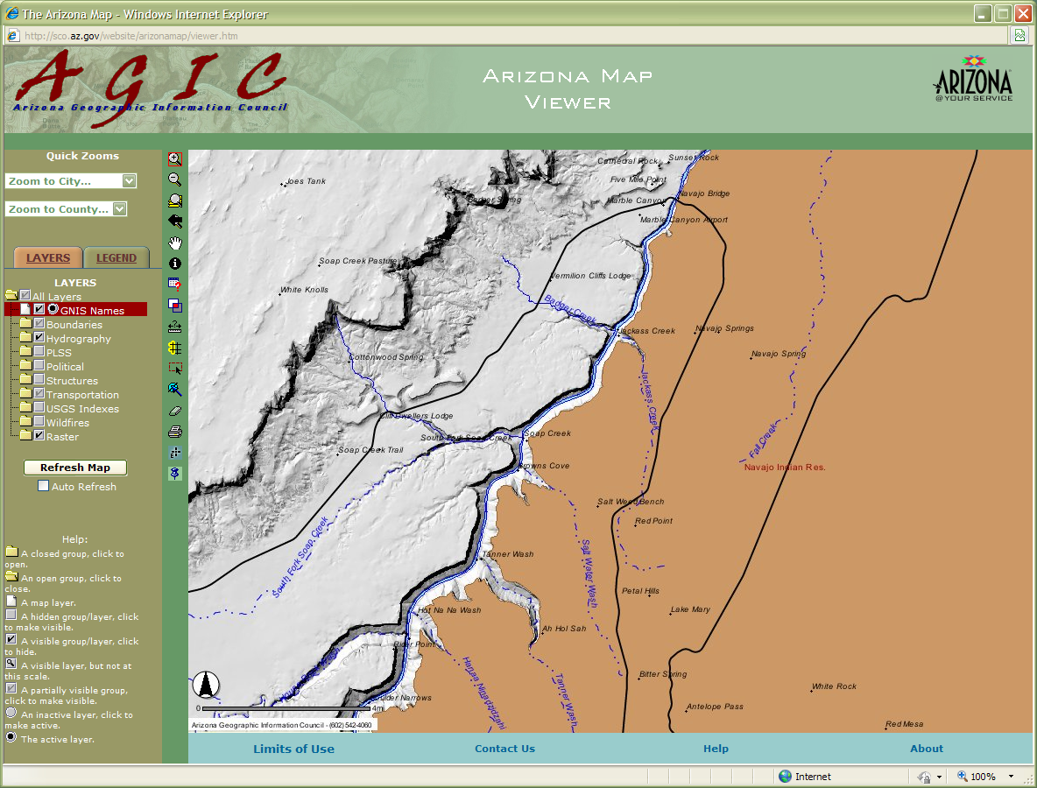
Arizona Geographic Information Council
http://sco.az.gov/website/arizonamap/viewer.htm
Notes:
Here is another government sponsored map maker. It has a few more bells & whistles than our last few examples but isn’t too hard to figure out. We still can’t do things like export data yet but this one has even more layers to turn on & off, a legend tab, and tools for querying and identifying spatial data. In the screen shot here it didn’t take long to turn on the layers and zoom into the area. We now have a quick map of several side canyons off the Colorado River right below Navajo Bridge. We can print this off from our inkjet or screen shoot it into our report for tributary canyons east of the Cliffs of Vermillion.

Slide 12
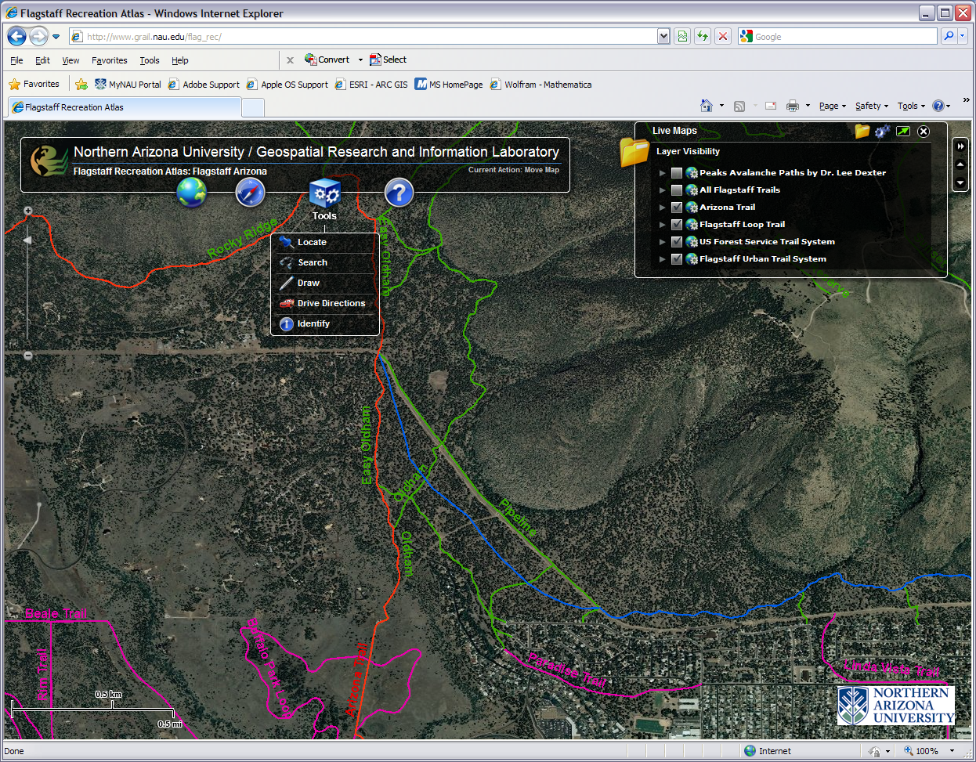
Flagstaff Recreation Atlas
http://grail.nau.edu/flag_rec/
Notes:
Quick online map making machines are being developed all over the world wide web. This a fun and useful product recently made available by NAU’s GRAIL. With the Flagstaff Recreation Atlas you can turn on & off different layers, have satellite, topographic, or street map backgrounds, and the tools let you draw on the map. Right now there is even an environmental layer about the Peaks avalanche paths and wildfire perimeters. This app is just getting started and more layers are forthcoming.

Slide 13
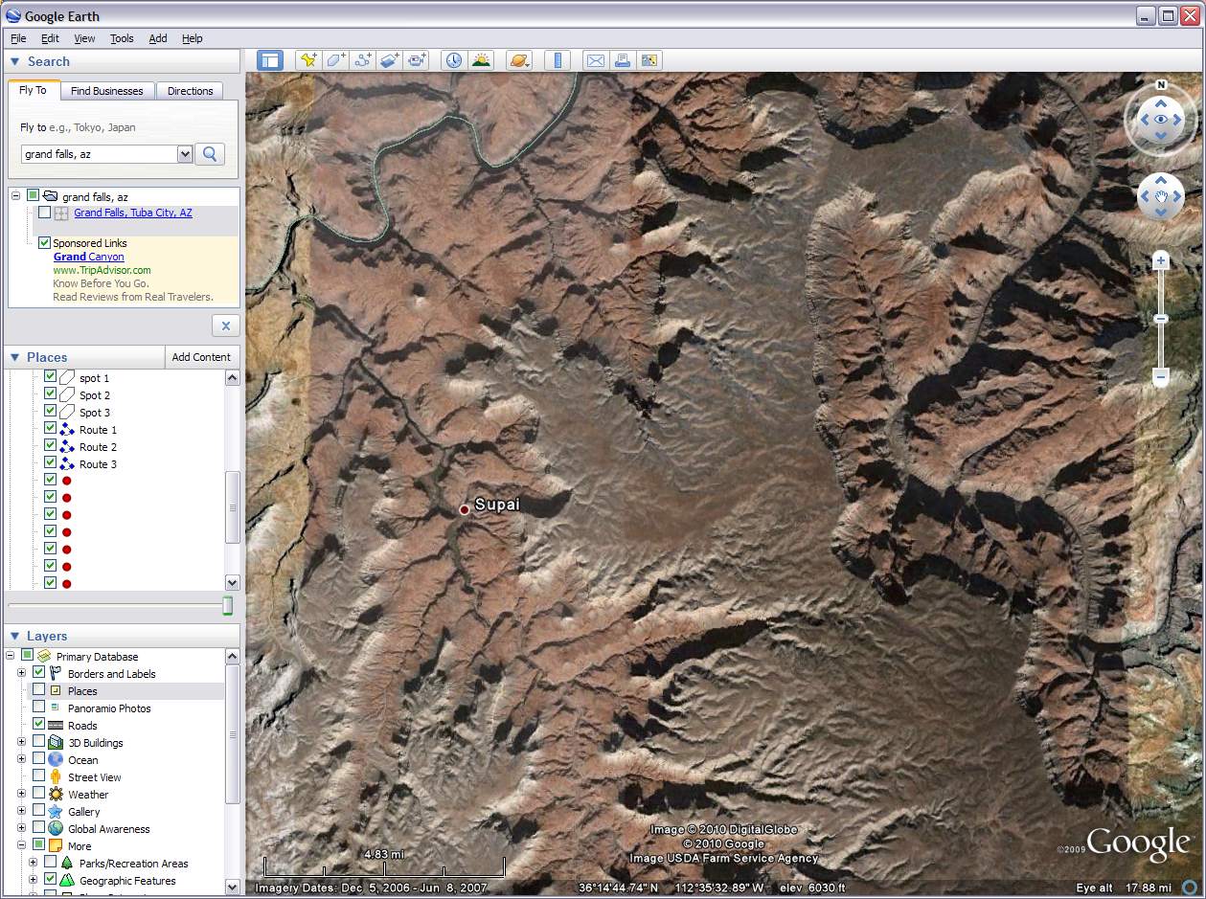
Google Earth
Notes:
GIS software also combines online database servers and desktop applications. From the friendly folks at Google this free download provides more than just a pretty picture. This popular app that many of you may already be familiar with is actually very useful in light cartography and other GIS projects. You can turn off & on different layers like others we have discussed but there seems to be more general interest layers here than most offer. There is also much to play with on the top tool bar from drawing to comparison of past imagery. Some of the 3D things you can do with this are out of this world, literally. You can explore the night sky, make maps of the Moon, and have your own rover mission on Mars. But coming back down to earth, Google has some simple tutorials for most of the fun things you can do with this digital globe. In the professional versions you pay for you can export data that can be used by high end GIS software.

Slide 14
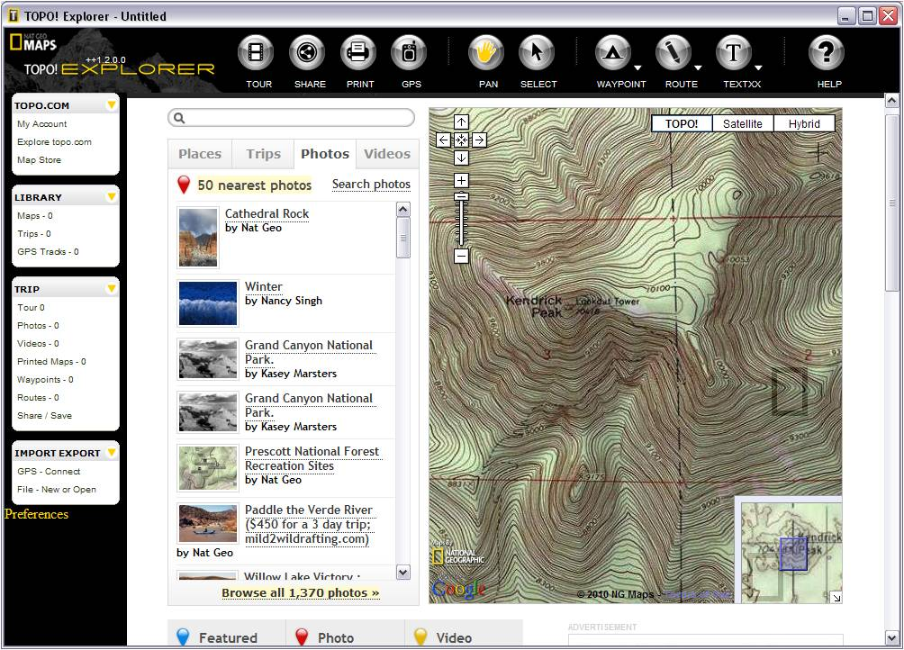
TOPO! Explorer, TOPO! State Series,
& Delorme Topo USA
Notes:
National Geographic came out a few years ago with the TOPO! Series. The first to come out was the State Series which is still a high quality product (and my personal recommendation). You can buy a digital seamless version of all the USGS topographical maps for a state, zoom in to the level you want, draw, mark, and measure routes and waypoints, and then print or download the map onto your GPS unit. There are many other functions too. Although TOPO! Is targeted for recreation interest it can be use for other light to medium GIS/mapping projects and topographical maps make good base maps. TOPO! Explorer operates in a similar way. With TOPO! Explorer you download the viewer or view online, set up an account, find the topo you want and order it for either download or print. Delorme makes a similar product called Topo USA for both urban and rural general mapping needs.

Slide 15
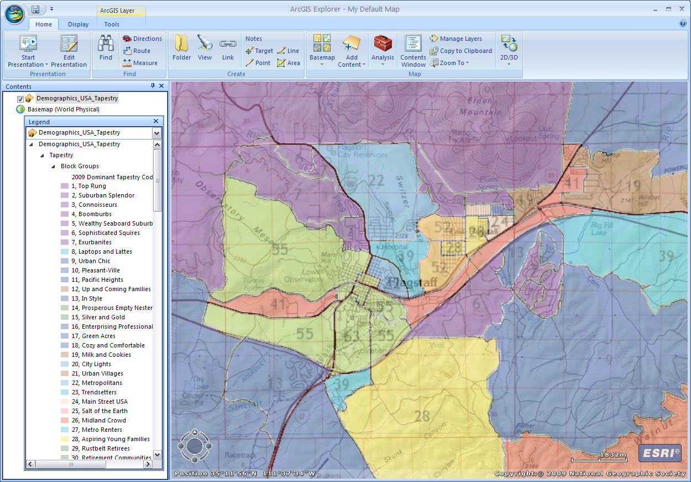
ArcGIS Explorer
Notes:
ArcGIS Explorer is a free download from ESRI or can be used online at arcgis.com and clicking on the word map. The online version is a bit more limited so I prefer to download the desktop version. This app is a very simple GIS map maker. It comes with online access to some basemaps when you download it. When you click on the add content icon you can add your own data and also add data from the arcgis.com community. You can draw on your own lines, points, and shapes as well as set the map in a presentation mode. It is a useful tool with access to free data without having to be a GIS professional. It does export data to small degree in proprietary or its own unique format.

Slide 16
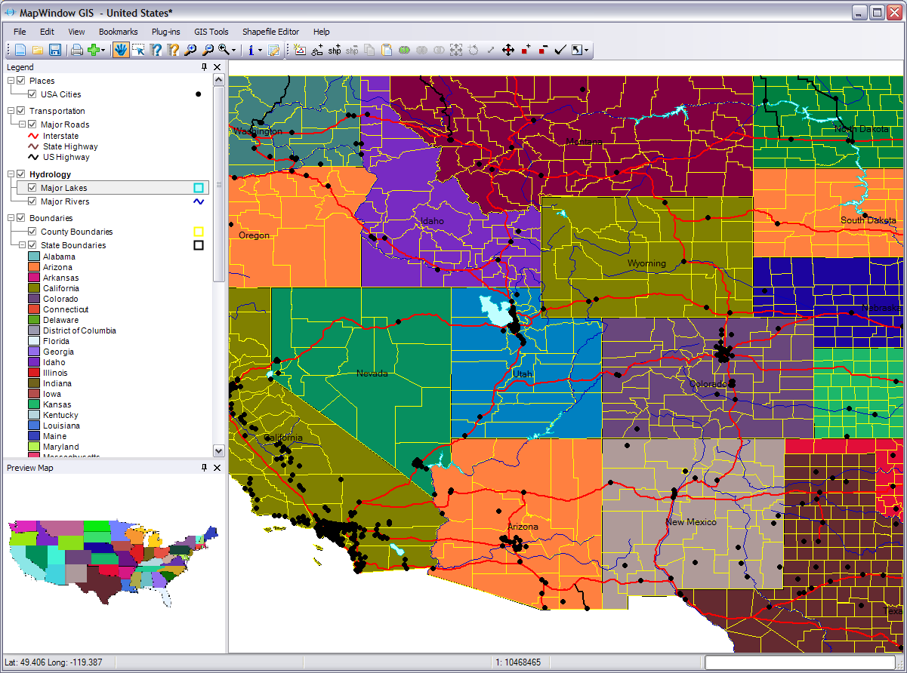
MapWindow GIS
Notes:
MapWindow GIS is a professional desktop GIS software. It is open source software that can be downloaded and run for free. With MapWindow GIS you can edit shapefiles, run various geoprocessing tasks and analysis, and create some GIS products. Many simple GIS projects can be done using this software. It is useful if you are not able to get access to higher end GIS software and does more than the software previously discussed. It does come with some simple datasets but for the most part you need to add you own data. As similar open source download is Quantum GIS.

Slide 17
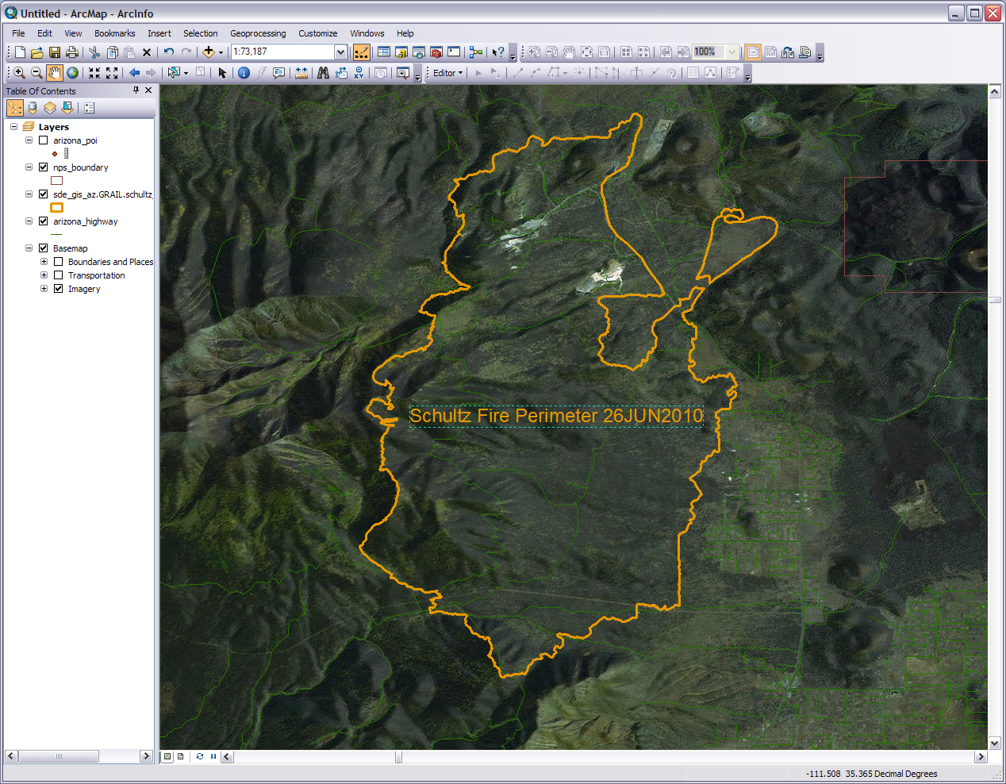
ArcGIS
Notes:
Top of the line full on professional GIS software. ArcGIS is used by small businesses to national governments. This does everything from a simple map to high end 3D geospatial visualization. You can access some basic datasets for it from ESRI but it is made for you to manipulate your you own spatial data in a thousand and one different ways. Some parts of it are rather easy to operate and others are beyond the comprehension of mere mortals. ArcGIS is actually a suite of programs. Shown here is ArcMap where much of the visualization and final work is done. You also have ArcToolbox, ArcCatalog, and others that are used for processing of spatial data before, after, and during work in ArcMap. The software can technically be obtained for free but you need a costly annual license to operate it.

Slide 18
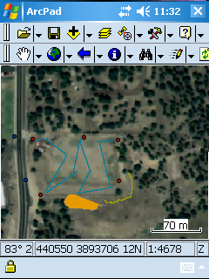
Notes:
GIS software can also come in packages meant for data gathering, specific processing, and application analysis. For example: ArcPad is a hybrid of GIS and GPS software. It works as an extension on your GPS unit of the ArcGIS software on you desktop or laptop. You can upload your data to it, go out in the field and edit it, then take it back to the home or office and download all the data back to the original project.
In this made up scenario I run a architectural landscaping company who had contracted with NAU to do some upgrading to this sports field on the basemap. This screen shot shows red dots I had uploaded to ArcPad on the GPS unit previous to my going out there. These were spots I already knew were utility access points. As I walked along the GPS and ArcPad automatically created the blue lines where I planed to put in new pipes for the sprinkler system (i.e. tracks). The lines are broken up because of inconsistent satellite reception and my meandering was a bit random. I used the GPS to mark the two dark blue dots (i.e. waypoints) along the roadway where signs with information about the field should be put up. The yellow gold line was where I thought it might be good set up a score board and announcer’s booth. The orange polygon is a good spot to add some bleachers, snack stand, and storage. I can now take these points, lines, and polygon that I have edited in, download them to my computer, and update my GIS projects on my home or office computer.

Slide 19
WWW & Cloud Technology
Data & Community
Arizona GAP Vegetation Data Arizona Regional Image Archive(ARIA) The Arizona State Cartographer's Office
GIS Data Depot The National Map The USDA Geospatial Gateway USGS Seamless Data Distribution USFS Forest Inventory Data Online (FIDO) The National Atlas of the United States of America Natural Resource Conservation Service Soil Data Mart
NPS Data Store
Geospatial One-Stop (GOS) Colorado Plateau Environmental Metadata Clearinghouse The National Biological Information Infrastructure (NBII) Metadata Clearinghouse
GRAIL Spatial Data Library
Notes:
A quick word about the World Wide Web, cloud technology, and the internet. We’ve already seen how online GIS software is a big asset. Additionally online is where a large amount of GIS data is obtained and shared. In GIS work you may spend a significant amount of time gathering data. If you can find data online you don’t have, it can save quite a bit of time. For example if you need some basic shapefiles for the roads in the National Park Service units in Arizona you can just download them from a site like the NPS Data Store (http://www.nps.gov/gis/data_info/) without having to go into the field with a GPS unit and reinvent the wheel. It can take some practice though to navigate different sites.
The are also many way to communicate with other people doing GIS. You can collaborate on projects, publish products, and if your having a problem with running a spatial analysis on ArcMap you can go on the web and see if someone else has had the same problem and came up with a solution. In a GIS project you can spend as much time on the internet as off. You can click on these links and explore them while the slide show is running.
Online technology is a big thing with GIS. Unfortunately that is a whole other workshop we don’t have yet. Explore the internet and see what you can find out. You might be surprised.

Slide 20
People and GIS
The Human Element Involvement
Project Planning
Data Collection
Data Processing
Data Maintenance
Data Analysis
Data Management
Security of Data
Control of Data Dispersal
Output of Products
Notes:
Any tool, automated, power, or hand, would be valueless without a person to use and operate it. The same with a GIS. From project inception to closing deliverables people’s preferences, thoughts, styles, interactions, and perceptions are controlling factors in GIS. You are what makes a GIS work. A good example is a consulting firm/coffee shop we’ll call Bull n’ Bean, contracts with you and your expert GIS skills to find some possible new store locations in Casa Grande. They have their preferences of site locations, you both have different thoughts on what is needed, you have your own style of doing GIS work, both the client and contractor have to be in constant communication, and both of you have your own views of what is going on. I once was co-directing a GIS lab. My fellow director was full of numbers and I am a visual guy. To get the projects done of course we had to use both of our skills. Keep in mind that a key cog of the system in geographic information systems is people.

Slide 21
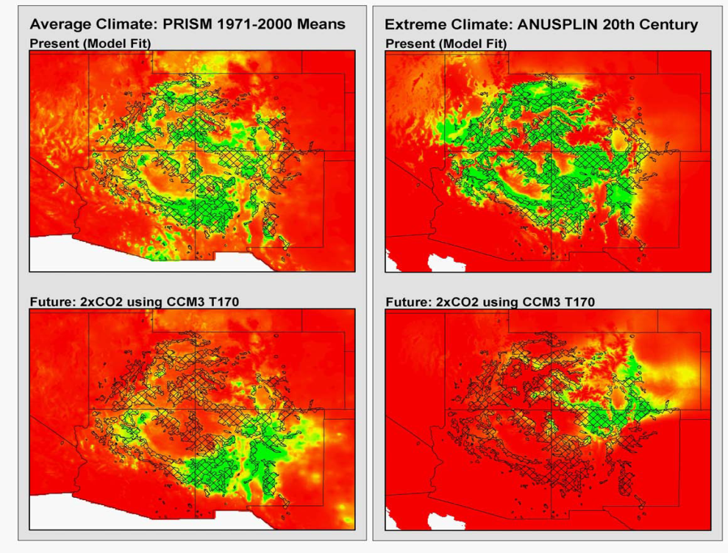
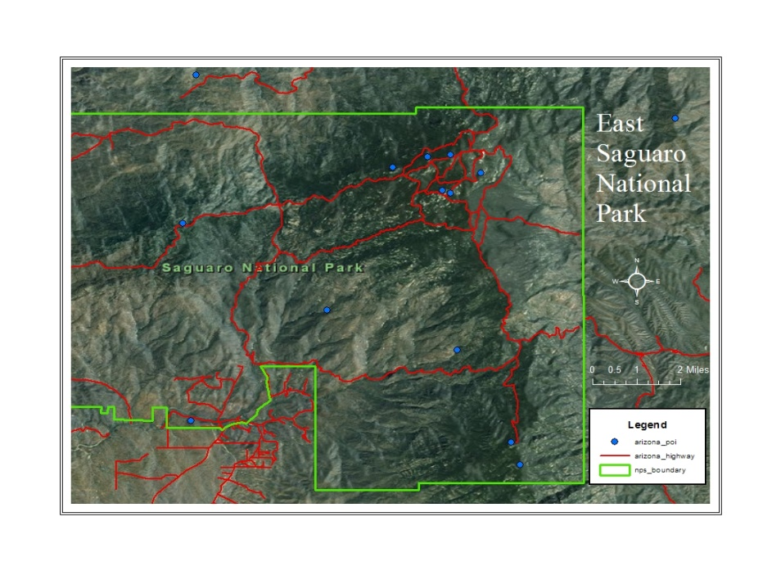
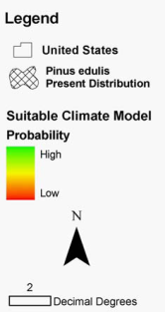
Different Baselines and Different Variables of Interest result in Different Predictions
For the Future
PRISM Group, Oregon
State University,
http://www.prismclimate.org,
created 10 Jul 2002
Arundel, S., Northern
Arizona University,
http://www.geog.nau.edu/gl
obal_change/climate_surfac
es.html, created 7 Jan 2003
(Duffy et. al, 2003)
(Govindasamy et. al, 2003)
(Cole et. al, 2007)
(Ironside Unpublished Data)
Outputs
Notes:
After people have collect all their data with hardware and the internet and processed the data with various software they come up a GIS product. The outputs resulting from GIS are tools used to communicate to you and others an understanding of geographic relationships of an area and/or location. The deliverable products can be maps, documents, images, posters, presentations, navigation information, Computer Aided Drafting (CAD) associations, verbal communications, tactical communications, spreadsheets, academic papers, engineering projects, and the display on your screen. These outputs have a variety of uses such as organizing a company’s product distribution and keeping a forest firefighter team in the right area.
The most common GIS output and a component of other outputs is the map so let’s about talk that. A good map is more than just a satellite image or aerial photograph and has many elements to it. The elements are what defines the map. What I mean by this is the elements that go into the map give the map shape and dimension so that it is useable to those reading the map. Something to keep in mind while we go over the elements is the map or any other GIS deliverable is a creative product. How the map turns out depends quite a bit on how you manipulate and layout the elements.

Slide 22
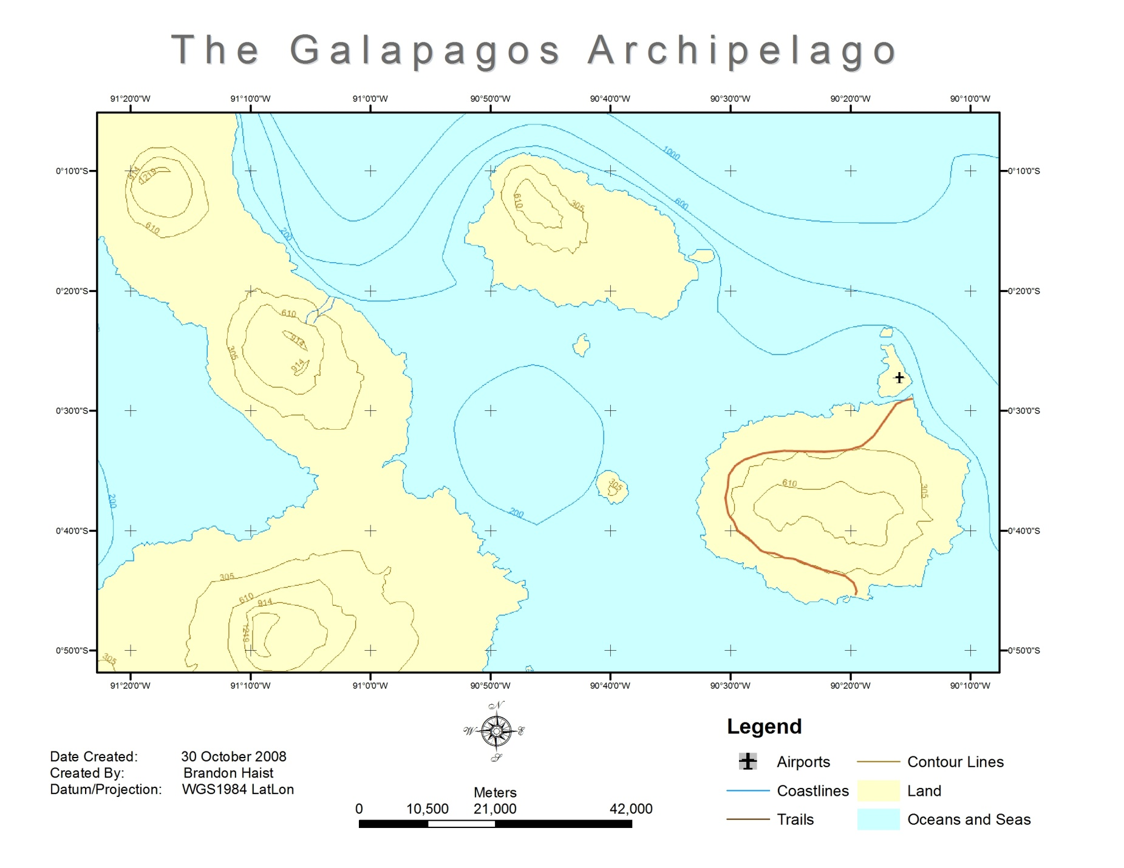
Map Title
Map area
Data Frame
Neatline
Grid
Legend
Documentation
Scale Bar
North Arrow
Notes:
Let’s cover each of these common map elements starting at the top. This a finished product of a GIS NOT a working GIS project window so please don’t get the similar terms here confused with such. First off we have the map title. Simple and intuitive. This of course tells us what we are looking at and the gives an idea of the purpose of the map.
Next, moving to our left, is the data frame. This marks the boundary between the data and the metadata or if you will, the main entrée and the supporting side dishes. Regarding the metadata, in this map everything inside the data frame might be able to stand on its own but without the stuff outside the data frame you lose quite a bit of background and interpretation about the main data including how to understand and use it.
Moving on we go next to the neatline. The frame of the whole product keeps everything organized and focuses our attention. Simple but effective.
Now we’ll take a look at the documentation. The documentation is important because it is raw and specific metadata that verbally gives the map’s background information. When someone refers to a product’s metadata they usually mean the documentation, especially in GIS. Here is a user case example: if we were tracking the customer base for a business using a map with “date created: 5 May 2001” we might not be able to track those customers who live in a new housing subdivision that was build in 2006. In this simple case if the documentation wasn’t there we might be using a map that was irrelevant for our purpose. You will want to document any pertinent information the reader of the map is going to need. The more technical the map the more documentation is needed.
Moving to our right we find the familiar scale bar. This friendly element can be a graphic as show here, can be stated with text such as 1 inch = 21,000 meters, or both can show up together on the map. So on our map here if were to measure a 1 inch distance between one point and another it would be equivalent to 21,000 meters on the actual earth.
Next up is the popular North Arrow or compass. This of course tells us what direction on the map is north. It can also orient us with east, south, and west. Even though it usually is, DO NOT make the mistake of assuming that the top of the map is always north. Always take at least a quick glance at the north arrow or compass (sometimes called the compass rose). Case in point: I have a trail map of the Paria Canyon, a really long canyon. The map is folded into several sections and it is easier to hold and read if done horizontally. This makes north on the left or right side of my Paria map depending on which way I am headed. On some maps the north arrow or compass will point in a direction other than the top of the paper or you rotate the map yourself like I did with my Paria map.
So Rounding the bend we have the Legend or key. This explains what the lines, areas, and points on the map mean. We can probably figure out that the blue areas on the map represent oceans and seas, but without the legend we could easily be puzzled regarding that curving brown line on the big east most island.
Now we come to the grid also know as the gradicule which is based off of a coordinate system. Most people are familiar with latitude and longitude and that is the grid you’ll most often find on a map you by at the store. They may also have simple coordinate system for that specific map of letters up one side and numbers across the top or bottom. The grid or grids (there may be more than one) allow the user to locate specific points and areas on a map and relate them or the whole map to the rest of the globe.
Lastly we arrive at the map area (which is often one and the same with the data frame). This is the meat of the map, the whole purpose for having the other elements, and where you communicate to your target audience. The map area contains your image, mountains, valleys, trails, rivers, lakes, streams, overlays, population data, traffic data, contemporary and historical battles, points of interest, locations of endangered rocks in Safford, the distribution of starving cats in Kingman, and other spatial relevance. In the map area you are visually presenting the spatial relationships of the physical components of a spot on earth and data connected to that spot.
There are additional elements that can be included such as a small reference image off to the side, a magnetic north arrow, a zoomed in inset map of a certain spot, or others but the ones shown here are the basics.

Slide 23
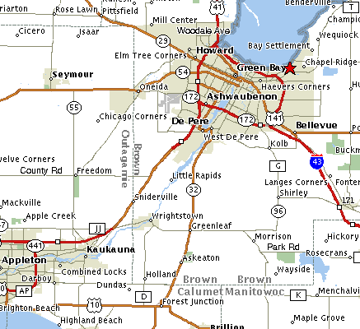
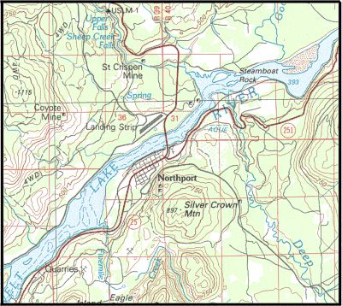
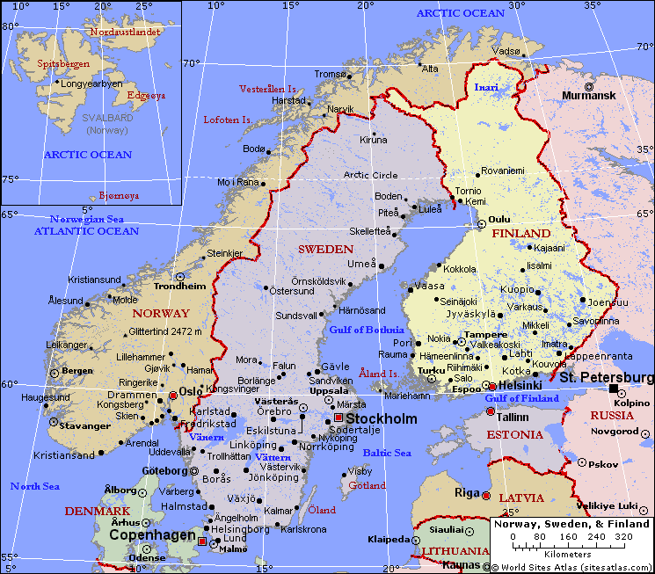
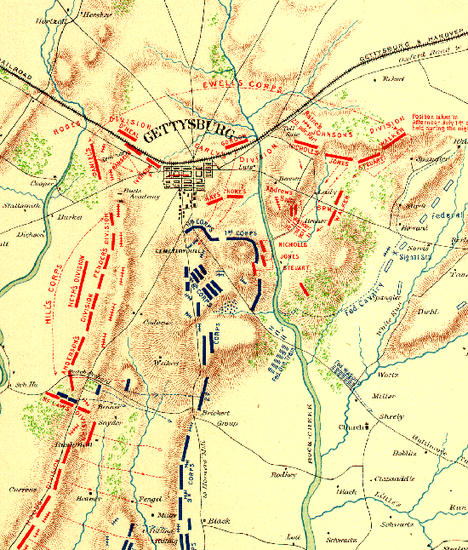
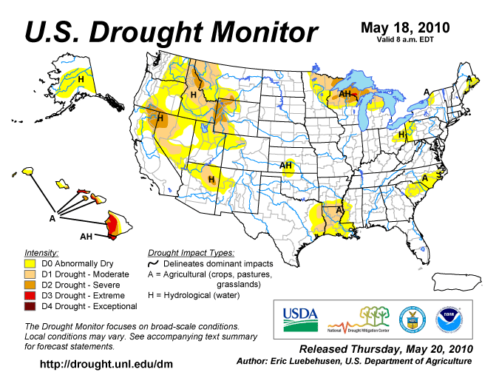
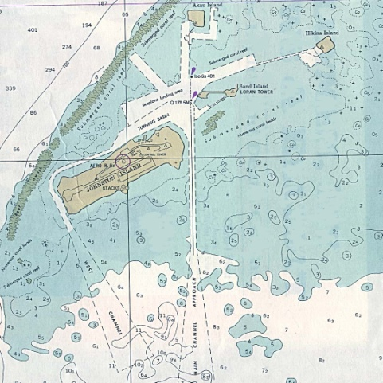
m
Map Types
Street/Directional
Topo/Physical
Political/Reference
Historical
Thematic
Charts
Notes:
The elements in your map also determine the type of map you are creating. For example, if you were to prepare a report for the county commissioner or you political science teacher you might want to use elements of a political or street map. Different people use different names and categories for different map types but here we are just trying to help you see there are different map types and the elements in them. Most of these are familiar if you’ve ever looked at a map.
First is the ever popular street or directional map. These show of course streets and where they are relative to each other. They won’t show much about the physical terrain other than blue for water and green for relevant park and tree areas. The street map usually has a have a plain background and may also show some points of interest like post offices and theme parks.
Second you have the topographical or physical map. The defining characteristic element of these maps are the contour lines that show elevation. These are meant for understanding trails, non-major roads, rural areas, topography (hence the name), basic hydrology, and the general lay of the land. They aren’t to good at showing urban areas but they do make good basemaps and are very good at helping people understand the shape of the land. They are often used with GPS units. The GPS units tells you where you are and the topo will tell you about the area. If you plan on adventuring outside of the city take one or more of these along and study it.
Third we have the political or reference map. These maps have the purpose of showing political boundaries relative to one another. They may show some major roads , cities, lakes, and rivers. They are good for understanding where places are in the world with out having being cluttered with contour lines (like in topos), detailed grids, insignificant points of interest, or every single road and town in the country. Like street maps, they too are not much good for understanding the terrain or elevation.
Fourth in line is the historic map. The historic map’s purpose of course is to help us understand the spatial conditions of an event or place in history. These can contain any of the defining elements of the three previously discussed map types as well as the next two maps types we will discuss. Historic maps have their own category because their unique element is the event or time they communicate. This type of map is an snap shot about a specific spatial happening. This can be as old as The Battle of Gettysburg shown here or as recent as the oil spill in the Gulf of Mexico. Also included in this category are vintage maps. The vintage may not show a specific event but because of the way maps were made back then we can learn something about the era in which it was made.
Fifth is the thematic map. I suppose any map could fit in this category as all maps have some sort of theme in them, but what makes this type stand out is that they are made to communicate specific contrasts in data distributed spatially. In other words the thematic map show the different amounts of certain type of data spread out over a geographic area. This can be anything from the population growth in a county over the past year to the number of guest on the different slides at Sunsplash. Sometimes part of the theme includes change over time. In the example here the map shows a theme of drought across the U.S. on May 18, 2010. Notice if you can, in the legend the color comparison of possible levels of drought and the distribution of those colors in the map area. Thematic maps are quite common in GIS.
Last we have charts. These cartographic products are important technical navigation tools for boats, ships, planes, and helicopters. The one shown here shows specific depths in the water at certain points as well as shore lines, sandbars, and other obstacles.

Slide 24
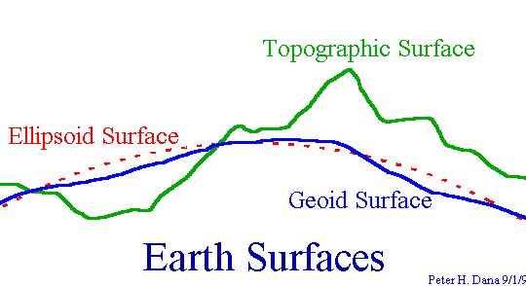
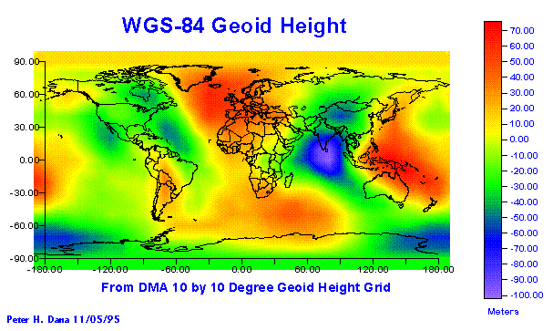
Geodetic Datum: What are they?
Define the size and shape of the earth
Used as basis for coordinate systems
Variety of models:
- Flat earth
- Spherical
- Ellipsoidal
WGS 84 defines geoid heights for the entire earth
Notes:
Our maps and other outputs are effective two dimensional representations of a real three dimensional world. Even if the final product can be viewed in virtual 3D. In GIS datum, projections, and coordinate systems are used to model the 3D into 2D. They help not only with the transition of dimensions but also with the spatial location of data. We start with Geodetic datum which define the size and shape of the earth and are the origin and orientation of the coordinate systems used to map the earth. Hundreds of different datum have been used to frame position descriptions since the first estimates of the earth's size were made by Aristotle. Datum have evolved from those describing a spherical earth to ellipsoidal models derived from years of satellite measurements. Modern geodetic datum range from flat-earth models used for plane surveying to complex models used for international applications which completely describe the size, shape, orientation, gravity field, and angular velocity of the earth.
While cartography, surveying, navigation, and astronomy all make use of geodetic datum, the science of geodesy is the central discipline for the topic. All you need to understand about datum in this workshop is that they are what provide the reference foundation for the coordinate system of your spatial data. You should also be aware that unless proper transformation happens while working with two or more datum in one project it may show the data layers added to the original layer as slightly off because each datum has a different way of taking the measurements of an irregular 3D earth and putting them on a uniform 2D surface.

Slide 25
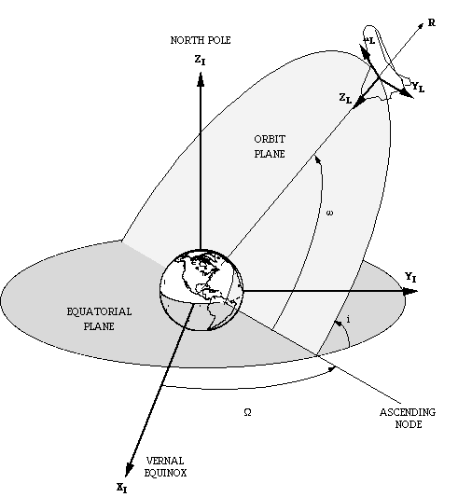
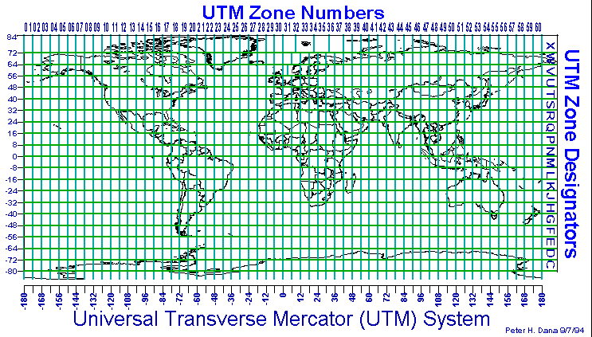
Coordinate Systems
Based on Geodetic Datum
Describe locations in two or three dimensions (ie. X,Y,Z or X,Y)
Local and Global
Common systems
Geodetic Lat, Long (global)
UTM (local)
State Plane (local)
Variety of transformation methods
Notes:
From the datum we get projections; from the projections we get coordinate systems. All three of these combined are often generically referred to as the projection. The projection is what develops the datum into a coordinate system. The coordinate system basically is a calculated grid placed over your data to put the data in the right place. Based on what datum are used to project a two dimensional surface of the earth you can come up with several different coordinate systems.
Most people are familiar with latitude and longitude but there are many others that are commonly used in work from engineering to marketing. Some are focused on the entire globe while others are for a local area (geocentric). Even though the coordinate grid may be geocentric it can often work for the entire world. The State Plane grid system was set up for state, county, and city governments and won’t work outside the United States but the UTM grid system developed by the United States Army Corps of Engineers works great world wide.
When the GIS software knows where your data is located via a datum based coordinate system it can project it onto other geographic layers such as a map and put it in the right place. Even though everything is in the right place the difference in projections may cause some visual misalignment.

Slide 26
Data in Google Earth
(Plate Carree)
Data in ArcMap
(AZ State Plane)
Common issue of working between different databases, Datums, and Projections – Data sometimes does not line up or has conflicts
Notes:
As I mentioned earlier when talking about datum, when we use two different projections you can get slightly off data. Polygons of buildings on the west side of central NAU campus were overlaid on a raster image with the projections Plate Carree on the left and Arizona State Plane on the right. As you can see two different projections are close but may not match up. The polygons on the left are not necessarily wrong but are in a projection that may have measured the earth differently enough from the projection of the raster image to cause a visual discrepancy. This can easily be fixed by simply re-projecting either the raster or polygon layer with GIS software. The problem may also lie in the database where the layers are stored and it may take some more technical work to get things to line up.

Slide 27
Any Questions?
Please Contact:
Mark Manone Training Facility Coordinator Mark.Manone@nau.edu (928) 523-9159
“To map out a course of action and follow it to an end requires courage”
Ralph Waldo Emerson
Notes:
So in this module we covered the different components of a GIS and how they work together. In the next three modules we will show you how to do some quality GIS projects. Please feel free to contact us at GRAIL with any questions. Also take a look at the next two screens about GPS/GIS and Remote Sensing.

Slide 28
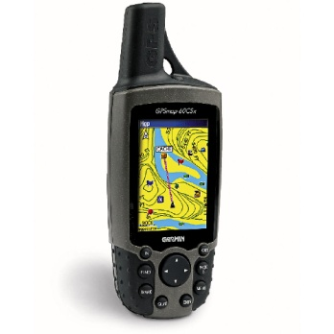
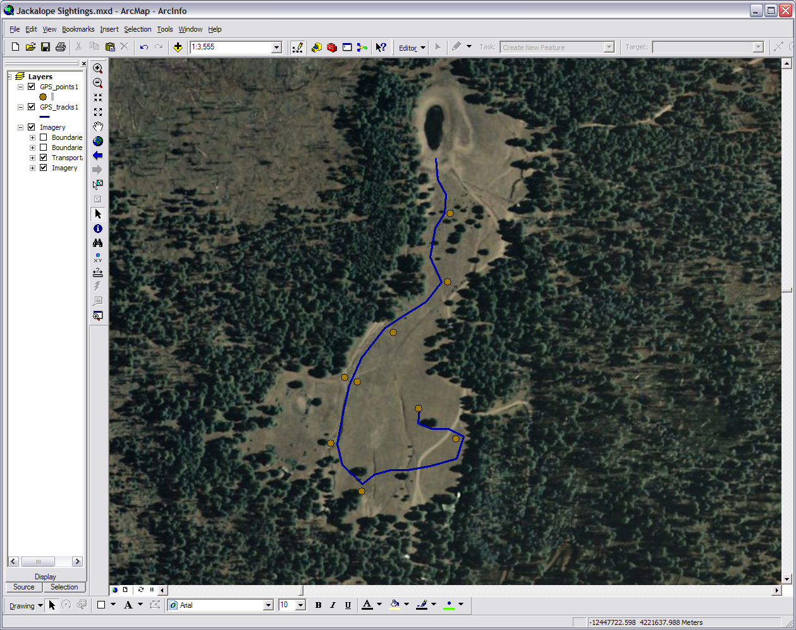
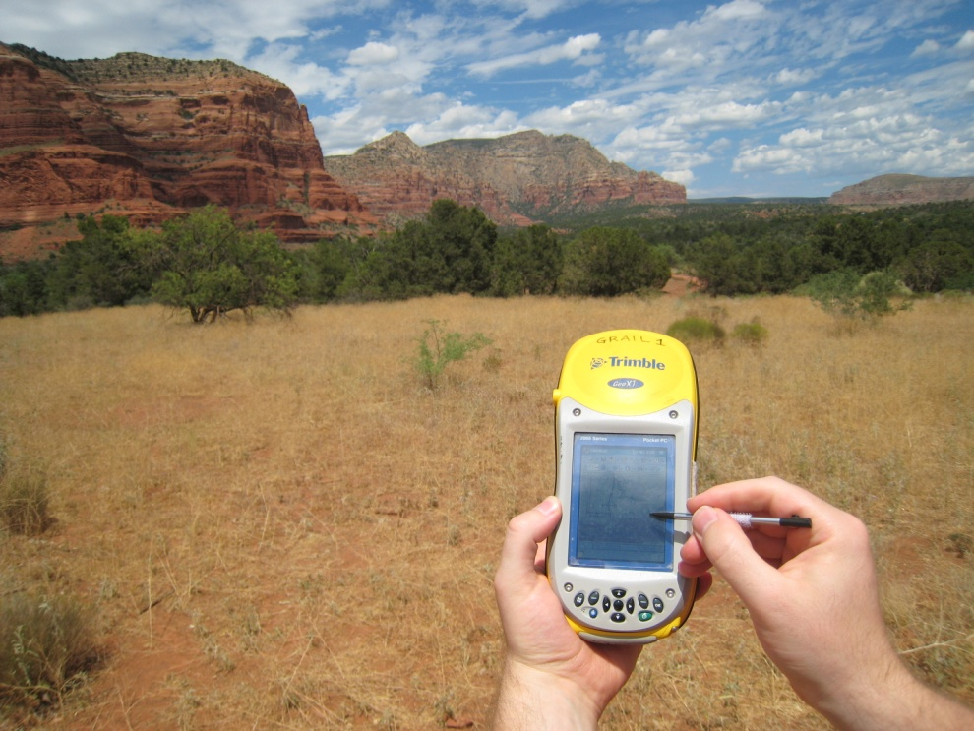
Satellite A
Satellite B
GIS
GPS
Satellite C
Satellite D
Notes:
GPS (Global Positioning System) is a common tool in GIS. Techniques for gathering data in the field often use a GPS receiver unit in some form or another. The way GPS work is there is a constellation of GPS specific satellites orbiting the earth that are constantly sending out signals and your GPS unit picks up those signals. Using a method called triangulation or trilateration the satellites and unit can pinpoint your position.
If you will look at the satellites and their signal spheres in the upper left image you see A and B overlap at the large white area. Bring in C and you have a more precise location at either the red or green dot. With D all four only meet at one point: the green dot. That is where you are. The GIS program on you home or office computer interacts with the GPS unit.
In the image on the bottom right I went out on a run near Kendrick Mountain and marked all the spots (waypoints) where I saw a jackalope burrow. The unit also created a record of my running path. I took my unit back to the office, download the waypoints and the auto created track, used a GIS program to put them on top of an image, and made a map.

Slide 29
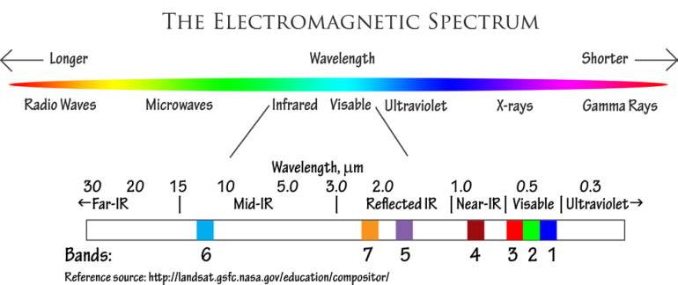
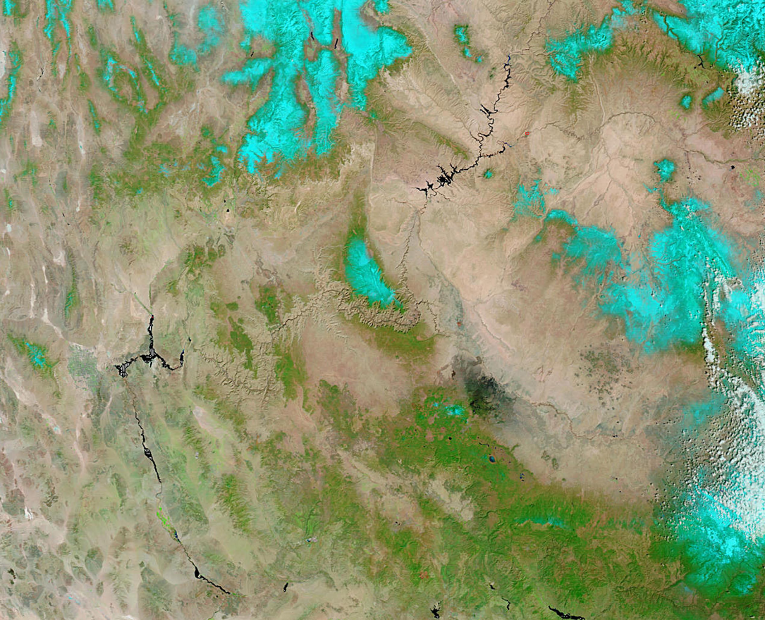
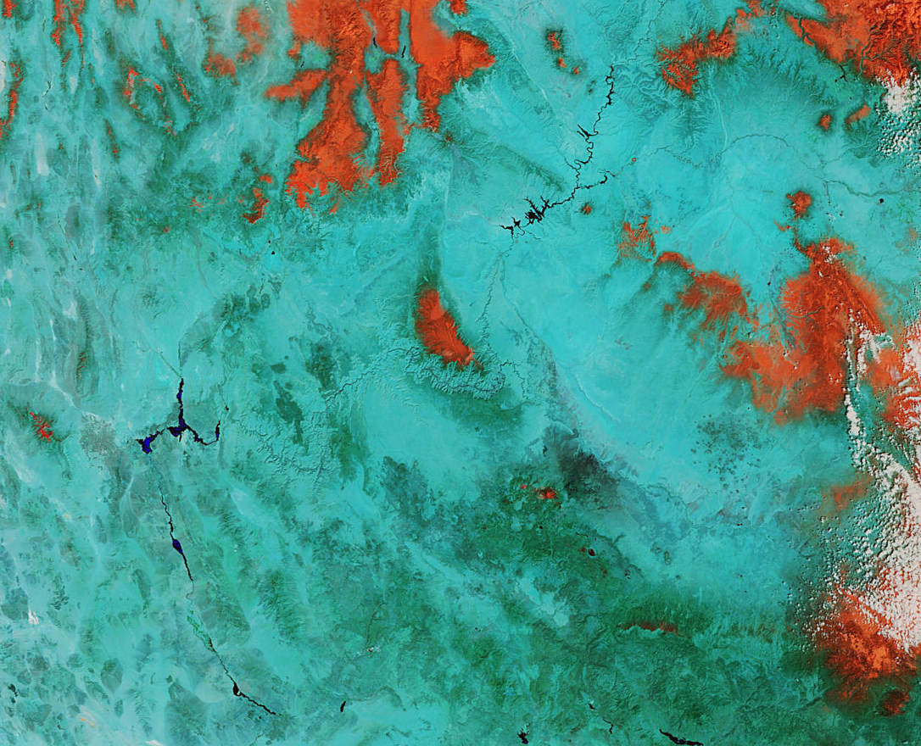
Remote Sensing
This image of the southwest corner of the Colorado Plateau is from the MODIS satellite system. The image is a combination of bands 7, 2, 1 in that order. This band combination is good for showing burn scars and potential flood areas after a fire. The burn scars show up as a distinct shade of red. Some of the more noticeable burn scars appear at the bottom center of the image and at the center of the image near the Grand Canyon. Date of image 27mar09, 500 meter resolution, source: http://rapidfire.sci.gsfc.nasa.gov/faq/#faq03
This image is also from the MODIS satellite system. The image is a combination of bands 3, 6, 7 in that order. The snow and ice appear orange because bands 6 and 7 are very good short-wave infrared bands for reflecting snow and ice. The darker the orange, or more red in color, then the thicker the ice crystals are. Date of image 27mar09, 500 meter resolution, source: http://rapidfire.sci.gsfc.nasa.gov/#faq03
Notes:
Where do we get the raster images of places on earth? From remote instruments that sense the radiation reflecting off the earth. The one you are probably most familiar with is a point & shoot camera. Remote Sensing is a discipline that often parallels GIS. It takes images from a device such an aerial camera or a satellite and manipulates them to analyze certain subjects. For example a satellite can remotely gather reflected radiation bands from the earth, visible and not, and make an image. Using different band combinations you can discover various kinds of information.
The two images here are of the exact same location but because of the dissimilar band combinations we have two sets of data. Let’s say we are doing a GIS project on ice and cold in this area over the winter of 2009. We can use the image on the right, and because the satellites picks up and send data regularly, use before and after images to provide thematic data. We can add tables and points of specific sites we’ve monitored from the ground, make all the data into several time progression maps, throw those maps onto a presentation poster, and have a complete GIS product.

