Slide 1
Cadet AFROTC Enrollment Templates
The following slides guide you on how to fill out the ROTC Releases and forms required when applying to AFROTC via the Holm Center website.
SSgt Deedrah Seth
Notes:
-Title Slide, Example

Slide 2
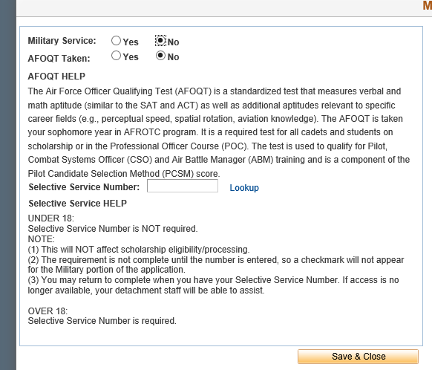
Required for Males Only Selective Service
Selective Service Requirement is for Males 18 and over Only. Females can skip this slide.
Under the Military Background tab in WINGS application process (Page 13 of the Applicant Guide) you will find the Selective Service Number Lookup block. If you click the blue lookup link it will direct you to the site to see if you already have a selective service number. If a record is not found you can use the site below to register.
When you are finished registering. A registration acknowledgement form will pop up. Please sign and upload into the additional supporting documents section (Page 21 of the Applicant Guide).
HOW TO REGISTER
The easiest and fastest way for a man to register is to register online
REGISTER ONLINE
Young men may now register online with Selective Service: www.sss.gov
Notes:
Easiest way to register is using the link above, www.sss.gov. Click the REGISTER ONLINE words at the top of the screen. Fill in the required information. Once You have received this information you will put your SS number on the AFROTC FORM 20 in the Selective Service Number box.

Slide 3
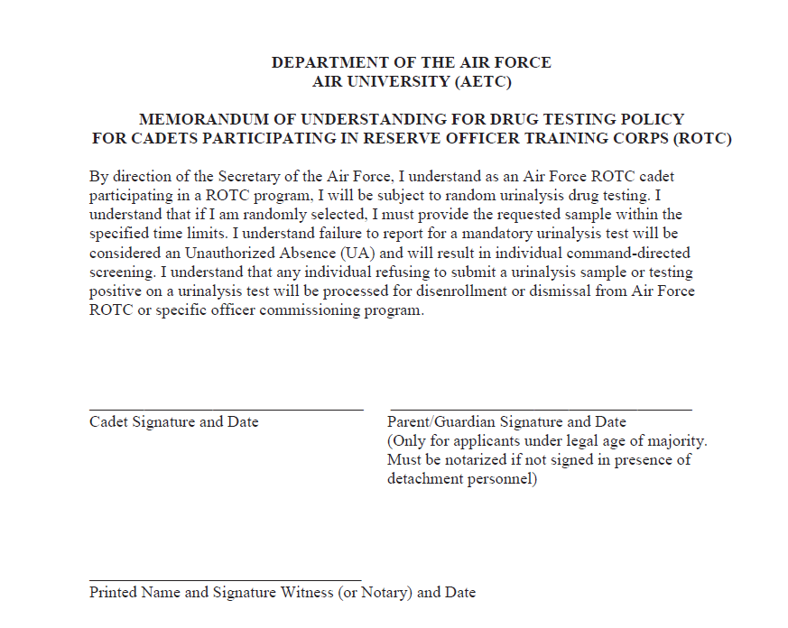
Drug Testing Policy
This form basically explains you are subjected to Drug Testing while participating in the AFROTC Program.
Please read statement and Sign and Date the Cadet Signature block. Please use date format shown DD Mon YYYY.
If you are over 18 the parent/guardian block can be left blank.
Note. If you are under 18 the form requires a parent’s signature. Parents will need to sign the form at your inprocessing appointment. If they are not available to attend inprocessing. They will need to sign the form in the front of a Notary. If the form needs a Notary signature you will need to bring the original form to your inprocessing appt.
Printed Name or Signature Witness or Notary. If you are over 18 leave the block blank. If you are under 18 and your parent is not able to attend inprocessing, that is where the Notary will need to sign. If the form needs a Notary signature you will need to bring the original form to your inprocessing appt.
Jane P. Doe
29 Aug 2019
Parent’s signature and Date is only required if you are under 18.
DO Not Write on this line for DET USE Or NoTARY USE Only

Slide 4
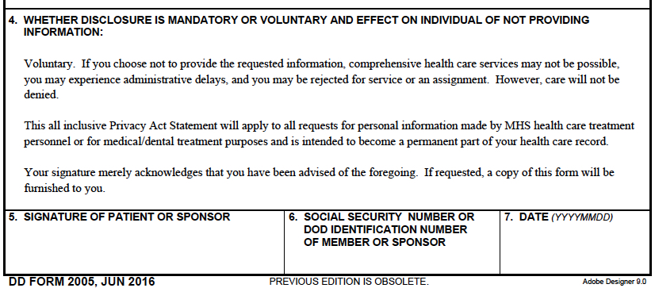
DD Form 2005
DD Form 2005-Privacy Act statement details what we will use your privacy act information for .
Read Entire form and sign Block and Enter SSN in Block 6 and enter date in Block 7.
Jane P. Doe
123-45-6789
20190829

Slide 5
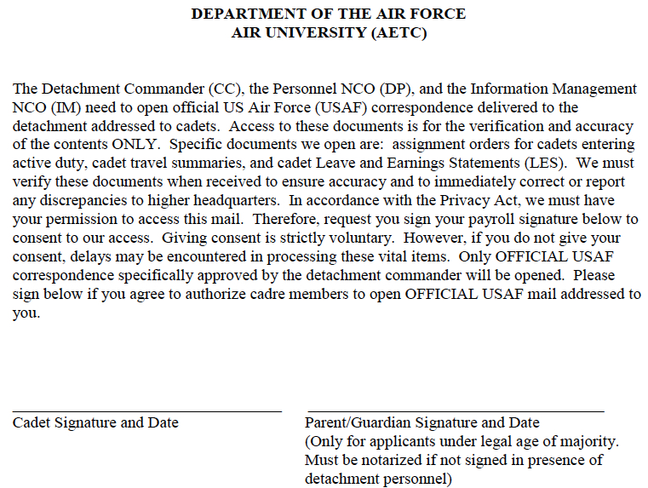
Mail Access Authorization MOU
Mail Access Form- Read the statement and sign and date on the Cadet Signature line. If you are under 18 your parent will need to sign the parent line. They must sign in our presence at inprocessing or if they are not available to come to NAU they must sign it in front of a Notary. If the form needs a Notary signature you will need to bring the original form to your inprocessing appt.
John D. Doe 28 Aug 2019

Slide 6
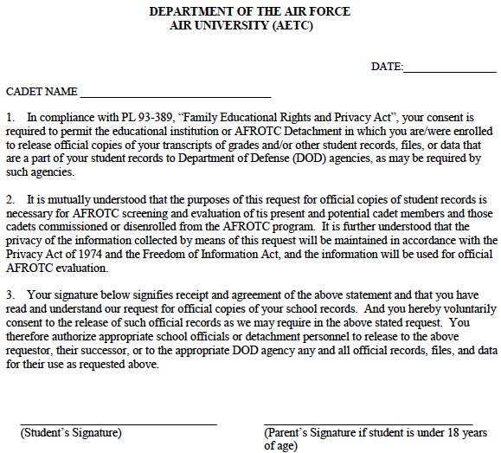
Request and Consent for Release of Student Records
20190829
Release of Student records- Authorizes the Air Force to receive student records from the school.
Read Entire form and sign on Student signature block. If you are under 18, make sure your parent signs as well.
Jane P. DOE
Jane P. DOE

Slide 7
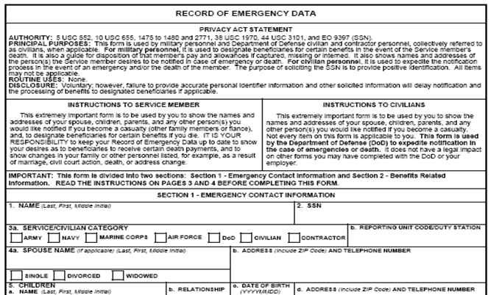
DD Form 93
This form basically explains who we need to contact in case of an emergency.
Block 1- Enter Last, First MI
Block 2-Enter Social Security Number
Block 3a- Mark appropriate Status with a “X” most Cadets are Categorized as a Civilian. Unless you are in the Active Duty or Reserve of any of the branches.
Block 3b.- Annotate AFROTC Det 027
Block 4a. Enter Spouse name if you are legally married. If not annotate N/A Single.
Also Mark the applicable block with an X…Single, Divorced or Widowed.
Block b. – Enter your current NAU address and cell phone number as shown. If you do not know your NAU address you can put your home of record address which is usually where you reside when you are not in school. Ex. Parent’s address.
Doe, Jane P.
123-45-6789
X
AFROTC Det 027
N/A Single
123 Apple Lane Kent, OH 45431
(937) 555-1012
X
Notes:
Use Pencil

Slide 8
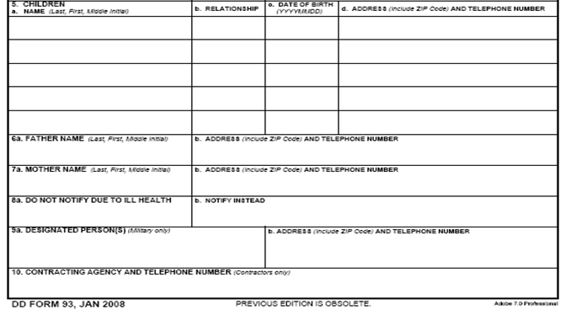
DD Form 93
Continuation of DD Form 93
Block 5- Enter N/A if you don’t have children. If you do have children list the applicable information as shown. For your children’s telephone if they are not old enough to have a phone list the primary care giver’s phone number.
Block 6a and 7a-List Father and Mothers Info as shown. Be sure to include full address and phone numbers. If your parent is deceased, please annotate “deceased” after their name.
8a/8b- Put N/A if we are allowed to contact you parents for any health emergency. If you do not want one of both of your parents notified if you are in ill health. Please list their names and who we should contact instead.
Block 9a/9b/10- Mark N/A. These blocks do not apply to you.
N/A
Doe, Kent J.
123 Apple Lane Dayton, OH 45431
(937) 555-1012
Son
20180204
Doe, Buck J.
Address
123 Apple Lane Dayton, OH 45431
(937) 555-1012
Doe, Betsie A.
123 Apple Lane Dayton, OH 45431
(937) 555-1012
Address
N/A
N/A
Doe, Jane Paula
N/A
N/A
X
Single
N/A
X
Notes:
Use Pencil

Slide 9
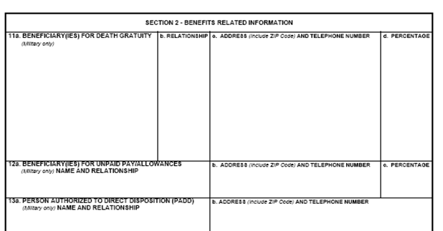
DD Form 93
Continuation of DD Form 93-Section 2 basically details who we can give your death benefits and remains to.
Block 11a-d- Input the applicable information of the individuals you would like to receive your death benefits. You can list as many as you desire. But the final percentage has to equal 100%.
Block 12a-b-List applicable information for the person you would like to receive your unpaid allowances in case of your death.
Block 13a-b- List the person we are authorized to release your remains to.
Doe, Buck J.
Father
123 Apple Lane Dayton, OH 45431
(937) 555-1012
50 %
Doe, Betsie A.
Mother
123 Apple Lane Dayton, OH 45431
(937) 555-1112
50 %
Or
Mother
123 Apple Lane Dayton, OH 45431 (937) 555-1112
100%
Doe, Betsie A.
123 Apple Lane Dayton, OH 45431
(937) 555-1012
100%
Doe, Buck / father
Doe, Buck / father
123 Apple Lane Dayton, OH 45431
(937) 555-1012
Notes:
Use Pencil

Slide 10
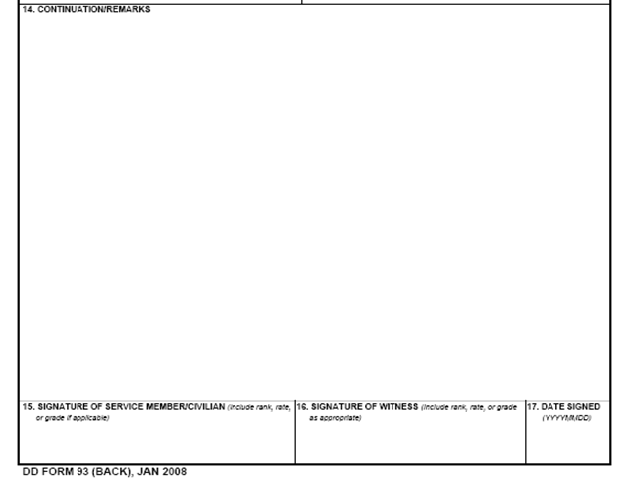
DD Form 93
Continuation of DD Form 93
Block 15- Sign and annotate Cadet after your signature.
Block 16-Do Not Sign- This is for DET use
Block 17-Annotate date as shown
Jane P. Doe, Cadet
Do Not Sign-NCO signs
20190828
Notes:
Sign & Date in Pen

Slide 11
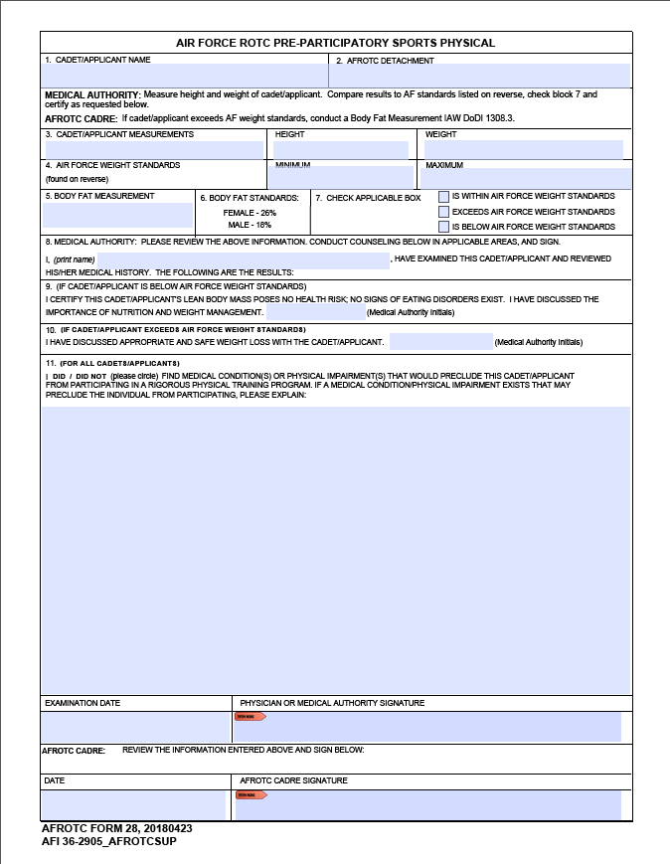
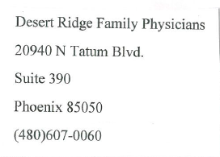
AFROTC Form 28 Sports Physical
John P. Doe
Det 027
68 in
155 lbs
Pre-Participatory Sports Physical (attached – Form 28 - Put your own name under #1. Take this form to your doctor or clinic and have them complete this form. They MUST add their (rubber) stamp to this form that denotes their name and/or clinic. This is required as most often the signature is unreadable. THIS form cannot be emailed—but instead delivered in person the next time you are at NAU. FYI—You cannot partake of any PT classes (beginning Fall 2019) if we do not receive this form. You will be required to attend the class but not participate.) Flagstaff also has Urgent Care (behind Dairy Queen) which charges $25 for this service; other areas charge $80!!
125
164 lbs
x
18%
Dr. Fix Doe
FD
FD
Doctor will need to List any medical conditions that preclude you from participating in Physical Training.
Ask Doctor to add their (rubber) stamp or typed info to this block that denotes their name and/or clinic. This is required as most often the signature is unreadable. Example Below
8-15-2019

Slide 12
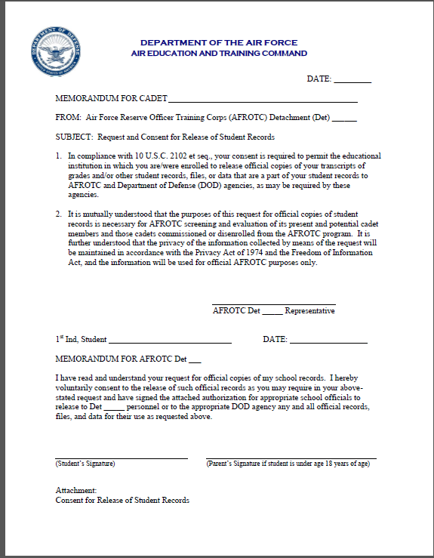
NAU Consent for Release
NAU Release Form This form is a student records release form for NAU. It authorizes the Detachment and Air Force to receive your student records. NAU requires a different form than the Air Force. Therefore, you are technically filling out two student release forms due to different format requirements by the Air Force and NAU.
Please fill out all items annotated in green with the applicable information. DO NOT WRITE ON THE RED LINE IT IS FOR DET USE ONLY.
28 Aug 2019
28 Aug 2019
Jane Doe
027
DO Not Write on this line for DET USE
Jane Doe
28 Aug 2019
027
027
Parent’s signature is only required
if you are under 18.
Jane P. Doe

Slide 13
Questions?
If you have any questions regarding the WINGS online application process or any of the forms please contact SSgt Deedrah Seth
Telephone: 928-523-4301
Email: Deedrah.Seth@nau.edu
Notes:
-Have pre-developed questions to promote Q&A
-Give time for the mentor/instructor to give their insight, if applicable

