Slide 1

Things we Wish we Knew
A top-down Perspective

Slide 2
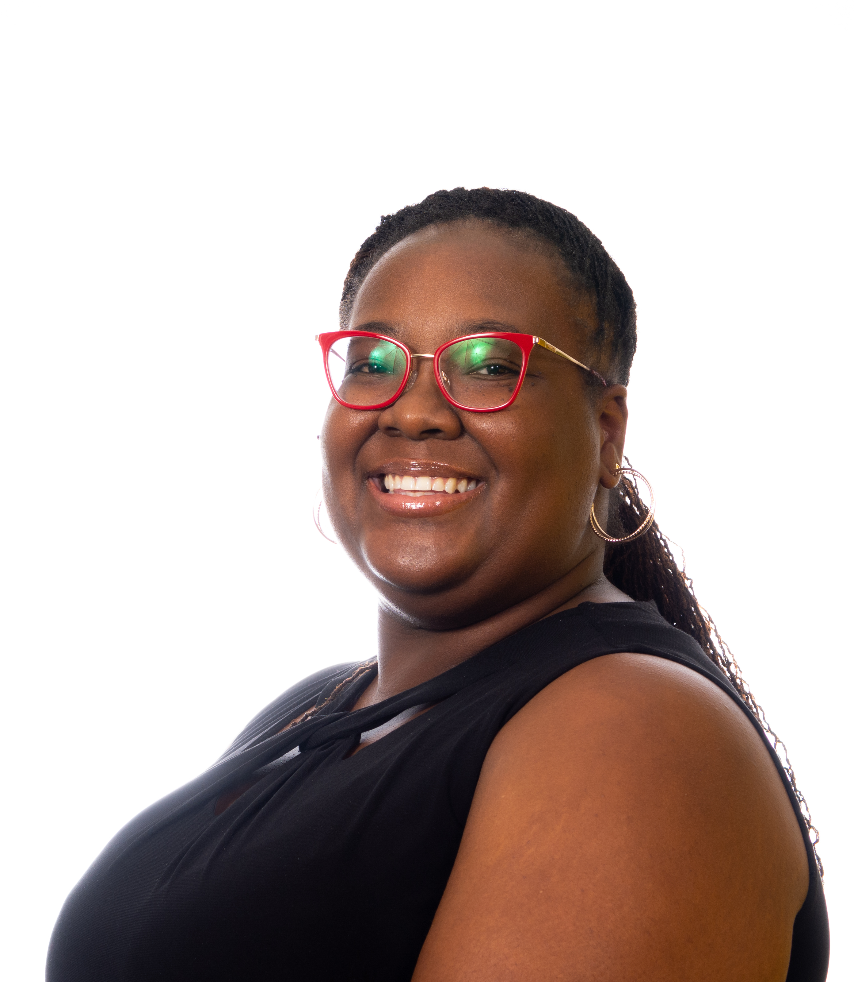
Jasmine Dean M.Ed.
5.5 years in Higher Education
3 years with ASU GEAR UP
6 months with Arizona GEAR UP (NAU)
Notes:
Who am I? Basic grant details

Slide 3
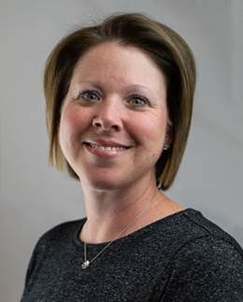
Jennifer Murphy Ph.D.
__ years in education
6 years in Higher Education
4 years with ASU GEAR UP
Notes:
Who am I? Basic grant details

Slide 4
ASU GEAR UP Grant
Award year 2018
1st GEAR UP Grant
Partnership

Slide 5

Year 1 – Part I Award Announcement & Preparation
October 2018
To
December 2018

Slide 6
October 2018 – December 2018
Accomplishments
District Meetings
Introduce grant guidelines
Develop working relationship for program success
Hiring
Hired entire professional team
Began hiring student workers to support tutoring efforts

Slide 7
Year 1 – Part II 7th Grade Initiating the grant
January 2019
To
March 2019

Slide 8

Full staff Day 1
Notes:
Describe day 1 sitting around going over the grant

Slide 9
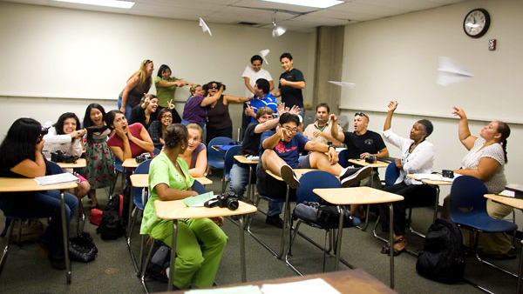

Full Staff Day 3
Notes:
Describe day 3 PEPS at Kino

Slide 10
Year 1 January – March 2019
Accomplishments
GEAR UP Overview
Sharing who we are to students, parents and school staff
PEPS
Interacted with entire cohort
Adapted for schools
Match
Began discussions on what and why
Good amount collected
College Visits/Guests
Three college visits
GEAR UP kick-off and motivational assembly

Slide 11
Year 1:
Things we wish we knew
How to get buy-in from admin and teachers
Insight from other GU programs
Attendance rosters don’t work
How to convince a school to want to work with you
How data needed to be collected
What data was important to collect
How to best compile the data
Who was our person

Slide 12
What is a growing pain you have experienced in your first year with GEAR UP?
What advice may you be able to offer to another program who may be struggling in that same area?

Slide 13
Year 2 8th Grade
April 2019
To
March 2020

Slide 14
Year 2 April 2019 – March 2020
Accomplishments
Cultural Engagement
Plays
Museums
Volunteer opportunity
Data Management
Acquired data management system
Back filled data
Involvement
Interest in resources
Buy-in from parents, students and school
National GU WEEK
Planned spirit week
Engaged entire school
Prizes
Summer School
Remedial math
Designed all-day summer school
Tutoring
Push-in and pull-out tutoring models
Focus on math

Slide 15
Year 2:
Things we wish we knew
How to show willingness to go above and beyond
How to get full buy-in to GEAR UP services
How to embed ourselves into the school
The secret to getting match
How to get commitment from school leaders
How to best reach guardians

Slide 16
Where are areas you feel your grant still needs to improve in?
Do you have any suggestions for these changes?

Slide 17
Year 3 9th Grade
April 2020
To
March 2021

Slide 18
Year 3: April 2019 – March 2020
Accomplishments
Good Relationships
Middle school relationships flourished, helpful in transition
Synergy Access
Open access to student records
District support
Adapted
Setup virtual resources
Supported everything
Tools
Tutoring platform
Texting platform
PDSA

Slide 19
Year 3:
Things we wish we knew
We were starting over
Our cohort would double
How to best prepare for services with half of the resources
How to provide better tutoring strategies at larger scale
To prepare for staff turnover
How to document emails, phone calls etc.

Slide 20
What is a tool or strategy you picked up during the pandemic that you have continued using?
How has this tool or strategy benefited your program?

Slide 21
ASU Pandemic Tool
Plan-Do-Study-Act (PDSA)

Slide 22
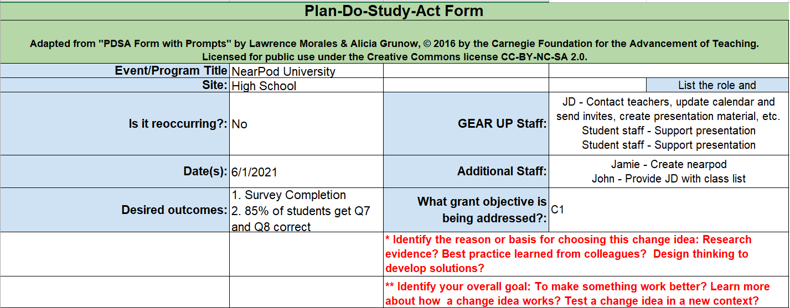
Plan-Do-Study-Act (PDSA)

Slide 23
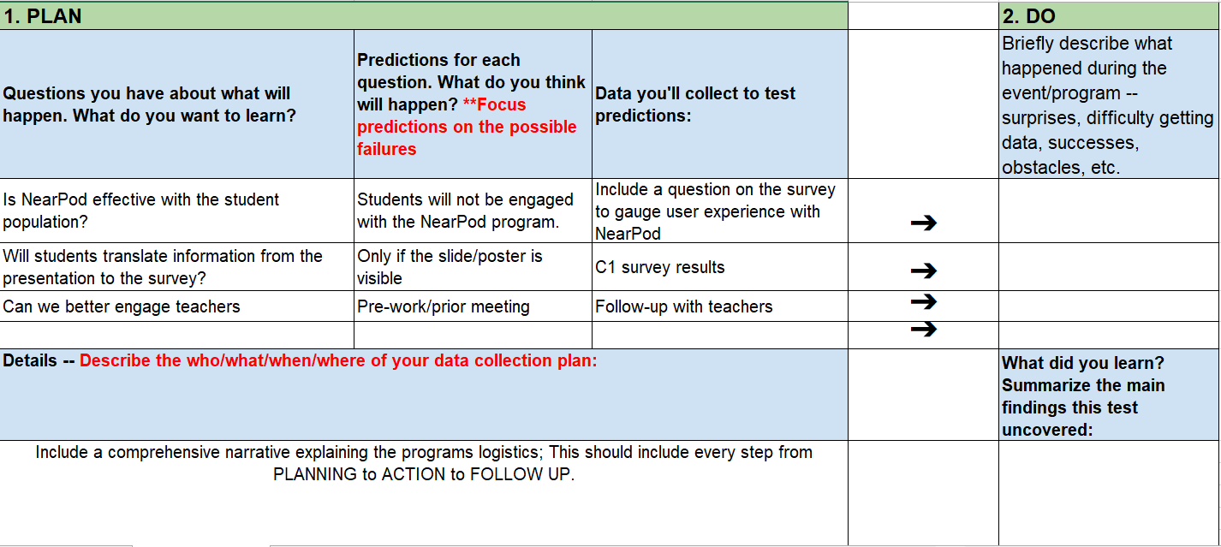
Plan-Do-Study-Act (PDSA)

Slide 24
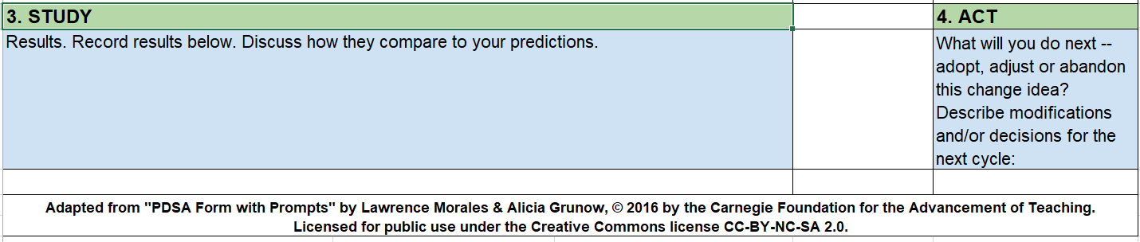
Plan-Do-Study-Act (PDSA)

Slide 25
Questions?
Jasmine Dean
Jasmine.Dean@nau.edu
Jennifer Murphy
Jennifer.Murphy@asu.edu

