Slide 1
June 11-16, 2017
GEAR UP Summer Leadership Academy

Slide 2
GEAR UP Summer Leadership Academy

Slide 3
Mission/Goal
The Mission of GEAR UP:
To significantly increase the number of students who graduate high school and succeed in college.
The goals of GUSLA:
To motivate students to succeed academically and to enhance students’ communication, decision-making, and leadership skills.
To help students create a vision of a positive future in which they see themselves as leaders in high school and as future college students -- all in a fun and supportive environment.

Slide 4
Administrative Staff
Steve Hart
Roxanne
Tie Guy
Andrea
Shawn
Rhae Lynne
Taylor
Notes:
Have each person stand up as you say their name and their role / how they will aid the TLs and students this week.

Slide 5
Pamela
Rena
Yolanda
Amber
Carmen
Maria
Daniel
Alfred
Workshop
Facilitators
(WFs)

Slide 6
Rayleen
Isabella
Kimberly
Geina
Darci
Camille
Chris T.
Efrain
Eliazar
Elizabeth
Lacey
Eleanor
Kevin
Jacob
Josely
Tim
Itzel
Stephanie
Kindra
RJ
Team
Leaders
(TLs)

Slide 7
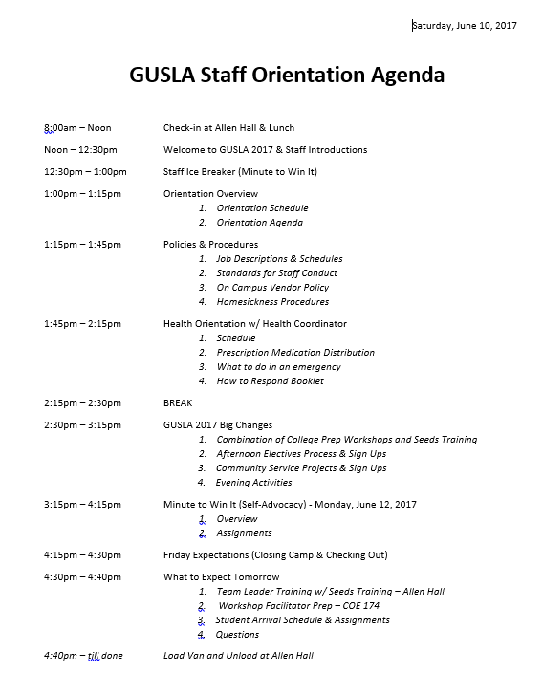
Orientation Overview
Orientation Schedule & Agenda (TAB 1)
Notes:
The schedule and agenda for this afternoon are behind Tab 1 in your binders.

Slide 8
Meal Card & Venues

Slide 9
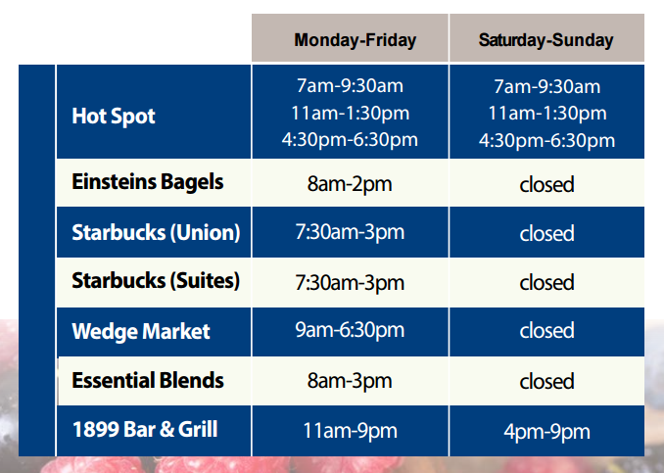
$250

Slide 10
Policies & Procedures

Slide 11
Job Description & Schedules (Tab 1)
TLs support Session Facilitators during scheduled activities by
helping to ensure that all students are engaged in discussions and activities; and
Consistently enforcing/reinforcing GUSLA rules and expectations for conduct. (You will be in the Student Orientation tomorrow when I go over the rules & expectations with students)
TLs facilitate/oversee students’ daily recreational activities.
TLs serve as role models for the students
TLs ensure the safety and well-being of the students at all times. (#1 priority)
Specific responsibilities/duties in job Description (Tab 1)
Long hours
take care of yourselves)
H₂0 to avoid altitude sickness

Slide 12
Team Leader Roles
Combine roles of former RAs and TAs
Residential Responsibilities
Wake Up Student
Breakfast, Lunch & Dinner Duty
Morning & Evening Medications
Evening Activities
Quick Hall meeting to give information about the following day (if needed) & Elective Sign-up
On call over night

Slide 13
Team Leader Roles
“Teacher” Assistant Responsibilities will only apply to Seeds Training.
Time Off
When you are not working with Seeds Training you are off
Monday – Wednesday
8:00am – 11:30am
2:00pm – 5:00pm

Slide 14
Standards for Staff Conduct (TAB 1)
No alcohol, tobacco or drugs
No obscene or derogatory Language
Maintain Professional boundaries
Sexual harassment prohibited

Slide 15
On Campus Vendor Policy (TAB 1)
GUSLA Student Use - With 240 GUSLA students, other summer camp students, and summer college students on campus, vendors can become very busy with long lines and long wait times. GUSLA students are expected to participate fully in all program activities, and waiting in vendor lines may cause delays that conflict with the schedule of activities. Therefore, students’ purchases from these vendors is limited to the following:
Vending machines, during breaks only, and only in buildings that allow food and drinks on premises.
NAU Book Store only during supervised, scheduled visits.

Slide 16
Homesickness
Familiar surroundings, people, and routines help us feel secure and relaxed. A new place feels unfamiliar at first, and the students are not sure what to expect. They may find themselves missing the comforts of home and loved ones. Those homesick feelings are completely normal. They might feel a little lonely, sad, or stressed.
Once the new surroundings and people become more familiar, feelings of homesickness go away.

Slide 17
Homesickness Tips
Keep the student active. Try not to let the student sit on the sidelines, they'll have more time to think about feeling sad. Have them talk to other students. Get them involved in activities. Before they know it, they'll be too busy to be homesick.
Have the student call home. A quick call to hear a parents’ voice or sibling can be comforting.
Have the student write in a journal. Putting feelings down on paper can help students understand them. Writing about homesickness can remind them what they really love about home. Tell them to make sure to write about some of the good parts of the new place, too.

Slide 18
Homesickness Tips (cont.)
Adjust expectations. Sometimes homesickness can include feelings of disappointment when a camp doesn't live up to their dreams. Help them accept the situation for what it is and make the most of it.
Encourage the student to talk to an adult. Missing their family and home is normal. But if after a couple of days away they're still feeling overwhelmed by homesickness, have them sit and talk to an adult, see if there is an adult they have started to develop trust with to share their feelings. That person can help them work through this tough time.

Slide 19
Homesickness (Cont.)
Remember that there's a good side to homesickness, too: It means they have family and friends worth missing and a place they want to return to when their adventure away from home is over.

Slide 20
Health Coordinator
Taylor (MA)

Slide 21
Health Coordinator Schedule
Office Hours
Allen Hall Health Coordinator Office – Room #235 (6:15am – 7:15am): Morning Meds
GUSLA Office/COE Health Coordinator/Director’s Office – COE Room #170 (8:00am – 5:00pm)
Afternoon Meds will be dispensed at lunch by the counter outside the Hot Spot entrance
Evening Meds dispensed at The Allen Hall Health Coordinator Room #235 (9:00pm – 10:00pm)
Always on call –
Cell phone : (425) 445-5004

Slide 22
Over the Counter Medication Distribution
There will be Medical Kit with basic over-the-counter (OTC)medications, plus a few extra items, e.g., feminine care products at Ashurst during Seeds Training. These medications can only be distributed by Admin Staff (Tie Guy, Roxanne, Taylor, Rhae Lynne & Andrea). They need to check the student application and document which OTC meds are allowed for each student.
During the workshops go to the Health Coordinators Office in COE Room #170 for student needs.

Slide 23
Medications
All prescriptions and over the counter medicine (Tylenol, Advil, Tums, Vitamins, etc.) must be turned into the Health Coordinator.
If you have any of these medications tell your RA this evening and bring it to the Health Coordinators Office tonight.
Notes:
This is what the students are being told

Slide 24
Prevent Altitude Sickness
Take it easy the first 48 hours
Drink Lots of WATER
Sleep
Notes:
This is what the students are being told

Slide 25
In case of an Emergency
Make sure the student is safe
Don’t leave student alone
If there is an Admin Staff in the area have someone get them
Call the Health Coordinator
If it is a big emergency call 911 & then Tie Guy
Responding to Illness & Injuries Booklet in front pocket of your binder; spend a little time this evening reviewing it so you are familiar with basic emergency response procedures.

Slide 26
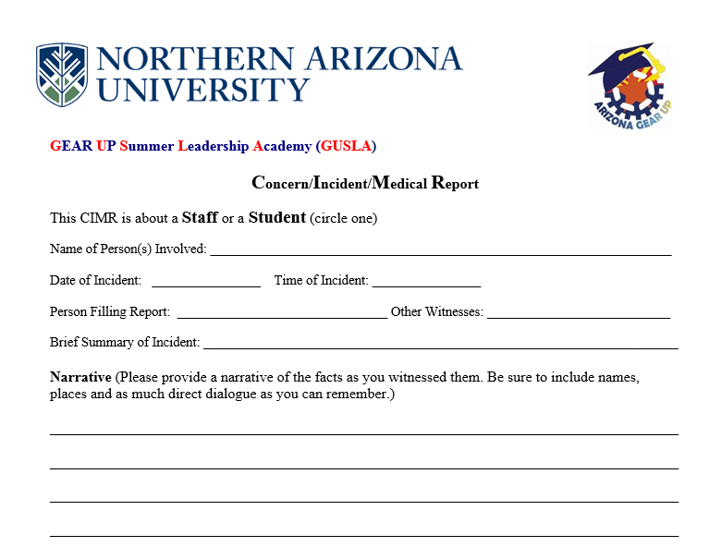
Concern/
Incident/
Medical Report Form
To be completed if you witness an accident, injury, or are requested to be GEAR UP Staff

Slide 27
Break…

Slide 28
GUSLA BIG CHANGES
Your Role, The Schedule, the Facilitators
Notes:
The role of the former TA and RA has been changed to the Team Leader, the schedule is very different from prior years and instead of classroom teachers facilitating small group sessions, we have an outside Youth Leadership Training Company facilitating large group activities for most of the day, Mon-Wed. These changes are all intertwined, and I’ll go over each in more detail now.

Slide 29
College Prep Workshops
College Game (Time Management)
Mock Interviews
College Panel
Scholarship Search
FAFSA & Financial Aid
Personal Statements
Socratic Seminar

Slide 30
Youth Training
http://www.seedstraining.com/

Slide 31
Seeds Training, Inc.
Justin Boudreau, Director of Programs and Lead Trainer
Hector Araujo, AZ GEAR UP Graduate, former GUSLA RA.
Kirk Hensler, videographer
Seeds Training has partnered with GEAR UP programs across the country to facilitate leadership activities at camps like this
Notes:
You will meet them and learn more at the training that starts at 8 am tomorrow

Slide 32
Team Leader Roles (cont.)
Seeds Training
Help facilitate the planned activities
Be a role model
Motivate Students to be active & participate

Slide 33
Afternoon Activities

Slide 34
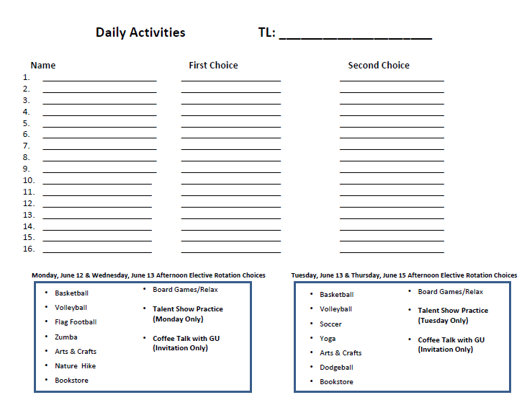
Afternoon Electives (12:30pm-2:00pm; M-Th)
Notes:
Before we go on to the Schedule for Thursday, I want to talk briefly about social media

Slide 35
Team Leader Roles - Electives
Make sure students sign up for their afternoon elective at night and turn in your sign in sheets by 10:30pm in the Health Coordinator Office
In the morning go to the Health Coordinator Office and check your mail box for your student afternoon elective roster. Remind your student what they signed up for, so they have everything they need before leaving the dorm, no changing elective later.
Prepare for the afternoon elective
Make sure you have your students at all times

Slide 36
Community Service Project & Personal Statement Day
Thursday, June 15, 2017

Slide 37
Service Projects
WFs will lead the Community Service Project and TL will assist
WFs
Know where you are going, contact person information & how you are getting there
Supplies needed
Take photos of kids in action
Group Photo

Slide 38
Evening Activities

Slide 39
Evening Activities
Minute to Win It (Self Advocacy)
Monday, June 12, 2017
Talent Show
Tuesday, June 13, 2017
Seeds Training
Wednesday, June 14, 2017
Dance
Thursday, June 15, 2017

Slide 40
Minute to Win It
Self Advocacy Evening Activity

Slide 41
Minute to Win It! (Self Advocacy Evening Activity)

Slide 42
Friday Expectations
Closing the camp & checking out

Slide 43
Morning
Normal morning
Wake students
Morning medications
Breakfast
After Breakfast
Walk student to Ashurst (same as Orientation)
Closing Ceremony
You will give the certificates to your Residential Students
Student Survey
WFs will bring student to assigned lab at the assigned time in COE.
Roxanne, Rhae Lynne, Shawn & Andrea will have the SAIS ID#s for students and will facilitate the survey

Slide 44
Checking Out Students
Students Pack and clean their rooms (including trash to dumpsters)
Collect borrowed linens
Check the students’ rooms. Make sure they are clean & have all their belongings. Once everything is good, collect their meal cards & room keys (they keep their lanyard and name tag)
Send students downstairs with their belongings and tell them to put their stuff by their school name poster
Once all your students are downstairs, come down stairs to help with lunches and supervision

Slide 45
After All Students are Gone
We will have a quick goodbye meeting in the Allen Hall Lobby
Turn student keys into the front desk
Make sure the residential hall is picked up, furniture returned to original place
Get lunch

Slide 46
Checking Out (3:30pm at the latest)
Clean your room & take out trash
Bring all belongings downstairs
Meet TG at the front desk
I will work with Allen Hall Staff to make sure you turn in your room key, access key card and meal card, then I will give you your pay check
Safe Travels

Slide 47
What to Expect Tomorrow
Sunday, June 11, 2017
Notes:
In the last five minutes, I’ll just review what you can expect tomorrow

Slide 48
Sunday June 11 (Student Day 1)
8am- TL training with Seeds (Allen Hall)
11 am – lunch
Noon – prep for students’ arrival
1 pm students Arrive / greet; help in dorm; walk to orientation
3:30 - orientation
5 pm – dinner
6 pm kick off with Seeds
8 pm - residence hall orientation; “brown bag”; settle in; prep for lights out
10 pm – lights out
Notes:
Describe what TLs are to do at each of these times… (Brown Bag described on next slide)

Slide 49
Sunday, June 11, 2017
Schedule
8:00am-11:00am Seeds Training in the 2nd floor meeting room in Allen Hall
11:00am-noon Lunch
noon-1:00pm Prep for student arrival
1:00pm WFs in Allen Lobby guiding students & TLs outside your room waiting for your students

Slide 50
Sunday, June 11, 2017
Schedule
1:00pm-2:00pm Have student put their belongings in their room, they will have time to unpack tonight. Once all students have checked in and are downstairs, come downstairs to help supervise
2:00pm Gather your students downstairs and start walking to Ashurst for Opening Ceremony
2:30pm-4:30pm GUSLA Student Orientation & Seeds Orientation

Slide 51
Sunday, June 11, 2017
Schedule
5:00pm-6:00pm Dinner
6:00pm-8:00pm Seeds Kick-Off Event
8:00pm-10:00pm Residential Hall Orientation, Settle In, “brown bag” items from students, prep for lights out
10:00pm Lights out

Slide 52
Day 2-4 (Monday-Wednesday)
6:00am Wake Up & Get Ready for the Day
7am—7:45am Breakfast in the Student Union
8am—11:30am Leadership & Workshop Activities
11:30am—12:15pm Lunch in the Student Union
12:30pm—2pm Elective Activities
2pm—5pm Leadership & Workshop Activities
5pm—5:45pm Dinner in the Student Union
6pm—9pm Evening Activities
9pm—10pm Team Leader Check-in, Sign Up for an Elective & Lights Out Preparation
10pm Lights Out

Slide 53
Day 5 (Thursday, June 15)
GUSLA Service Day
8am-10am Service Projects
10am-11:30am Socratic Seminars
11:30am-12:30pm Lunch
12:30pm-2pm Afternoon Electives
2pm-5pm Personal Statement & Survey
5pm-5:45pm Dinner
6pm-9pm Dance

Slide 54
Day 6 (Friday June 16)
Breakfast
Closing Ceremony
Pack up / Clean up
Depart NAU at 1pm

Slide 55
Brown Bag
Last Chance
If you do not want the item(s) back
Brown Bag it and throw it in your Residential Team Leader’s trash
If you want the item(s) back
Show your Residential Team Leader the item(s)
Put it in a Brown Bag with your name
Give to your Residential Team Leader
Notes:
This is what the kids will be told during the 3:30 orientation. So in the evening, when you’re doing your Residence Hall Orientation, be sure to pull out your brown bag and ask the students to deposit any “non-allowed” items in it.

Slide 56
Social Media
& AZ GEAR UP

Slide 57
Facebook
We have two Facebook Accounts
Arizona GEAR UP https://www.facebook.com/AZGEARUP/
GUSLA https://www.facebook.com/AZGUSLA/
Please have students follow, like, share, & tag, and post photos and impressions throughout the week.

Slide 58
Instagram
We have a GUSLA Instagram Account. This account is student-centered. It is used to motivate students and promote GUSLA.
GUSLA https://www.instagram.com/azgusla/
Please tell your students to follow, like, tag, & share GUSLA stories/photos throughout the week.
Notes:
Be aware of students who DO NOT have photo releases. Do NOT take and post their photos!

Slide 59
Questions?

