Slide 1
Creating a College-Going Culture: How Are We Doing?

Slide 2
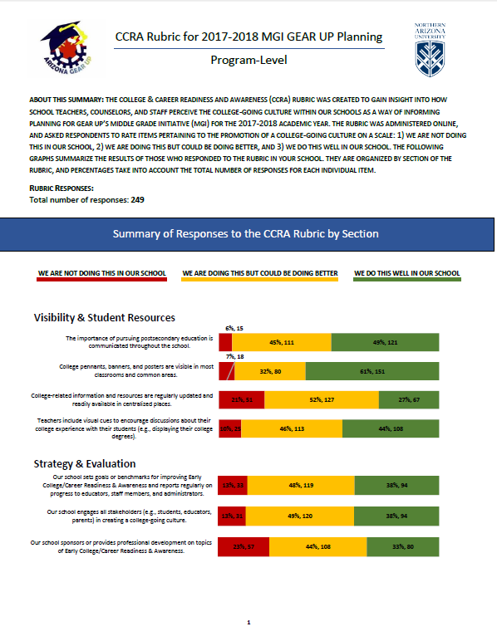
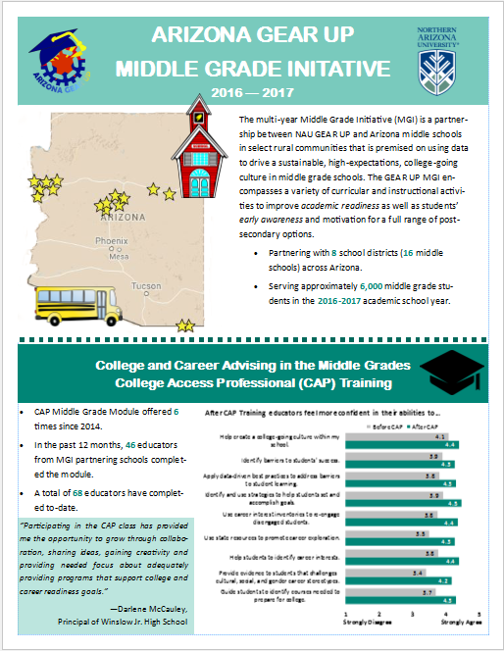
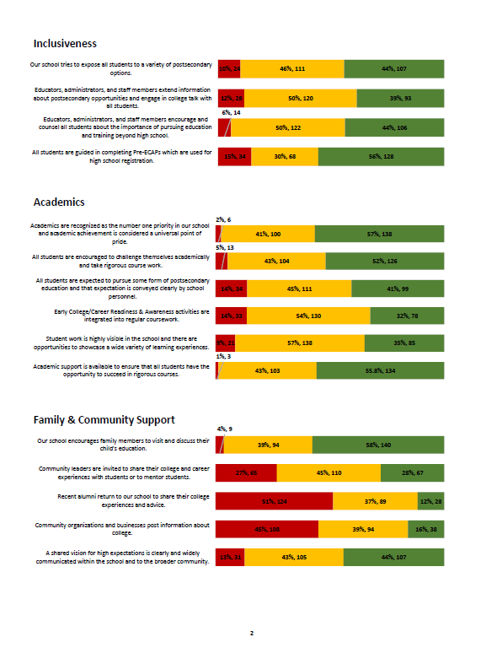
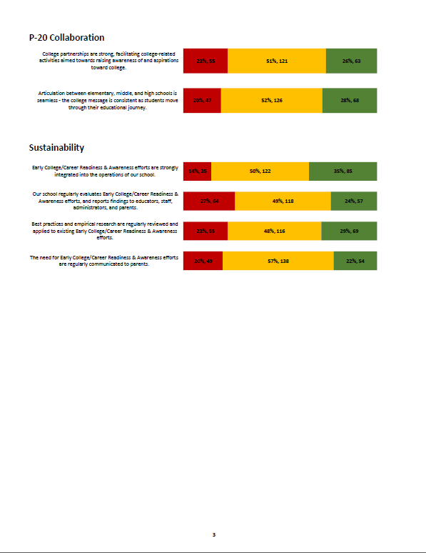
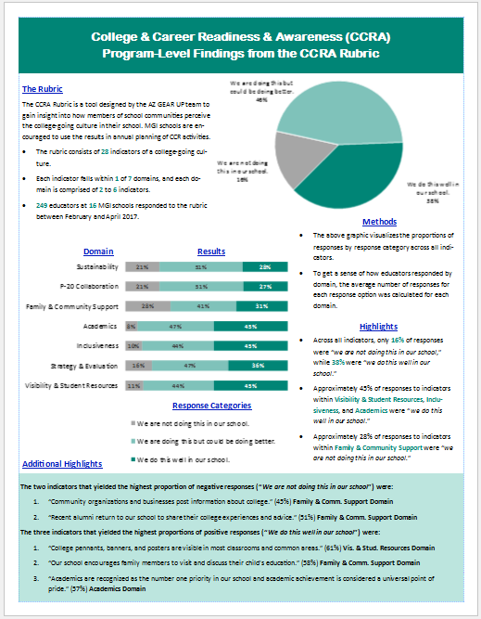

Slide 3
How are we doing, according to educators?
College & Career Readiness and Awareness (CCRA) Rubric
“To what extent are we enacting indicators of a CCRA-culture in our school”
28 total indicators
Indicators categorized within one of seven domains
Visibility & Student Resources | Family & Community Support
Strategy & Evaluation | P-20 Collaboration
Inclusiveness | Sustainability
Academics
Notes:
Second year tool has been used.
2015-2016 (n = 307)
2016- 2017 (n = 249)
All 16 MGI schools participated.

Slide 4
Visibility & Student Resources

Slide 5
Strategy & Evaluation

Slide 6
Inclusiveness

Slide 7
Academics

Slide 8
Family & Community Support

Slide 9
P-20 Collaboration

Slide 10
Sustainability

Slide 11
College Access Professional (CAP) Training Class
Specific Middle Grade Module has been offered 6 times since 2014
In the past year, 46 educators from MGI partnering schools have completed the module.
Since 2014, 68 have completed.
Average of 9 completers per district. (3 – 18, Median: 5)
“In what ways do participants feel more confident in their abilities before and after completing the CAP Class?”
Notes:
It is important that the professionals who go through this class are given opportunities to utilize their skills.
Later this morning, we will hear from some of your colleagues about how they’ve applied materials from the CAP class in their school.
When reviewing the data, it might be useful to think how this class, and those who have completed it, could be used in your schools.

Slide 12
Prompt | Pre-test Mean | Post-test Mean
It is important to focus on College & Career Readiness in the middle grades. | 4.6 | 4.8
I am a part of a team that aims to promote a college-going culture in my school. | 4.4 | 4.5
I feel confident in my abilities to help create a college-going culture in my school. | 4.1 | 4.4
I feel confident in my abilities to identify barriers that impact students' ability to reach their education and career goals. | 3.9 | 4.3
I feel confident in my abilities to apply data-driven best practices to address at least one barrier to student learning. | 3.8 | 4.3
I feel confident in my abilities to identify and use strategies to help students set academic goals and monitor progress towards those goals. | 3.9 | 4.5
Notes:
Discuss the prompt
Discuss why this text differs from what’s on the IG

Slide 13
Notes:
It is important to focus on College & Career Readiness in the middle grades.
I am a part of a team that aims to promote a college-going culture in my school.
I feel confident in my abilities to help create a college-going culture in my school.
I feel confident in my abilities to identify barriers that impact students' ability to reach their education and career goals.
I feel confident in my abilities to apply data-driven best practices to address at least one barrier to student learning.
I feel confident in my abilities to identify and use strategies to help students set academic goals and monitor progress towards those goals.

Slide 14
Prompt | Pre-test Mean | Post-test Mean
I feel confident in my abilities to use career interest inventories and other strategies to re-engage disengaged students | 3.8 | 4.4
I feel confident in my abilities to use state resources to promote career exploration in my school. | 3.5 | 4.3
I feel confident in my abilities to help students to identify their career interests. | 3.8 | 4.4
I feel confident in my abilities to provide evidence to students and their guardians that helps to challenge and dispel cultural, social, and gender career stereotypes. | 3.4 | 4.2
I feel confident in my abilities to guide students to identify courses needed to prepare for college and career. | 3.7 | 4.3
I have adequate resources to help promote a college-going culture within my school. | 3.3 | 4.3

Slide 15
Notes:
I feel confident in my abilities to use career interest inventories and other strategies to re-engage disengaged students
I feel confident in my abilities to use state resources to promote career exploration in my school.
I feel confident in my abilities to help students to identify their career interests.
I feel confident in my abilities to provide evidence to students and their guardians that helps to challenge and dispel cultural, social, and gender career stereotypes.
I feel confident in my abilities to guide students to identify courses needed to prepare for college and career.
I have adequate resources to help promote a college-going culture within my school.

