Slide 1
HOW TO FILL OUT A TRANSMITTAL AND AN HOURLY TIME SLIP CORRECTLY

Slide 2
Initial Step’s to completing the transmittal and time slip
Final Deadline for transmittals and time slips is due by 3:30pm Monday of Pay Week. This will change for Holidays.
Both transmittal and time slip must be completed in INK, not pencil.
You can find the transmittal and time slips on the Human Resources website at: www.hr.nau.edu under the "Forms Index".

Slide 3
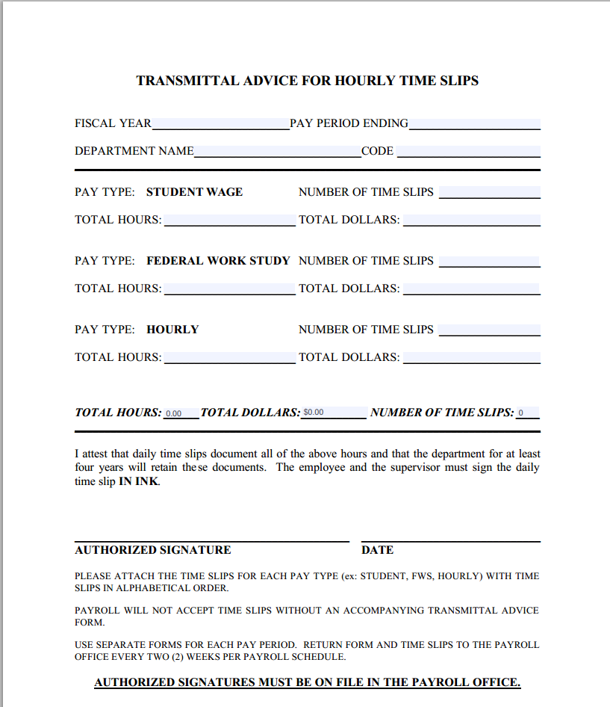
Example of a Transmittal Form – A Transmittal Form must accompany an hourly time slip. Complete the appropriate shaded areas.

Slide 4
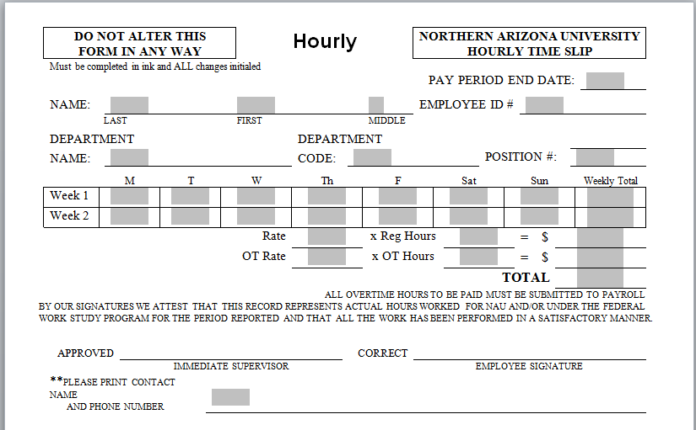
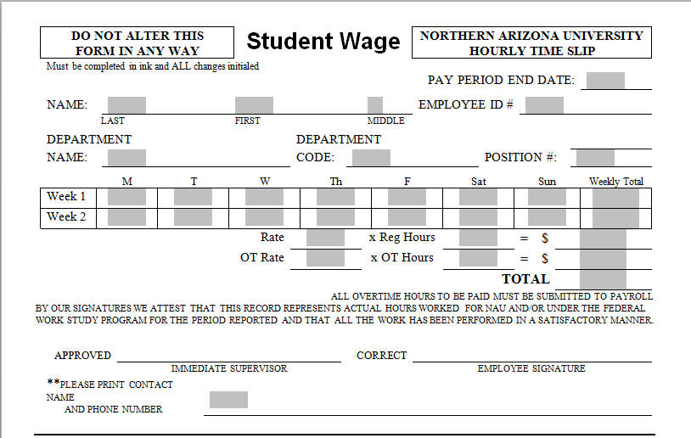
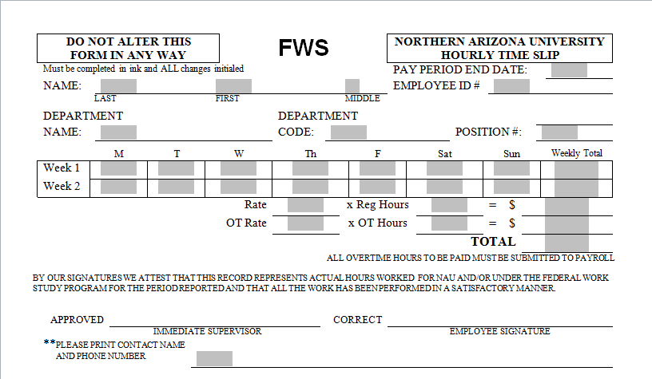
Example of a Hourly Time Slip. Please use the appropriate time slip for the Empl Group (Student Wage, FWS or Hourly). The Hourly time slip is for Part-Time Temp positions.

Slide 5
Next Steps
If this is for Back Pay write ‘BACK PAY’ across the top of the time slip.
PLEASE AUDIT THE TIME SLIP BEFOR SENDING OVER TO HR. It’s Very Important the Transmittal and Time Slip are completed in their entirety for Payroll entry.
If information is missing the next step is for HR to contact the department and this may run into time constraints when Payroll is closing and may delay the employee from getting paid timely.
Fill in the pay period end date according to the Payroll Schedule. This would be the last day of the pay period, not the last day worked during the pay period according to the payroll schedule.

Slide 6
Fill in the employees ID number. This is not their Social Security number. All entry done by payroll is done using the employee ID number.
Fill in the Department Name.
Fill in the Department Code (HR Department Number).
Fill in the correct position number. Be sure the position# is active for the pay period.
Fill in the weekly total of hours for Week 1 and Week 2. Do not add hours that are back pay from a previous pay period onto the hours for the current pay period. Adding hours from a previous pay period may result in overtime hours and possibly an overpayment.

Slide 7
Fill in the correct hourly rate x the total number of hours worked for the pay period = the total dollars.
The supervisor must sign the form approving the hours for the employee. They are confirming that everything is correct. "On File" is not acceptable. Without a signature the employee will not get paid.
Make sure there is a contact name and phone number printed clearly at the bottom and the entire time slip is legible. IF WE CAN'T READ IT WE CAN'T PAY IT.

