Slide 1


OFFICE OF GRADUATE & PROFESSIONAL STUDIES
3-MINUTE RESEARCH PRESENTATION (3MRP) COMPETITION INFORMATION
Thursday, April 9, 2026

Slide 2
What is the 3MRP?
The 3-Minute Research Presentation (3MRP) is a dynamic competition where graduate students showcase their thesis, dissertation, capstone project, or creative work and research, and explain its significance to an intelligent, non-specialist live audience in just three minutes.
Participants are allowed one stationary slide to support their presentation, making clarity and impact essential.
Participants must present research that includes some existing findings or evidence. The project or research does not need to be fully completed, but it must go beyond a proposal and show data or results that have already been collected.

Slide 3
Background
Based on the “3-Minute Thesis” (3MT®)
Developed by The University of Queensland, Australia in 2008
3MT® is a form of research aimed at:
“Developing academic, presentation, and research communication skills and supports the development of research students’ capacity to effectively explain their research in three minutes in a language appropriate to an intelligent but non-specialist audience.”
NAU’s 3MRP competition will allow students to:
  Communicate the significance of their research to a general audience in a public forum.
  Develop skills that increase a language-base suitable for a wide range of audiences.
  Develop and improve presentation and communication skills.

Slide 4
Rules
A single static PowerPoint slide is permitted
  No slide transitions, animations, or any form of movement; the slide must be visible from the start of the oration.
No additional props (e.g., costumes, musical instruments, laboratory equipment) are permitted.
Data and research presented in the competitions should be considered as information likely to enter the public domain.
Presentations are limited to three minutes, and competitors exceeding three minutes will be disqualified.
Presentations are to be spoken word (no poems, raps, or songs).
No notes, assistance, or reading/partial reading of the presentation is allowed.
The announcer of the 3MRP program will introduce you by name and the title of your presentation. The timer will start as soon as the presenter begins talking.
The decision of the judges is final.

Slide 5
Preliminary Heats vs Final Competition
Although the Preliminary Heats will be held on Zoom, the finals will be in person. Your score results in the preliminary round determine whether you advance to the final competition.
Key Expectations:
  Same Level of Effort - Prepare and present as if you are in the final competition.
  Professionalism Matters - Dress appropriately, minimize distractions, and ensure your technology works smoothly.
  Be Fully Prepared - Memorize your presentation and rehearse thoroughly.
  NOTE: Judging Standards Are Consistent - Judges will evaluate preliminary heats using the same criteria as the final competition.

Slide 6
Evaluation Criteria
Comprehension of Presentation (Maximum Score = 15)
  Clarity (5 pts.)
  Delivery (5 pts.)
  Visuals (5 pts.)
Intellectual Impact (Maximum Score 10)
  Intellectual Significance (5 pts.)
  Intellectual Curiosity (5 pts.)
Audience Communication (Maximum Score = 10)
  Suited to a Non-Specialist Audience (5 pts.)
  Context (5 pts.)
For more information please visit:
https://nau.edu/graduate-professional-studies/3-minute-research-presentation/

Slide 7
Deadlines & Timelines
Event | Deadline Date
Prepare Slide | Between January 31st- February 19th
Submit Preliminary Heat slide to 3MRP@nau.edu | By February 20th
Sign up for Preliminary Heat time slot (link will be provided) | By February 23th
Preliminary Heats via Zoom - Presentation slots will be 15 minutes each | March 3rd and March 4th
Notification of finalists to NAU email | March 6th
Submit Bio, headshot, and final 3MRP slide to 3MRP@nau.edu | By March 20th
Final Competition Presentations | Thursday, April 9th, 3:00-4:30pm Location: NAU- Flagstaff Mtn. Campus, Ashurst Auditorium, Bldg. #11

Slide 8

Resources
Cline Library:
Subject Librarians: https://nau.edu/library/contact-your-subject-librarian/
Video recording/editing equipment and software
Practice rooms and quiet spaces
The Studios: https://nau.edu/library/the-studios/
Office of Graduate & Professional Studies: Email: 3MRP@nau.edu
3MRP Website: https://legacy.nau.edu/graduate-professional-studies/3-minute-research-presentation/
Example Presentations:
Global 3MT®: https://threeminutethesis.uq.edu.au/watch-3mt
NAU 3MRP YouTube: https://www.youtube.com/channel/UCbQ9jexnahuTLb1faE7KPGw
UBC 3MT®: http://3mt.grad.ubc.ca/videos-images/2013-finalists/
Additional Tools:
“Making the Most of Your 3 Minutes”: https://simonclews.com/wp-content/uploads/2018/06/YTSN.pdf
3MT® Competitor Guide: https://threeminutethesis.uq.edu.au/resources/3mt-competitor-guide
Career Development: Professional clothing through the Career Closet: https://in.nau.edu/career/closet/
Photo of a stack of books

Slide 9
The Slide - Things to Think About
Edit down - Less is better.
One impactful image or diagram that encapsulates your research (be creative)
You don’t need a title on your slide, but if you want to include text:
  It could be a question to spark the audience’s interest
  It could be a quote (remember to cite it)
Slide should not detract from the presentation
  The focus is on you and your presentation
  The slide enhances; it does not "upstage"
We will create a title slide containing your name, program, faculty advisor/mentor, and title of your presentation

Slide 10
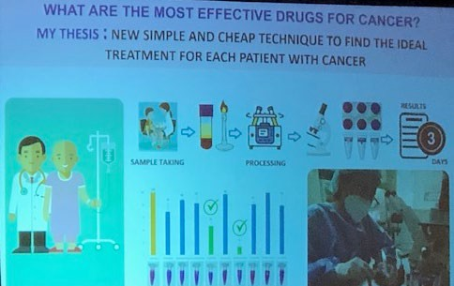
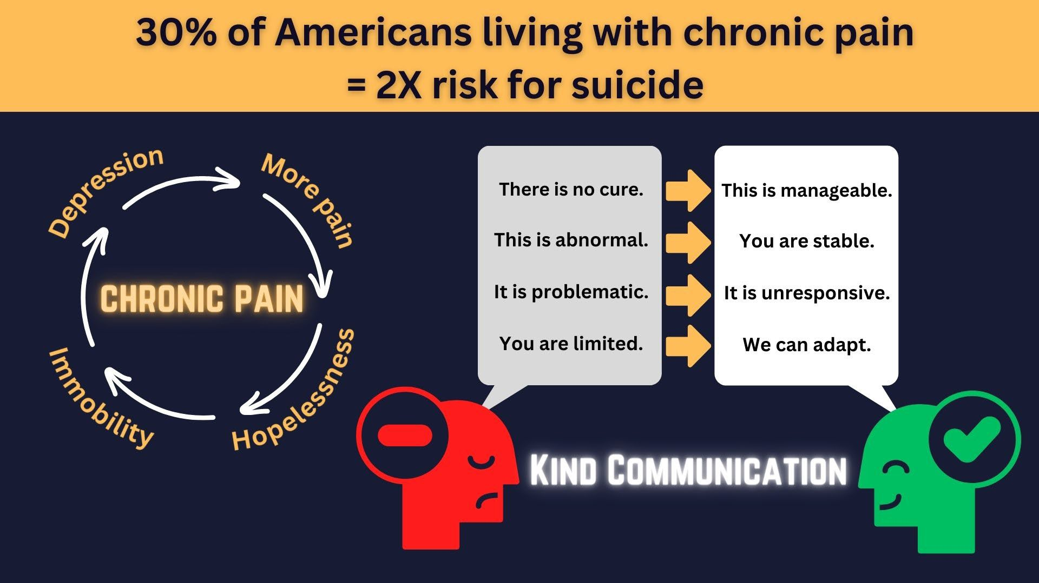
Sample Presentation Slides
Sample slide #1
Confusing layout
Too much content
Inconsistent images
No hierarchy
Difficult to understand topic
Photo of a poorly organized poster
Sample slide #2
Clear layout
Balanced content
Consistent visual theme
Easy to understand topic
Professional
Photo of a well-organized poster

Slide 11
Quick Narrative Tips
Explain concepts or process as needed
  Understand your audience’s level of knowledge
  Use specialized terms as needed, but define them (briefly)
  Address the “Why/Potential Impact”
Use language and numbers for impact
  Don’t overwhelm with numbers, but illustrate trends
  Use analogies to explain a complex topic
Map out your narrative flow
  Narrative = plot or story: getting from point A to B to C
  Raise a question, then satisfy expectations
  Underscore the challenges, then release that tension

Slide 12
Oral Communication
Speaking
  Be concise
    Use shorter sentences
    Choose active verbs over passive verbs
  Avoid technical jargon and acronyms
  Slow down and think about rhythm and pacing
Using your voice and body
  Voice - Vary tone, pause, project
  Body - Make eye contact, watch hand gestures, exude confidence
  Take a deep breath before you begin speaking

Slide 13
What to Avoid
Muttering Static Vocalisms (a pause is OK)
  “um”, “ah”, and “er”
  “like” or “you know?”
  “OK?”
Looking at the floor or obviously avoiding eye contact
Hands in your pockets or hyper-gesticulation
Self-criticism before or during your presentation
Comparing your presentation to others
Making changes 24 hours before the presentation

Slide 14
Thank you!
If you have questions, please contact:
3MRP@NAU.EDU
Office of Graduate & Professional Studies

