Slide 1

Universal Waste Training
Notes:
Welcome to Northern Arizona University’s Universal Waste Training, presented by Environmental Health and Safety

Slide 2
Why You’re Here
Universal waste=certain exempt hazardous wastes
U-waste regulation intentions:
Reduce hazardous waste in landfills
Promote collection/recycling
Reduce regulatory burden
Notes:
Universal Wastes (or “u-wastes”) are a particular subset of hazardous wastes. U waste regulations were put forward primarily to reduce hazardous materials from being landfilled; encourage recycling and proper disposal; and ease the regulatory burdens of managing u-wastes as hazardous wastes.

Slide 3
General Definitions
Generator: Person, site, entity, etc. whose acts produce universal waste
Handler: Anyone who manages universal wastes
Generator Types:
Small Quantity Handlers accumulate <11,000 lbs
Large Quantity Handlers accumulate >11,000 lbs
Notes:
The hazardous waste regulations put forward two general definitions when it comes to universal waste-generators and handlers. Generators include any person, site or entity whose acts or processes produce universal wastes. Handlers are those individuals who manage universal wastes for disposal.

Slide 4
Universal Waste Types
Fluorescent Lamps
Batteries
Mercury containing equipment
Pesticides
Notes:
There are 4 types of universal wastes-fluorescent lamps or bulbs, batteries, mercury containing equipment, and pesticides. We’ll look at examples of each.

Slide 5
Universal Waste Lamps
High Intensity Discharge
Neon
Mercury Vapor
High Pressure Sodium
Metal halide
Notes:
Universal waste lamps include all fluorescent bulbs including but not limited to high intensity discharge, neon, mercury vapor, high pressure sodium, and metal halide lamps.

Slide 6
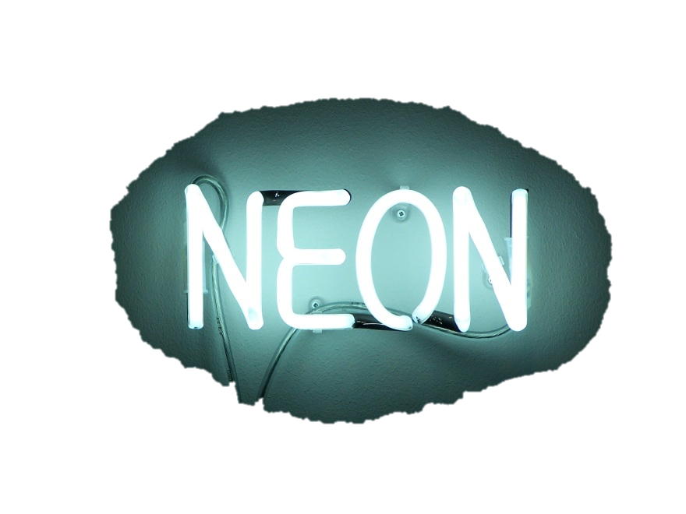
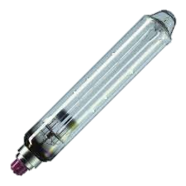
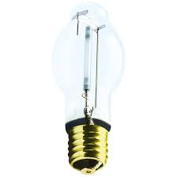
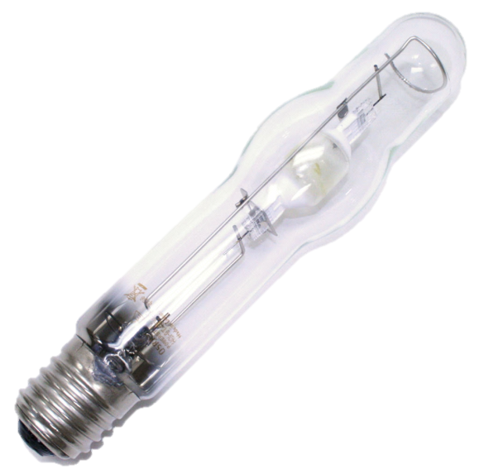

Types of Universal Waste
Notes:
Here are some examples of Universal Waste Lamps.

Slide 7
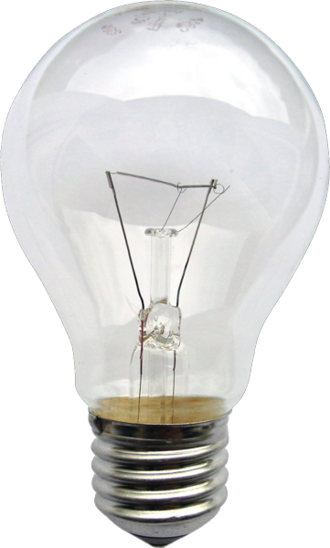
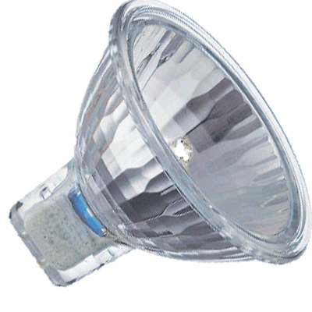
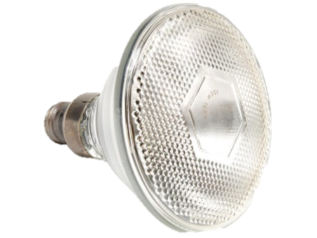
Types of Universal Waste
NOT
Notes:
These bulbs are not Universal waste.

Slide 8
Universal Waste Batteries
Nickel-Cadmium
Lithium Ion
Lead Acid
Rechargeable
Button
Alkaline*
Notes:
Universal waste batteries include nickel-cadmium (or ni-cads), lithium ion, lead acid, rechargeable, and button or watch batteries. Alkaline batteries (double a, triple a, d, etc.) are also collected here at NAU for recycling, despite not being considered universal waste by the regulations.

Slide 9
Universal Waste Mercury
Thermostats
Thermometers
Barometers
Manometer
Notes:
Universal waste mercury includes devices that contain elemental mercury such as thermostats, thermometers, barometers, and manometers.

Slide 10
Universal Waste Pesticides
Recalled
Suspended
Cancelled
Must be hazardous waste=rare
Notes:
Universal waste pesticides are pesticides whose contents have been recalled, suspended, or cancelled. In addition, pesticides whose contents do not fit the definition of hazardous waste, cannot be universal waste pesticides. Pesticides at NAU rarely meet these requirements. Pesticides bound for disposal at NAU are not sent out as Universal wastes but as Non-EPA regulated waste by Environmental Health and Safety.

Slide 11
U-waste Containers
Containers MUST:
Be stored “in a manner that will prevent releases” (can fall over without spilling)
Have a collection start date
Have a label indicating contents using correct terminology
Used Batteries, Used Lamps, Used Mercury Thermostats
Dead Batteries, Used Bulbs
Notes:
U-Waste Containers have very specific federal and state requirements. Containers have to be capable of falling over without losing their contents, this includes all boxes of lamps, buckets of batteries. The day that a container begins collecting a u-waste, the date must be written on the container. Last, the container must have a label indicating it’s contents using 1 of 3 acceptable titles. Rather than demonstrate each one, the simplest thing to remember is to put the word ”Used” and then the name of the waste. So Used batteries, used lamps, etc. DO NOT use other terms like spent bulbs or dead batteries.

Slide 12
Handling and Safety Procedures
All U-waste generators and handlers must wear appropriate glove and eye protection
Lamp crusher use requires:
Gloves
Eye Protection
Filter change out (bag filter and HEPA filter)
Once crushed, no longer u-waste. It is hazardous waste.
Notes:
PPE must be worn during universal waste processing. At a minimum, u-waste working employees should wear eye protection and leather gloves. A voluntary use respirator may also be worn. The lamp crusher bag filter must be changed every half drum, while the inner high efficiency particulate air filter is changed every 10 drums. Once a lamp is crushed, the waste is now hazardous waste, not universal waste.

Slide 13
Lamp Ballasts
Ballasts made before July 1, 1979 may contain Poly Chlorinated Biphenyls (PCBs)
Non-PCB containing Ballasts manufactured between July 1, 1978 and July 1, 1998 are labeled with “No PCBs”
Assume Ballasts without the “No PCBs” designation contain PCBs, unless manufactured after 1998
Notes:
Ballasts may contain Poly Chlorinated Biphenyls, or “PCBs”. If a ballast was manufactured prior to 1979, it should be assumed to contain PCBs. Ballasts manufactured between July first of 1978 and July first of 1998, are labeled specifically with the words “No PCBs”. Assume any ballast without the No PCBs designation contains PCBs, unless it was manufactured after 1998.

Slide 14
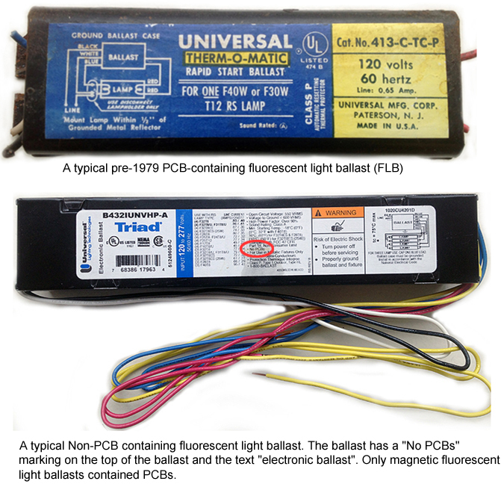
LAMP BALLAST (FLBs)
Notes:
Here are a couple of examples of balla

