Slide 1
Sales and Use Tax

Slide 2
Sales and Use Tax
The University is not tax exempt!!!
In general, all sales made to the University are subject to sales tax imposed by Title 42, Chapter 5, of the Arizona Revised Statutes.
Some purchases may be subject to use tax rather than sales tax, depending on the seller’s business presence in Arizona. If an out-of-state seller does not invoice a tax amount, the University is required to report use tax.

Slide 3
What is Taxable?
The retail sale of tangible personal property and certain services.
What does that mean?
Anything which may be seen, weighed, measured, felt or touched or is in any other manner perceptible to the senses.

Slide 4
Sales Tax
If a vendor (either in-state or out-of-state) charges sales tax on an invoice, and it is at least 5.6%, no other tax is due.

Slide 5
Use Tax
Use tax is the tax on tangible property purchased from an out-of-state vendor that did not collect sales tax.
Calculated at 5.6%

Slide 6
Any Exceptions?
Several technical exemptions apply to auxiliary operations, e.g. prescribed drugs and devices sold at Campus Health Services, and printed and other media materials for use in Cline Library.
Machinery and equipment used ONLY for research and development. Must complete the Certification Form for Tax Exempt Machinery and Equipment Purchased for Research and Development and upload to PeopleSoft Financials with the other purchase documents.
Supply an AZ 5000 to vendor.

Slide 7
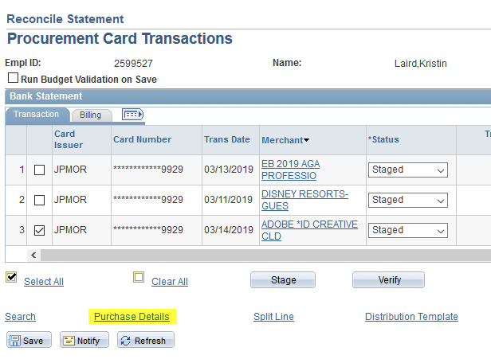
Reporting Use Tax on a P-Card

Slide 8
Reporting Use Tax on a P-Card

Slide 9
Reporting Use Tax on a P-Card
Tax Applicability: Select Use Tax Applicable from the drop down menu.
Use Tax: Enter the dollar amount of use tax for the transaction line using 5.6%. Note-the SUT Code Pct: will display incorrectly-this is a bug that has been reported to Peoplesoft.

Slide 10
Reporting Use Tax on a P-Card
Click OK
The system automatically routes back to the Purchase Details page.

Slide 11
Questions?
If you are unsure if a transaction is taxable, or how to apply use tax on a transaction, contact Ask-FAS@nau.edu.

Slide 12
Additional Resources
Comptroller Policy 120: Sales and use tax on purchases
https://nau.edu/university-policy-library/comptroller-policies/
PeopleSoft Financial Training Documentation
https://nau.edu/comptroller/peoplesoft-financial-training-documentation/
Arizona Department of Revenue – Transaction Privilege Tax
https://azdor.gov/transaction-privilege-tax-tpt

Slide 13
Questions?

