Slide 1
Compliance: how to spend university money while following policy. What items are restricted and why?

Slide 2
Policy
Arizona Board of Regents (ABOR)
State of Arizona
Federal government
University Policy Library

Slide 3
Policy exceptions
What does policy state and who “owns” that policy?
ITS
Comptroller
Marketing
Equity & Access
NO ONE is authorized to make exception to a State or Federal policy.
Ex. Conflict of Interest

Slide 4
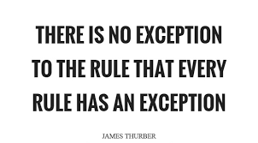
Exceptions
Exception to policy request form
The Comptroller’s Office will review and request additional documentation if required.

Slide 5
Restricted purchases overview
University Policy Library
Campus Operations
Equal Opportunity and Access
Financial Management
General Administration
Human Resources
Information Technology

Slide 6
Generally restricted BUT allowed with proper documentation/approval
Advertising
Capital Equipment
Computers
Consulting Services
Flowers
Gifts/Gift Cards
Printing Services
Promotional Items
Software

Slide 7
If it’s in peoplesoft….
All policies apply
No Foundation reimbursements for prohibited items.
Ex. Alcohol

Slide 8
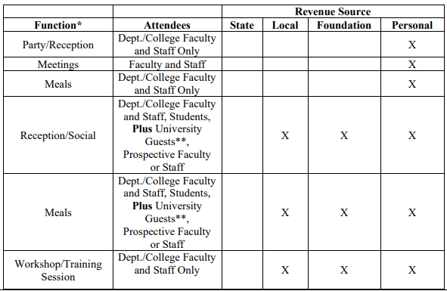
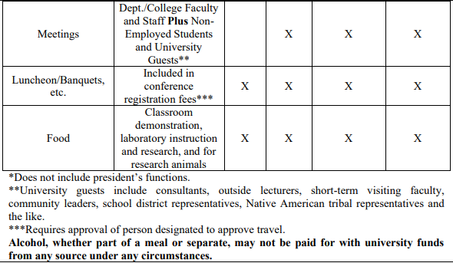
Food purchasing
CMP 420-02 Food and Refreshments & CMP 420-04 Business Meals
Don’t forget the Business Food/Meal Purchase Authorization form!

Slide 9
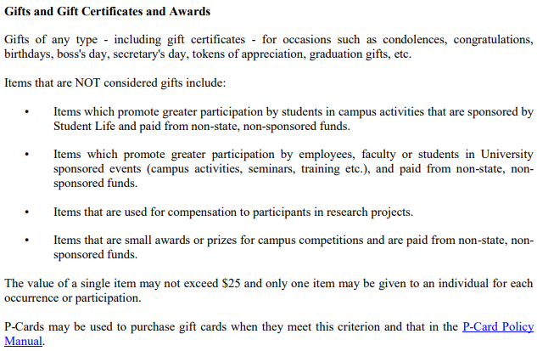
Gifts/Gift cards
CMP 401-03 Prohibited Transactions

Slide 10
Gifts/Gift cards

Slide 11
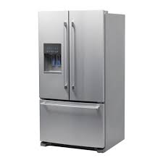
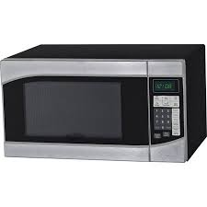
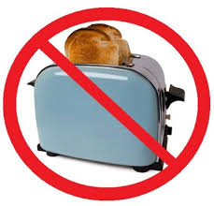
Certain kitchen appliances
CMP 401-08 Purchase of Kitchen Appliances
YES: Refrigerators, Freezers, Microwave Ovens
NO: Toasters, Coffee Makers, Blenders, Panini Makers, Instant Pots

Slide 12
Personal care items
CMP 401-03 Prohibited Transactions
Hand sanitizer
Hand soap
Dish soap
Tissues
Toothpaste
Body lotion
The above items must be available for public use in kitchens, breakrooms, bathrooms etc.

Slide 13
Amazon
All Amazon Prime memberships are prohibited.
Prime
Student
Mechanical Turk
The why…
Personal gain
Not able to monitor
Stay tuned for a University Amazon Business account.

Slide 14
Bottled water
Yes it requires an exception!

Slide 15
flowers

Slide 16
If you don’t know…just ask!
We are here to help!
Instructed to make a purchase
Not sure how to interpret policy

Slide 17
Violations and processes
Improper Card Use by Others
Multiple/split Transactions
Not Approved by Deadline
Not Verified by Deadline
Personal Purchase
Restricted Commodity
Other
Notification of Violation (NOV) Form
Backup Documentation
Proof of Reimbursement

Slide 18
Recent violation examples
Saved credit card information…
Amazon
UBER
iTunes
Restricted Commodities
Amazon Prime
Flowers
Gifts
Travel Meals
Gas in a personal vehicle

Slide 19
Reminder…
Two personal purchases in a two year period will result in termination of your purchasing card privileges.
Other frequent violations…
Department can decide to revoke your card.

Slide 20
Reconciling responsibilities
As a reconciler…
Public purpose and a copy of the receipt.
As an approver…
By approving you are accepting responsibility that the transaction is valid.
Not reconciling/approving, changing default account codes and uploading documentation is being recorded on a monthly basis. You will receive an email from the Comptroller’s Office with your departments statistics.

Slide 21
Reconciling continued…
Public purpose
Description
Traveler Information
Speedchart
Account Code
Use Tax
Documentation in OnBase
Verify/Approve
BUDGET CHECK

Slide 22
Resources
PeopleSoft Training Guide
Pcard@nau.edu

Slide 23
Here’s what we can see
Demo of PaymentNet capabilities.

Slide 24
Audits
Auditors have PSF access
Include all documentation
Types of audits

Slide 25
Questions?

Slide 26
Thank you!!

