Slide 1
FY26 Budget Kickoff March 2025

Slide 2
agenda
Welcome
FY26 Landscape
Budget Timeline
FY25 Process and Expectations
Questions and Contacts

Slide 3
looking at fy26
State allocation down $6M
Enrollment decreasing
Net tuition and fee component –
FY25 growth compared to FY24 less than 1%
FY26 projecting relatively flat – mix impacts the $$ impact
Grant impacts - Unknown

Slide 4
budget oversight roles
Cabinet/Department Fiscal Oversight Role
The Fiscal Oversight role oversees proper management and integrity of the cabinet/department’s budget, ensuring compliance with all university regulations concerning management of the related budget(s), confidentiality of records, security requirements, and other related provisions on behalf of the Vice President for their respective cabinet/department.
Responsibilities Include:
Verify expenditures are authorized, appropriate, and accurate
Verify accuracy of budget allocations
Ensure funds are expended for their intended purpose
Reconcile and report financial status monthly including a forecast for year end
Report and document an action plan during monthly review for resolving any anticipated budget deficits

Slide 5
Fy26 budget timeline
March 25th: Budget Kickoff
March 21st: FY25 Year End Projections due in Anaplan
March 25th – April 8th: Confirm all positions are accurately budgeted
April 11th: All ePARS and funding changes must be submitted
April 22nd: All State and Local budget templates must be complete in Anaplan
April 22nd: Budget Office will begin review of FY26 Operating budgets
April 24th: FY26 salary increase will be loaded into Anaplan
April 24th: Budget Office reviews loaded salary budgets
May 2nd: Budget documents due to ABOR

Slide 6
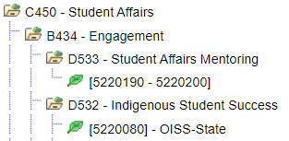
Fy26 budget process – fy26 financial tree in people soft financial
What is a Financial Tree?
The hierarchy structure of your financial accounts
FY26 tree pulled into Anaplan reflecting any requested reorganizations
Review the tree for your area and communicate any changes ASAP
Cabinet
Branch
Department
DeptIDs

Slide 7
account structure: funds
FUNDS
State (Appropriated): Monies allocated by legislation
Local (Non-Appropriated): Doesn’t require further legislation

Slide 8
account structure: program codes
PROGRAM CODES
Program codes, also referred to as functional expense classifications, are a method used to group expenses according to the purpose for which the costs are incurred.
Reports why an expense was incurred rather than what was purchased.

Slide 9
account structure: speedcharts
SPEEDCHARTS
XXXXXXX
_AXXX_
2X
XX
DEPT ID
PROGRAM
FUND
XXXXXXXF2X

Slide 10
account structure: revenue classes
Student Health & Wellness Fee
IT/Athletics Fees
Grad Program Fees
Facility Rentals
Interest Income
Campus Living – Rent Campus Supply
Parking Permits
Dining

Slide 11
account structure: expenses classes
Budget lines will only be open for lines that have a budget. If you plan to spend in a certain expense class, you must have a budget on that line.
IT Network
Risk Mgt. Insurance Admin – Overhead

Slide 12
fy26 budget process – fy26 account classes
FY26 Account Changes
Restructuring of the interdepartmental revenue accounts (555*)
Why? To allow revenues to roll up to accurate GL revenue account code for financial reporting purposes

Slide 13
fy26 budget process fy25 year-end estimates
FY25 Year-end Estimates
Due in Anaplan March 21st
Will any of your DeptIDs end FY25 with a deficit?
YES: Email a completed Plan of Action to your UBO representative by April 4th.

Slide 14
fy26 budget process – position budgeting
 | Employee Name | Position ID | Title | Organization | Employee ID | FY25 Budgeted FTE | FY25 Actual FTE | FTE Difference | FTE Change | FY26 Budgeted FTE | FY25 Budgeted Salary | FY25 Budgeted Full Salary | FY25 Actual Salary | FY25 Actual Full Salary | Salary Difference | Salary Change | FY26 Total Salary | Annual ERE Total
POS_00030474 |  | POS_00030474 |  | 5000040_E005_1500_0000000 |  | 1.00 | 1.00 | - | - | 1.00 | $ 10,000 | 10,000 | $ 10,500 | $ 10,500 | $ 500 | - | $ 10,000 | $ 3,000
Review each position
Is FTE count correct
Split funded positions: confirm they total 100%
Communicate with other departments involved in split
Is the funding source correct
No: submit ePAR and/or funding change form (by April 11th)

Slide 15
fy26 budget process – vacant positions
 | Employee Name | Position ID | Title | Organization | Employee ID | FY25 Budgeted FTE | FY25 Actual FTE | FTE Difference | FTE Change | FY26 Budgeted FTE | FY25 Budgeted Salary | FY25 Budgeted Full Salary | FY25 Actual Salary | FY25 Actual Full Salary | Salary Difference | Salary Change | FY26 Total Salary | Annual ERE Total
POS_00030474 |  | POS_00030474 |  | 5000040_E005_1500_0000000 |  | 1.00 | 1.00 | - | - | 1.00 | $ 10,000 | 10,000 | $ 10,500 | $ 10,500 | $ 500 | - | $ 10,000 | $ 3,000
Review Vacant Positions
Truly vacant positions will be inactivated
Not approved by Bjorn and Josh
Not actively being searched
Not posted
Any positions that is not going to be used in FY26 need to be deactivated.
To deactivate email the Budget Office, Budget@nau.edu. Include the position(s) you would like inactivated and any pertinent information to the inactivation.
Future need for new positions should be presented to the budget office for discussion with a source of funding identified.

Slide 16
Fy26 budget process – position budgeting
 | Employee Name | Position ID | Title | Organization | Employee ID | FY25 Budgeted FTE | FY25 Actual FTE | FTE Difference | FTE Change | FY26 Budgeted FTE | FY25 Budgeted Salary | FY25 Budgeted Full Salary | FY25 Actual Salary | FY25 Actual Full Salary | Salary Difference | Salary Change | FY26 Total Salary | Annual ERE Total
POS_00030474 |  | POS_00030474 |  | 5000040_E005_1500_0000000 |  | 1.00 | 1.00 | - | - | 1.00 | $ 10,000 | 10,000 | $ 10,500 | $ 10,500 | $ 500 | - | $ 10,000 | $ 3,000
Salaries will roll into Anaplan on April 24th
UBO will review salaries beginning April 25th to confirm they are accurate
Consider position costs when budgeting operations, funding must be left to cover salaries/wages and ERE.

Slide 17
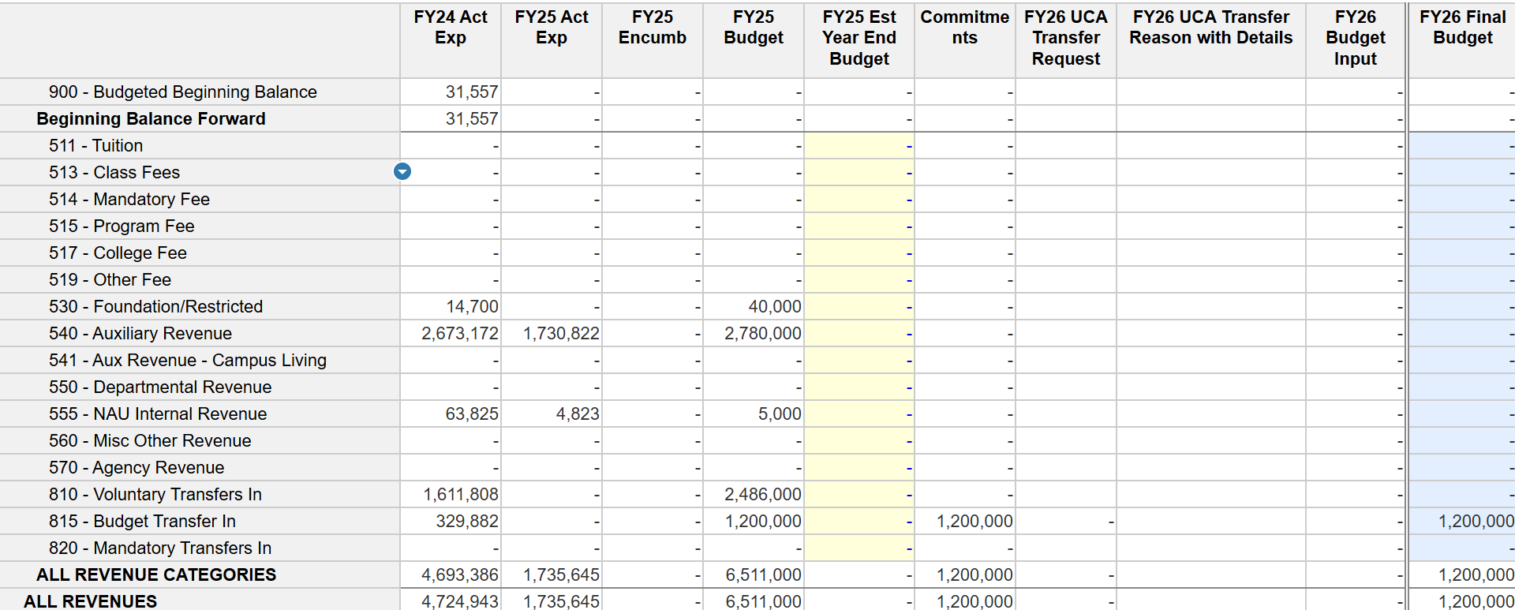
fy26 budget process– local fy26 revenue budget
Enter FY26 projected revenues into the FY26 Budget Input column
Review your FY25 estimate – did you hit your budget? Use this as information to budget FY26 your FY26 revenues
Administrative Overhead will automatically be calculated for eligible revenues

Slide 18
fy26 budget process – Local fy26 expense budget
Enter FY26 projected expenses into the FY26 Budget Input column
Salary expense (711) and EREs (720) automatically load from the position budget template
Non-personnel expense can be reallocated with the changes to the budget netting to zero

Slide 19
fy26 budget process – Local fy26 expense budget
Administrative Overhead Charge
Consider this expense when setting fees and rates for some services and conferences
Expense is budgeted as an operating expense in class 741 – University Charges

Slide 20
fy26 budget process – Local fy26 expense budget
Risk Insurance
Vehicle calculation is based on total number of automobiles
Manually enter budget in account class 741 – University Charges
Liability based on % of prior year personnel services (711, 712, 713, 714, 715)
Automatically calculated in account class 741 – University Charges

Slide 21
fy26 Budget Process – Local fy26 expense budget
ITS Network Charge and Long Distance
Charge for network expenses is calculated as a % of personnel services (711, 712, 713, 714, 715)
Automatically calculated in account class 740 – Utilities/Other Ops/Insurance
Long Distance Calls
Continue to be an additional charge and should be budgeted
Manually enter budget in account class 740 – Utilities/Other Ops/Insurance

Slide 22
fy26 budget process – Local fy26 transfer budget
Non-UCA Transfers Between DeptIDs
Input on the Local transfer tab at DeptID level
Coordinate with the other departments or Fiscal Oversight representatives if part of the transfer is outside of your direct area

Slide 23
fy26 budget process – local fy26 transfer budget
Transfer Account Classes
Used by University Budget Office

Slide 24
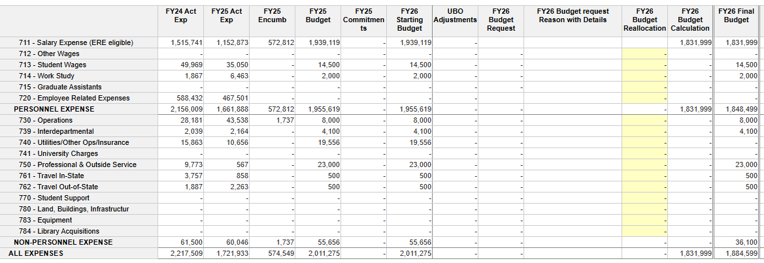
fy26 budget process – state fy26
-7000
1000
1000
24000
The State budget template calculates the FY26 Final Budget by adding the FY26 Starting Budget with the FY26 Budget Reallocation column.
Other columns are for UBO use
The 1% Network Fee is auto calculated in 740 – Utilities/Other Ops/Insurance
Non-personnel expenses can be reallocated – must net to zero

Slide 25
FY26 RATES
FY26 RATES

Slide 26
FY25 Rates
Facility Services
Utilities
Engineering Health and Safety
Parking
Shuttle Services
Fleet
Facility Use
Printing Services
Coming Soon

Slide 27
QUESTIONS AND CONTACTS
Presentation & Guidelines will be added to the Budget website.
Questions?
Thank you for your partnership! We look forward to continuing to work with you all this budget season!
Budget Contacts:
Renee Miller
Megan Cunningham

