Slide 1
FY25 Budget Kickoff
March 2024

Slide 2
Agenda
Welcome
FY25 Landscape
University Budget Advisory Board
Budget Timeline
FY25 Process and Expectations
Anaplan Refresher
Questions and Contacts

Slide 3
looking at FY25
State allocation is overall flat to slight decline
Enrollment is increasing; revenues not seeing same increase due to mix
Net tuition and fee component – flat is most likely scenario

Slide 4
University Budget advisory board
UBAB Charge / Purpose
“Important deliberative and advisory body for our university. UBAB will consider our constraints and opportunities in setting budgetary priorities and identify fiscally responsible strategies to meet these priorities, advance our mission, and enhance the financial sustainability of our university.
“At the forefront of UBAB’s initial priorities will be developing guiding principles for budgeting priorities – principles that can guide us from year to year regardless of the level of resources.
“UBAB will prioritize developing a three-year plan that will lead to a minimum 10% increase to faculty and staff salaries during that timeframe...work to be completed in the fall with implementation of salary increases beginning January 2023 and plan that can be incorporated into the fiscal year 2024 budget planning process.”

Slide 5
University Budget advisory board
Principles/Guidelines – Budgeting Priorities
Budget priorities support the institution’s core functions and are aligned with the university mission as expressed by Elevating Excellence 2025.
Budget decisions are informed through data-analysis and projections.
Near term allocation complements long term planning.
Units manage operations within allocated resource levels across all funding sources with discrete allocation of personnel and non-personnel budgets.

Slide 6
University Budget advisory board
Principles/Guidelines – Budgeting Priorities
VP’s reallocate and redesign functions to reduce marginal operating costs.
Units transparently manage funds with maximum effectiveness and understanding that unrestricted revenue and funds outside unit operations are shared university funds.
Budget reorganizations require transparent analysis and coordinated communication from initiation of change to process completion.

Slide 7
FY25 BUDGET TIMELINE
March 19th: FY24 year end projections due in Anaplan
March 20th: Budget Kickoff
March 20th: Anaplan OPEN for entry
March 20th – April 5th: Confirm all positions are accurately budgeted – FY25 salaries will roll into Anaplan April 5th
March 25th – March 29th: UBO meets with Cabinets to discuss allocations
April 10th: All ePARS and funding changes must be submitted
April 26th: All State and Local budget templates must be complete in Anaplan
April 29th: Budget Office reviews and finalizes the FY25 Budget
May: Budget documents due to ABOR

Slide 8
FY25 Budget Process – Local FY24 Estimates
FY24 Year-end Estimates
  Forecasting estimates need to be manually added to the local finance template – FY24 Est Year End Budget column
  Will any of your DeptIDs end FY24 with a deficit?
    YES: Email a completed Plan of Action to your UBO representative by April 5th.

Slide 9
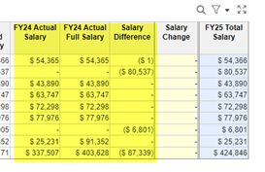
FY25 Budget Process – Position budgeting
Review each positions
  Is FTE count correct
    Split funded positions: confirm they total 100%
    Communicate with other departments involved in split
  Is the funding source correct
    No: submit ePAR and/or funding change form (by April 10th)
  Is the salary amount correct (new salaries – 3% increase should roll into Anaplan April 5th)
    No: Copy Salary Difference into Salary change Column to reflect updated salary.
ERE
  Anaplan automatically calculates the ERE

Slide 10
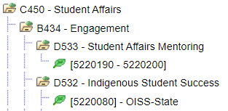
FY25 Budget Process – fy25 financial tree in people soft financial
What is a Financial Tree?
  The hierarchy structure of your financial accounts
  FY25 tree pulled into Anaplan reflecting any requested reorganizations
    Review the tree for your area and communicate any changes ASAP
Cabinet
Branch
Department
DeptIDs

Slide 11
FY25 Budget Process – Local FY25 revenue budget
FY25 Revenue Budget Entry
  Program Fee RSA will remain at 14%
    86% of program fee revenue is directed to designated fund DeptID
  Enter FY25 projected revenues into the FY25 Budget Input column
    Review your FY24 estimate – did you hit your budget? Use this as information to budget FY25
    Plan for administrative overhead costs that may be associated with your revenues (budget in line 741)

Slide 12
FY25 Budget Process – Local FY25 expense budget
FY25 Expense Budget Entry
  Salary expense (711) and EREs (720) automatically load from the position budget template
  Non-personnel expense can be reallocated with the changes to the budget netting to zero
Administrative Overhead Charge
  Consider this expense when setting fees and rates for some services and conferences
  Expense is budgeted as an operating expense in class 741 – University Charges
  *NEW – Energy rebates will be assessed 20% OH rate

Slide 13
FY25 Budget Process – Local FY25 expense budget
Risk Insurance
  Vehicle calculation is based on total number of automobiles
    Manually enter budget in account class 741 – University Charges
  Liability based on % of prior year personnel services (711, 712, 713, 714, 715)
    Automatically calculated in account class 741 – University Charges

Slide 14
FY25 Budget Process – Local FY25 expense budget
ITS Network Charge and Long Distance
  Charge for network expenses is calculated as a % of personnel services (711, 712, 713, 714, 715)
    Automatically calculated in account class 740 – Utilities/Other Ops/Insurance
Long Distance Calls
  Continue to be an additional charge and should be budgeted
    Manually enter budget in account class 740 – Utilities/Other Ops/Insurance

Slide 15

FY25 Budget Process – Local FY25 transfer budget
Non-UCA Transfers Between DeptIDs
  Input on the Local transfer tab at DeptID level
  Coordinate with the other departments or Fiscal Oversight representatives if part of transfer is outside of your direct area

Slide 16
FY25 Budget Process – state FY24
The State budget template calculates the “FY25 Final Budget” by adding the “FY24 Starting Budget” with the “FY25 Budget Reallocation” column
  Non-personnel expense can be reallocated with the changes to the budget netting to zero
    Make changes in the FY25 Budget Reallocation column

Slide 17
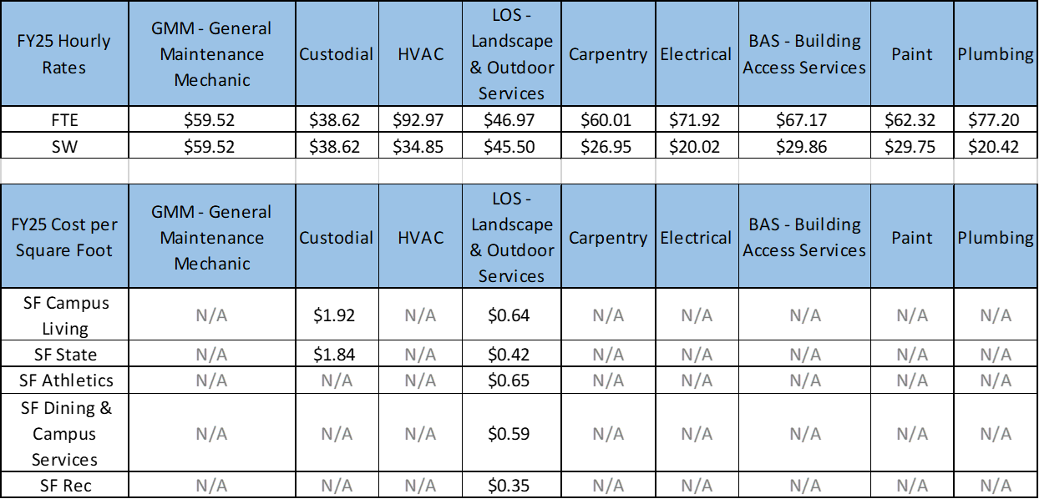
FY25 Rates
Facility Services Trade Charge-out Rates:

Slide 18
FY25 Rates
For Campus Living Only:
For purposes of Custodial billing, the billable SF is the same as FY24 at 1,574,425 SF.
For purpose of LOS billing, the billable SF is a 250 SF decrease from FY24 at 1,031,267 SF. This is due to updated mapping of landscape in the GIS system.
For Rec Only:
For purposes of Custodial billing, the billable SF is a 38,161 SF decrease from FY24 at 108,035 SF. This is due to a SF review between Custodial and Rec during FY24.
For purposes of LOS billing, the billable SF is the same as FY24 at 453,602 SF.
For Campus Services Only:
For purposes of Custodial billing, the billable SF for ATC is the same as FY24 at 13,561 SF.
For purposes of Custodial billing, the billable SF for Dining is the same as FY24 at 49,399 SF.
For Athletics Only:
For purposes of LOS billing, the billable SF is the same as FY24 at 269,685 SF.

Slide 19
FY25 Rates
Utility Rates:
The utility rates are consistent with the variable rate methodology developed in FY24. This provides a greater accuracy for how generation costs are billed.
The actual monthly utility cost from our vendors to produce each commodity is added to the operation cost for a month, then divided by the actual usage of the commodity for that month to get each month’s rate.
Each month we bill exactly what it costs to produce the commodity, and 1/12th of our yearly operating costs, preventing future deficits or overages.
This method we developed to account for changes in utility costs from vendors, and energy reduction efforts across campus.
  Under the old method if buildings use less energy than expected, utilities collects less than the budgeted operating costs.
Below are the estimated average calculated rates based on FY23 data. Each month will fluctuate based on actuals incurred.
* Sewer and Refuse are combined into the water rate for billing; there is no longer a separate calculation.

Slide 20
FY25 Rates
Printing Services – 1% increase
PENDING
  Engineering Health & Safety
  Parking/Shuttle/Fleet
  Facility Use Rates

Slide 21
NEW - Cabinet Sources/uses template

Slide 22

Anaplan refresher
  www.Anaplan.com

Slide 23
QUESTIONS AND CONTACTS
Questions?
Thank you for your partnership! We look forward to continuing to work with you all this budget season!
Budget Contacts:
  Megan Cunningham
  Renee Miller

