Slide 1
WordPress Unit Web Coordinators
Monthly Summit – February 2022

Slide 2
Agenda
Siteimprove – Dashboard
Siteimprove – Link Cleanup
Marketing Updates
Q&A

Slide 3
Siteimprove – Dashboard
After some new updates from Siteimprove, we have gained the ability to build out our own Dashboards in the tool! We hope to provide users with quick routes to the most important fixes, and add some context on how to make those fixes right into the dashboard to make it easier than ever to keep your sites functional and professional.
Expected rollout: March 2022
Will be available to all Siteimprove users
Prepares us for upcoming changes Siteimprove will be making to the Reports functionality currently in use

Slide 4
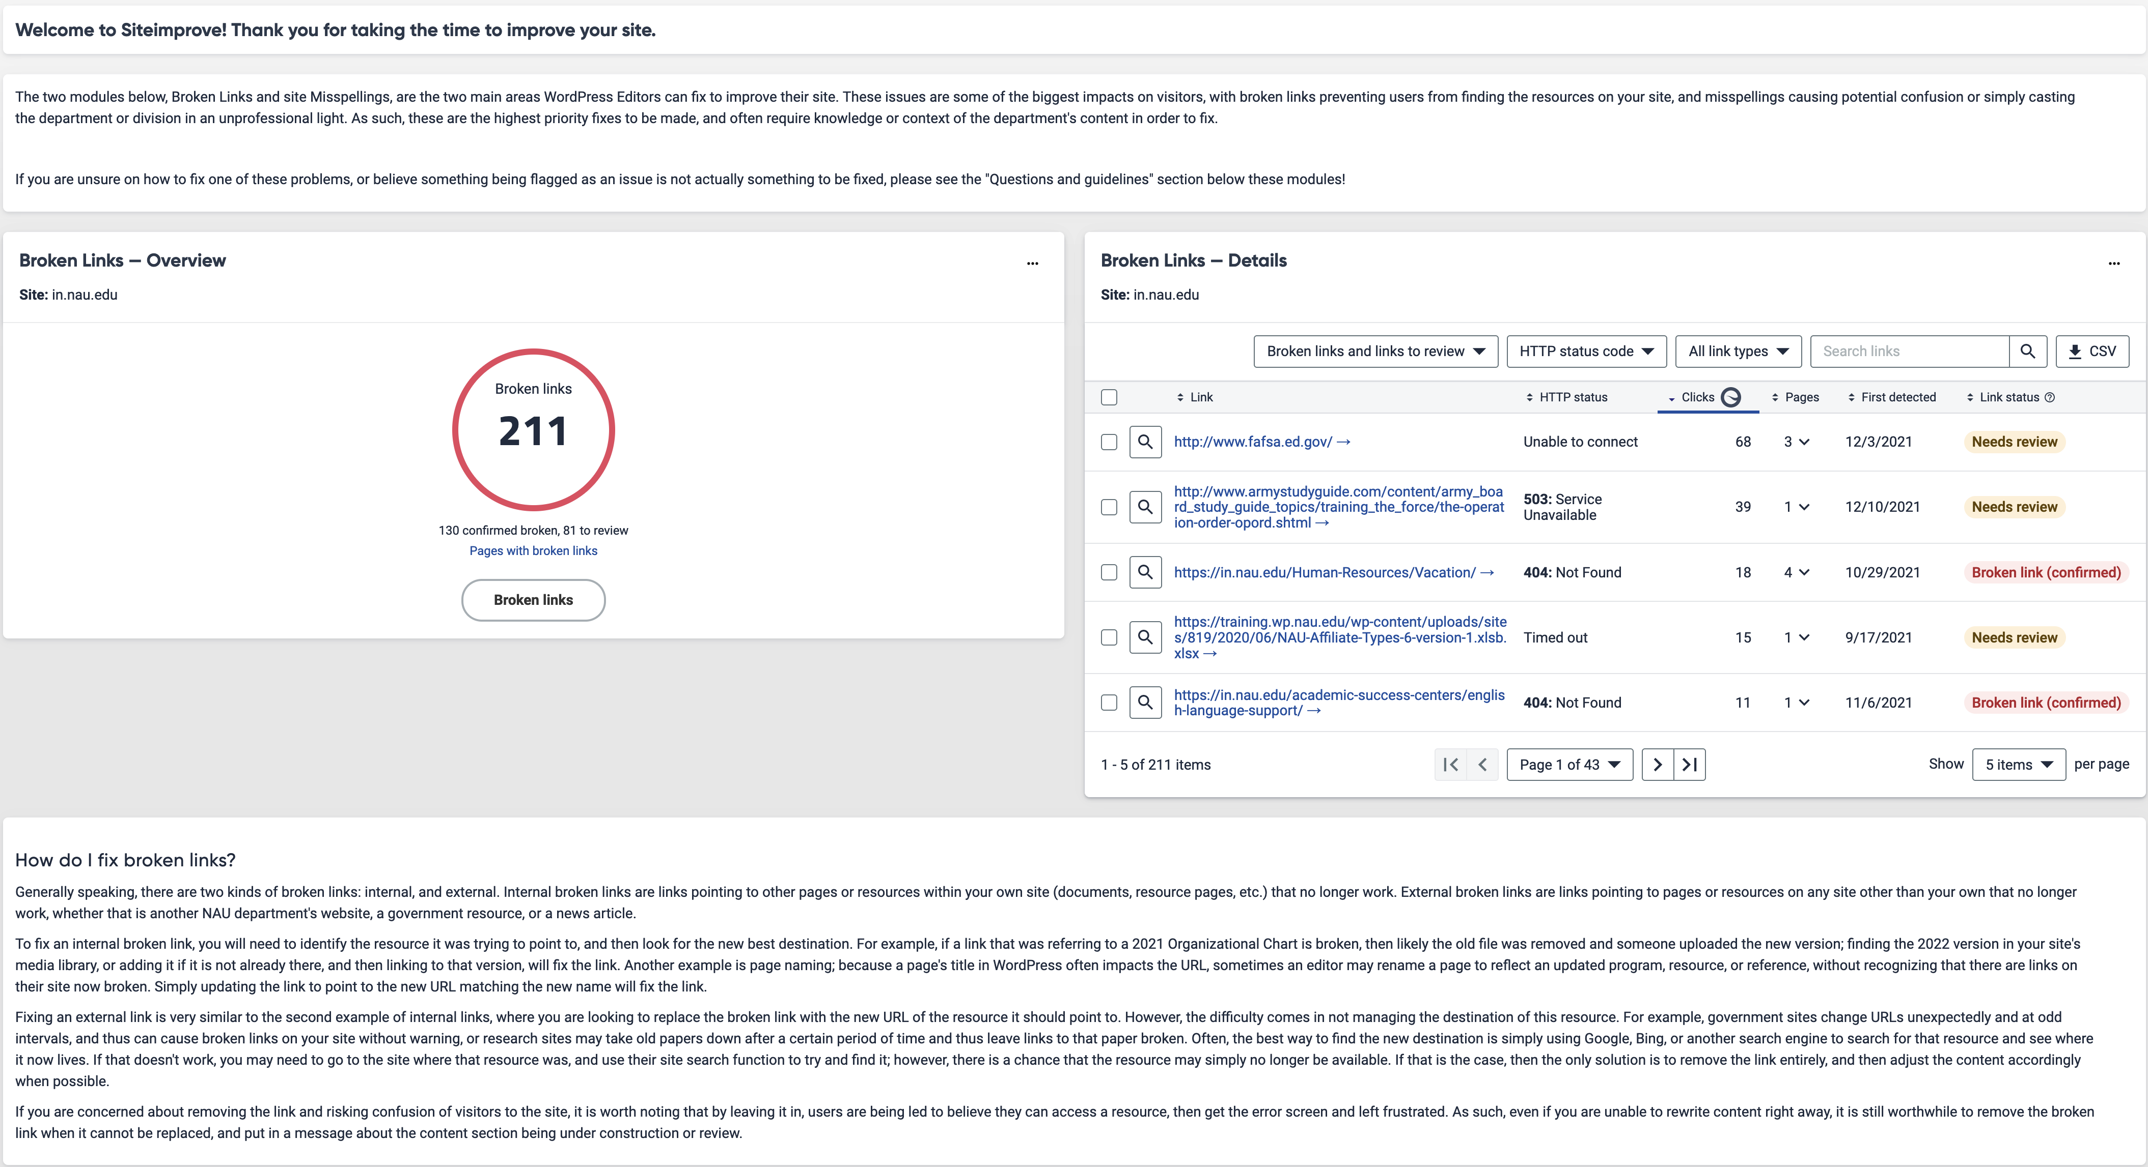

Slide 5
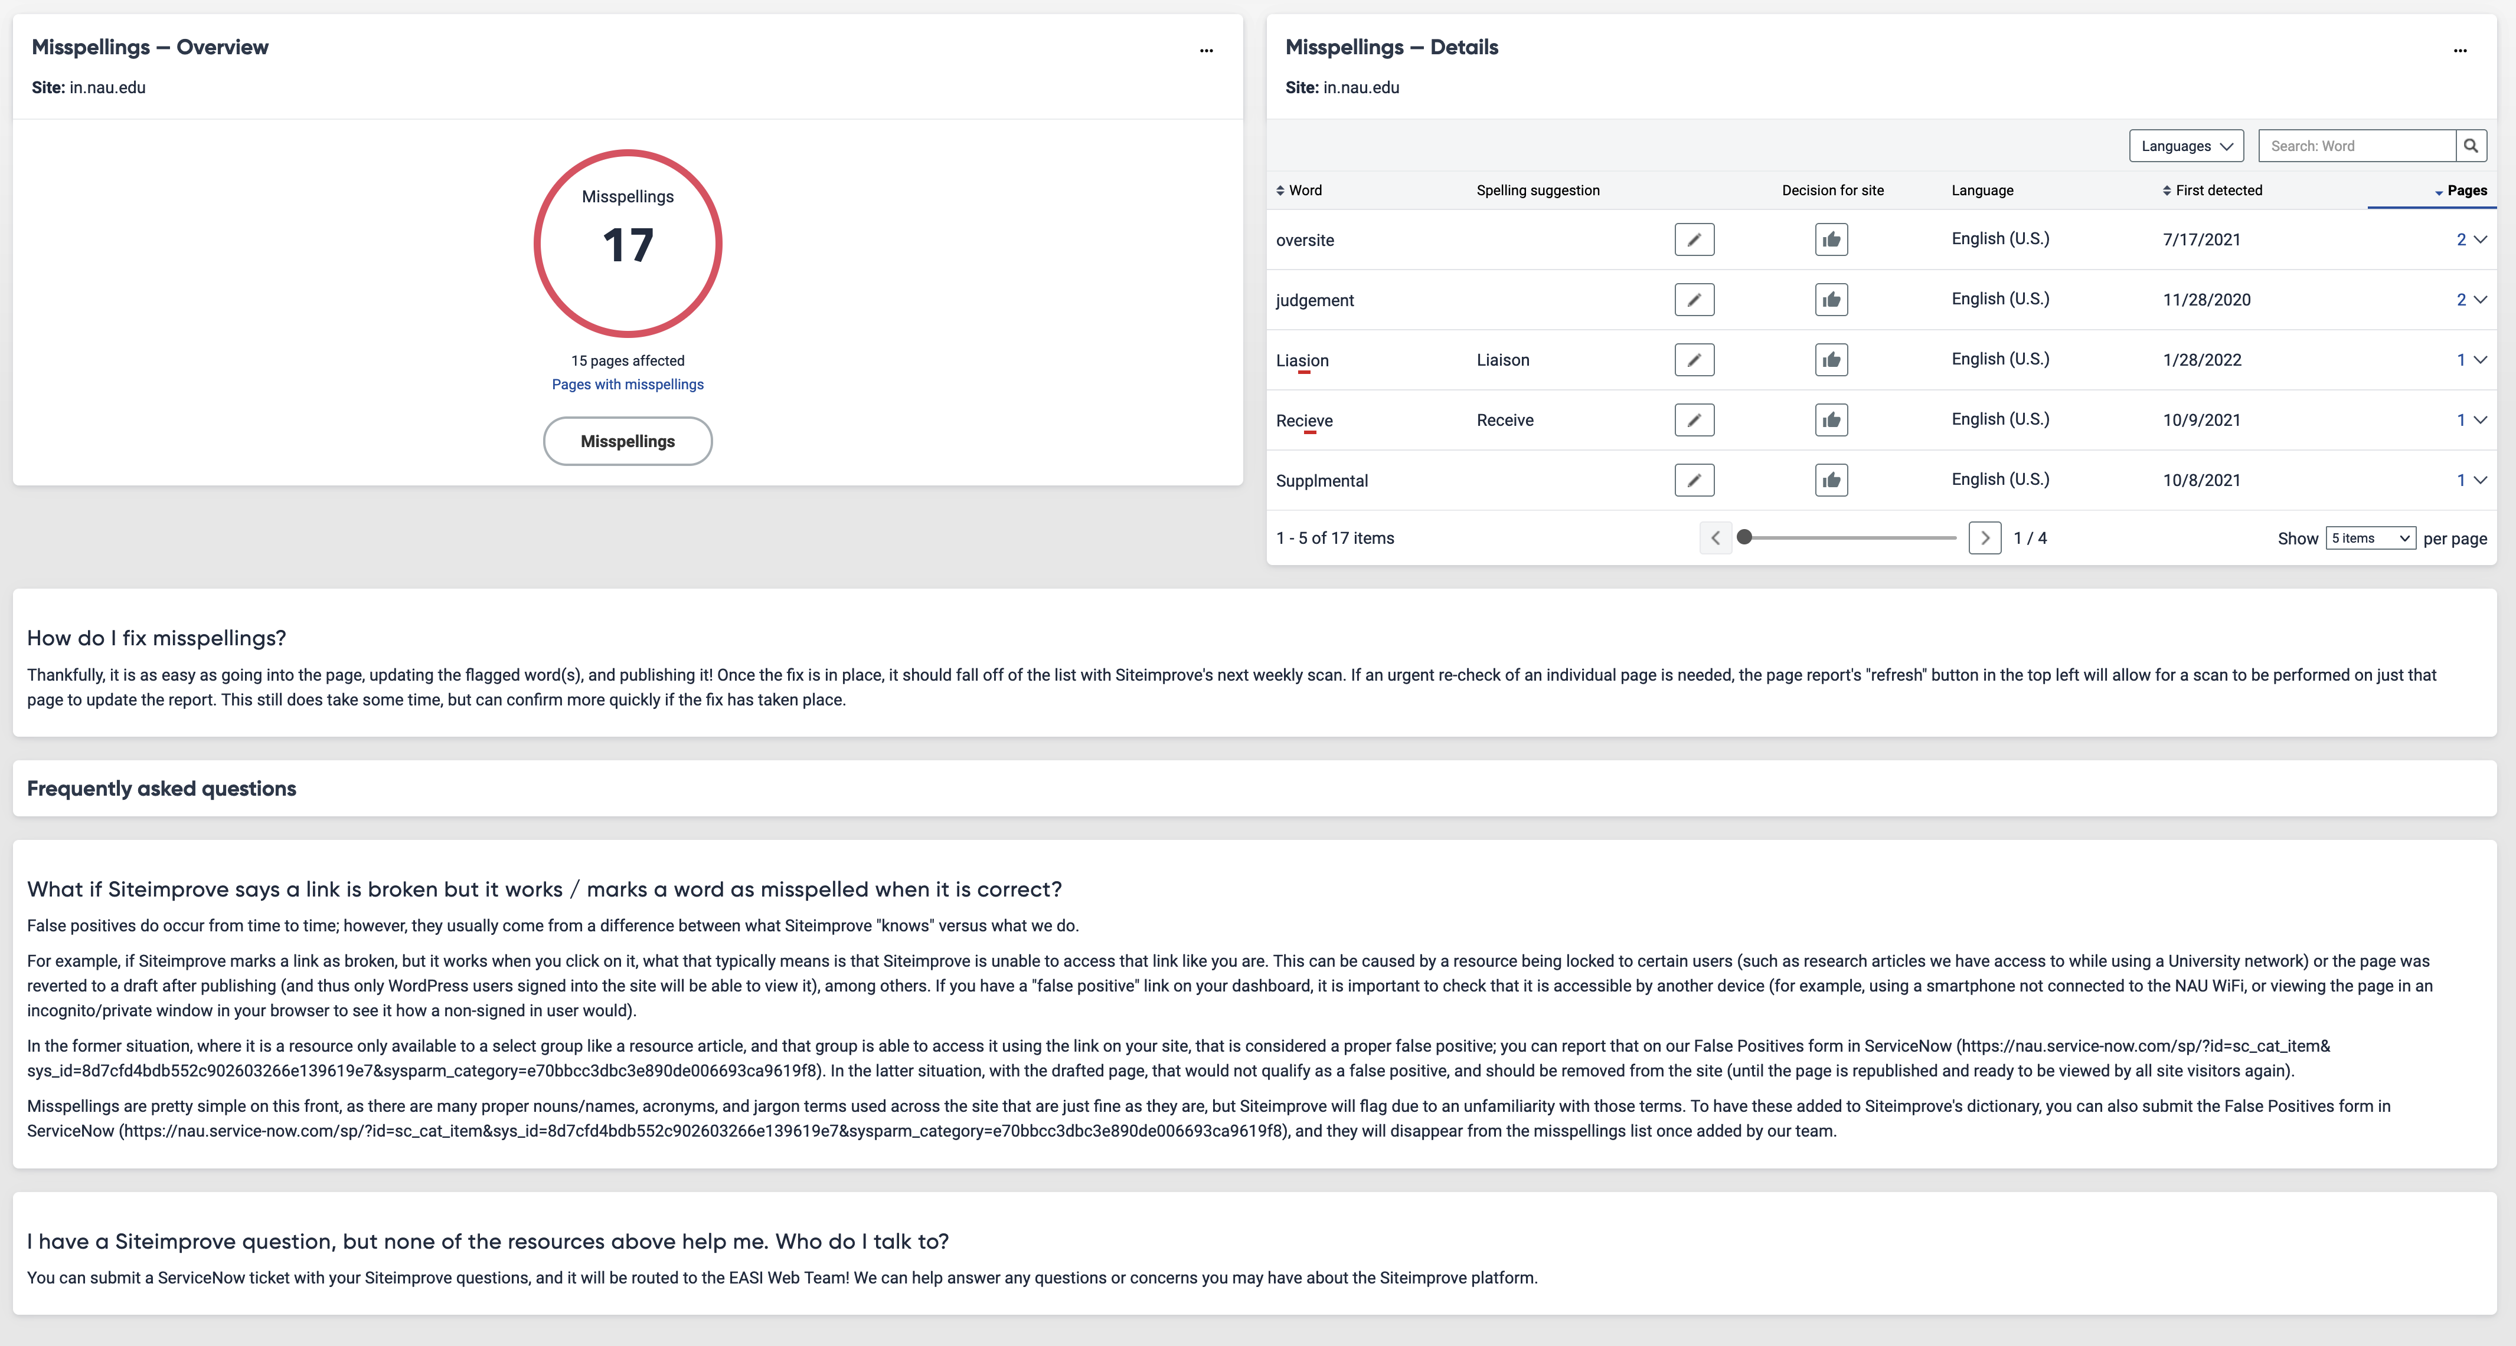

Slide 6
Siteimprove – in.nau.edu Link Cleanup
In April, we will be pursuing a new broken link cleanup initiative on in.nau.edu sites
Like the last one in 2020, this will remove all links that have been left flagged as broken in the system for more than 2 months
Aside from the removal of the link itself, all text and content will remain unchanged
We encourage Unit Web Coordinators to ensure their Site Stewards have access to Siteimprove and are reviewing their sites regularly after the new dashboard launches in March

Slide 7
Marketing Updates
NAU21, Degree search, and looking forward

Slide 8
Thank you for the continued support and involvement to deliver a high-quality OneNAU website!
Questions?

