Slide 1
MCCONNELL SIDEWALK & MULTIMODAL IMPROVEMENTS
NAU Project No. 08.030.176
RFQ for Design Professional Services
Pre-Submittal Conference
Wednesday, February 20, 2019 at 10:00 AM

Slide 2
Team Introductions
Judith Scholar Winfield – Primary RFQ contact
Andrew Iacona – Project Manager - NAU
Anne Dunno – Project Manager - NAIPTA

Slide 3
Partnership between NAU and NAIPTA
Work with the formal partnership of NAU & NAIPTA as well as other agency stakeholders such as City of Flagstaff & Arizona Department of Transportation to meet the needs of each organization.
NAIPTA and NAU are working in partnership with FTA under a federal grant reserved for this project to NAIPTA from the FTA and other possible sources.
The project must conform to federal, state and local design and accessibility standards, campus and community building and development codes, sustainability goals and visual acceptability. Proposers should be aware that all federal regulations and certifications etc. that apply to federally funded design and construction projects generally apply to the design and construction of this

Slide 4
Project Scope
• Design development of the area including the McConnell Drive corridor from NAU’s western boundary to the pedestrian bridge near The Suites on-campus housing structure
Improve campus transit infrastructure to flow more efficiently in the surrounding vicinity
Realign McConnell Drive further to the South away from the Sinclair Wash floodway to allow for a 10’ wide pedestrian pathway and bike lane on the North side of McConnell Drive
Include a roundabout at the intersection of McConnell Drive and Pine Knoll Drive
Include a traffic signal at the intersection of McConnell Drive and Knoles Drive
Include a bus transit stop that allows for more capacity and better access for pedestrians and busses

Slide 5
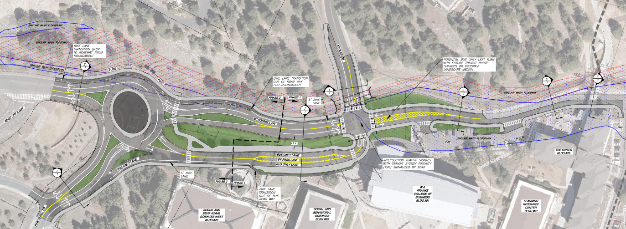
Feasibility Study – Layout 2C

Slide 6
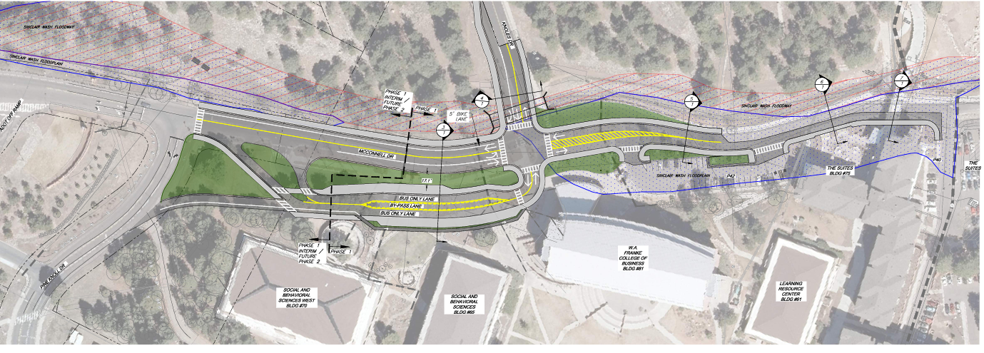
Feasibility Study – Layout 2C – Interim Phase 1

Slide 7
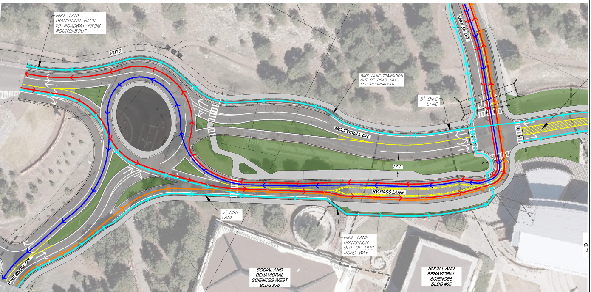
Feasibility Study – Layout 2C – Bus and bicycle map

Slide 8
key dates:
Deadline for Inquiries: March 1, 2019, 2:00 PM
Qualifications Due: March 11, 2019, 2:00 PM (Public Opening)
Shortlist Firm Interviews: April 2 or April 3, 2019
Begin Contract Period: April 2019
Final Design Development Package: December 2019

Slide 9
Qualifications Submittal Info
Federal Regulation Compliance
Disqualification items
Submission location and delivery via FedEx, USPS, or UPS

Slide 10
Additional Pertinent Items
The selected DP Firm shall be responsible to be familiar with the University’s DP draft contract for this project. The draft contract for this project can be found along with the other information relating to this RFQ at https://in.nau.edu/facility-services/bids-rfq/
The selected firm will also need to make themselves familiar with the University’s current University Design Guidelines and Technical Standards. The current version of the University Design Guidelines and Technical Standards can be found at:
https://in.nau.edu/facility-services/dp-contract/

Slide 11
QuestiONS

