Slide 1
Poster Design

Slide 2
“The more visually striking your presentation is, the more people will remember it. And more importantly, they will remember you.” - Paul Arden

Slide 3
The Purpose of an Academic Poster
A means for displaying information in a clear, concise way while generating interest to engage in discussion

Slide 4
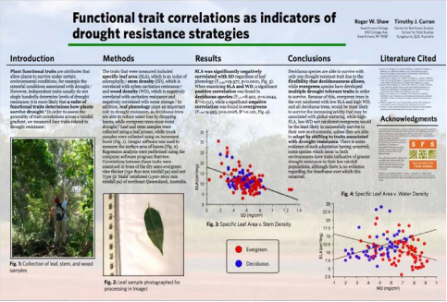
Preparing your poster
Consult conference rules and/or rubrics
Collaboration with your research mentor
Create a storyboard/plan
Use concise writing
Include transitions between sections when possible
Know your audience

Slide 5
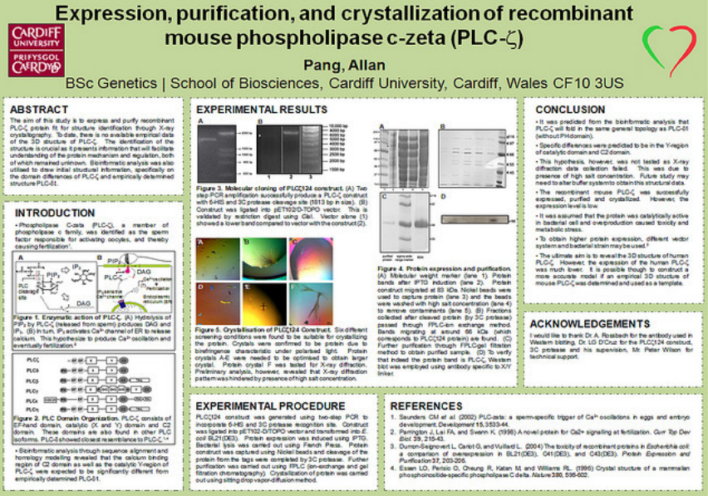
Poster Appearance
Make poster visually appealing
Balance text and images
Include headings
Make an obvious flow
Should be “stand alone” display
Unobtrusive or neutral background
Use white space or color frames to organize sections

Slide 6
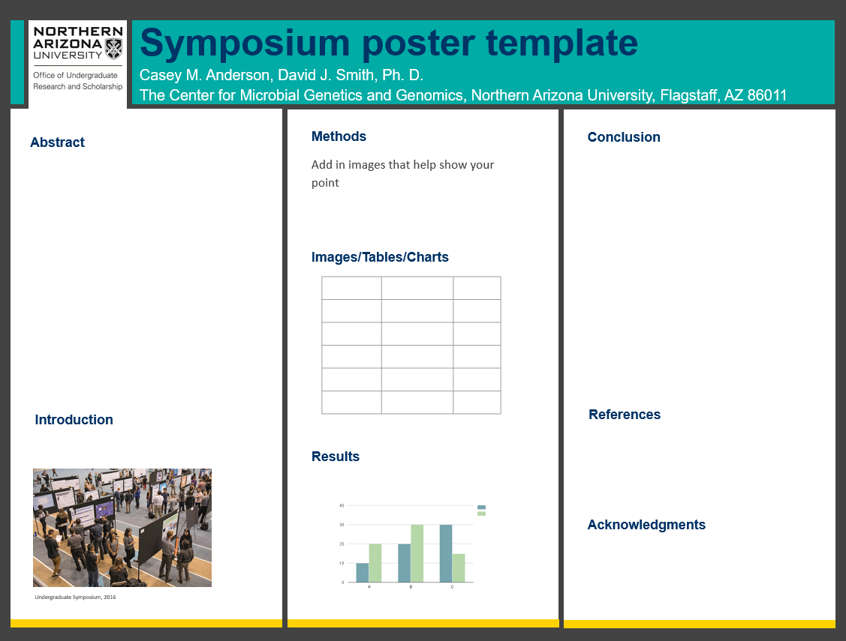
Main Elements of a Poster
Title
Names (First MI Last)
Logo
Department
University
Headings
Graphs,tables, and/or images

Slide 7
Poster Appearance
Create the poster the size you need in PowerPoint or PDF
(In PowerPoint, select Design –> Slide Size)
Avoid using dark, solid color backgrounds
Generally more graphics & less text is preferred
No more than 800 words
Avoid technical jargon
Use high resolution images

Slide 8
Poster Appearance
Put your research in context
Use pictures and graphs to convey your results
Should be readable by a non-technical, educated audience
Edit your poster carefully for typographic or grammatical errors and image quality
Acknowledge all sources of funding
Don’t cram in too much information
Cramming too much information into too small of a space is the most common mistake in academic poster design

Slide 9
Poster Appearance
Beneath the title, list:
Name(s) of the student author(s)
Faculty sponsor(s)
Department/school
Include the NAU logo
http://www.physics.nau.edu/PosterLogos/

Slide 10
Poster Tour - layout, colors, fonts, headings, spacing, graphics

Slide 11
Poster Appearance
Use traditional fonts (Arial, Times New Roman, Garamond)
Don’t use more than two or three fonts
Use italics or bold for emphasis, not for all your text
Avoid ALL CAPS
Item | Font Size (points) | Comments
Title | 150+ | Should be visible from across a room!
Headings | 32+ | Should be easily readable from 5 feet away
Subheadings | 20+ | This text is smaller than headings, but more noticeable than main text size
Main Body Text | 16-18 | This is a comfortable text size for someone who comes closer to read more
Captions | 12-16 | These can be a bit smaller than main text

Slide 12
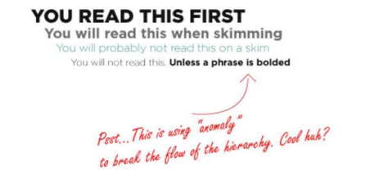
Visual Hierarchy
A person will scan your poster in less than 10 seconds to decide if they want to learn more
We tend to focus on differences, not similarities

Slide 13

Poster Headings
Abstract (summary of presentation)
Introduction
Methods
Results
Conclusion/Discussion
References
Acknowledgements

Slide 14
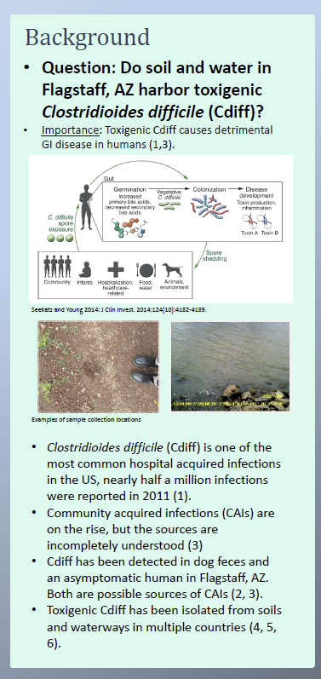
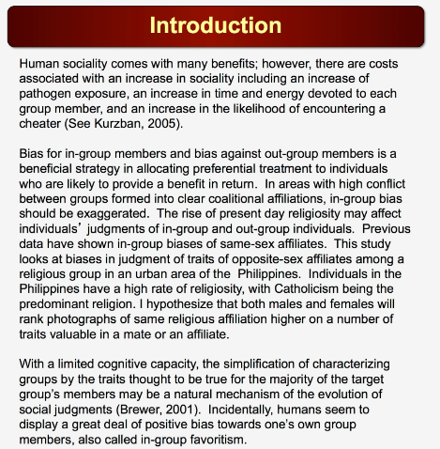
Introduction
Clearly state the problem or concept being investigated or demonstrated
Include the significance of the study – why should we care about this topic?
Include related current investigations and foundation for your work
Usually contains citations and references
May have purpose and hypothesis embedded
Get viewers interested!

Slide 15
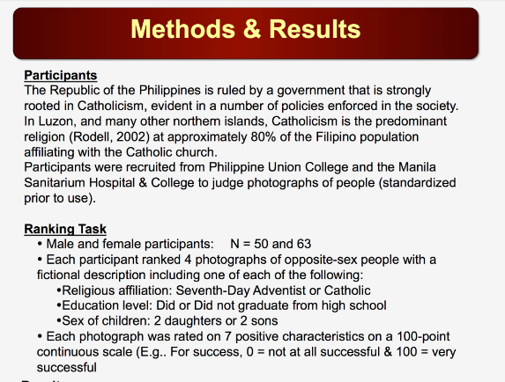
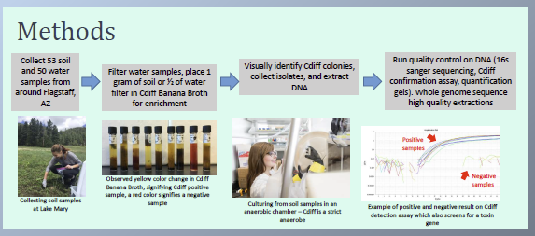
Methods
Describe procedures in detail to allow observer to understand how, when, and where data was obtained
Include text with subheadings to group content
Include (if relevant):
Subjects
Experimental design
Equipment used
Statistical methods
Why you chose the method
May include a flow chart to help flow
May include citations
Describe challenges

Slide 16
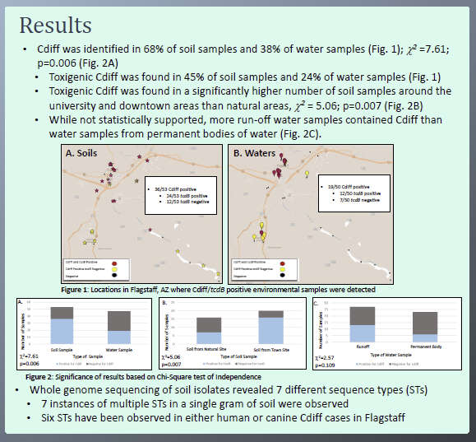
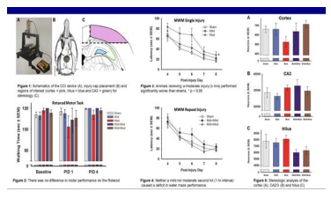
Results
Summarize data and reports findings
Make image-based when possible – maximize use of figures
Keep simple, easy to see, text large enough
Don’t present raw data
Minimize use of tables
Often this is the largest section

Slide 17
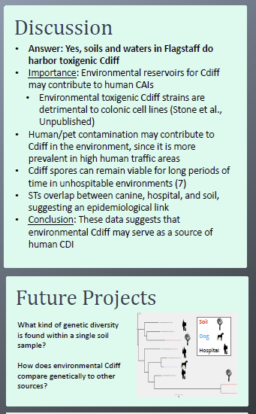
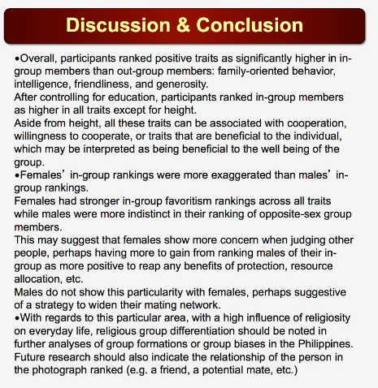
Conclusion/Discussion
Interpret the meaning or implications of your results
Mention alternative explanation for results
Tie back to a real-world problem
Communicate why this is important
Bulleted points work well

Slide 18
Final Tips
Make sure everything is clearly laid out and easy to follow in the absence of a presenter
Keep text concise and check for spelling and typographical errors
Keep the background unobtrusive
Include labels for figures and tables
Use photographs, tables, and graphs that improve understanding and enhance the visual appeal
Check online for samples and ideas
http://www.flickr.com/groups/688685@N24/
Good luck with your posters!

Slide 19
Important Dates
Register to present: Feb 1 – Apr 1
Workshops - 2 in February, 2 in March, dates TBD
Poster design/editing workshops
Public speaking/presentation workshops:
More information available at nau.edu/symposium

Slide 20
Virtual Undergraduate Symposium
Monday - Friday, April 12-16
Register at nau.edu/symposium

