Slide 1
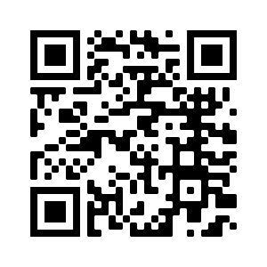

Poster title
Tables & Miscellaneous information for your reference
Theory or main findings
Casey Anderson, David Smith
The Pathogen and Microbiome Institute, Northern Arizona University, Flagstaff, AZ 86011
How to Create a QR Code
Find your link
A QR code is a graphic function that will take you to a specific link. To start, you must be sure your link is the exact page you will want the QR code to take you to.
Creating the QR Code
Go to Google, and in the search bar, search “Free QR Code Generator”.
Choose the QR Code generator that is the best and most trustworthy website to fit your needs. *Be sure to avoid websites that have a “free trial.” If you begin a QR code free trial, your code will expire at the end of the free trial and will no longer be usable. Note: The Office of Undergraduate Research and Creative Activity does not endorse, recommend, or provide support to any third party software.
Copy your original link into the generator’s URL input.
After the input, a QR code will generate as an image. You can download this image as a PNG or a JPG.
After downloading, place your QR code file into any document.
Checking if your QR code works
Using a smartphone, open the camera feature.
Face your camera toward the QR code, and your phone will recognize it as a link. Once it recognizes the link, it will ask you if you would like to visit this link.
If this option takes you to the website you’d like, your QR code works!
Type text here
Introduction
Type Text here in bullet point form
Methods
Type text here in bullet point form
Results
Type text here in bullet point form
Discussion
Type text here in bullet point form
Scan the QR code to watch a video with information on this type of poster design
Add QR code
Add QR code here

