Slide 1

How to Make a Video
For the Undergraduate Symposium

Slide 2

Why do you need to present your poster in a video?
Provide experience for you to verbally explain your work
In case the Symposium is moved to a virtual platform due to COVID-19
Your video will be archived with your poster for a long-term record

Slide 3

Video Length
Poster Presenters need to make a 5-minute video
Professional
Concise
Educational
Oral Presenters need to make a 20-minute video
Group presenters can make longer videos

Slide 4

Prepare for your video
CREATE YOUR SPACE
Good lighting
Remove distractions
Plain, non-cluttered background

Slide 5

Introduce yourself & your Project
Full name
Title of your project

Slide 6

Present your research Question
Explicitly state research question
Describe why your question is important

Slide 7

Describe your Research process
Use language that is understandable
Do not use jargon

Slide 8


Explain your results
Include data and figures
Use cursor to point out important information
Zoom in on features

Slide 9

Explain what your results mean
Interpret your results
Explain why your results are important

Slide 10

Summarize your main points
Include acknowledgements

Slide 11
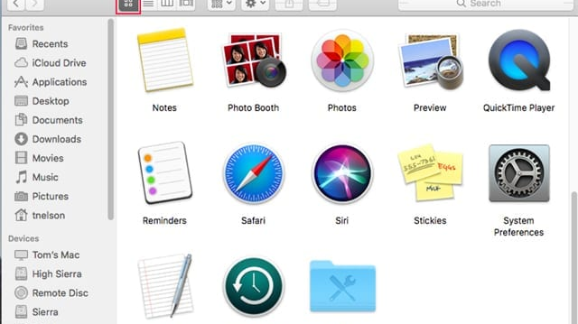

Accessing A Camera- MAC
Applications
Photo Booth

Slide 12
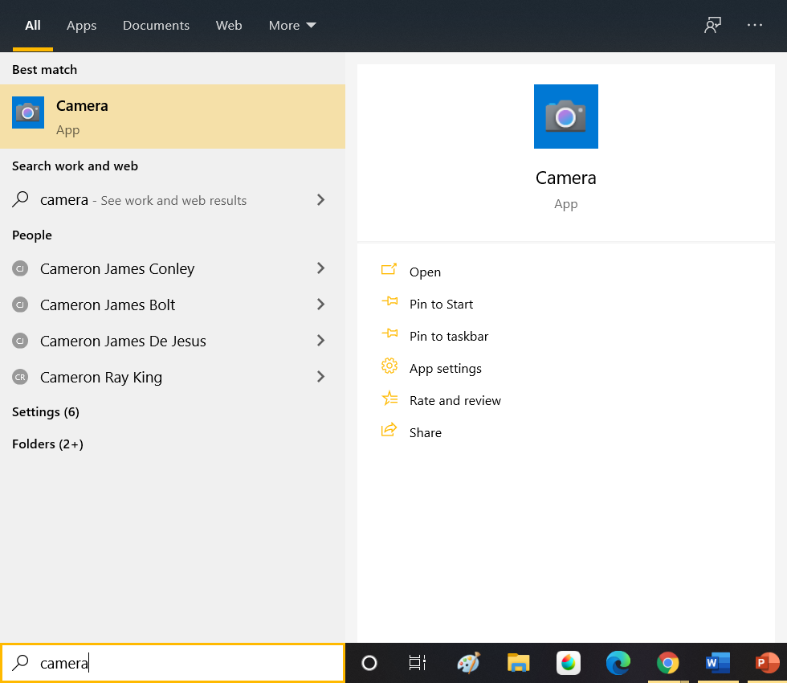
Accessing A Camera- PC
Click on the Camera App to Open the webcam
Search “Camera” under the start menu

Slide 13
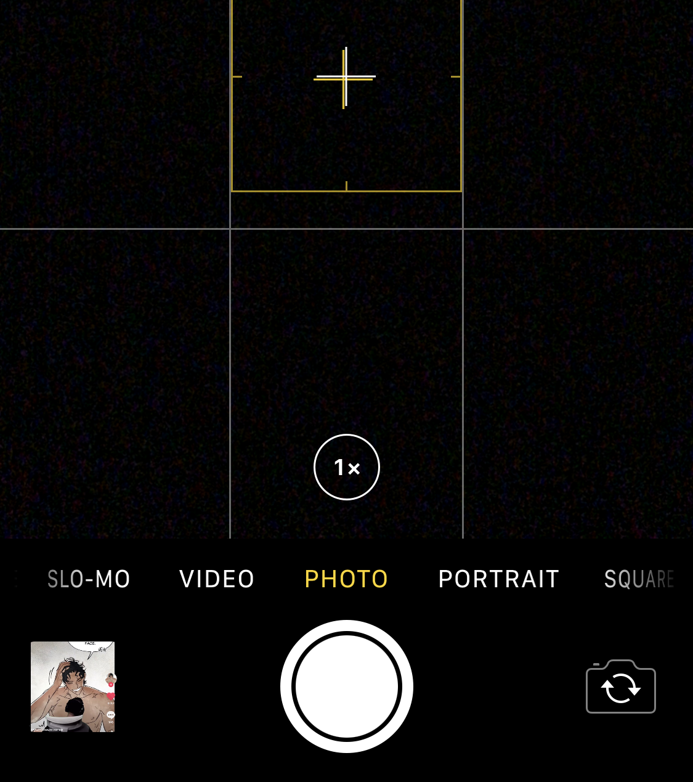
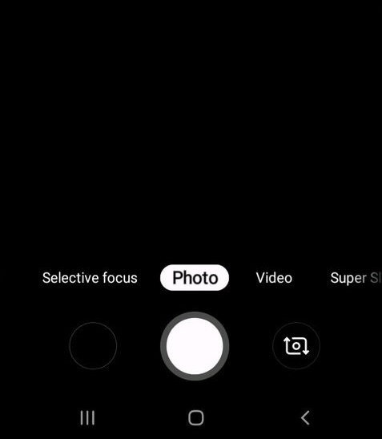
Accessing Camera-Phone

Slide 14

Tips for Filming on your phone
Set your phone against something or use a tripod to avoid shaky camera shots
Film in “Landscape” mode for a more professional look

Slide 15

Practice your video
Time yourself
Keep it natural
Rehearse in front of a camera
Practice until your presentation flows

Slide 16
Completing your video
Edit your video (Optional)
iMovie (Macs & iPhone)
Window Movie Maker (PC)
Openshot.org
Clipchamp.com
Correct Video Format
Popular web, consumer, and professional media formats such as MP4, MPEG-2, AVI, AAC, FLV, 3GP are acceptable, however ARRI and RED are not
Under 2 GB

Slide 17
Resources
Linkedin Learning
nau.edu/ugr

