Slide 1
Preparing your HURA/Urdea/SPArCS Proposal

Slide 2
Office of Undergraduate Research & Creative Activity
nau.edu/hura
ug-research@nau.edu
Notes:
Welcome to this Office of Undergraduate Research Application Workshop!
Are you looking for funding to do a special project? This workshop may be just what you’re looking for.
In this PPT, I’ll share information and insider tips that can help you write a successful HURA/Urdea/SPArCS proposal.

Slide 3
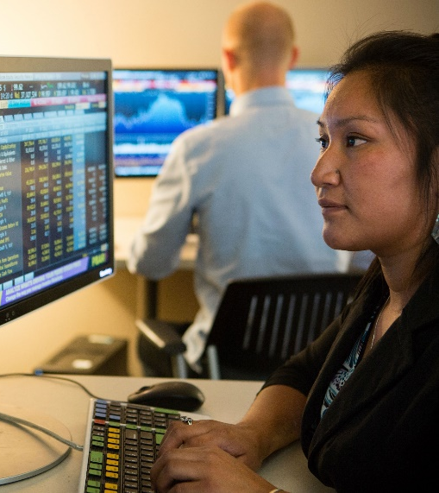

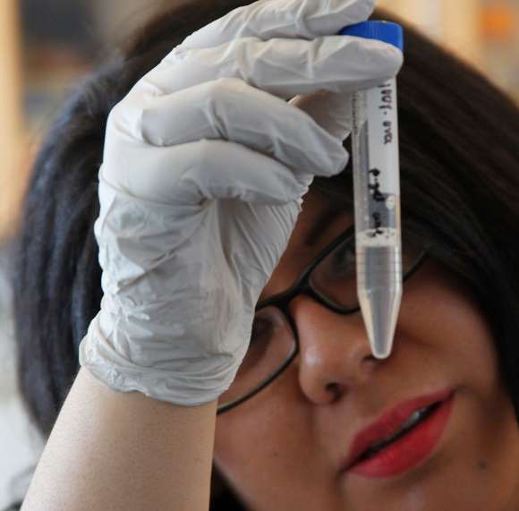
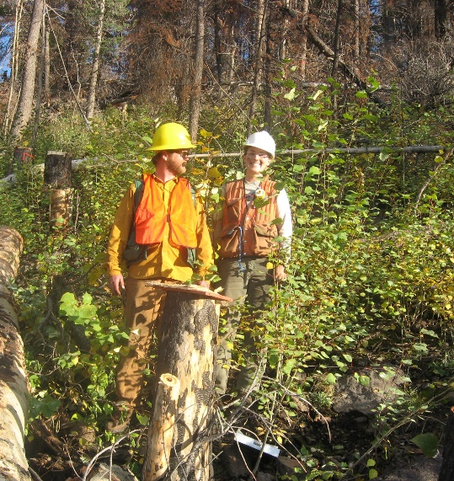

Presentation Outline
What • Why • Who • When • How
Notes:
This presentation will provide answers to the following questions:
What is a HURA/Urdea/SPArCS award?
Why should you consider writing a proposal?
Who is eligible to submit a proposal?
When are proposals being accepted and when will your project be funded?
Finally, it will take me a number of slides to explain how to write a fundable proposal.

Slide 4
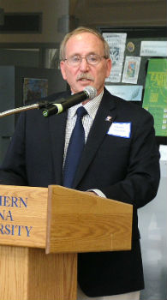
WHAT Is a Hooper Undergraduate Research Award (HURA)?
Provides funding for student-led research, scholarly, or creative projects
Proposals accepted from all academic disciplines or majors
Application can be from
an individual or two students
$5000
a team of 3 or more students
$7500
Notes:
Dr. Hooper is a professor emeritus in physics. He set up the funding for this program when he was the Associate Vice President for Academic Affairs, Research and Graduate Studies and the Dean of the Graduate College.
Since the beginning of the program, more than 400 students across all of NAU’s colleges have completed HURA projects.

Slide 5
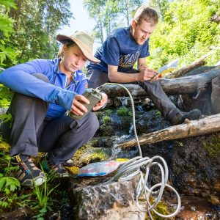
WHAT Is an Urdea Undergraduate Collaborative Research Award?
Similar to HURA
Provides up to $7,500 to fund student-led research, scholarly, or creative projects
An interdisciplinary project that includes
At least 1 student from CEFNS
At least 1 student from CEIAS
Notes:
Dr. Mickey Urdea, the donor of this program, is an alumnus of NAU. He is founder and partner for Halteres Associates, a biotechnology-consulting firm.
The intent of the Urdea Research Award is to encourage interdisciplinary projects between undergraduate students from the College of Engineering, Informatics, and Applied Sciences and the College of the Environment, Forestry, and Natural Sciences in research, scholarly, and creative activities supervised by a faculty mentor.
This project began in 2019.

Slide 6
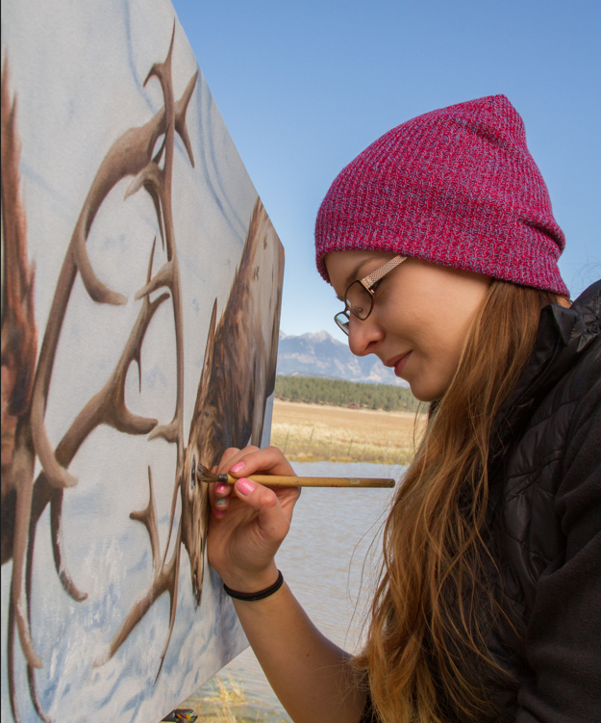
WHAT Is a Student-Led Project in the Arts, Creative Activity, And Scholarship Award (SPArCS)?
Provides funding for student-led art, scholarly, or creative projects
Designed for students in CAL and Communications
Application can be from
an individual or two students
$5000
a team of 3 or more students
$7500
Notes:
The intent of the Student-led Projects in the Arts, Creative Activity, and Scholarship (SPArCS) is to encourage greater participation of undergraduate students in the arts, letters, humanities, photography, and film supervised by a faculty mentor.
This program, started in 2023.

Slide 7
WHY Submit a HURA/Urdea/SPArCS Proposal?
87% of employers surveyed say they are more likely to hire a recent college graduate who has participated in research
Gain experience as a grant writer and principal investigator to add to your resume or graduate school application
Establish a professional relationship with a faculty mentor for recommendations
Be paid to work on a thesis or capstone project
Cover the costs of supplies
Notes:
As previous award recipients will tell you, writing a grant proposal and serving as the PI (or principal investigator) for the project opens many doors for post graduation employment and/or graduate school.
For example:
Bryan Kimoto (a philosophy major) paid himself to write his senior thesis and went on to get his Masters degree at Loyola Marymount University and is now in the PhD program at the University of Memphis.
Art history/history/museum studies major Margaret Sheble used her HURA funding to create her capstone museum exhibit (Reflections of Flagstaff) along with team members Kiran Haynes and Erin Carter. Margaret went on to complete a master's program at the University of Wales-Bangor and is now a graduate student at Purdue University.
Josh Majoral (biomedical sciences) built on his UG research experiences to be accepted to the Einstein School of Medicine in New York
Psychological sciences major Brett Velez (a transfer student) so impressed the admissions committee at the University of Illinois at Urbana-Champaign that he went directly from his bachelor’s degree into a PhD program in neuroscience.

Slide 8

WHO: Eligibility Requirements
Applicant(s) must be:
an undergraduate student
enrolled full time for
If the award is for Fall 24/Spring 25, be enrolled in both semesters of academic year of the award
If the award is for Summer 24/Fall 24, be enrolled in Spring 24 and Fall 24
in good academic standing at the time of application and during funding period
Notes:
Who can apply for a grant?
Most applications come from current juniors to fund projects during their senior year.
However, sophomores have also successfully submitted proposals and received funding when they were juniors. Several of these went on to submit new proposals as juniors to fund related projects as seniors.
Although there is no specific GPA requirement, most successful applicants have GPAs of 3.0 or higher.

Slide 9
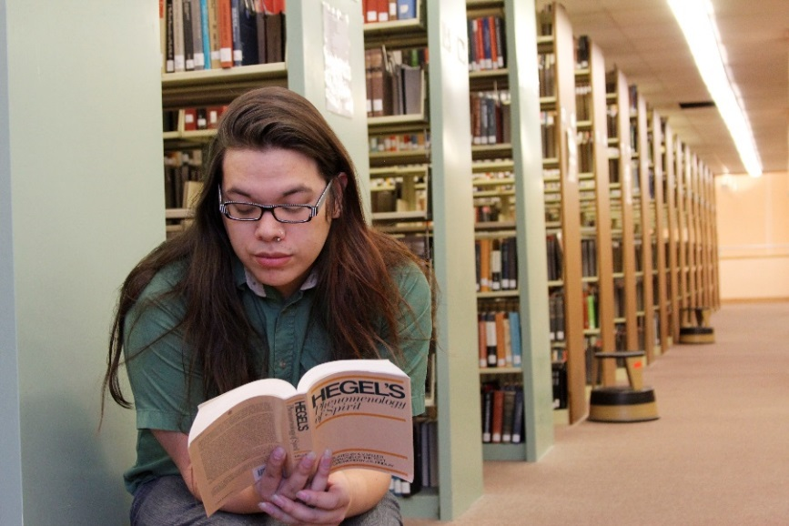
WHEN: Timelines
Projects may be started as early as May 15, 2024 and must end by May 9, 2025
Proposals accepted:
February 1 –
March 1, 2024
Notes:
Writing a proposal takes A lot of pre-planning. The applications must be submitted by March 1 for projects to be funded the following academic year. This deadline is a hard one….NO LATE applications will be accepted…so don’t wait until the last minute to try to put an application together!!
Most projects start at the beginning of the fall semester, although some projects require students to do field work in the summer. Think very carefully about whether this is appropriate for you. Consider whether your mentor be available to help you during the summer. Specific justification for summer work must be provided in the budget; this option is only available with approval by the coordinator

Slide 10

HOW to Apply: Know Your Audience!
The review committee is made up of faculty and professional research staff at NAU from various departments
Your proposal will be reviewed by a faculty member who is not from your department, so be sure to avoid unexplained jargon
Have your application reviewed by:
your mentor(s)
someone who is NOT an expert in your discipline
Notes:
When you prepare to write something….anything…the first thing you should consider is your audience. Knowing who will be reading your writing tells you what style and language to use.
Description of “reviewers” here … also handling jargon
I cannot stress enough the importance of having another person who is not in your field or discipline read what you’ve written and give you feedback on the clarity of your proposal. Ask them to summarize what your project is about, what the purpose is, and how you’re going to carry out the work. Are there any unexplained or unfamiliar words or abbreviations in your proposal?
I would say, “Ask you mom” but not all moms will give you critical advice…often they are just amazed at what you know and are planning to do! So, if you know a faculty member or graduate student in a completely different field of study who would be willing to provide critical feedback on your proposal, ask them to do this – just don’t wait until the last minute!

Slide 11
HOW to Apply: Know Your Audience!
Lumberjack Writing Center
is available to help!

Slide 12
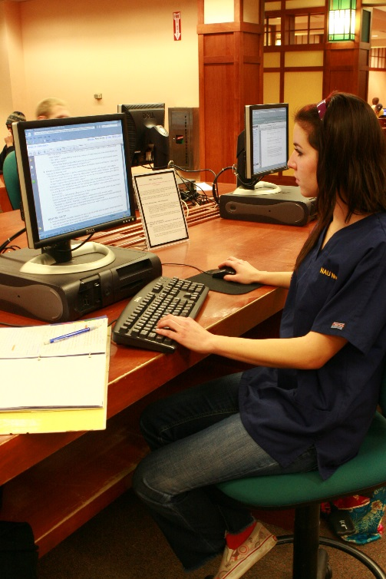
The Application Process: Step 1 of 8
Go to nau.edu/hura or nau.edu/urdea or nau.edu/sparcs
Download and save on your computer
Request for Proposals (RFP)
Budget Worksheet
Application Template
Carefully read the RFP instructions
Forward a copy of the instructions to your faculty mentor
Notes:
Your first stop is the webpage: nau.edu/hura or nau.edu/urdea or nau.edu/sparcs
It is important for you to know all of the information about the application requirements and process. You must follow these to the letter. Download the documents and back these up in more than one location – on your computer and in the other places, such as flashdrives, GoogleDoc, and/or the cloud.
YOU will be the PI - principal investigator - on this grant; it is YOUR responsibility to follow all the procedures. This grant does not belong to the faculty mentor; it is awarded to a specific student to conduct the specific project described in the proposal
The Request for Proposals – or RFP - provides all the information about the proposal process, what can and cannot be included, and how it will need to be activated and administered if you do receive one of these grants. The RFP is part of a contract between you and the Office for Undergraduate Research & Creative Activity with expectations clearly described; your award letter will be the other component of the contract. Your faculty mentor may not be familiar with the up-to-date proposal expectations so do share the RFP with your mentor.

Slide 13

The Application Process: Step 2 of 8
Develop an idea for your project
Find ideas from courses you’ve taken, scholarly interests of a faculty member, or your own ideas
Project may be in any field of study
Something you’re passionate about
Project usually related to your major or minor
Notes:
You probably already have an idea about what you might like to do, but now is the time to start developing an idea. Ideas might come from a faculty mentor, a literature search, or something that you are really passionate about doing.
For this award, we consider any project that adds to the knowledge in the discipline as “research.” In the humanities this might be a scholarly paper or thesis; in the creative arts, this might be an exploration of new techniques, creating new works (e.g., compositions, designs, etc.). Market research, economic or cost-benefit analyses, or business plans could also be a project. Science projects might be experimental, working in a lab setting, or field work, or some combination of those.
Be thinking about whether this might also serve as a capstone project in your discipline. Some students have made arrangements in their departments to have this award be their capstone project.

Slide 14
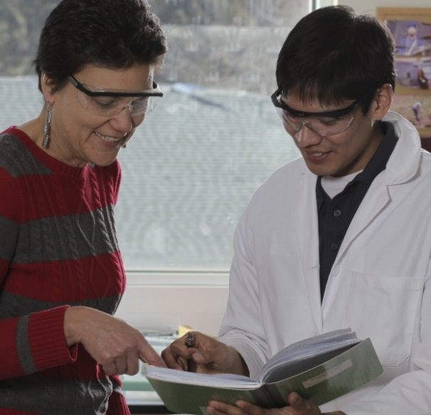
The Application Process: Step 3 of 8
Collaborate with your faculty mentor and agree on:
Nature and scope of the project
Method of inquiry or creative activity
Expected outcomes
Timeline for completion
Proposed budget
You should meet with your mentor several times during this process!
Notes:
Step 3: If you haven’t already done so, you will need to find a faculty mentor to help you with your project. You and your mentor will collaborate to refine your proposal idea or question, determine the methods you will use, define what you expect to find, learn, and/or produce as a result of this project, establish a feasible timeline for completing the work, and create a reasonable budget within the limitations of what this grant will support. Be sure to check out the chart in the RFP that explains Who Does What.
Most likely, this process will take more than one meeting, as you write drafts of sections and get feedback from your mentor.
Your faculty mentor is a key figure in crafting a good proposal. Even more importantly, the mentor’s recommendation also plays a significant role in receiving favorable reviews. Choose your mentor wisely!

Slide 15

The Application Process: Step 4 of 8
Write the Project Description
Introduction
Potential Importance
Methods
Expected Outcomes
Dissemination Plan
Roles of the Participants
Notes:
Now we come to writing the proposal itself – what’s included.
There are 6 components in the written proposal, which we’ll talk about on the next 3 slides. If a given section is not applicable for a proposed project, that section should still be included, followed by the text “Not applicable.” Each section can be as brief as one or two sentences or can be several paragraphs, depending on the project.
These are all described in general terms in the Request for Proposal (RFP) that is posted on the webpages under the heading “Program guidelines and application instructions.” First and foremost, the Project Description described here must not exceed 5 pages.
Now let’s get to describing what goes into application.

Slide 16
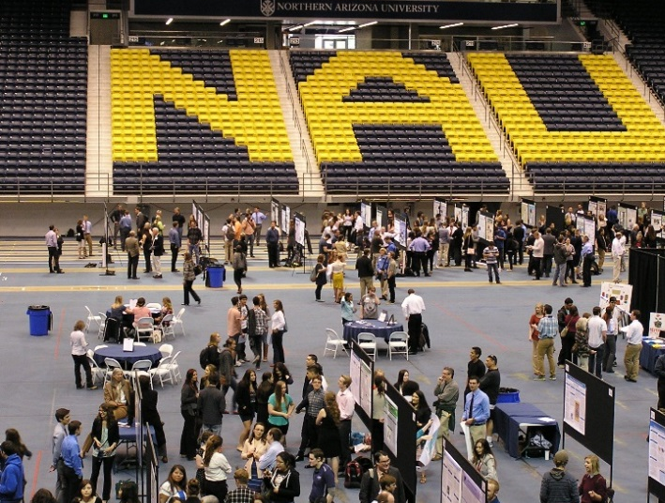
The Application Process: Step 4 of 8 Cont.
Dissemination Plan
OURCA Award Reception
(April 2025)
NAU Undergraduate Symposium (April 2025)
Notes:
Research and creative work does no one any good if you don’t share your results. Dissemination is a critically important part of the research/scholarly/creative process!
As shown on this slide, you are required to do two presentations: the OURCA Reception and NAU’s Undergraduate Symposium.
Planning to present your work at other conferences or submitting a manuscript for publication are other good options. Besides conferences and journals in your discipline, you might also want to submit an abstract for the National Conference of Undergraduate Research (NCUR) which is usually held in early April. In additional to journals in your discipline, you can find links to other UGR journals on the nau.edu/ugr website under “Sharing your results: Publishing your results.”
In any case, be sure to give specifics about which conferences and the months of those meetings and which journals you plan to use to disseminate your work.

Slide 17

The Application Process: Step 4 of 8 Cont.
Compile:
Timeline
References cited, if applicable
Qualifications (2-page resume)
Notes:
Timeline: This will provide a calendar of each phase of the project. Use the template provided to give specific descriptions of all the activities and tasks to be completed. Working with your mentor, be sure to allocate sufficient time for each of these. Do be specific in your descriptions…don’t just say “collect data.” If you are proposing to include paying yourself and/or team members to do the work, estimate the number of hours for each of the tasks on your timeline. The total number of hours on this timeline MUST MATCH the total number of hours to be paid by your budget. If you have non-personnel expenses included in your budget, indicate the costs of these when they are likely to be purchased.
References: If you cited sources in your introduction or methods sections, please include the list of references in whatever style (e.g., MLA, APA, etc.) that is appropriate for your discipline.
Resume: Your resume is limited to 2 pages and it should not include your name! We are doing this to insure a blind review process. Try to target the resume toward your qualifications for successfully completing your proposed project. For example, if there are courses that you’ve taken that directly relate to the content knowledge you need, be sure to list these (not just by course number) with a brief description of applicable content. If you served as a project manager, even as a volunteer, such as coordinating an event, a homecoming float, etc., be sure to include a description of that in your experience section. Think very broadly about what knowledge, skills, and dispositions (e.g., time management, persistence, goal-orientation) would be important to being a successful PI and include those in your resume. Make your resume look professional…use one of the many business resume templates that can be found in Word or online. The resume of each team member will need to be included, if more than one student is involved in the project. Remember - no names, please! You could put “Principal Investigator” or “Co-PI#1” in that space in the resume, if you like.
Budget: There is no “typical” amount as each project has different funding needs. Your budget may not exceed a total of $5,000 for one to two students or $7,500 for three or more students.
The last component of the application to be completed is the Mentor Recommendation. This form is just below the Project Information section of the application template. It is to be completed by your faculty mentor AFTER she/he reviews the final application. The reviewers pay close attention to what your mentor says about your preparation, qualifications, and likelihood of successfully completing the project.

Slide 18
The Application Process: Step 5 of 8
Create Budget and Justification
No “typical” amount of funding per project; based on needs of project
May not exceed $5000 for year or $7500 for group of three or more
Use provided Excel worksheet template!
If you have other support, provide details in green columns
Justification must stand alone
Notes:
Putting together a complete and thoughtful budget is very important in writing a successful proposal.
It is helpful if you have the budget worksheet open at this time so you can see what I am referring to.
I’ll mention some important points now; more details are provided in the RFP. If you have additional questions about how or where to enter information in the spreadsheet, do not hesitate to contact the Undergraduate Research Program Manager (details on last slide).

Slide 19
The Application Process: Step 5 of 8 Cont
Personnel
May request up to 15 hours/week; 14 weeks/semester
Number of hours requested must match hours allocated on timeline
$16.50/hour
Operations - $1500 max
Only expendable items (no equipment, reference books)
Can include contract expenses (e.g., services)
Travel - $1500 max

Slide 20
The Application Process: Step 6 of 8
Request Mentor and Department Recommendations
Department recommendation is from someone in your department that can comment on the feasibility/quality of your project; they don’t have to comment on your abilities
Confirm that they both are willing to write you a recommendation
Provide faculty mentor’s/department name & email
an automatic request will be emailed to faculty mentor/department to complete recommendation form
It’s your responsibility to ensure that your faculty mentor/department recommendation is submitted no later than 11:59 pm March 1, 2024.

Slide 21
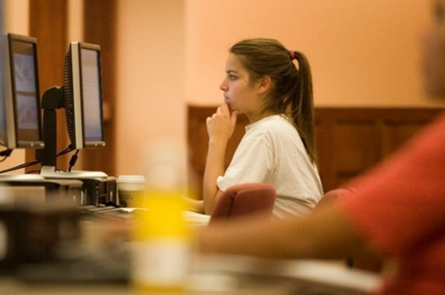
The Application Process: Step 7 of 8
Save your Application (the project description, timeline, and resume) as a single Word or PDF document
Save your competed budget as an Excel or PDF document (use template on nau.edu/hura)
Proofread; edit; have someone else proofread;
edit again!
Notes:
OK…you’re almost done with the application!
I hope you have not waited until the last minute to finalize this. There are still a few very important steps to complete!
I cannot stress enough that all the components of the application be in the order specified in the RFP and that you use the headings. There is a template to use on the website. The rubric that the reviewers use is set up in exactly this order, so do not irritate your readers by expecting them to “hunt” around in your proposal for your responses to each section!
Equally important to content is grammatical clarity and correctness. Grammar and writing is actually a separate scoring section on the review rubric. Now is the time to find a grammar guru or get assistance from one of the writing labs or tutors if this is not your area of expertise. Reviewers are quickly distracted by poor writing, spelling and punctuation errors, and confusing (usually lengthy) sentences and undefined technical terms. So proofread…edit…proofread again…edit again!
When you’re done with all the proofing and editing, save the document.

Slide 22
Required Proposal Formatting
Format MUST match the following criteria:
Font: Any standard font (Times New Roman, Arial, etc.)
Type Size: 12-point or larger
Spacing: Single or double, but must be consistent throughout
Margins: No less than ½ inch on all sides
Project Description: limited to 5 pages
Use Headings provided in Application Template
Notes:
The application template that you downloaded is set to these specifications. Best word of advice is to USE IT!
Sometimes copying/pasting from another document will change the formatting. If so, be sure that you reset it to the above criteria.
Make sure that your Project Description (sections a through f) does NOT exceed 5 pages!!
Use the headings…these are aligned with the rubric the reviewers use to score the proposals.

Slide 23
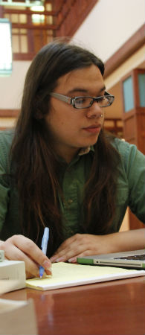
The Application Process: Step 8 of 8
Go to nau.edu/hura or nau.edu/urdea or nau.edu/sparcs
Sign into online submission portal using your Louie login
Upload Proposal and Budget documents
Notes:
As you may have noticed on the Application Template and in the RFP, you are not to include your name should not appear in any of the sections that the reviewers will see. This is so we can provide your application with a blind review process.

Slide 24
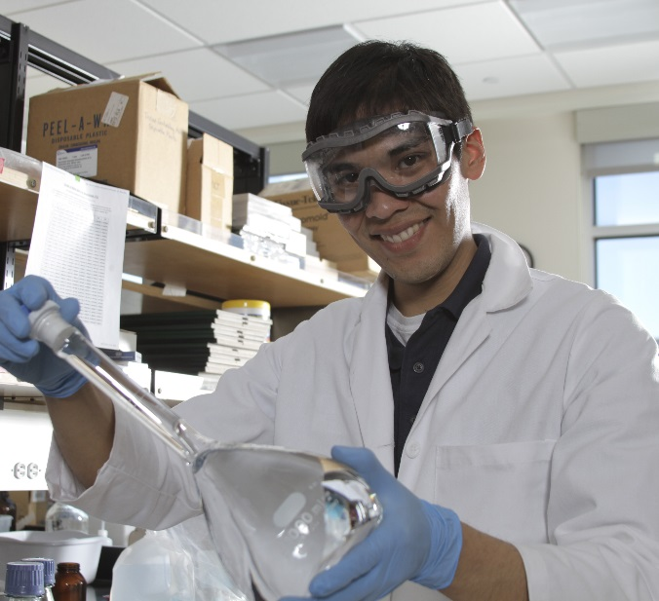
THEN WHAT? Application & Notification
Applications are reviewed on:
Significance of the project
Quality of the proposal
Feasibility of timeline
Educational benefit to you
Diversity of disciplines
Award notification by April 3, 2024
Notes:
Once your application has been submitted, then what? Each application will be assigned to 3 reviewers.
After the award notifications are sent out, we will compile all the reviewers’ comments. These will be available after you have received notification of your award..

Slide 25
Questions or Additional HURA Information
Please visit the UGR websites:
http://nau.edu/HURA
http://nau.edu/Urdea
http://nau.edu/SPArCS
Contact Lara Dickson:
ug-research@nau.edu
(928) 523-5569
Notes:
If you have any additional questions that have not been answered in this presentation, on the HURA webpage, or in the RFP, do not hesitate to send an email to ug-research@nau.edu.
I hope that you submit a brilliant HURA application.

