Slide 1

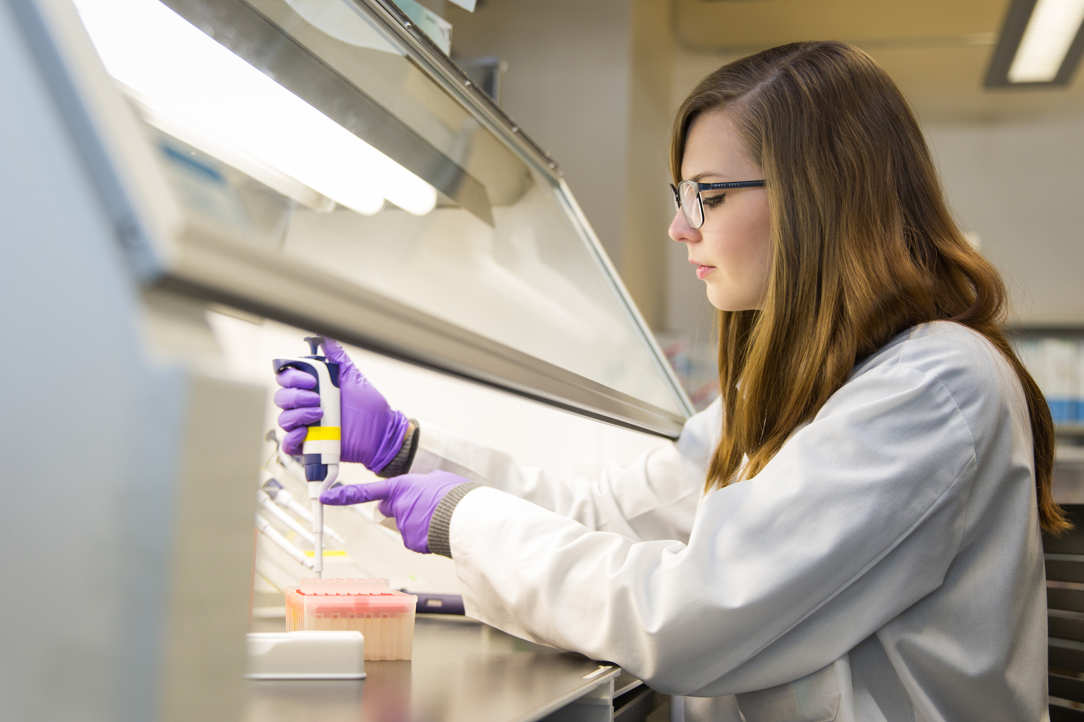
Symposium poster template
Casey Anderson, David Smith
The Pathogen and Microbiome Institute, Northern Arizona University, Flagstaff, AZ 86011
Abstract
Methods
Results
Conclusion
References
Acknowledgements

