Slide 1
Using Geospatial Methods to Visualize Fiscal Data at the Arizona Bureau of Land Management
Committee Members:
Alan A. Lew, chair
R. Dawn Hawley
Mark Manone
Kayla Resnick
Northern Arizona University
Oral Defense for M.S. in Applied Geospatial Sciences
December 1st, 2016

Slide 2
Practicum Objective
The intent of this practicum is to aid the Bureau of Land Management (BLM) in obtaining operational excellence and achieving their strategic goals by spatially connecting on the ground accomplishments to budget and fiscal data. The result is a visual representation of budget allocations and spending, connected geospatially to Arizona BLM Field Offices across the state.

Slide 3
Background
The BLM is a federal agency tasked with “sustaining the health, diversity, and productivity of America’s public lands” (BLM.gov 2012)
They use their operating budget of over $1 billion to regulate activities such as grazing, recreation, timber use, commercial leases, and energy development
The duties of the BLM are carried out across the United States by a hierarchy of Federal, Regional, State, District, and Field offices. Within Arizona, there is one state office, four district offices, and eight field offices.

Slide 4
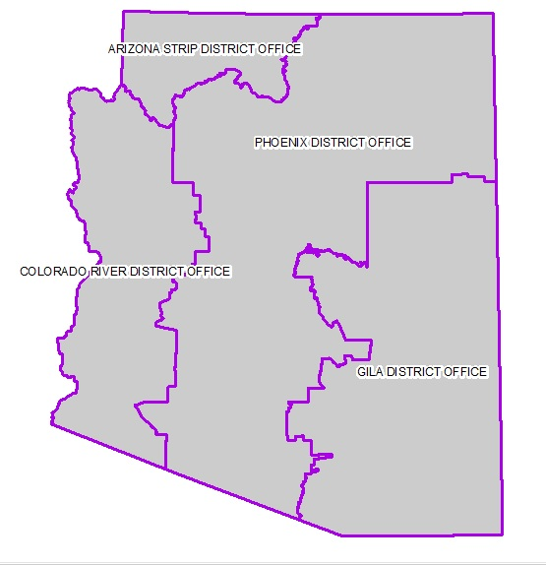
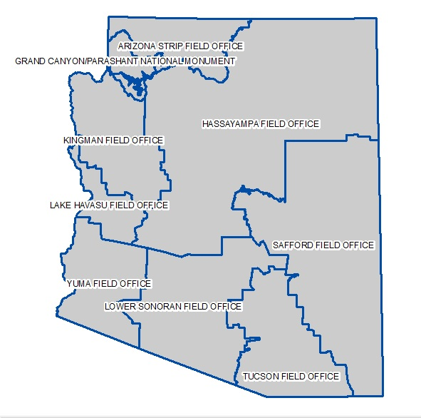
Arizona BLM

Slide 5
Research Questions and Outcome
Questions
How well are we planning and executing our workload?
How well are we planning and executing our budget?
Outcome
Results can be viewed by management to make budget decisions, visualize spending, and understand patterns.

Slide 6

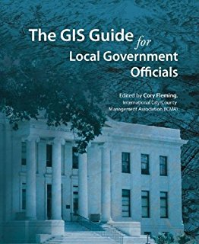

Literature Review
History and Importance of Visual Data
  Maps as vehicles
  Maps for non-spatial data
2) GIS use in Government Offices
  Resource distribution
  Doing “more with less”
3) BLM GIS Management
  Guiding documents

Slide 7
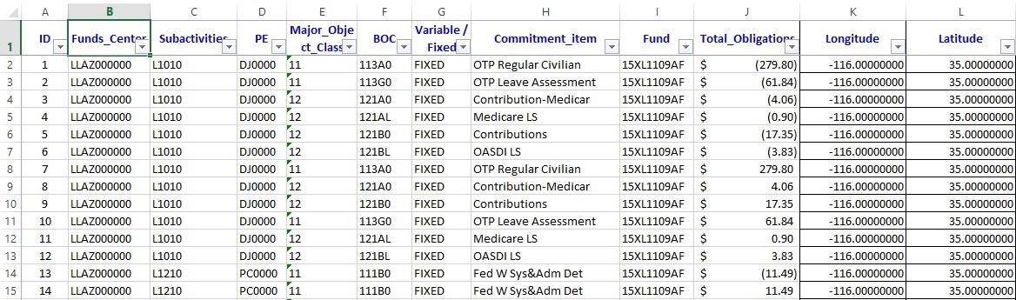
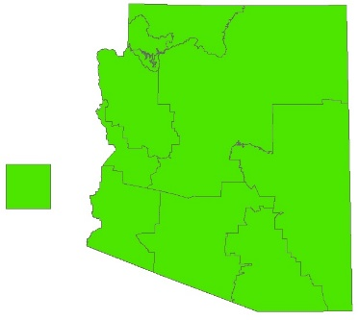
Data
Spatial: ArcMap
Boundary files such as state, district, and field offices
Also wilderness and conservation areas, national monuments
UTM NAD 1983 Zone 12N
Retrieved from BLM.gov GIS library
Fiscal: Excel
2 budget tables
  Master Budget for budget questions
  2015PMDS for workload
Retrieved from BLM “Budget Tool” or BLM Budget Officers.

Slide 8
Data
Performance Management Data Systems (PMDS)
  Workload tracking method with multiple units of measurement including acres, projects, buildings, evaluations, agreements, permits, and sites
2) Financial & Business Management System (FBMS)
  Budget, procurement, obligations, and expenses
3) Program Elements (PE)
  2 digit tracking codes tied to PMDS to measure workload
4) Budget Object Codes (BOC)
  Type of spending category, demonstrates labor and operations budget costs

Slide 9
Methodology
Fund Center | Name | Longitude | Latitude
LLAZ9xxxxx | State Office | -116.18700000 | 33.55100000
LLAZA00000 | Arizona Strip District Office | -113.14700000 | 36.60000000
LLAZA01000 | Arizona Strip Field Office | -112.80400000 | 36.65900000
LLAZA02000 | Vermilion Cliffs National Monument | -111.84000000 | 36.84900000
LLAZA03000 | Grand Canyon National Monument | -113.63900000 | 36.23700000
LLAZC00000 | Colorado River District Office | -113.71400000 | 34.16200000
LLAZC01000 | Kingman Field Office | -113.78500000 | 35.15400000
LLAZC02000 | Yuma Field Office | -114.03200000 | 32.97900000
LLAZC03000 | Lake Havasu Field Office | -114.03500000 | 34.14400000
LLAZG00000 | Gila District Office | -110.12200000 | 33.13000000
LLAZG01000 | Safford Field Office | -109.86100000 | 33.67300000
LLAZG01100 | Gila Box Riparian NCA | -109.43700000 | 32.93300000
LLAZG02000 | Tucson Field Office | -110.78600000 | 31.96700000
LLAZG02100 | Las Cienegas NCA | -110.56400000 | 31.89200000
LLAZG02200 | San Pedro Riparian NCA | -110.16700000 | 31.36200000
LLAZG03000 | Ironwood Forest National Monument | -111.44300000 | 32.45500000
LLAZP00000 | Phoenix District Office | -111.94300000 | 33.13000000
LLAZP01000 | Hassayampa Field Office | -111.15600000 | 35.46400000
LLAZP02000 | Lower Sonoran Field Office | -112.46700000 | 32.66400000
LLAZP03000 | Agua Fria National Monument | -112.05200000 | 34.22200000
LLAZP04000 | Sonoran Desert National Monument | -112.42200000 | 32.90900000
Assign a Cartesian coordinate to the center of each field office
Add data
Display XY Data
Result: stacked points
Export to feature class
Summarized spatial join

Slide 10
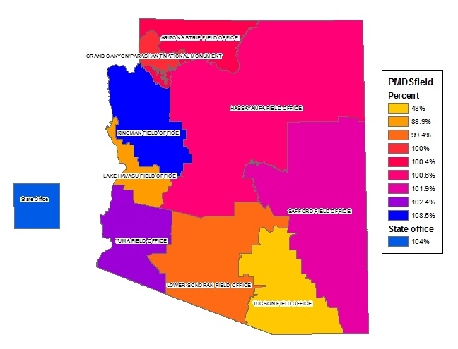

Slide 11
How well are we planning and executing our workload?
This data examines PMDS target and actual achievements per Field Office.
Overall PMDS achieved at state, district, and field office level
PMDS achieved per specific program element
  BH – Inventory abandoned mine lands (sites)
  FH – Process and manage special recreation permits (permits)
  EE – Issue grazing permits/leases (permits)
  JA – Apply shrub/grass vegetation (acres)

Slide 12
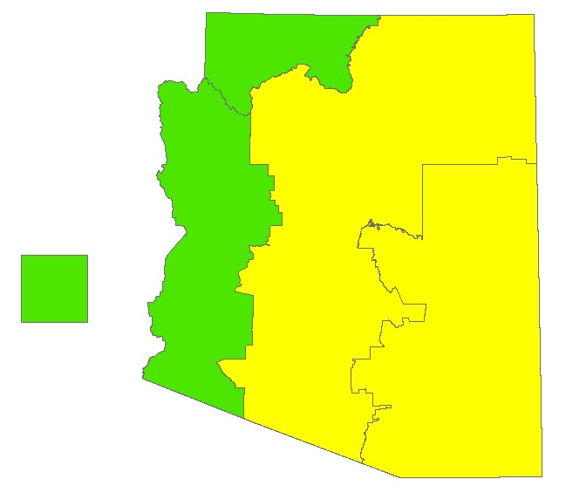
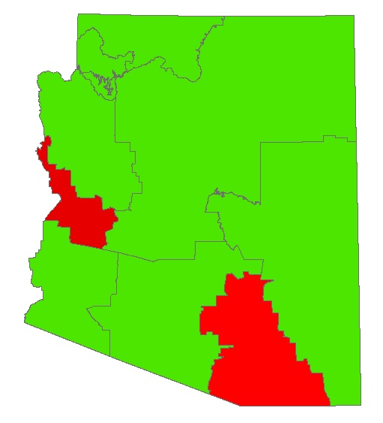

Total Percent of PMDS Achieved

Slide 13
Case Study: Tucson
The Tucson Field Office accomplished 126,429/263,311 workload measures, equal to 48%.
This value is most affected by Evaluating Recreation Areas (MA) Program Element, particularly within the National Monument and Conservation Areas. This Program Element is measured in acres, and Tucson fell far short of its target.
This figure was also influenced by acres evaluated for Invasive and Noxious Weeds, where Tucson evaluated 0 of its target 42,280 acres.

Slide 14
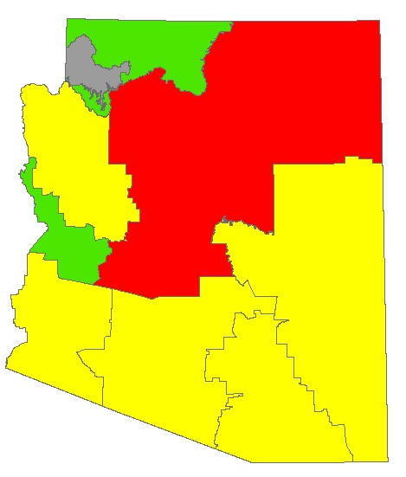
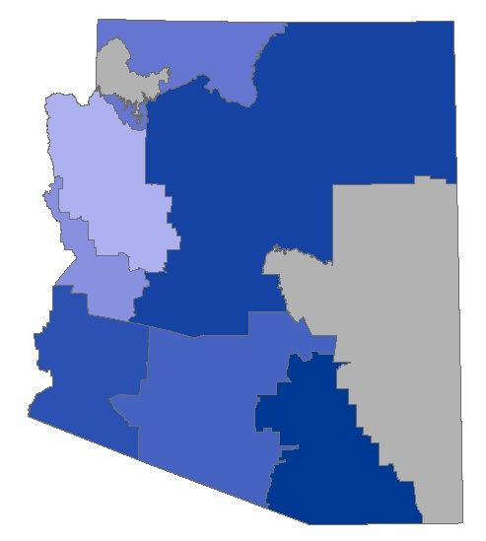
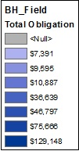
Percent of PMDS Achieved by PE and FBMS by PE - BH

Slide 15
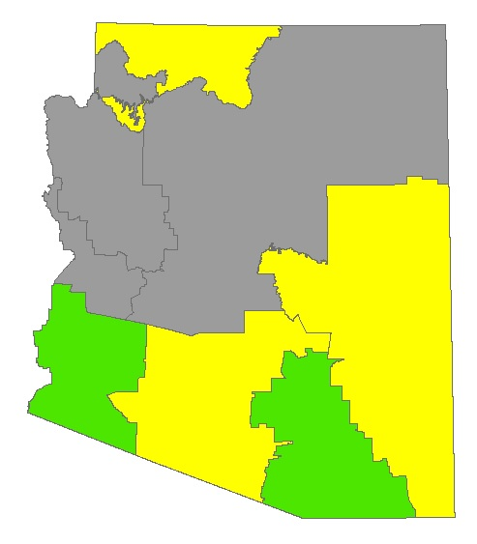
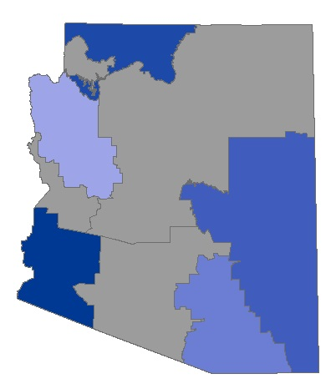
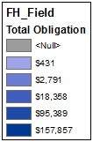
Percent of PMDS Achieved by PE and FBMS by PE - FH

Slide 16
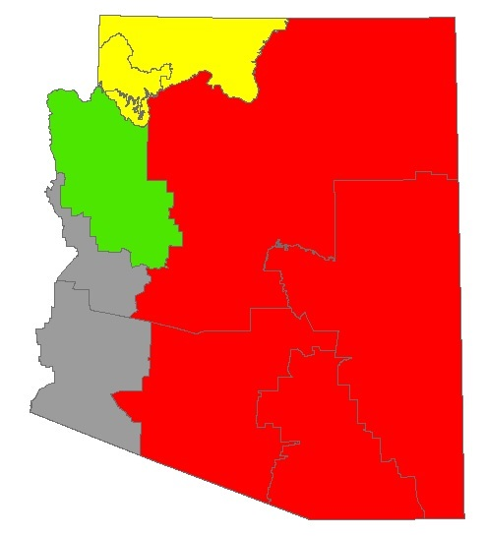
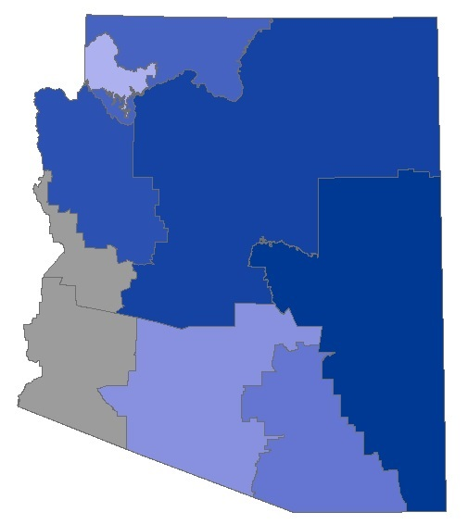
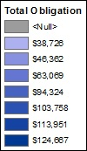
Percent of PMDS Achieved by PE and FBMS by PE - EE

Slide 17
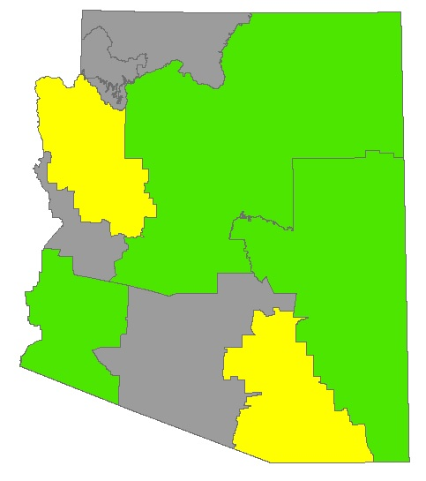
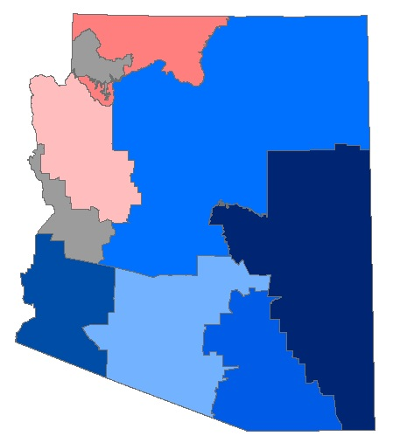
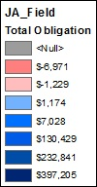
Percent of PMDS Achieved by PE and FBMS by PE - JA

Slide 18
How well are we Planning and executing our Budget?
This section examines three categories of data.
  FBMS spending per field office by sub-activity
    1020 – Rangeland Management
    1210 – Wilderness Management
    1220 – Recreation Management
    1711 – National Monument and Conservation Areas
  Direct and Indirect costs by PE
    Indirect costs: P, X, Y
    Direct costs: all others
  Budget Object Codes for labor and operations
    Labor: 11 & 12
    Operations: all others

Slide 19
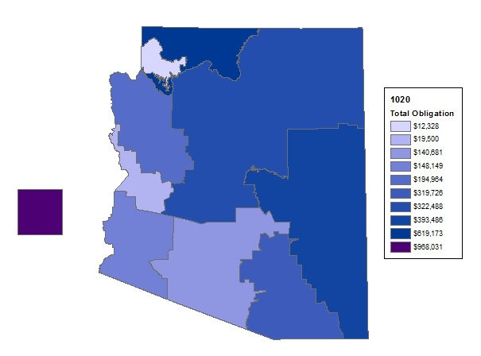
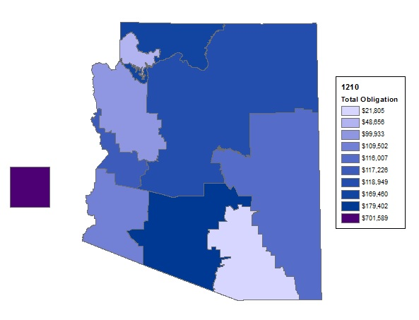
FMBS Spent per Sub-activity
1020 – Rangeland Management
1210 – Wilderness Management

Slide 20
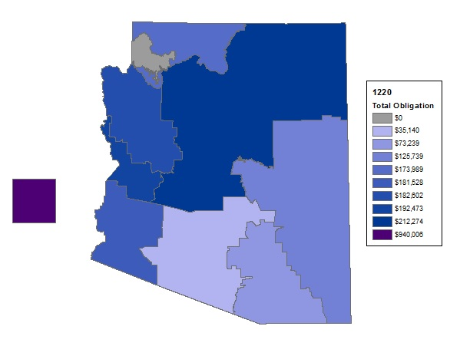
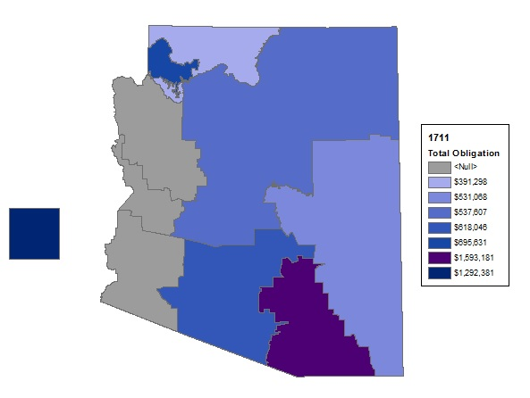
FMBS Spent per Sub-activity
1711 – National Monuments &
Conservation Areas
1220 – Recreation Management

Slide 21
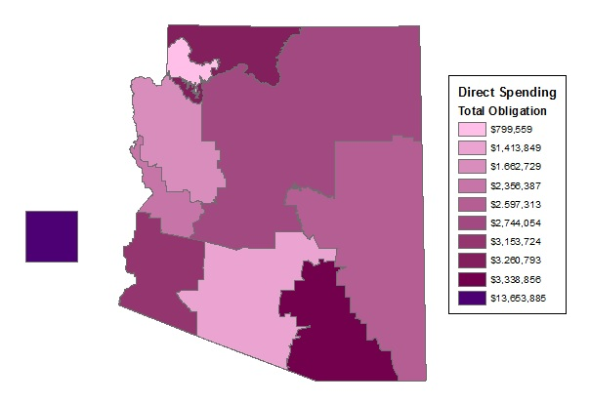
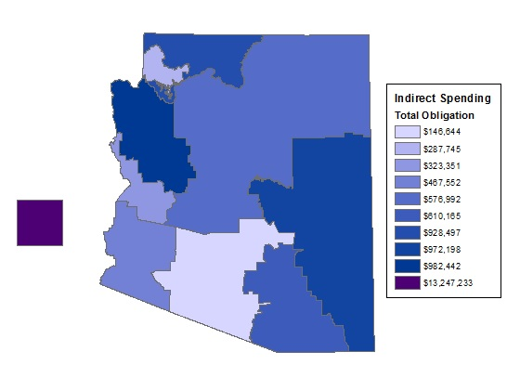
Spending per Field Office
Direct
Indirect

Slide 22
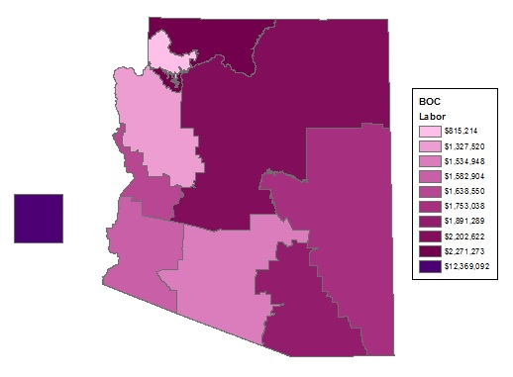
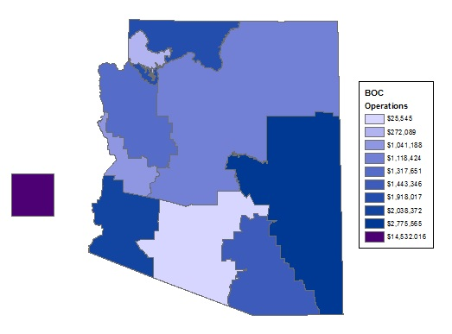
BOC Labor and Operations
Labor
Operations

Slide 23
Conclusions
The results produced for this practicum are intended to represent data accurately, illustrate patterns, and raise questions.
Results demonstrate that the BLM is planning and executing their budget and workload effectively. Areas of possible concern are highlighted, allowing for further exploration. Field office economic data can be compared across the state in multiple spending categories.
Results are most beneficial for those familiar with BLM procedures

Slide 24
Reflection
Practicum objective accomplished
Practicum agency: Practicum provides an opportunity to spot potential budget issues, determine their true cause, and track changes over time.
Personal: Practicum provided useful and tangible deliverables for the agency and allowed me to demonstrate technical skills acquired through coursework.
Most useful as a methodology and framework
Opportunities for future work

Slide 25
Thank you
Kayla Resnick
Northern Arizona University

