Slide 1
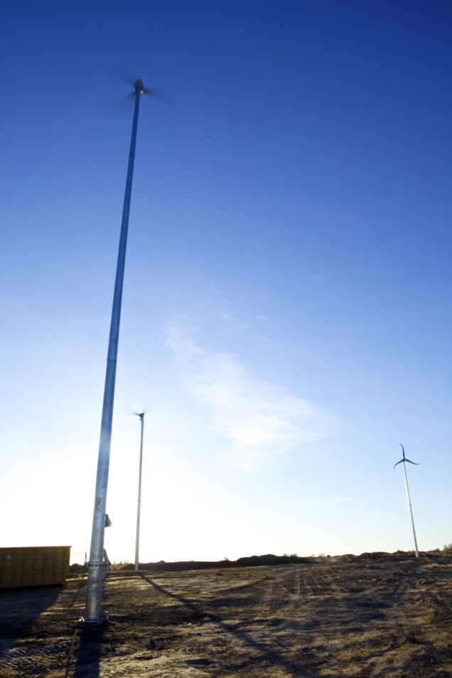
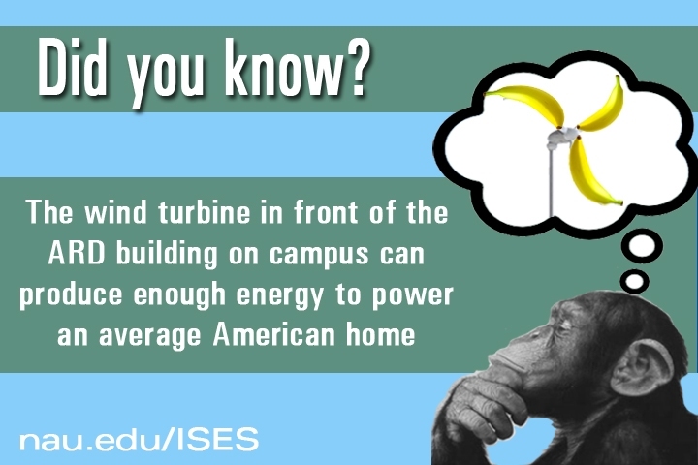
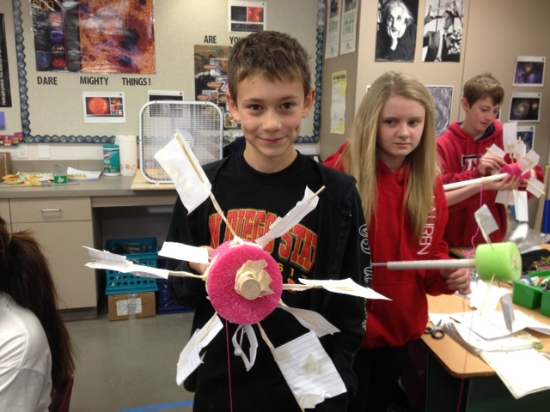
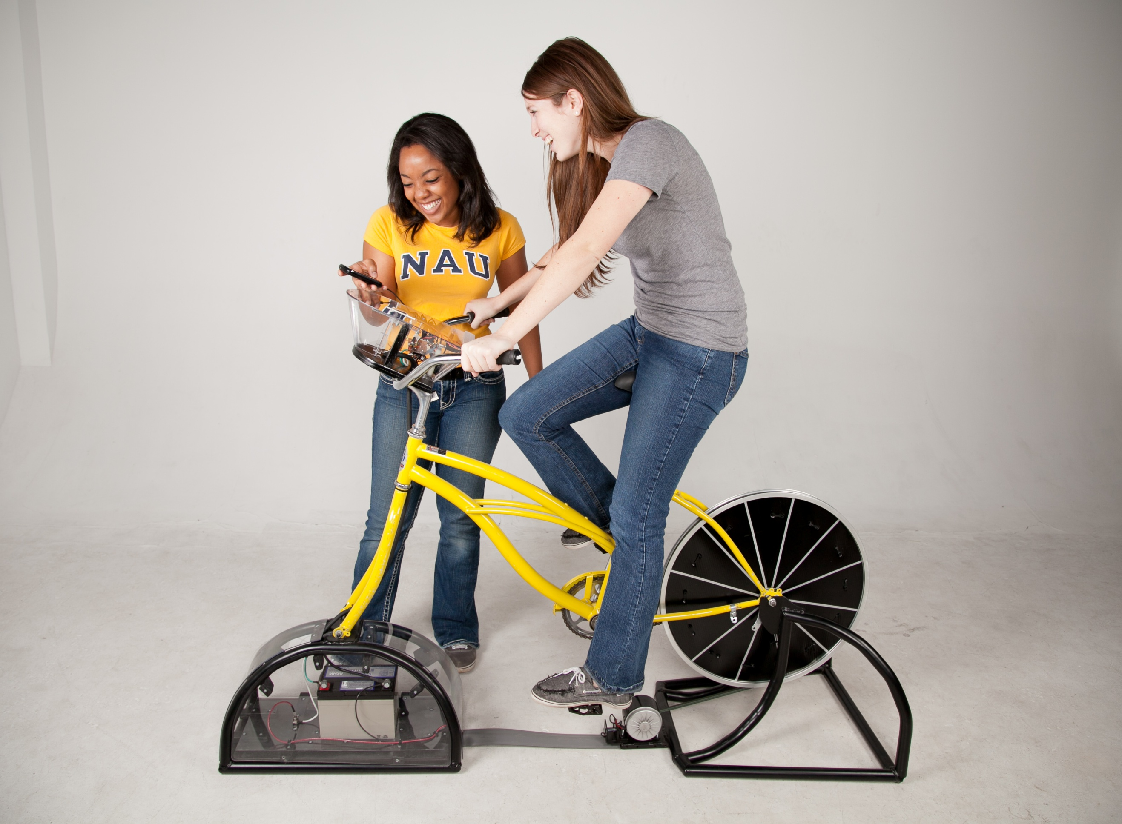
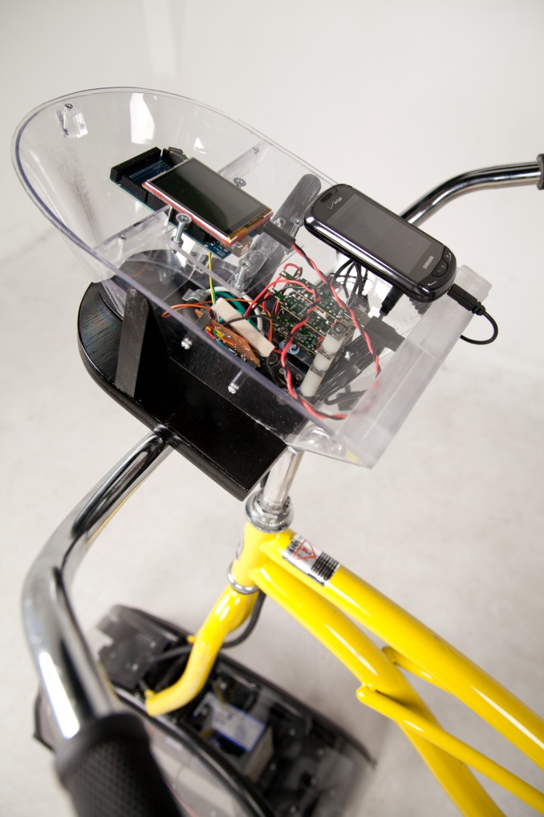
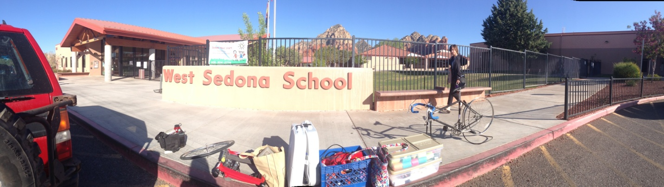
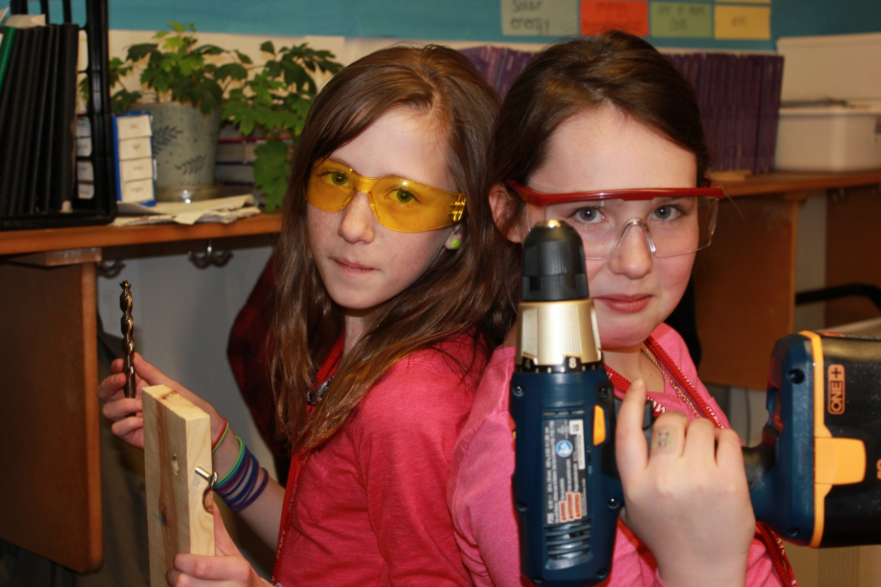
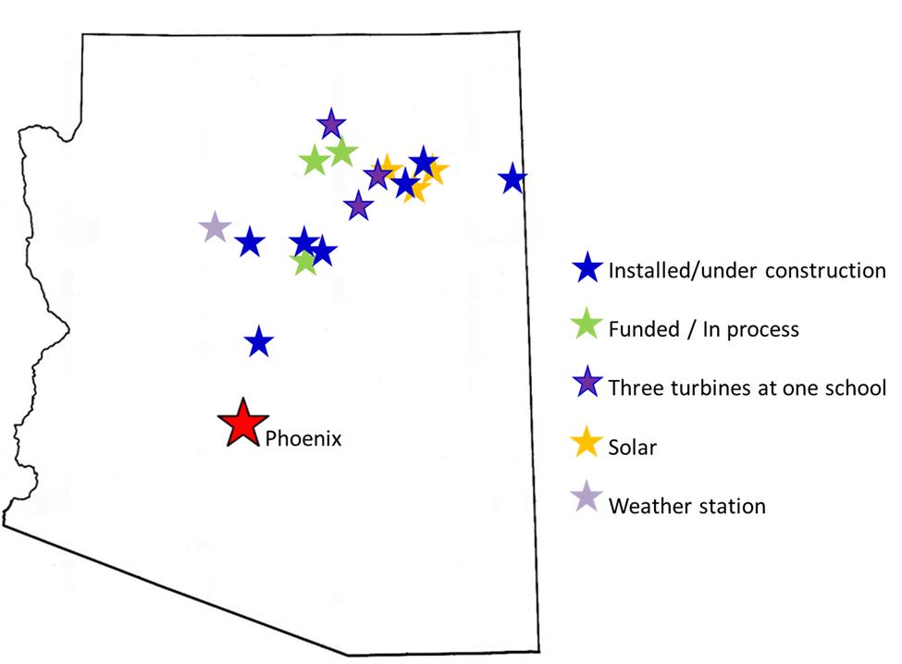
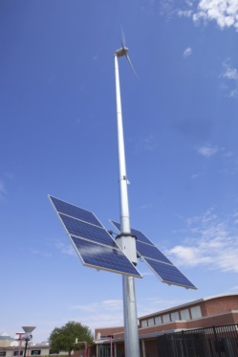
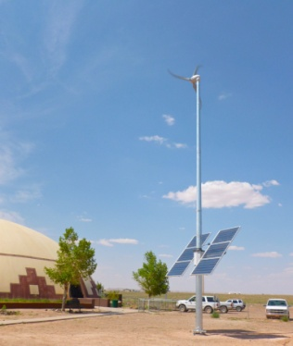
KEYS TO SUCCESS: The Arizona Wind for schools EXPERIENCE
Karin Wadsack
Project Director, ISES
Marilla Lamb
Graduate Student, Mechanical Engineering
Abstract
The Arizona Wind for Schools Project’s runaway success was supported by the U.S. Department of Energy’s WindPowering America program from August 2010 to September 2013. During the grant period, project staff helped to raise $600,000 from other sources, including the wind industry and electric utilities, state research and technology funding, charitable foundations, and the NASA Space Grant program. This supported the installation of 16 wind turbines (as shown in Figure 1), 3 photovoltaic arrays, and 1 weather station at partner schools, as well as the paid employment of 19 students at NAU. The Wind for Schools team worked with 288 teachers in 20 teachers’ workshops, and performed direct education activities with more than 2900 K-12 students in the classroom. Nearly 2400 students and parents also participated in wind outreach activities at special events on and off campus. At the university, 465 NAU students were enrolled in wind-related classes, and presentations in 22 other classes reached an additional 556 students. The program was featured in 44 news stories (Fig. 2).
Sub-programs
The Wind for Schools program was not only a way for NAU students to teach students and teachers in the community about wind energy. Working for the program also allowed them to learn about the roadblocks facing those trying to raise awareness of energy issues among the public. Working with NAU project leaders and other like-minded students on the Wind for Schools team provided a place to find creative solutions to these challenges.
From this creativity were born several 'subprograms' and other projects not directly related to wind energy, but which helped achieve the over-arching goal of the Wind for Schools program. Energy literacy on all levels supported student and teacher understanding of wind energy issues, policy, science and engineering.
Some of these subprograms included the bicycle generators project, the on-campus energy education initiatives, and the installation of PV systems at schools where solar energy was more abundant than wind.
NASA Space Grant
Each year, students on the Wind for Schools team applied for NASA Space Grant internship funding to support specific sub-projects within the program. An example project was the initiative to bring Wind for Schools activities into special education classrooms, successfully performed in 2012-2013.
On-campus education initiatives
The Wind for Schools project reached out to NAU faculty in a wide variety of disciplines across campus, offering to visit classes to discuss energy issues, talk about NAU’s own renewable energy projects, and teach students basic energy concepts. This outreach resulted in staff and NAU student presentations in classes ranging from engineering to environmental sciences to seminar course on the arts and civic engagement. This education at NAU also included the development of marketing materials such as the slide shown in Figure 6 (right), which was displayed on TV screens in student union buildings.
Table 1. Wind for Schools three-year program activity summary by impact numbers.
Figure 1. Kayenta school wind turbine installations
Program Results
Program area | Impacts
Partner schools (installations and lessons in class) | 39
Wind turbines installed | 16
Weather station installed | 1
PV arrays installed | 3
Participation at special public events or events at NAU | 2341
Students employed at NAU or volunteers for NAU credit | 19
NAU students in wind-related classes | 465
Presentations/special projects in NAU classes | 22
Students at presentations/projects in NAU classes | 556
K-12 students impacted by direct education activities | 2727
Teacher workshops | 20
Teachers trained at workshops | 288
Media coverage (print, radio, TV) | 44 stories
Total program funding obtained | $776,000
Figure 6. A slide with information about the NAU Skystream installation was displayed on TV screens in the student unions.
Bicycle Generators
Several team members and partner teachers shared an interest in bicycles and their potential for teaching students some basic energy concepts in a hands-on manner. This initiative created several sub-projects, including the construction of a bicycle-powered charging station at NAU, shown in Figure 4, and the implementation of a small grant to build bike generators with 6 partner middle and high schools in 2012-2013, (Fig. 5). These initiatives were supported by the APS Leadership Grant program and by NAU’s student Green Fund, and involved students in engineering and the sustainable communities degree program.
Figure 2. Media coverage featured K-12 student engagement
Figure 4. Bike-powered charging station at NAU.
Figure 7. Unloading materials for three days of science, social studies, and math classes at West Sedona middle school in April 2013.
Figure 3. Middle school students building McGyver windmills,
Northland Preparatory Academy, 2012
Lasting Impacts
The Wind for Schools project installed 16 turbines, 3 solar arrays, and one weather station at partner schools, as shown in Figure 8 (right) and Figure 9 (below). These systems continue to generate renewable energy and data for the schools and their teachers and students. The vast majority of the installations are at schools with primarily Native American students.
In addition, dozens of teachers statewide now have the expertise, materials, and comfort level to perform a variety of wind energy lessons and activities in their elementary, middle, or high school classrooms.
The students who worked on the Wind for Schools team at NAU had an invaluable opportunity to enrich their education through teaching others, managing projects, and contributing a valuable service to professional teachers across the state.
Lessons Learned
The key challenges of the Wind for Schools project included:
performing education statewide with college students;
obtaining funding for staff time; and
getting teachers comfortable performing lessons independently.
By being creative in program development, utilizing the flexibility of the existing Wind for Schools structure, tapping into the wealth of existing resources for teachers, and reaching out to industry partners, the team was able to develop methods for success to overcome these challenges.
Figure 5. Middle school students at Mount Elden Middle School working on building their bicycle generator in the STEM club, Spring 2013.
Methods for success
The Wind for Schools project at Northern Arizona University (NAU) was managed through a student team, working with one staff director and a number of faculty advisors. The team of students had structured internships with specific project responsibilities, goals and deliverables, such as coordinating teacher workshops, developing curriculum, or assisting with installation management with partner schools. All students also participated in outreach events and K-12 education activities.
The student team met weekly for project management, students met individually with the project director once at the middle of each semester for individual mentorship, and students wrote project evaluation reports at the end of each semester.
While the project performed a small amount of advertising to make the Arizona educational community aware of available opportunities, the majority of activities took place in response
to requests from motivated partner teachers, organizations, and
schools. Developing a network of strong teacher champions at partner schools supported the success of the project.
The team developed a model for institutionalizing wind education activities at partner schools. First, the team performed a workshop to familiarize teachers with the available curriculum and to have them perform a few activities in a group. Then the team followed up by visiting teacher classrooms to perform the activities with the teachers (Figures 3, 7), and finally the team provided the teachers with kits of materials so that they could perform the activities on their own.
Working with locally-motivated partners, such as the wind industry companies building capacity in Arizona, allowed the project to offer education programs that industry can’t, and to leverage industry funds for the improvement of K-12 wind energy education in areas where wind plants were developed.
Figure 8. Installations of the Arizona Wind for Schools project as of September 2013.
Thank you, key partners:
U.S. Department of Energy
KidWind
NEED
Southwest Windpower
Arizona Public Service Co.
Arizona Science Teachers’ Association
NASA Space Grant program
NAU Student Green Fund
Hopi Tribe Renewable Energy Office
NextEra Energy Resources
Westwind Solar Electric
Prometheus Renewables
Iberdrola Renewables
NAU Student Green Fund
Grand Canyon Trust
Salt River Project
Figure 9. Wind/Solar systems installed at Dilcon and Little Singer schools.

